Slide 1

EXPANSION
Units 1–4
(part 2)

Slide 2
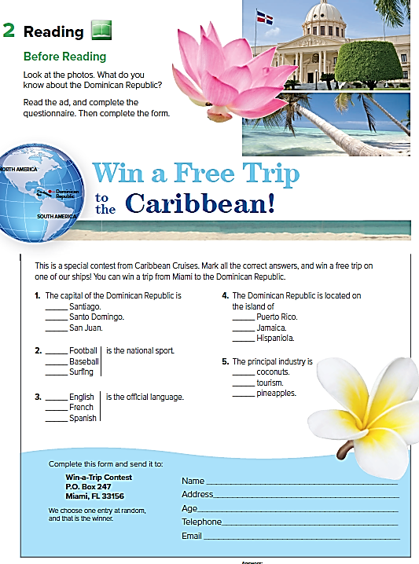



Slide 3
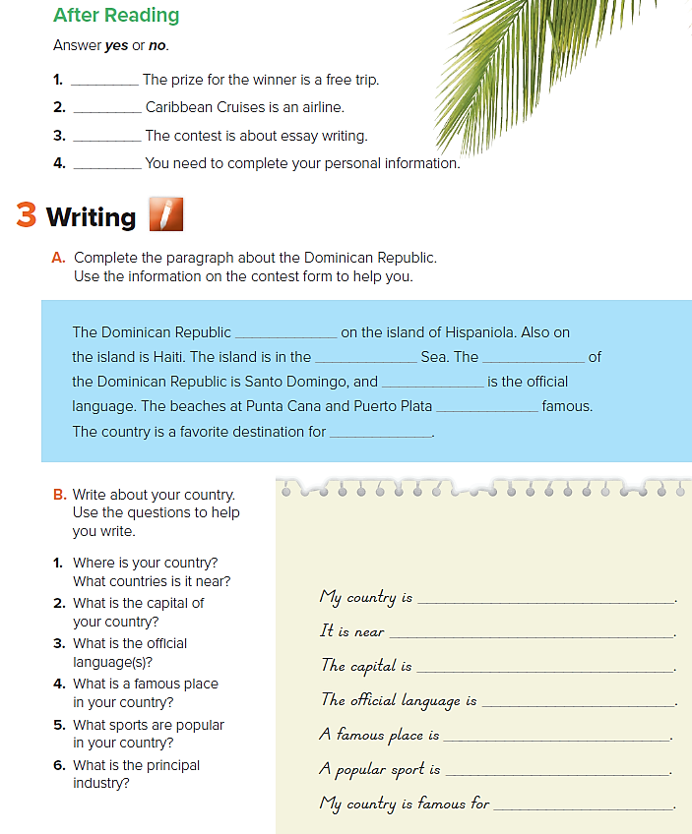
yes
no
no
yes
is
Caribbean
Spanish
are
tourists
capital
Kingdom of Saudi Arabia
The Arabian Gulf
Riyadh City
Arabic
The Holly Kaaba
football
oil industry

Slide 4
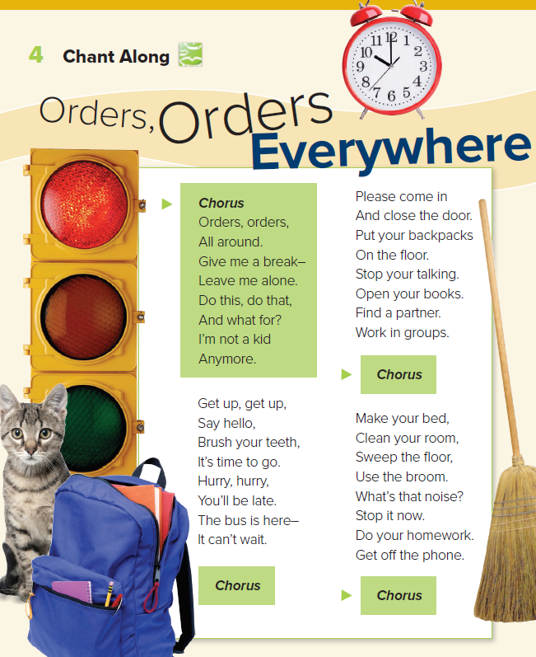

Slide 5
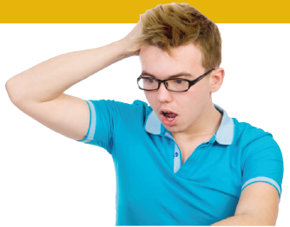
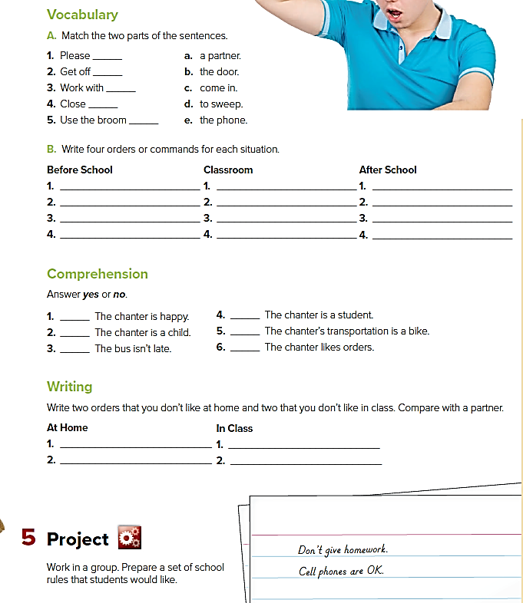
c
e
a
b
d
Get up.
Say hello.
Brush your teeth.
Hurry.
Please come in.
Close the door.
Stop your talking.
Open your books.
Do your homework.
Clean your room.
Sweep the floor.
Get off the phone.
no
no
yes
yes
no
no

Slide 6
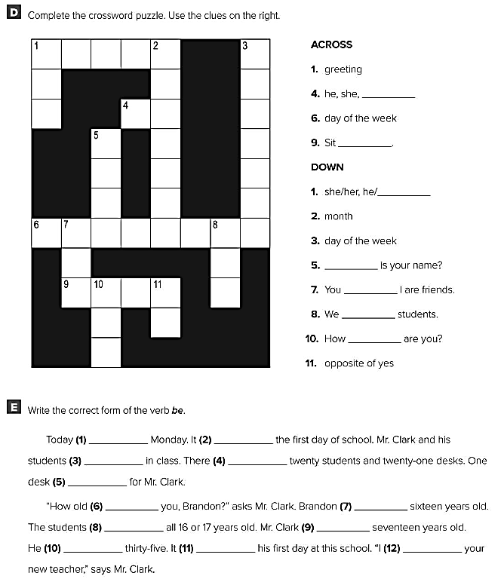
is
is
are
are
is
are
is
are
isn’t
is
is
am

