Slide 1


Slide 2


Good Morning

Slide 3
Mega Goal3.1
Influential People

Slide 4
Listen & Discuss

Slide 5
Goals:
1-Complete the sentences with the correct words
2-Discuss the traits of wealthy and influential people
3-Answer questions about the stories from the text
4-Demonstrate Steven Jobs' determination
5-Explain the event that gave Jobs self satisfaction
6-Relate information to Abdul Latif Jameel
7-Define the meaning of money industries
8-Summarize information in a text

Slide 6
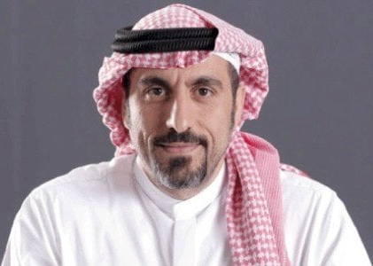
Who is he?

Slide 7
Influential people
What does this phrase mean?
It refers to any situation where a person goes from being poor (and wearing rags for clothes) to being rich

Slide 8


What qualities do you think a person needs to make a fortune?

Slide 9
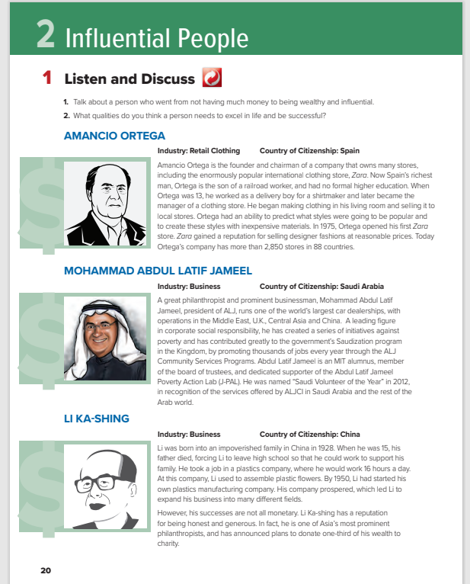
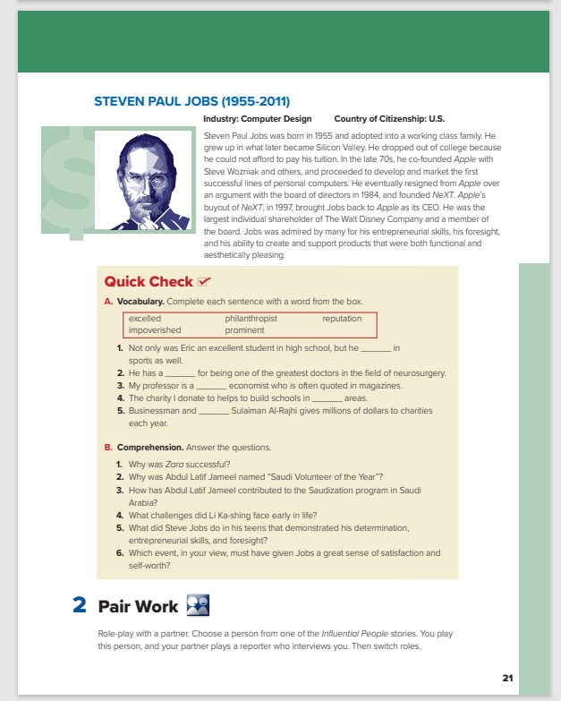
Students Book
P.20-21

Slide 10

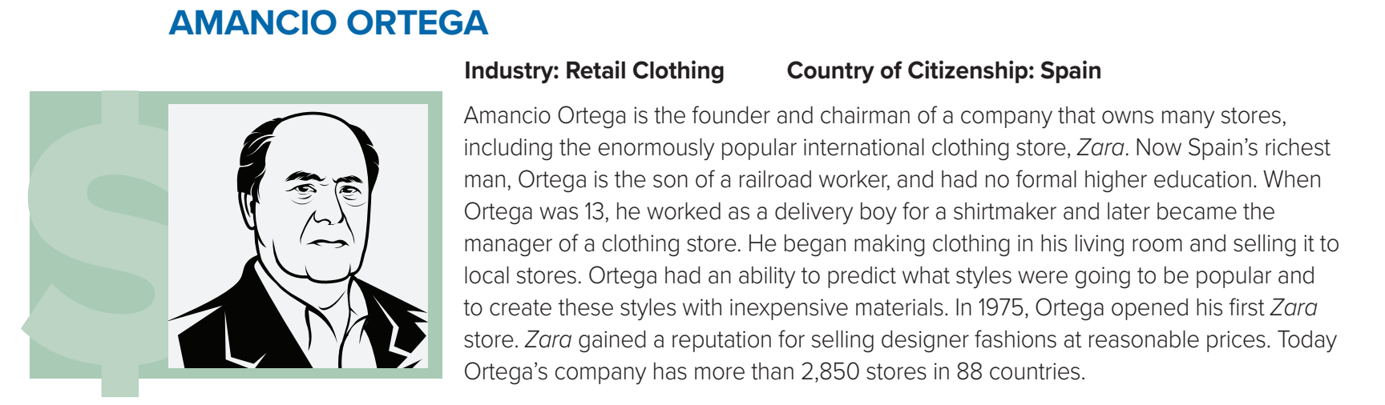
Do you recognize any of these people?
What does industry refer to?
This is the business or career in which the person made their money

Slide 11



Listen
Do you recognize any of these people?
What does industry refer to?
This is the business or career in which the person made their money

Slide 12
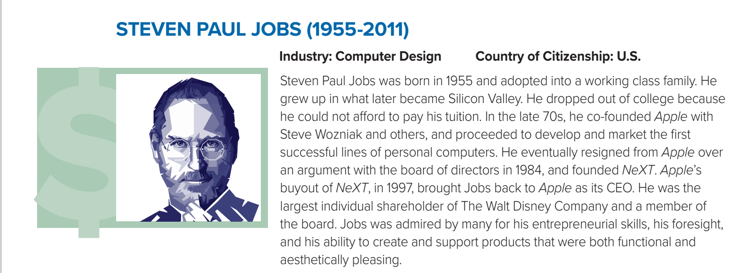
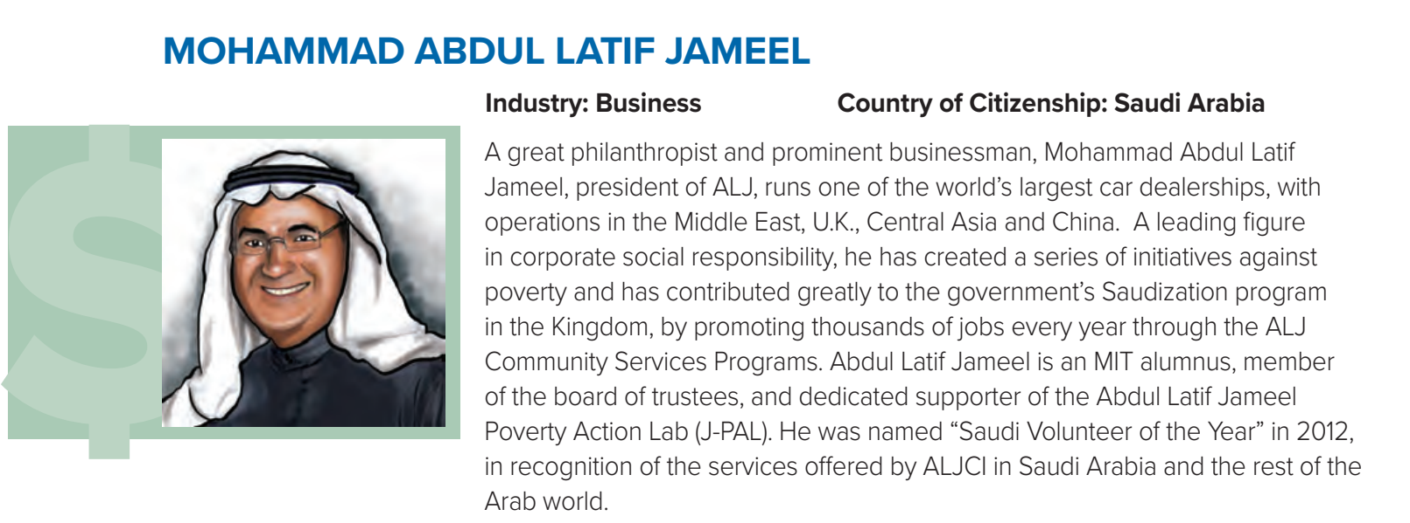
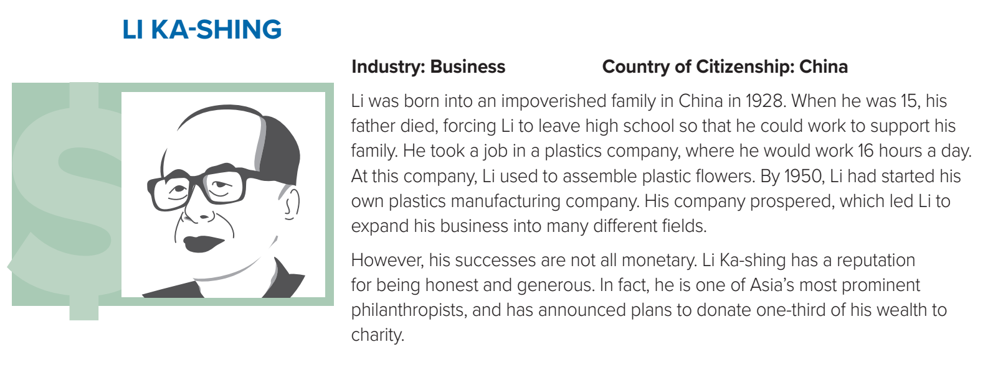
Listen as long as you read
What kinds of stores does Amancio Ortega own?
Where are his stores located?
clothing stores
in 71 countries, or all over the world)

Slide 13
Listen as long as you read
What kind of company does he run?
How did he contribute to the government’s Saudization program in the Kingdom of Saudi Arabia?
(one of the world’s largest car dealerships, with operations in the Middle East, UK, Central Asia and China)
(by offering and creating thousands of jobs every year through the ALJ Community Services Programs)

Slide 14
Listen as long as you read
(plastics)
What kind of business did Li Ka-shing start out in?
What else is he known for?
being honest, generous, and a philanthropist)

Slide 15
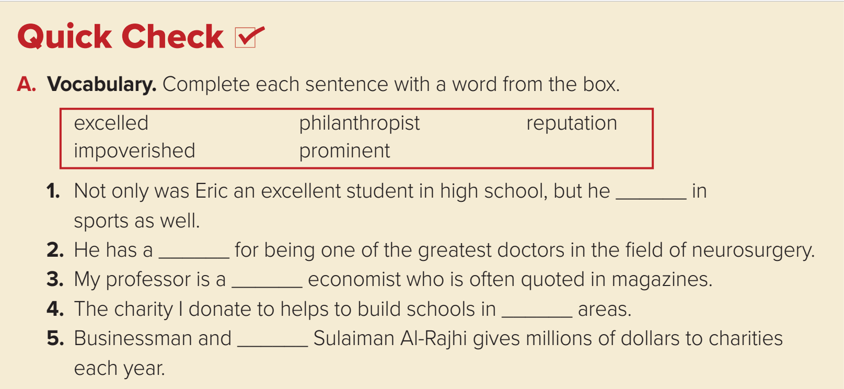
Listen as long as you read
What was Steven Paul Jobs most famous for?
Why had he resigned from Apple?
(he co-founded Apple with Steve Wozniak)
(He resigned over an argument with the board of directors in 1984.)

Slide 16
excelled
reputation
prominent
impoverished
philanthropist

Slide 17
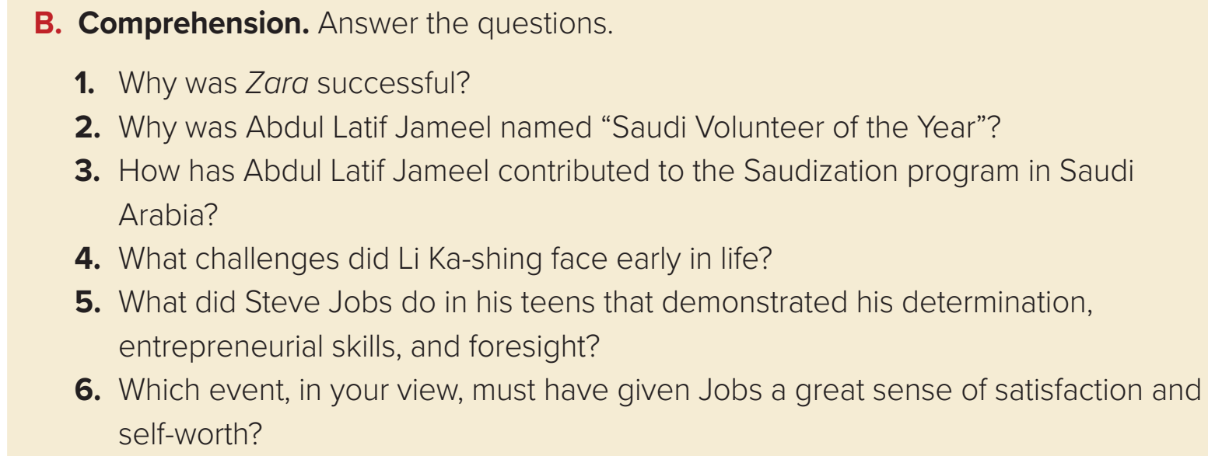
1.It sold designer fashions at a reasonable price.
2. In recognition of the services offered by ALJCI in Saudi Arabia and the rest of the Arab world.
3. By offering thousands of job opportunities on an annual basis.
4. He was poor and had to leave high school when his father died to help support his family.
5. Although he dropped out of college, he co-founded Apple, and developed and marketed personal computers.
6. Whereas he argued and resigned from Apple, Jobs was brought back and became Apple’s CEO.

Slide 18


