Slide 1
U 4 writing p 32
Tr. Nora Khalid

Slide 2
Write about Ss hobby or pastime using “gerunds” as a subject and an object.

Slide 3
Ask me!
Walking
Running shoes & track suit
Every morning
Along the road
With my friend
I love walking because it’s relaxing and good for body

Slide 4
Write

Slide 5
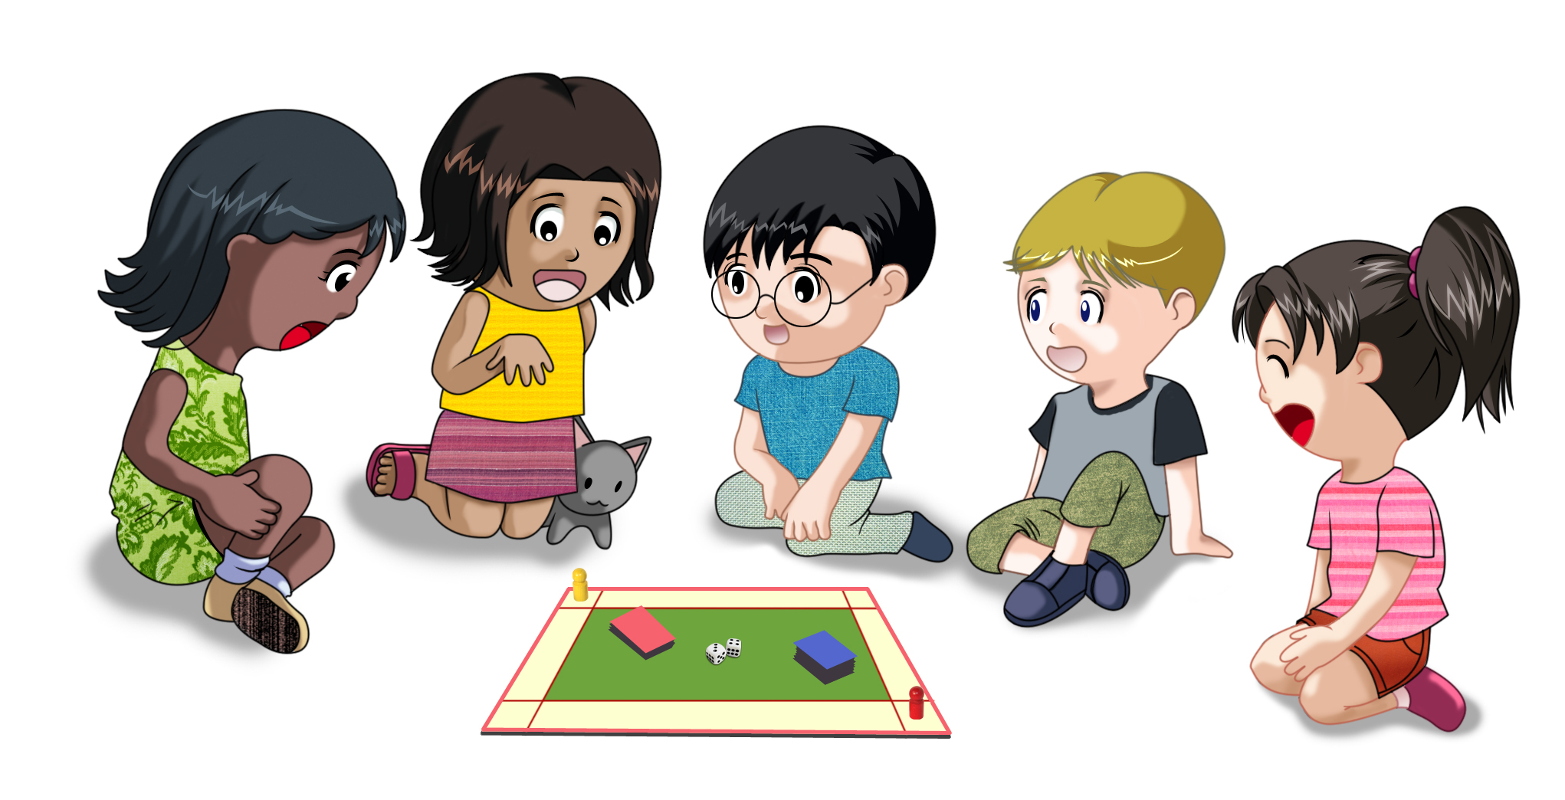
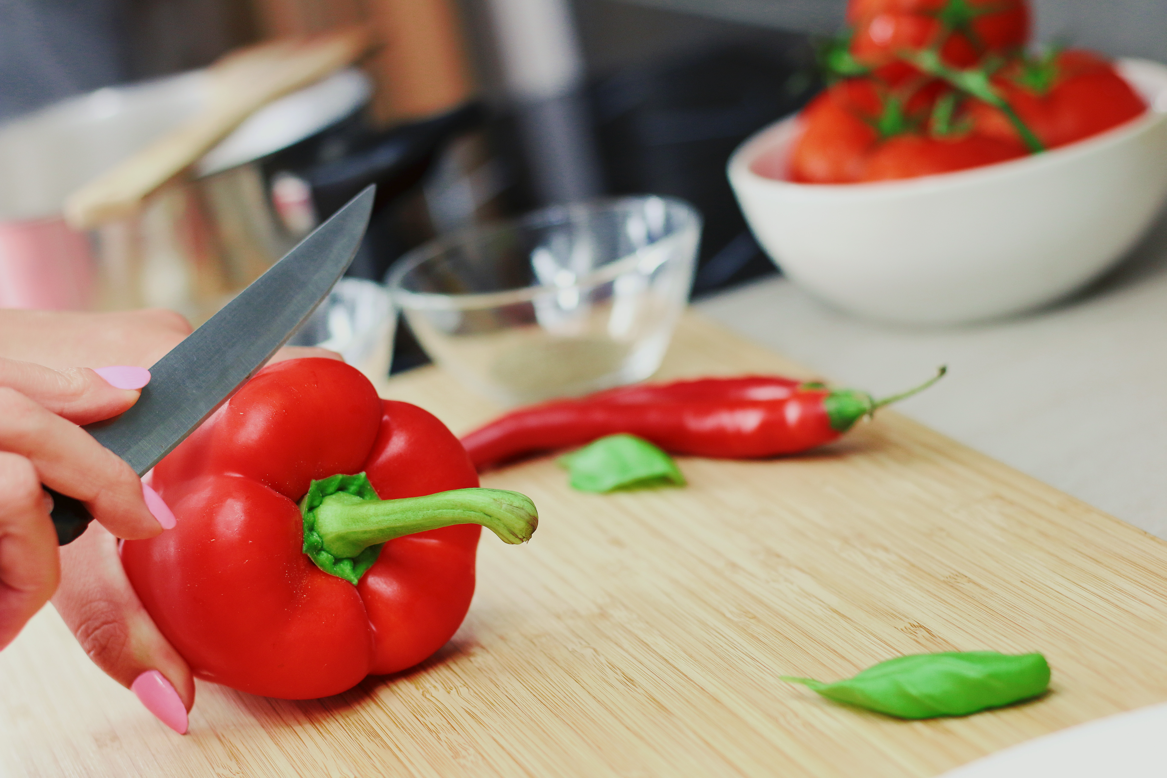
playing
Cooking
dancing

Slide 6
Are you watching TV?
Do you prefer watching TV?

Slide 7
She is painting a picture.
Painting is a relaxing hobby.
What other activities or sports use the -ing form?

Slide 9
I enjoy cooking in
my free time.
say a sentence about your hobby

Slide 12
Write about your hobby or pastime.
Use your notes from the chart and
ideas from this unit

