Slide 1
Conversation

Slide 2
He knows how to cook.
He knows how to design houses.
They know how to play golf
He knows how to speak English.
He knows how to take photos.

Slide 3
Objectives
Read the conversation correctly
Use the "real talk" phrases in new sentence
Answer question in the book

Slide 5
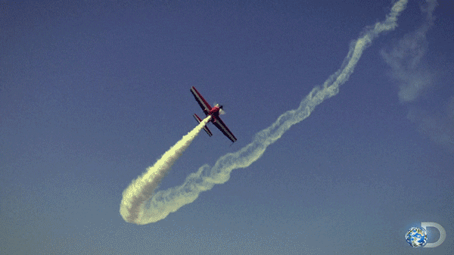
aerobatics
stunts

Slide 6
@ page 30

Slide 7
What are the people in the picture doing?
What are they talking about?
How many characters in this conversation?
@ page 30
Who are they ?

Slide 9
What is the plane doing?
aerobatics
stunts
Is this a pastime you would like to do?
Why or why not?

Slide 10
-I go to cooking classes once a week.
-You mean, you learn how to cook?
I play football and basketball and stuff like that.
Who offers an invitation in the conversation?
What language does he use?
How does Jason respond?

Slide 11
1. He flies model airplanes.
2. He normally does it on the weekend.
3. Yes, he does.
4. He invites Jason to come along with him.
5. He thinks Rick flies planes.

Slide 13
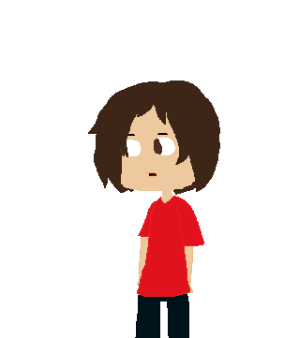

Slide 14
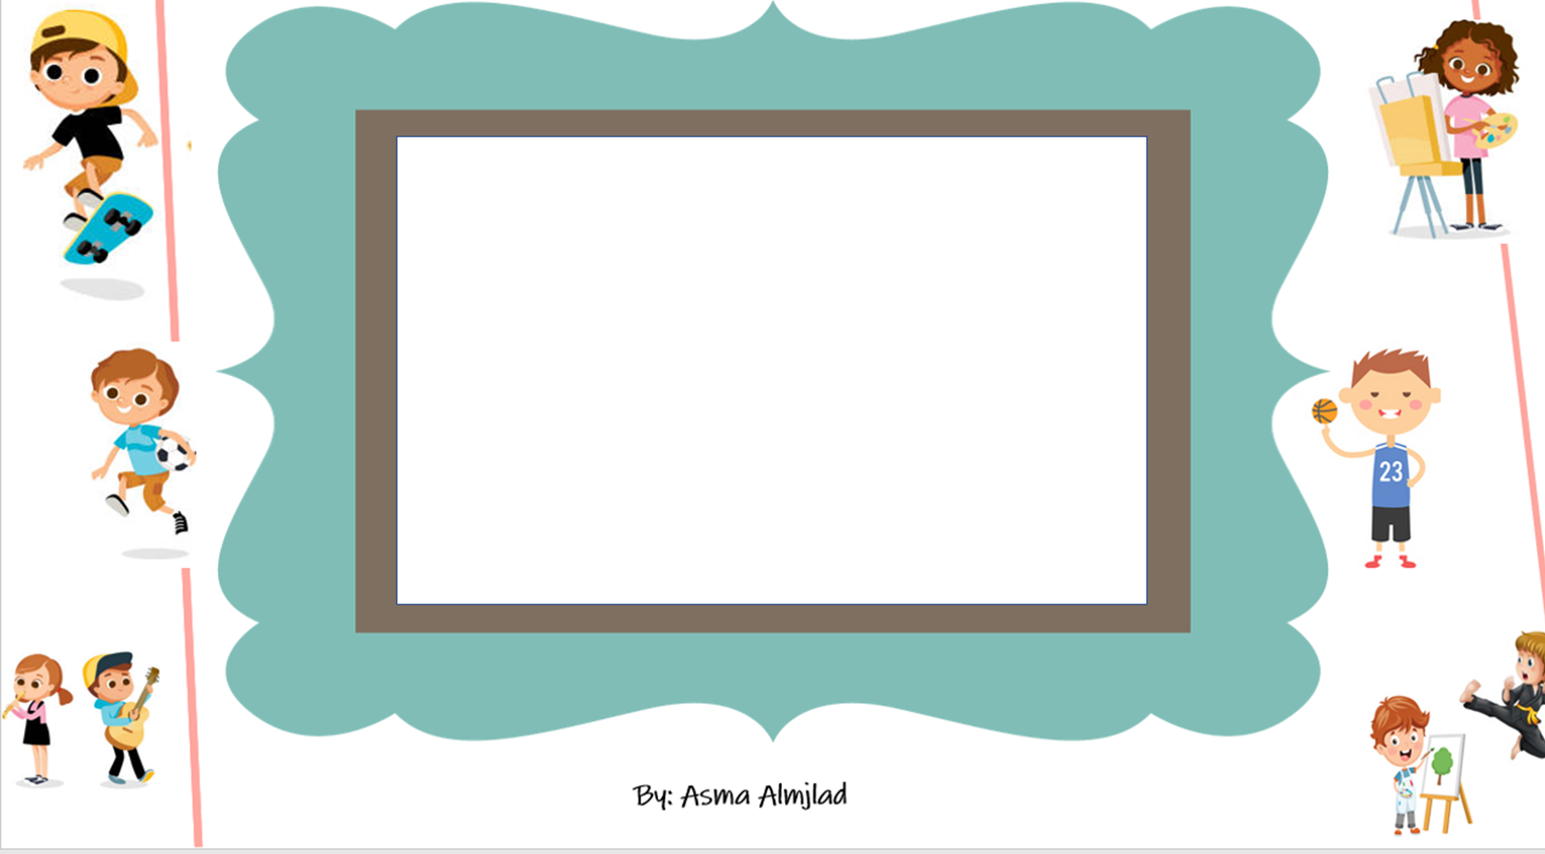

Slide 15
What is the opposite of usual ?
Unusual

Slide 16
What is the opposite of exciting ?
Boring

Slide 17
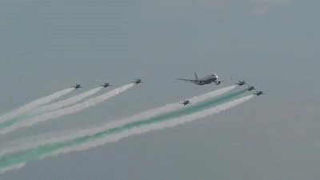
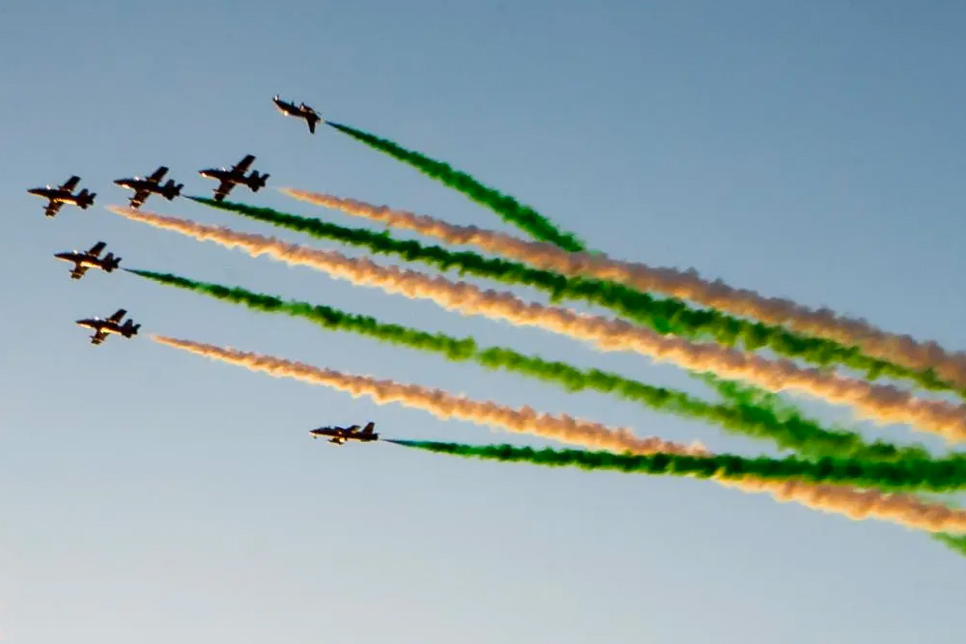

Slide 18
199 (E)

