Slide 1


Slide 2


Slide 3

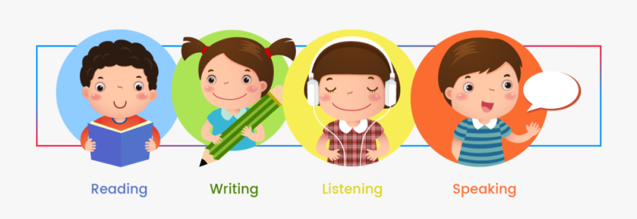

Slide 4
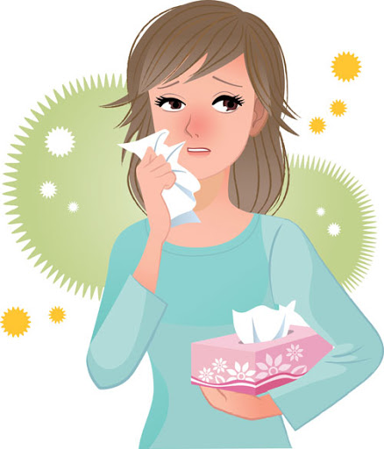
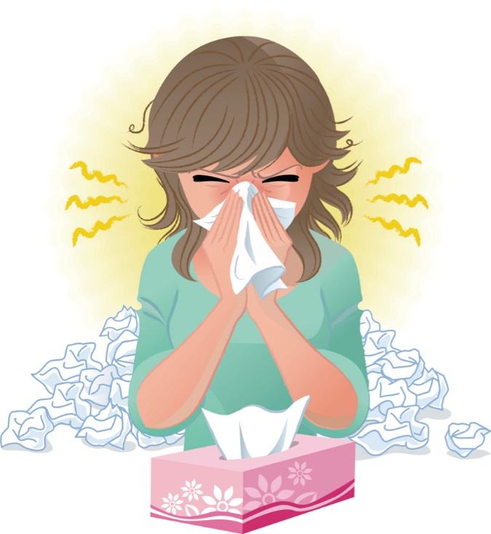

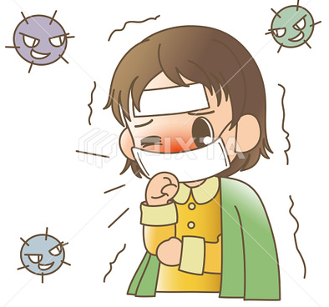
Covid 19
☺Avoid gathering !
☺We must wear a mask before
going out.
☺Social distancing is not a
choice, it is a must!
☺Keep a distance of 2 meters
to avoid accountability
☺wash hands constantly.

Slide 5


Slide 6
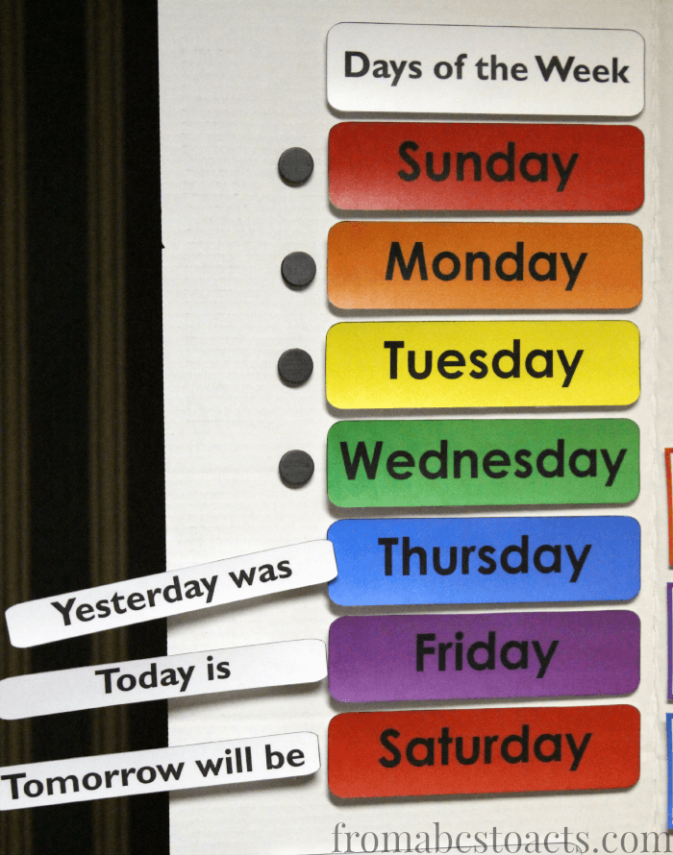

Slide 7




♥
☺
☺
♥

Slide 8
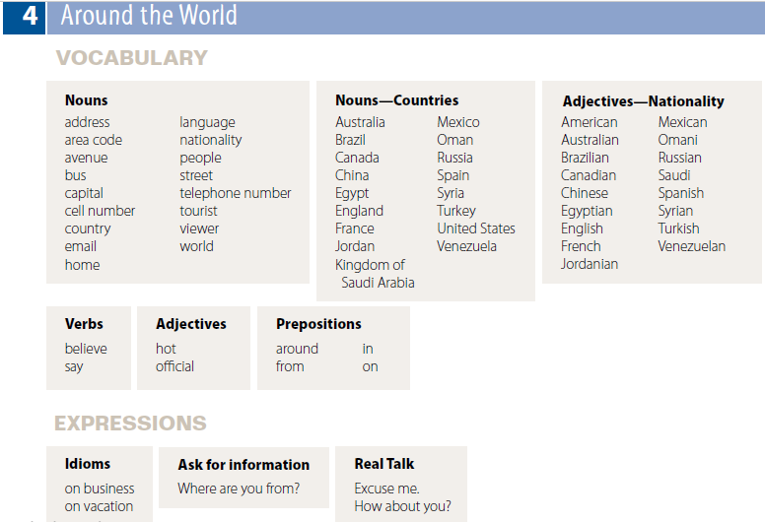

Slide 9

Nouns
address
area code
avenue
bus
capital
cell number
country
email
home
Nouns—Countries
Australia
Brazil
Canada
China
Egypt
England
France
Jordan
Kingdom of
Saudi Arabia
Nouns—Countries
Mexico
Oman
Russia
Spain
Syria
Turkey
United States
Venezuela
Nouns
language
nationality
people
street
telephone number
tourist
viewer
world
Adjectives—Nationality
American
Australian
Brazilian
Canadian
Chinese
Egyptian
English
French
Jordanian
Adjectives—Nationality
Mexican
Omani
Russian
Saudi
Spanish
Syrian
Turkish
Venezuelan

Slide 10





Slide 11
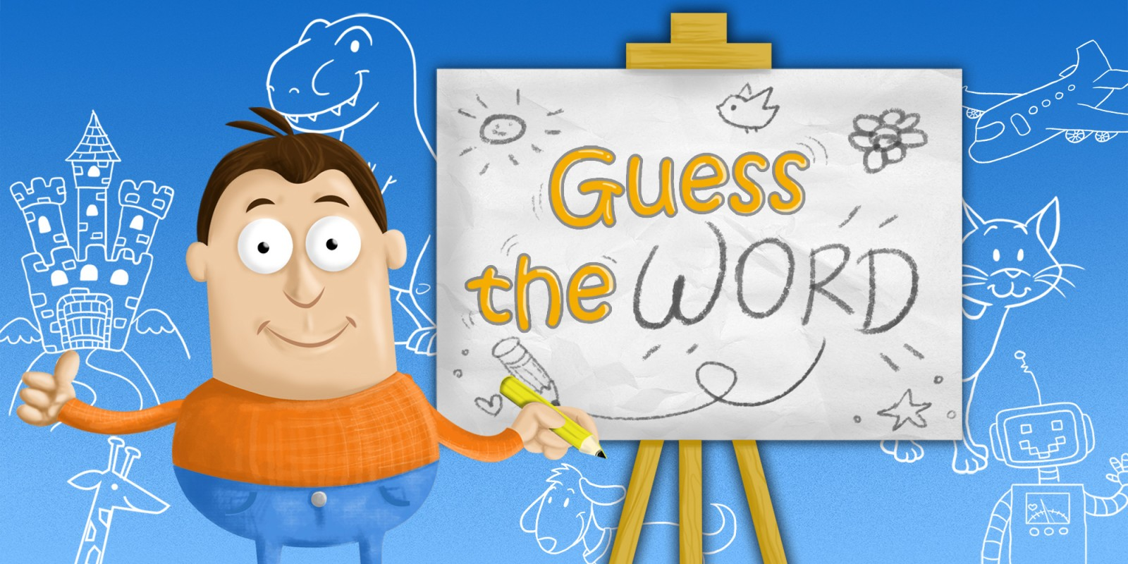

Slide 12








Slide 13



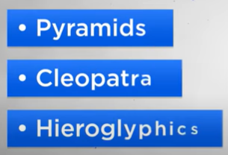
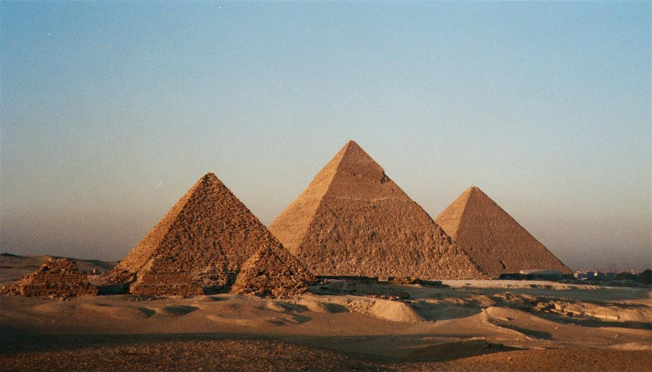

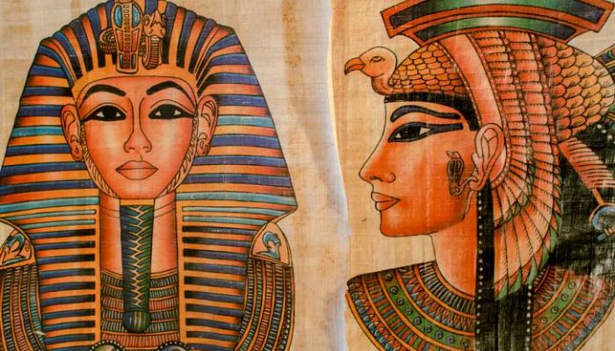

clues about three or four different countries
hieroglyphics
a system of writing that uses pictures instead of words,
especially as used in ancient Egypt
Pyramids
Cleopatra

Slide 14

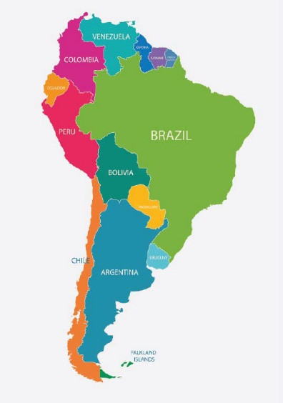

clues about three or four different countries
It’s in South America.
It’s a big country.
The people speak Portuguese.
What’s the country?
Brazil.

Slide 15
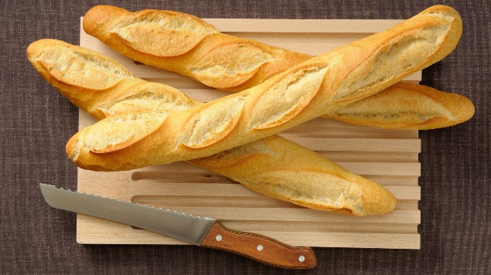
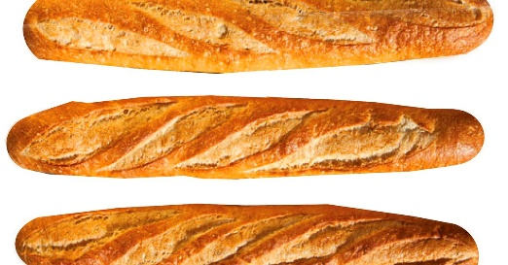

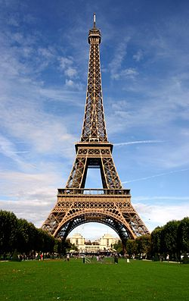
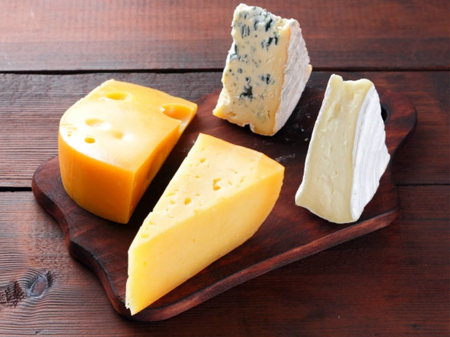

Baguettes, Eiffel Tower, Cheese.
Paris
Which country do these 3 clues describe?
baguette
a long, thin stick of white bread, of a type that originally came from France
Eiffel Tower
cheese

Slide 16



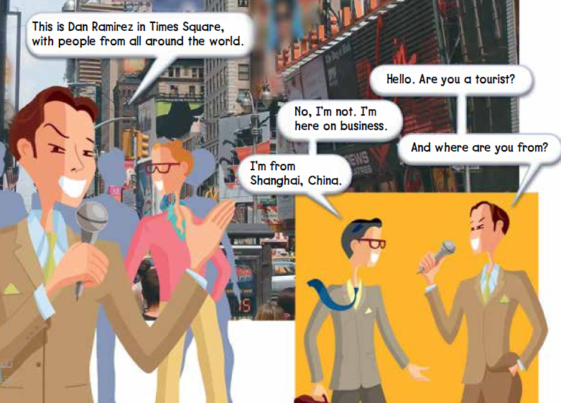
Page 26
Where is this?
It’s New York City.
Have you ever been to New York?

Slide 17
Page 26
Who’s Dan Ramirez?
He’s a reporter from a television station.
He’s talking to people in Times Square in New York City.
☺ Times Square is a popular tourist destination.
There are a lot of stores and restaurants there.
viewers = the people who are watching the television program
tourist = someone traveling on vacation
on business = refers to someone traveling for work

Slide 18


Page 26
listen and repeat or speak along with the recording.

Slide 19
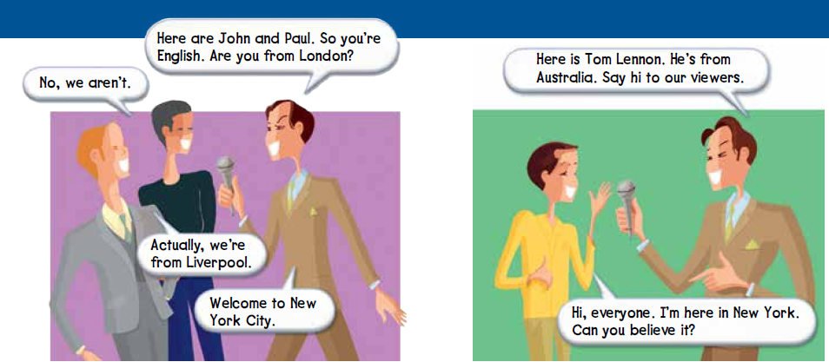
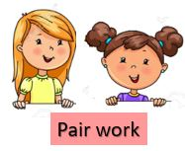
Page 27
Choose one conversation to practice. Then have different pairs act out each conversation for the class.

Slide 20

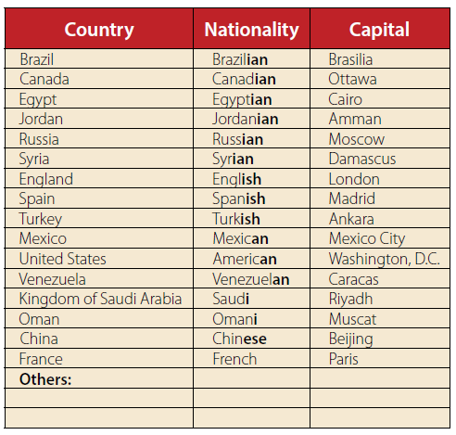
Page 27
Is your/ our country in the chart?
If it is, point to it.
If it isn’t, write it in at the bottom of the chart under “Others.”
Listen and repeat the words or speak along with the recording
Saudi Arabia
Saudi
Riyadh

Slide 21
Page 27
Where are John and Paul from?
England
What’s their nationality?
English
Where’s Tom Lennon from?
Australia
What’s his nationality?
Australian

Slide 22


Page 27
Circle the country and nationality names in the chart that you use often. Then they write down other countries that you talk about often
write the names of other countries, nationalities, and capitals that you choose.
Read your lists for the class.
Write the new countries, nationalities, and capitals on the board.
Find the countries on a world map

Slide 23
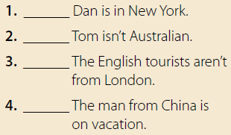
Page 27
yes
no
Tom is Australian.
yes
no
He’s on business.

Slide 24


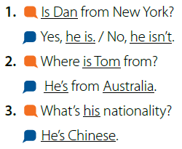

Page 28
listen and repeat or speak along with the recording.
Model the first conversation with a volunteer. Use a different name.
use different names and nationalities.

Slide 25


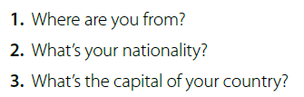
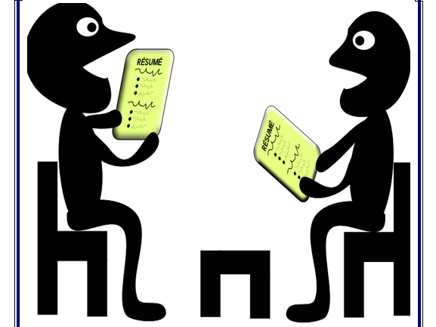
Page 27
Ask and answer the questions about yourselves with true information

Slide 26
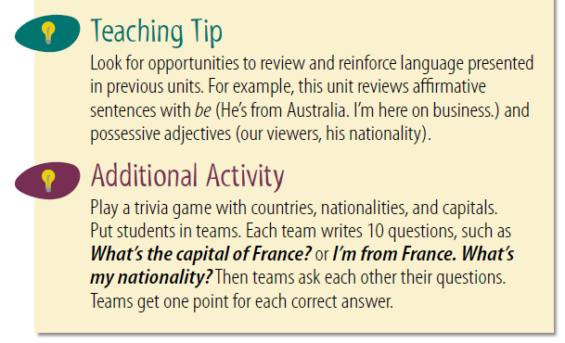

Slide 27
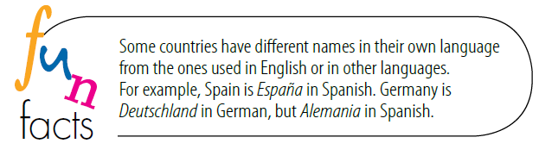

Slide 28







Assign page 101 for practice with vocabulary for
countries and nationalities.

Slide 29

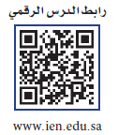
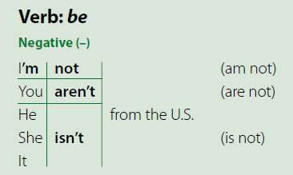
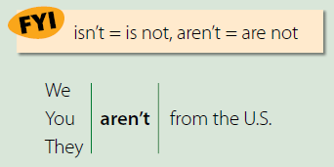

Page 28
Verb be: Negative
What’s the contraction for is not?
isn’t
What’s the contraction for are not?
aren’t
☺☺ the apostrophe replaces the omitted letter o.
For example,
Paris isn’t the capital of Spain, or I’m not from ………country

Slide 30
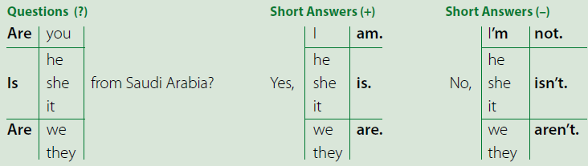
Page 28
Verb be: Questions and Short Answers
affirmative sentence
He’s from China.
Is he from China?
Yes, he is. and No, he isn’t.

Slide 31
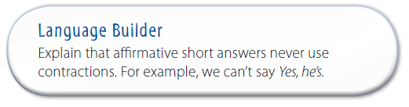

Slide 32
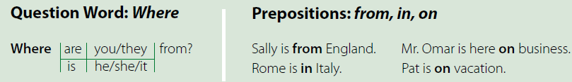
Page 28
Question Word: Where
Questions with Where and other question words use the same inversion of subject and verb as the yes/no questions.

Slide 33
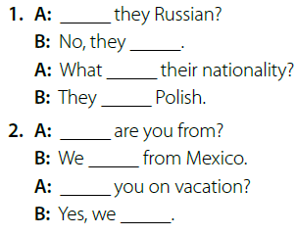
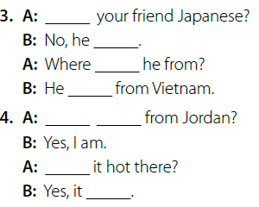
Page 28
Do the exercise
Take turns playing the A and B roles in the conversations
Are
Is
aren’t
isn’t
’s
is
’re
’s
Where
Are you
are
Are
Is
is

Slide 34
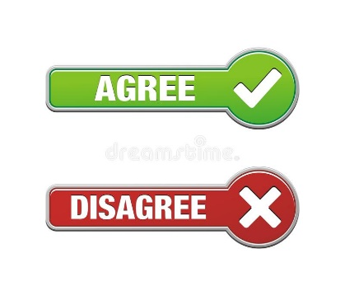
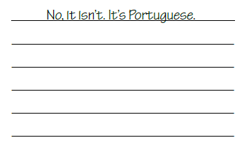
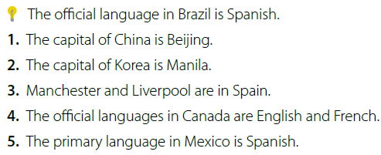


Page 28
to disagree. (No, it isn’t.)
London is the capital of England.
agree by using the short answer form Yes, it is.
if you aren’t sure of an answer you can guess or say I don’t know.
1. Yes, it is.
2.No, it isn’t. The capital of Korea is Seoul.
3.No, they aren’t. Manchester and Liverpool are in England.
4.Yes, they are.
5.Yes, they are.

Slide 35





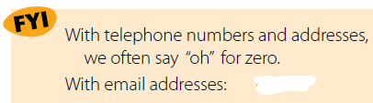


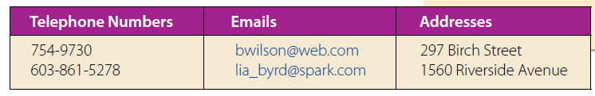
Page 29
How to say telephone numbers, email addresses, and street addresses.
The FYI box with the words used for the email symbols.
Give an example of an email address.
Repeat or speak along with the recording.

Slide 36

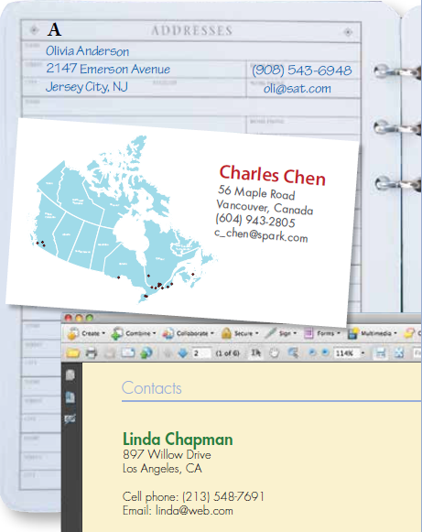
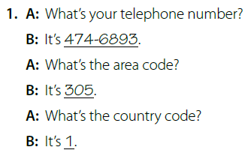
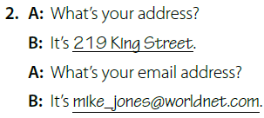
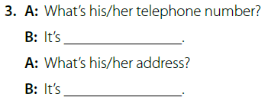
Page 29
the personal profiles
take turns playing the A and B roles and role-play the conversation

Slide 37
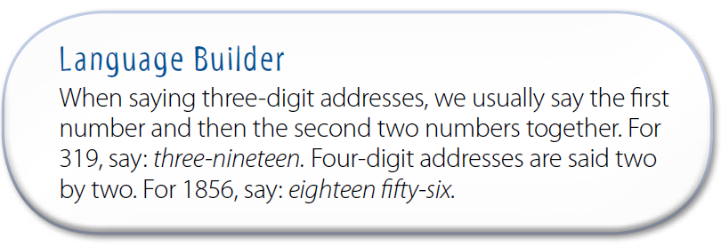

Slide 38



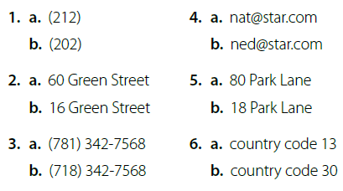
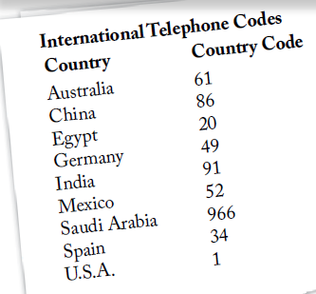

Page 29
You are going to hear different phone numbers, email addresses, and street addresses. You should read the choices and circle the one they hear.

Slide 39


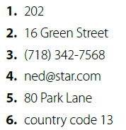

Slide 40
Assign pages 102–103 for practice with the grammar of
the unit.

Slide 41
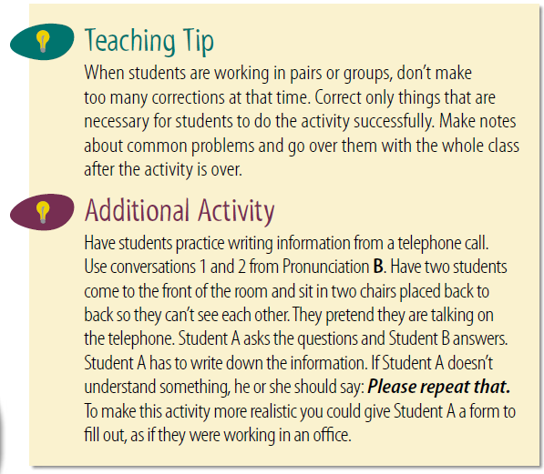

Slide 42
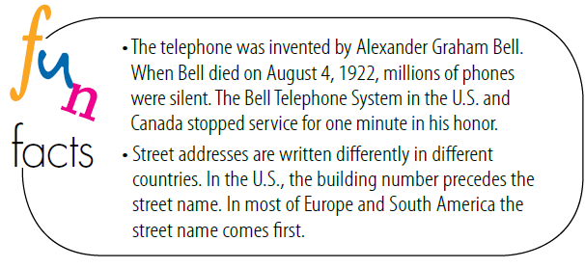

Slide 43



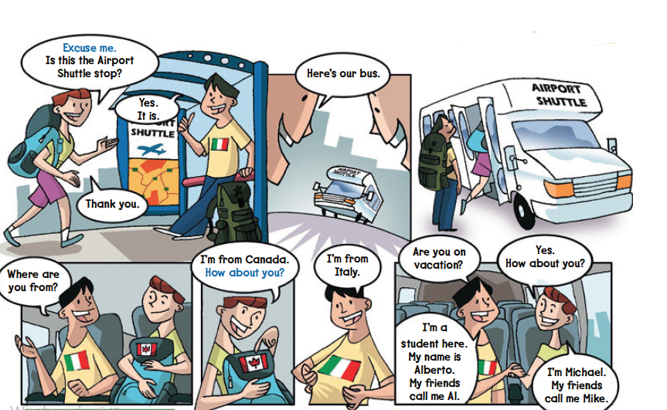

Page 30
at the comic strip
Where are the people going? (to the airport)
to the airport
What are their names?
Alberto/Al and Michael/Mike

Slide 44


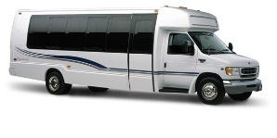
Page 30
Listen and follow along with the text and the pictures
What is the shuttle? it’s a bus because Al says, “Here’s our bus.”
A shuttle is a form of transportation that travels back and forth between two points. It can be a bus, train, or airplane.

Slide 45

Page 30
Find the expressions Excuse me and How about you? in the conversation.
Describe other situations in which you might say Excuse me

Slide 46


Slide 47


Page 30
Which ending you think is the most likely?
Find out how many students chose each ending and write the results on the board.
Why did you choose each ending?

Slide 48




Page 30
Take turns asking and answering the questions.
1. He’s from Italy.
2. Yes, he is.
3. No, he isn’t. He’s on vacation.
4. He’s Canadian.

Slide 49





Page 30
Role-play the conversation with a partner.
You choose one of the endings to use in the conversation.
Substitute different names and countries for Mike and Al.
Act out the conversation for the class
Place two chairs in front of the class as the seats on the shuttle bus.
Students can act out getting on and off the bus.

Slide 50






Page 30
One student in the group the role of reporter.
Your job is to report some of the information from the group conversation to the class.
the reporter from each group to tell the class two or three interesting things about the people in their group.

Slide 51


Slide 52



Slide 53


Slide 54


Slide 55


Slide 56







Page 31
at the pictures and map before they answer.
at the picture of the northern lights (Aurora Borealis).
What do you know about this phenomenon?
Where can you see this?
Find Finland and the Arctic Circle on a world map.
Find the reindeer in the picture.

Slide 57






Page 31
Read along as you listen

Slide 58




Page 32
Complete the chart with information from the article.
☺ Who is telling us about the midnight sun? (Hannun)
in pairs fill in the chart.
Where did you find the information in the article.
When is the darkest time of the year?
December 21st
Is there sunlight in November?
No, there isn’t.
Hannun
Lapland
Finland
Rovaniemi

Slide 59


Slide 60


Slide 61


Slide 62


Slide 63


Slide 64


Slide 65







Page 32
Take turns asking and answering the questions.

Slide 66




Page 32
Write your addresses on your note. Make sure they use capital letters for the street name
Read the example aloud as a class. Write two or three phone numbers on your notebook. read them aloud.
Read aloud the example email addresses. Write two or three more email addresses on your notebook. Some email addresses have an underscore in the name.

Slide 67




Page 32
Complete the information form in your books. Then prepare two more information forms in your notebooks.
Take turns asking for your classmates’ information.
ask for verification of the information.
to prove that something exists or is true
= proving or checking that something is true or correct
When the forms are completed, exchange forms to verify each other’s information is written correctly.

Slide 68






Page 32
Write your name, home address, telephone number, cell phone number, and email address on a piece of paper and give it to me.
compile
= to collect information from different places and
arrange it in a book, report, or list:
Compile the information into a directory. Review the directory before making
copies or posting it. Is it OK to distribute your personal information beforehand.

Slide 69









Page 32
look for information about your country. Find pictures of the cities or places of interest.
Collect the information
In groups ,make a poster about your country. You can illustrate the poster with the pictures you found or drawings you create themselves.

Slide 70
Assign page 104 for practice with writing personal
information, including completing forms.

Slide 71

Page 33
Requests and Offers: Can / Will
Requests
Read the first part of the chart. read the requests and read the agreements and refusals.
these requests are questions. In questions, the modal verbs Can and Will come before the subject.

Slide 72


Page 33
Requests and Offers: Can / Will
Offers
Look at the next part of the chart. Read the offers and read the acceptances and refusals.
☺ it is considered polite to say No, thank you or the less formal No, thanks when refusing an offer. Another possibility is No, that’s all right/OK.

Slide 73

Page 33
role-play the conversation in the picture.
What does the teacher say when the boy opens the window?
Thank you.
Then what does the boy say?
You’re welcome.

Slide 74


Page 33
Read the example and read the polite requests.
The example is imperative and the polite request is a question.
What other word in the request is polite? (please)
Where else can please go in the sentence? (Before the verb: Can you please help me?)
Can/Will you close the door, please?
Can/Will you please be my partner?
Can/Will you open your books, please?
Can/Will you please give me an eraser?
Can/Will you write your telephone number, please?
Can/Will you please tell me the country code for Saudi Arabia?
Can/Will you spell your name, please?
Can/Will you repeat that, please?
Can/Will you please repeat that?

Slide 75

Page 33
Make requests and offers. respond differently each time.
Use polite expressions such as please, thank you, you’re welcome.

Slide 76
The end
Noureyah Alghamdi

Slide 77




Slide 78

Role play is the act of imitating the character and
behaviour of someone who is different from yourself,
Benefits of Role-Play
☺Build confidence:
☺Develop listening skills:
☺Creative problem-solving:
☺Develops communication and language skills:
☺Allows students to act out and make sense of real-life situations:
☺Develops social skills as children, collaborate with others:
☺Encourages children to express their ideas and feelings in a relaxed environment:
☺Sparks creativity and imagination:

Slide 79



Page 83

Slide 80


