Slide 1

Super goal 1
Unit 4
Lesson 2 Grammar+ listening+ pronunciation
اعداد المعلم / يحيى المنقري متوسطة المأمون بالهفوف

Slide 2

Learning Objectives
*By the end of this lesson, Ss will be able to:
1-use verb to be in negative and in questions .
2- use prepositions in sentences .
3- make questions using WHERE.

Slide 3


Slide 4





e.g. Ksa_1@gmail.com
Underscore
AT
dot

Slide 5
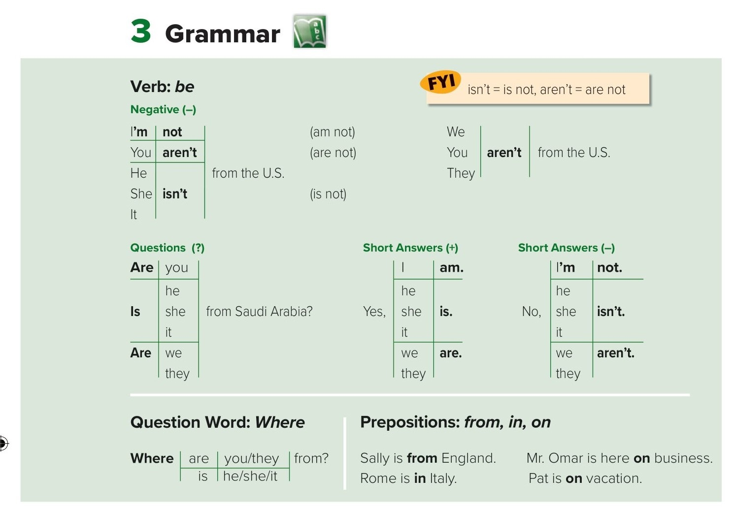
am
is
are
I
am
He
She
it
is
You
We
They
are
He is a student .
Is he a student ?
Yes, he is .
No, he isn't .

Slide 6
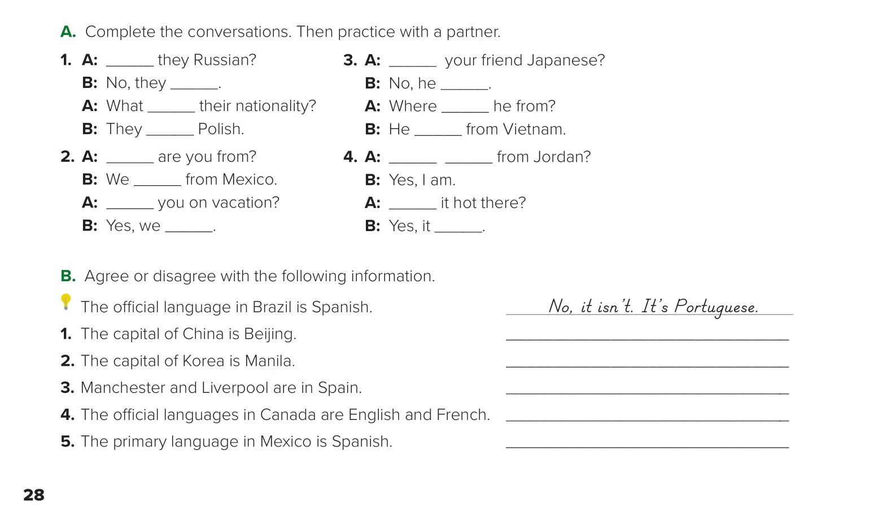
Are
Is
aren’t
isn’t
is
is
are
is
Where
Are you
are
Are
Is
are
is
Yes, it is.
No, it isn’t. The capital of Korea is Seoul.
No, they aren’t. Manchester and Liverpool are in England.
Yes, they are
Yes, it is

Slide 7
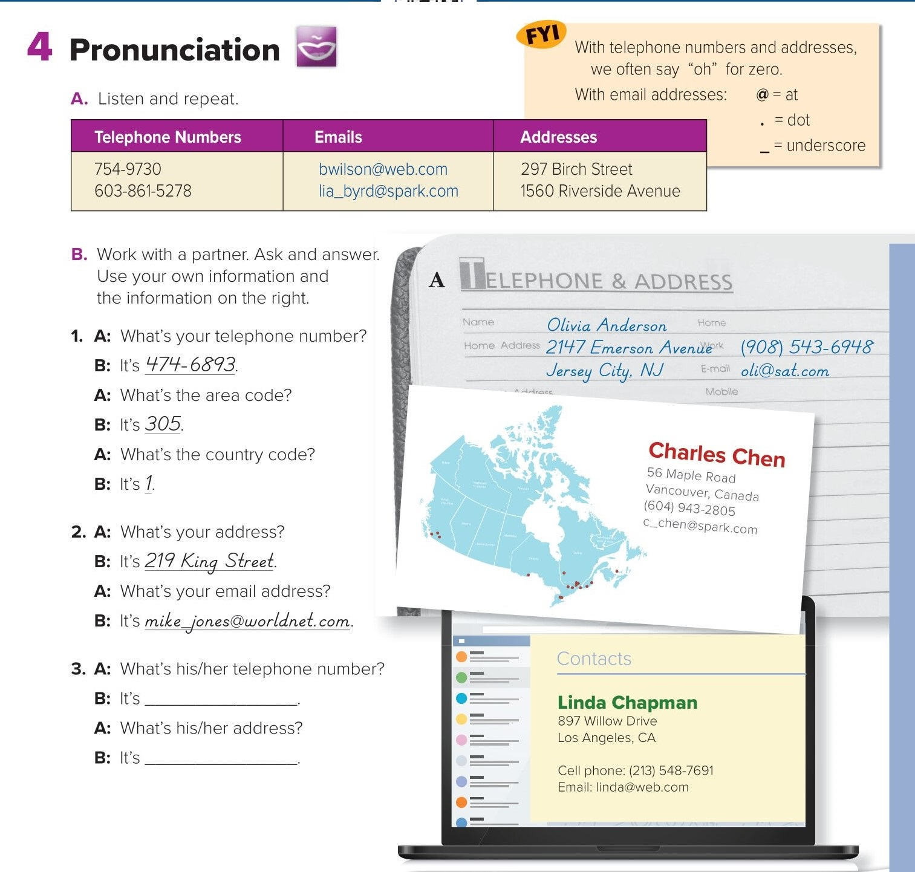
It's 823420.
It's 31 King Street.

Slide 8
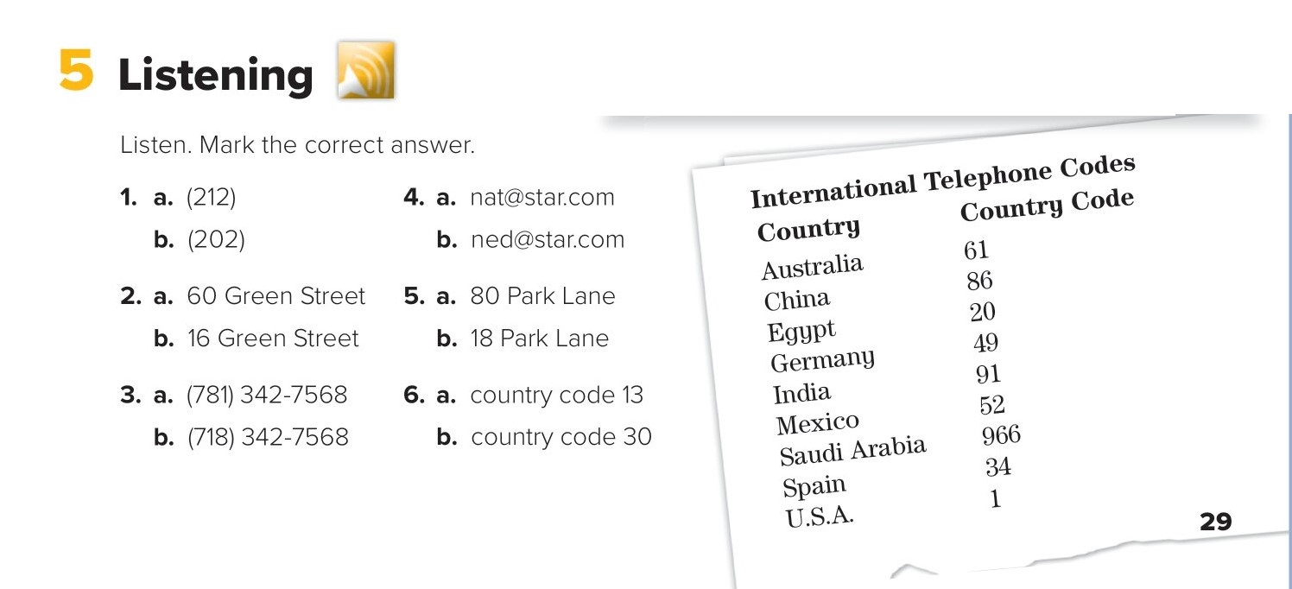
✓
✓
✓
✓
✓
✓

Slide 9
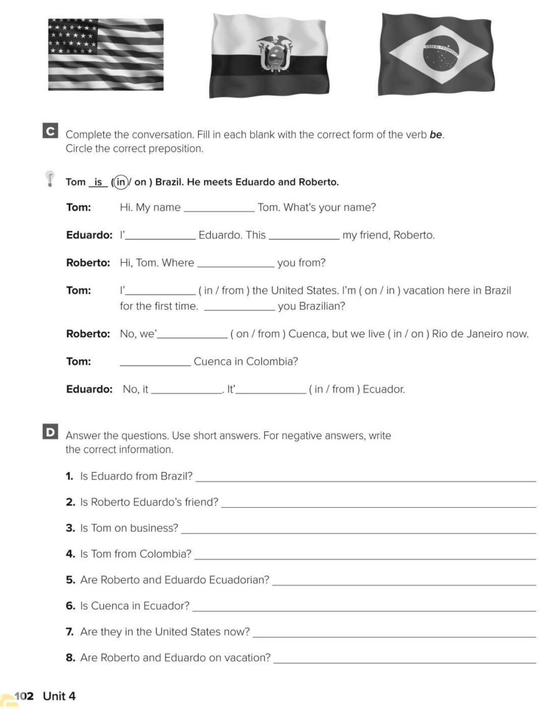
is
m
is
are
m
are
re
Is
isn’t
s
No, he isn’t. He is from Ecuador.
Yes, he is.
No, he isn’t. He’s on vacation.
No, he isn’t. He’s from the United States.
Yes, they are.
Yes, it is.
No, they aren’t. They are in Brazil now.
No, they aren’t. They live in Rio de Janeiro.

Slide 10
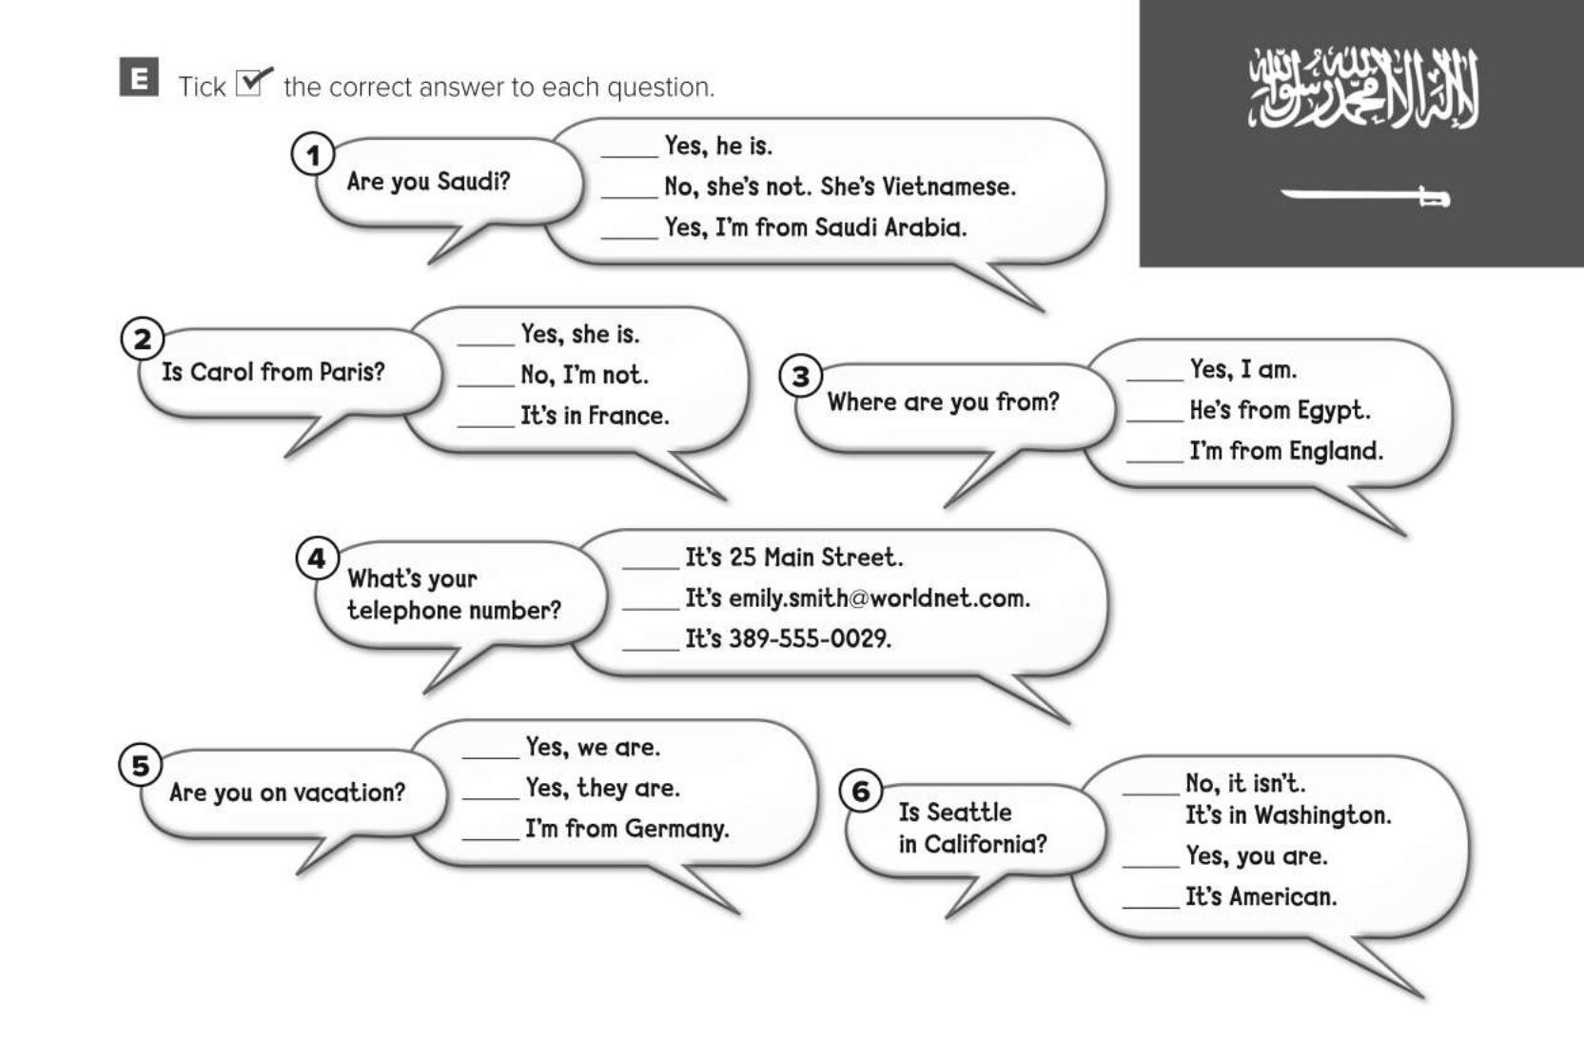
✓
✓
✓
✓
✓
✓

Slide 11
Choose the correct answer :
1-
We …….. From Saudi Arabia .
are
is
2-
Where are …… ..… ? I am from KSA
from you
you from
3-
4-
dot
Slash
Comma
Underscore

Slide 12


Slide 13


Back

Slide 14


Back

