Slide 1

Super goal 1
Unit 4
Lesson 3 conversation & about you
اعداد المعلم / يحيى المنقري متوسطة المأمون بالهفوف

Slide 2

Learning Objectives
*By the end of this lesson, Ss will be able to:
1-answer questions about personal information.
2-establish a conversation including information about nationality and
Country..

Slide 3


Slide 4
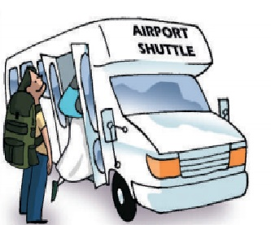

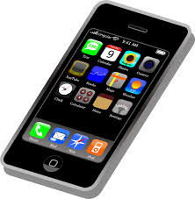


Shuttle
address
Cellphone

Slide 5
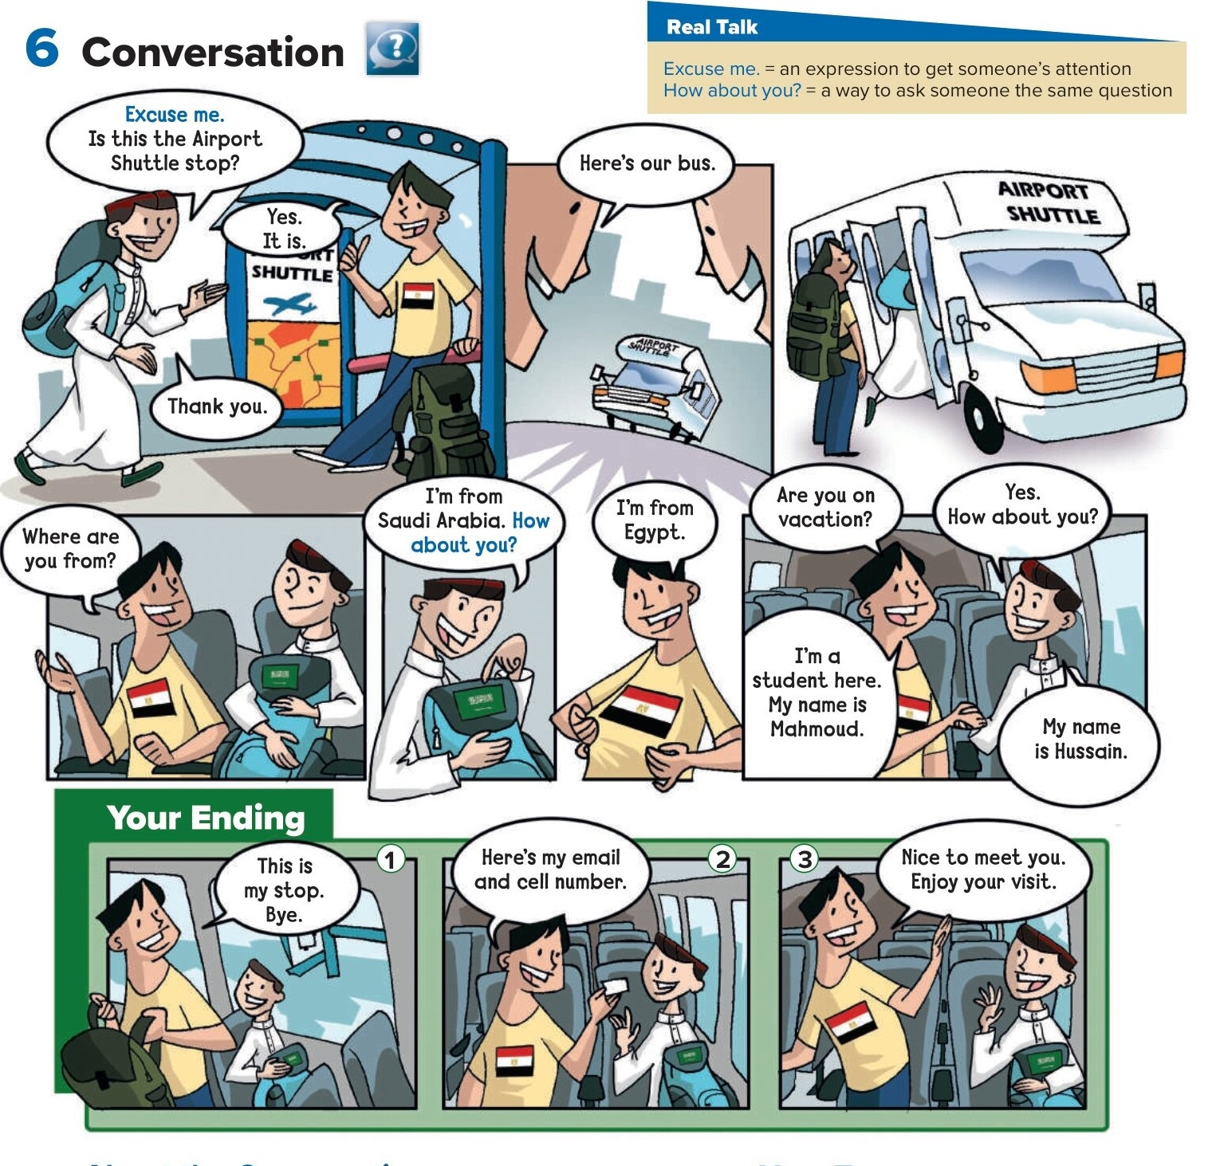

Slide 6
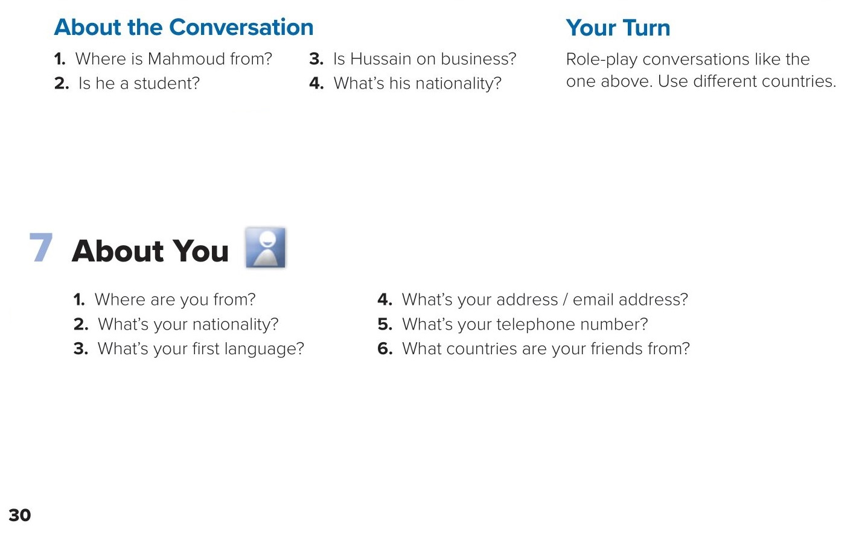
1. He’s from Egypt.
3. No, he isn’t. He’s on vacation.
2. Yes, he is.
4. He’s Saudi.

Slide 7
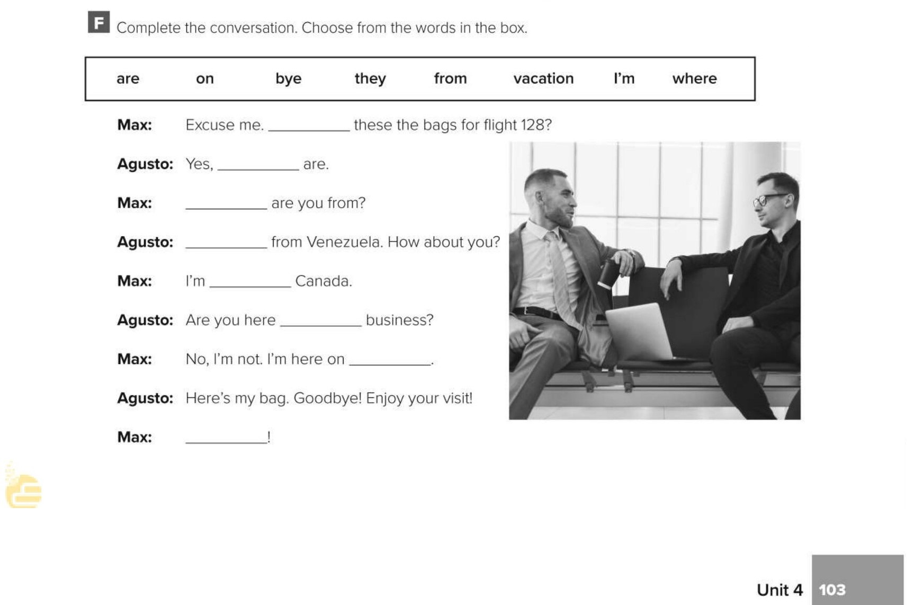
Are
they
Where
I’m
from
on
vacation
bye

Slide 8

Choose the correct answer :
1-
What’s your nationality?
I am a student
I am Saudi
2-
Where is Naif from ?
he is from Oman
He’s on vacation
3-
4-
Shuttle
Cellphone
address
doll

Slide 9


Slide 10


Back

Slide 11


Back

