Slide 1
Unit3 What Will They Think of Next Listen & Discuss
Mega Goal 3.1
Done by : Entisar Al-Obaidallah

Slide 2
Lesson Objectives
1
2
3
4
Discuss
Make
Answer
Match
Technology invented over the last one hundred years
Predictions about life in the year 2100
some questions about the topic
the words with their meanings

Slide 3
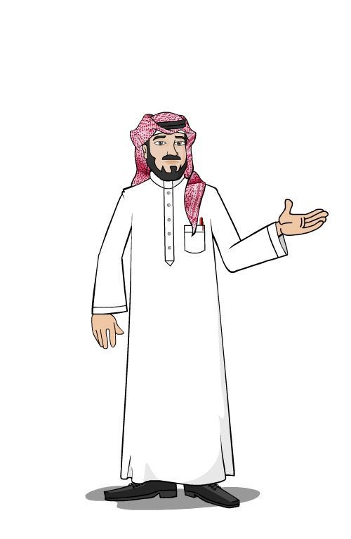
Warm Up
What does these words indicate to ?
What Will They Think of Next
Predictions of Future

Slide 4
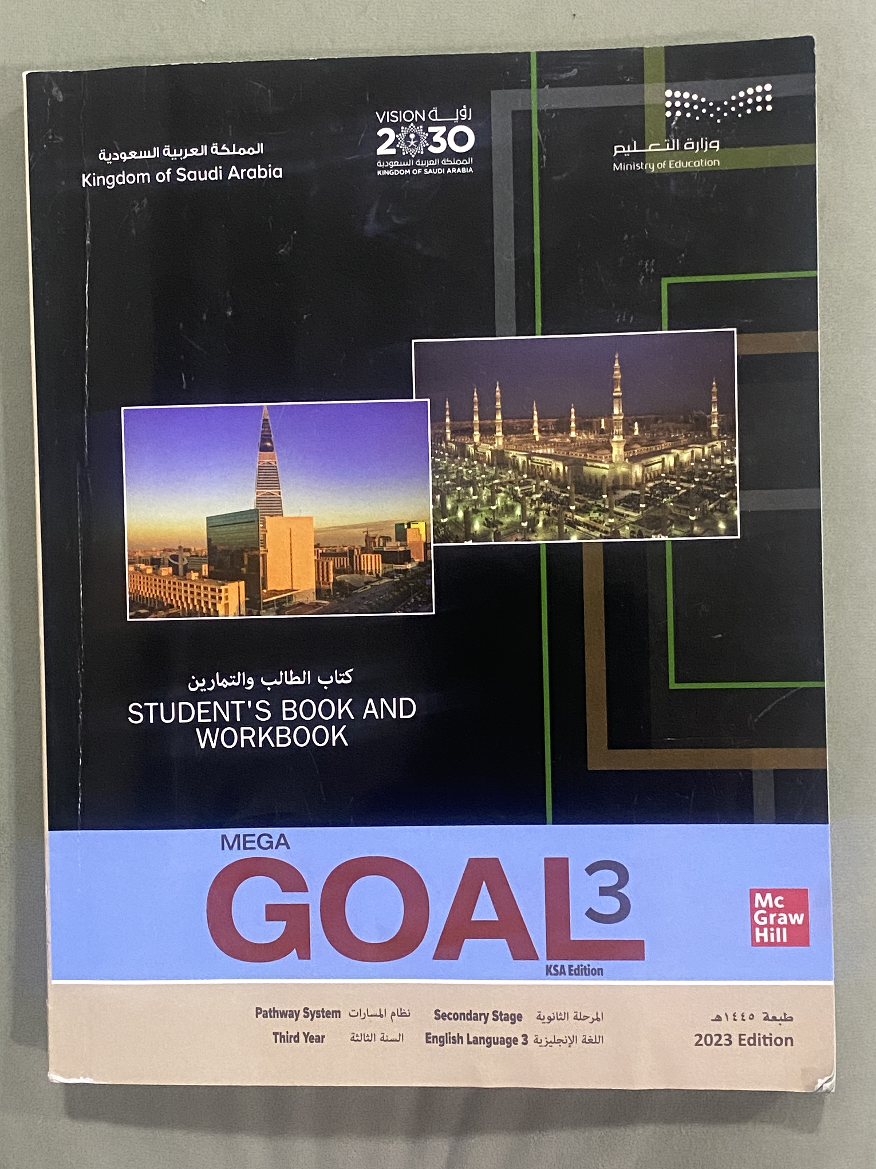
Open
your student’s book
p. 34

Slide 5
What things that we take for granted today did people NOT have 100 years ago?
Name a discovery or development that you think people will have (or use) 100 years from now

Slide 6
What things that we take for granted today did people NOT have 100 years ago?
computer
clothes
internet
Smart phone
transportation
entertainment
Abundance food
life style
Electricity

Slide 7
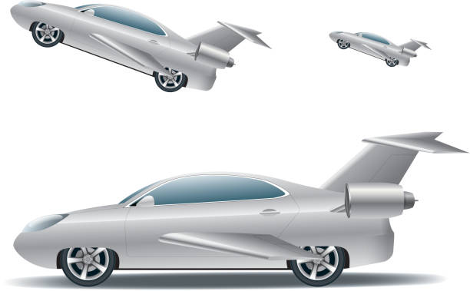
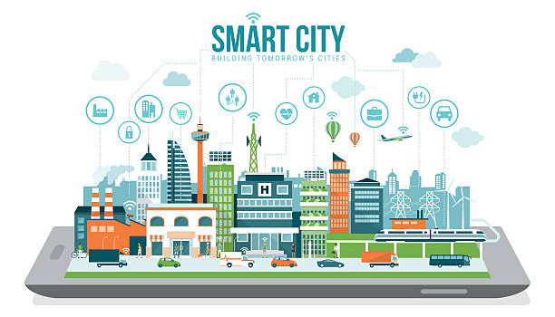
Name a discovery or development that you think people will have (or use) 100 years from now.
Space Elevator
Robot Cop
3D printing of house
Flying cars
Smart city

Slide 8
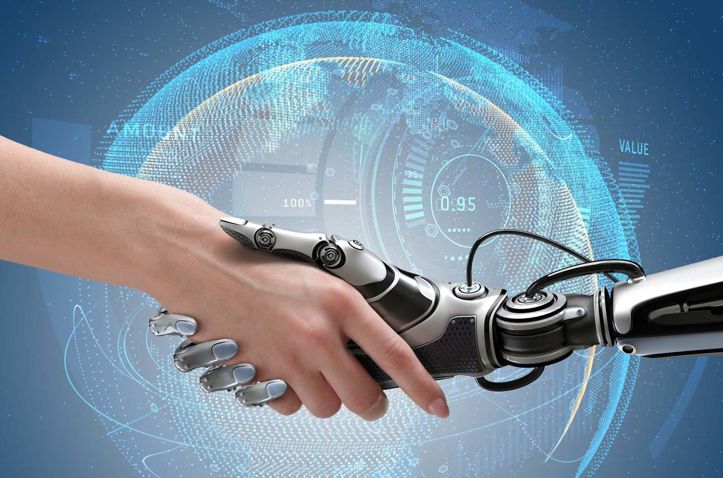
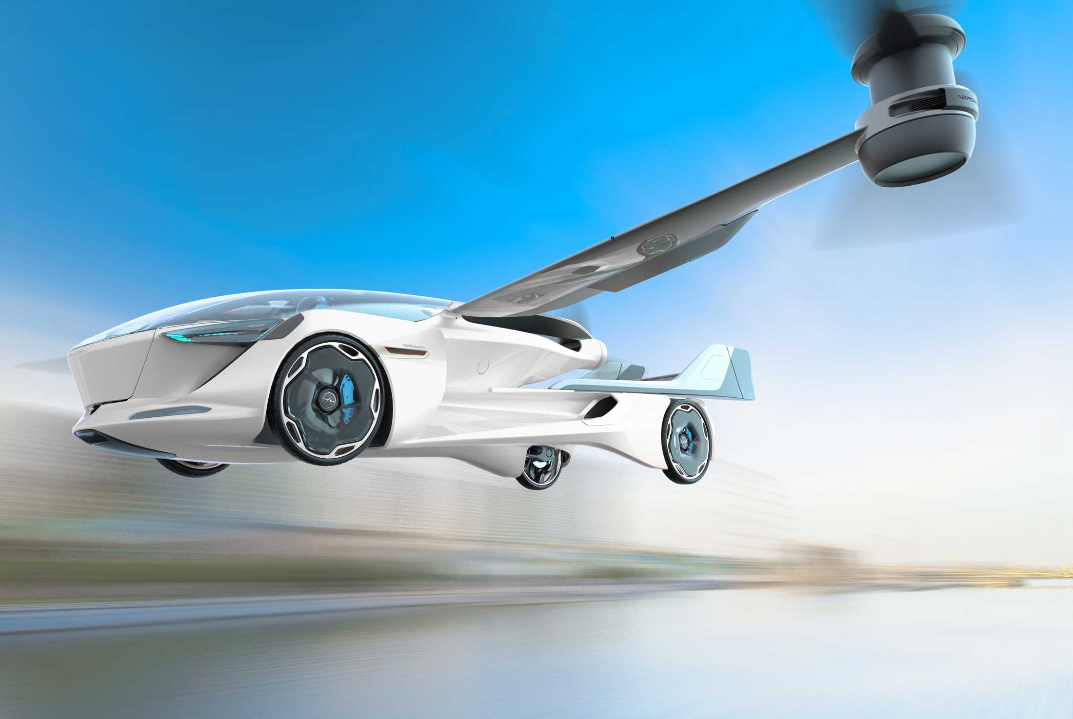
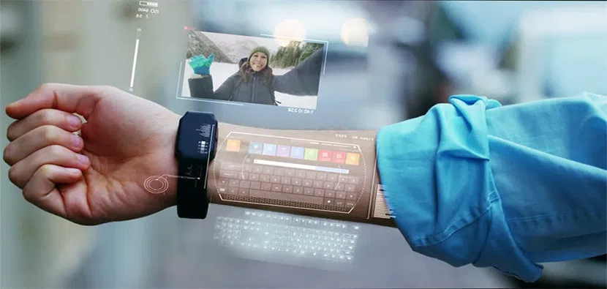
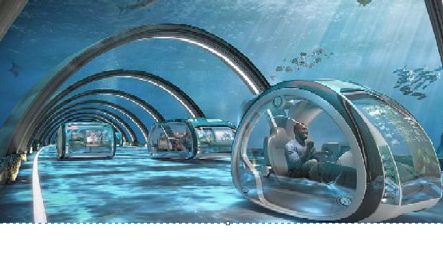
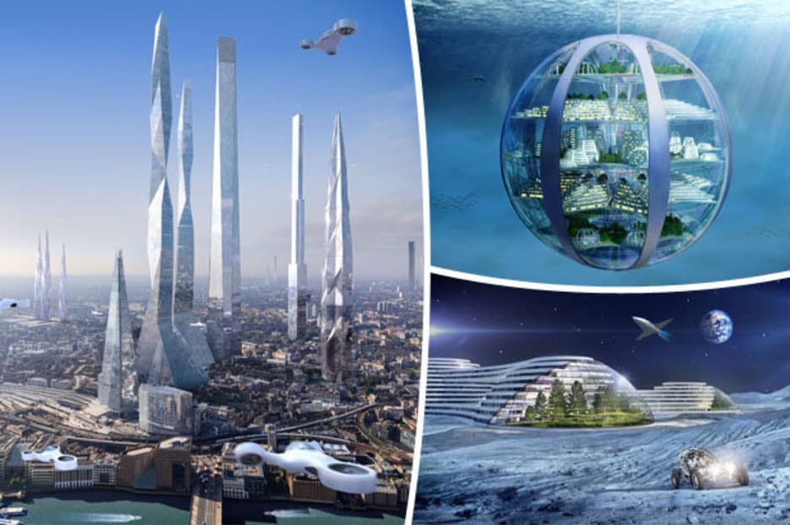
These are pictures of somethings may happen in the future
All these things related to technology

Slide 9
Most people think of “technology” when they talk about future

Slide 10
What predictions does this picture show?
The predictions related to transportation and traffic
Does this city look like a modern city?
Yes , it looks like
a digital city

Slide 11
When was this article written?
In 1900
What is the article about ?
about what life
would be like in the year 2001.

Slide 12
What predictions about PEOPLE have not come true?
People will be taller by one to two inches
What predictions about Language have not come true?
1-There will be no C, X, or Q in the English alphabet
2- English will have become a language of condensed words.

Slide 13
What predictions about transportation and traffic have not come true?
Vehicles do not have cushioned wheels, although modern tires are probably quieter than tires in
1900. Cities are still noisy

Slide 14
What predictions does the picture on page 35 illustrate?
the predictions about
media,
deliveries, and
communication

Slide 15
What predictions are in this part?
the predictions about media, deliveries, and
communication
Which predictions have come true?
It is easy for a person in New York to speak to someone in China wirelessly

Slide 16
Which predictions shown in the
picture have NOT come true?
Tubes are not able to
deliver goods to homes from stores

Slide 17
e
b
f
c
d
a

Slide 18
1 The average life expectancy in 1900 was 35 years.
2. He thought there would be no C, X, or Q; spelling would be by sound; the language would be condensed; and English would bethe most widely spoken language. The prediction about English being the most widely spoken language came true.
3. He was probably thinking about airplanes.
4. Automobiles have replaced all horse-drawn vehicles.
5. There will never be tubes connecting houses to a store. Thisis impossible

Slide 19
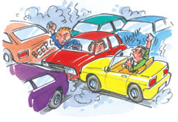
Traffic
People
Deliveries
Media
Language
Communication

Slide 20
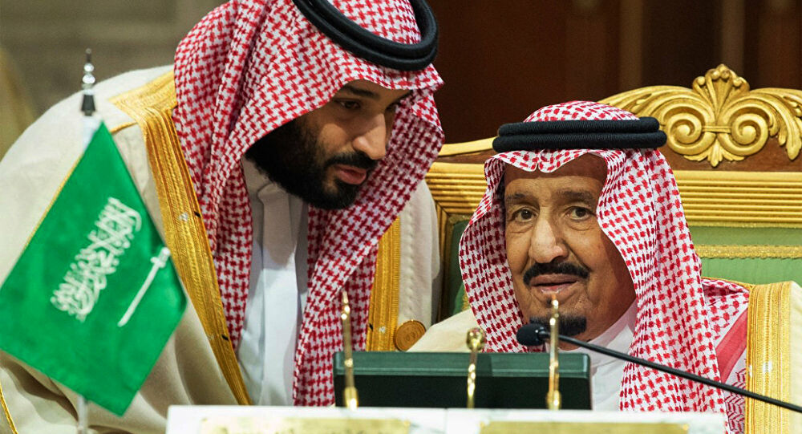
Write a list of predictions of changes that will have been made in
Saudi Arabia by 2030?

Slide 21
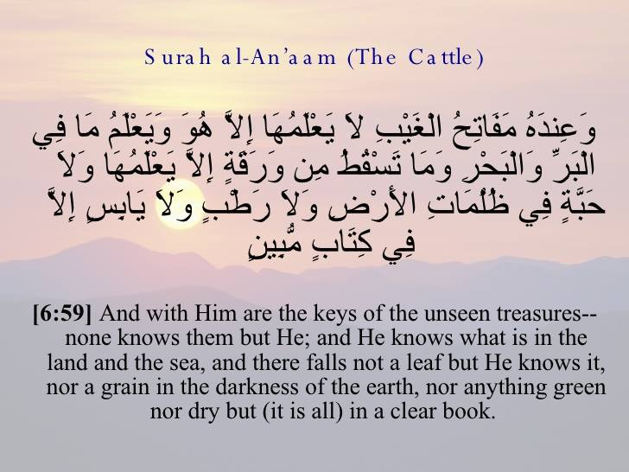
Remember…
These are just predictions
Not anymore , because no one knows about future except
Allah

Slide 22
Homework
your student’s book
p. (241)

Slide 23
Thanks

