Slide 1
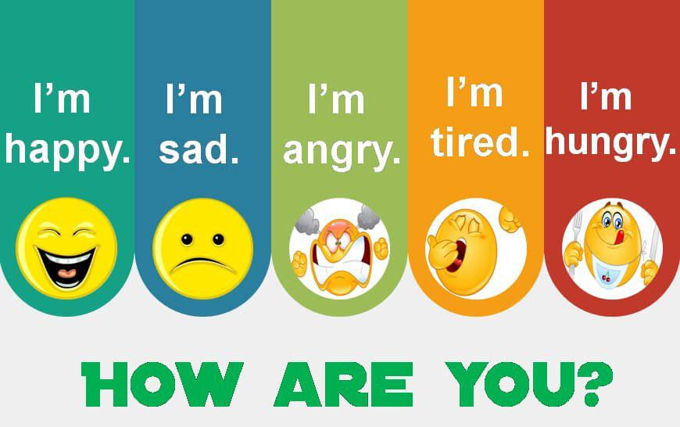

Slide 2
Warm up
Memory game

Slide 3
Hello!
Unit 3
الله أكبر، الله أكبر، الله أكبر، ( سُبْحانَ الَّذِي سَخَّرَ لَنَا هَذَا وَمَا كُنَّا لَهُ مُقْرِنِينَ * وَإِنَّا إِلَى رَبِّنَا لَمُنقَلِبُونَ )” اللهم إنا نسألُكَ في سفرنا هذا البرَّ والتقوى، ومن العمل ما ترضى، اللهم هون علينا سفرنا هذا واطو عنا بُعده، اللهم أنت الصاحب في السفر، والخليفة في الأهل، اللهم إني أعوذ بك من وعْثاءِ السفر، وكآبة المنظر وسوء المنقلب في المال والأهل”

Slide 4
Hi!
¡Hola!

Slide 5
At the end of this session, the students will be able to :
Read the text
- Recognize Saudi Arabia features
- Design Arabic language study program for foreigners
- Find the reason behind choosing Saudi Arabia to learn Arabic
- Find the meaning of the words in the context
Answer the questions about the text .

Slide 6
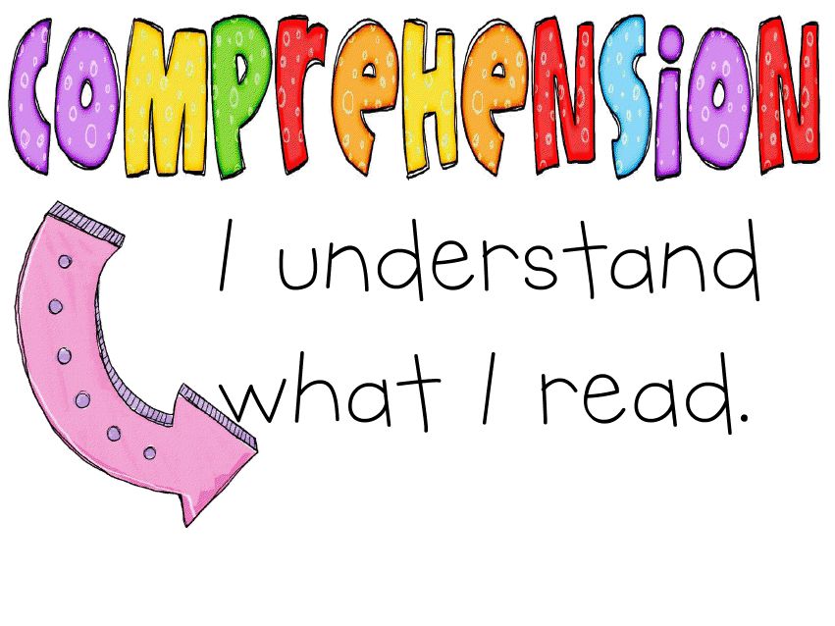
Page 28+29
Before reading
While reading
After reading

Slide 8
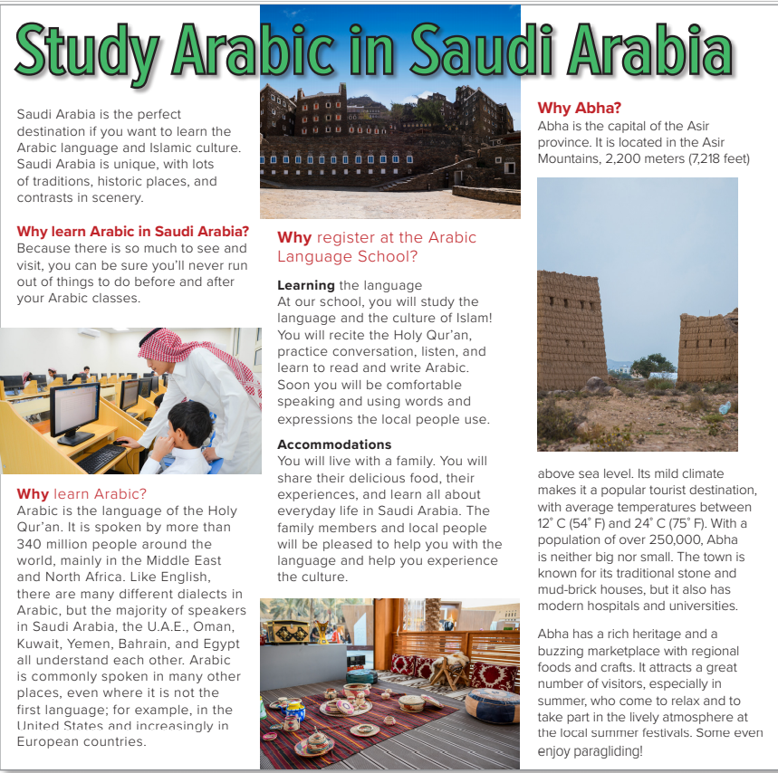
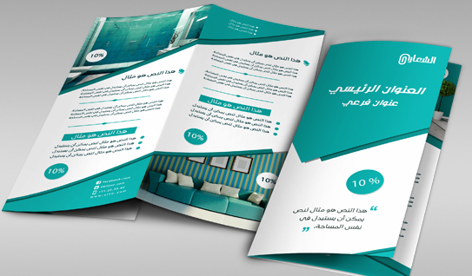
Is it a magazine article or a brochure?
(a brochure)
What is the title?
What are the subtitles?

Slide 9
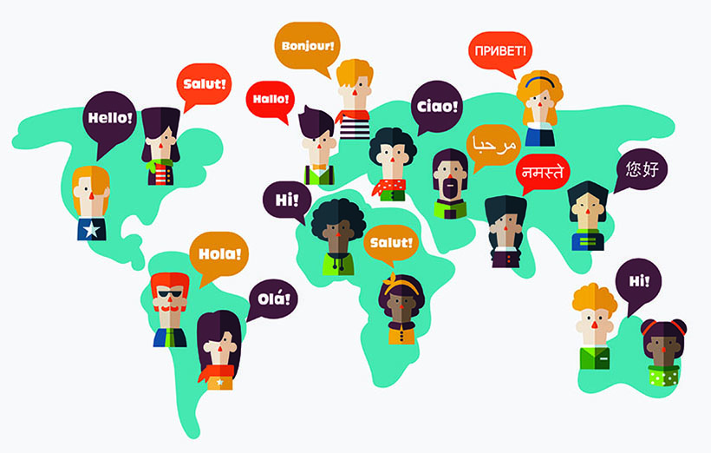
Page 28

Slide 10
Page 28
Who is the man?
What country do you think the pictures are of?
What is the brochure for?
What are good places in Saudi Arabia to visit?
(the Arabic Language School)
What is the climate like in Saudi Arabia?
Will the brochure give all the facts or just some of the facts?
Do you think Saudi Arabia is a good place to study Arabic?
Will the brochure have any negative information?
Why not?

Slide 11
Scan the text for a language:
Scan the text for a city:
Scan the text for a country:
Scan the text for a season:

Slide 12
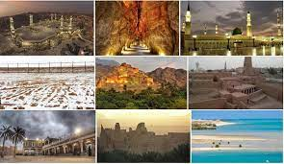
exchange student
scenery

Slide 13
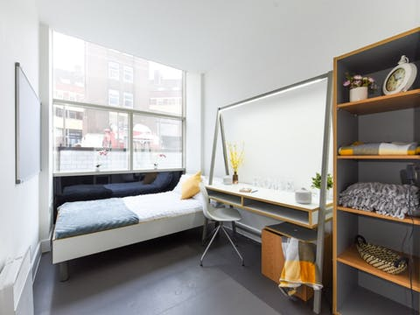
Accommodation
climate

Slide 14
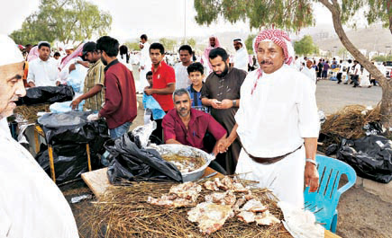
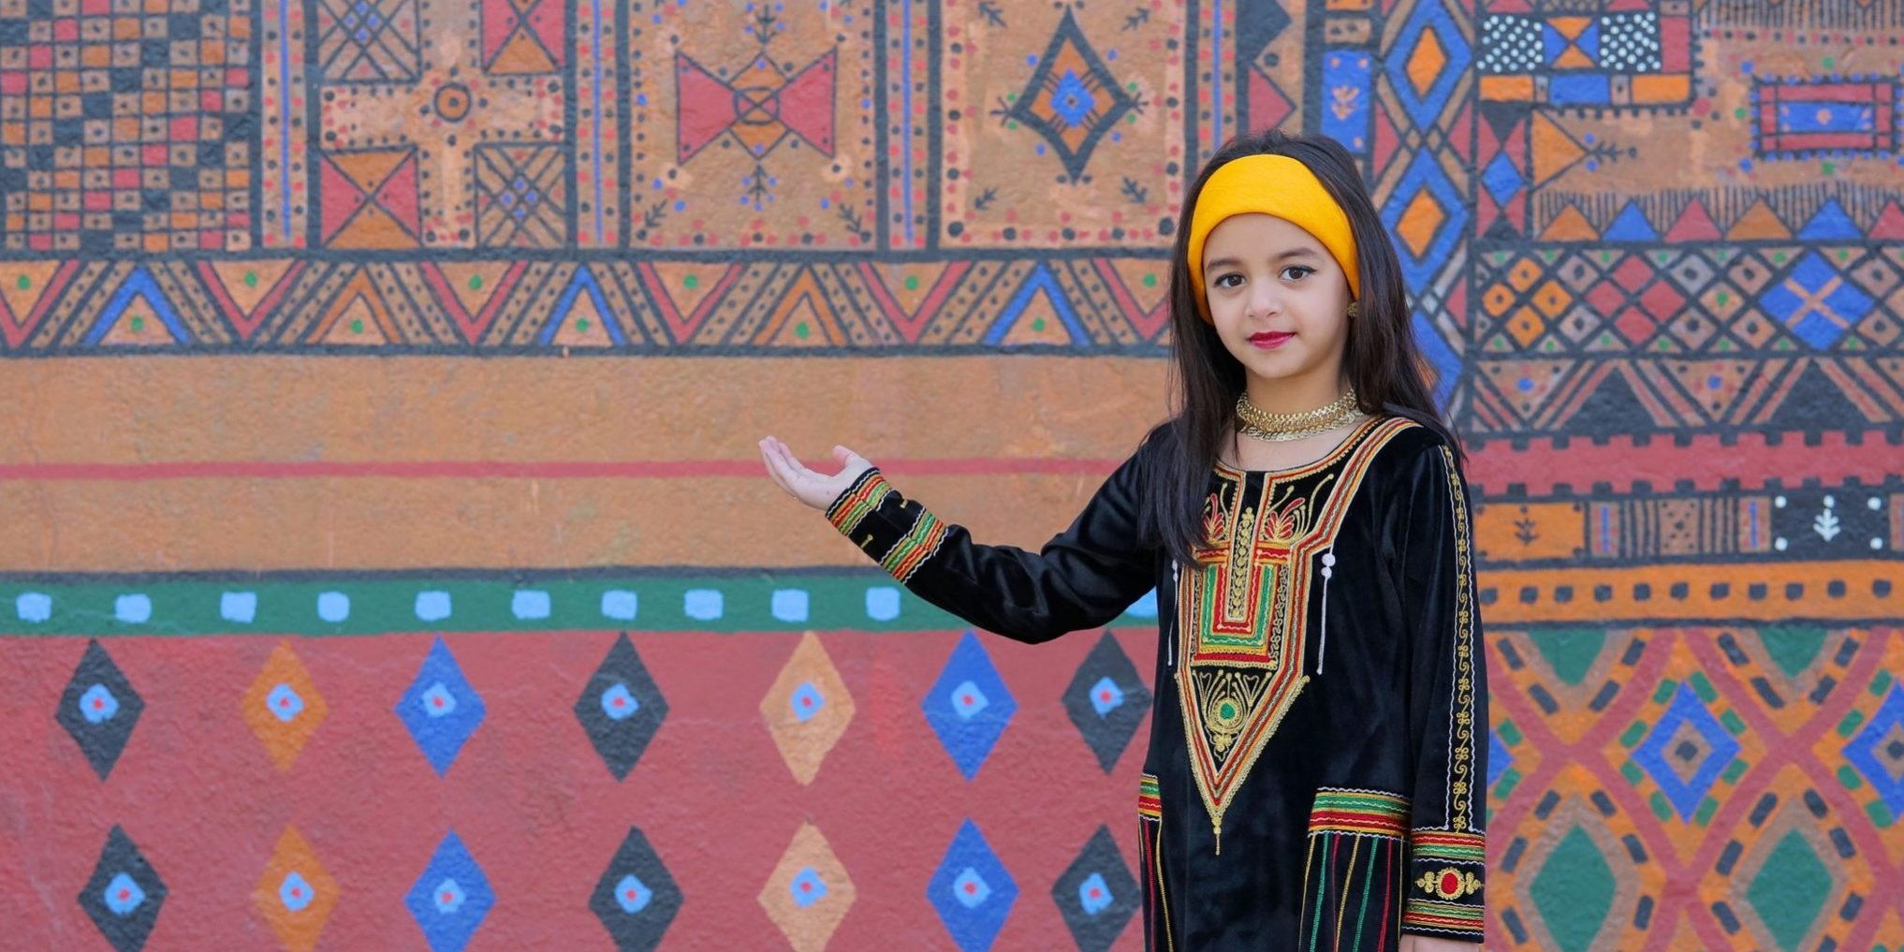
Buzzing market
heritage

Slide 15
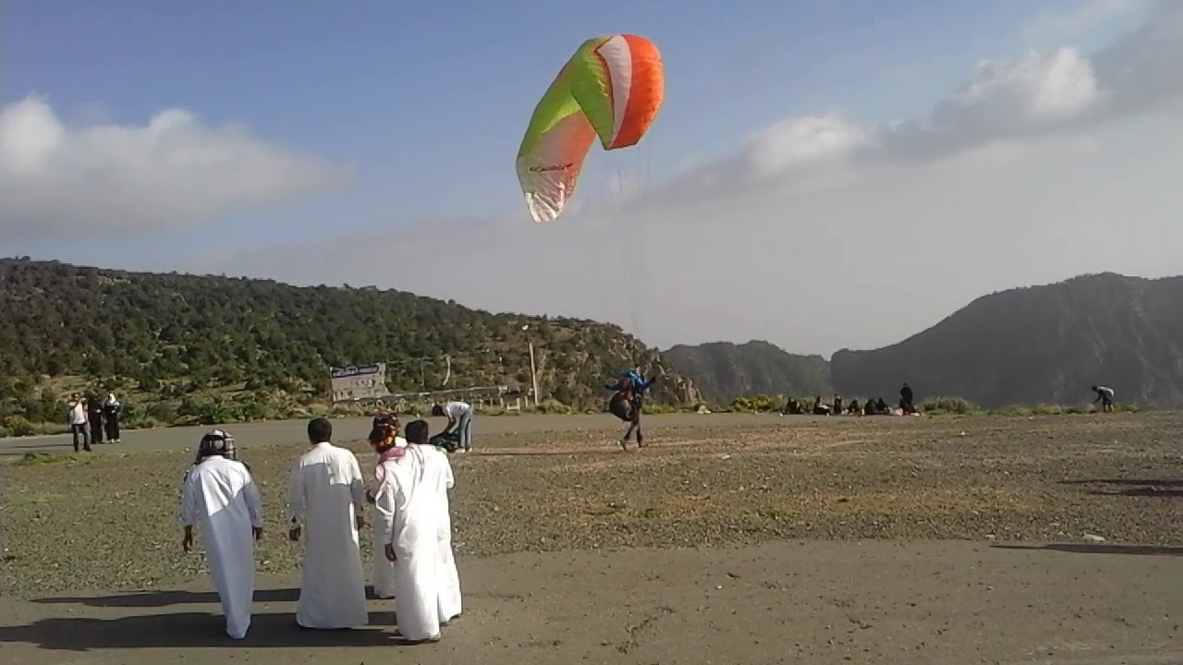
paragliding

Slide 16
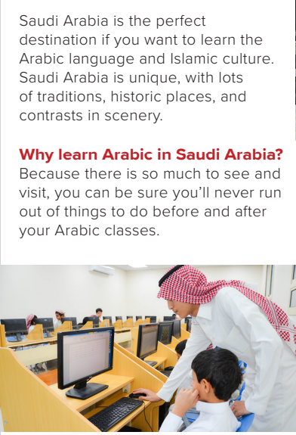
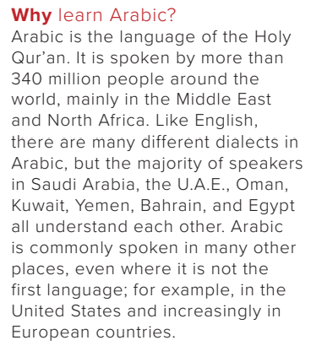
Page 28
What makes Saudi Arabia special?
(its traditions, historic places, and contrasts in scenery)
What makes Saudi Arabia a good place to learn Arabic?
(There are a lot of things to do outside of class.)
How many people speak Arabic?
(more than 340 million people)
Where do people speak Arabic?
(in the Middle East and North Africa, in the US and in European countries)

Slide 17
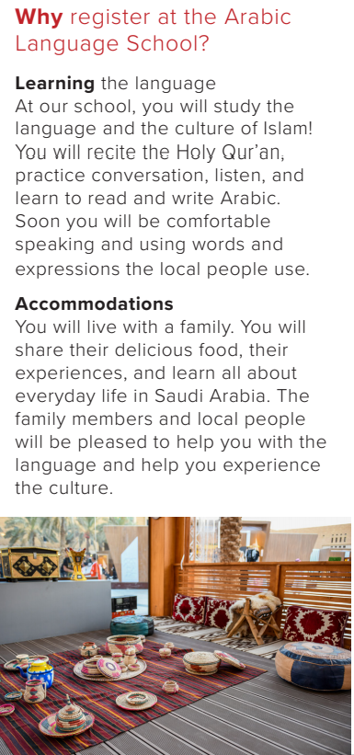
Page 28
What will you study at the school?
(the language and culture of Islam, the Holy Qur’an)
Why will it be good to live with a family?
(You will share their food, experiences, and learn about everyday life in Saudi Arabia.)

Slide 18
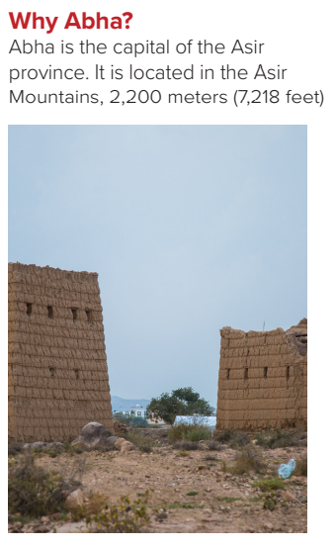
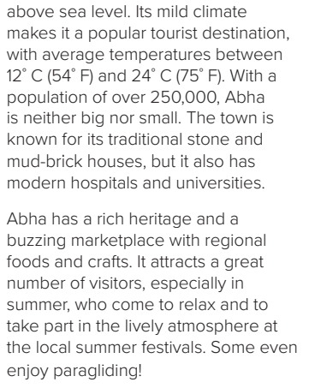
Page 28
Is Abha in the mountains or by the sea?
(in the mountains)
What is the climate in Abha like?
(It has a mild climate with temperatures between 12°C and 24°C.)
Is Abha an old city or a modern city?
(both)
What is the population of Abha?
(over 250,000)
What attractions are there in Abha?
(rich heritage, marketplace, summer festivals, paragliding)

Slide 19
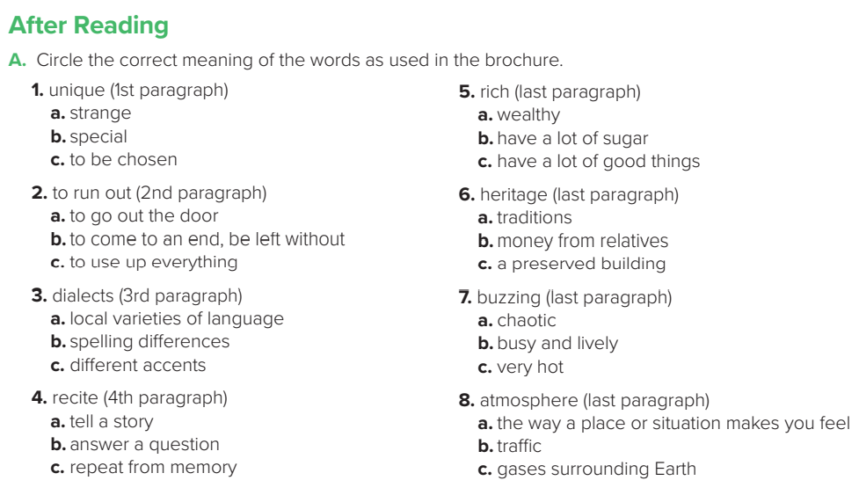
Page 29

Slide 20
Page 29
1.Arabic is spoken by more than 340 million people, so it can help you communicate with lots of people.
2. Students will recite the Holy Qur’an, practice conversation, listen, and learn to read and write Arabic.
3. Students will live with a family.
4. Abha has a mild climate with temperatures between 12°C and 24°C.
5. The climate is good, and Abha has a rich heritage, a buzzing marketplace, a lively atmosphere, summer festivals, and even paragliding.

Slide 21
Page 29

Slide 22
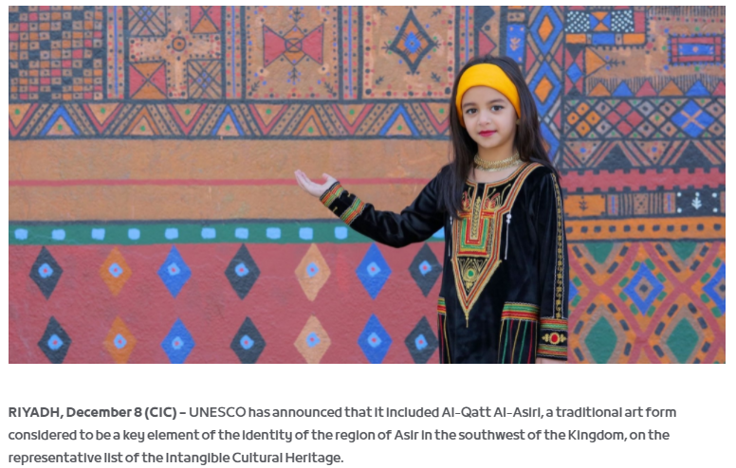
https://cic.org.sa/2017/12/unesco-includes-ancient-saudi-art-form-on-the-intangible-cultural-heritage-list/

Slide 23
Thank you!

Slide 24
Homework:

