Slide 1

When are you Traveling?

Slide 2
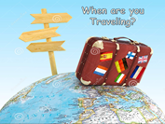

Lessons: 5 - 8
Objectives:
Judge the information you are listening to.
Listen to the -ing endings in the sentences.
Answer some personal questions
Invent a conversation with someone on a plane
Use the " Real Talk “ phrases in a conversation
Match questions with their answers

Slide 3
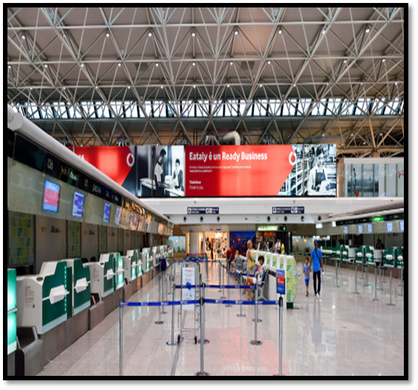

1. Where are the people?
2. What are they going to do?
3. Have you ever been in a long line at the airport?
4. What did you do while you were there?
5. Did anything unusual happen?

Slide 4
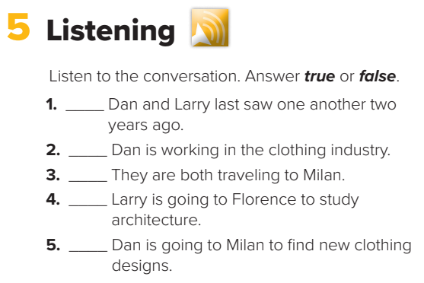
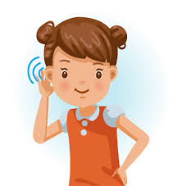

P. B. p. 26
F
T
F
F
T

Slide 5
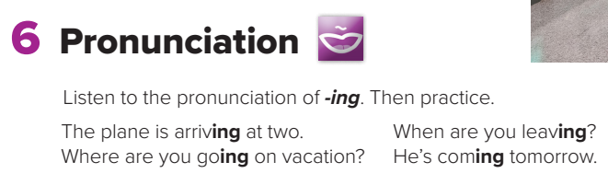

P. B. p. 26

Slide 6

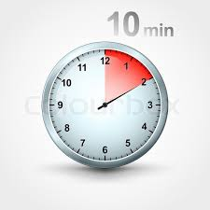
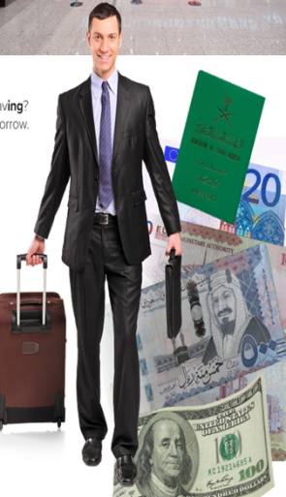
About You
P. B. p. 26
1. Have you ever traveled by plane?
2. Are you afraid of flying?
3. What do you like/dislike about plane trips?
4. What do you like/dislike about airports?
5. What do you think are the good and bad things
about traveling?
6. Have you ever had a bad travel experience?
Tell about it.

Slide 7
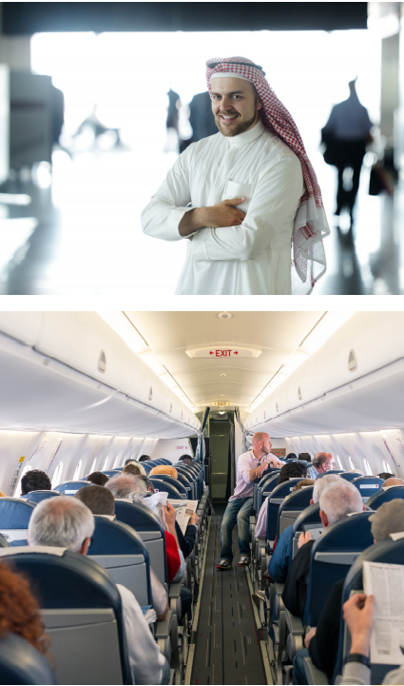

1. What is the connection between the pictures?
2. Where do you think the people on the plane are going?
3. What do strangers on planes often talk about?
4. Do you like to talk to strangers on planes? Why or why not?

Slide 8
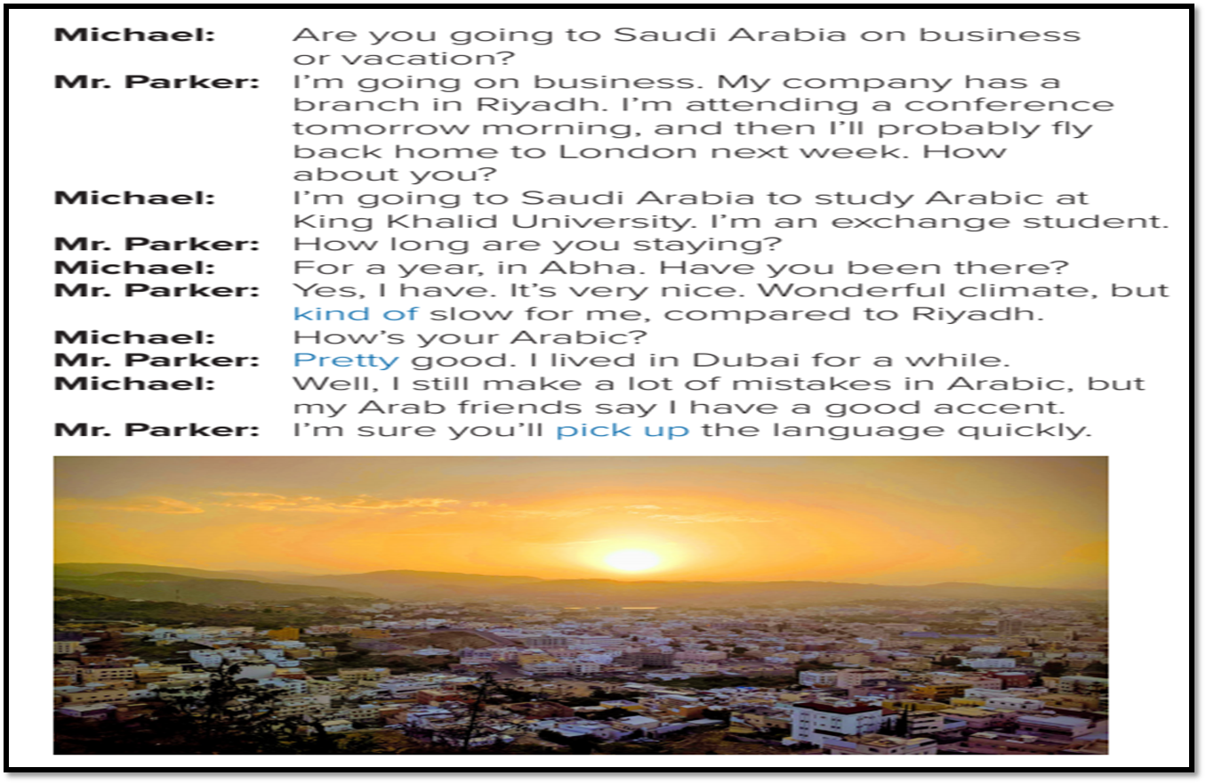
P. B. p. 27
1. Where is the plane going?
2. Do the two people in the conversation know each other?

Slide 9
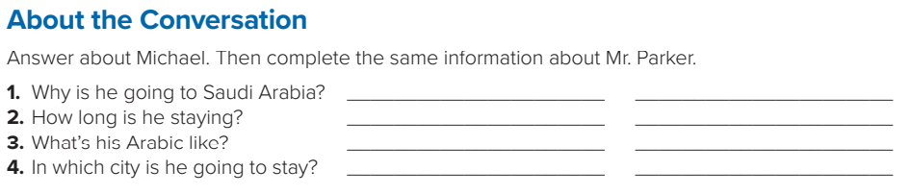

P. B. p. 27

Slide 10

Michael
1.He’s going to Saudi Arabia
to study Arabic.
2. He’s staying for a year.
3. He still makes mistakes
in Arabic.
4. He’s going to stay in Abha.
Mr. Parker
He’s going to Saudi Arabia on business.
2. He’s staying for a few days.
3. His Arabic is pretty good.
4. He’s going to stay in Riyadh.

Slide 11

Imagine you are traveling and you meet someone on the plane.
Role-play the conversation with a partner.
1. Where/ stay?
2. Why / go / name a place?
3. How long / stay ?

Slide 12


