Slide 1

When are you Traveling?

Slide 2


Slide 3
Objectives
SWBT:
Formulate correct sentences with present progressive tense
Use ( be + going to ) to talk about future plans
Illustrate a reason with the infinitive

Slide 4


Slide 5
Present Progressive

Slide 6
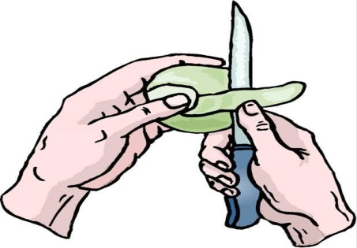
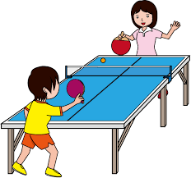

Present progressive
is peeling
1. Amani is peeling an apple now.
are playing
They are playing table tennis.
am studying
3. I am studying at the moment.

Slide 7
Choose the correct words:
She is [ cry – cries - crying ] again.
The boys [ go – goes – are going ] now.
I [ study – studies - am studying] at the moment.
Sami [ brush – brushes - is brushing ] his teeth every day.
We [ go – goes – are going] to the library now.
You never [ clean – cleans – is cleaning ] the house.

Slide 8
is not peeling
Present progressive
is peeling
1. Amani is peeling an apple now.
isn’t
are playing
They are playing table tennis.
are not playing
aren’t
am studying
3. I am studying at the moment.
am not studying
I’m not

Slide 9
Present progressive
now
V
at the moment
She
He
It
is
be
V + ing
am
I
playing
They
We
You
reading
are
watching
not

Slide 10
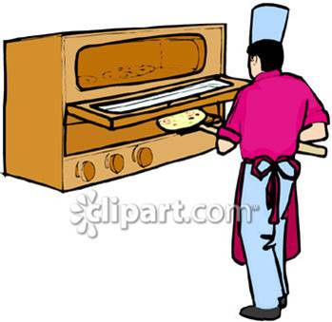


Look at the pictures and form sentences.
He is baking.
I am turning the light on.
I am turning on the light.
They are hugging each other.

Slide 11
Present progressive Yes / No questions
1. Amani is peeling an apple now.
Is
peeling an apple now?
Amani
They are playing table tennis.
Are
they
playing table tennis?
Yes,
they
are.
3. I am studying at the moment.
Are
you
studying at the moment?
No,
I
am not.

Slide 12
Present progressive
now
at the moment
1. Amani is peeling an apple now.
Is
Amani
peeling
an apple now?
Yes,
she
is
No,
is
she
not.

Slide 13
Present progressive Wh- questions
1. Amani is peeling an apple now.
What
Amani
is
peeling now?
They are listening to the teacher.
Who
are
they
listening to?
3. I am studying at the moment.
When
are
you
studying?

Slide 14
Grammar
Future
will
Grammar
Be + going to
present
past
future

Slide 15


Slide 16
Future
Going to

Slide 17
is going to
start
a course tomorrow.
She
I
am going to
call
Noura later.
are going to
travel
They
next week.

Slide 18
Future
tomorrow
later
V
next
soon
be + going to
V
is + going to
play
am + going to
read
are + going to
watch
Now form your own.

Slide 19
Use " going to" to form complete sentences:
He / read
He is going to read.
She / eat
She is going to eat.

Slide 20
Use " going to" to form complete sentences:
You / answer
You are going to answer the phone.
I / sleep
I am going to sleep.

Slide 21
They are going to travel next week.
v
She is going to start a course tomorrow.
is not
isn't
v
I am going to call Noura later.
am not
I’m not
v
are not
aren't

Slide 22
Future
tomorrow
later
V
next
soon
be + going to
V
is + going to
play
am + going to
read
are + going to
watch
not

Slide 23
2.They are going to travel next week.
Future Yes / No questions
1.She is going to start a course tomorrow.
Is
going to
start
a course tomorrow?
she
Are
they
going to
travel
next week?
Yes,
they
are.
3. I am going to call Noura later.
going to
call
Noura later?
Are
you
No,
am not.
I
I’m not.

Slide 24
Form questions:
1.They are going to read a story tomorrow.
2. Ahmed is going to travel to Paris next year.
Are they going to read a story tomorrow?
Is Ahmed going to travel to Paris next year?

Slide 25
2.They are going to travel next week.
Future –Wh questions
1.She is going to start a course tomorrow.
What
she
is
going to
start
tomorrow?
When
are
they
going to
travel?
3. I am going to call Noura later.
Who
are
you
going to
call
later?

Slide 26
Form questions:
1.They are going to read a story tomorrow.
2. Ahmed is going to travel to Paris next year.
3. I am going to learn French.
What are they going to read tomorrow?
Who is going to travel to Paris next year?
What are you going to do?

Slide 27
Rearrange the following sentences:
1. are / mosque / pray / They / in
/ to / going / the
2. mother / I / next / am /
my / Friday / helping
They are going to pray in the mosque.
I am helping my mother next Friday.

Slide 28
Future
will

Slide 29
They will travel next week.
v
She will start a course tomorrow.
v
I will call Noura later.
v
v
You will receive a gift soon.

Slide 30
They will travel next week.
v
She will start a course tomorrow.
will not
wont
v
I will call Noura later.
will not
wont
v
will not
wont

Slide 31
Choose the correct word:
  I will [ read – reads – reading ]
  the story.
  2. She will [ visit – visits – visiting ]
  her friend.
  3. Huda [ will – going to – is ] take
  a computer course.
  4. They will not [buying – buy – buys]
  a new car.

Slide 32
Future
tomorrow
later
V
next
soon
will
V
will
play
will
read
will
watch
not

Slide 33
Short form ’ll
I will
I’ll
He will
He’ll
She will
She’ll
It will
It’ll
You will
You’ll
We will
We’ll
They will
They’ll

Slide 34
2.They will travel next week.
Future Yes / No questions
1.She will start a course tomorrow.
she
a course tomorrow?
Will
start
they
next week?
Will
travel
Yes,
they
will.
3.I will call Noura later.
Noura later?
you
Will
call
No,
I
will not.
won’t

Slide 35
Form Yes / No questions:
He will move to Riyadh next week.
They will explain every thing later.
I will play again tomorrow.
The girls will buy new dresses.
Will he move to Riyadh next week?
Will they explain every thing later?
Will you play again tomorrow?
Will the girls buy new dresses?

Slide 36
2.They will travel next week.
Future -WH questions
1.She will start a course tomorrow.
What
she
start
tomorrow?
will
When
will
they
travel?
3.I will call Noura later.
Noura later?
Who
call
will

Slide 37
Form -Wh questions:
He will move to Riyadh next week.
They will explain every thing later.
I will play baseball tomorrow.
The girls will buy new dresses.
Where will he move to next week?
When will they explain every thing?
What will you do tomorrow?
Who will buy new dresses?

Slide 38
What will she be?
She’ll probably be a doctor.
I think she’ll be an engineer

Slide 39
The Future with “will”
Affirmative
He will leave tonight.
Will not = won’t
Negative
He won’t leave tonight.
Make Yes/No Question
Will he leave tonight ?
Yes, he will.
Answers
No, he won’t.
Make Wh- Question
When will he leave?

Slide 40
Infinitives
of Purpose

Slide 41


Slide 42
I
went
to the store
to buy milk.

Slide 43
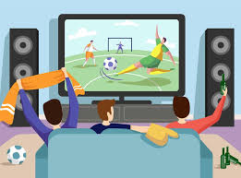
Why did they turn on the TV?
They turned on the TV
to watch football.

Slide 44
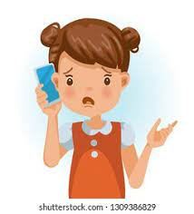
Why did she call Noura?
Hi Noura,
When is the math exam?
She called Noura
to ask about the math exam.

Slide 45
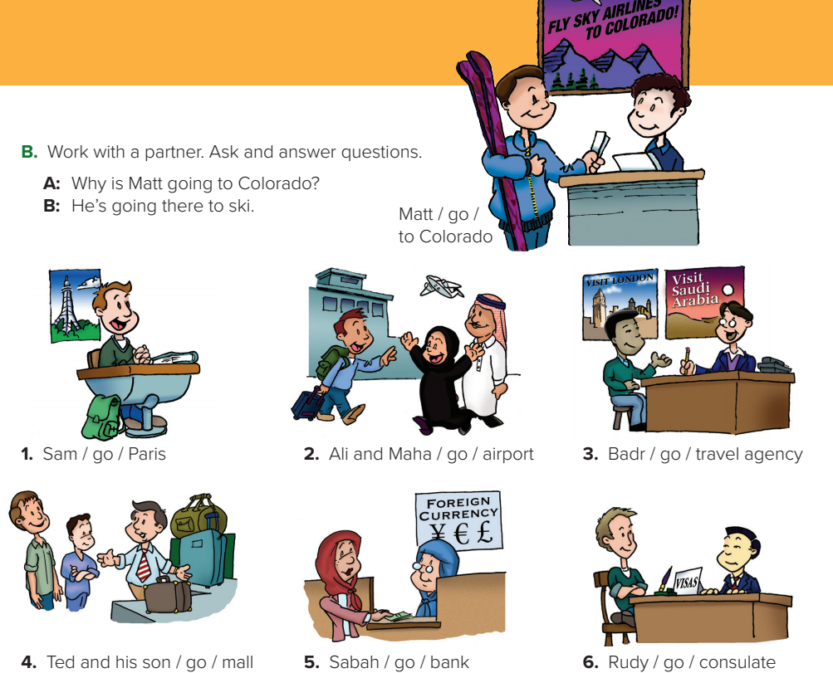
P.B.p.25. EX: B

Slide 46
1.A: Why is Sam going to Paris?
B: He’s going to Paris to study French.
2. A: Why are Ali and Maha going to the airport?
B: They’re going to the airport to meet their son.
3. A: Why is Badr going to the travel agency?
B He’s going to the travel agency to plan a trip.
4. A: Why are Ted and his son going to the mall?
B: They’re going to the mall to buy a suitcase.
5. A Why is Sabah going to the bank?
B: She’s going to the bank to get foreign currency.
6. A Why is Rudy going to the consulate?
B: He’s going to the consulate to get a visa.

Slide 47
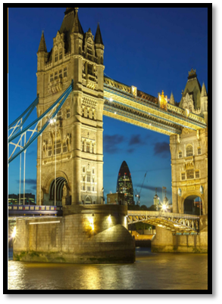
Language in Context
Yahya lives in Dammam.
He’s going to London vacation next month.
1. List 8 items he’s going to need. Compare with a partner.
2. What do you think he’s going to do in London?

Slide 48
1. List 8 items he’s going to need. Compare with a partner.
He’s going to need a passport.
He’s going to need a U.K. visa.
He’s going to need British pounds.
He’s going to need warm clothes.
He’s going to need a hotel reservation [ Booking].
He’s going to need a camera.
He’s going to need comfortable shoes.
He’s going to need an umbrella.

Slide 49
2. What do you think he’s going to do in London?
1. He’s going to take lots of photos.
He’s going to go sightseeing.
He’s going to go to the British Museum.
He’s going to speak English.

