Slide 1

Unit 4
What do I need to buy?
Grammar
PRESENTATION BY: SLIDECORE

Slide 2
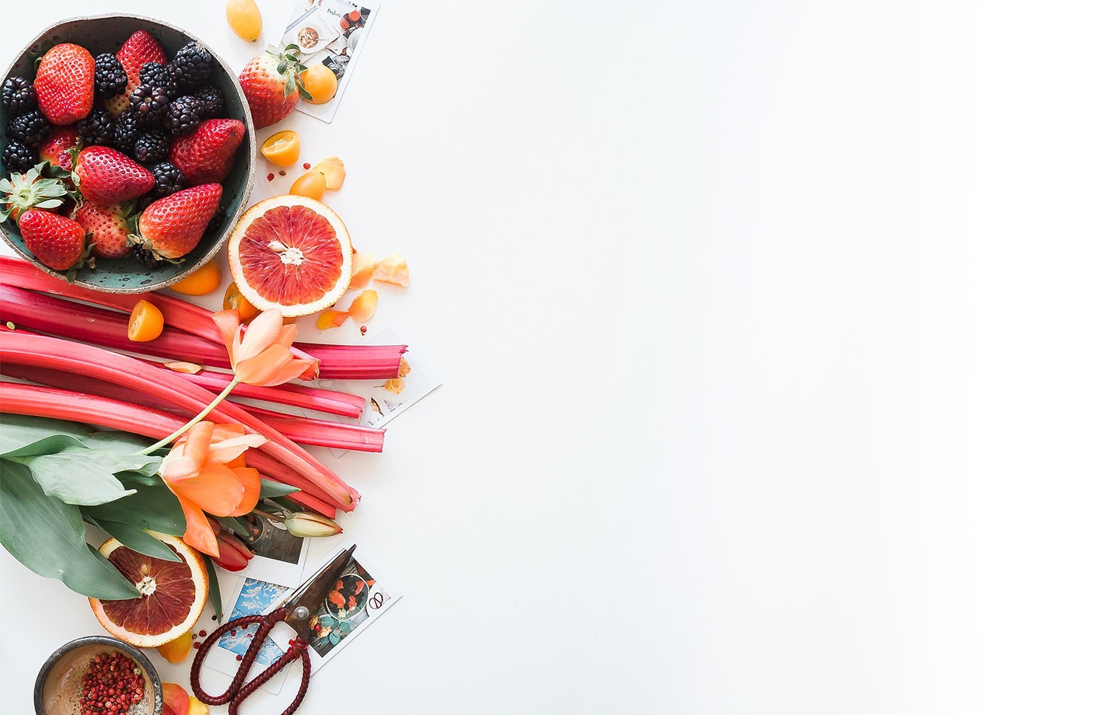
بسم الله الرحمن الرحيم
Day
Date

Slide 3
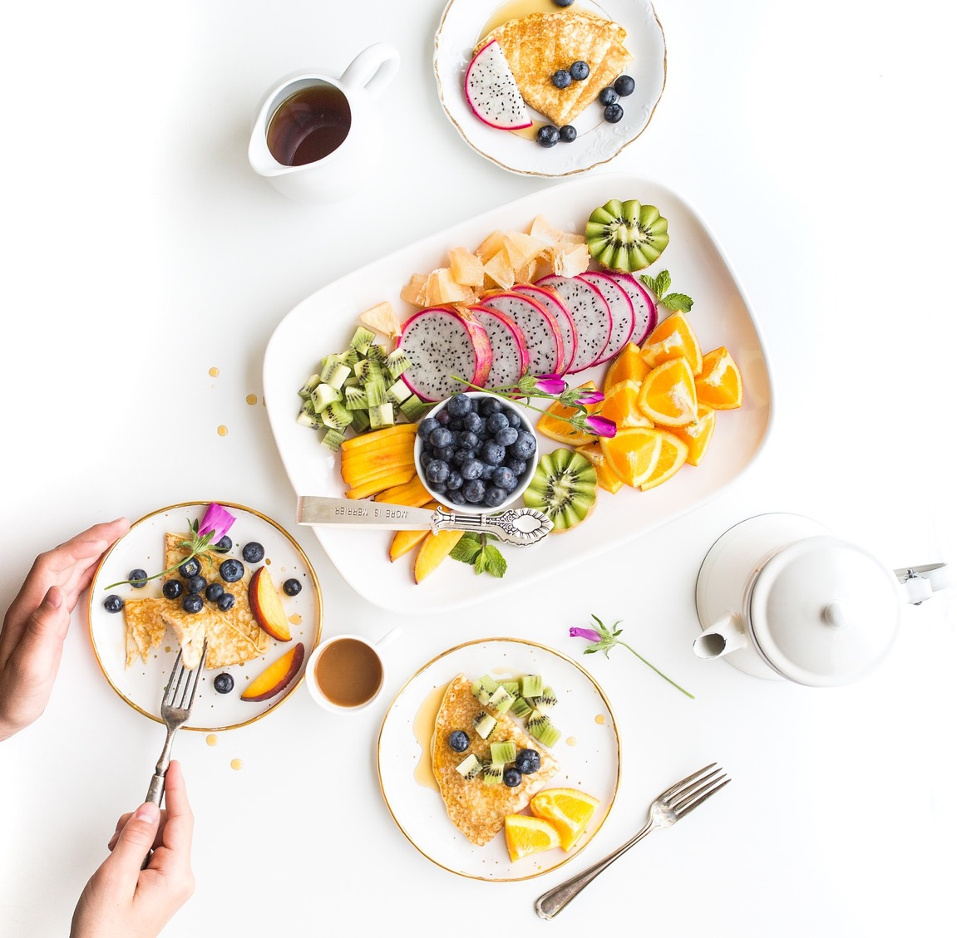

PRESENTATION BY: SLIDECORE

Slide 4
Learning Objectives
use pronouns in sentences correctly
02
differentiate between countable and uncountable nouns
01
Ask questions using How much…, or How many..
04
use quantity expression correctly
03
05
use sequences words in meaningful sentences.

Slide 5
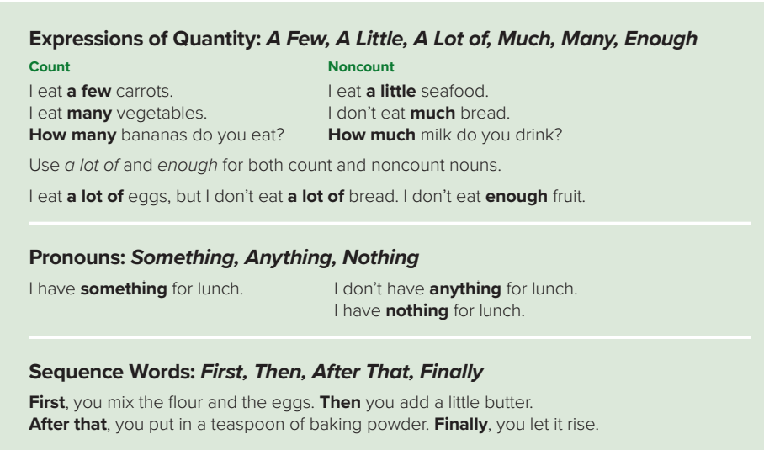
PRESENTATION BY: SLIDECORE
Page:40

Slide 6
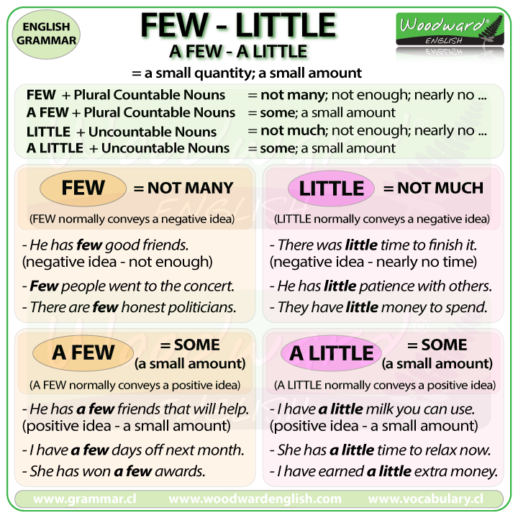

Slide 7
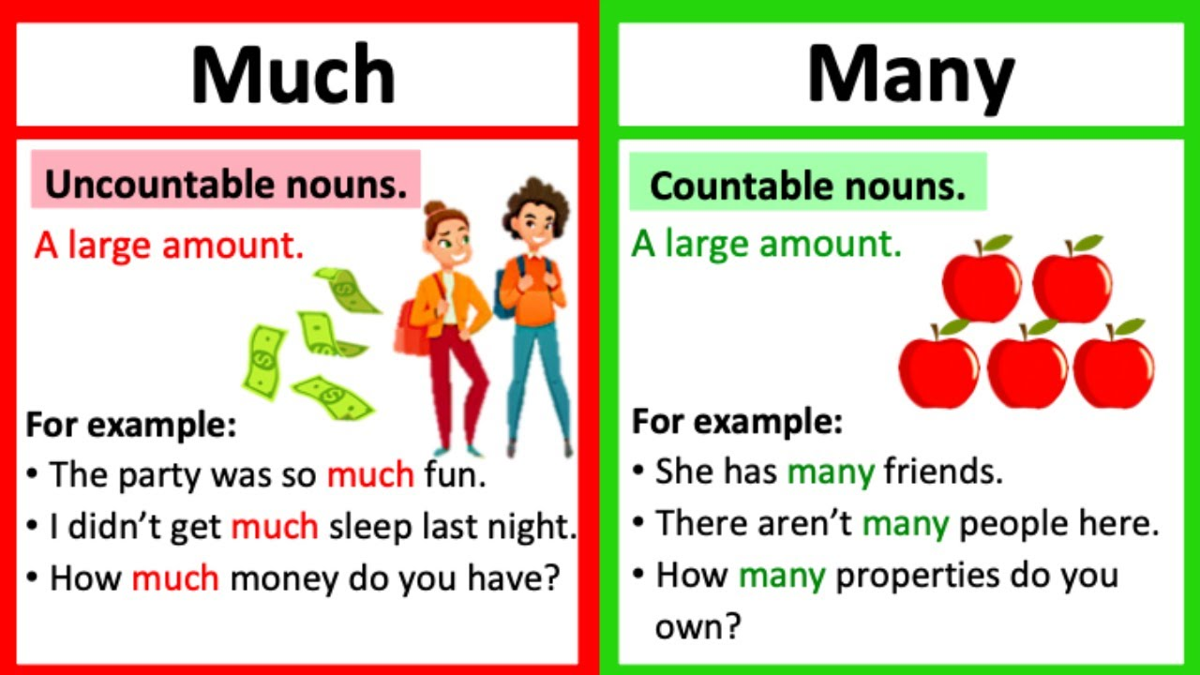

Slide 8
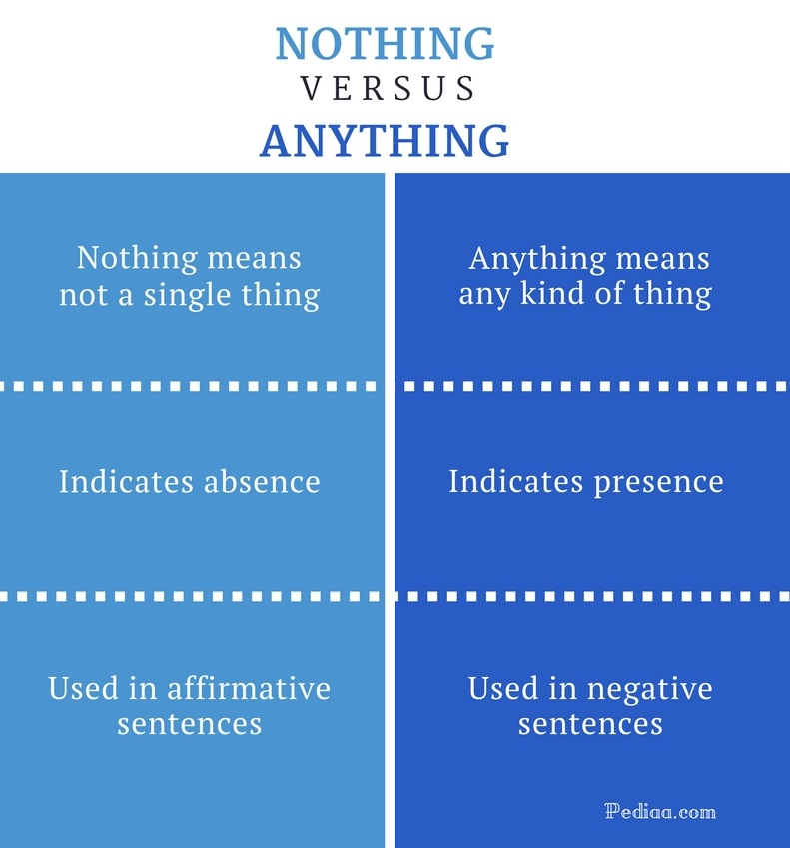

Slide 9
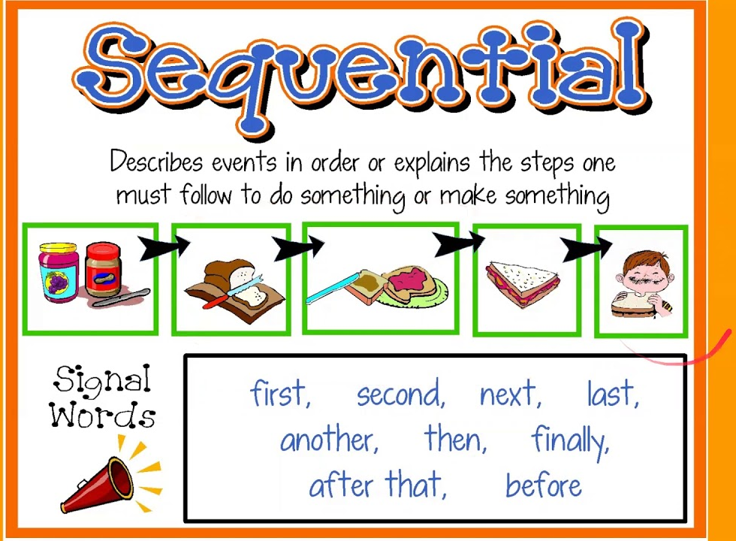

Slide 10
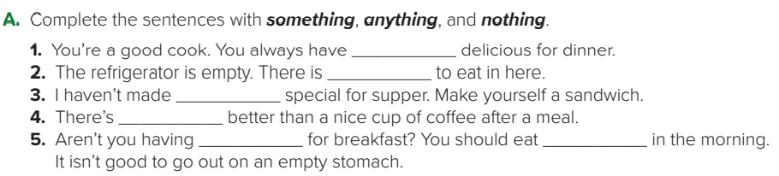
something
nothing
anything
nothing
anything
something

Slide 11
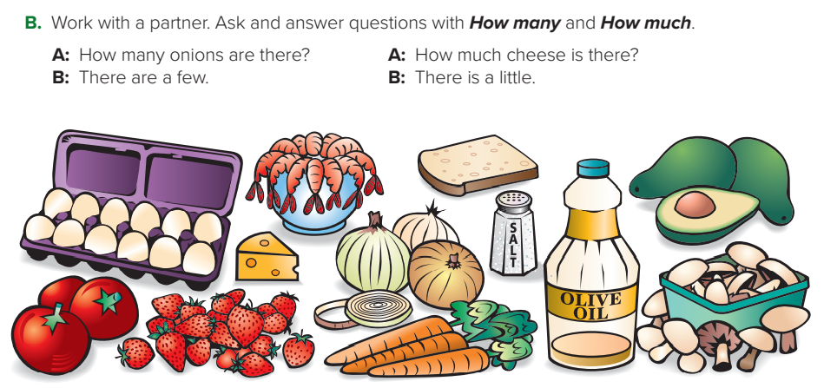
A: How many strawberries are there?
B: There are many.
A: How much oil is there?
B: There is a little.
A: How many carrots are there?
B: There are a few.
A: How many tomatoes are there?
B: There are a few.
A: How much salt is there?
B: There is a lot.
A: How many mushrooms are there?
B: There are a lot.

Slide 12
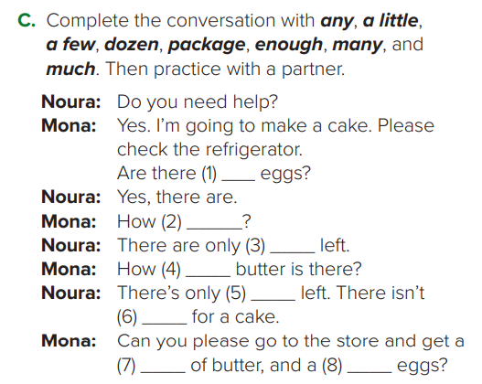
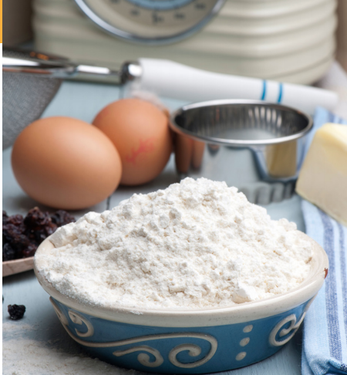
Page:41
any
many
a few
much
a little
enough
package
dozen

Slide 13
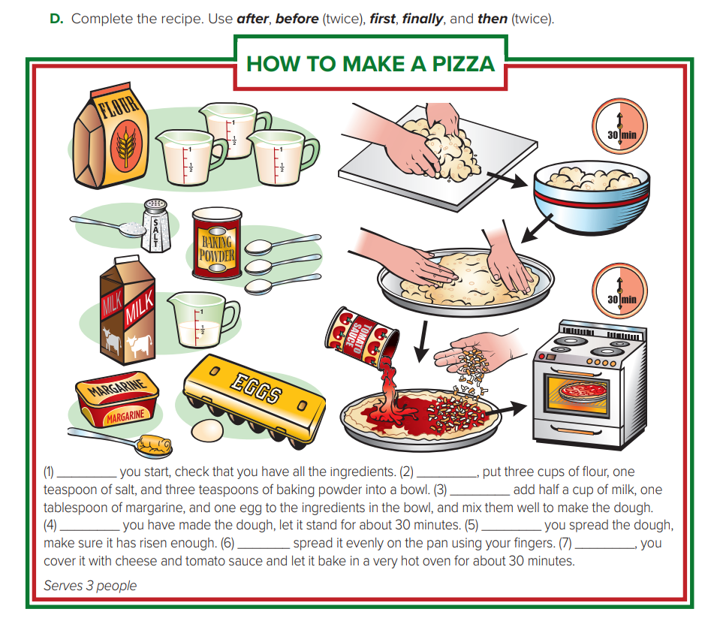
1. Before
2. First
3. Then
4. After
5. Before
6. Then
7. Finally

Slide 14
Practice

Slide 15
Homework
Workbook page 186

Slide 16
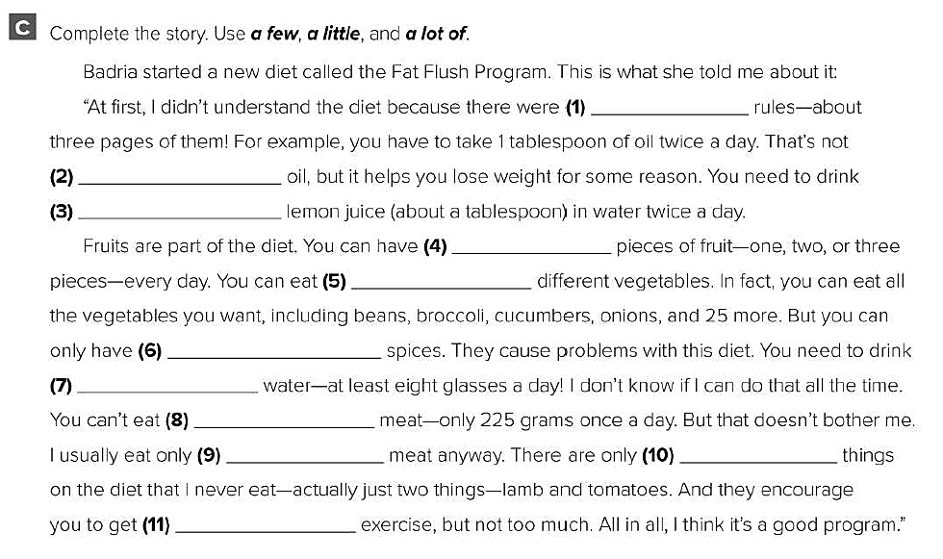
a lot of
a lot of
a little
a few
a lot of
a few
a lot of
a lot of
a little
a few
a little

Slide 17
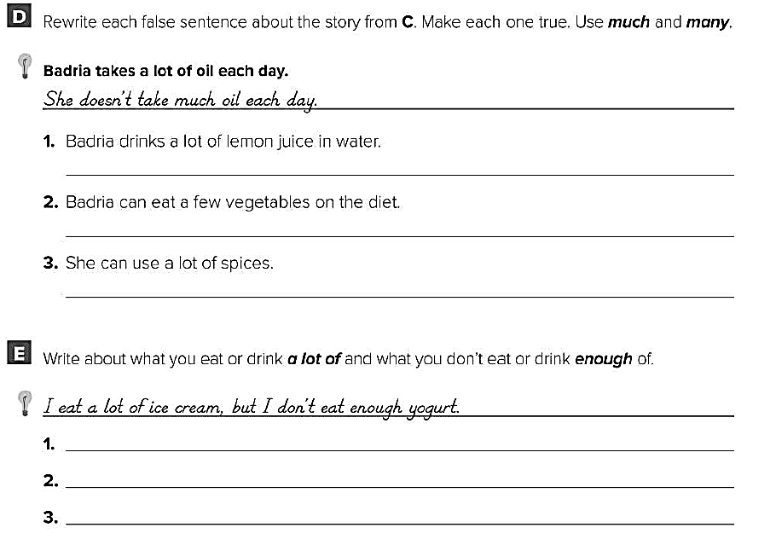
Badria doesn’t drink much lemon juice in water .
Badria can eat many vegetables on the diet .
She can’t use a lot of spices .
I eat a lot of meat , but I don’t eat enough vegetables .
I eat a lot of cookies , but I don’t eat enough fruit .
I drink a lot of soda , but I don’t drink enough water .

Slide 18
Healthy life Flaticon icon pack
Icons by Manthana Chaiwong

Slide 19
Colored Food & Drink Icons
Icons by Icons8

Slide 20
Editable Icon Set
Things you can do:
Resize the icon
Change fill color and opacity
Add stroke
Add dash lines

