Slide 1

Unit 4
What do I need to buy?
Reading
PRESENTATION BY: SLIDECORE

Slide 2

بسم الله الرحمن الرحيم
Day
Date

Slide 3
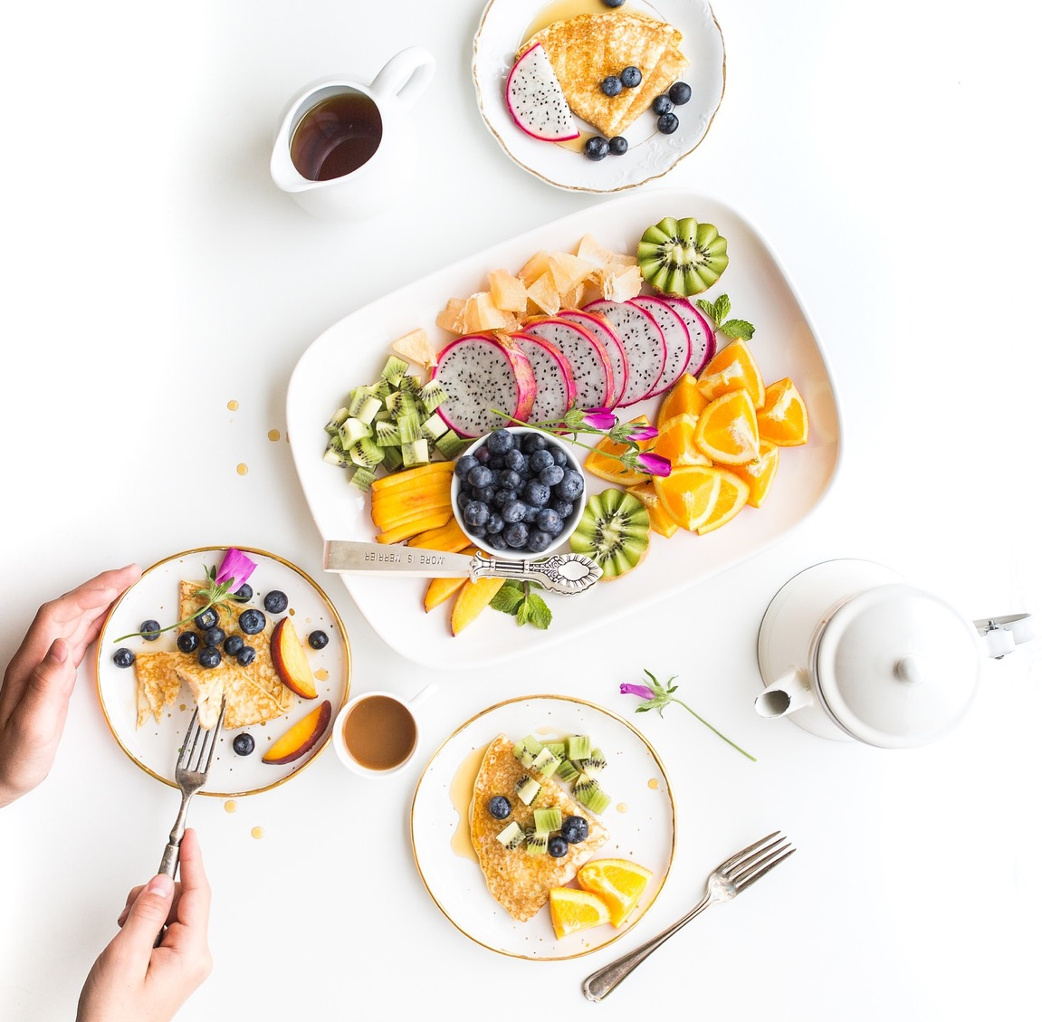

PRESENTATION BY: SLIDECORE

Slide 4
Learning Objectives
Identify specific information
02
Identify the main idea of reading)
01
identify different types of food
04
Give meaning of the new words
03
05
answer questions about the reading

Slide 5
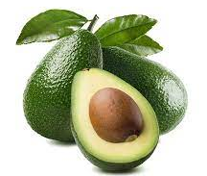
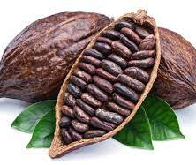
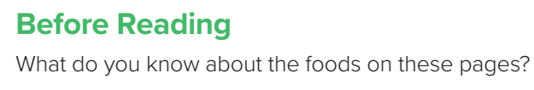
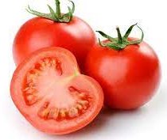
Page:44

Slide 6
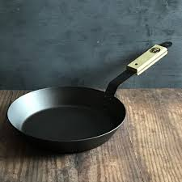
Vocabulary
pan

Slide 7
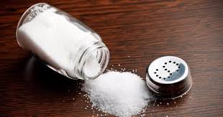
Vocabulary
Salt

Slide 8
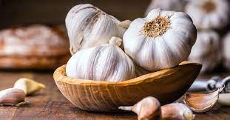
Vocabulary
garlic

Slide 9
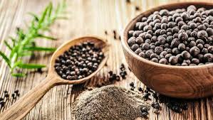
Vocabulary
pepper

Slide 10
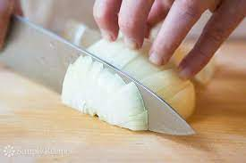
Vocabulary
chop

Slide 11
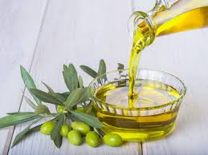
Vocabulary
Olive oil

Slide 12
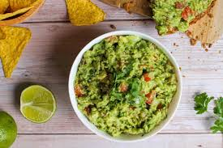
Vocabulary
guacmole

Slide 13
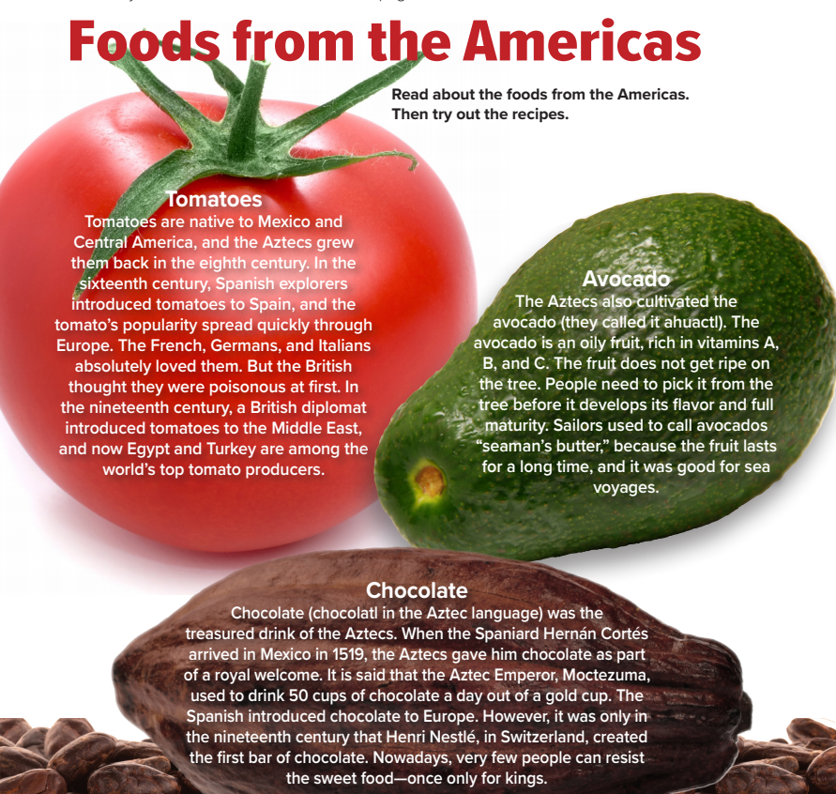
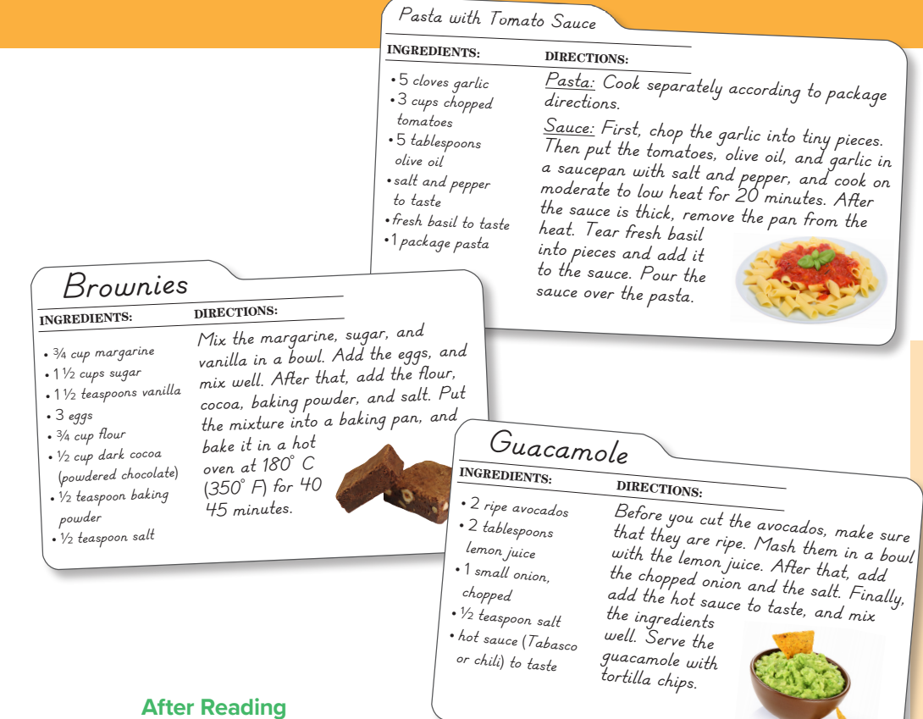
Page:44
PRESENTATION BY: SLIDECORE

Slide 14

PRESENTATION BY: SLIDECORE

Slide 15
PRESENTATION BY: SLIDECORE

Slide 16
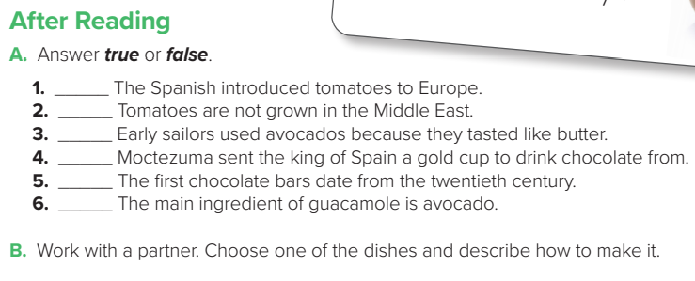
true
false
false
false
false
true
PRESENTATION BY: SLIDECORE

Slide 17
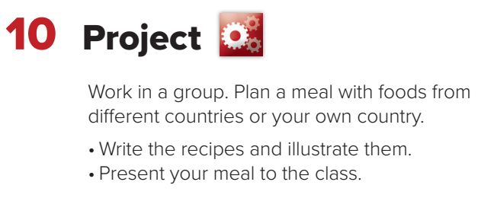
PRESENTATION BY: SLIDECORE

Slide 18
Homework
Workbook page 189

Slide 19
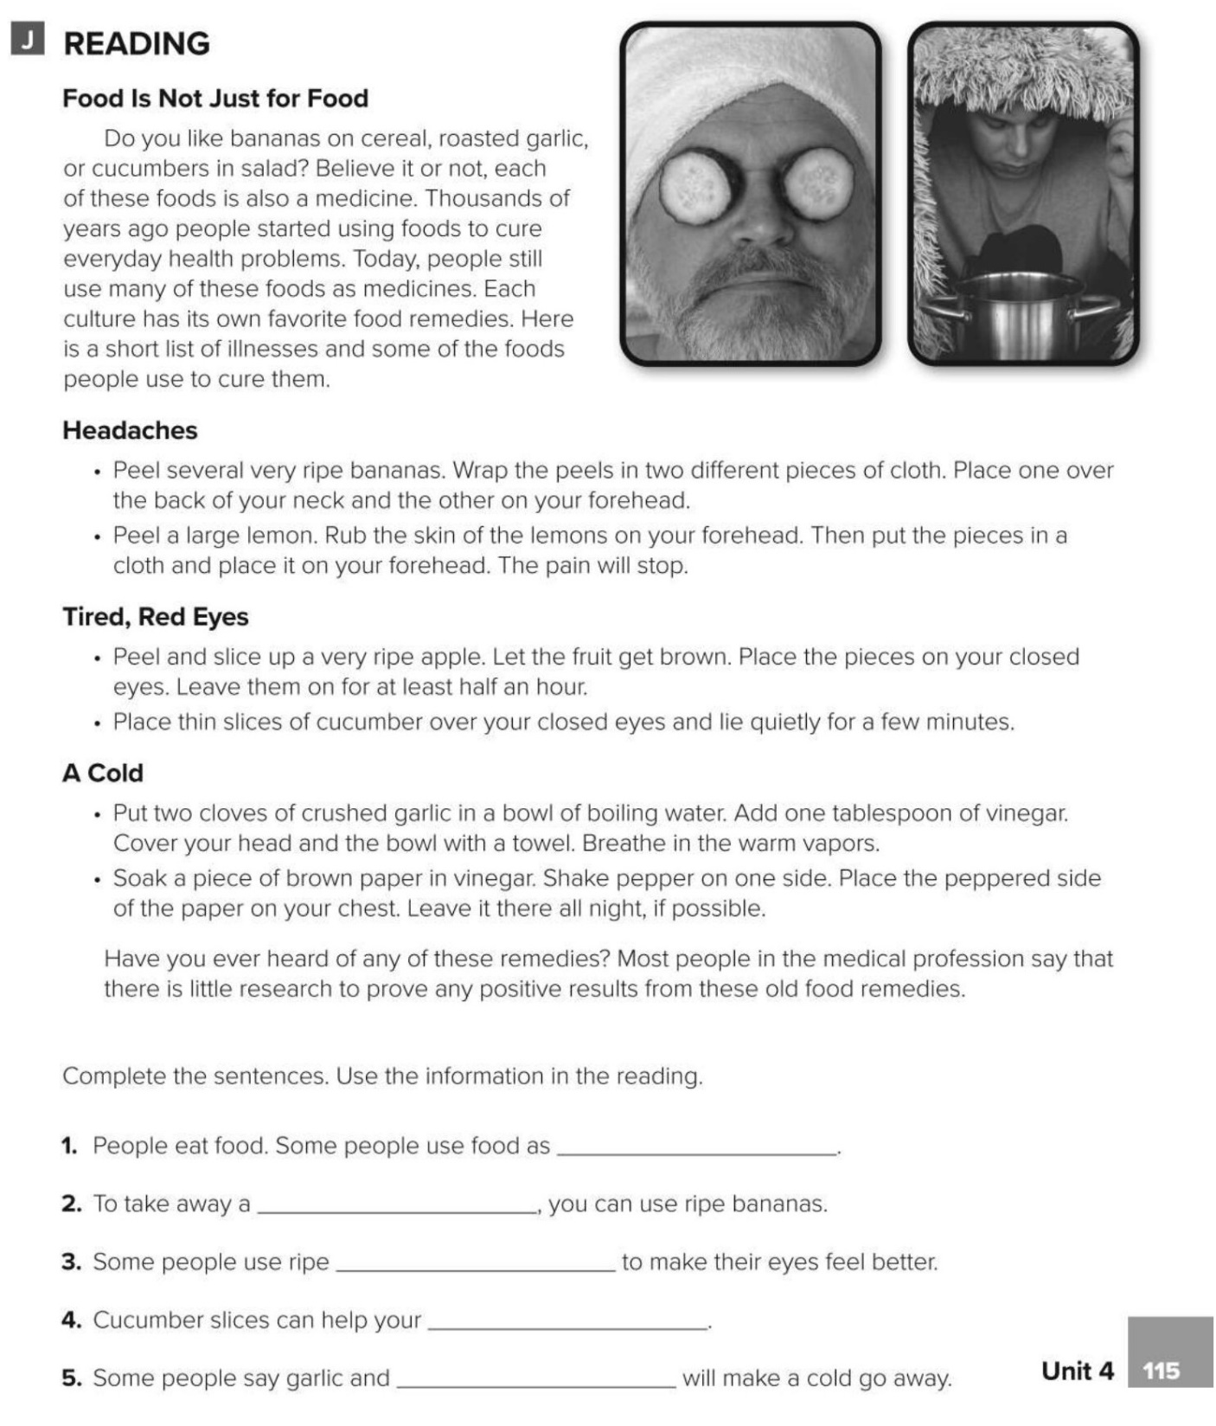
medicines
headache
apples
eyes
vinegar

Slide 20
Healthy life Flaticon icon pack
Icons by Manthana Chaiwong

Slide 21
Colored Food & Drink Icons
Icons by Icons8

Slide 22
Editable Icon Set
Things you can do:
Resize the icon
Change fill color and opacity
Add stroke
Add dash lines

