Slide 1

Super goal 5
Unit 3
Lesson 5 reading
اعداد المعلم / يحيى المنقري متوسطة المأمون بالهفوف

Slide 2

Learning Objectives
*By the end of this lesson, Ss will be able to:
1-Recognize Saudi Arabia features.
2-Design Arabic language study program for foreigns .
3-Find the reason behind choosing Saudi Arabia to learn Arabic.
4- Recognize the benefits of learning Arabic.
5-Find the meaning of a word throughout reading the text.

Slide 3


Slide 4

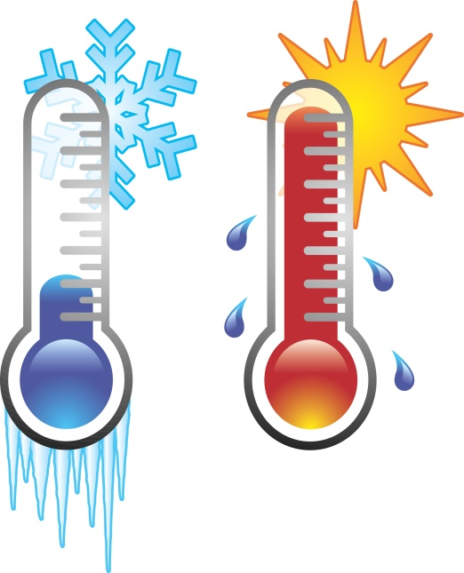



Temperature
Paragliding
Marketplace

Slide 5
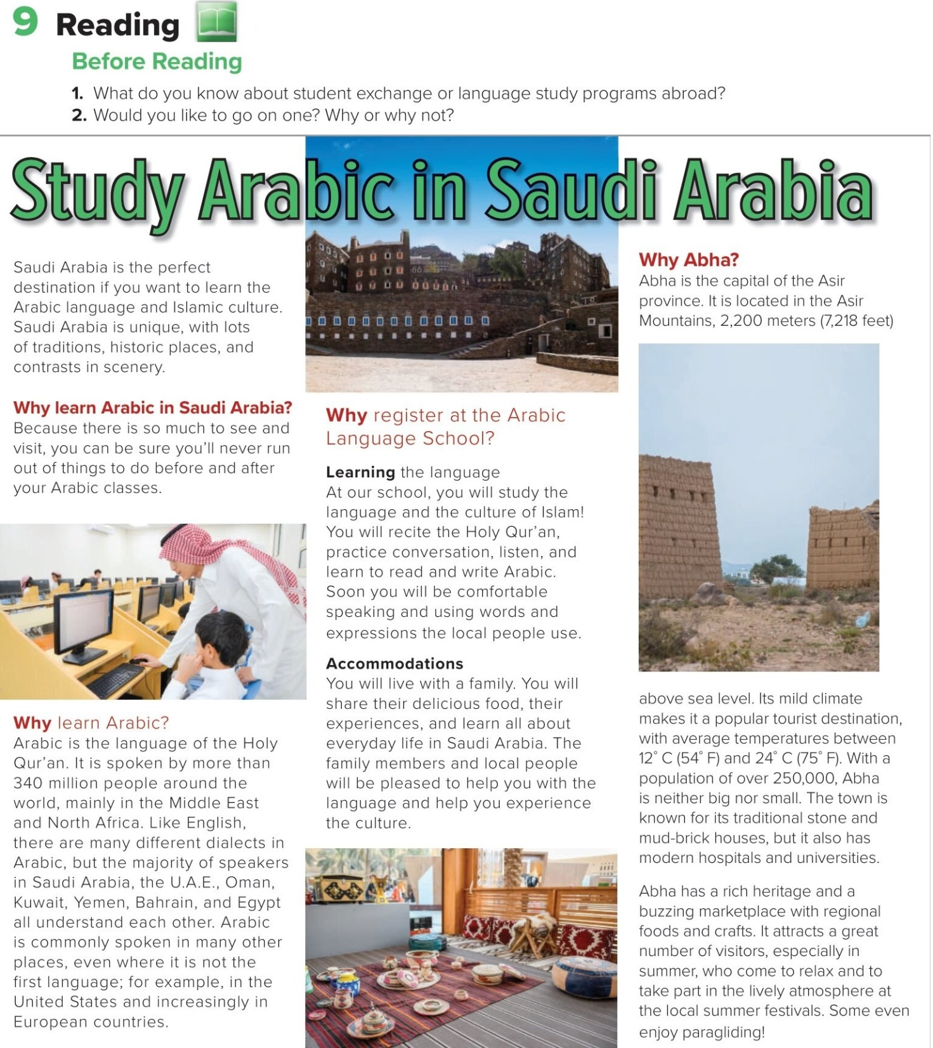

Slide 6
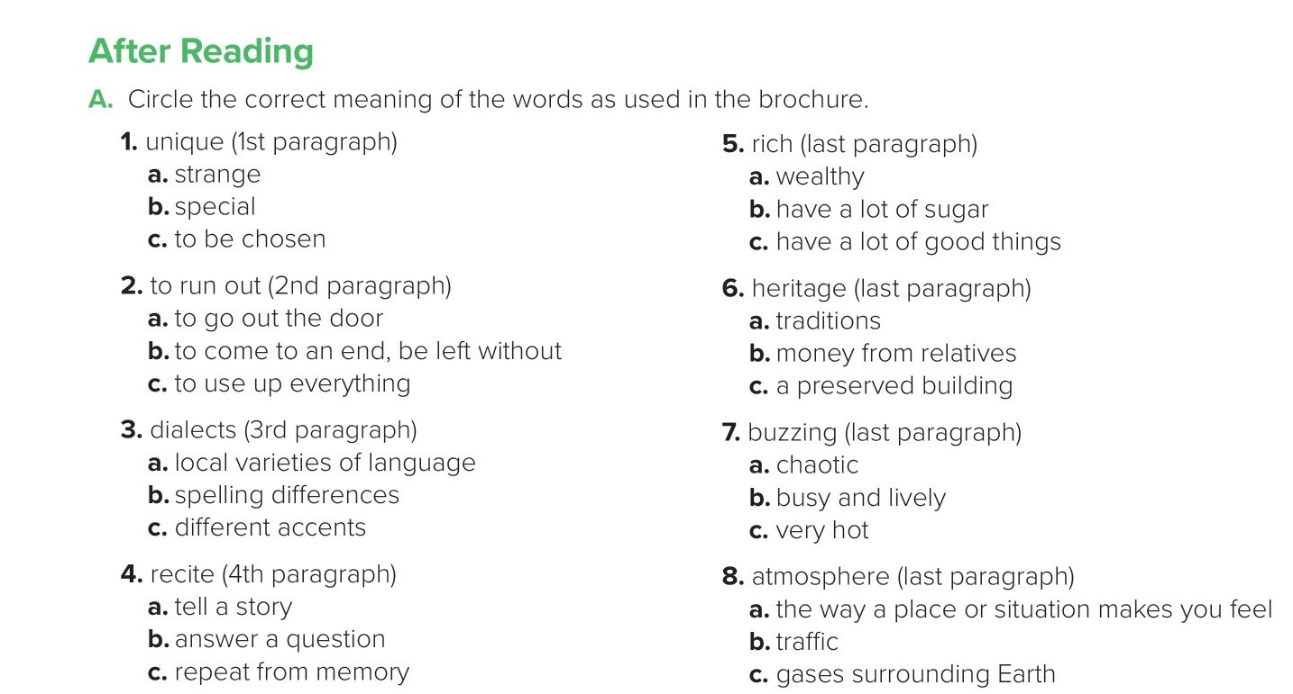

Slide 7
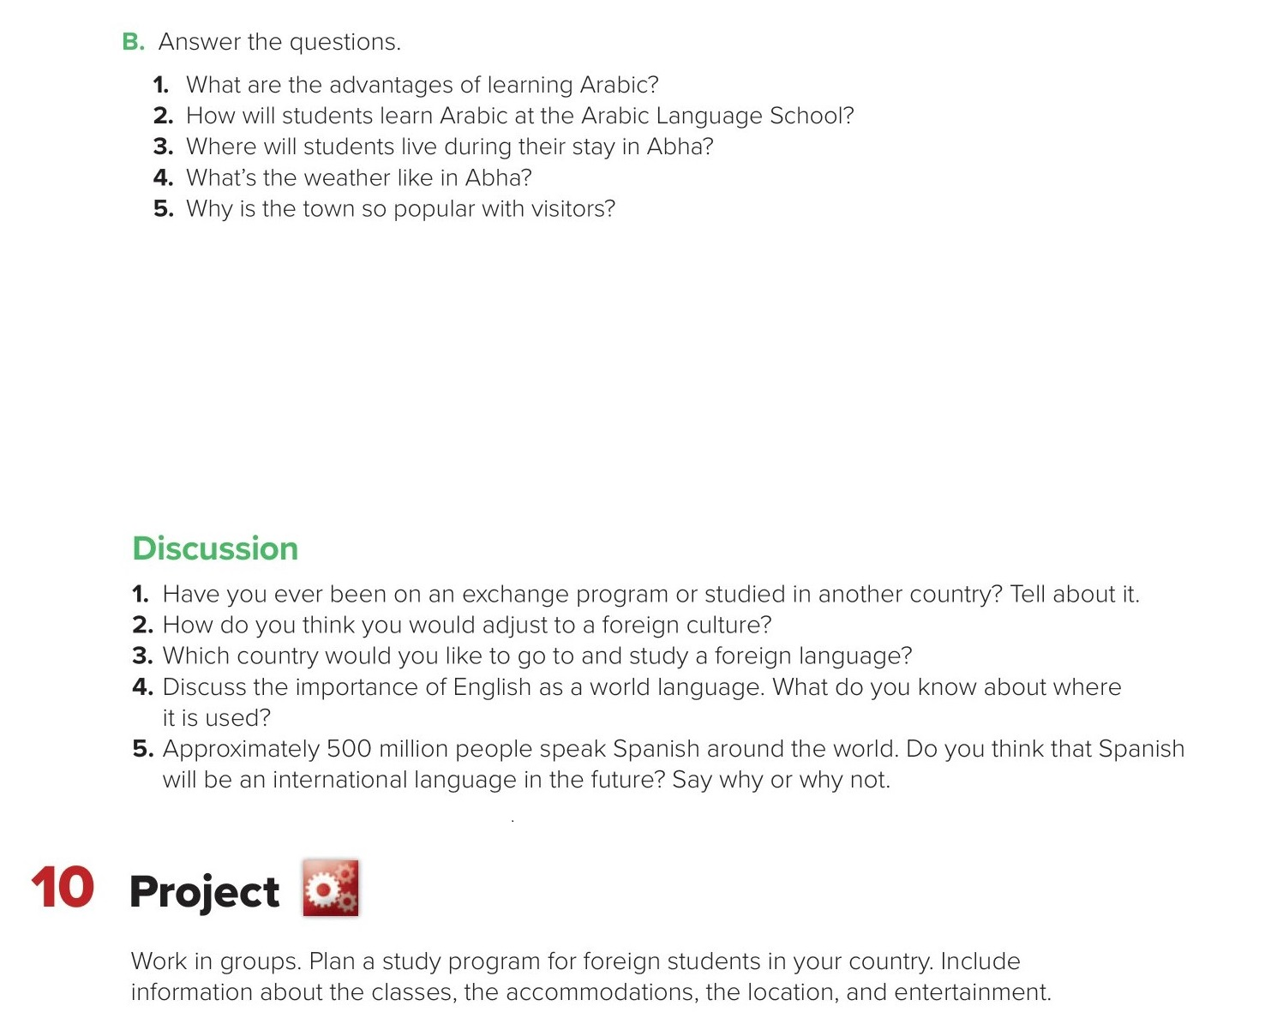
1. Arabic is spoken by more than 340 million people, so it can help you communicate with lots of people.
2. Students will recite the Holy Qur’an, practice conversation, listen, and learn to read and write Arabic.
3. Students will live with a family.
4. Abha has a mild climate with temperatures between 12°C and 24°C.
5. The climate is good, and Abha has a rich heritage, a buzzing marketplace, a lively atmosphere, summer festivals, and even paragliding.

Slide 8
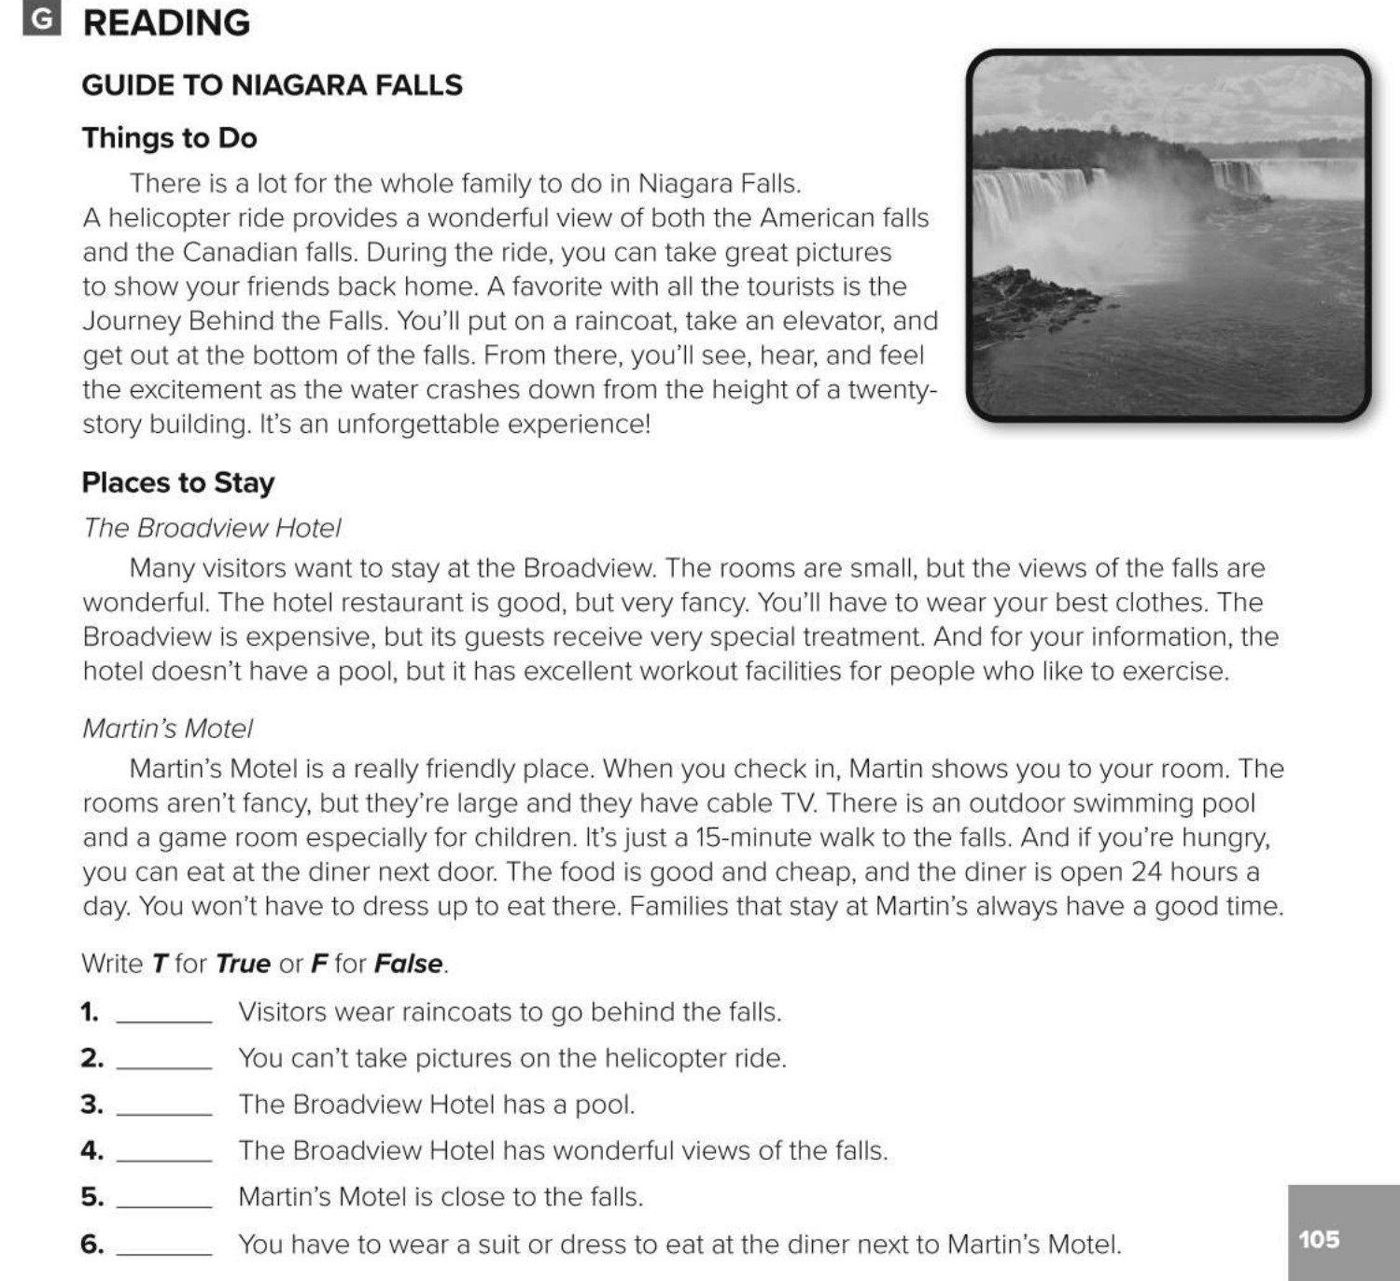
T
F
F
T
T
F

Slide 9
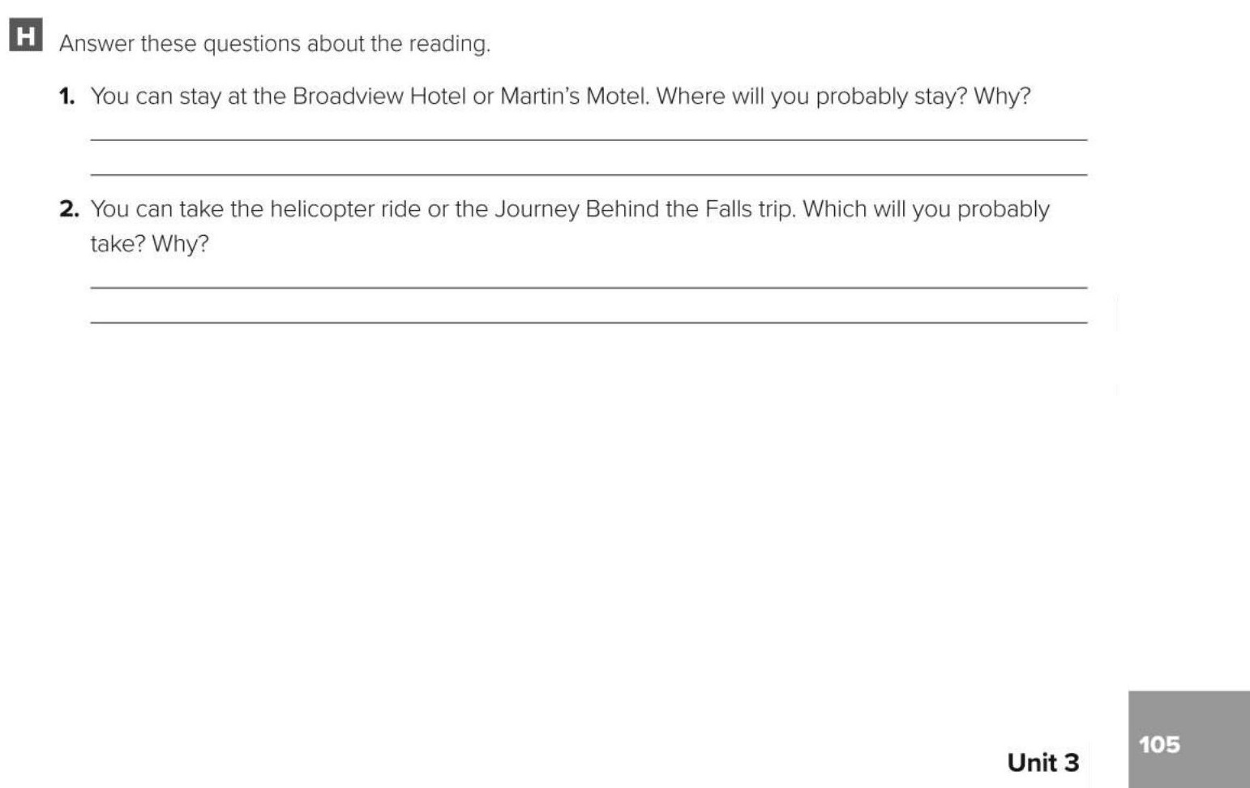
I probably will stay at the Broadview Hotel. I want to see the falls from my room.
I probably will take the helicopter ride. I want to get some good photos of the falls.

Slide 10

Choose the correct answer :
1-
How many people speak Arabic? more than
340 million
340 thousand
2-
Are there many dialects in Arabic?
yes
no
3-
4-
Temperature
paragliding
Climate
Marketplace

Slide 11


Slide 12


Back

Slide 13


Back

