Slide 1
Unit 4
What do I need to buy?
Reading
PRESENTATION BY: SLIDECORE

Slide 2
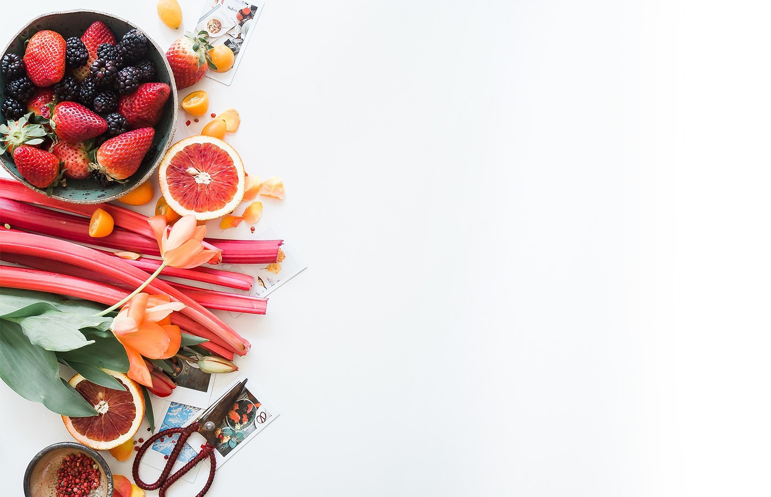
بسم الله الرحمن الرحيم
Day
Date

Slide 3
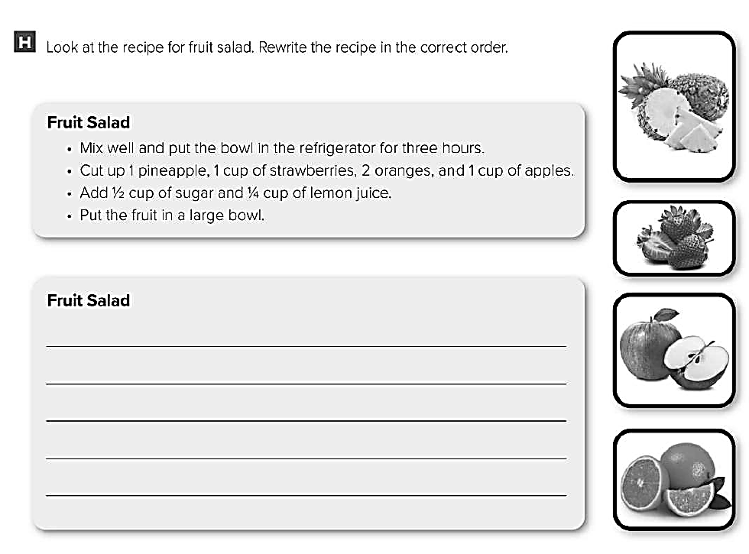
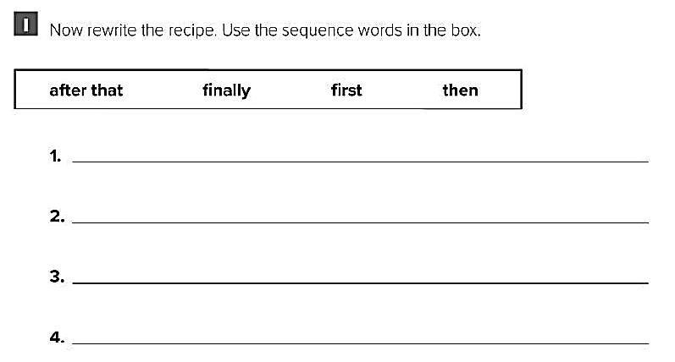
Cut up 1 pineapple , 1 cup of strawberries , 2 oranges , and 1 cup of apples
Add ½ cup of sugar and ¼ cup of lemon juice
Put the fruits in a large bowl .
Mix well and put the bowl in the refrigerator for three hours
First , cut up 1 pineapple , 1 cup of strawberries , 2 oranges , and 1 cup of apples
Then , add ½ cup of sugar and ¼ cup of lemon juice
After that , put the fruits in a large bowl .
Finally , mix well and put the bowl in the refrigerator for three hours

Slide 4
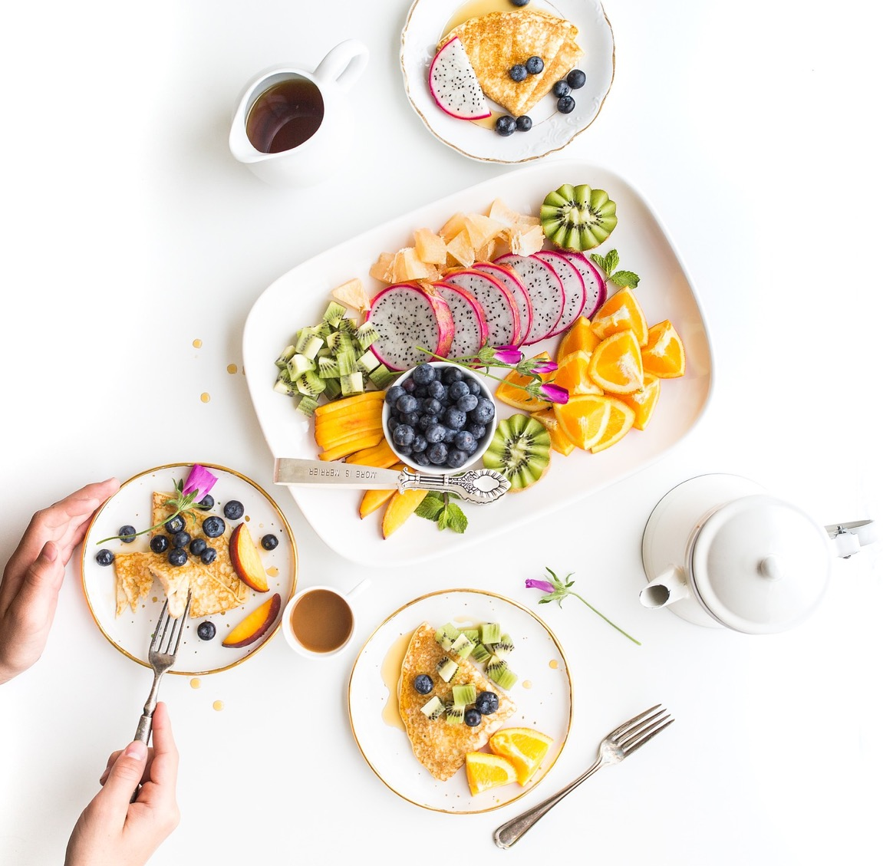
PRESENTATION BY: SLIDECORE

Slide 5
Learning Objectives
Identify specific information
02
Identify the main idea of reading)
01
identify different types of food
04
Give meaning of the new words
03
05
answer questions about the reading

Slide 6
Page:38-39

Slide 7
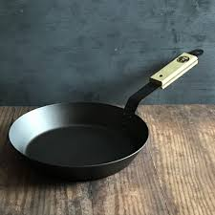
Vocabulary
pan

Slide 8
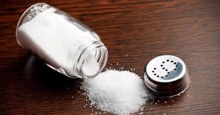
Vocabulary
Salt

Slide 9
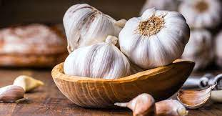
Vocabulary
garlic

Slide 10
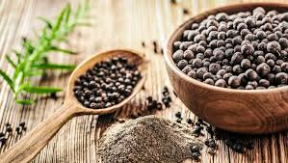
Vocabulary
pepper

Slide 11
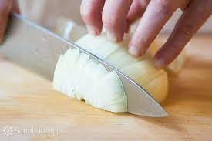
Vocabulary
chop

Slide 12
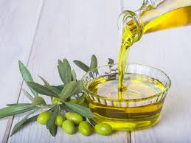
Vocabulary
Olive oil

Slide 13
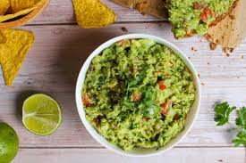
Vocabulary
guacmole

Slide 14
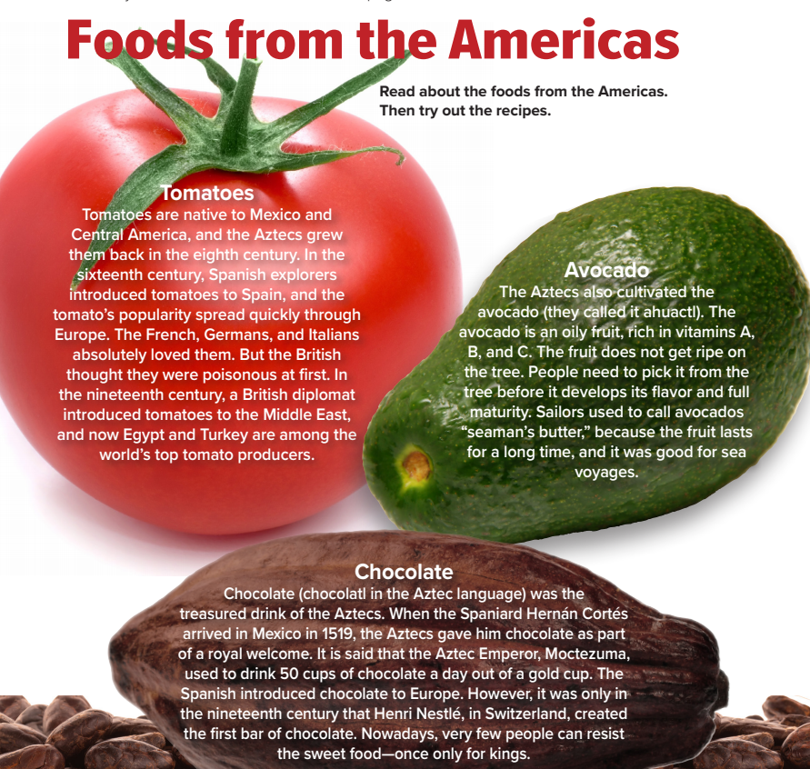
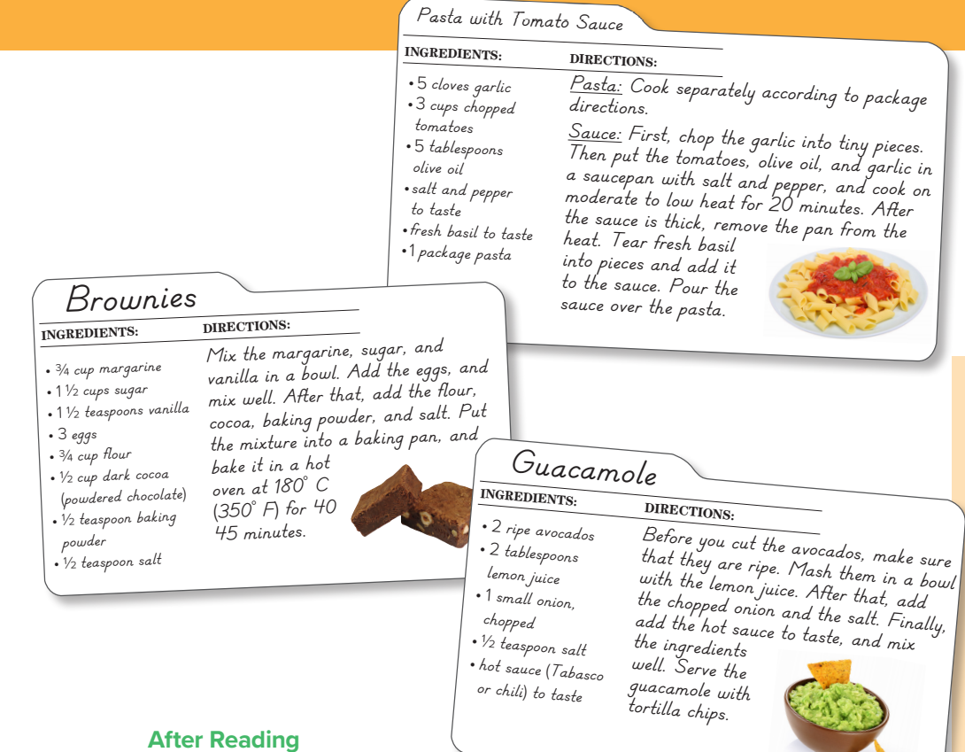
PRESENTATION BY: SLIDECORE
Page:38-39

Slide 15
PRESENTATION BY: SLIDECORE

Slide 16
PRESENTATION BY: SLIDECORE

Slide 17
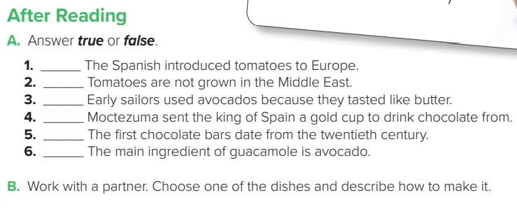
true
false
false
false
false
true
PRESENTATION BY: SLIDECORE

Slide 18
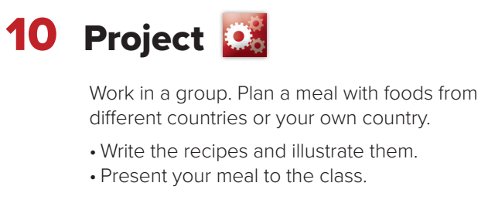
PRESENTATION BY: SLIDECORE

Slide 19
Homework
p.189

Slide 20
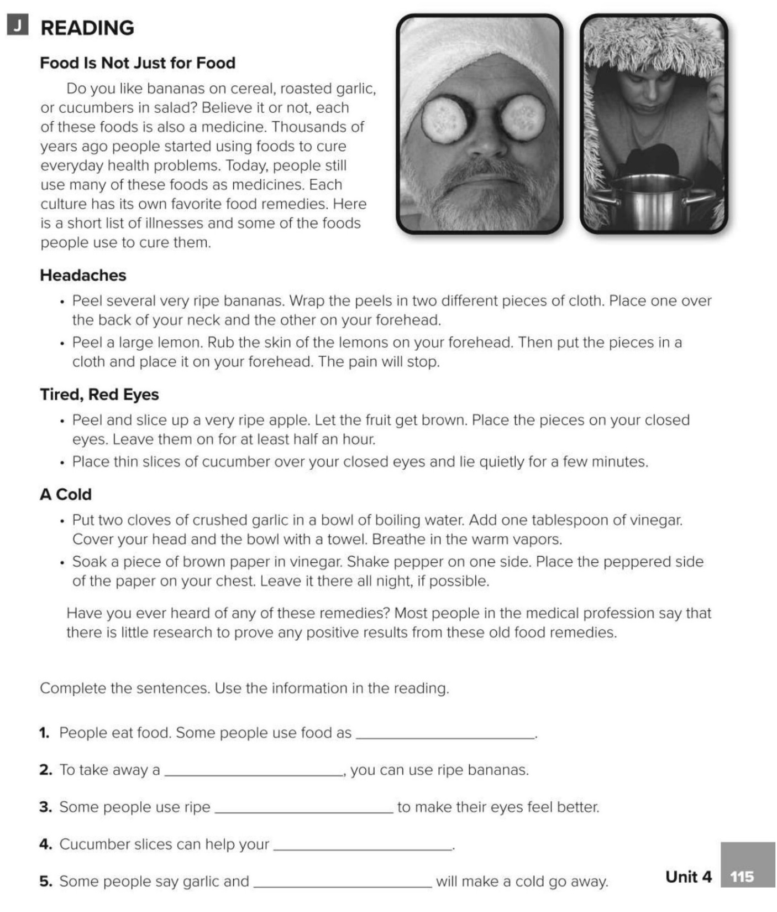
medicines
headache
apples
eyes
vinegar

