Slide 1


Unit 4
What do I need to buy?
Form, meaning & function
PRESENTATION BY: SLIDECORE

Slide 2
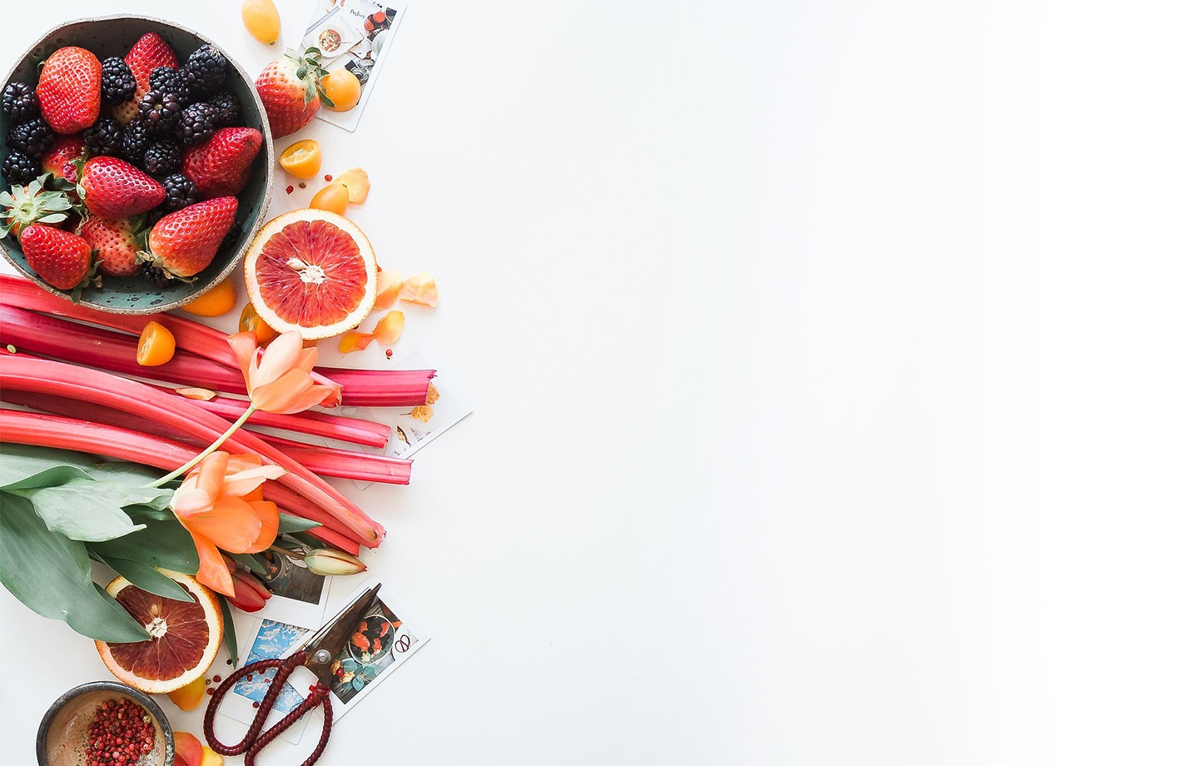
بسم الله الرحمن الرحيم
Day
Date

Slide 3
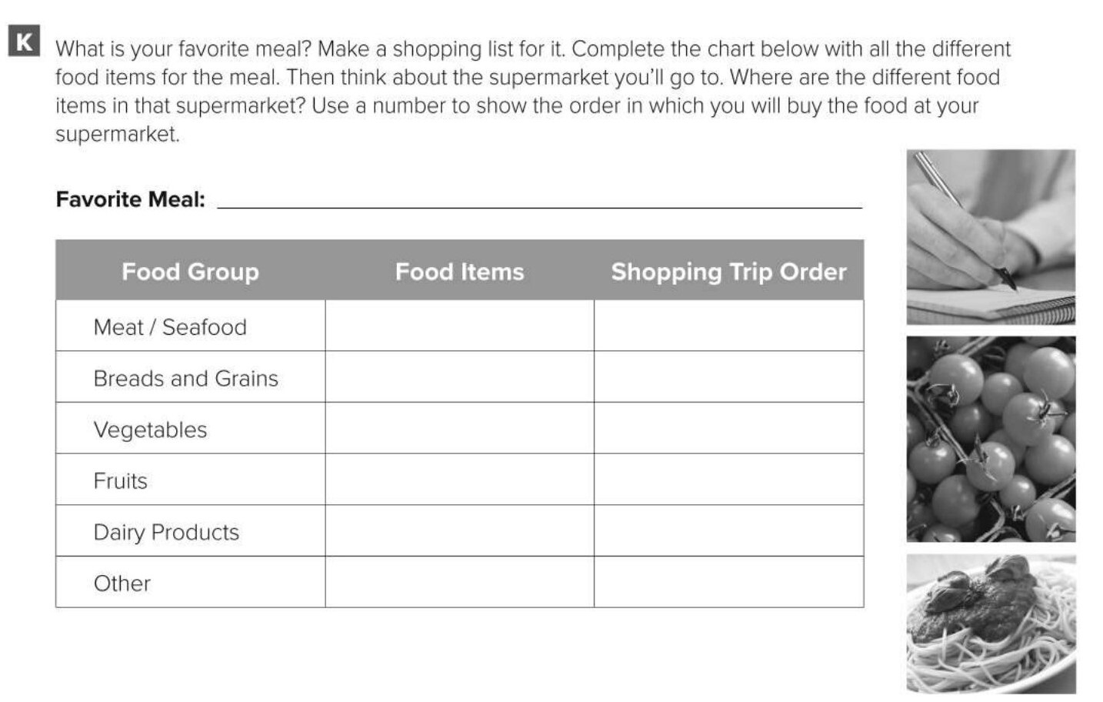
roasted chicken with salad and fries.
chicken
3
bread
1
lettuce, tomatoes,potatoes
2
cheese
4

Slide 4
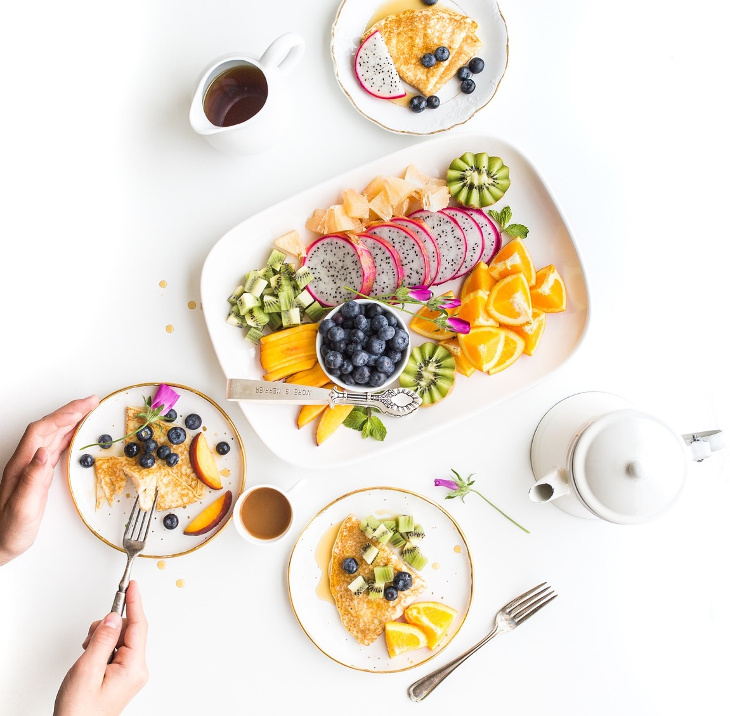

PRESENTATION BY: SLIDECORE

Slide 5
Learning Objectives
Use reflexive pronouns correctly
01
differentiate between the use of " because and so " correctly
02
express reasons and purpose correctly..
03

Slide 6
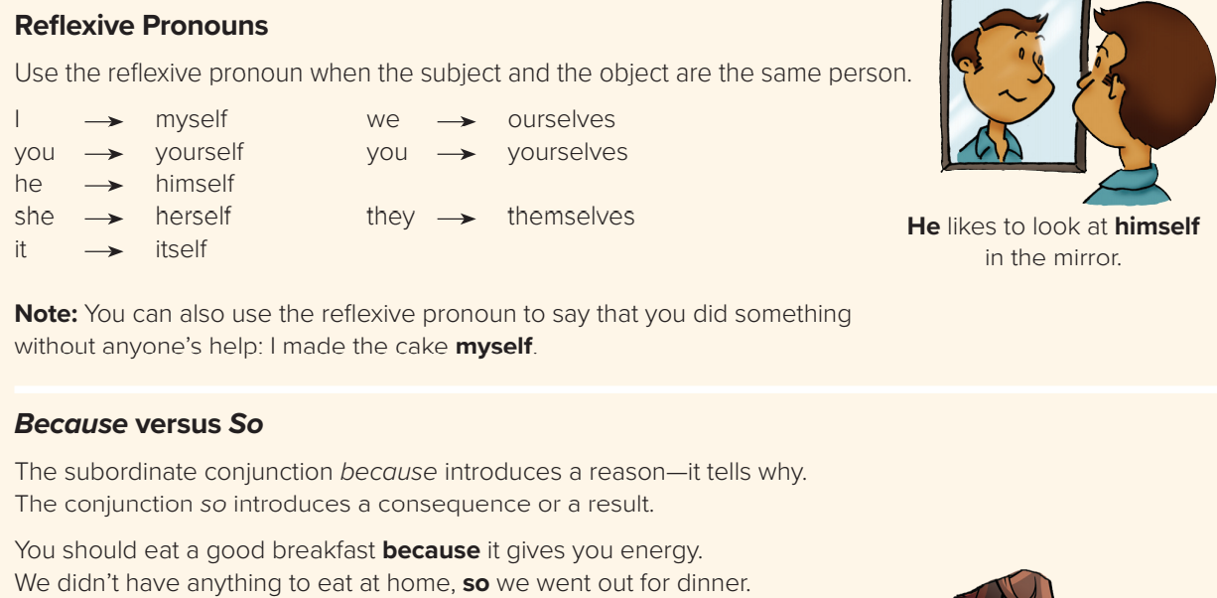
PRESENTATION BY: SLIDECORE
Page:41

Slide 7
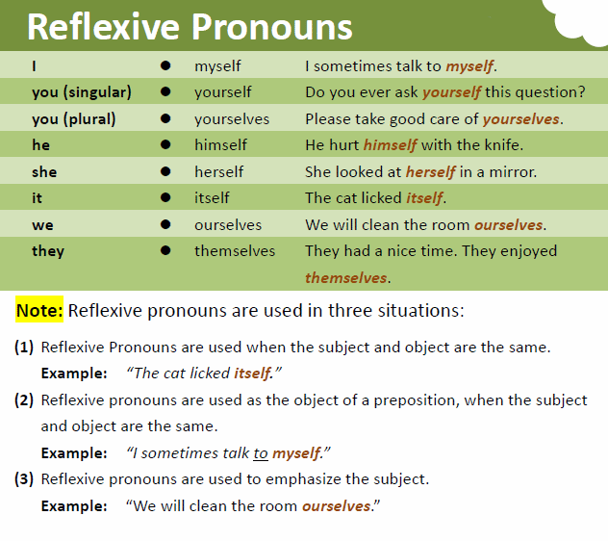
PRESENTATION BY: SLIDECORE
Page:41

Slide 8
PRESENTATION BY: SLIDECORE

Slide 9
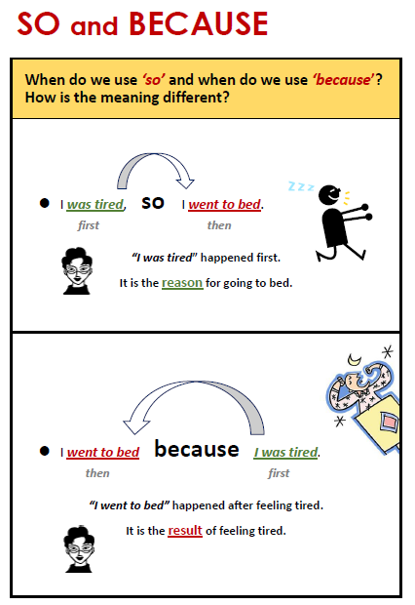
PRESENTATION BY: SLIDECORE

Slide 10
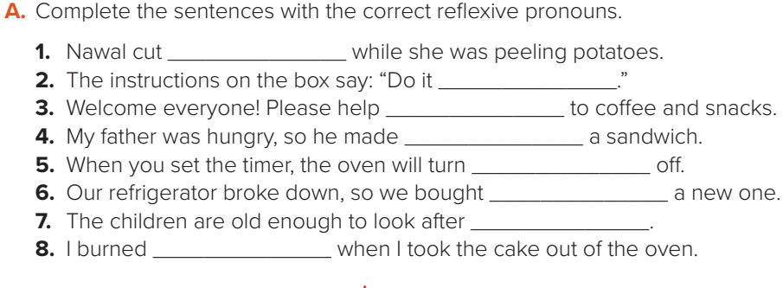
herself
yourself
yourselves
himself
itself
ourselves
themselves
myself

Slide 11
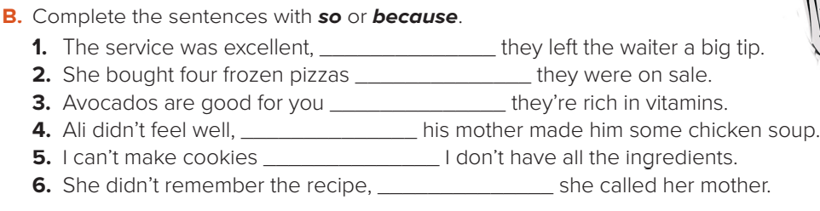
so
because
because
so
because
so

Slide 12
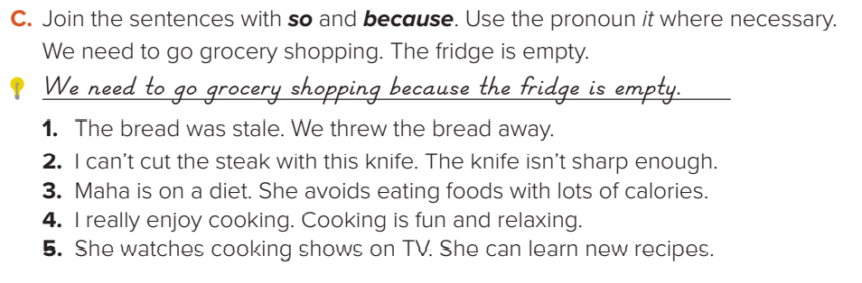
The bread was stale, so we threw it away./We threw the bread away because it was stale.
2. I can’t cut the steak with this knife because it isn’t sharp enough./ This knife isn’t sharp enough, so I can’t cut the steak with it.
3. Maha is on a diet, so she avoids eating foods with lots of calories./ Maha avoids eating foods with lots of calories because she’s on a diet.
4. I really enjoy cooking because it’s fun and relaxing./Cooking is fun and relaxing, so I really enjoy it.
5. She watches cooking shows on TV, so she can learn new recipes./ She can learn new recipes because she watches cooking shows on TV

Slide 13
Homework
P.190 (L)

