Slide 1

Unit 3
When Are You Travelling?
Revision

Slide 2
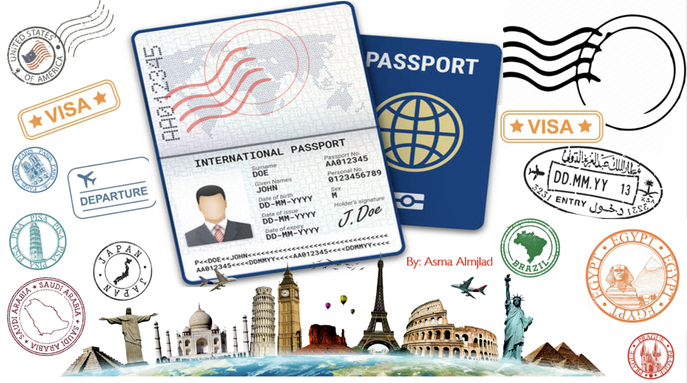

Slide 3
بسم الله الرحمن الرحيم
Day:
Date:

Slide 4
Choose the correct answer:
1-My mom is ( waiting – wait – waited ) me at the airport.
2-I (am –is – are) traveling tomorrow.
3- She is (leaving – left – leaves) at 6: pm tonight.
4-Sara will ( go – goes –going ) with us next week.
5-Maybe I won't (buy – buying – buys ) a new car .
6-I'm going to ( study – studies – studied ) hard next time.

Slide 5
Choose the correct answer:
7-Ali ( is – are – am ) going to fix his laptop tomorrow .
8- Mona went to the Café ( to – for –on ) meet her friend .
9- I'm going to Dubai to ( visit – visited – visiting ) my uncle.
10- They will sleep early when I ( turn – turns –turning) off the lights .
11-They went skiing when they ( was- were – is ) on vacation.
12-He will finish his work while his wife ( cooks – cook – cooked) the dinner .

Slide 6
Correct the underlined mistakes
Correct the underlined mistakes:
1. Mona will calls you.
Mona will call you.
2. She are going to make a cake.
She is going to make a cake.

Slide 7
Correct the underlined mistakes:
3. When I arrived, I will sleep immediately.
When I arrive, I will sleep immediately.
4. We are going to drawing a picture.
We are going to draw a picture.

Slide 8
Make Yes/No questions:
1- Jimmy will help you .
Will Jimmy help you?
2- They are going to camp next week .
Are they going to camp next week?

Slide 9
Correct the underlined mistakes
Make it negative:
1- I will go to school .
I will not (won’t) go to school .
2- She is going to learn Arabic language .
She is not going to learn Arabic language .

Slide 10
Correct the underlined mistakes
Change the order of the clauses :
1- I will tell you when I see you .
When I see you, I will tell you.
2- While he paints the house , Sara will go shopping.
Sara will go shopping while he paints the house.

Slide 11
Choose the correct answer:
1. Dave: What time is your. __________________?_ Ramon: It departs at 2:30.
A | baggage | B | flight | C |  | suitcase
2. Clerk: Are you checking any_________________? Billy: Yes. I have one bag.
A | baggage | B | flight | C |  | suitcase
3. Your ______________ is too big. It will not fit underneath your seat on the plane
A | boarding pass | B | carry-on | C |  | gate
4. Your ____________________ is B2. Please go there to board your plane.
A | boarding pass | B | carry-on | C |  | gate
5. Don’t forget your _________________. You can’t get on the plane without it.
A | boarding pass | B | carry-on | C |  | gate
6. Did you put a name tag on your _______________? You don’t want to lose it
A | gate | B | suitcase |  | C |  | baggage

Slide 12
Match words with their meanings:
1- pretty |  | a- learn
2- pick up |  | b- local verities of language
3- unique |  | c- busy & lively
4- recite |  | d- very/ quite
5- dialects |  | e- special
6- buzzing |  | f- repeat from memory
2
5
6
1
3
4

Slide 13
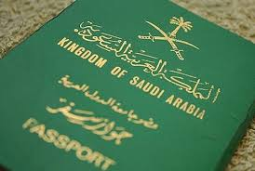
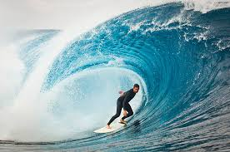
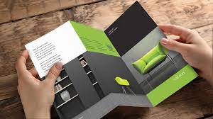
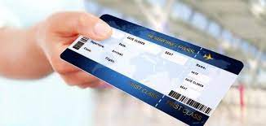
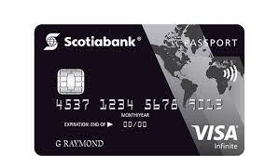
Identify the following objects:
Brochure –bag –surfing –ticket –passport –credit card
passport
surfing
brochure
ticket
Credit card

Slide 14


( SINGLE LARGE HEADER )

