Slide 1
Unit 3 who’s who?
Workbook pages (193 – 196)

Slide 2
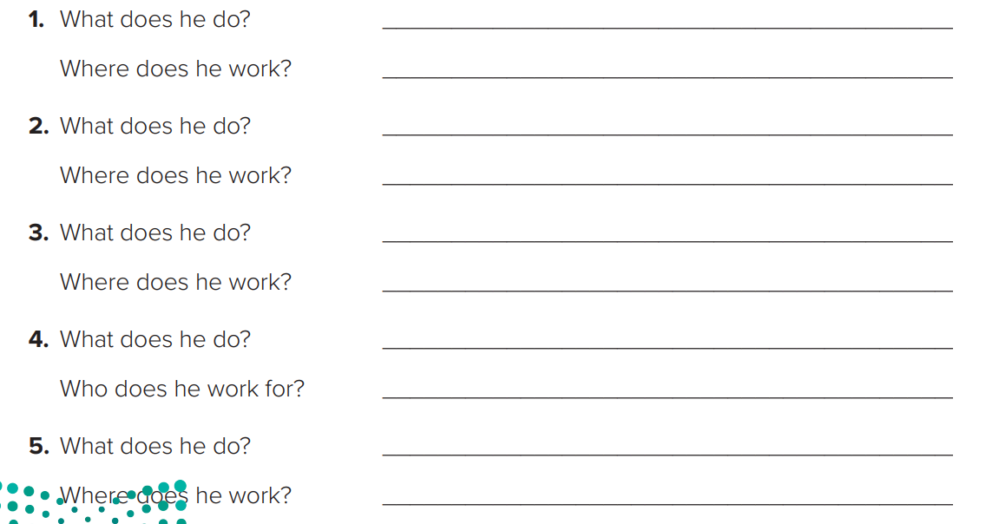
p.193
He’s a dentist.
He works in a dental office.
He’s a travel agent.
He works in a travel agency.
He’s a graphic designer.
He works in an advertisement firm.
He’s an engineer.
He works for construction company.
He’s a salesperson.
He works in a store.

Slide 4
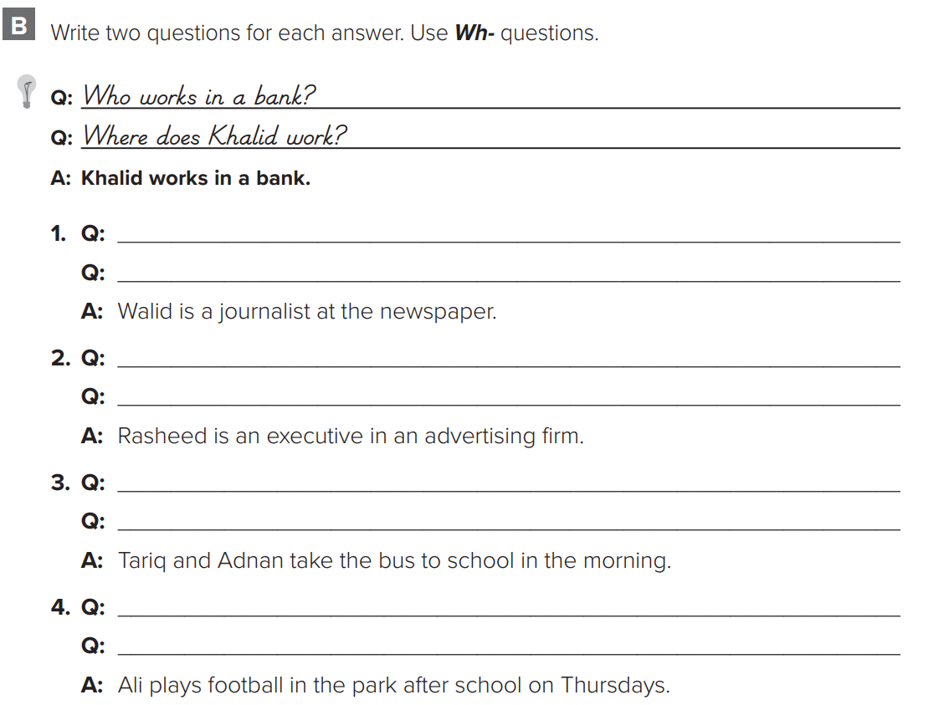
p.194
What does Walid do?
Who is a journalist?
Where does Rasheed work?
What does Rasheed do?
Where do they take the bus?
Who takes the bus to school?
What does Ali do on Thursdays?
When does Ali play football?

Slide 5
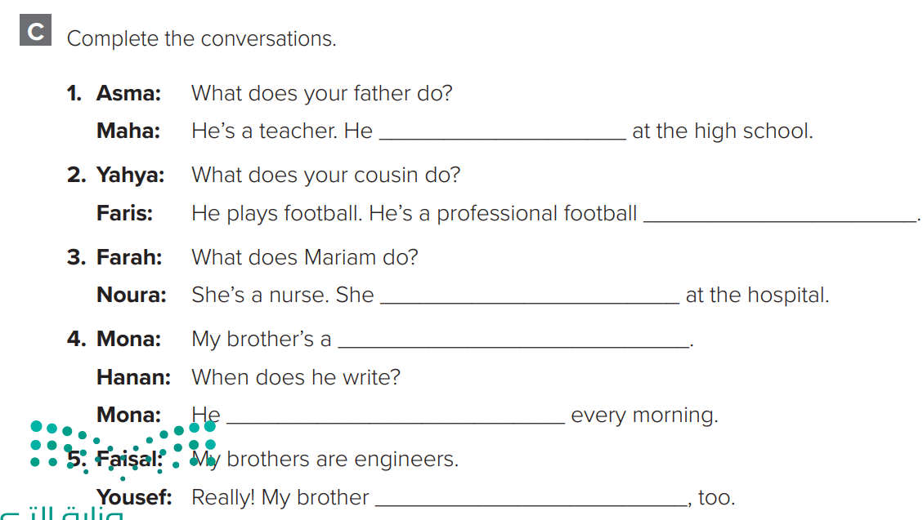
p.194
teaches
player
woks
writer
writes
Is an engineer

Slide 6
p.195
take the bus to work
drives to work
rides a bike to work
walk to work
take a taxi to work

Slide 8
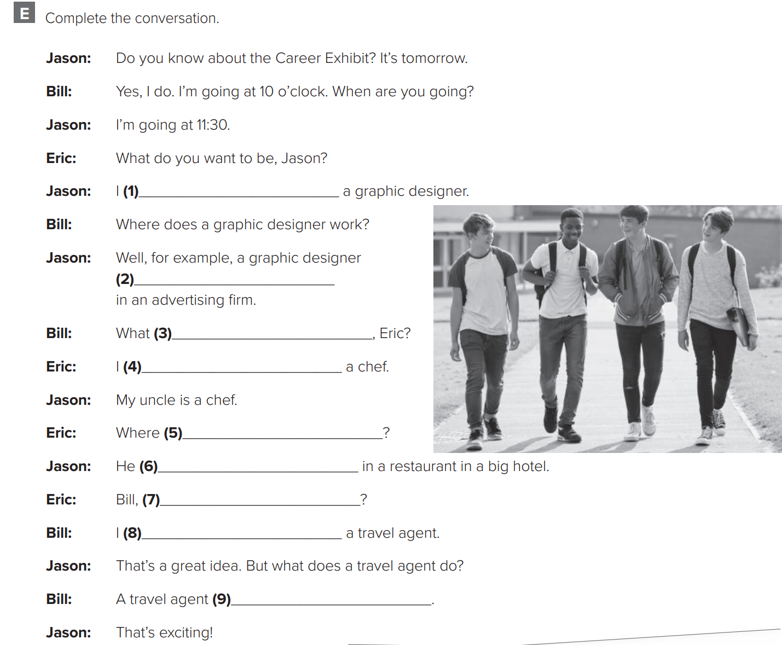
p.196
want to be
works
do you want to be
want to be
does he work
works
what do you want to be
want to be
arranges trips for customers.

Slide 9
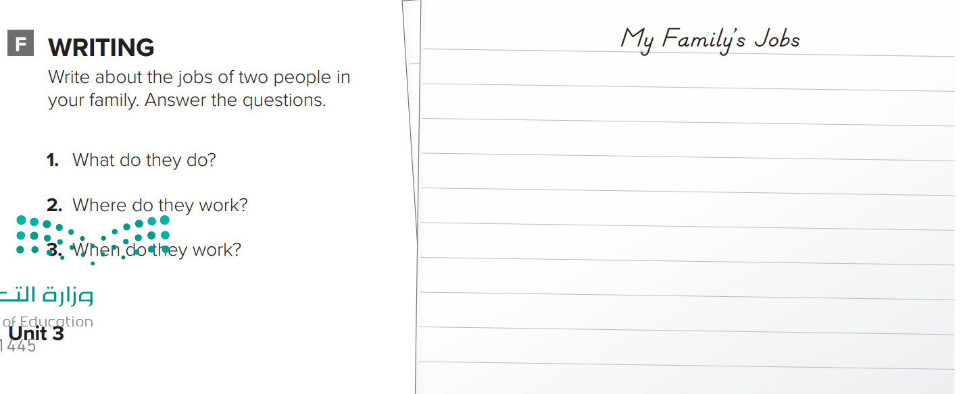
p.196
Answers will vary.
My father and uncle have great jobs. My father is a photographer. He works in an advertising firm. He takes photos for different customers. He works Sunday to Thursday. My uncle is a doctor. He works in the hospital. He helps sick people. And he works all the time.

