Slide 1
3 grammar
Today:
Date:
- -1445
Page 28
By: Dalal Al-Juaid

Slide 2
use verb to be in negative and in questions
make questions using WHERE
Warm up
lesson
use prepositions (in – on – from )in sentences
summative

Slide 3
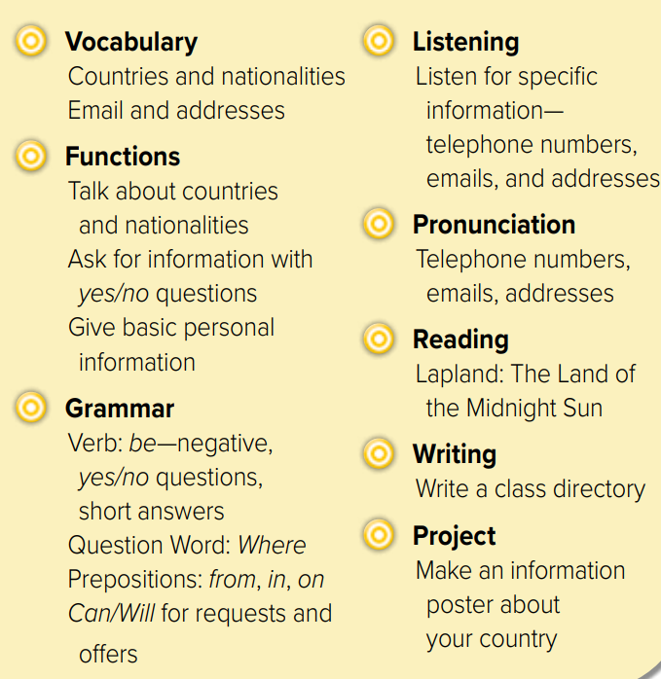

Slide 4
Make questions
name
age
Warm up
lesson
country
summative

Slide 5
What’s this?
Revision
country
nationality
capital
On business
…………….
#

Slide 6
am – is - are
Page 28
Warm up
lesson
summative

Slide 7
He
is
from
Abha
Where
is
He
from
?
Warm up
lesson
summative

Slide 8
Correct the mistake
Warm up
Jeddah is on Saudi Arabia
lesson
Haneen is from vacation
summative

Slide 9
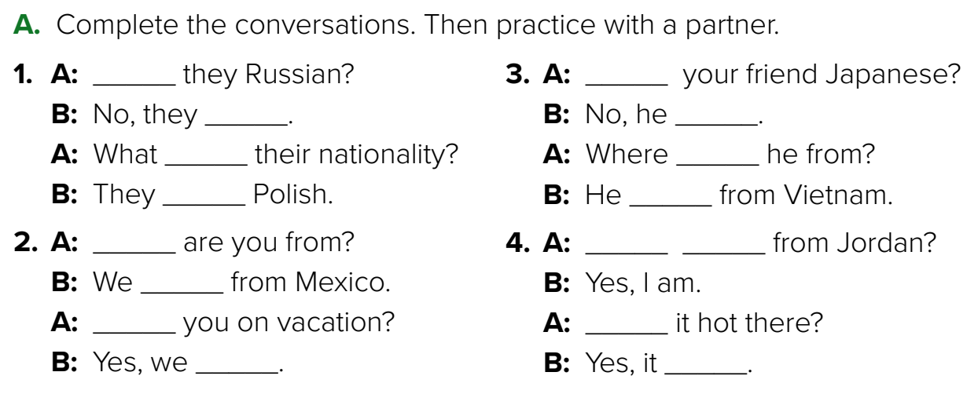
Think pair share
Are
Is
aren’t
isn’t
are
is
are
is
Warm up
Where
you
lesson
Are
are
Are
Is
are
is
summative

Slide 10
Yes, it is.
No, it isn’t.
It’s Seoul.
No, they aren’t.
They’re in England.
Warm up
lesson
summative

Slide 11
Lets play
Warm up
lesson
summative

Slide 12
page 200 Ex(C)
for practice grammar
Warm up
lesson
summative

Slide 13
p.200
is
m
is
are
Warm up
m
lesson
Are
re
Is
isn’t
is
summative

