Slide 1
We can 3

Slide 3
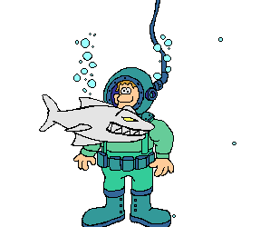
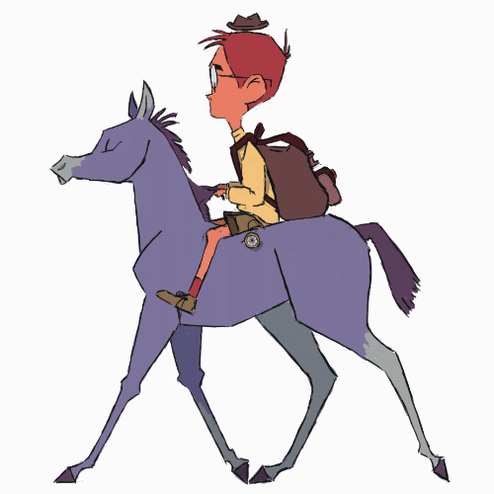
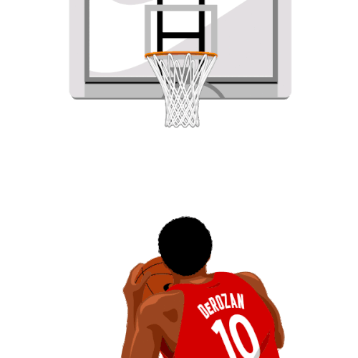
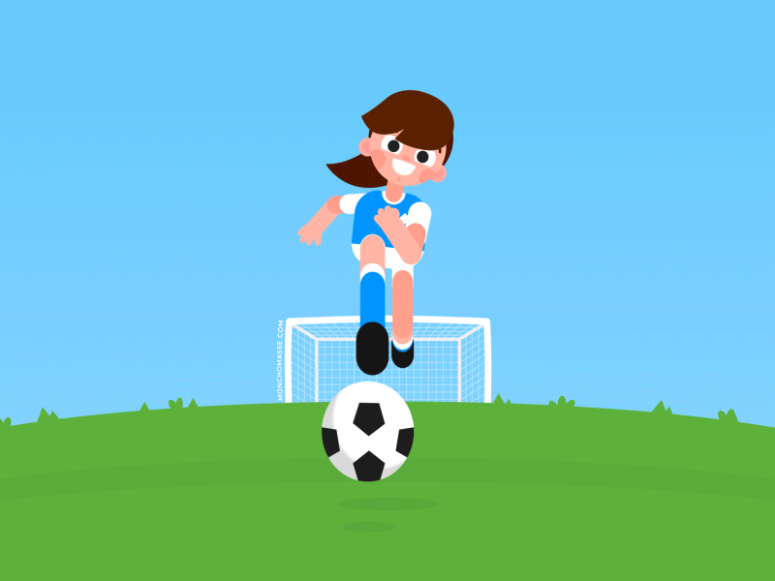
1-What sport do you like?
2-Do you play tennis?
3- does he rock climbing?

Slide 5
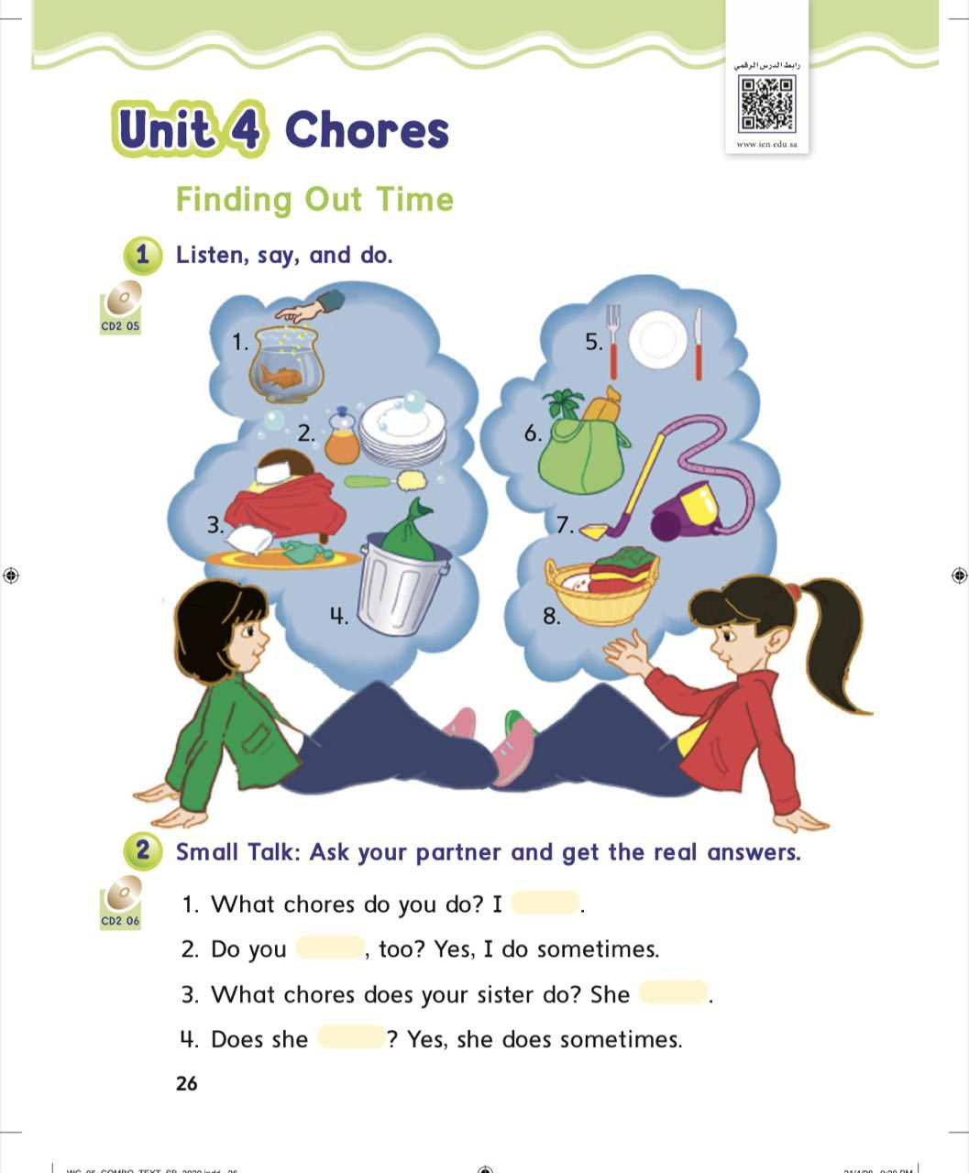
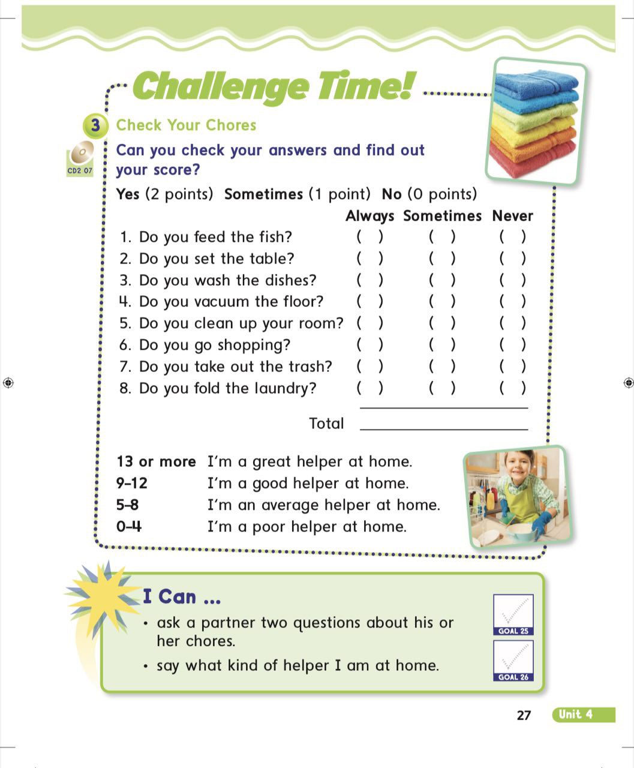

Slide 6
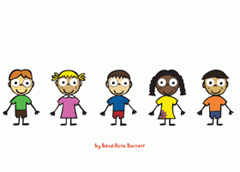

Slide 7
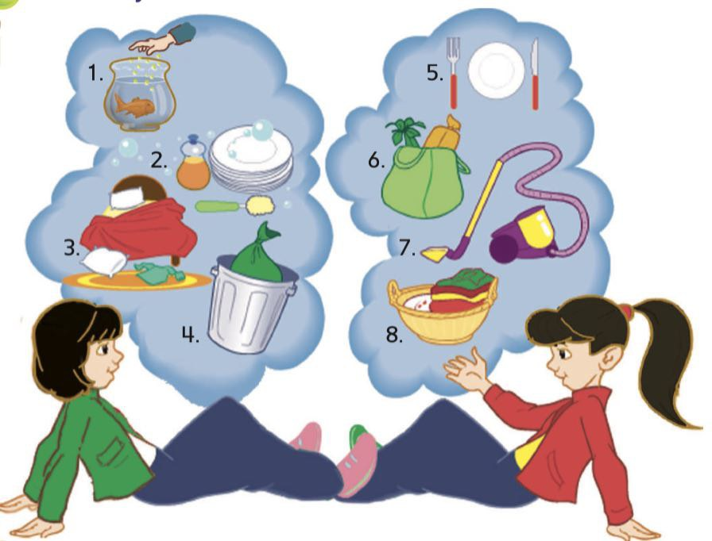

Slide 10
he
she
it
Verb + s

Slide 11
he
she
it
She feeds her cat.

Slide 12
he
she
it
The cat eats the rat.

Slide 13
he
she
it
He feeds the cat.

Slide 14
he
she
it
he goes shopping.

Slide 15
I
they
we
you
Verb

Slide 16
I
they
we
you
they go shopping.

Slide 17
I
they
we
you
I clean my room.

Slide 18
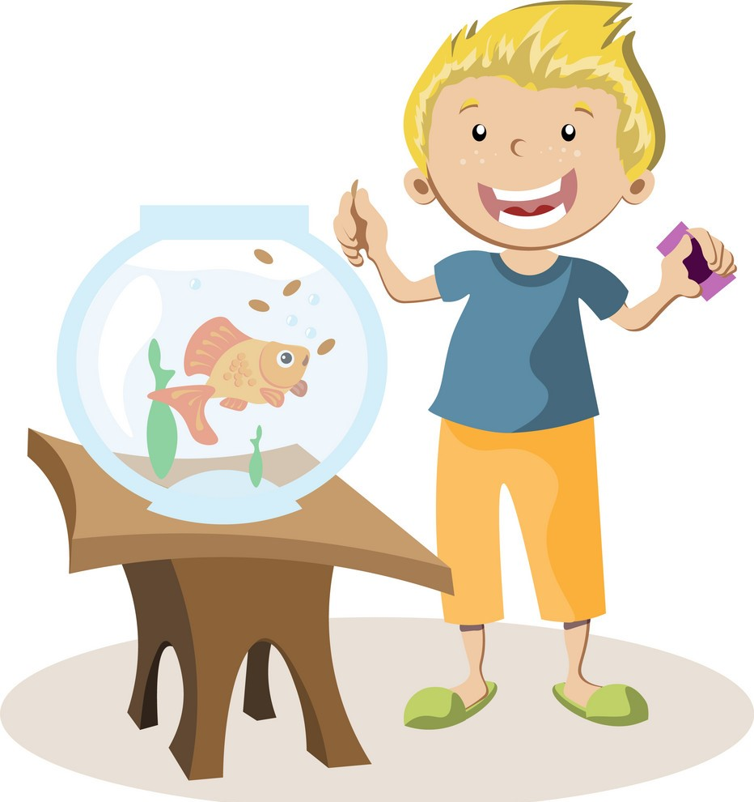
He feeds the fish

Slide 19
She washes the dishes

Slide 20
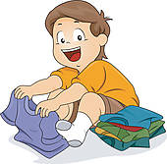
He folds the laundry

Slide 21
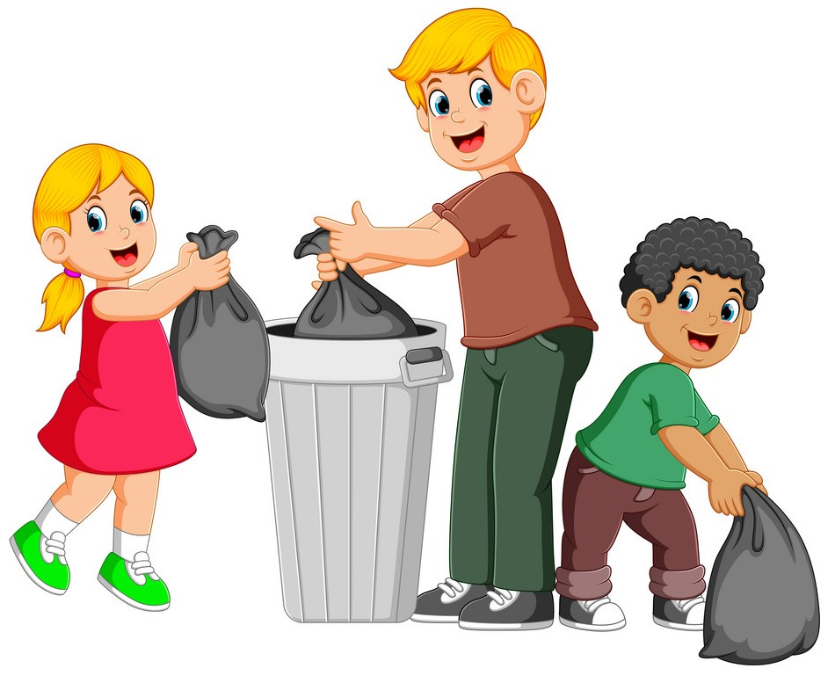
they take out the trash

Slide 22
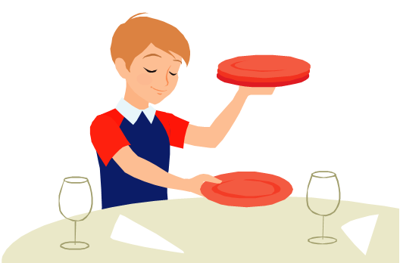
he sets the table

Slide 23
they go shopping

Slide 24
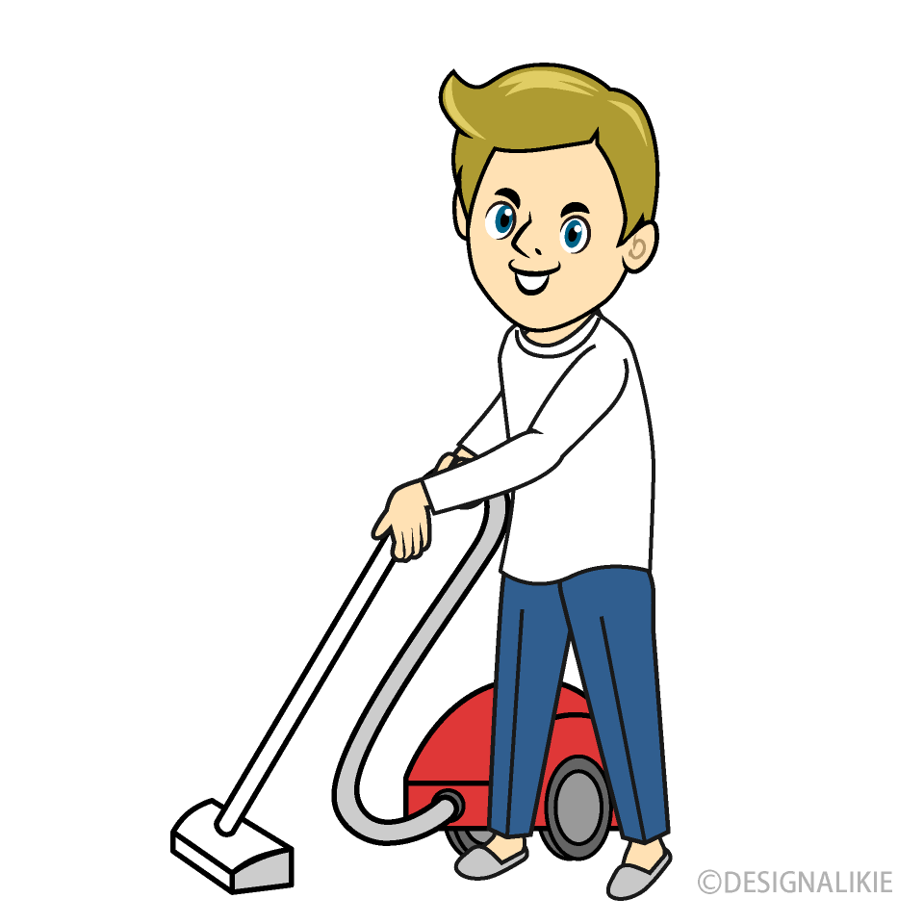
he vacuums the floor

Slide 25
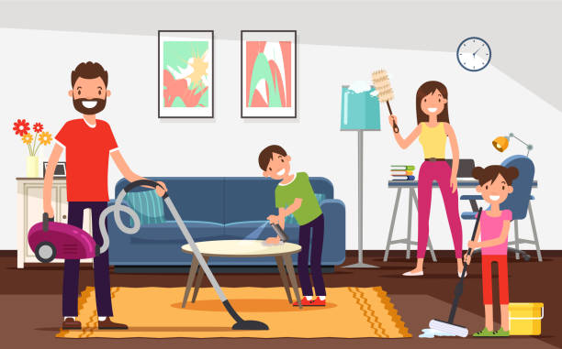
they clean the house

Slide 28
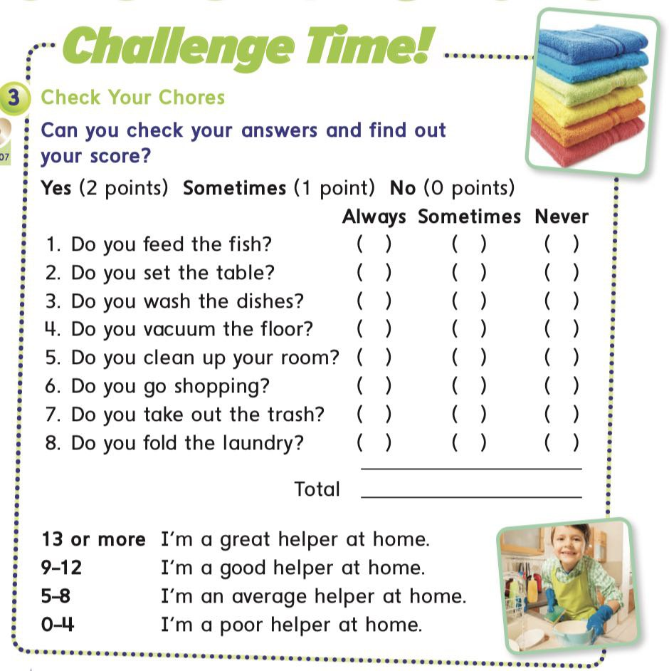

Slide 31
she
feed
The fish
they
feeds

Slide 32
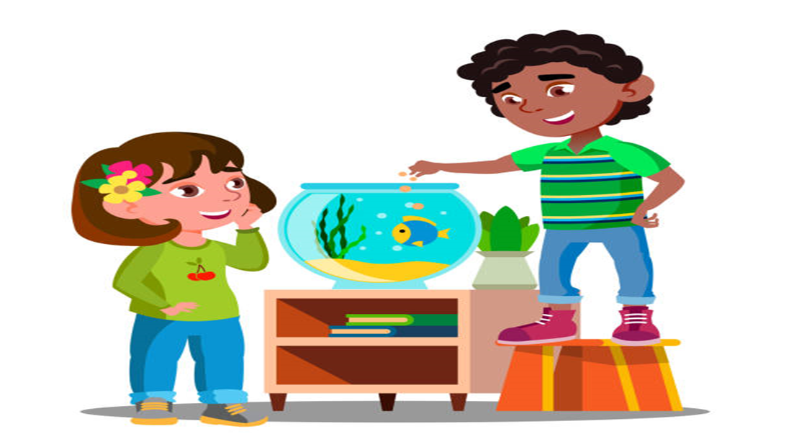
she
feed
The fish
they
feeds

Slide 33
she
wash
the dishes
they
washes

Slide 34
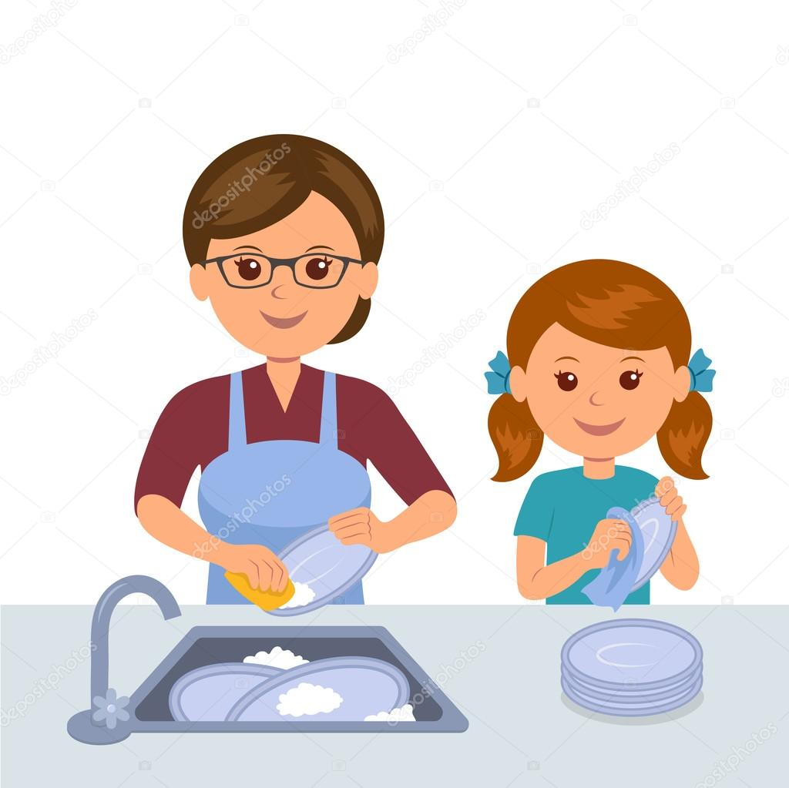
she
wash
the dishes
they
washes

Slide 35
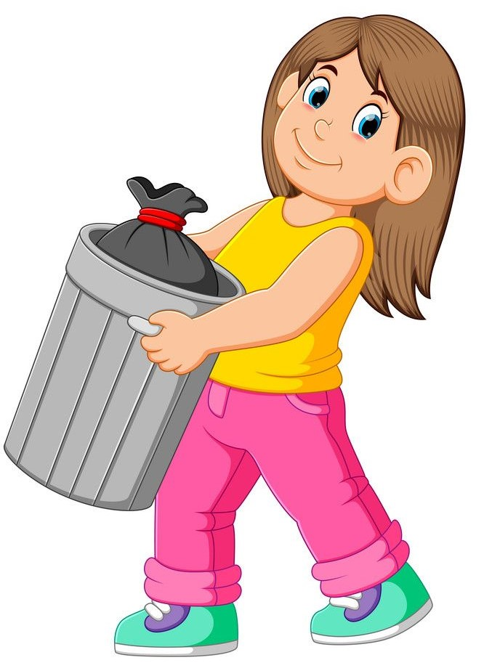
she
take
out the trash
they
takes

Slide 36
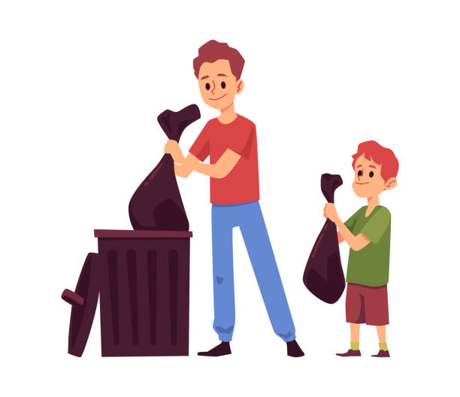
she
take
out the trash
they
takes

Slide 37
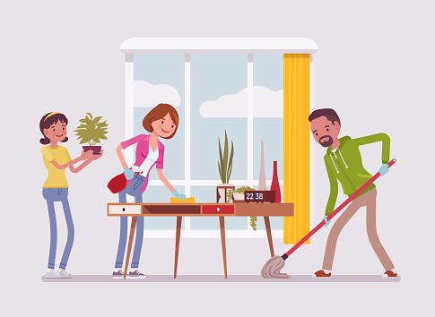
she
clean
the room
they
cleans

Slide 38
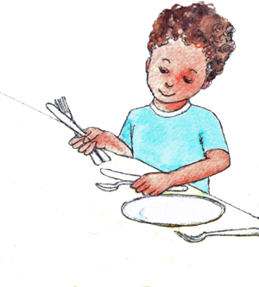
he
sets
the table
they
set

Slide 39
she
goes
shopping
they
go

Slide 40
she
go
shopping
they
goes

Slide 41
she
vacuum
the floor
they
vacuums

Slide 42
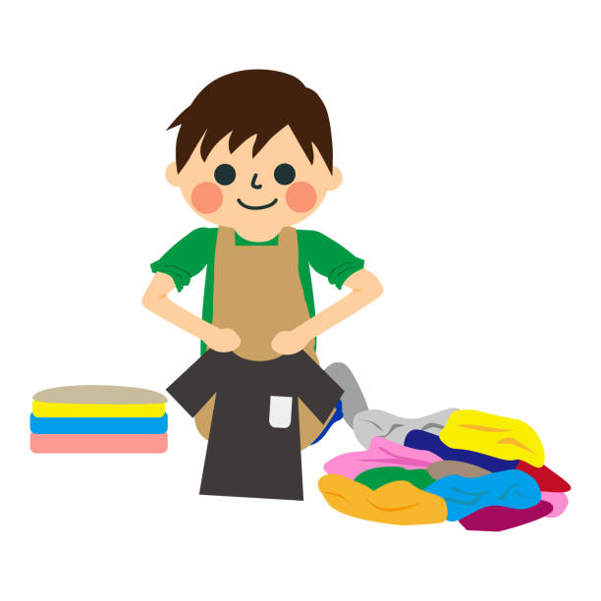
he
folds
the laundry
they
fold

Slide 43
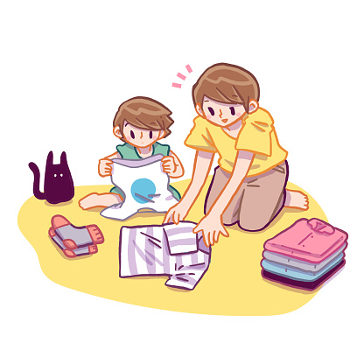
she
fold
the laundry
they
folds

Slide 46
Images
Reading

Slide 47
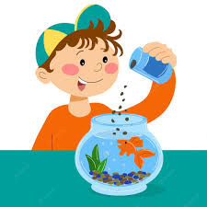

Slide 48
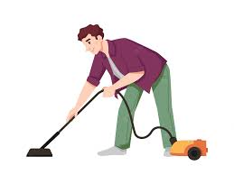

Slide 50
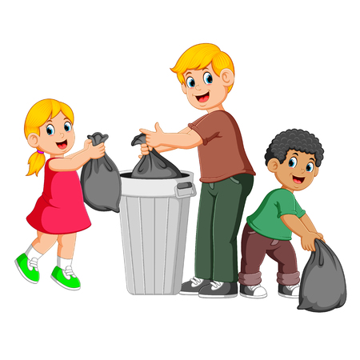

Slide 51
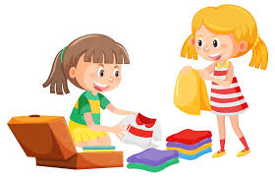

Slide 55
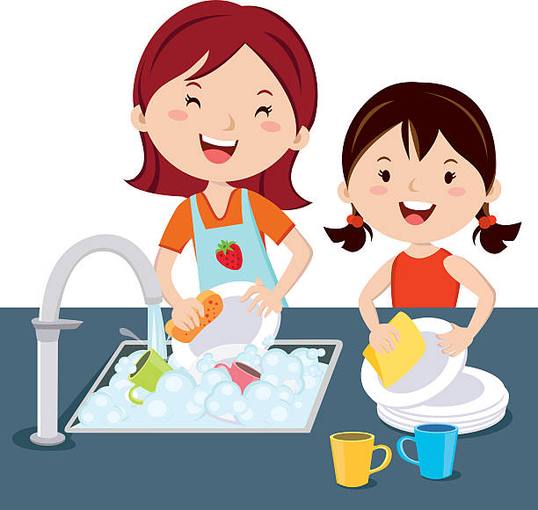

Slide 56
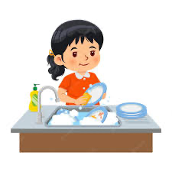

Slide 57
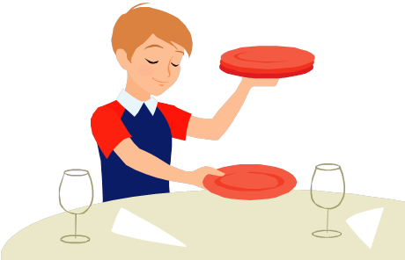

Slide 58
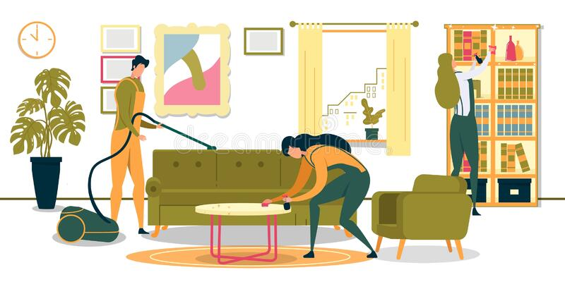

Slide 59
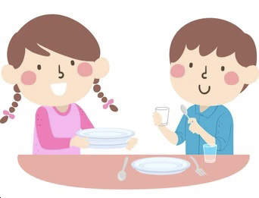

Slide 61
HOMEWORK

Slide 62
Goodbye

