Slide 1
We can 3

Slide 3
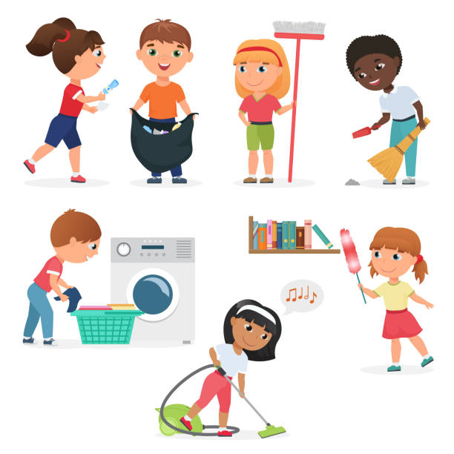
1-What chores do you do?

Slide 5
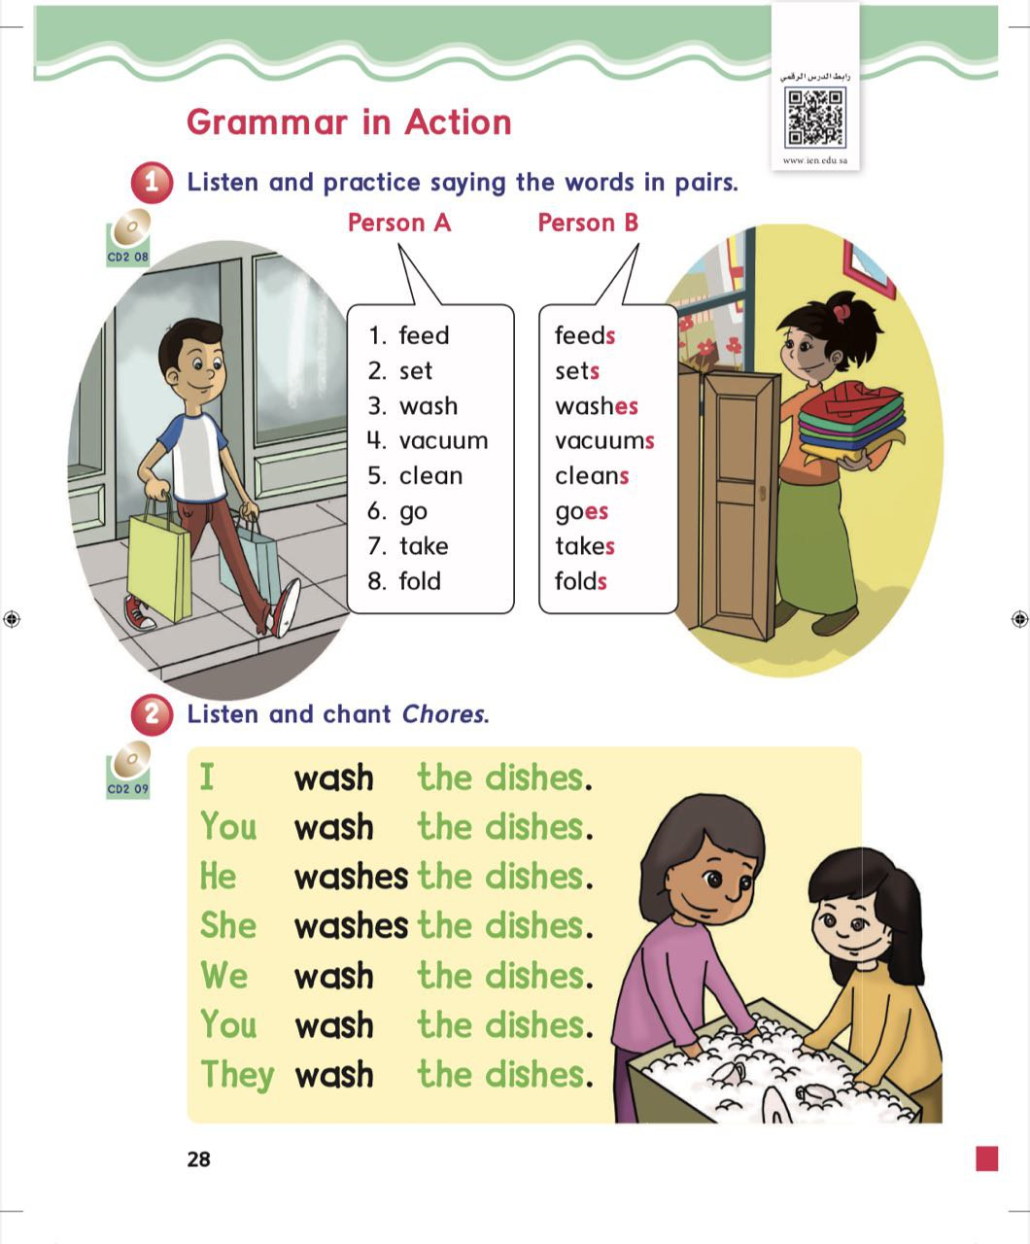
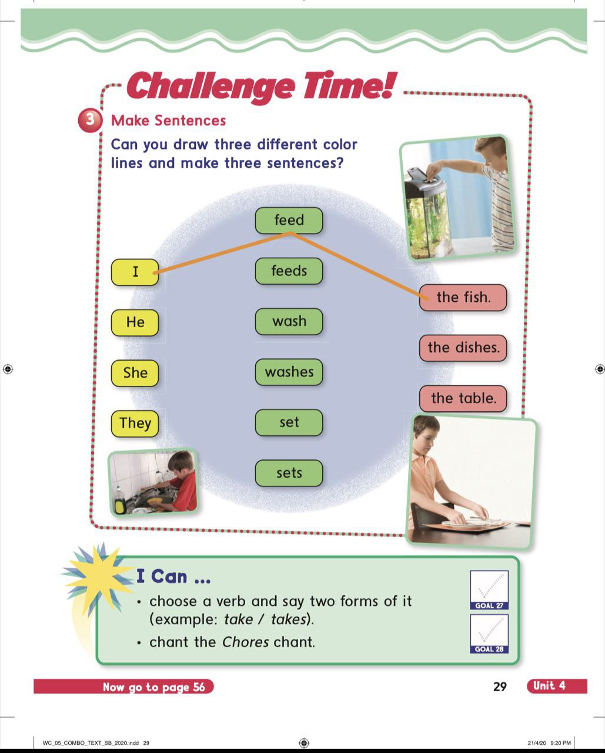

Slide 6
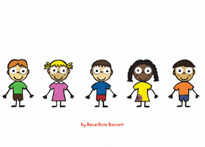

Slide 8
he
she
it
Verb + s

Slide 9
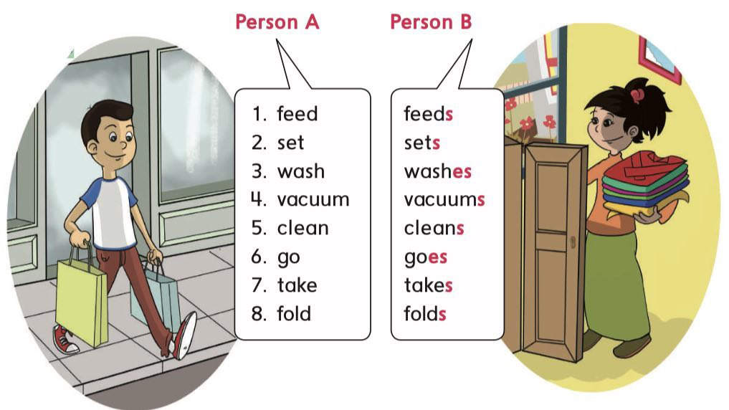

Slide 10
She washes the dishes

Slide 11
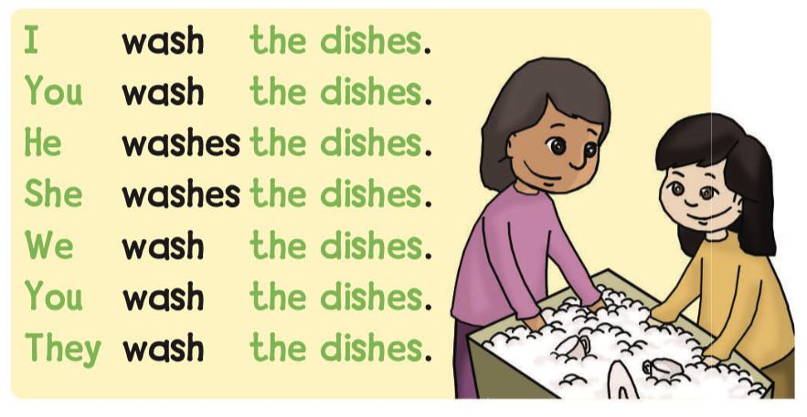

Slide 14
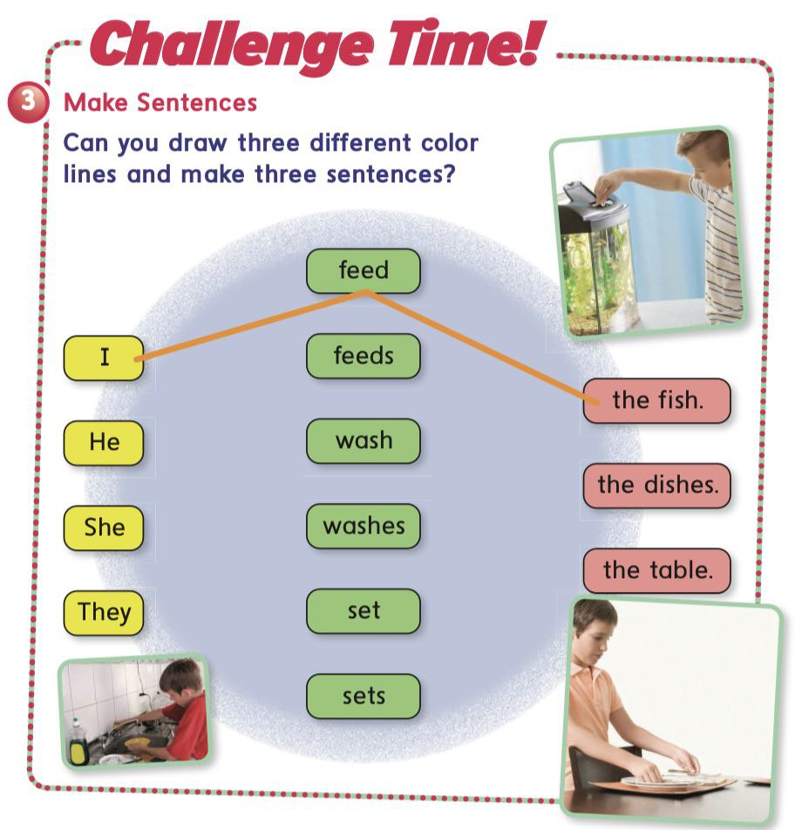

Slide 17
she
feed
The fish
they
feeds

Slide 18
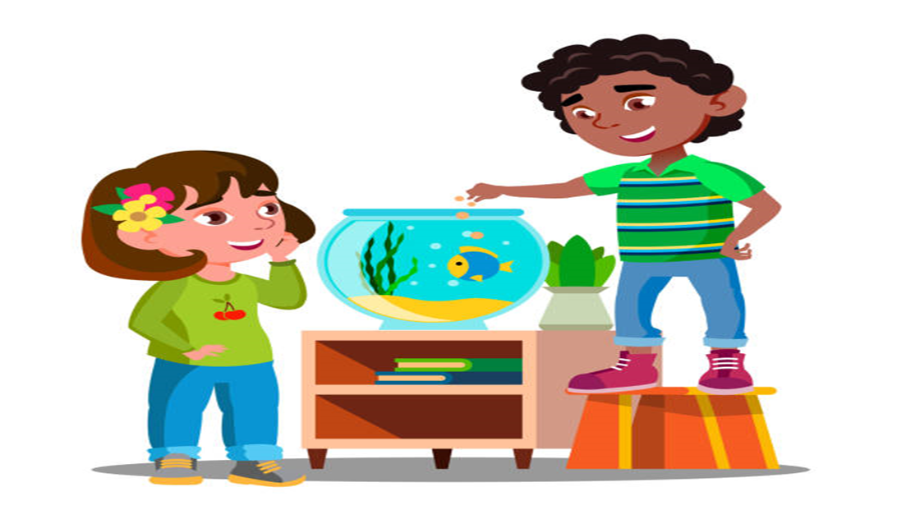
she
feed
The fish
they
feeds

Slide 19
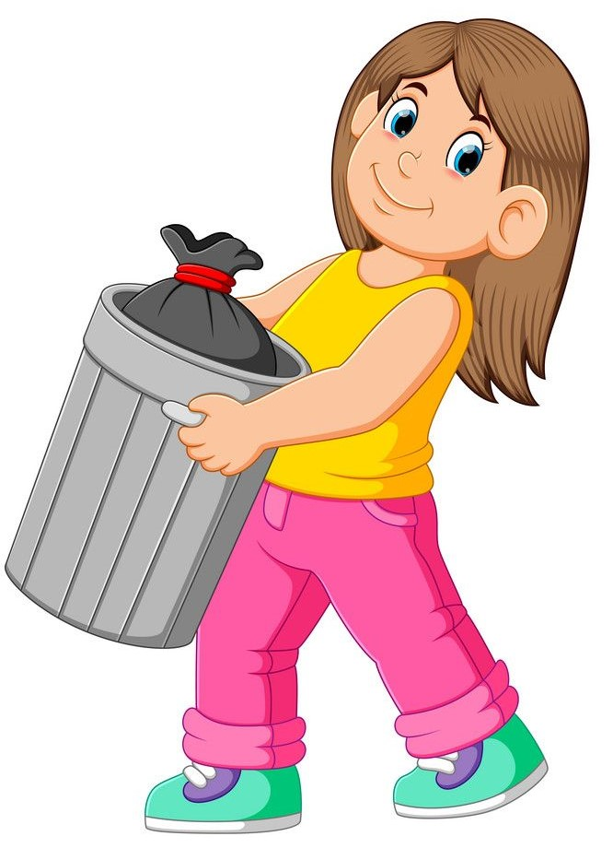
she
take
out the trash
they
takes

Slide 20
she
wash
the dishes
they
washes

Slide 21
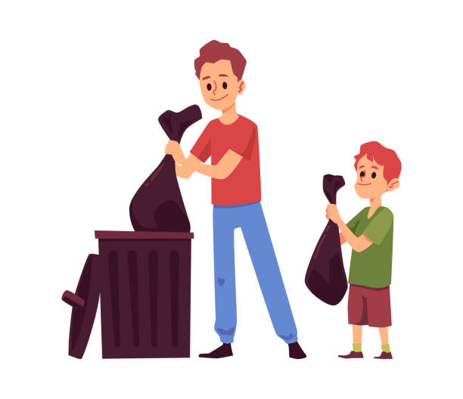
she
take
out the trash
they
takes

Slide 22
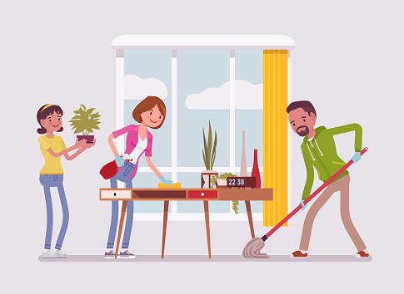
she
clean
the room
they
cleans

Slide 23
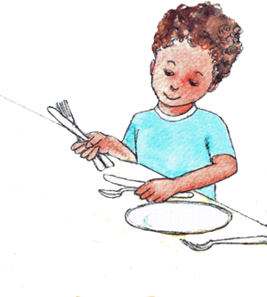
he
sets
the table
they
set

Slide 24
she
goes
shopping
they
go

Slide 25
she
vacuum
the floor
they
vacuums

Slide 26
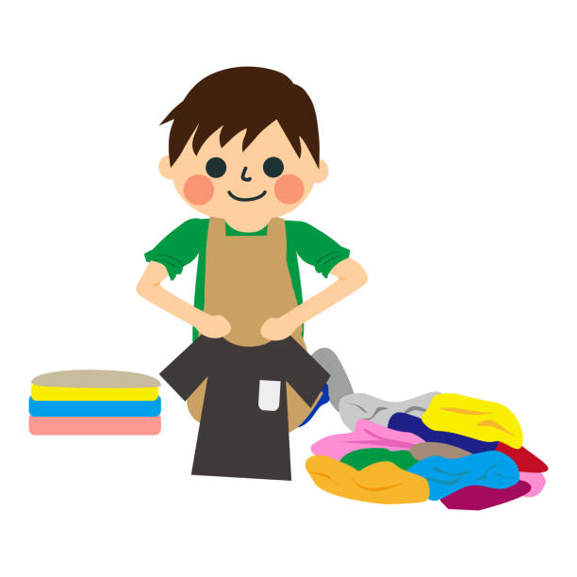
he
folds
the laundry
they
fold

Slide 29
We
He
She
I
They

Slide 49
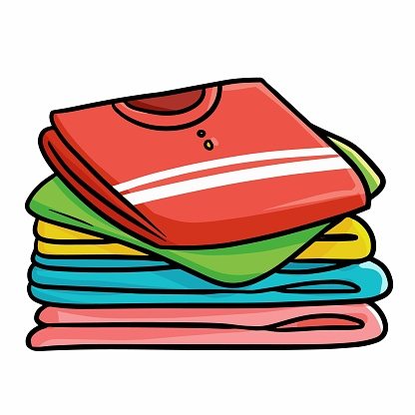

Slide 60
HOMEWORK

Slide 61
Goodbye

