Slide 1
We can

Slide 2
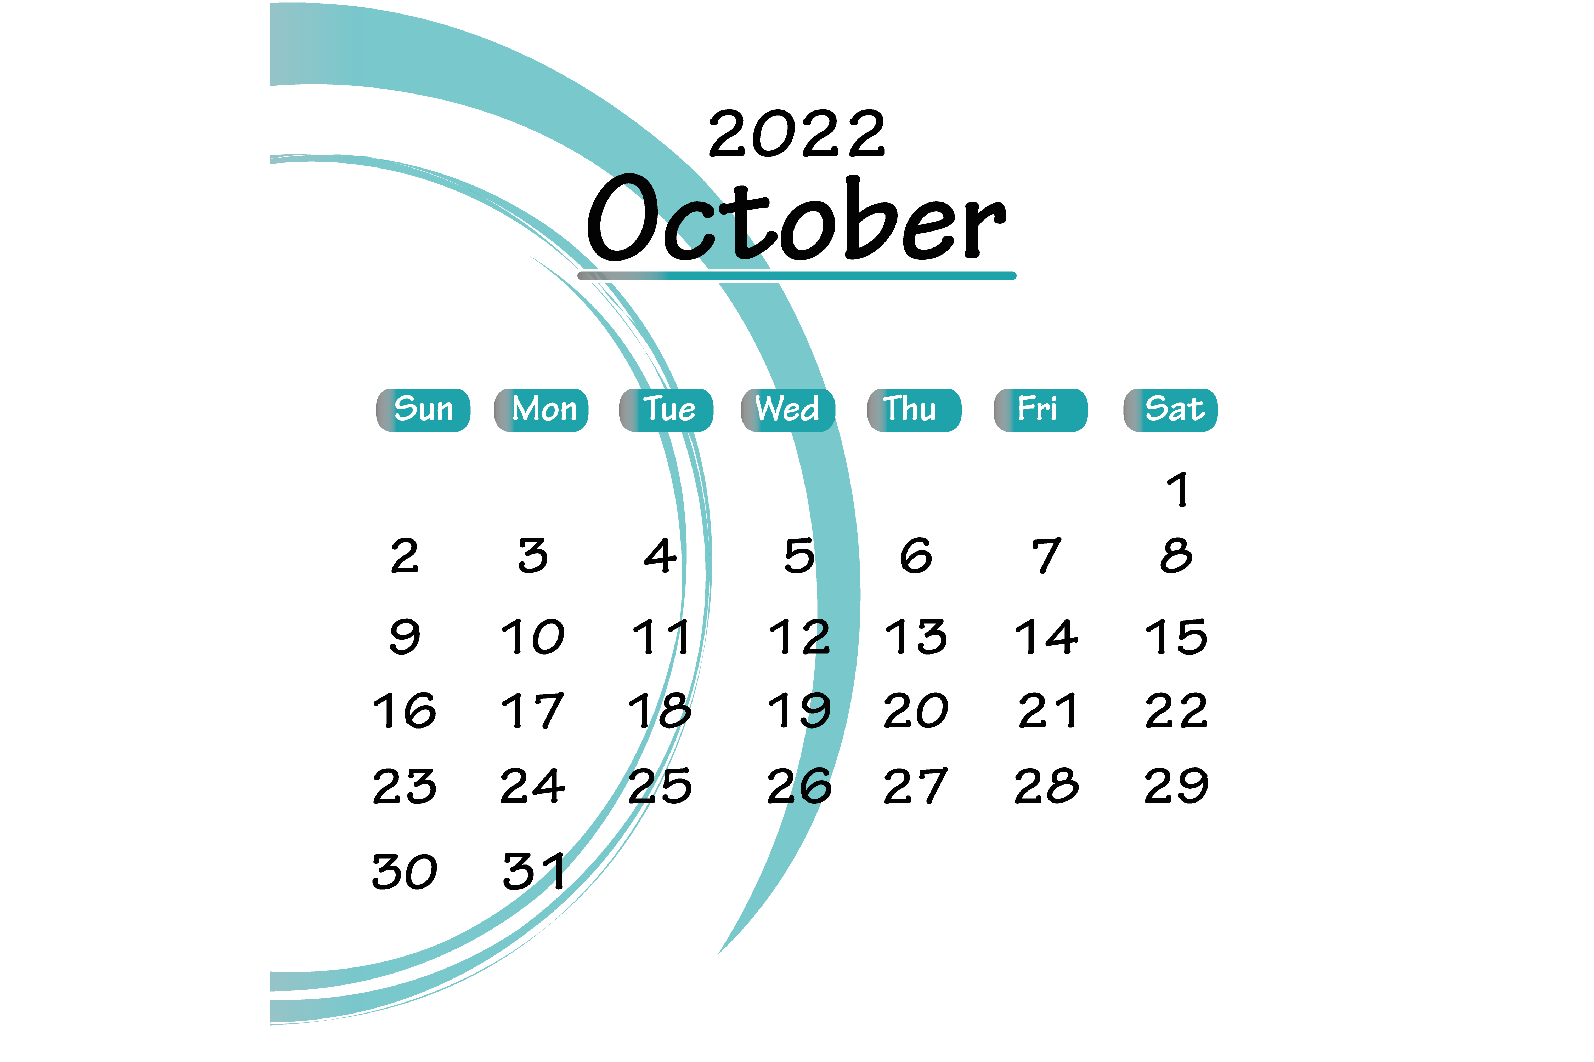

Slide 3
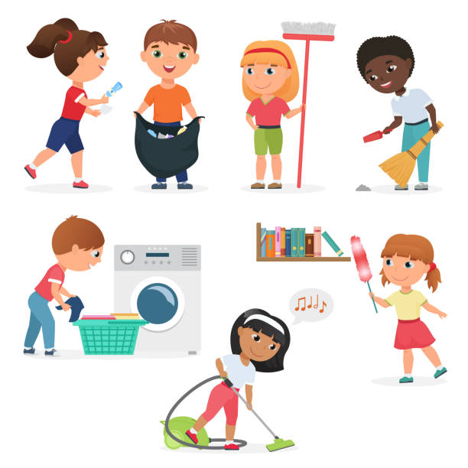
1-What chores do you do?
usually
now

Slide 5
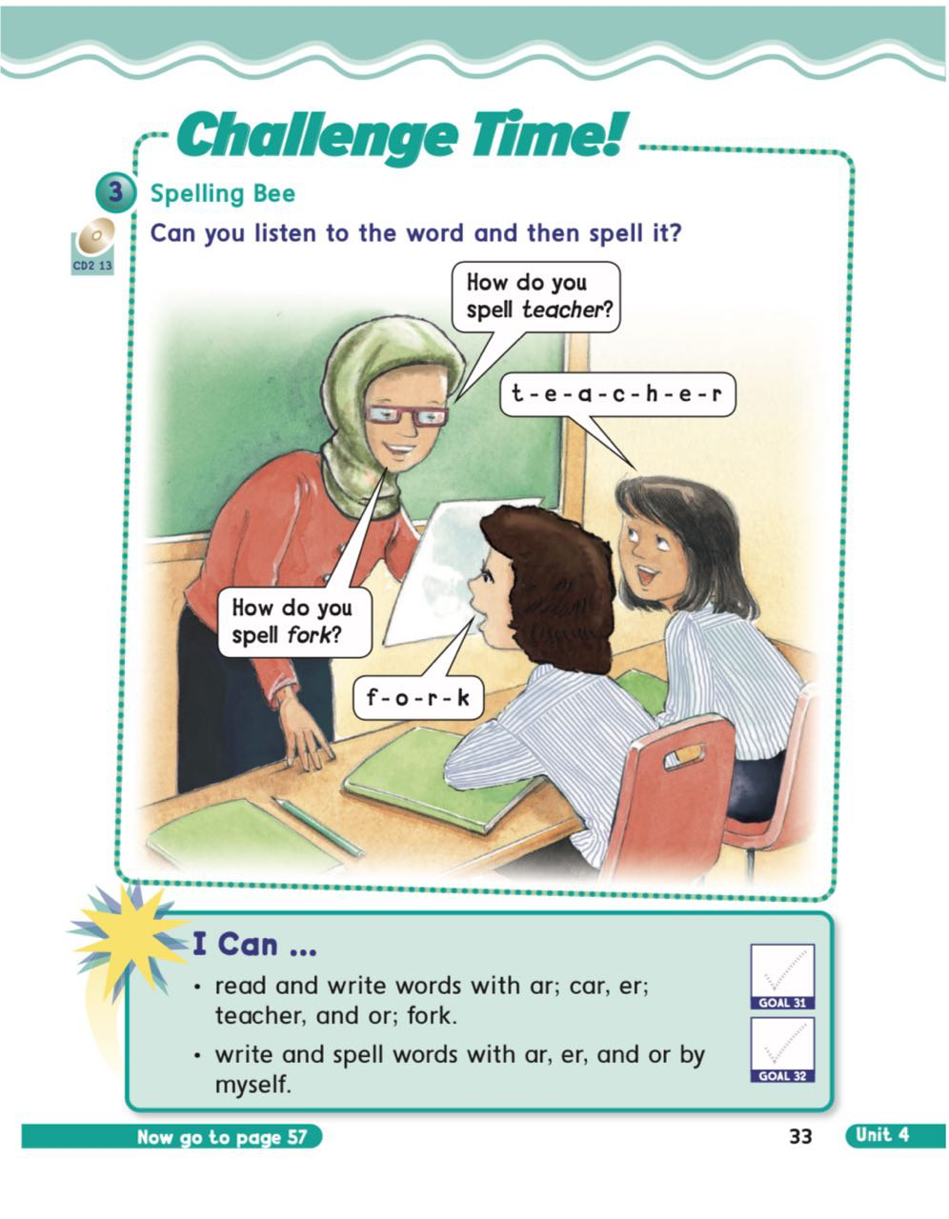

Slide 6
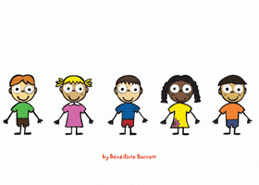

Slide 9
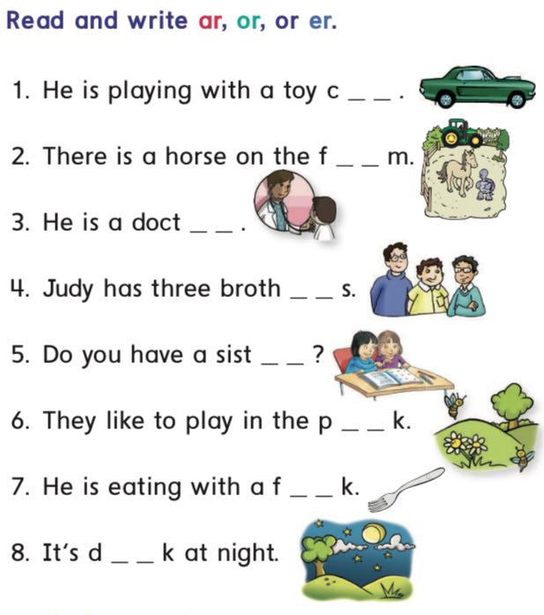

Slide 10
a r
a r
o r
e r
e r
a r
o r
a r

Slide 12
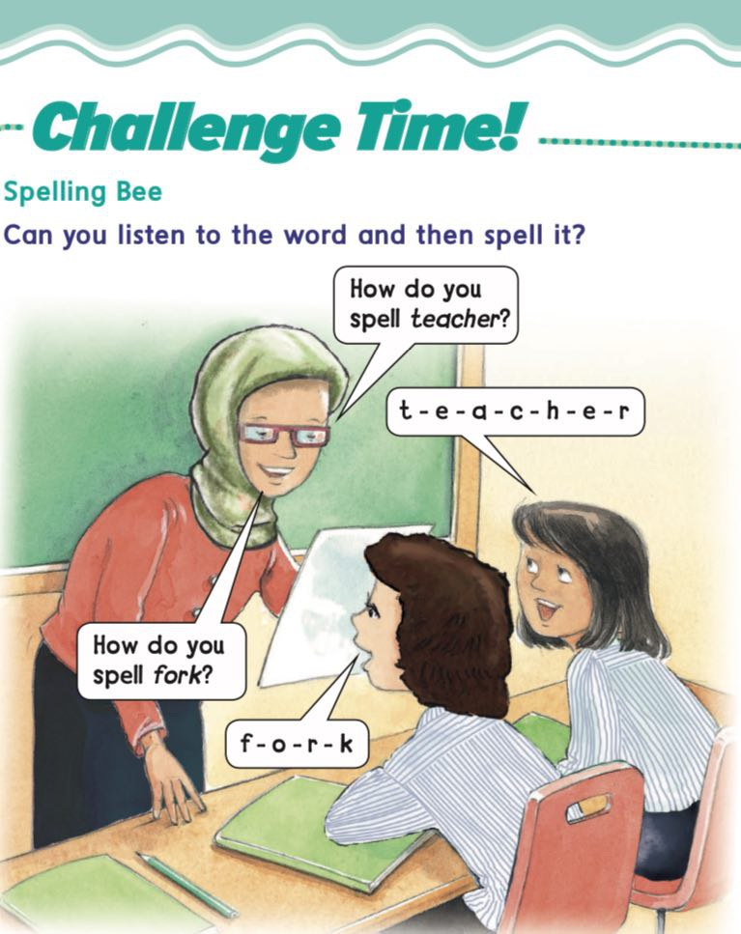

Slide 13
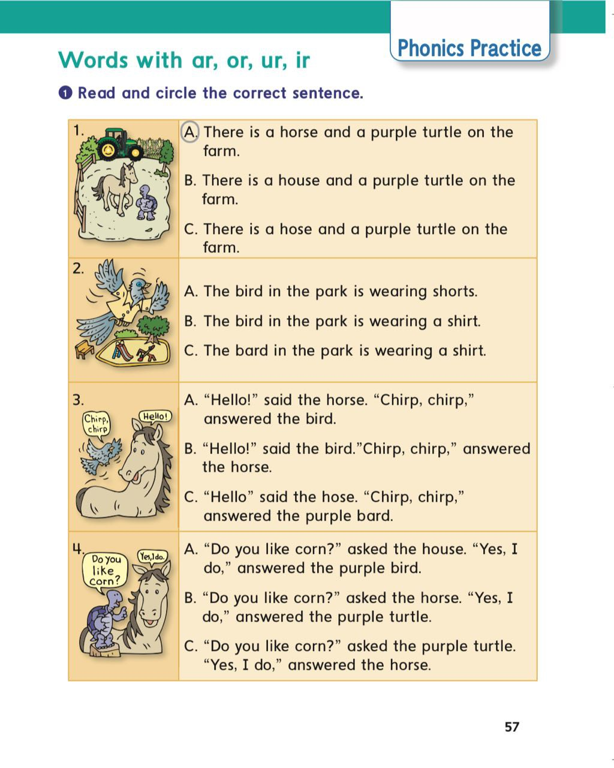

Slide 19
Read the images

Slide 20
D
O
T
C
R
O

Slide 21
T
I
E
G
R

Slide 22
S
T
A
R

Slide 23
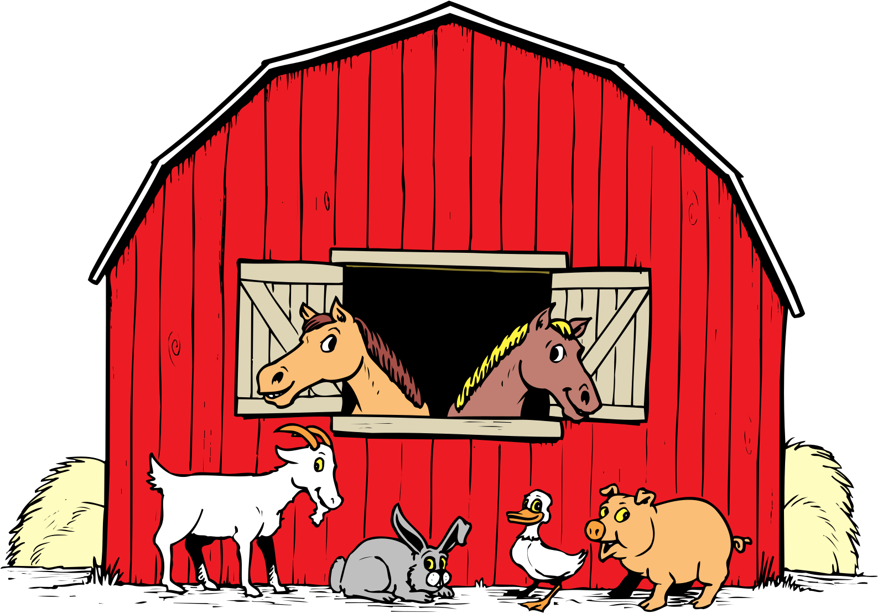
F
A
M
R

Slide 24
S
C
R
A
F

Slide 25
J
A
R

Slide 26
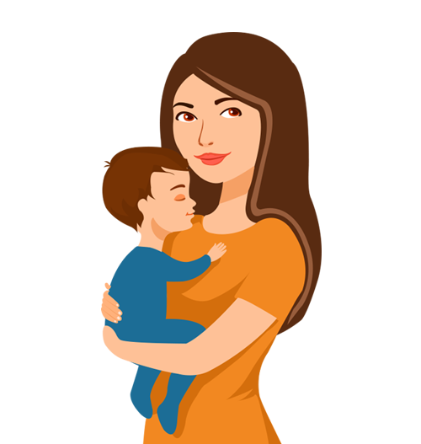
M
O
H
T
R
E

Slide 27
M
I
R
R
R
O

Slide 28
T
O
W
R
E

Slide 29
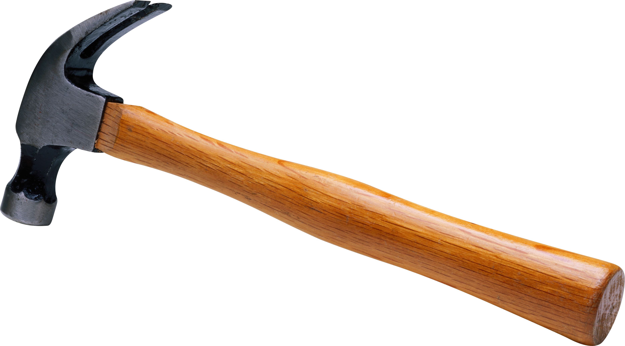
H
M
M
R
E
A

Slide 30
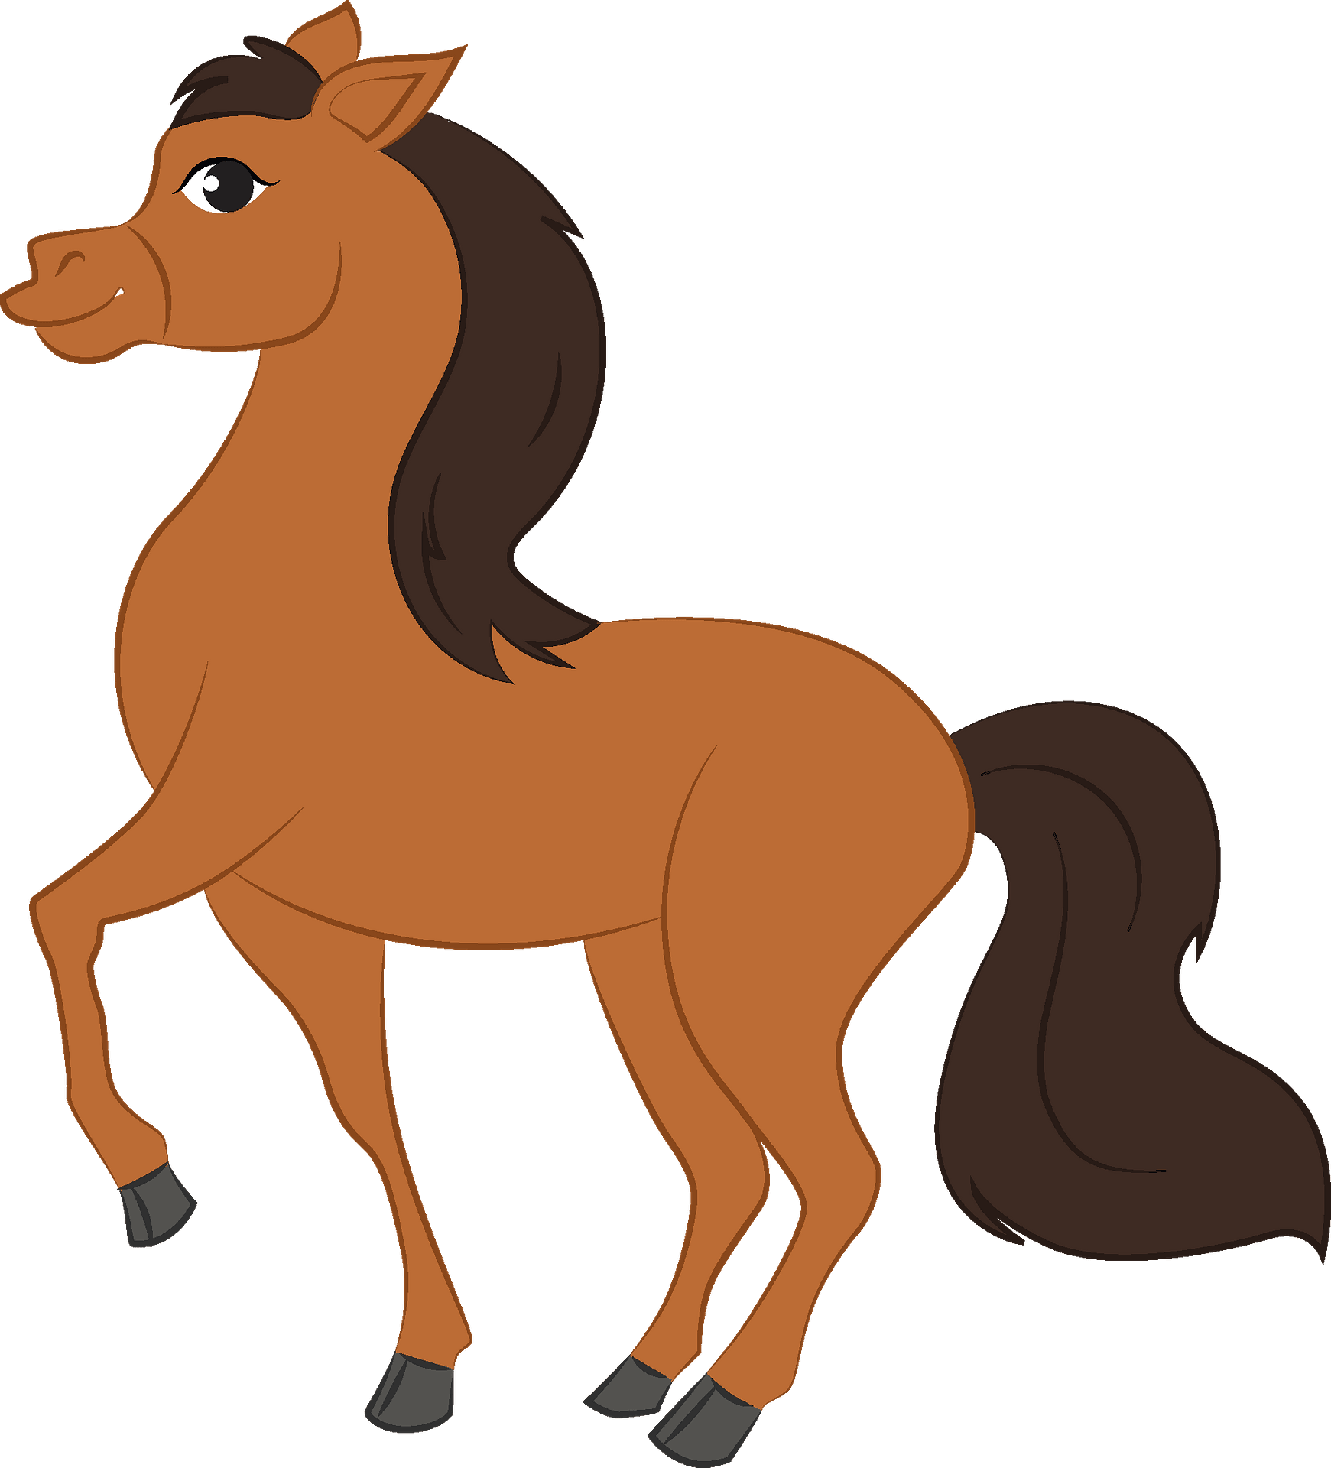
H
S
R
E
O

Slide 31
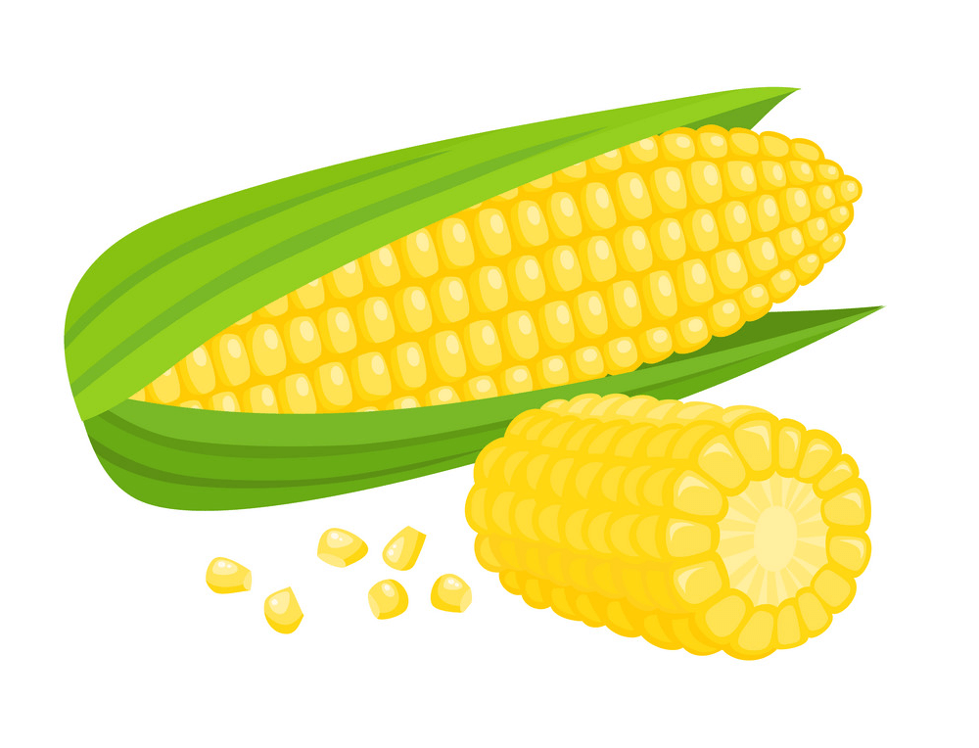
C
N
R
O

Slide 32
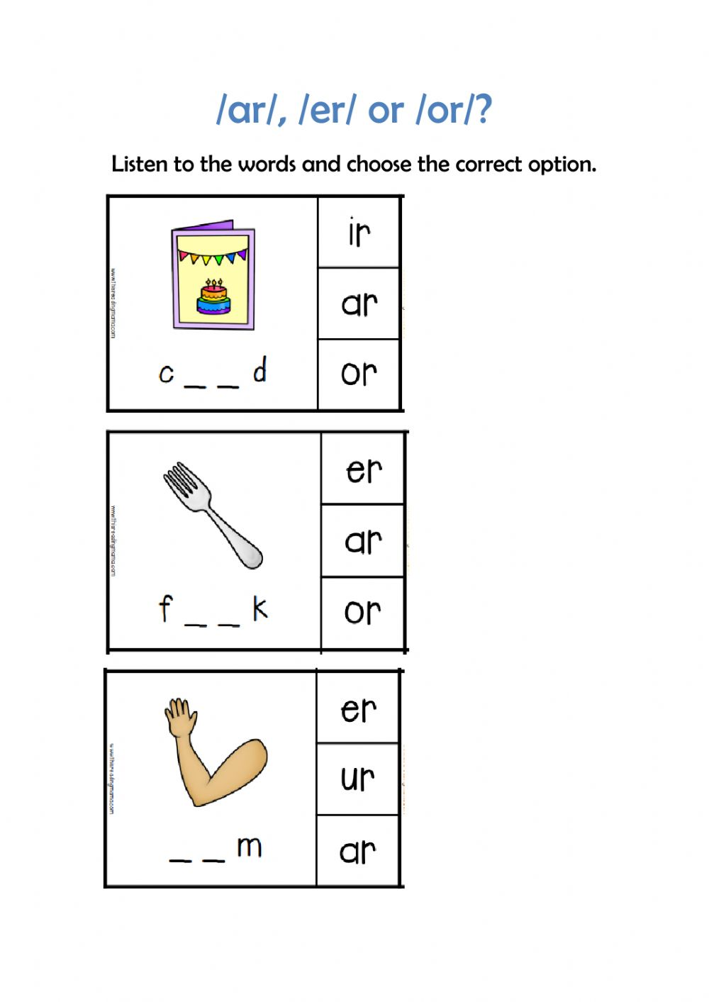

Slide 34
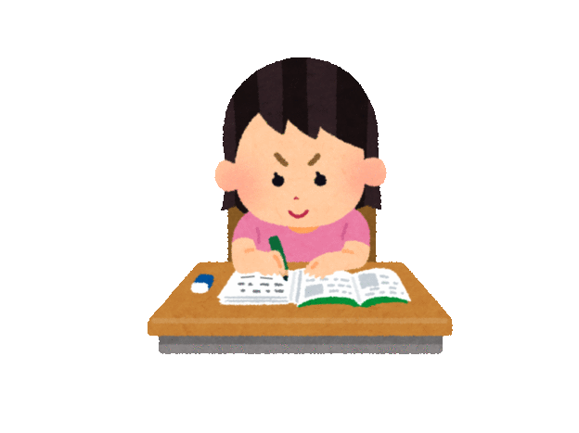
HOMEWORK

Slide 36
Goodbye

