Slide 1


Slide 2


Slide 3
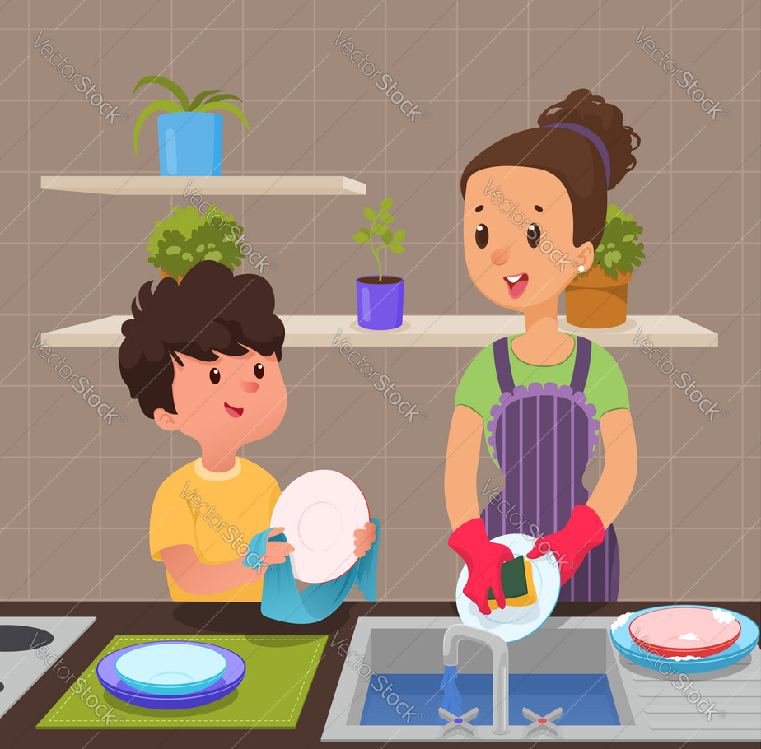
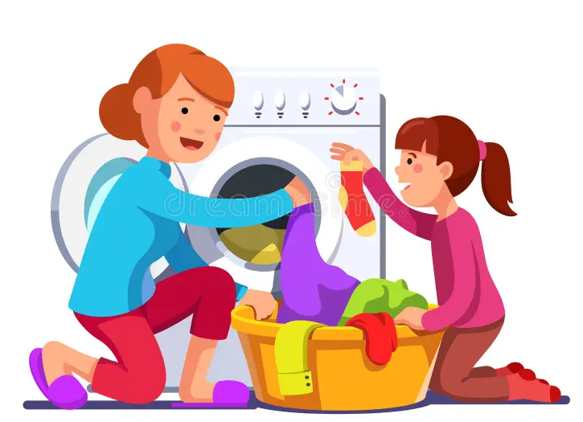
Do you help your Mom at home? ?
What do you do ??

Slide 4

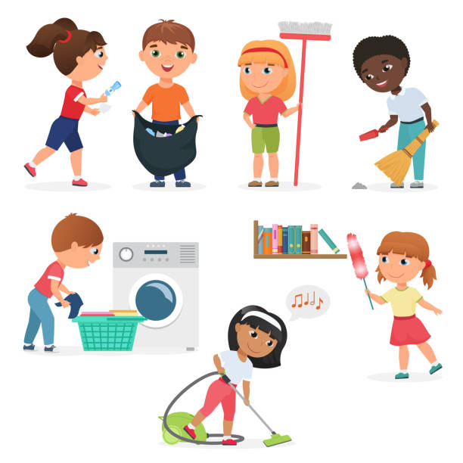

Slide 5
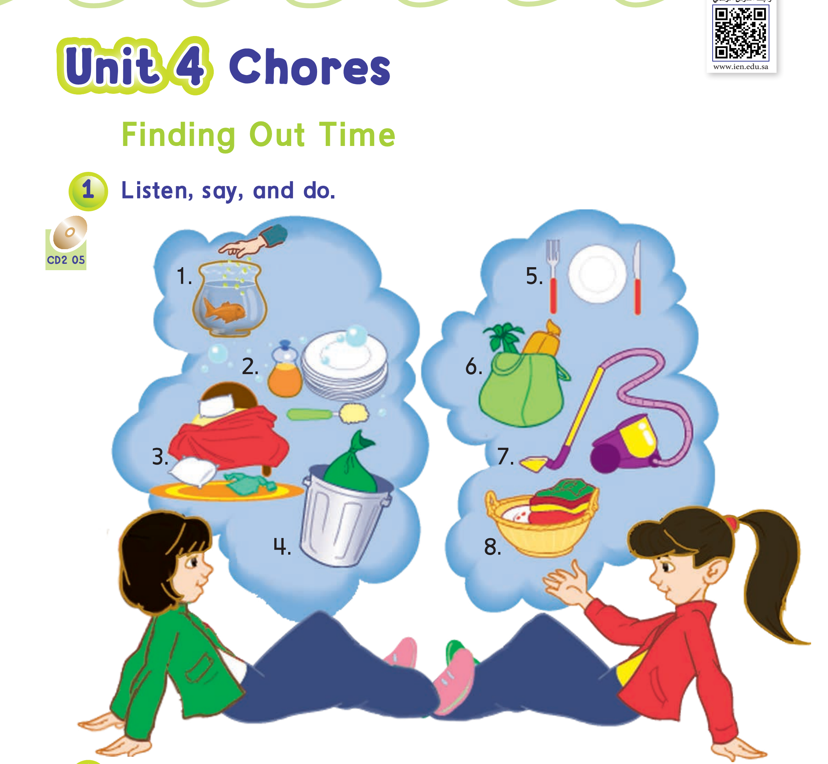
Page:26

Slide 6
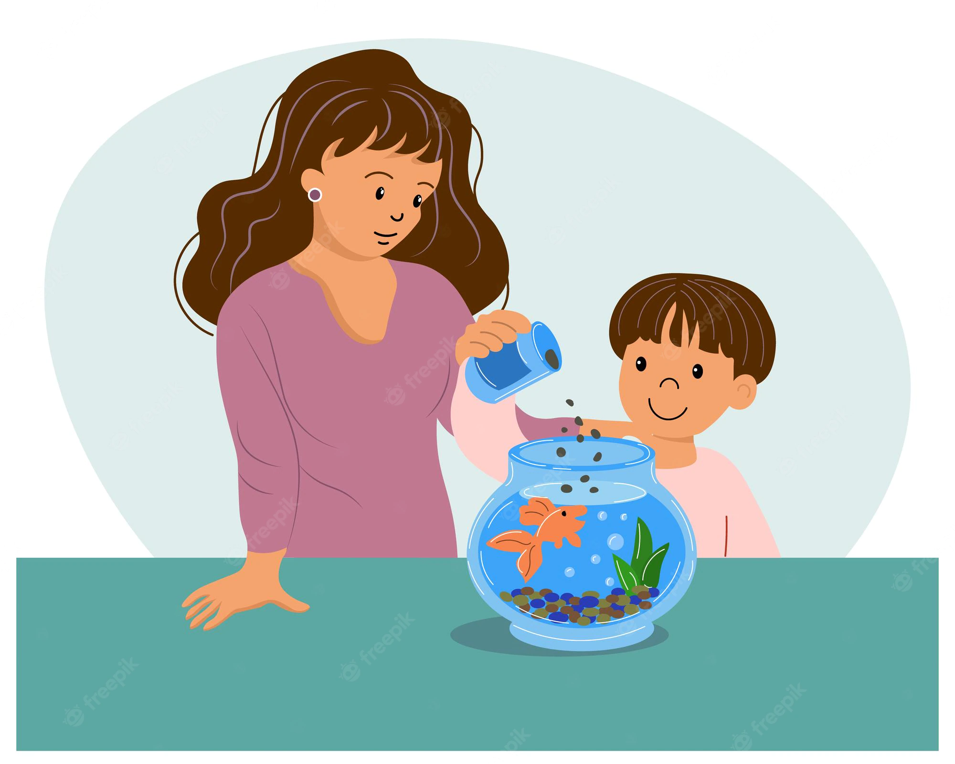
Feed the fish .

Slide 7
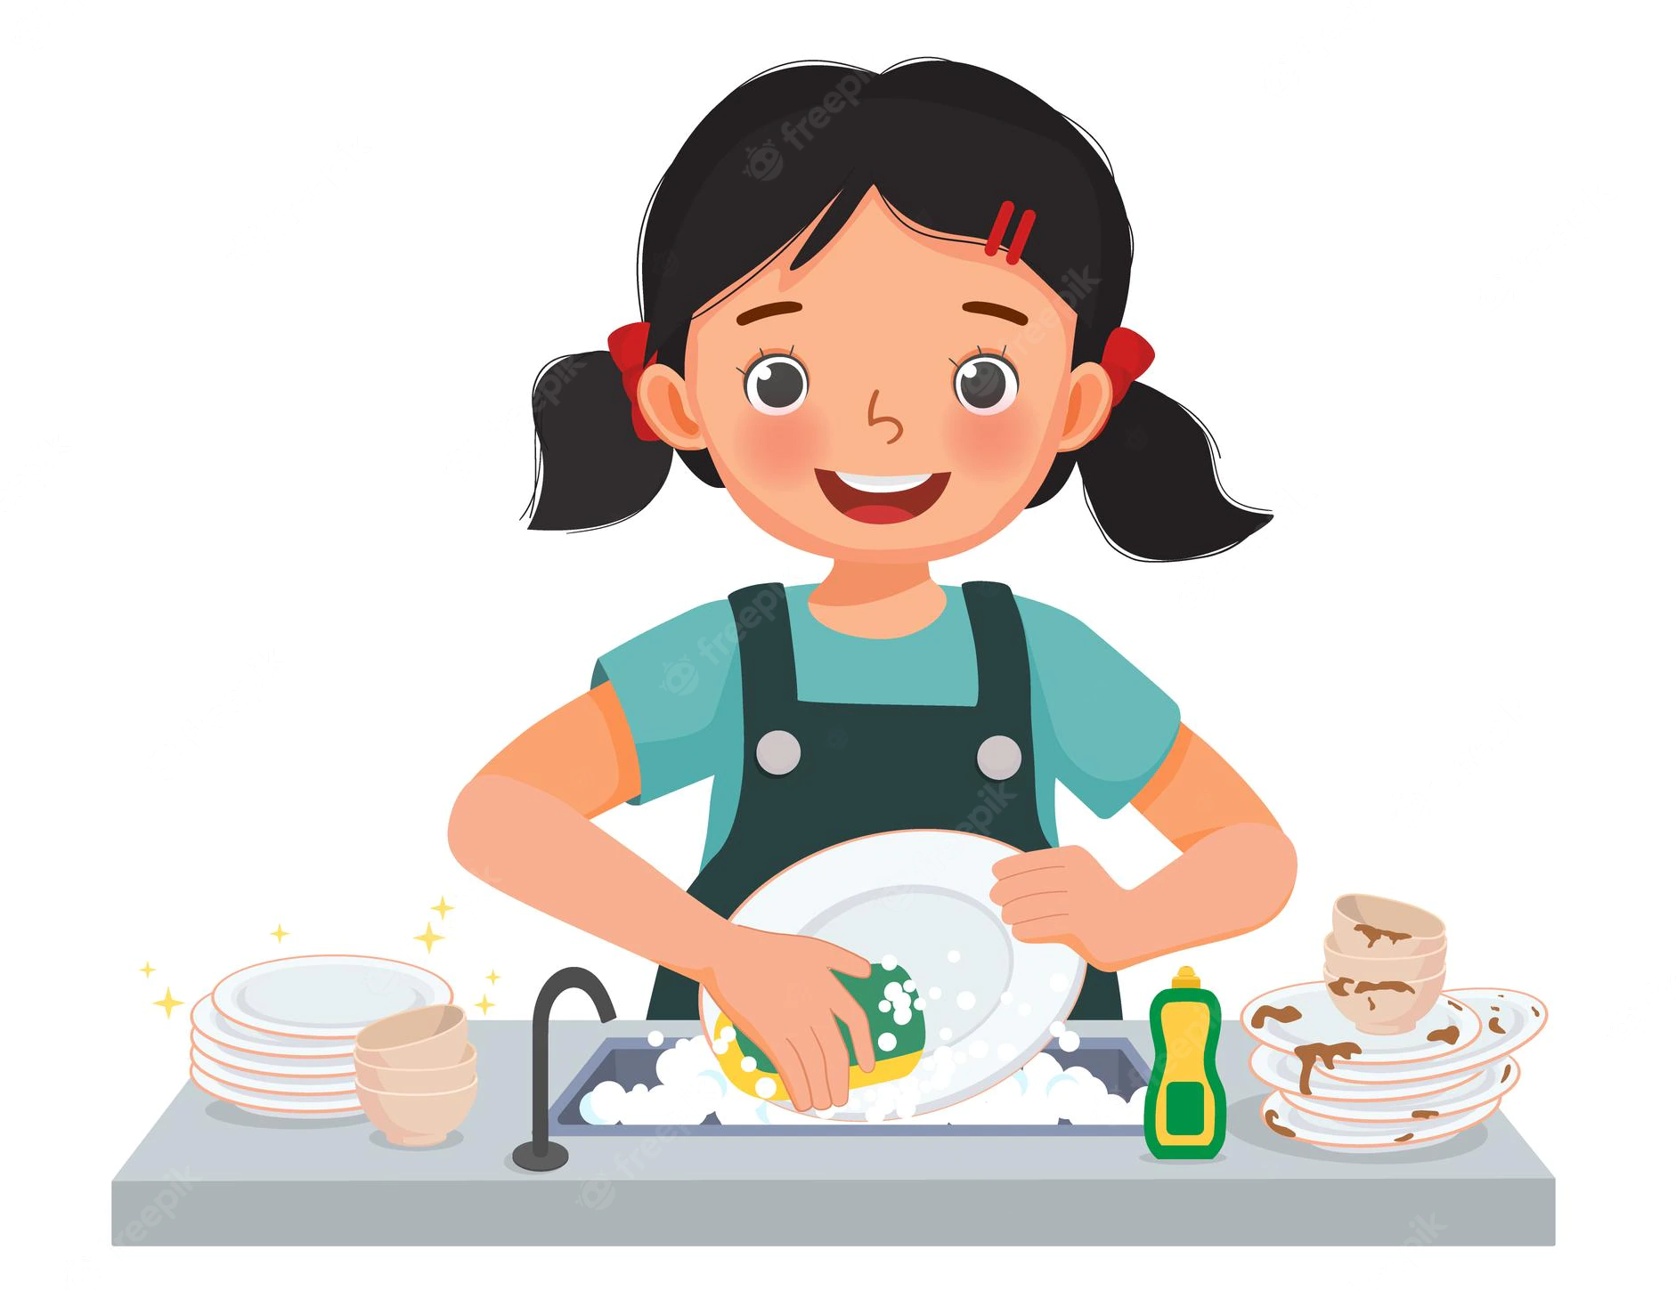
Wash the dishes .

Slide 8

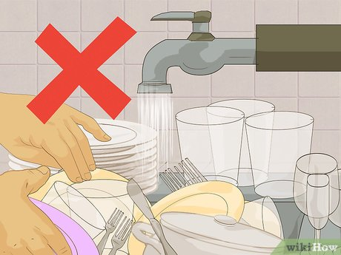

Is it a good behavior ?

Slide 9

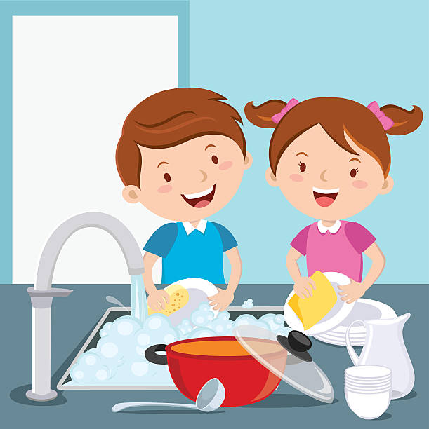

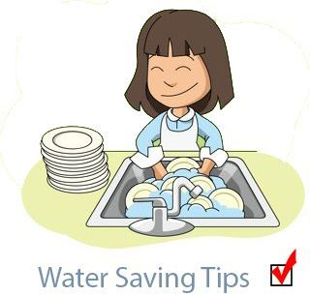

Save water
Turn off taps
after use.
do not let water run while washing dishes.

Slide 10
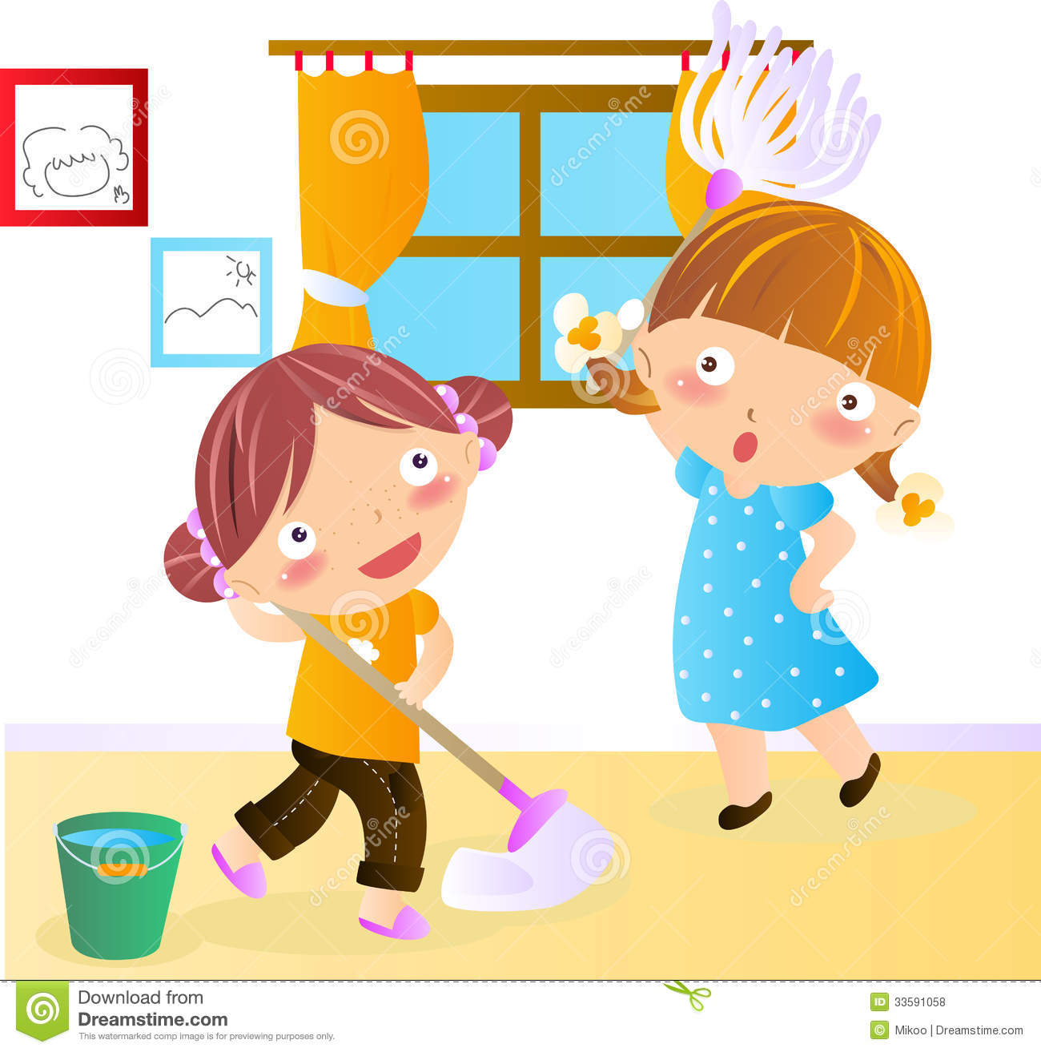
Clean up my room .

Slide 11


Take out the trash .

Slide 12
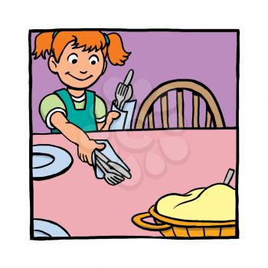

Set the table

Slide 13

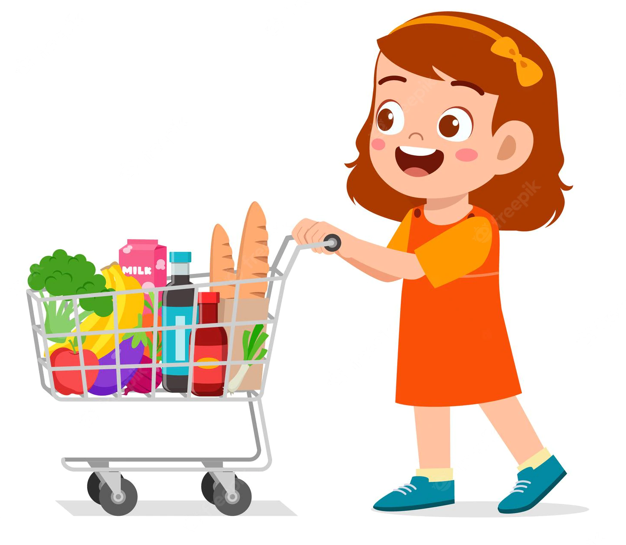
Go shopping .

Slide 14

Vacuum the floor .

Slide 15

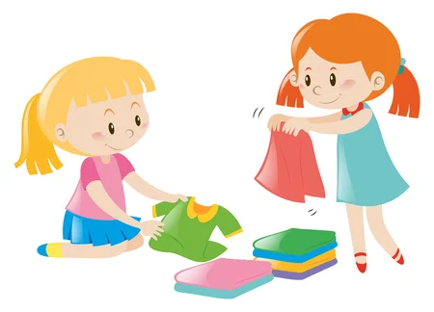
Fold the laundry

Slide 16


Slide 17

What chores do you do ?

Slide 18

Yes , I do .
No, I do not.
What chores do you do?
I …………………
Do you ……., too ?

Slide 19

Yes , she does .
No, she doesn’t.
What chores does your sister do?
She …………………
Does she ……., too ?

Slide 20
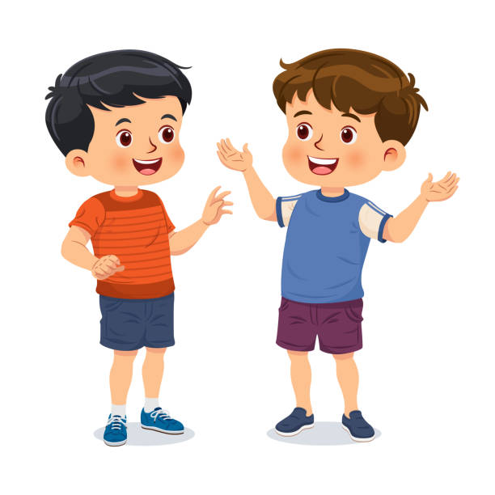
Yes , I do .
No, I do not.
What chores do you do?
I …………………
Do you ……., too ?

Slide 21

Yes , he does .
No, he does not.
What chores does your brother do?
He …………………
Do he ……., too ?

Slide 22
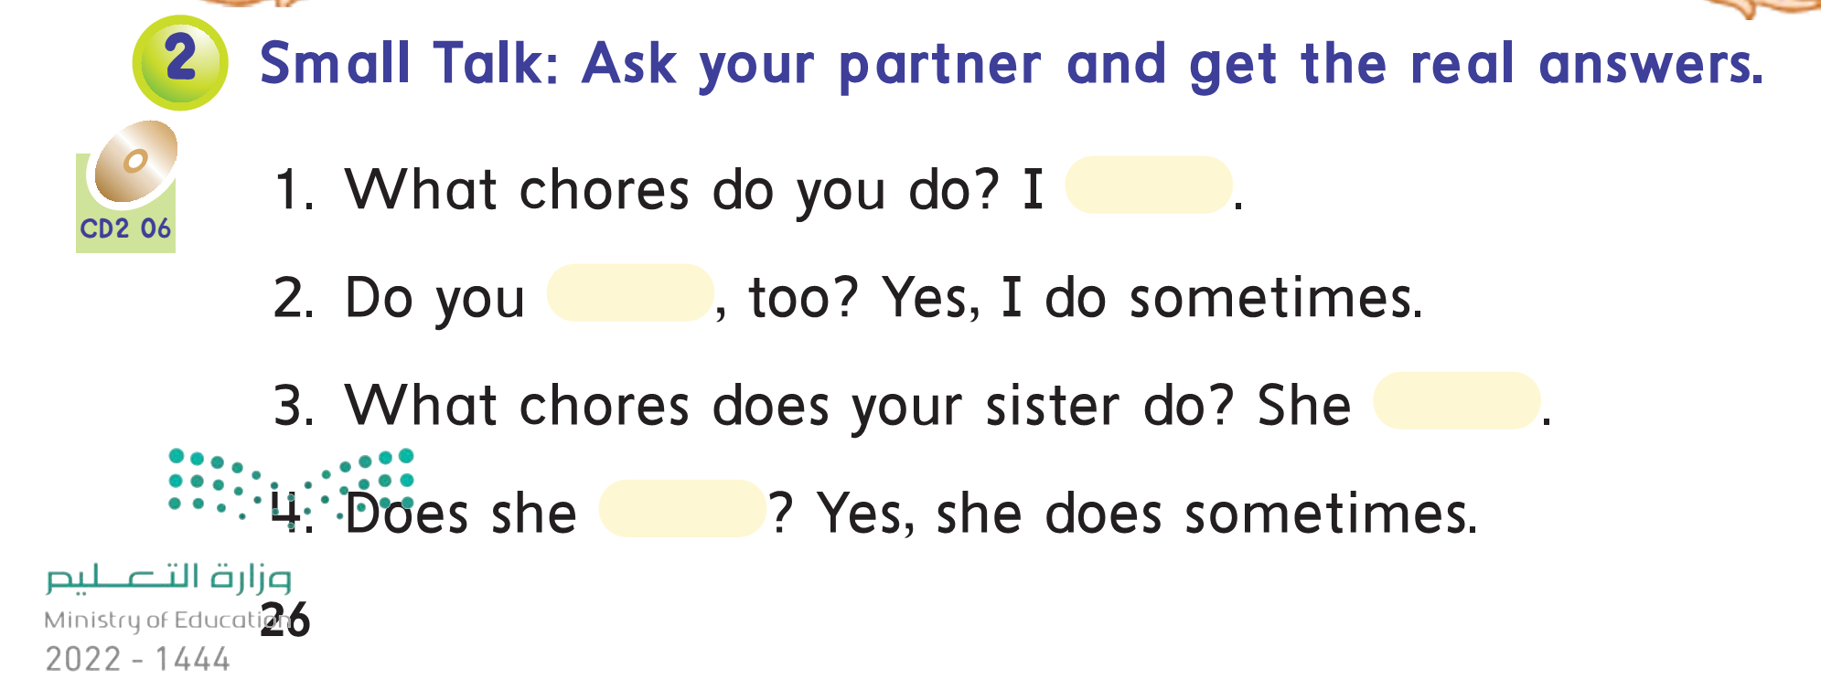

Slide 23
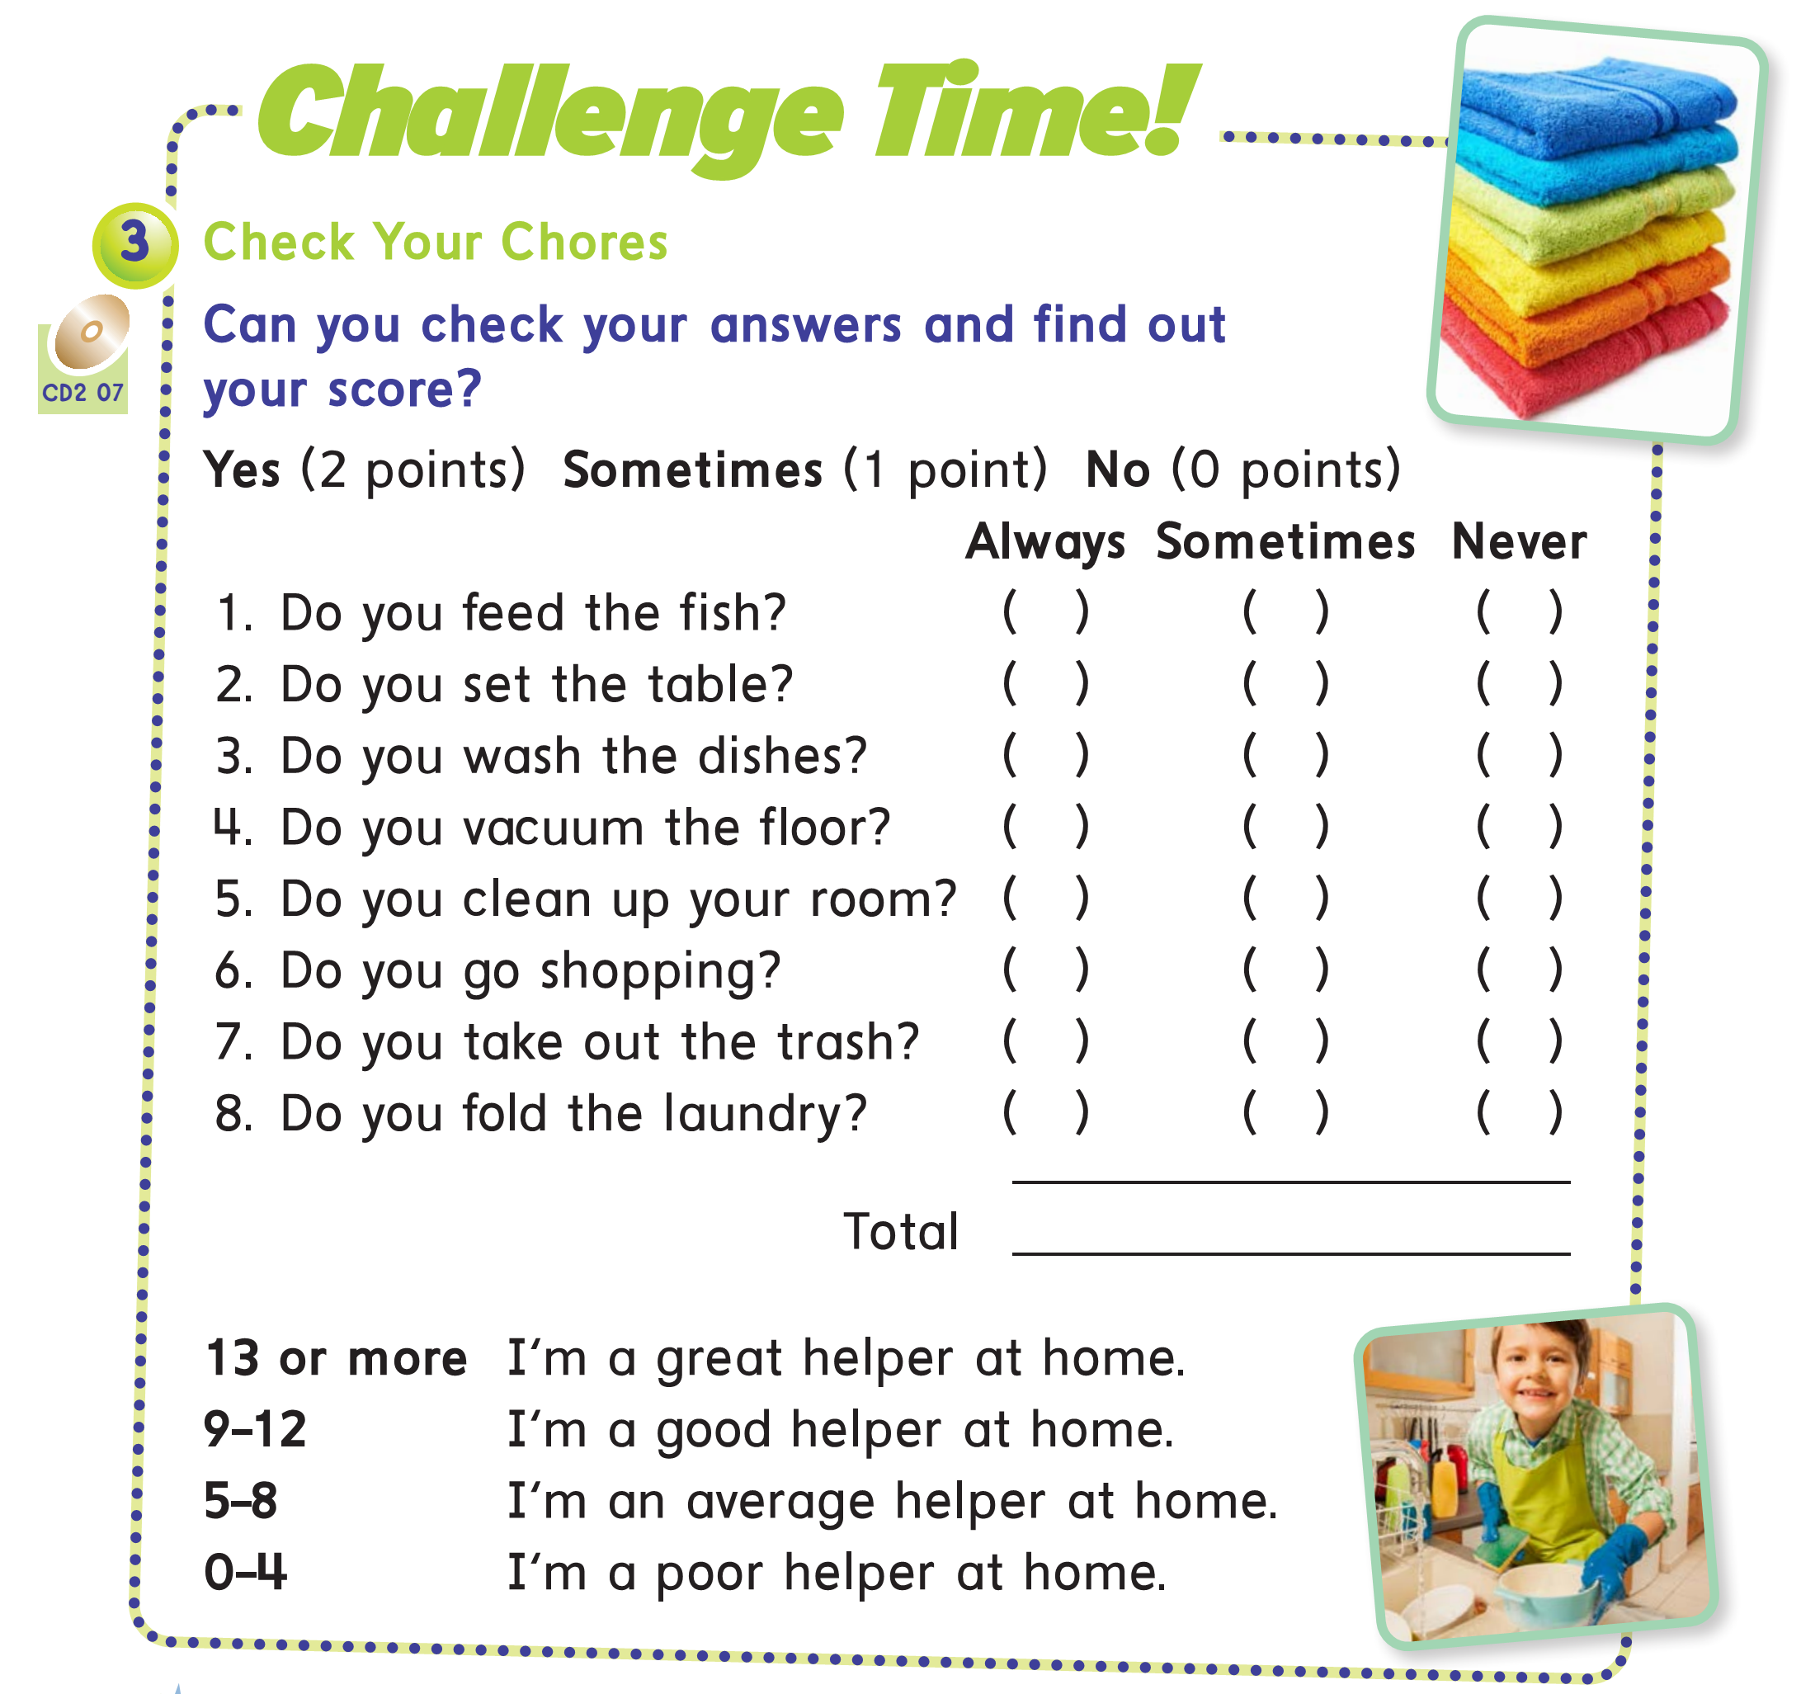

Slide 24


Slide 25

Workbook pages :163-164

Slide 26
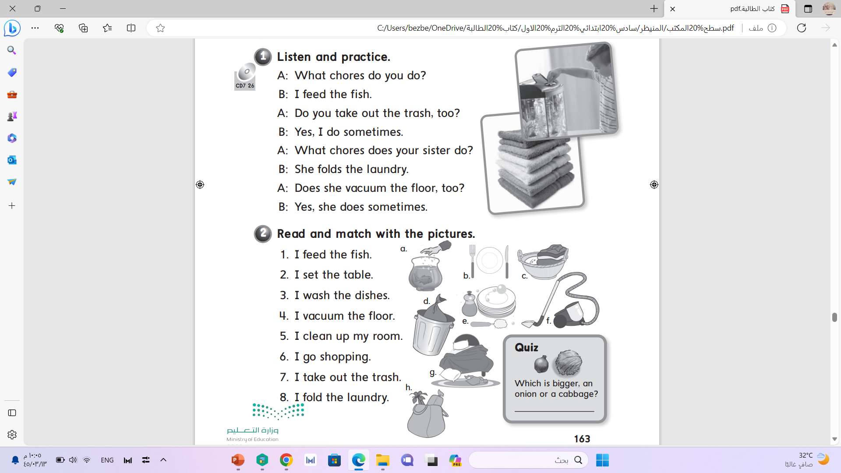

Slide 27
a
b
e
f
g
h
d
c
a cabbage

Slide 28
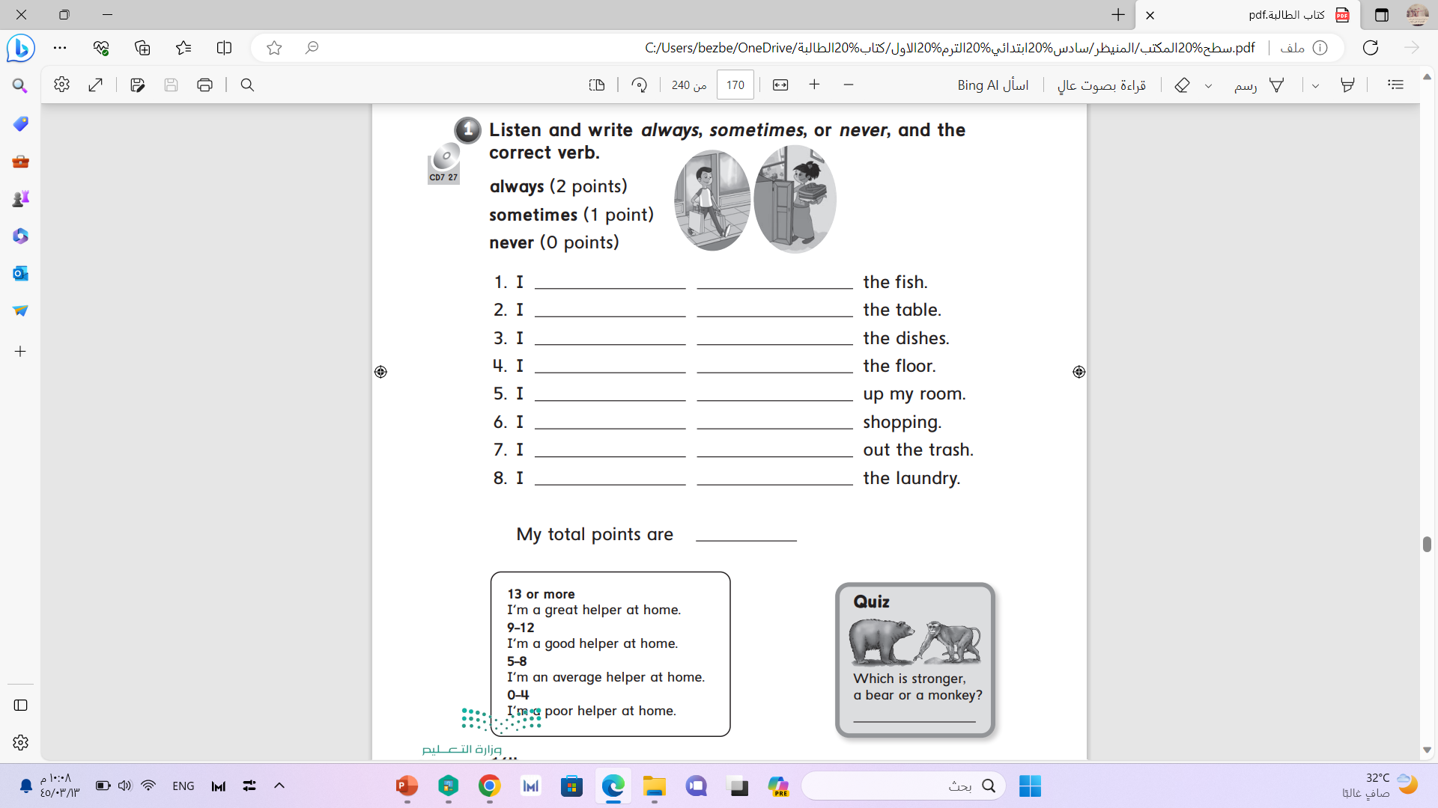

Slide 30


Slide 31


Slide 32
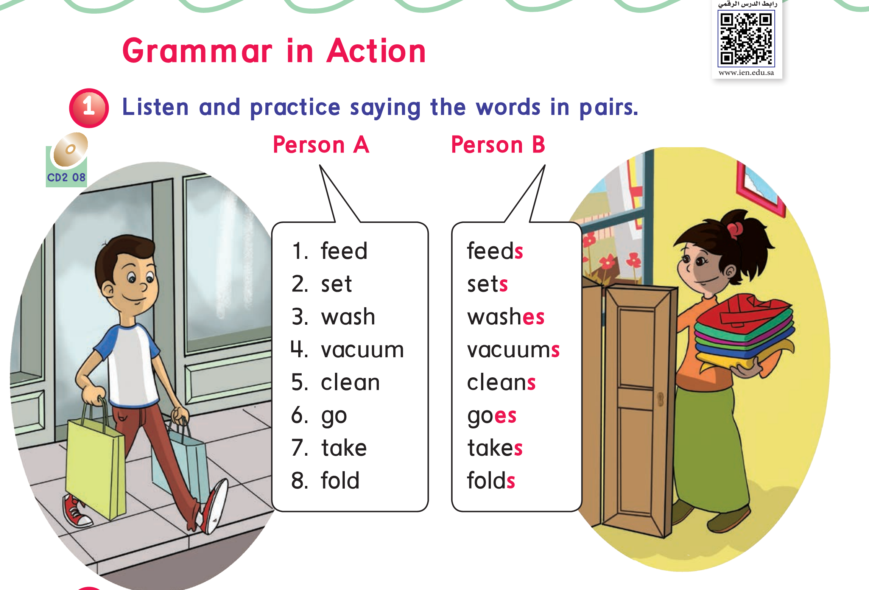

Slide 33
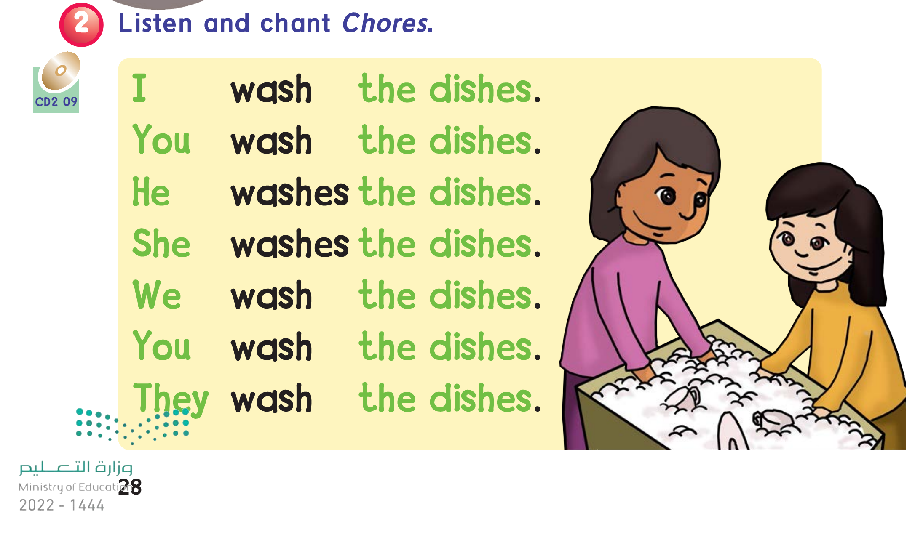

Slide 34
He
She
It
Verb + s
He washes the dishes .
She feeds the fish .
Verb + s
I
We
They
×
I wash the dishes .
They feed the fish .

Slide 35
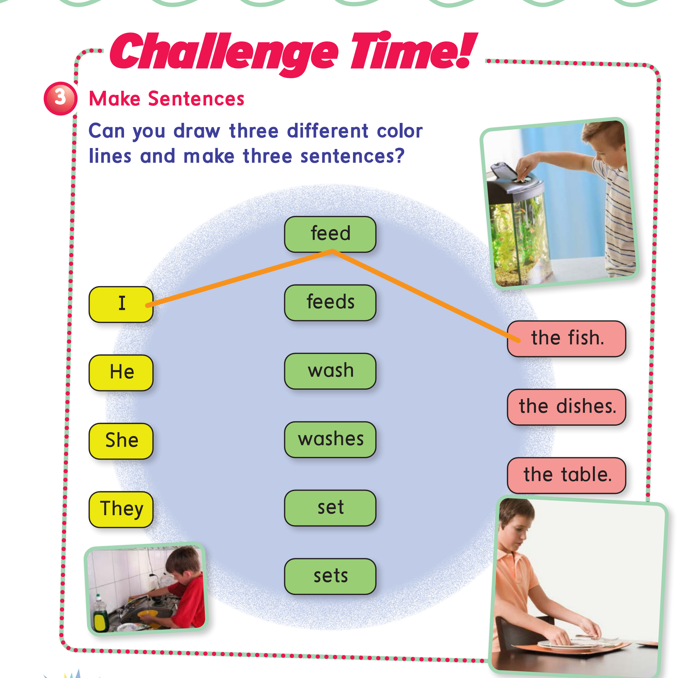

Slide 36

4th -5th -6th grade
3rd grade
Pages:40
Pages:104

Slide 37
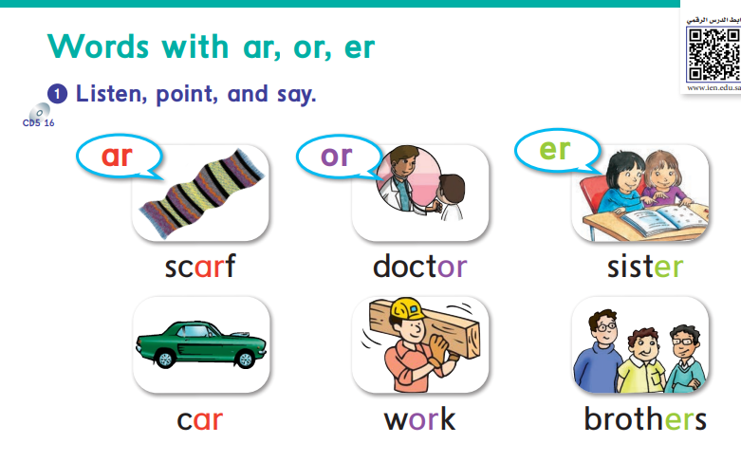

Slide 38
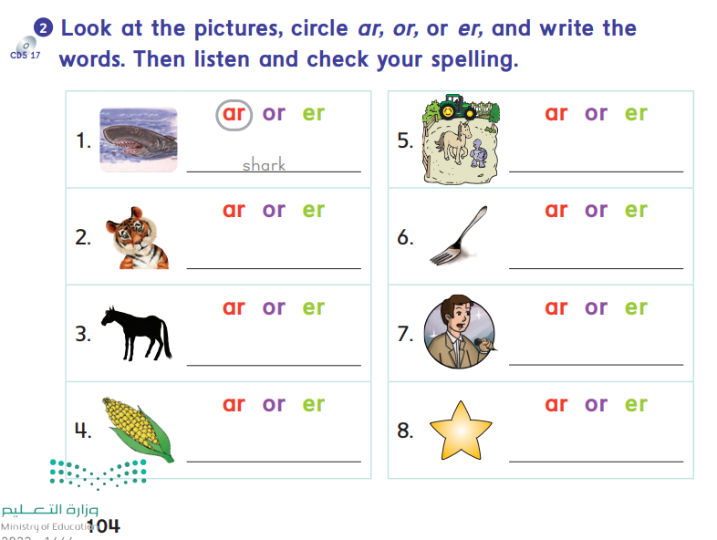
farm
tiger
fork
horse
reporter
corn
star

Slide 39
Workbook pages :165-166

Slide 40
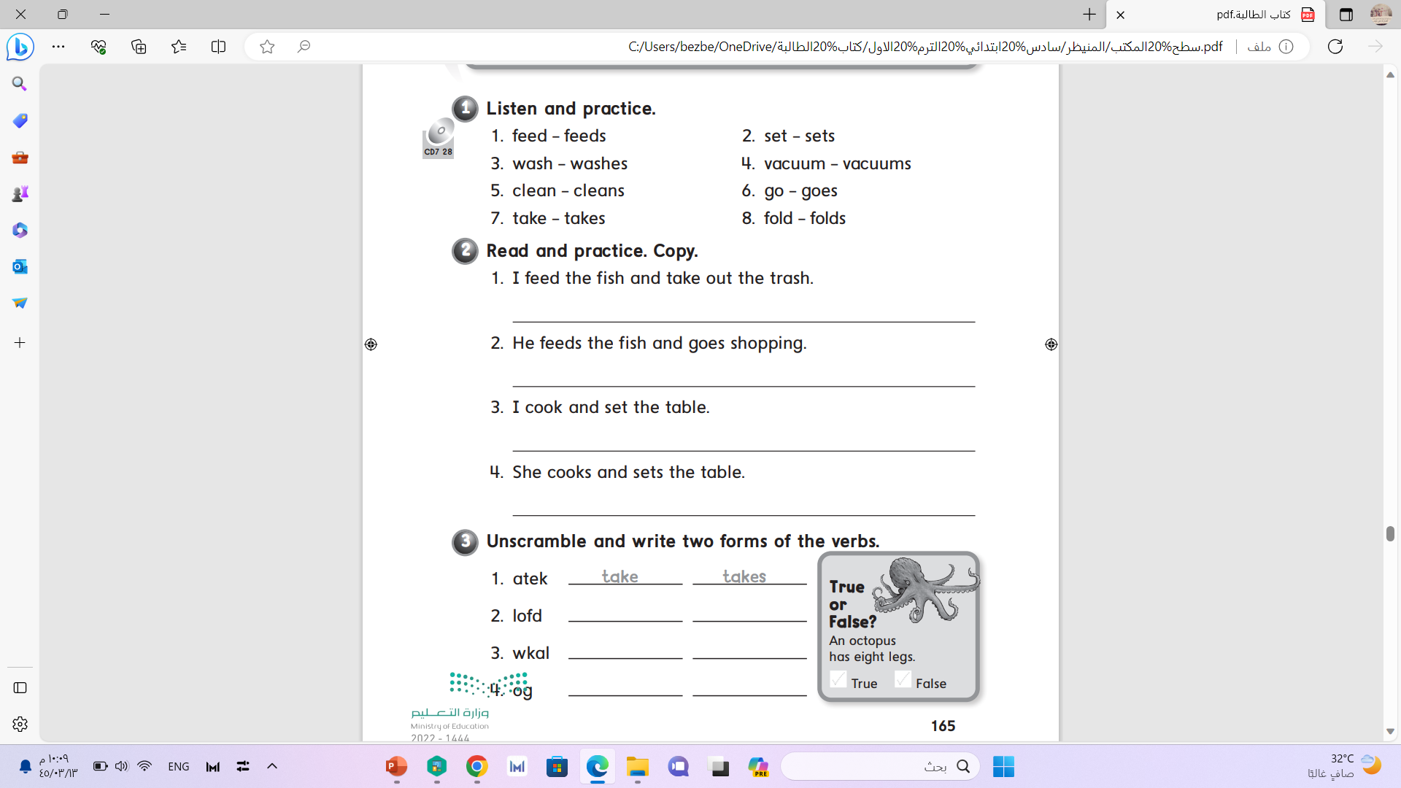

Slide 41
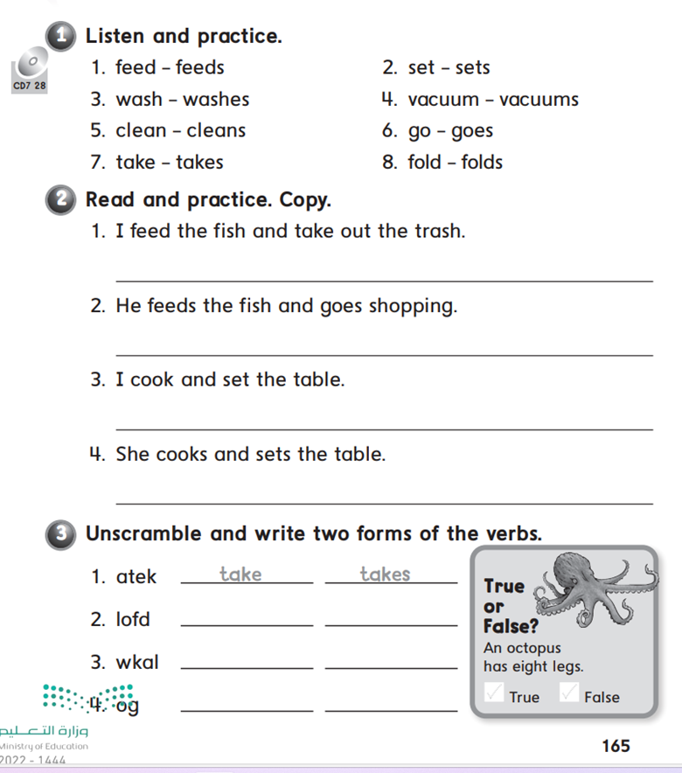

Slide 42
fold
folds
walk
walks
✓
go
goes

Slide 43


Slide 44


Slide 45


Slide 46
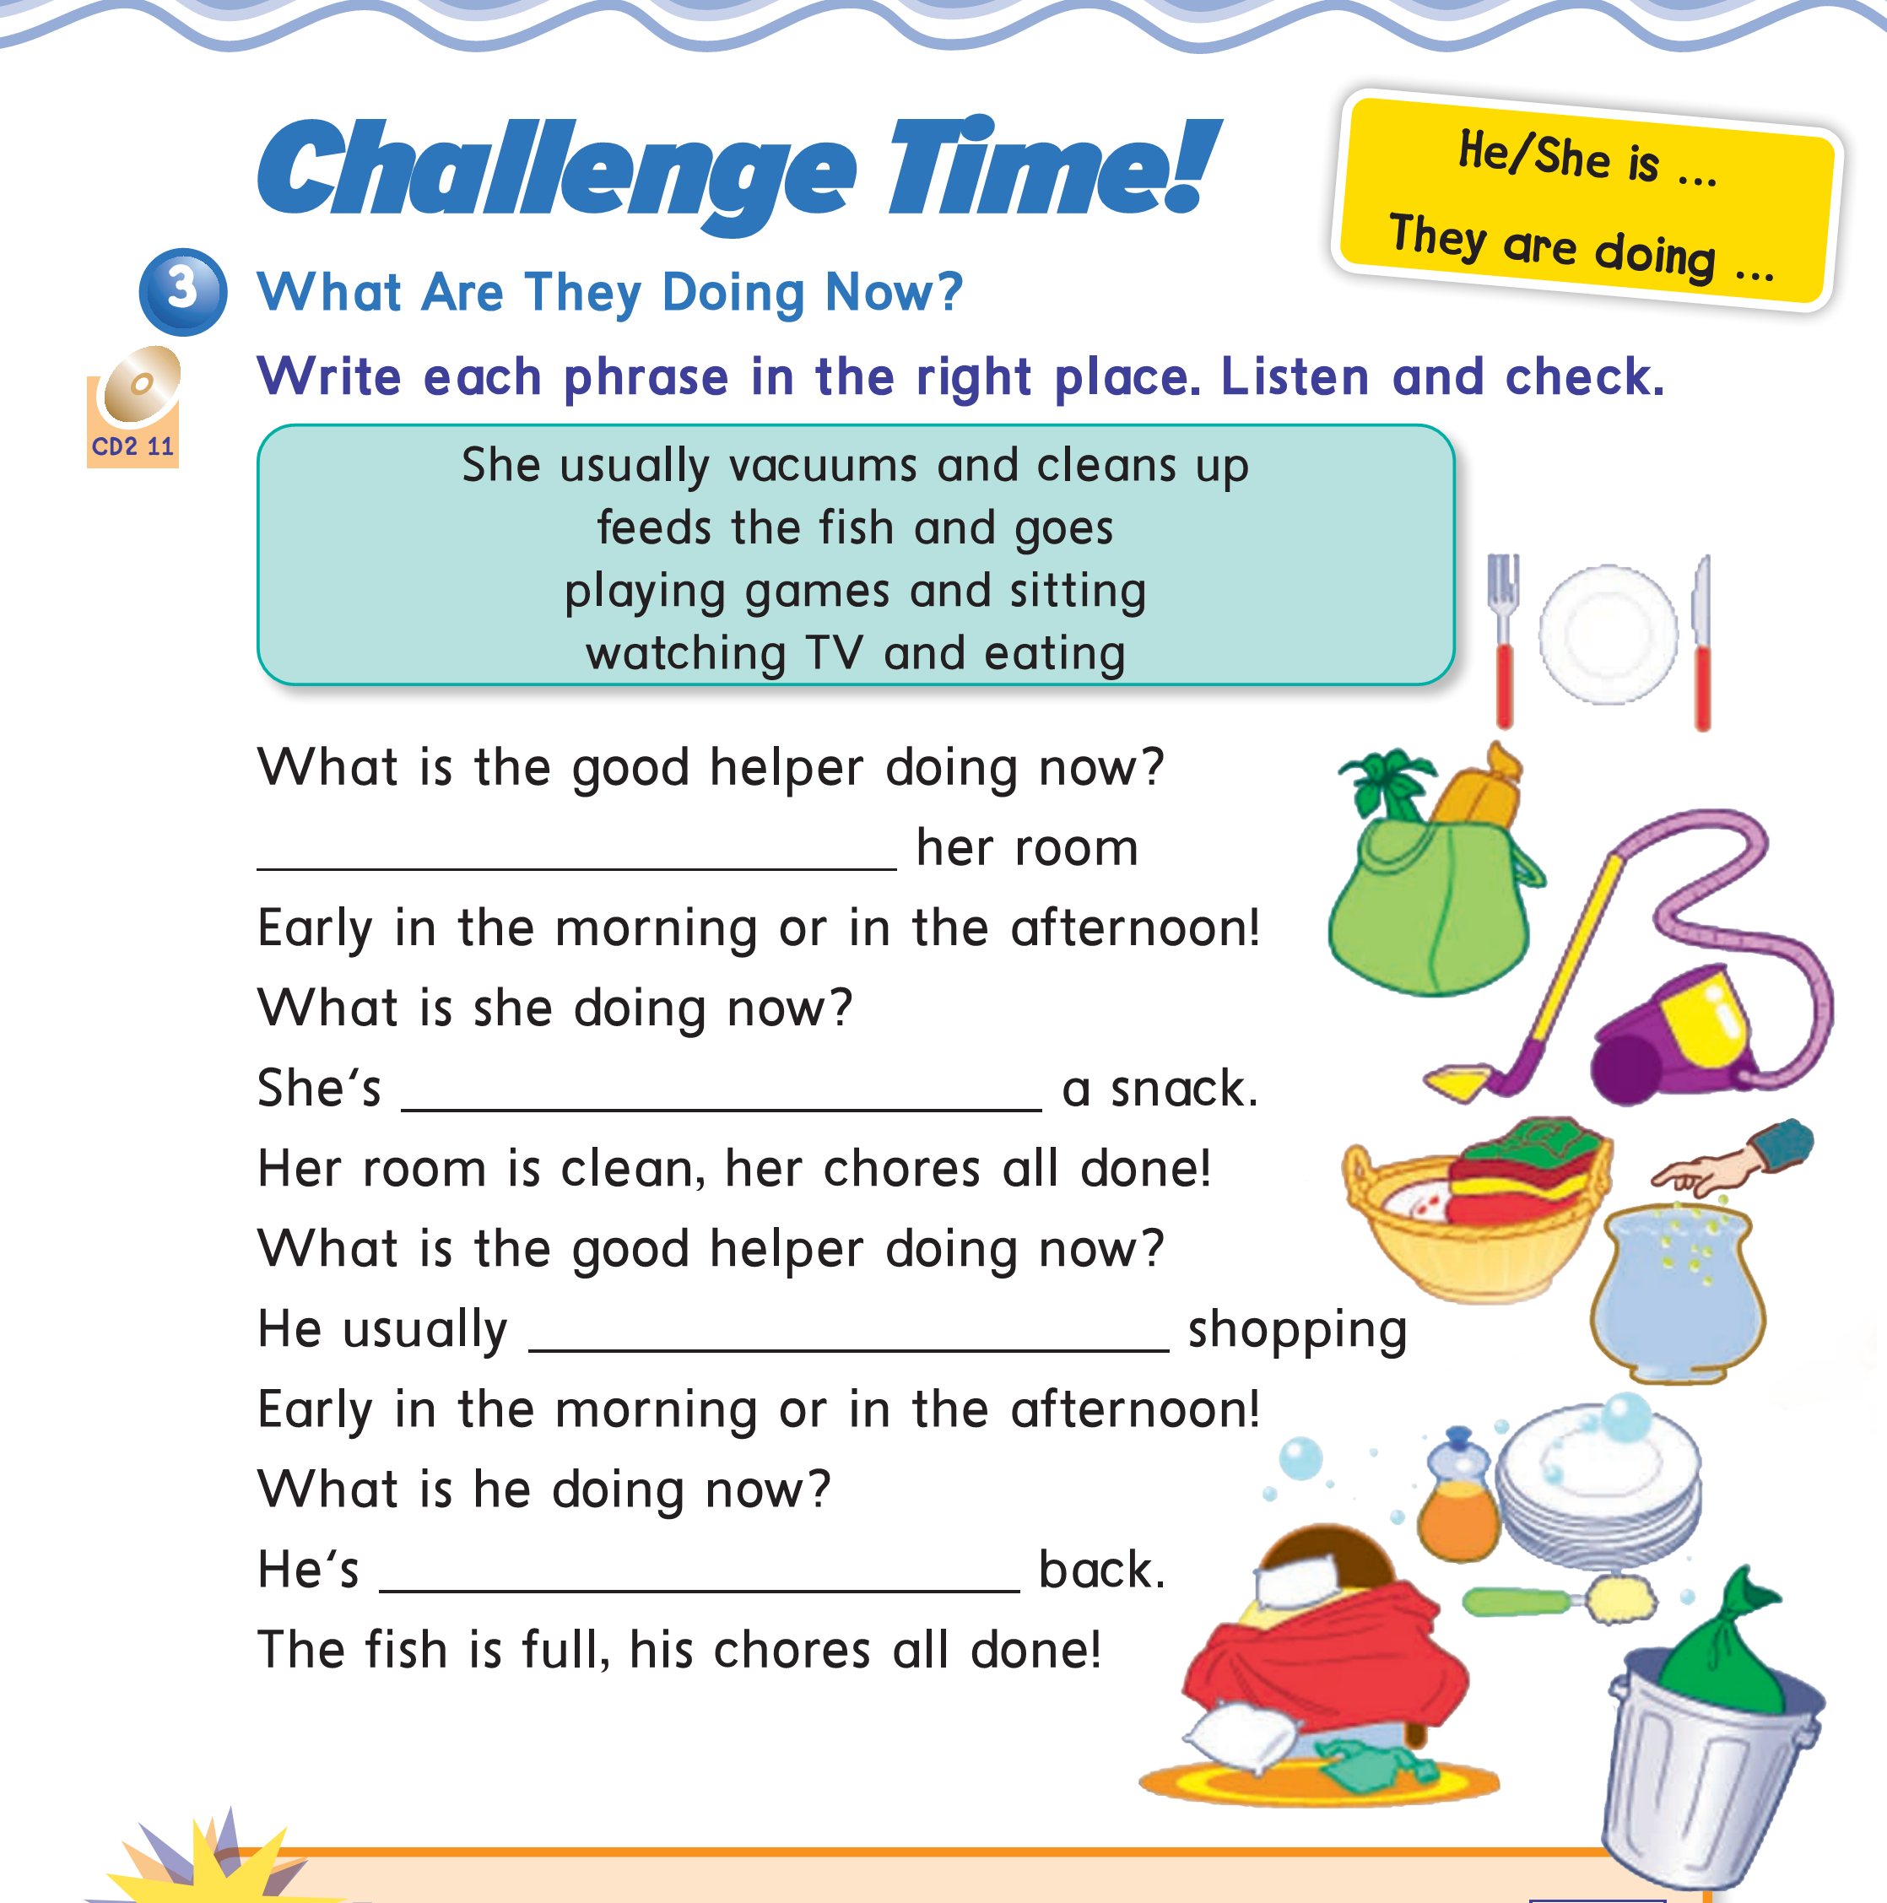
She usually vacuums and cleans up
watching TV and eating
Feeds the fish and go
Playing games and sitting

Slide 47
Workbook pages :167-168

Slide 48
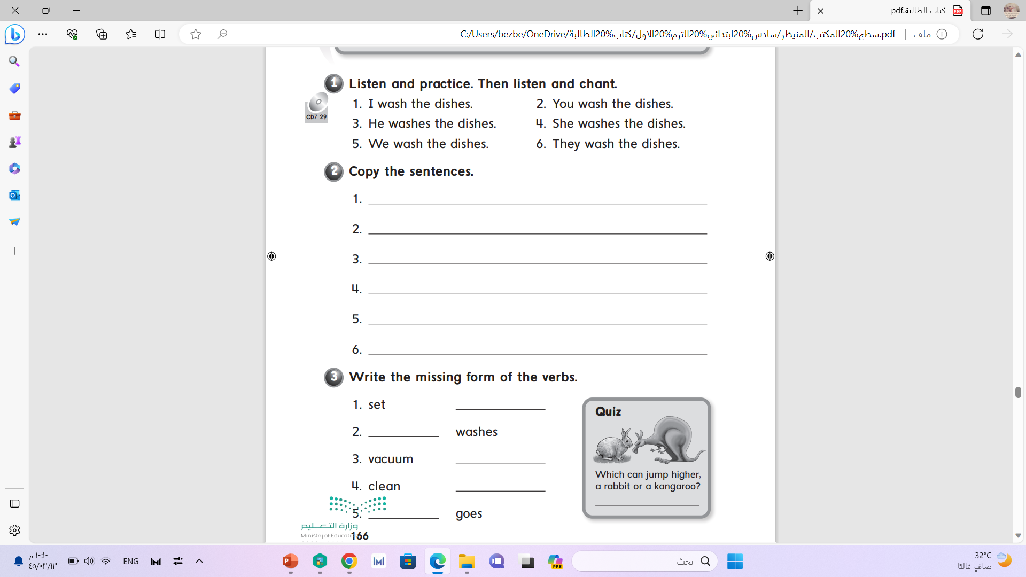

Slide 49
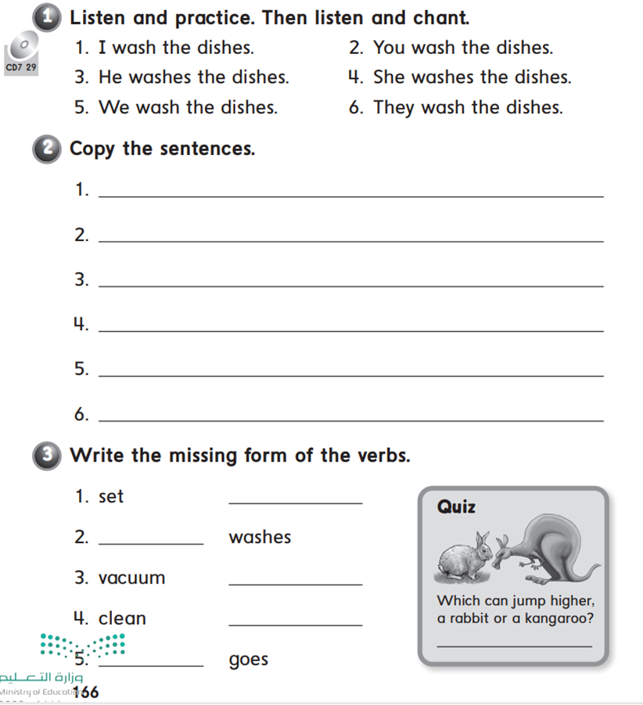
sets
wash
vacuums
cleans
go

Slide 50
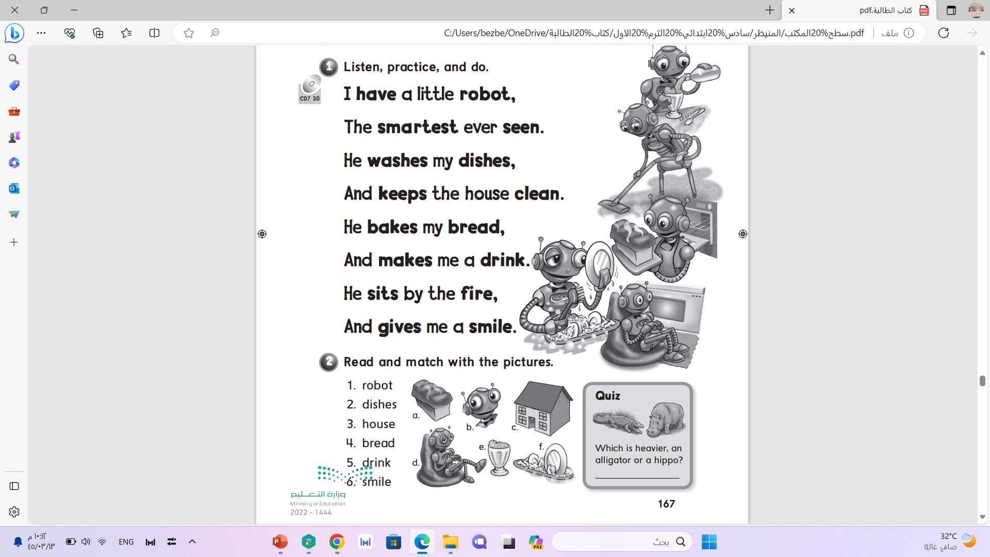

Slide 51
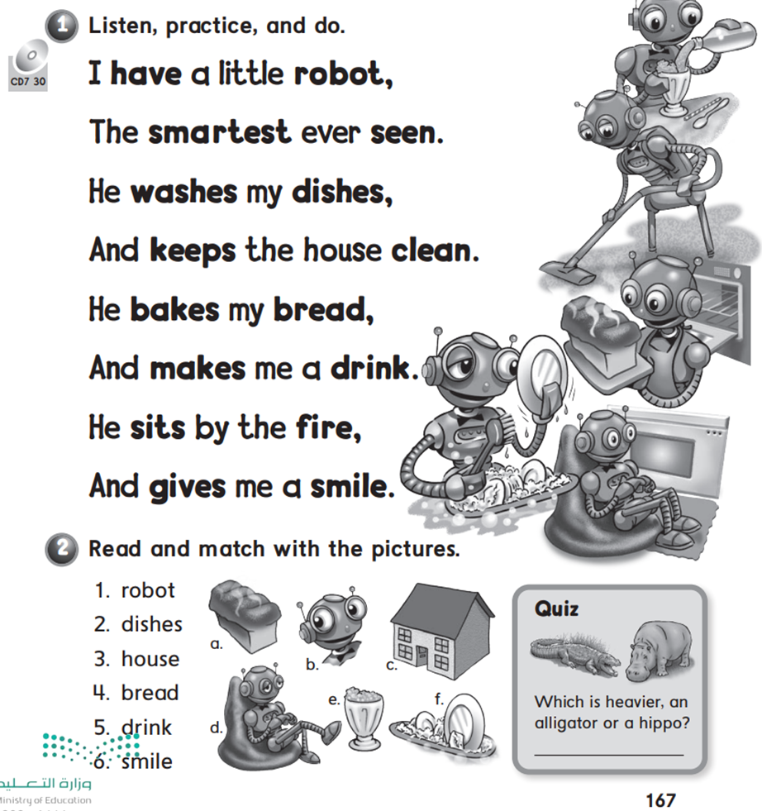
d
f
c
a
e
b

Slide 52
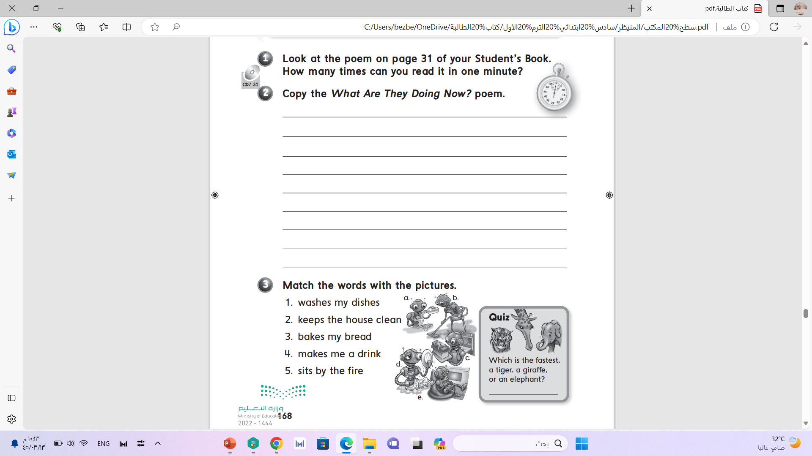

Slide 53
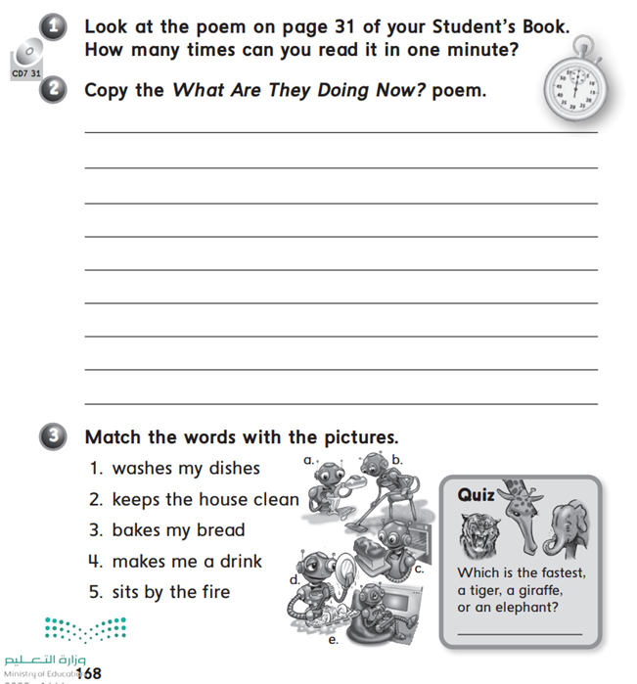
d
b
c
a
e

Slide 54


Slide 55


Slide 56


or
ar
er

Slide 57
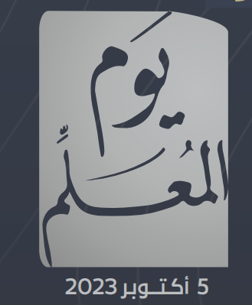
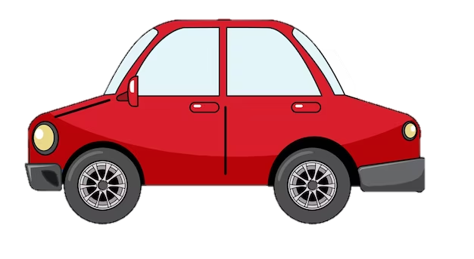

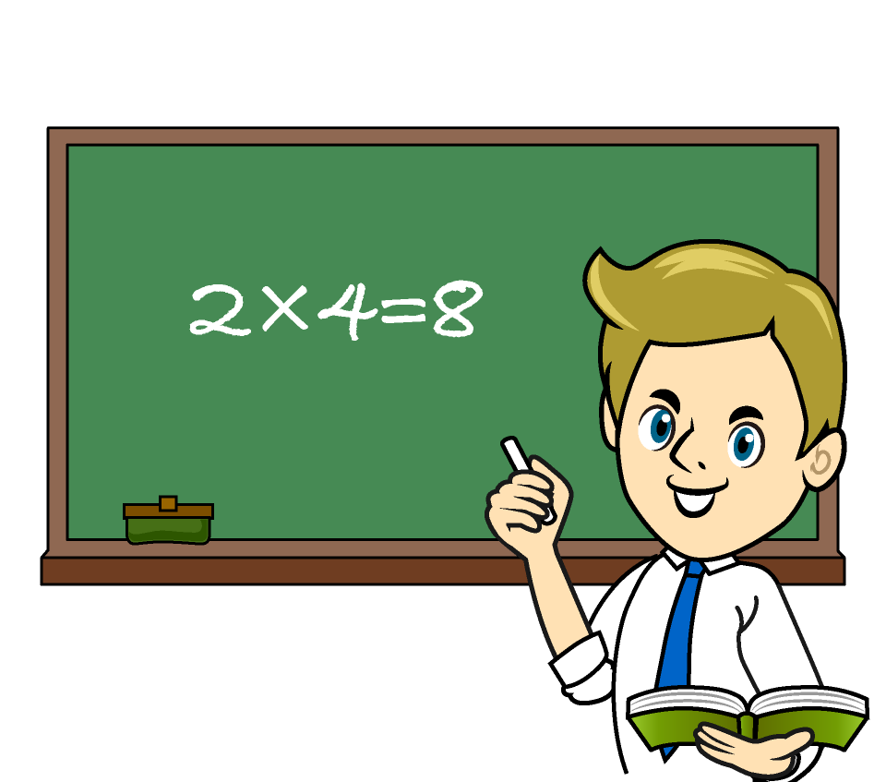
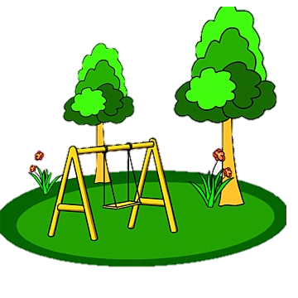


ar
or
er
car
doctor
teacher
park
fork
sister

Slide 58
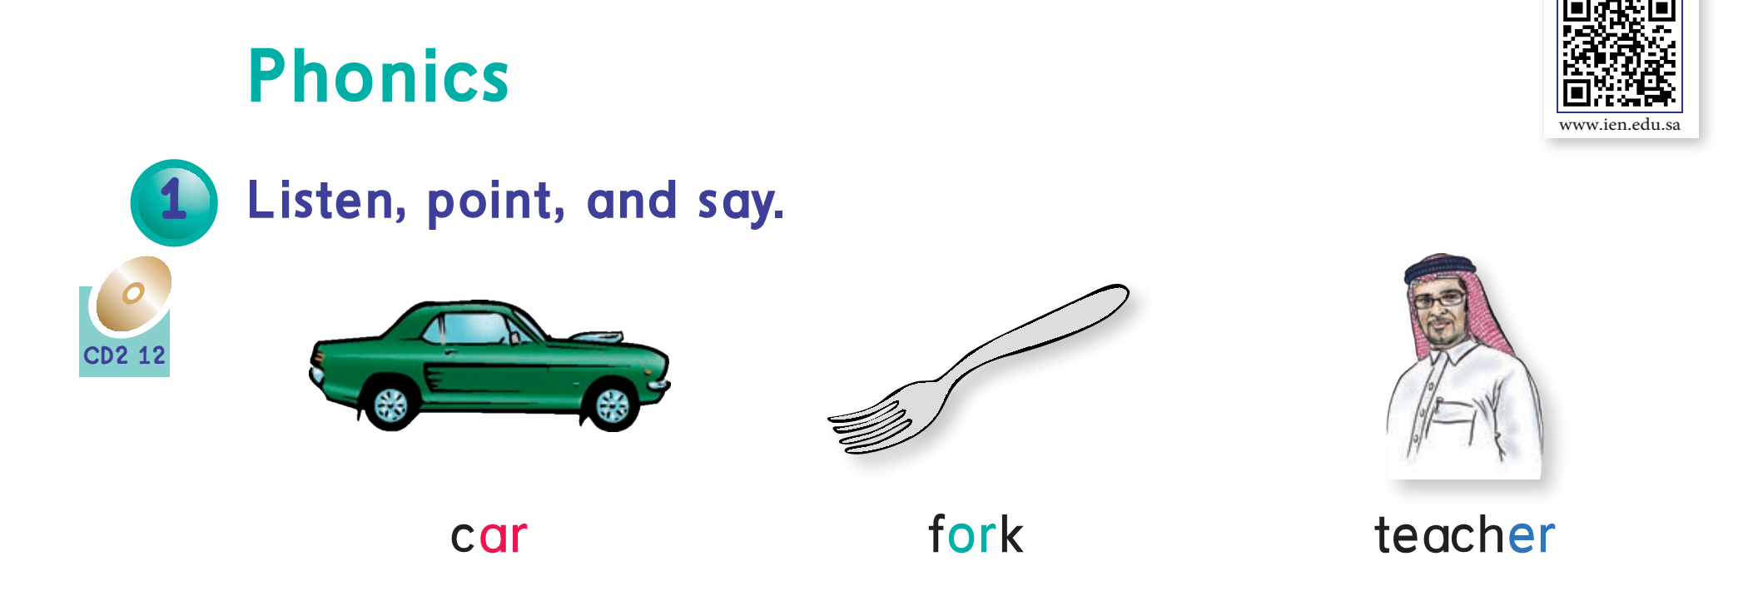

Slide 59
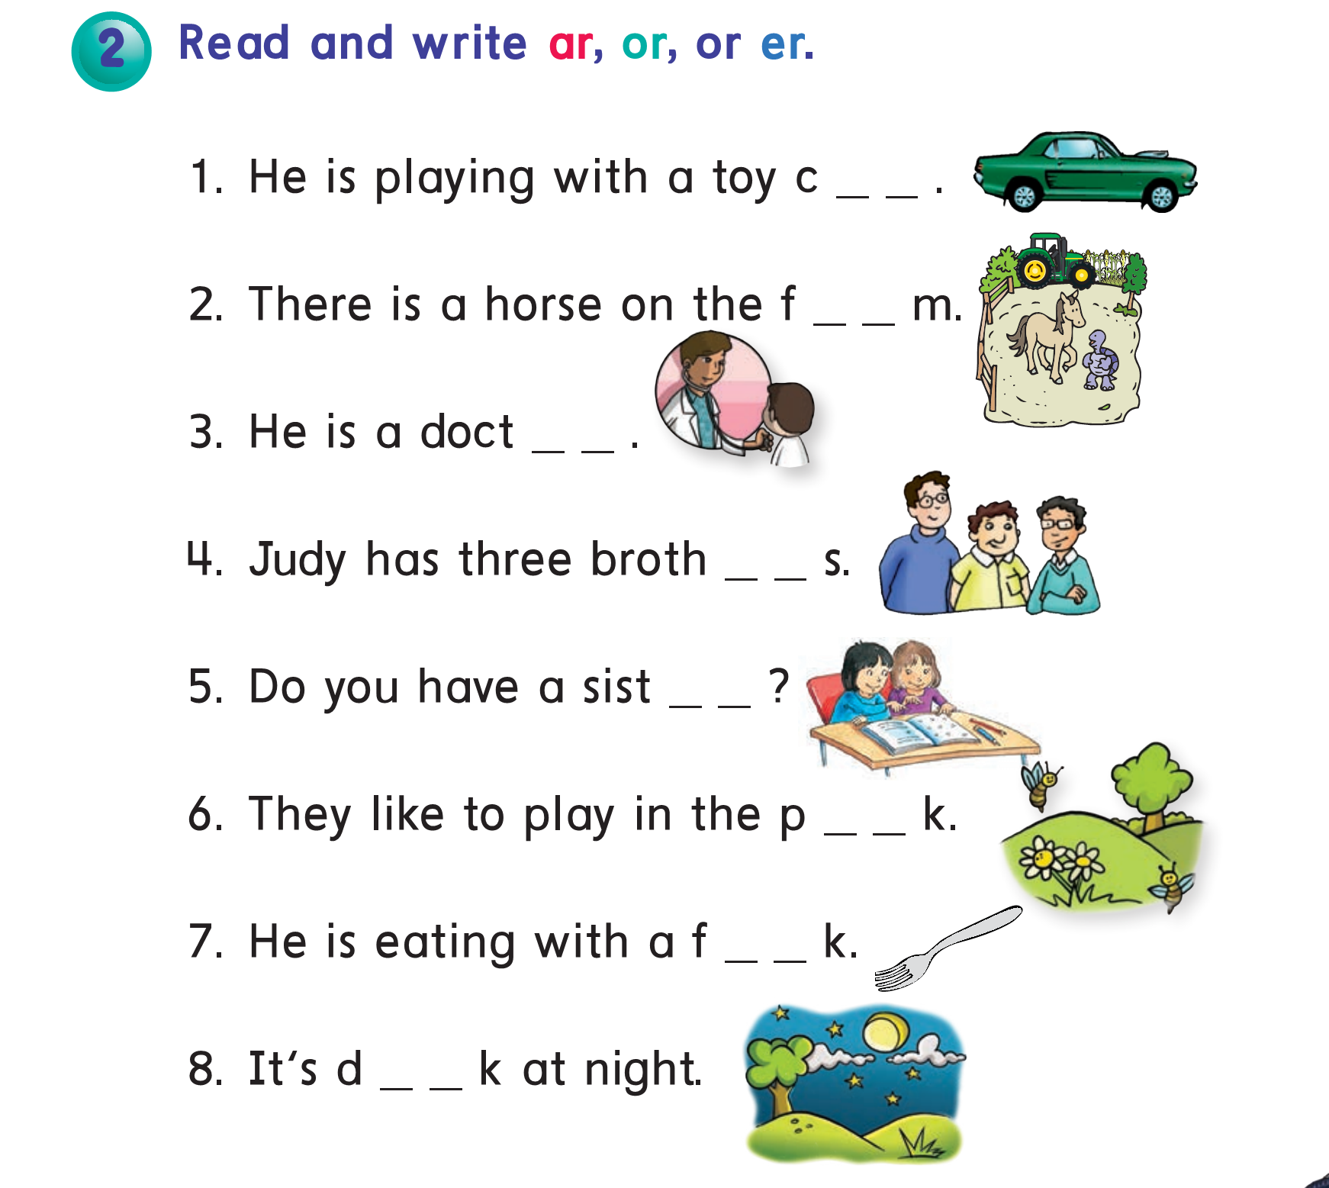
ar
ar
or
er
er
ar
or
ar

Slide 60


Slide 61

How do you spell
Fork?
F-o-r-k

Slide 62
How do you spell
Farm?
F-a-r-m

Slide 63
How do you spell
Teacher?
T-e-a-c-h-e-r

Slide 64
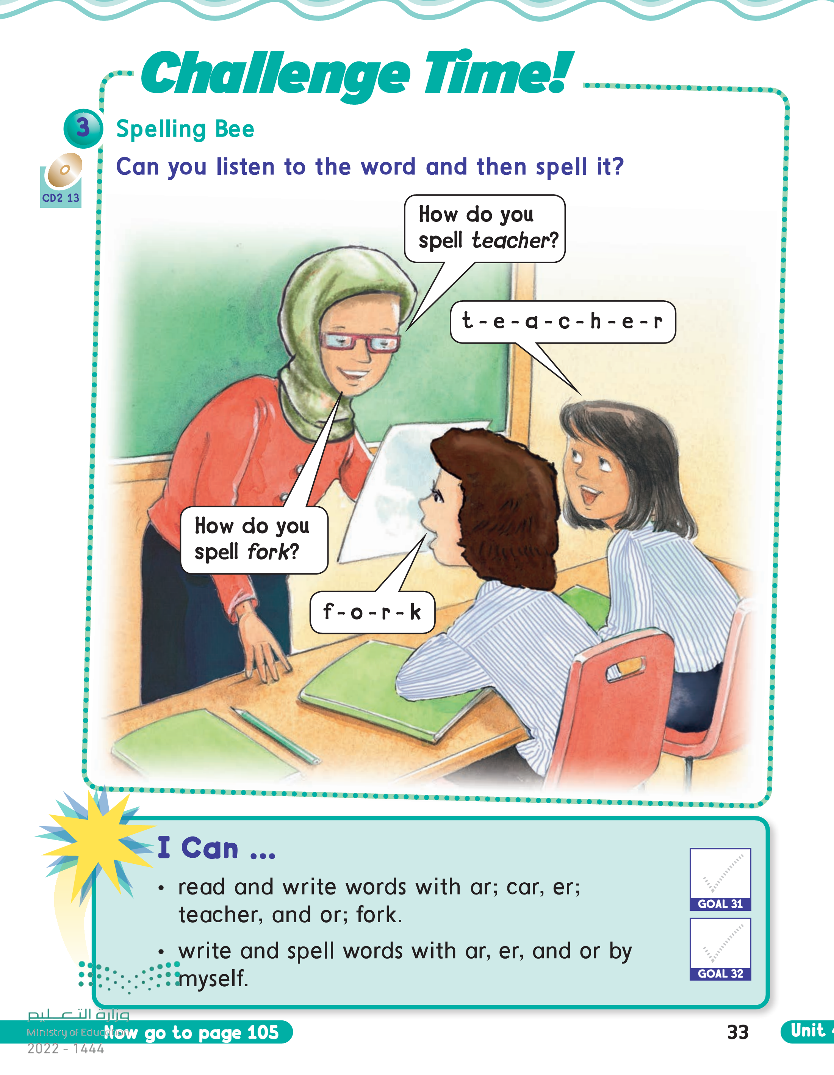

Slide 65
4th -5th -6th grade
3rd grade
Pages:41
Pages:105

Slide 66
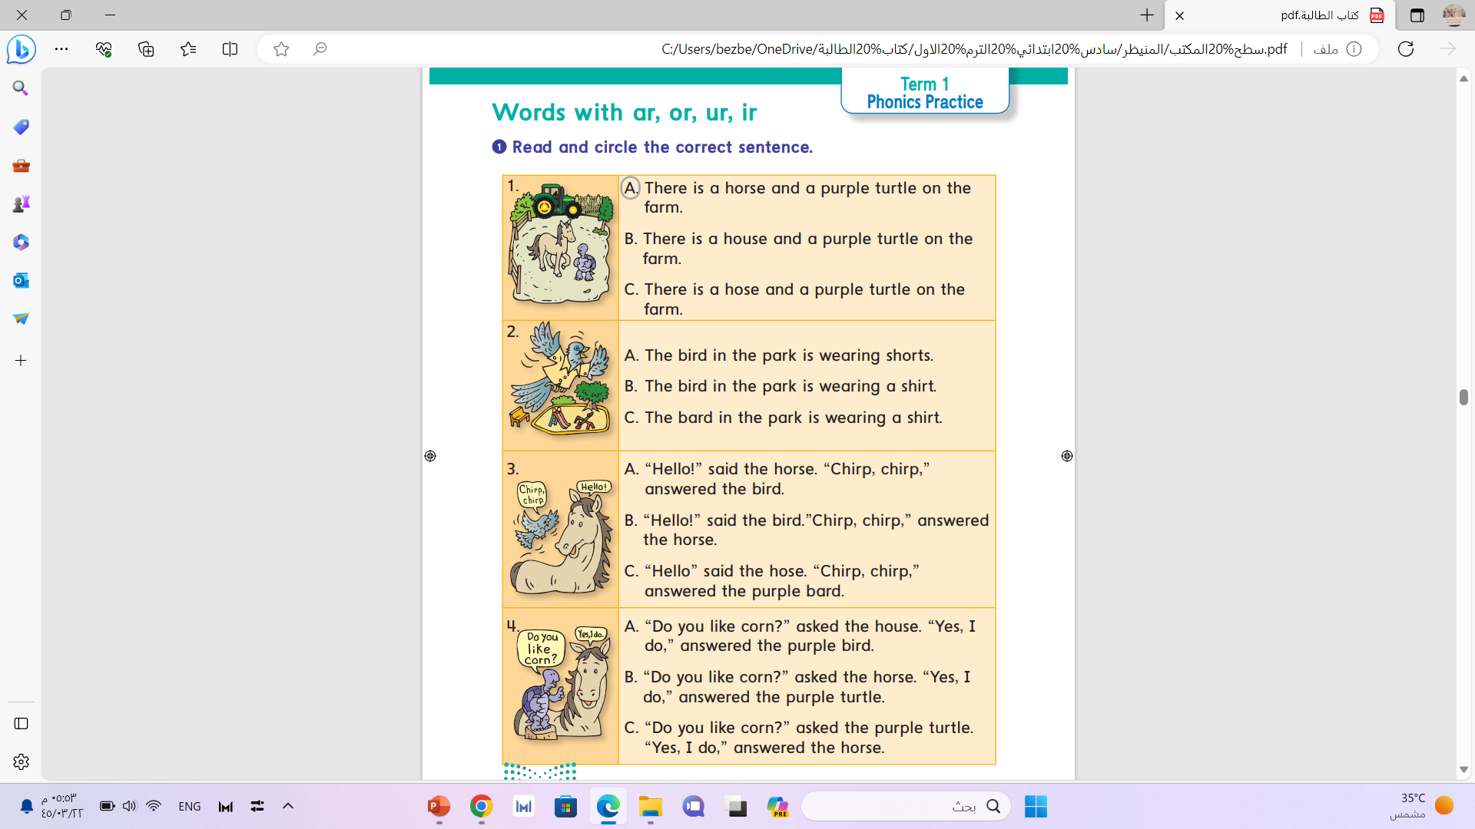

Slide 68
Workbook pages :169-170

Slide 69
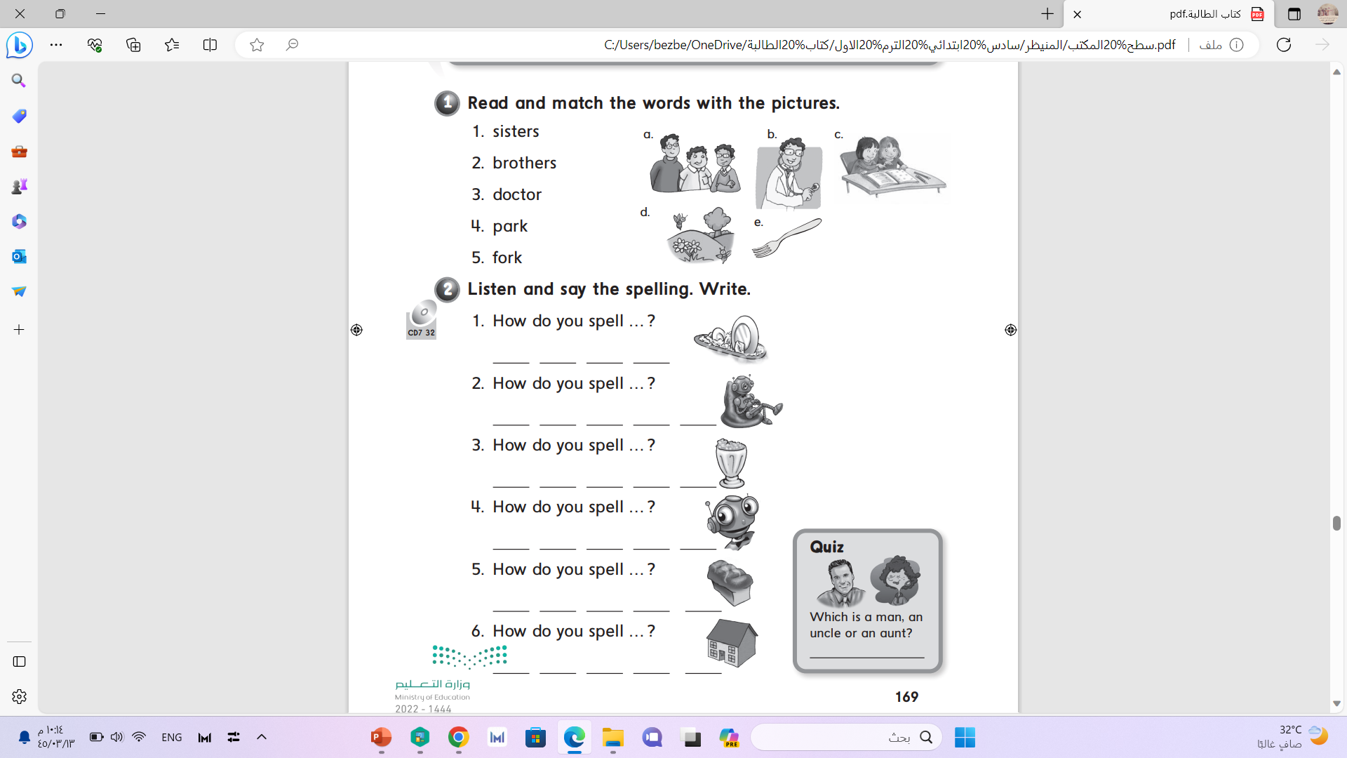
c
a
b
d
e

Slide 70
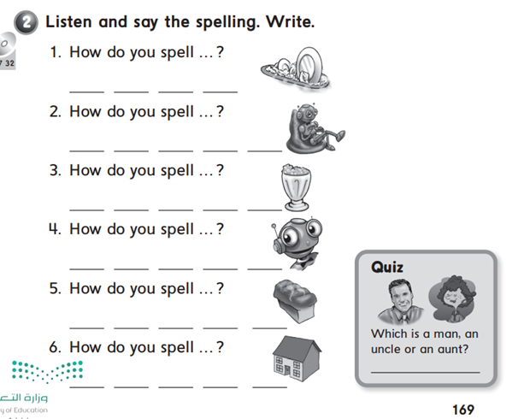
w a s h
r o b o t
d r i n k
s m i l e
b r e a d
h o u s e

Slide 71
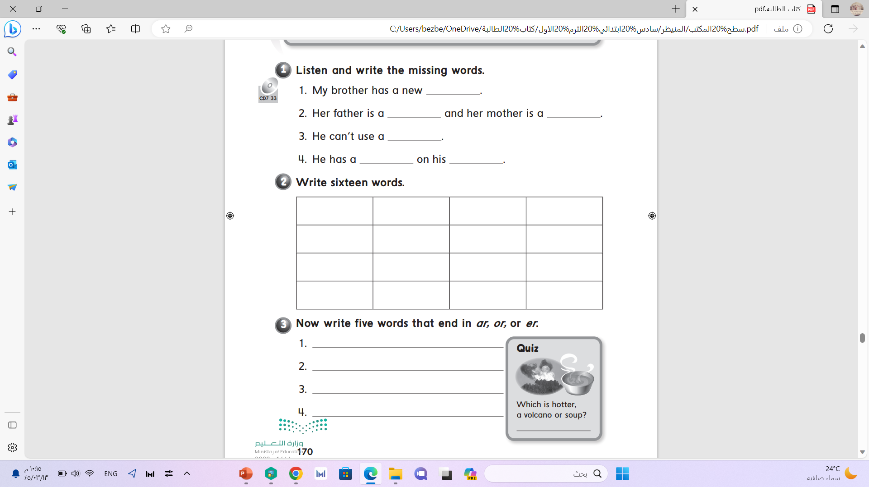
car
doctor
teacher
computer
horse
farm

Slide 72
