Slide 1

Done by : Hissah Alotaibi
Done by : Hissah Alotaibi

Slide 2
Good Morning

Slide 3

Unit-4-
The Art of Advertising
4 Language in Context
5 Listening
6 Pronunciation

Slide 4

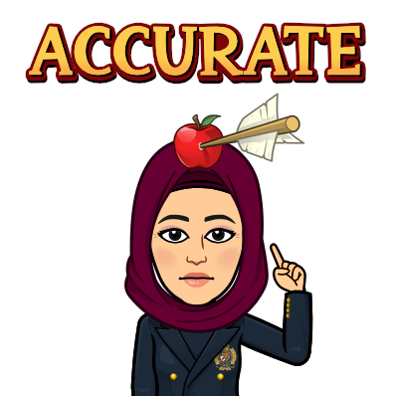
Objectives:
1
Match the products with the function students hear
2
Find answers for the general information
3
Find example of C+V and C+C sounds

Slide 5
4 Language in Context

Slide 6
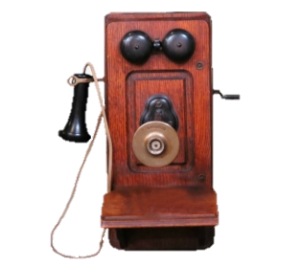
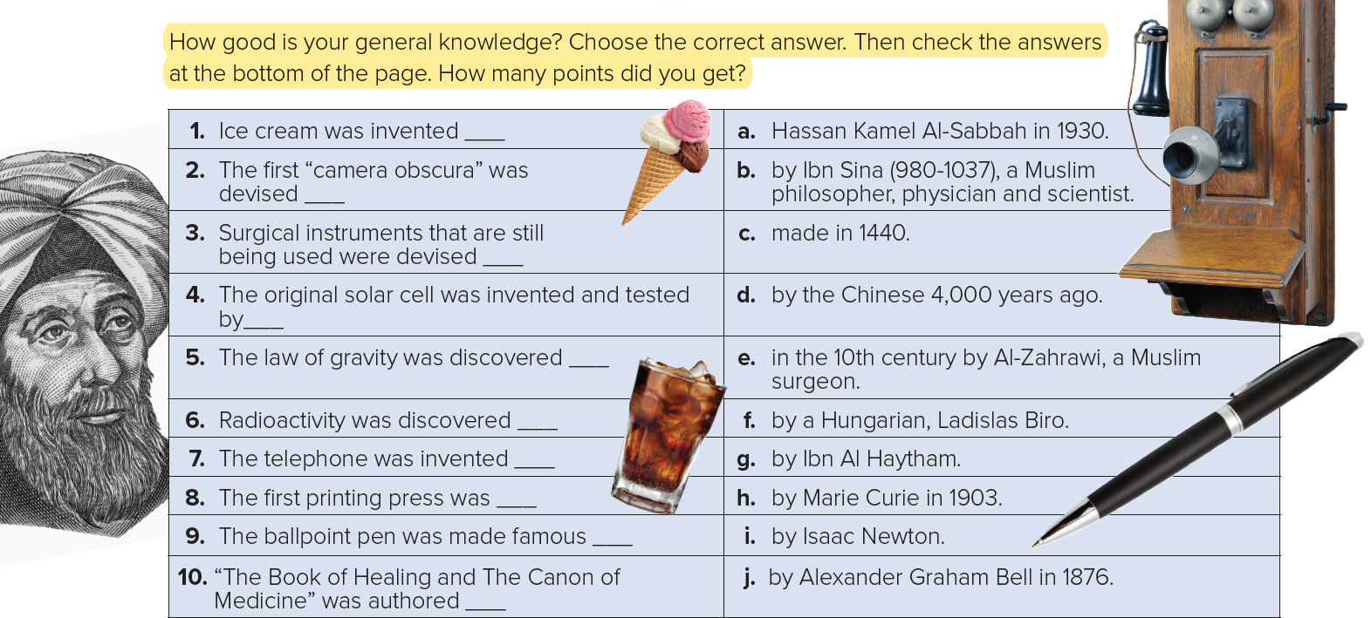
How good is your general knowledge? Choose the correct answer. Then check the answers at the bottom of the page. How many points did you get?
d
g
e
a
i
h
j
c
f
b

Slide 7
5 Listening

Slide 8



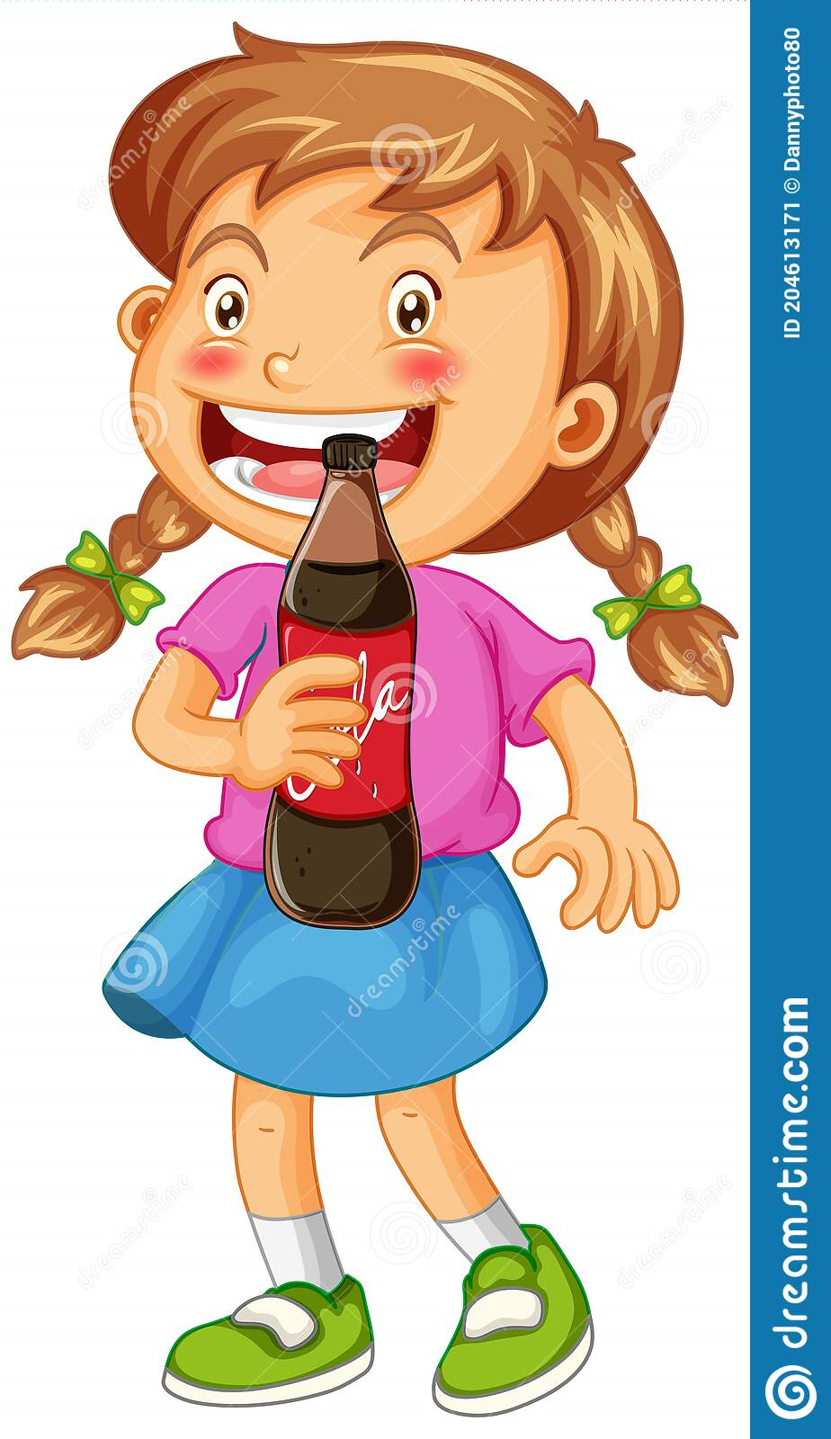

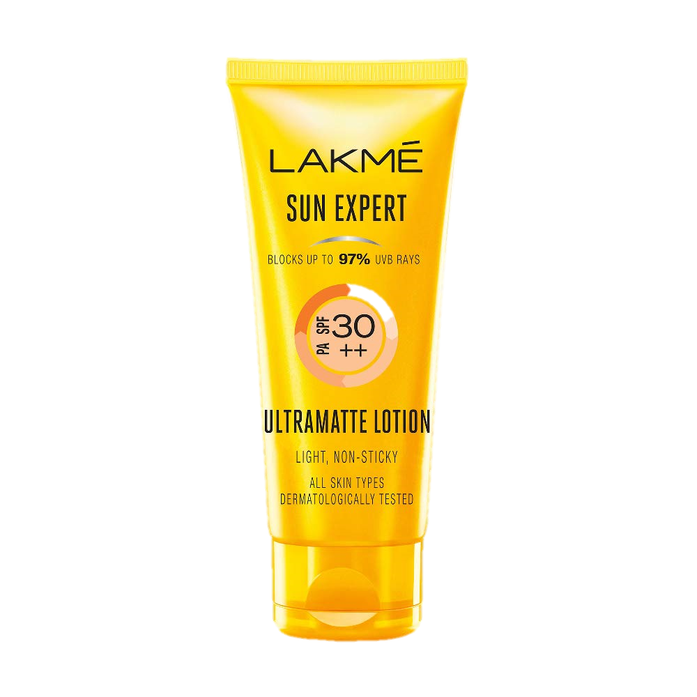
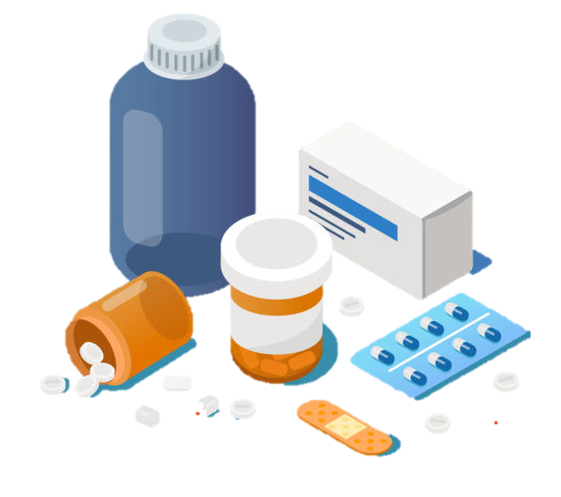
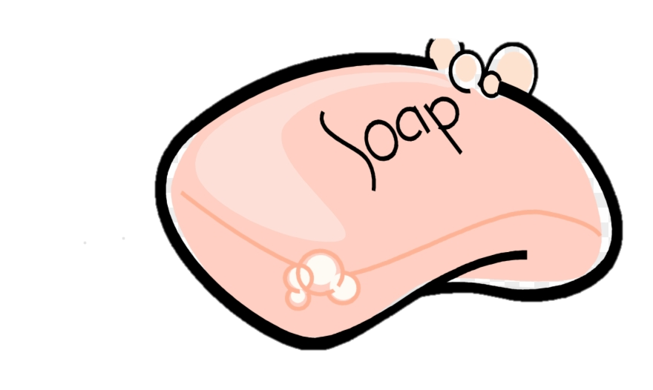
Listen to the ads and match.
1. ___ Sunray a. an effective pain killer
2. ___ Sparkle b. a lotion used to protect your skin
3. ___ NoAche c. a soap that removes dirt and leaves a nice fragrance
4. ___ Spotless d. a soft drink that provides a lot of energy
B
D
A
c

Slide 9
6 Pronunciation

Slide 10
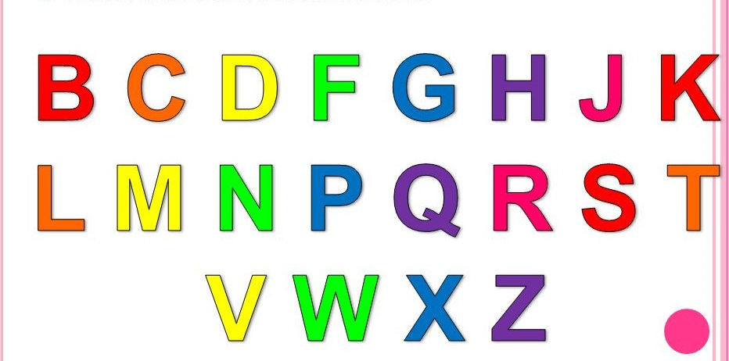
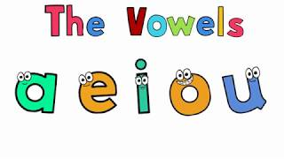
Linking Words
English Letters
consonant + vowel
Vowels
Consonant
triumph of Italian
consonant + consonant
two-seater was

Slide 11
Read the text about advertising. Find examples of consonant + vowel and consonant + consonant and practice reading them aloud.
the best ice cream
the most expensive bag
It was introduced in 1957.
consonant + vowel
consonant + consonant
the cleanest (t)eeth
in contrast (t)o the standard bike
a specially designed (d)olphin food

Slide 12


