Slide 1


Good Morning
Mega Goal 2.1
Far and Away

Slide 2
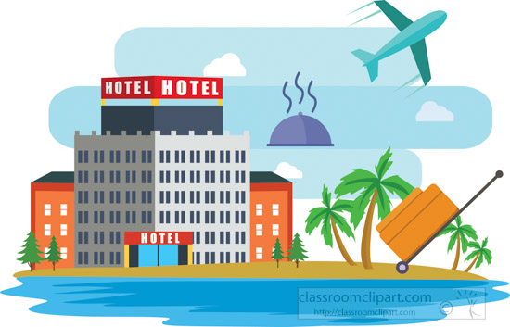
Good Morning
Mega Goal 2.1
Unit -3-
Far and Away
Listen & Discuss
Pair Work

Slide 3
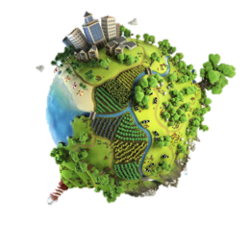
Unit -3-
Far and Away
Listen & Discuss
Pair Work
Good Morning
Mega Goal 2.1
Far and Away

Slide 4
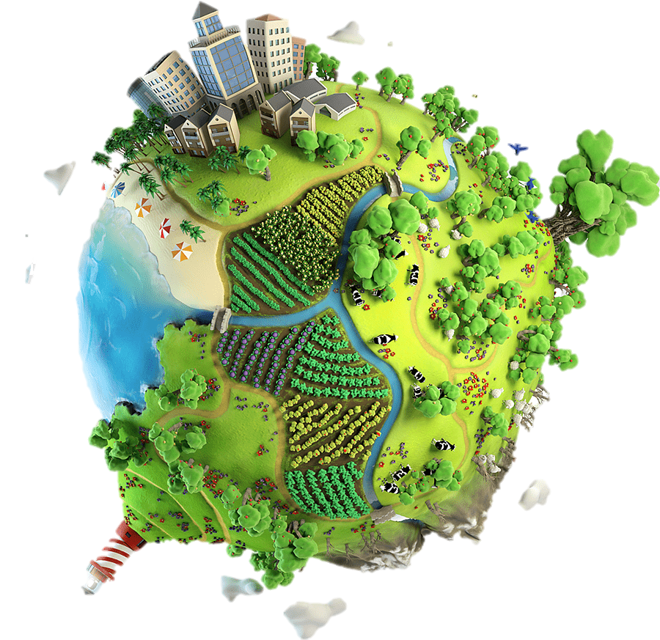
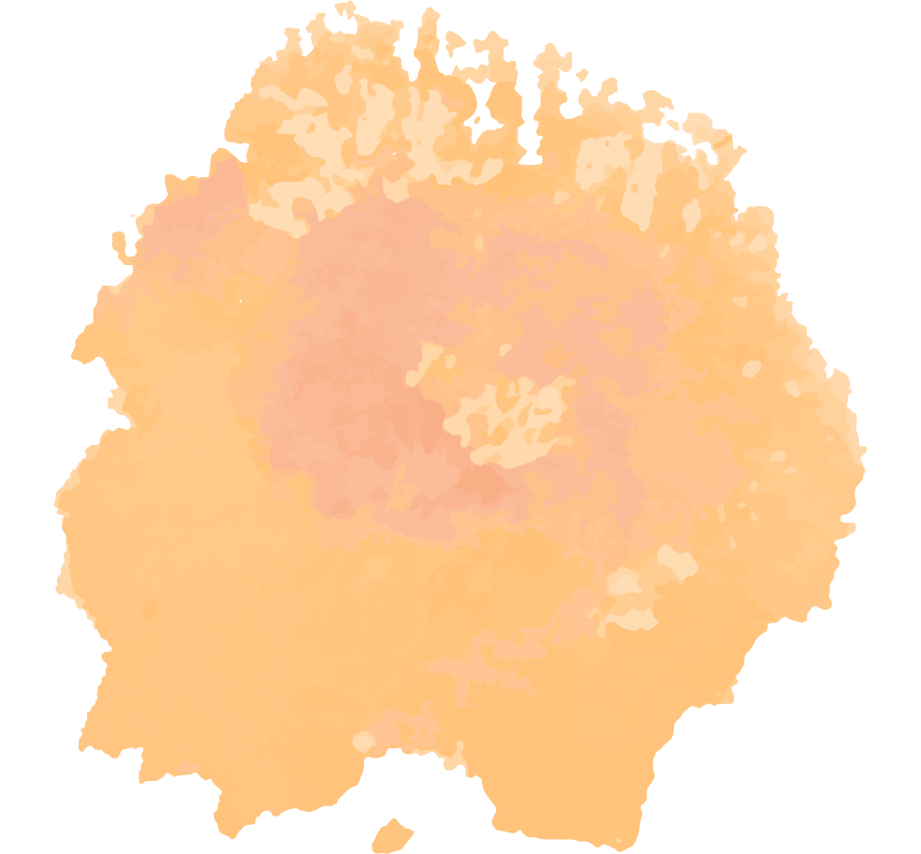


Objectives:
2
3
4
1
Create a written image of their own hotel .
List five things every hotel must have .
Find how each hotel is different .
List the benefits of traveling .
5
6
7
Correct information about the text .
Match the new words with meaning .
.
Complete a paragraph with new words .
.
Unit -3-
Far and Away
Listen & Discuss
Pair Work

Slide 5
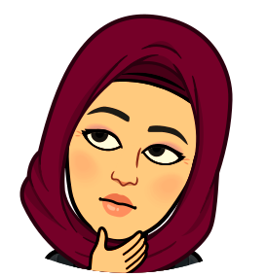
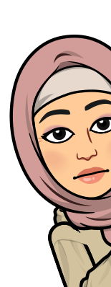

Guess
Far and Away
What does the title mean ?

Slide 6
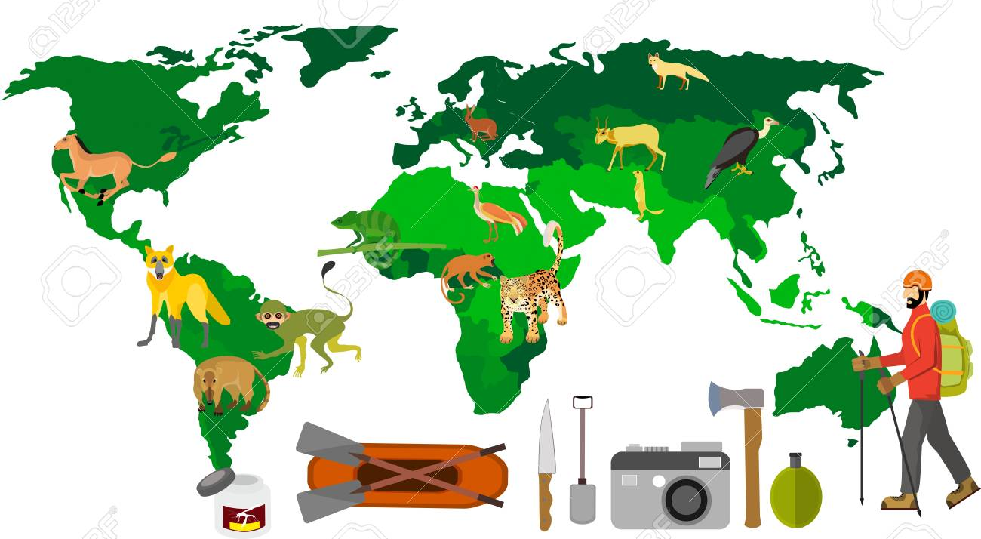
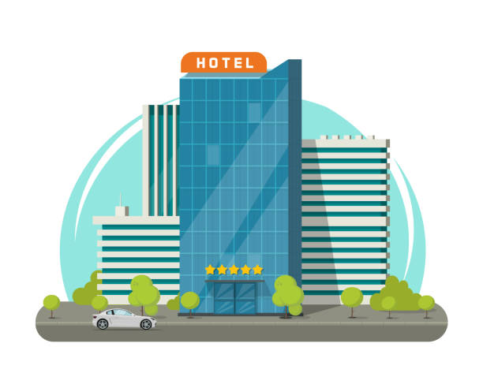
Guess
What does the title mean ?
Far and Away
an Expression used to say that something is much better than anything else .
Warm Up
Far and Away
Guess
What are the five things you expect a hotel to have?

Slide 7
Warm Up
What are the five things you expect a hotel to have?
Safety
Internet
Cleanliness
View
Food
Lighting
Pool
Phone charger
Benefits of travelling
Far and Away

Slide 8
Benefits of travelling
discovering the world’s
educational
as a stress buster
re-discover yourself
making memories
having fun of adventure
strengthens relationships
getting great ideas
gaining some new friends
refreshing

Slide 9
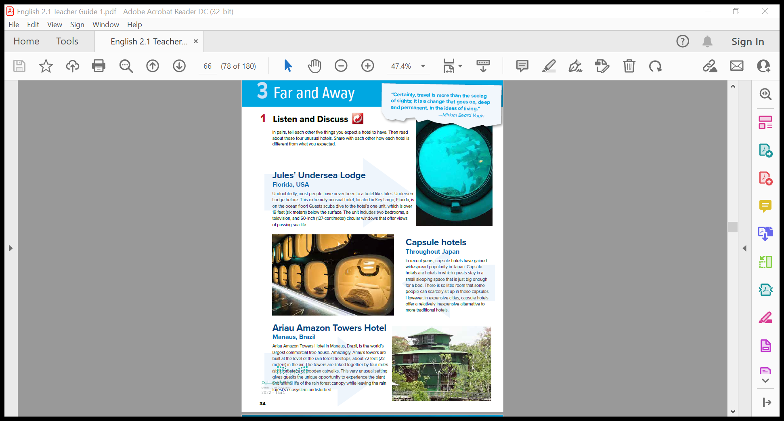
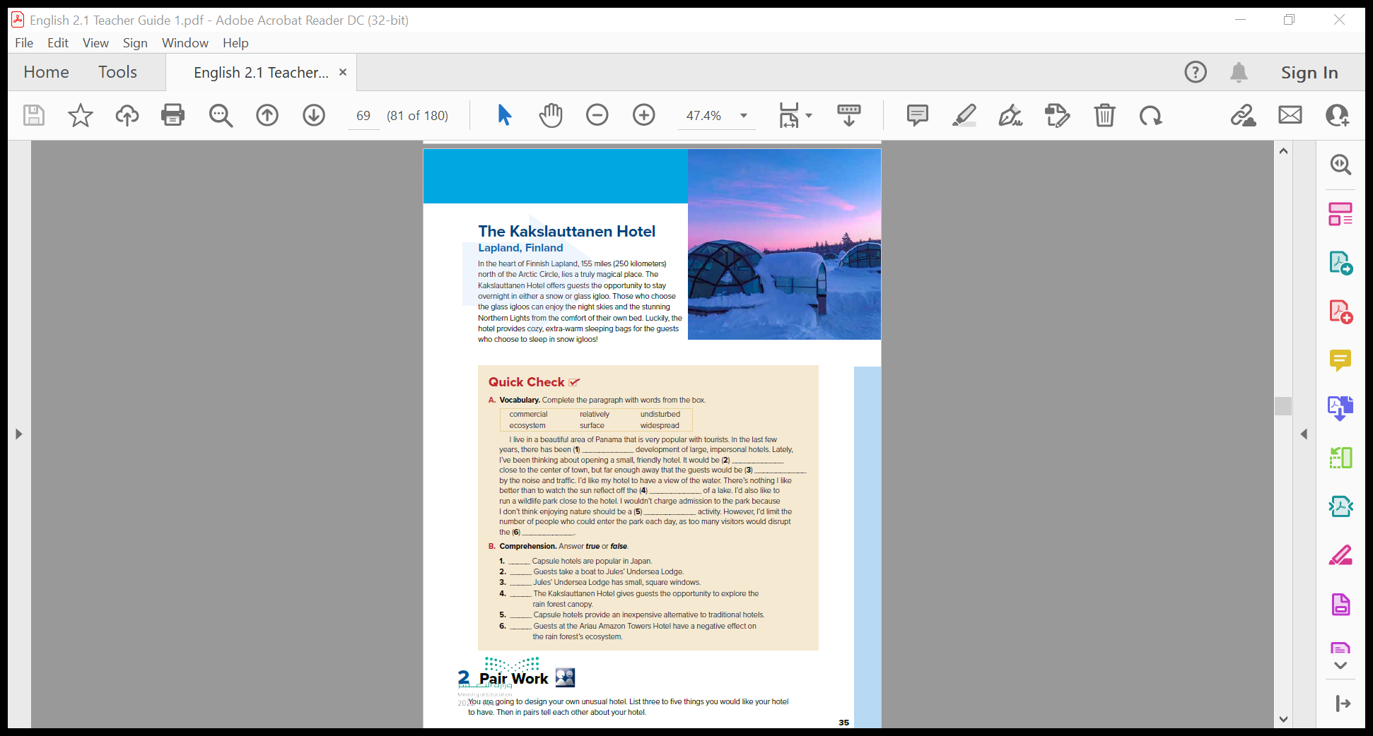
Student Book
P.34-35
What do you think they are?
How many?

Slide 10

Skimming
4
1
What do you think they are?
How many?
2
Usual?
Unusual?
3

Slide 11
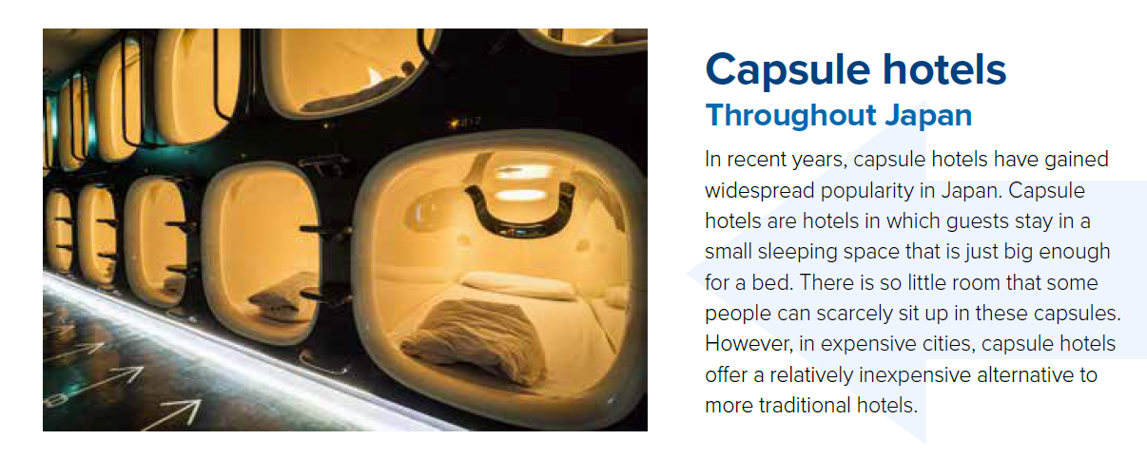
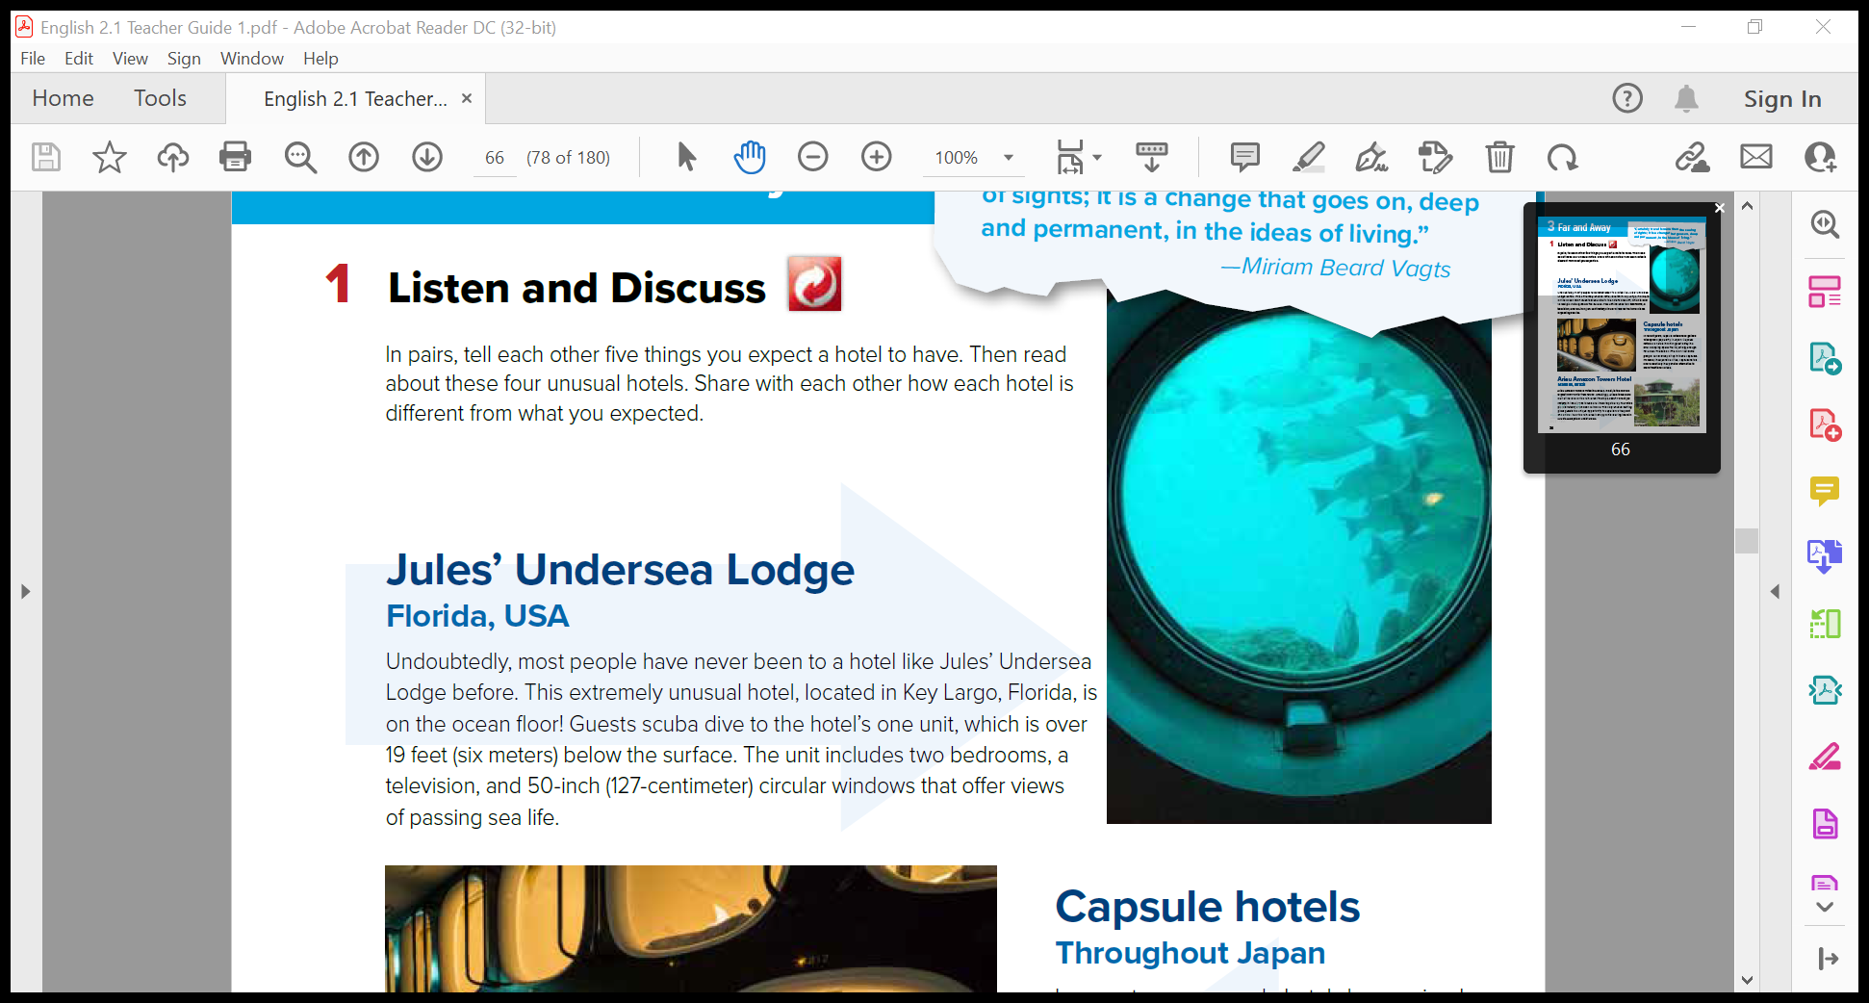
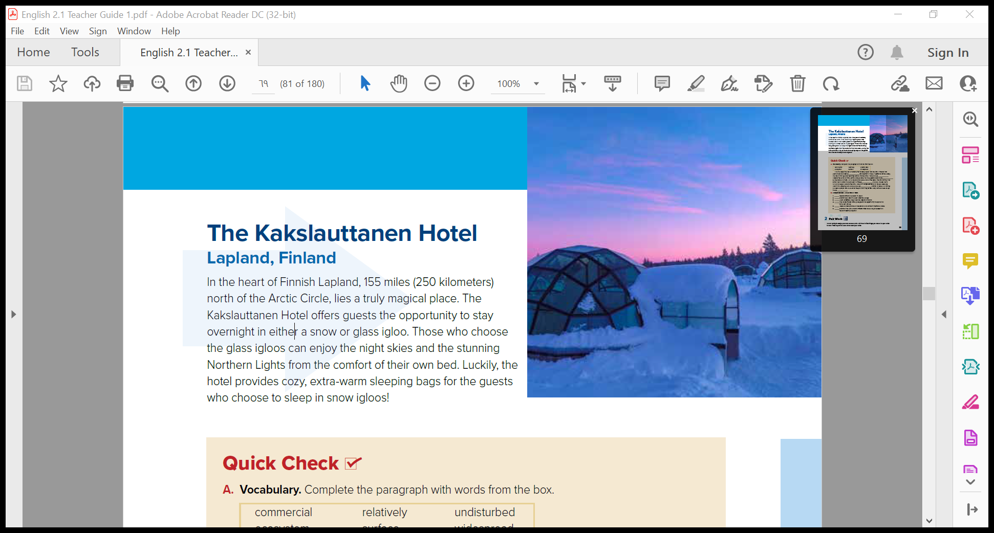

Ariau Amazon Towers Hotel
Manaus, Brazil
Ariau Amazon Towers Hotel in Manaus, Brazil, is the world’s
largest commercial tree house. Amazingly, Ariau’s towers are
built at the level of the rain forest treetops, about 72 feet (22
meters) in the air. The towers are linked together by four miles
(six kilometers) of wooden catwalks. This very unusual setting
gives guests the unique opportunity to experience the plant
and animal life of the rain forest canopy while leaving the rain
forest’s ecosystem undisturbed
Read Along as You listen

Slide 12
Ariau Amazon Towers Hotel
Manaus, Brazil
Ariau Amazon Towers Hotel in Manaus, Brazil, is the world’s
largest commercial tree house. Amazingly, Ariau’s towers are
built at the level of the rain forest treetops, about 72 feet (22
meters) in the air. The towers are linked together by four miles
(six kilometers) of wooden catwalks. This very unusual setting
gives guests the unique opportunity to experience the plant
and animal life of the rain forest canopy while leaving the rain
forest’s ecosystem undisturbed
Name ?
Where does it locate ?
What does the unit include ?
What makes it unusual ?
How do the guests reach to the hotel ?
Windows shape ?

Slide 13
Ariau Amazon Towers Hotel
Manaus, Brazil
Ariau Amazon Towers Hotel in Manaus, Brazil, is the world’s
largest commercial tree house. Amazingly, Ariau’s towers are
built at the level of the rain forest treetops, about 72 feet (22
meters) in the air. The towers are linked together by four miles
(six kilometers) of wooden catwalks. This very unusual setting
gives guests the unique opportunity to experience the plant
and animal life of the rain forest canopy while leaving the rain
forest’s ecosystem undisturbed
Name ?
What are capsule hotel ?
Where does it locate ?
What makes it unusual ?
Are they expensive ?

Slide 14
Ariau Amazon Towers Hotel
Manaus, Brazil
Ariau Amazon Towers Hotel in Manaus, Brazil, is the world’s
largest commercial tree house. Amazingly, Ariau’s towers are
built at the level of the rain forest treetops, about 72 feet (22
meters) in the air. The towers are linked together by four miles
(six kilometers) of wooden catwalks. This very unusual setting
gives guests the unique opportunity to experience the plant
and animal life of the rain forest canopy while leaving the rain
forest’s ecosystem undisturbed
Name ?
Where ?
What is it famous for ?
What makes it unusual ?

Slide 15
Ariau Amazon Towers Hotel
Manaus, Brazil
Ariau Amazon Towers Hotel in Manaus, Brazil, is the world’s
largest commercial tree house. Amazingly, Ariau’s towers are
built at the level of the rain forest treetops, about 72 feet (22
meters) in the air. The towers are linked together by four miles
(six kilometers) of wooden catwalks. This very unusual setting
gives guests the unique opportunity to experience the plant
and animal life of the rain forest canopy while leaving the rain
forest’s ecosystem undisturbed
Name ?
Where ?
What does the Kakslauttanen Hotel offer ?
What does the hotel provides for the guests ?

Slide 16

HOTEL
you would like to stay at?

Slide 17
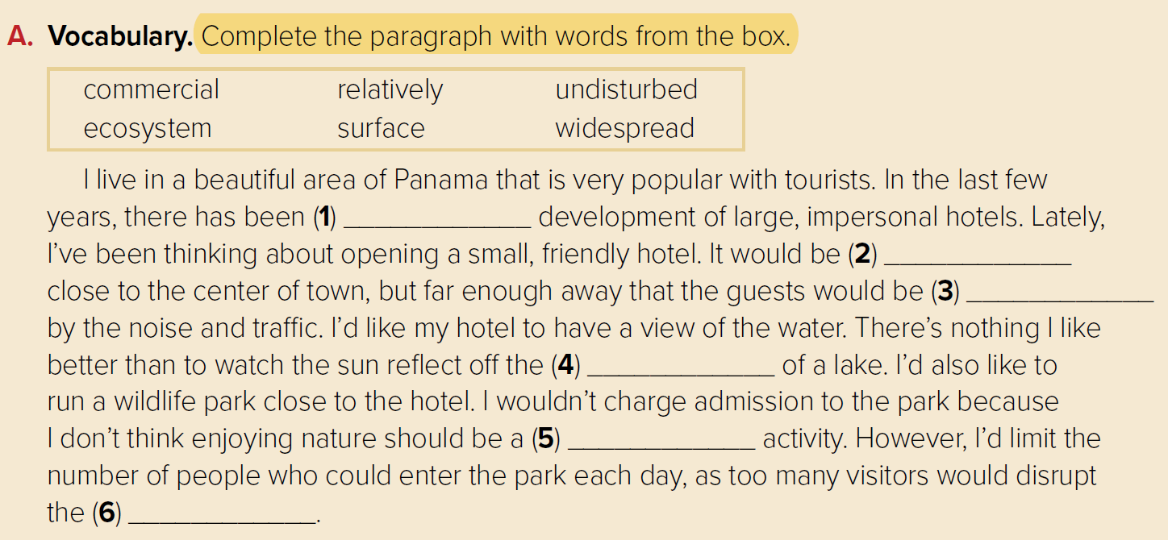

Scan
Jules’ Undersea Lodge
round
(circular)
Ariau Amazon Towers Hotel
connect
the tops of the trees in a forest
(link)
(canopy)
Capsule Hotels
another choice or option
(alternative)
Kakslauttanen Hotel
comfortable and warm
extremely
(cozy)
(stunning)

Slide 18
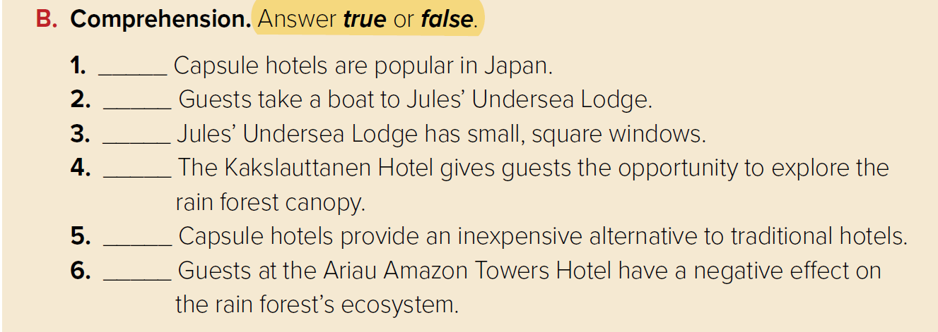
Quick Check
widespread
Where does the writer live?
(in a beautiful area of Panama)
relatively
undisturbed
What kind of hotel does the writer want to open?
surface
(a small, friendly hotel)
commercial
How much would the writer charge for admission to
the wildlife park?
(The writer wouldn’t charge any admission.)
ecosystem

Slide 19
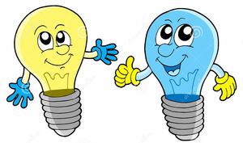
true
false
false
false
true
true

Slide 20
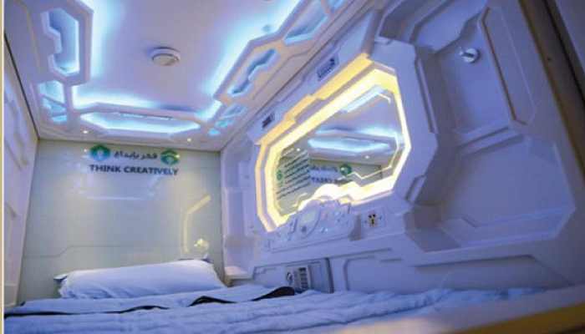
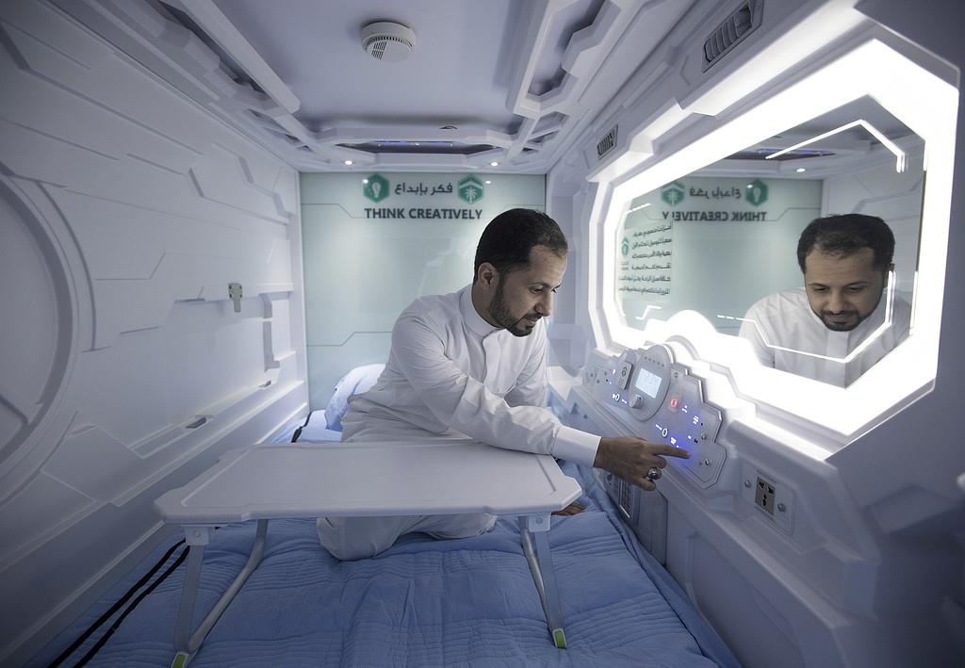
Pair Work
You are going to design your own unusual hotel.
List three to five things you would like your hotel to have.
Then in pairs tell each other about your hotel.

Slide 21
Hajj Capsule

Slide 22


