Slide 1
Day : Tuesday
Date: 25/3/1445

Slide 2
What do I need to buy?
Listen and discuss

Slide 3
Check Homework
Match
1-Take your ticket and passport with you
A- after he does his homework.
2-He’s going to play football with his friends
B- when I go to the shopping mall.
3- I won’t spend a lot of money
C- before you leave for the airport.

Slide 4
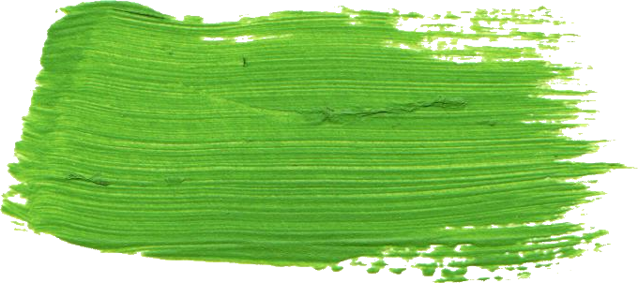
Revision
1-I ( read – reading – am reading) a book now
2-We ( are – is – am ) cooking a dinner now.
3- Richard ( makes - is marking - made ) a cake this afternoon
4-The students ( are playing - play - played ) tennis next Friday

Slide 7
objectives
Talk about food , buying food , planning meals
Perform a conversation talking about food shopping and describing quantities

Slide 8
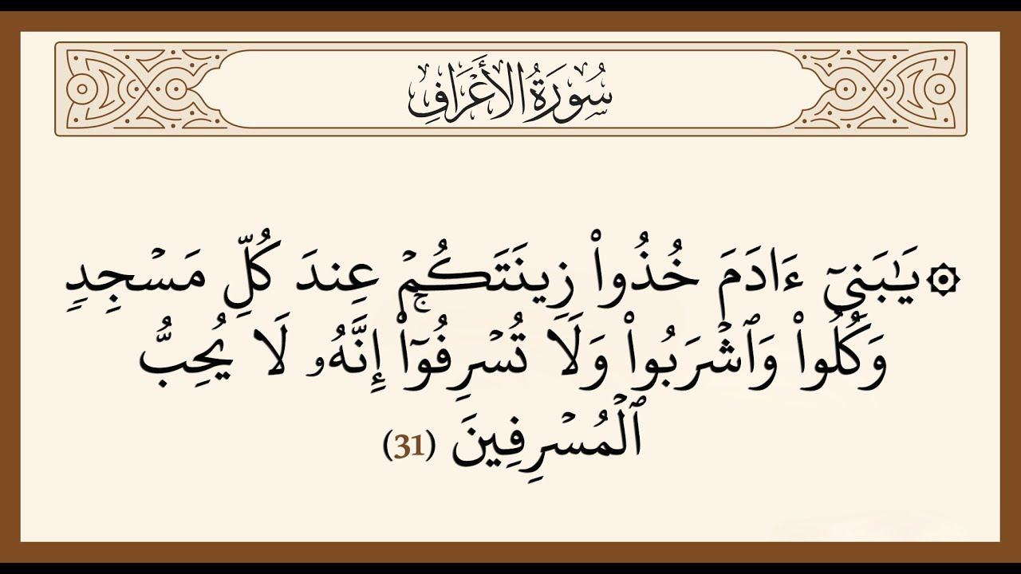

Slide 9
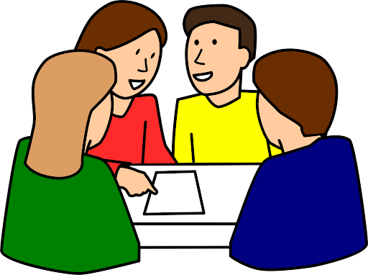
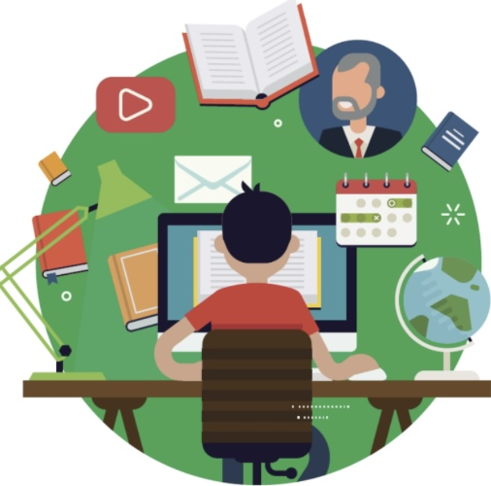

Slide 10
How often do you go to the supermarket ?
What do you usually buy?
Who buys the food and supplies in your family ?

Slide 11
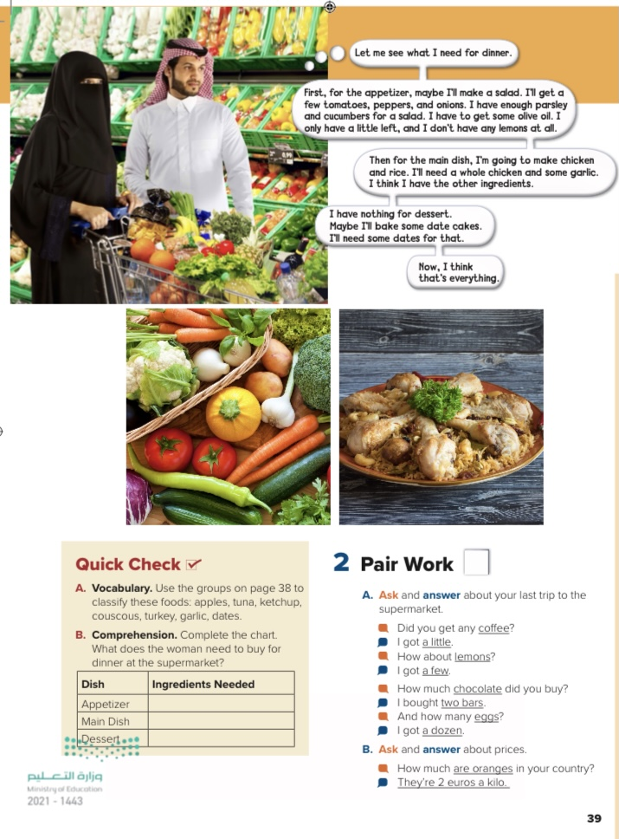
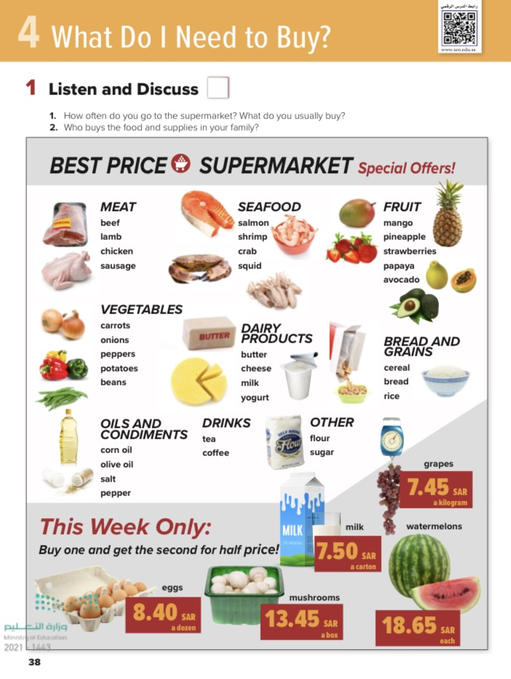
@ page 38 + 39
Pages 32-33

Slide 12
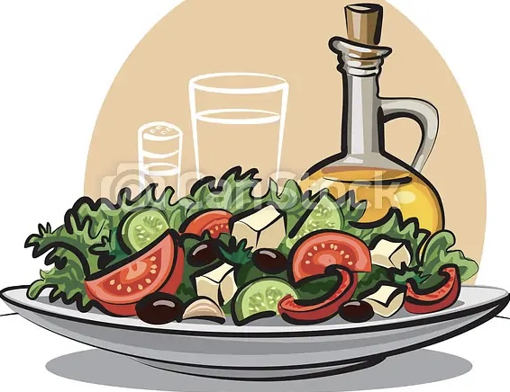
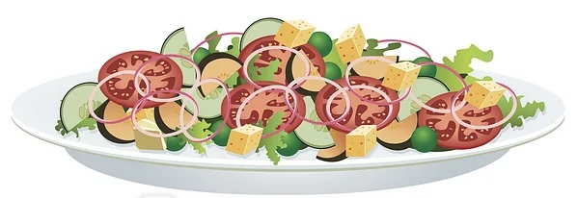
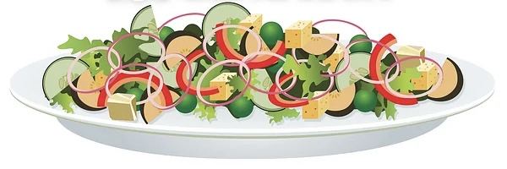
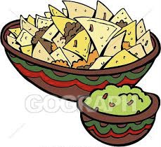
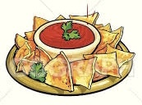
Appetizer

Slide 13
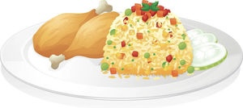
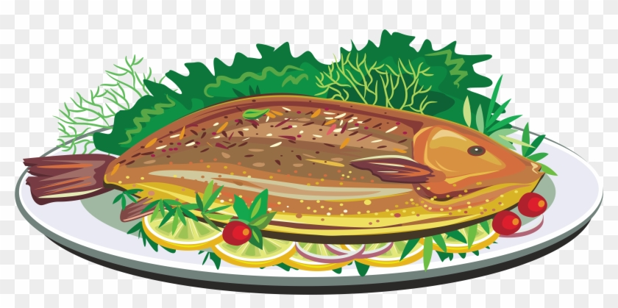
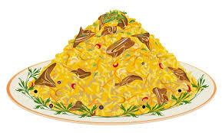
Main dish

Slide 14
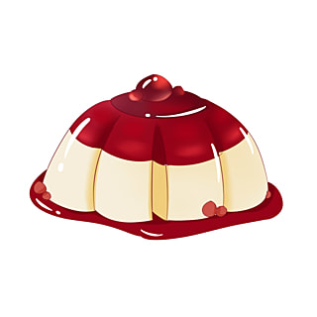
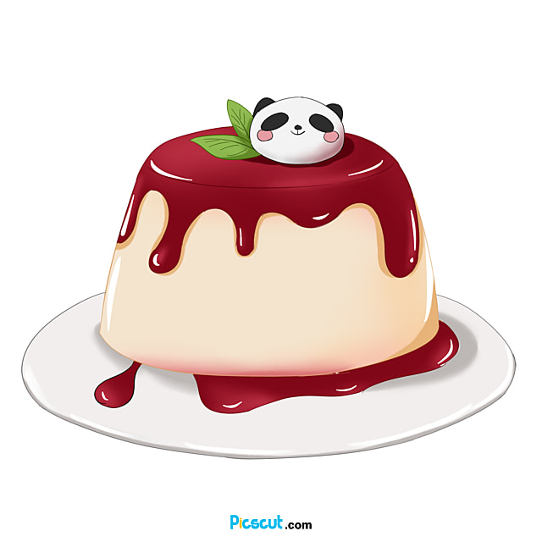
Dessert

Slide 15
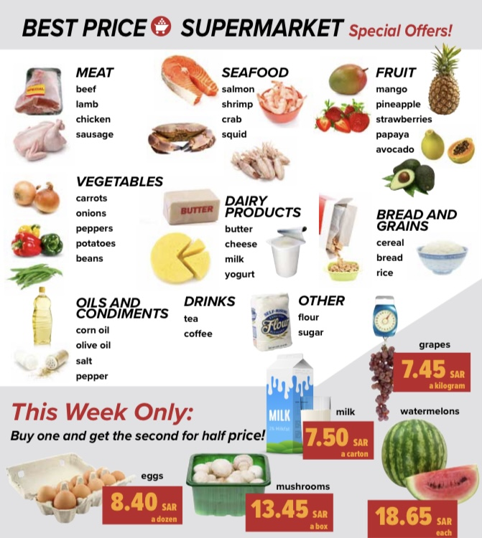
listen
How much is one kilogram of grapes?
How much is a watermelon?
How much are two cartons of milk?

Slide 16
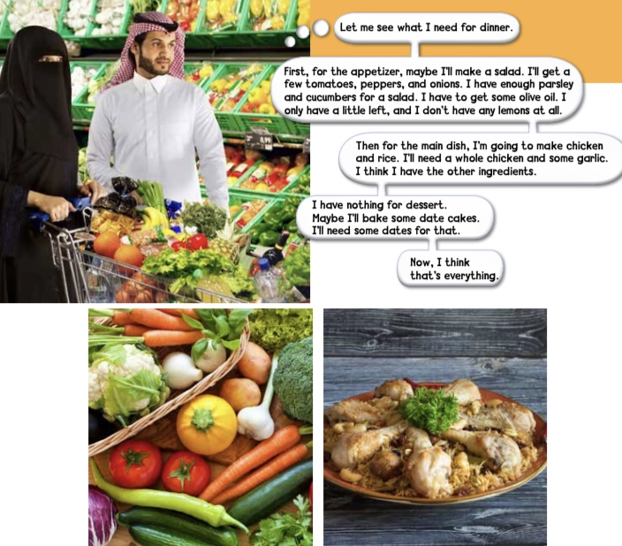
Where are they ?
What will she probably make for the appetizer?
What is she going to make for the main dish ?

Slide 17
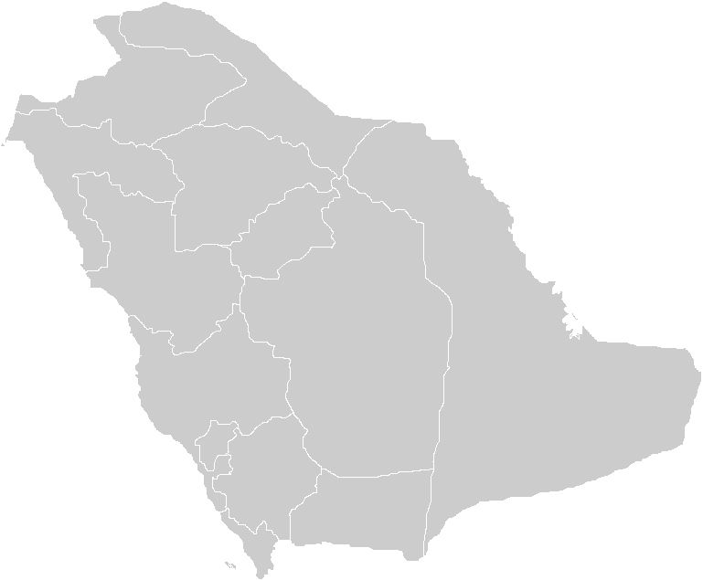
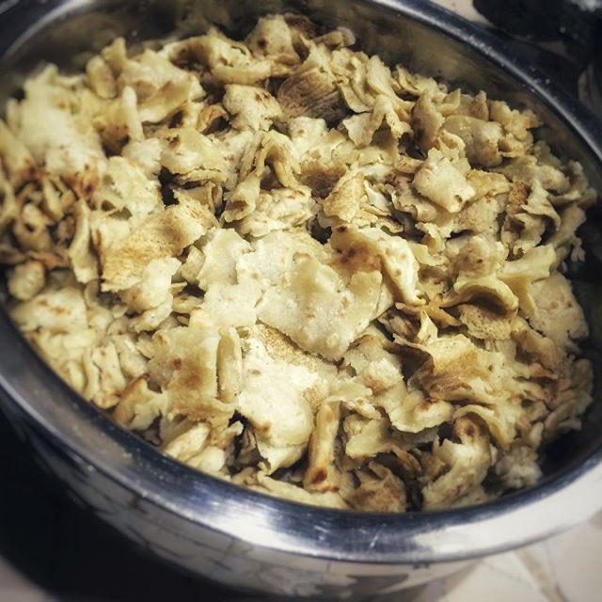
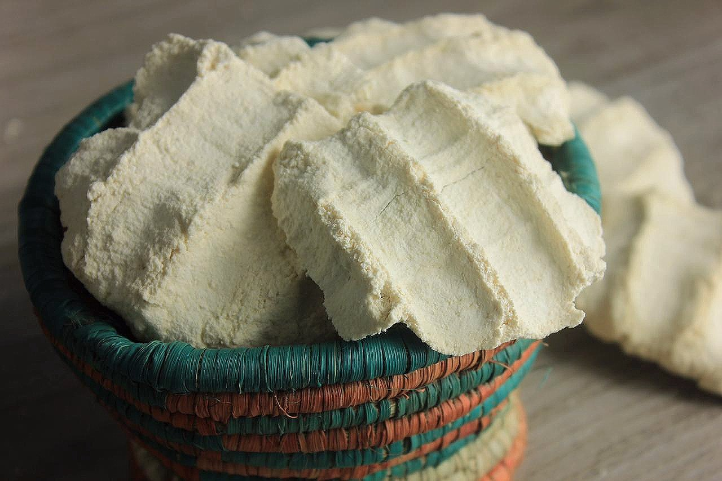
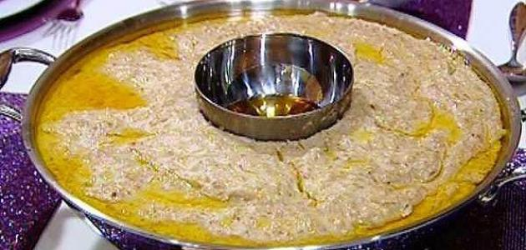
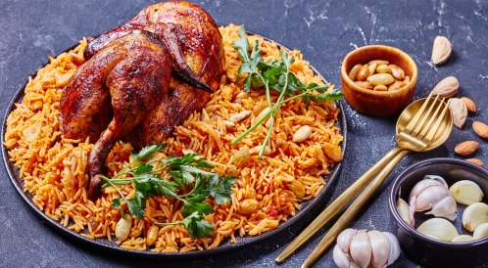
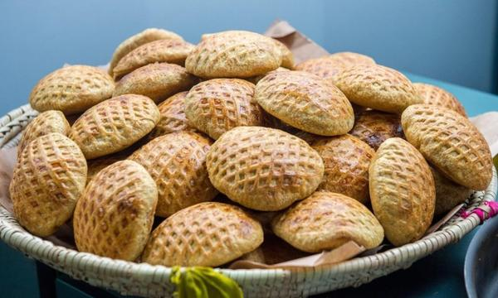
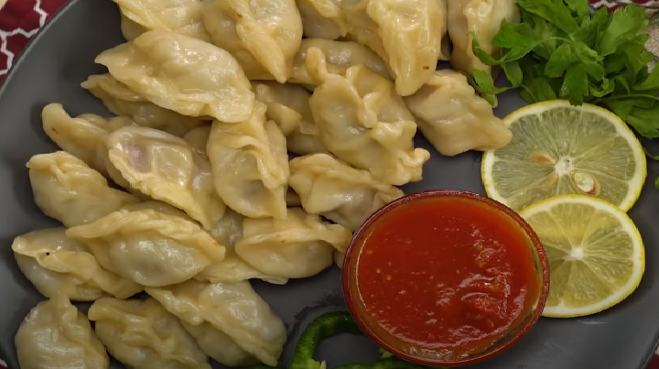
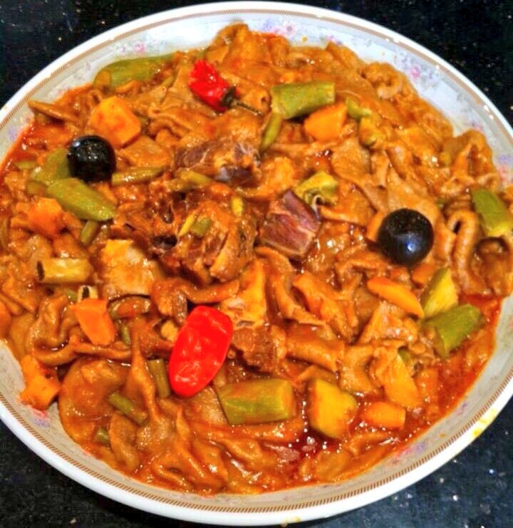
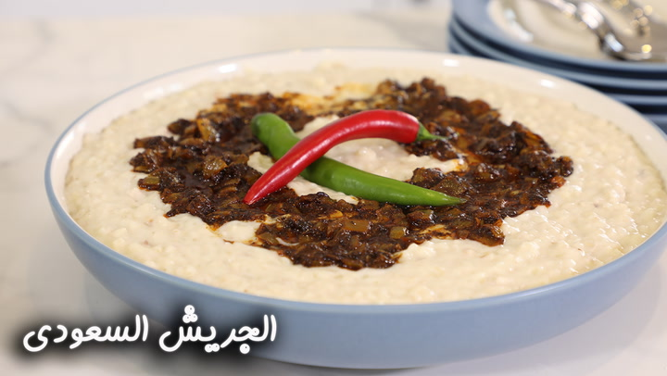
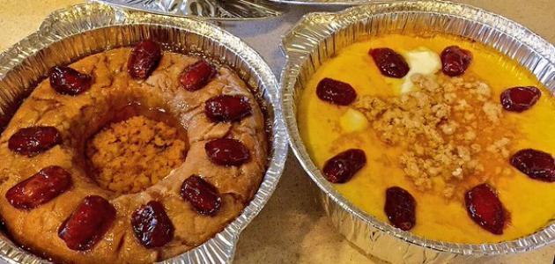
List some
Traditional dishes
in your country

Slide 18
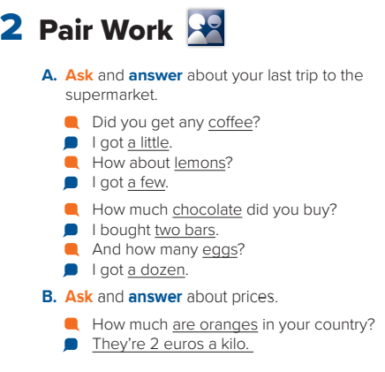

Slide 19
Oils and condiments
Bread and grains
meat
seafood
vegetables
fruits
garlic
apple , date
couscous
ketchup
turkey
tuna

Slide 20
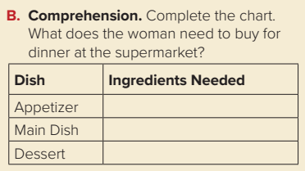
tomatoes, peppers, onions, olive oil, lemons
a whole chicken, some garlic
dates

Slide 21
Search on the internet about Nutritional value
Salman
Milk
Avocado

Slide 22
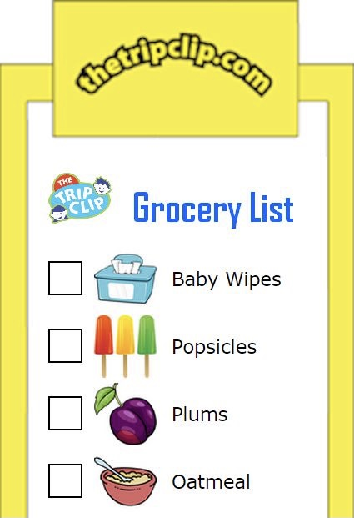
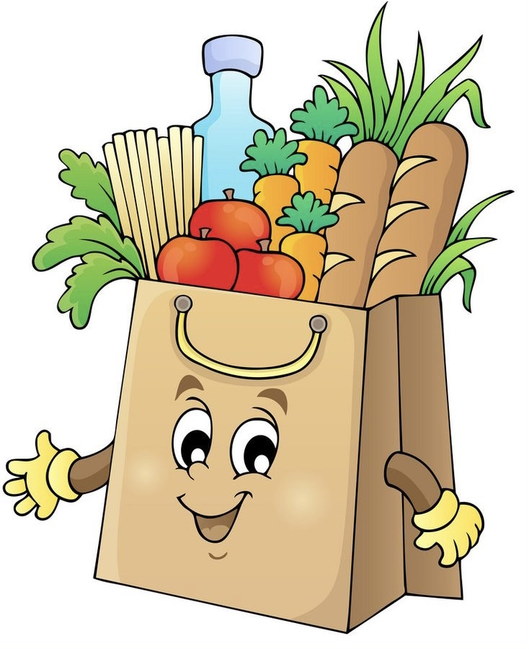
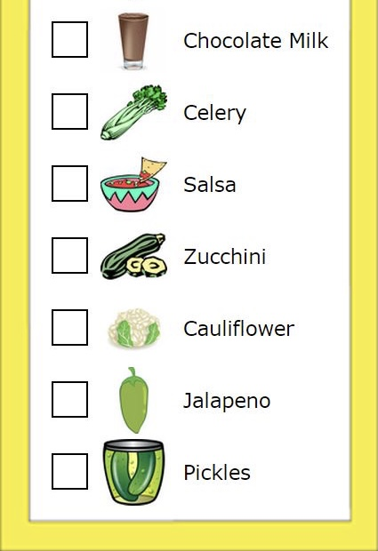
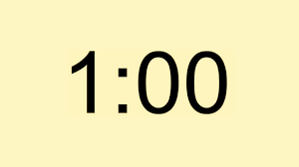
Prepare
the shopping list

Slide 23
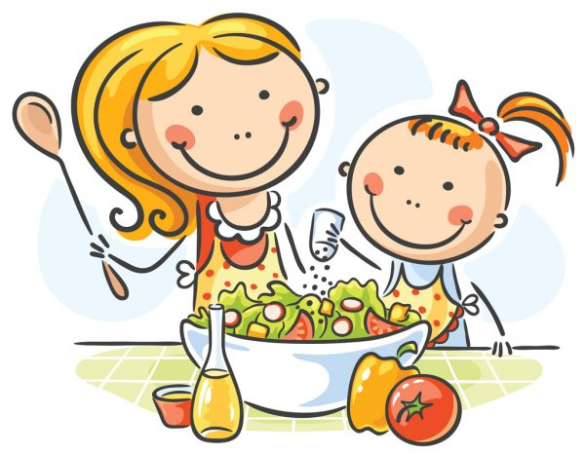

Slide 24
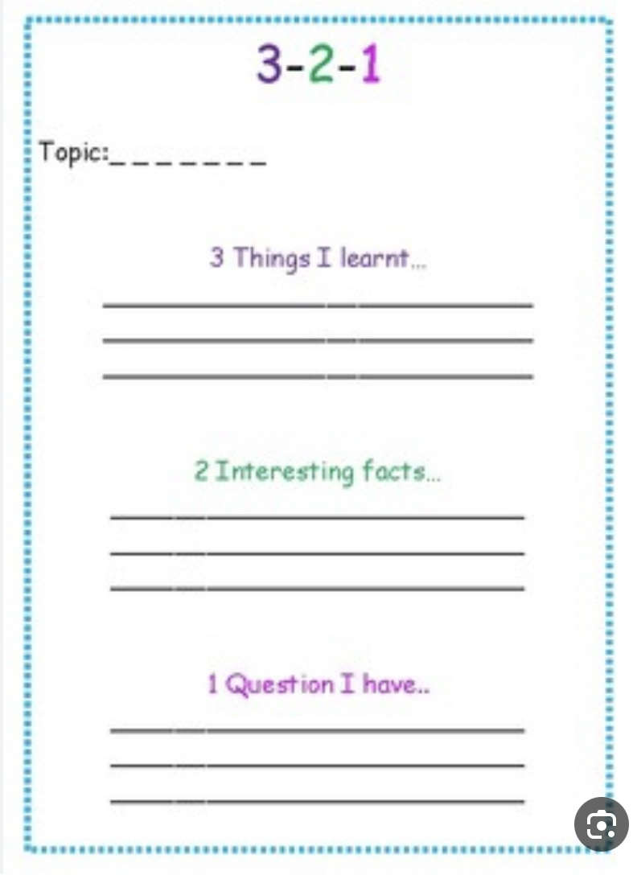

Slide 26
H.W
A- B
185

Slide 27
