Slide 1
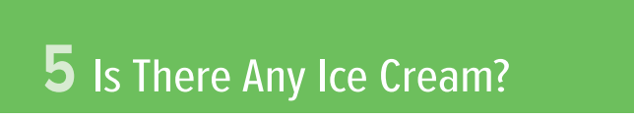
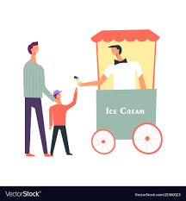
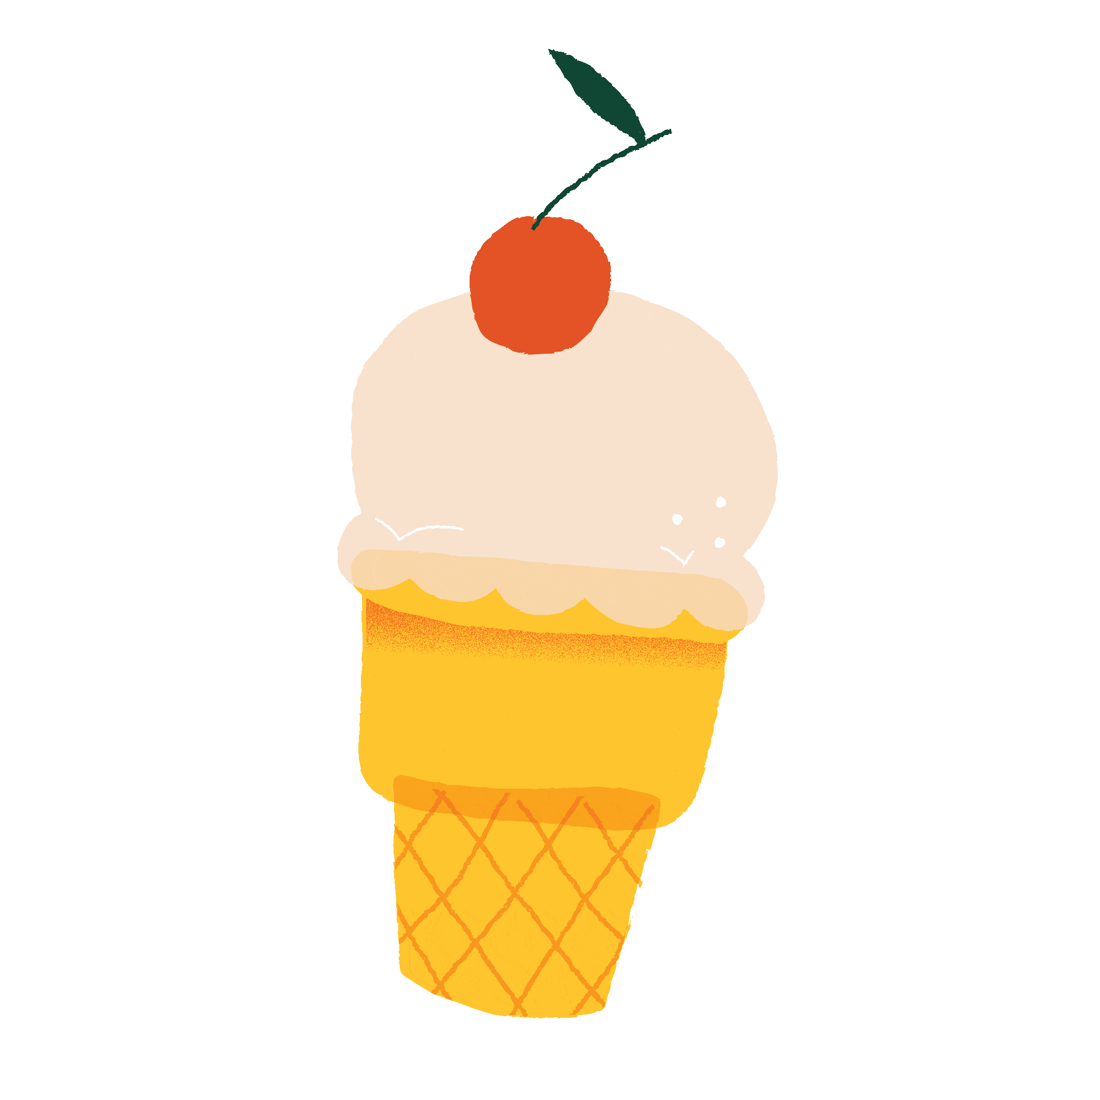

Slide 2
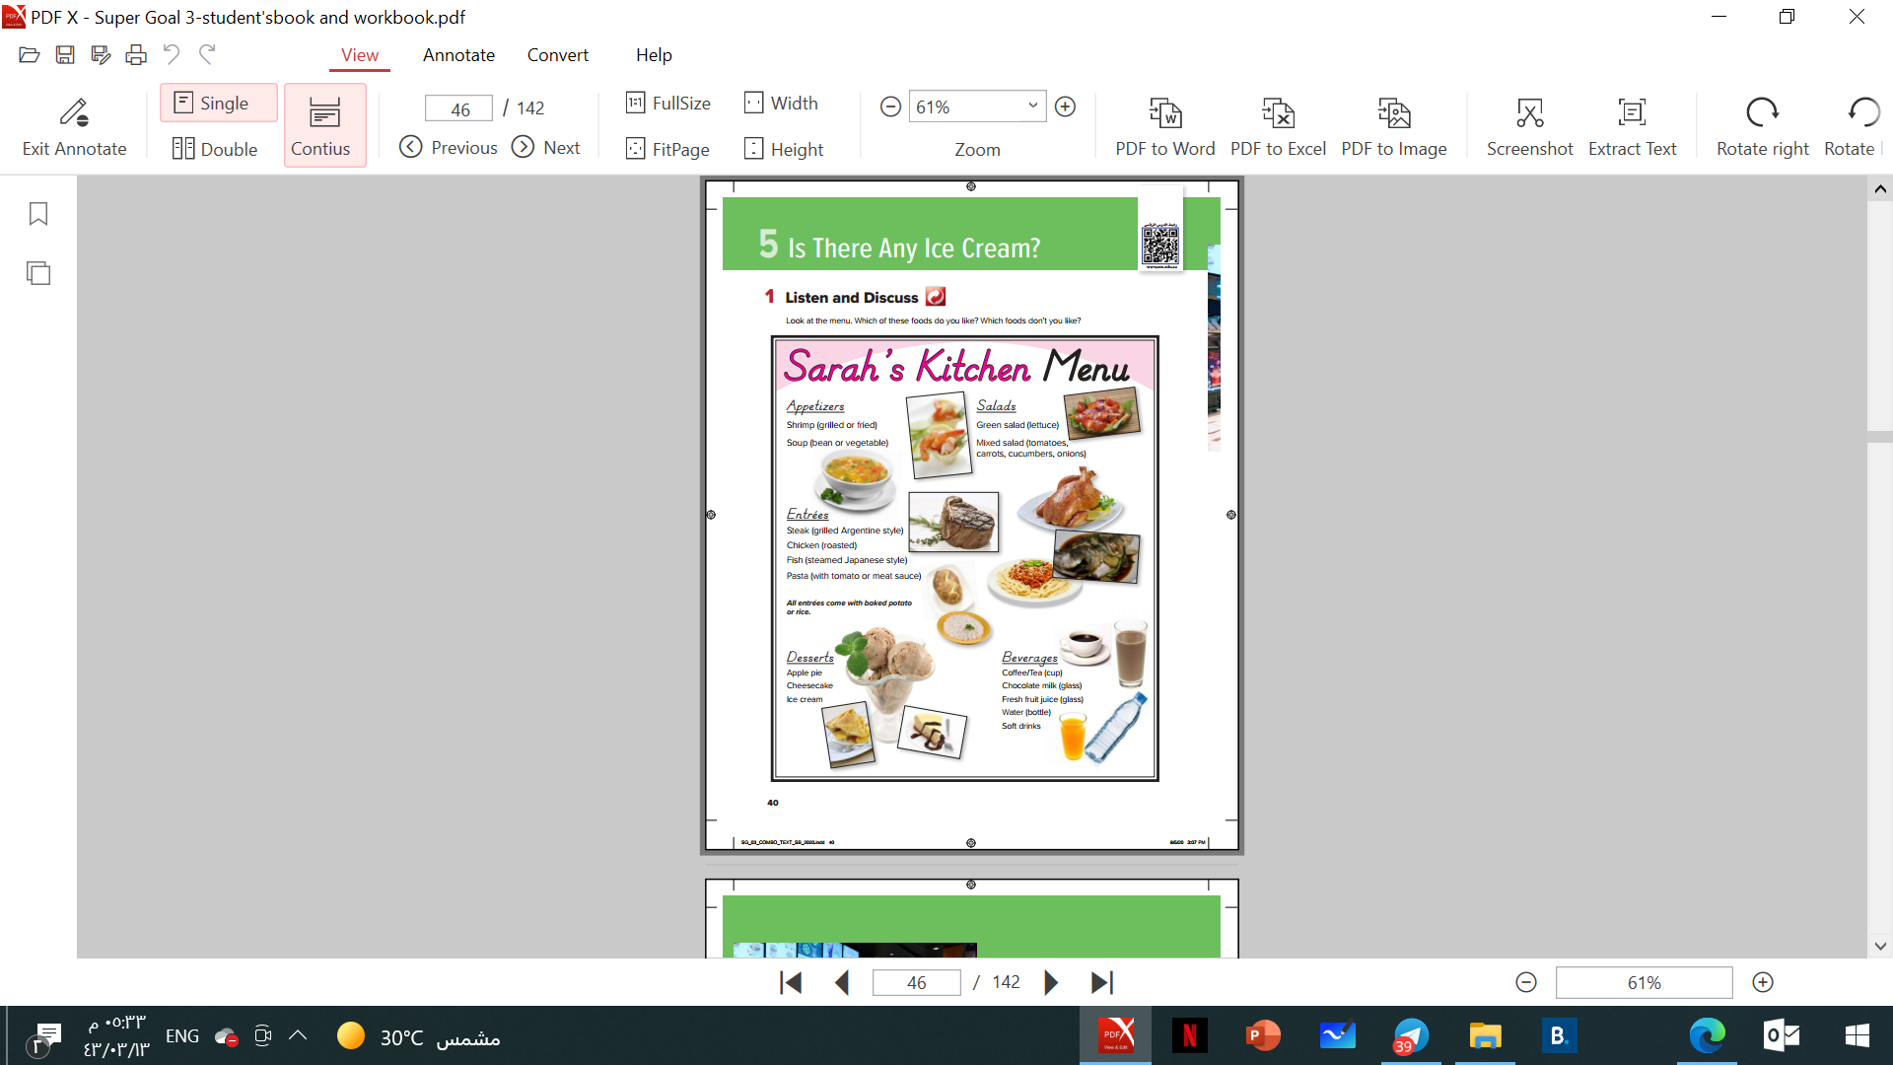
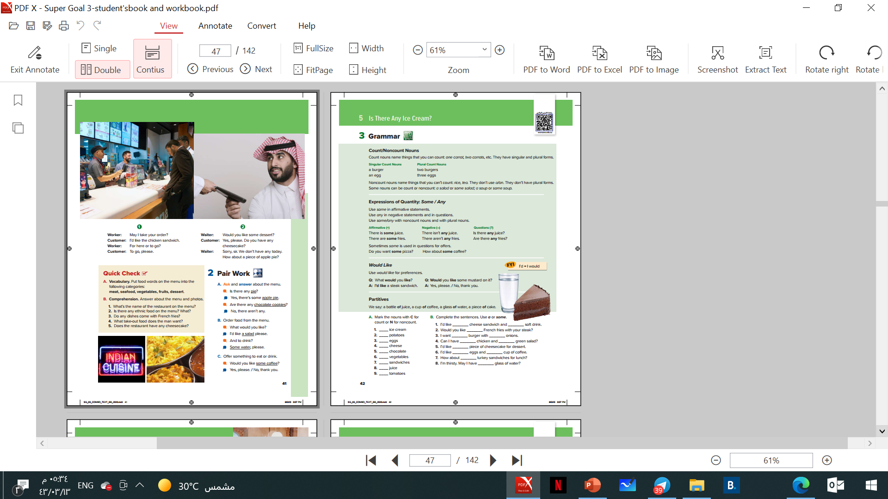

OBJECTIVES
● Practice ordering from a menu.
● Form correct questions about a menu.
● Categorize food type.

Slide 3
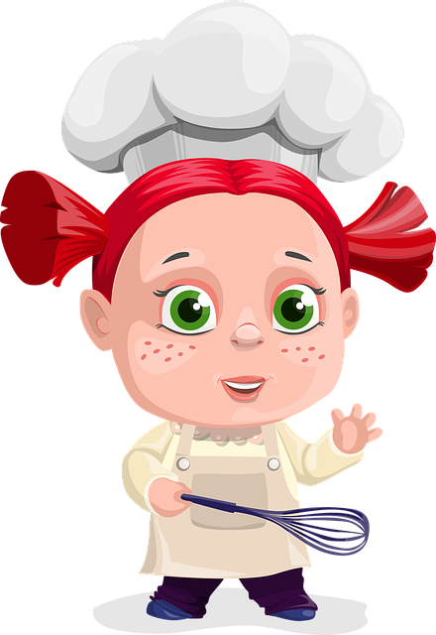
What’s your favorite food?

Slide 4
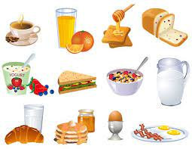
What do you usually have for breakfast?

Slide 5
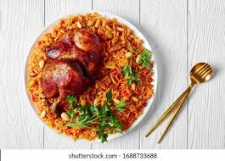
What do you usually have for lunch?

Slide 6
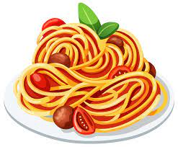
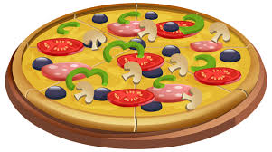
What do you usually have for dinner?

Slide 7
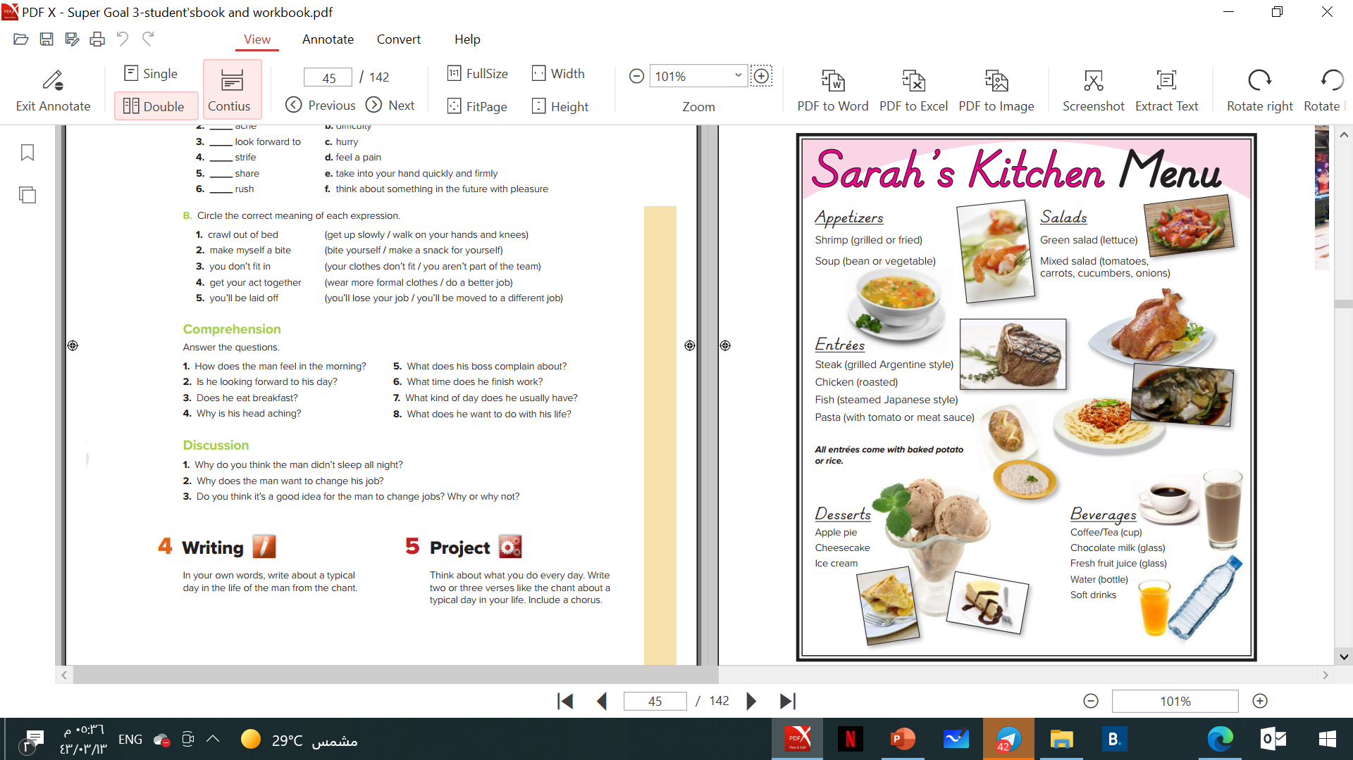
Main course

Slide 8
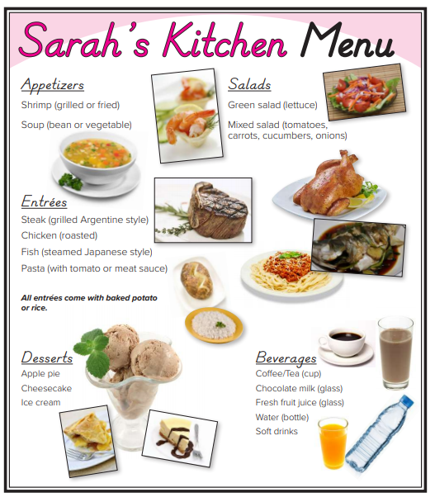
Page 40
What can you see?
Main course
What’s the name of the restaurant?

Slide 9

Page 40
Main course

Slide 10
Page 40
What kinds of beverages are there?
What kinds of appetizers are there?
What kinds of desserts are there?
What kinds of main courses are there?
What about baked potato and rice?
What kinds of salads are there?
Main course

Slide 11
Page 40
Which of these food do you like?
Main course
Which of these food you don’t like?

Slide 12
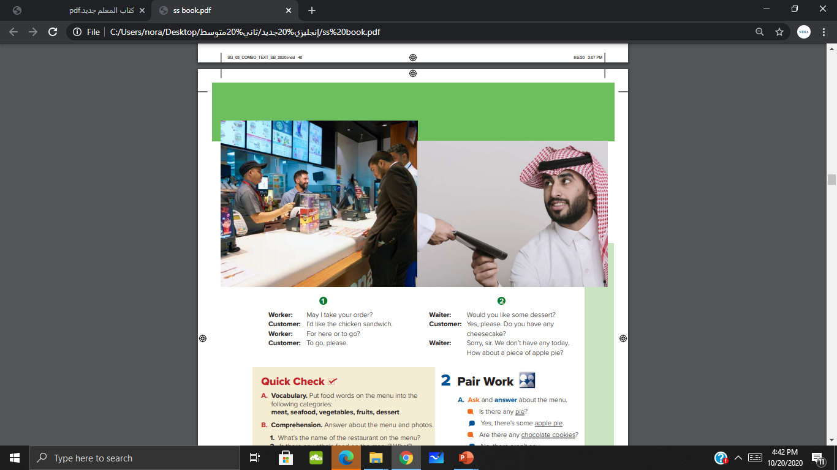
Where are the people?
Table servers
How are the restaurants different?
What are the customers doing in the restaurants?
They are ordering food.
Fast food

Slide 13
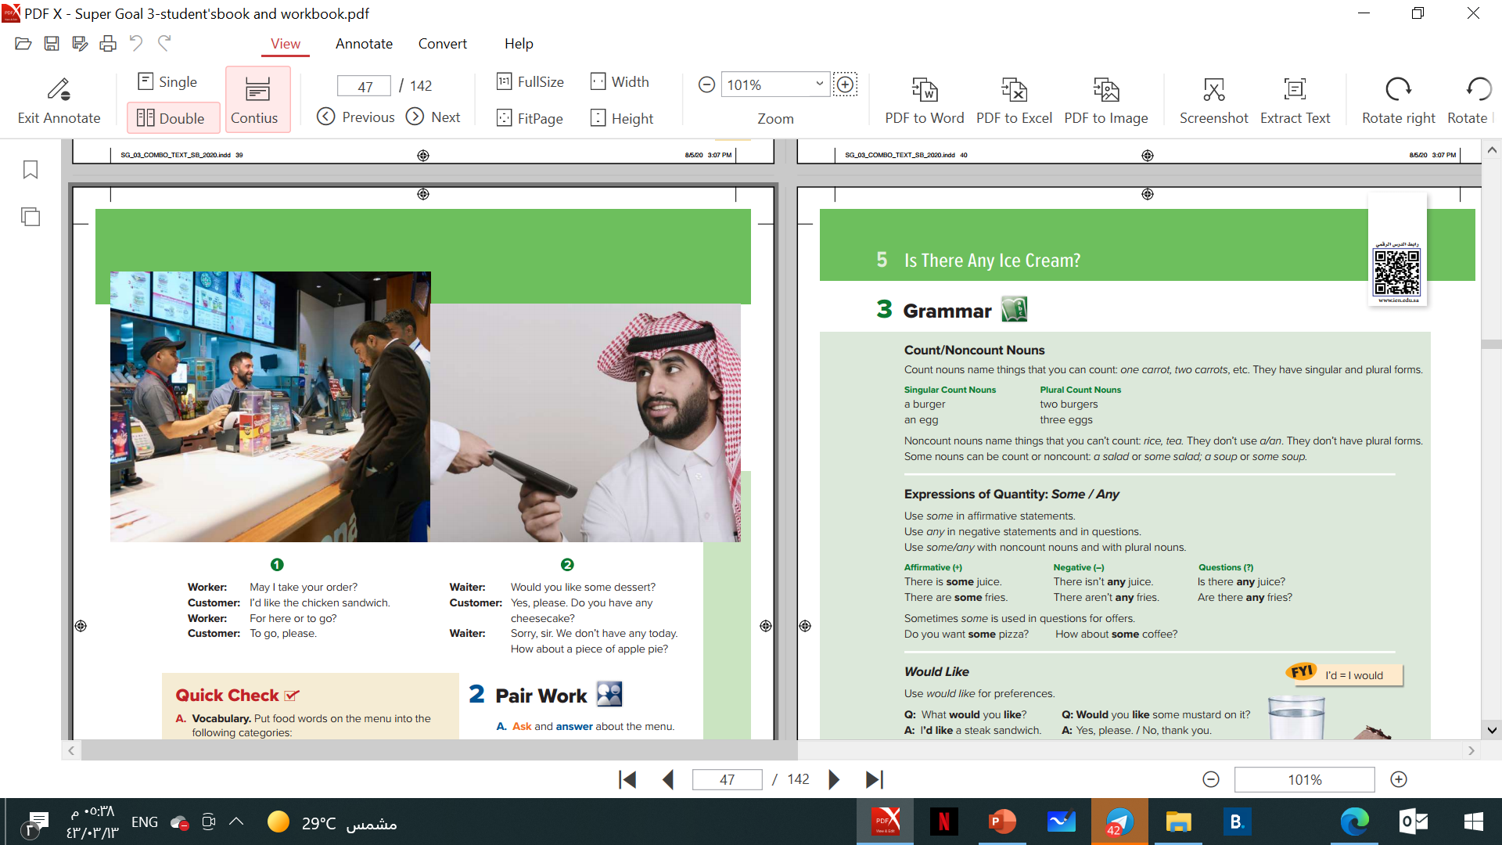
Page 41

Slide 14

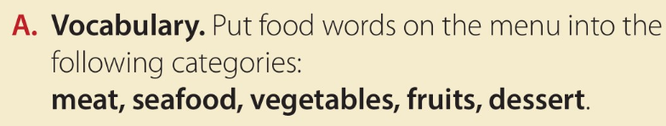
Page 41
meat:
steak
chicken
vegetables:
Carrots
cucumbers
lettuce
onions
potato
tomatoes
dessert:
apple pie
Cheesecake
ice cream
seafood:
Shrimp
fish
fruits:
apple

Slide 15
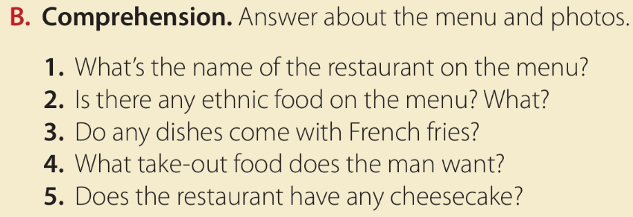
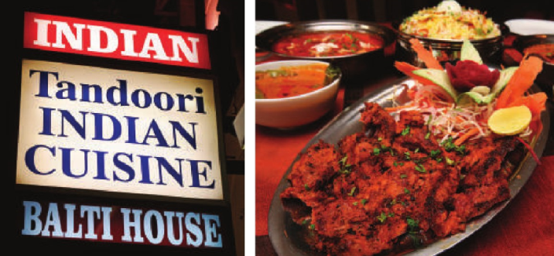
Page 41
1- Sarah’s Kitchen.
2- Yes, there is a steak Argentine style and
fish steamed Japanese style.
3- No, they don’t.
4- a chicken sandwich.
5- No, they haven’t.

Slide 16


Slide 17
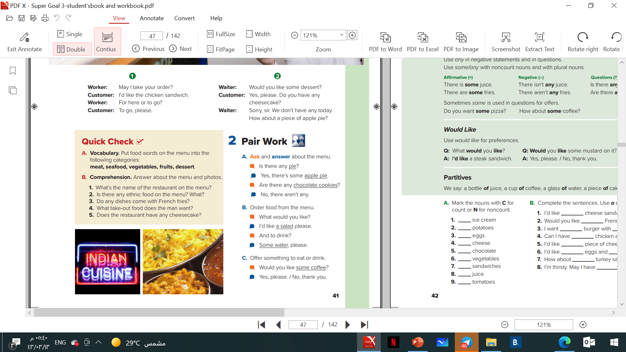

Slide 18


Page 201

Slide 19
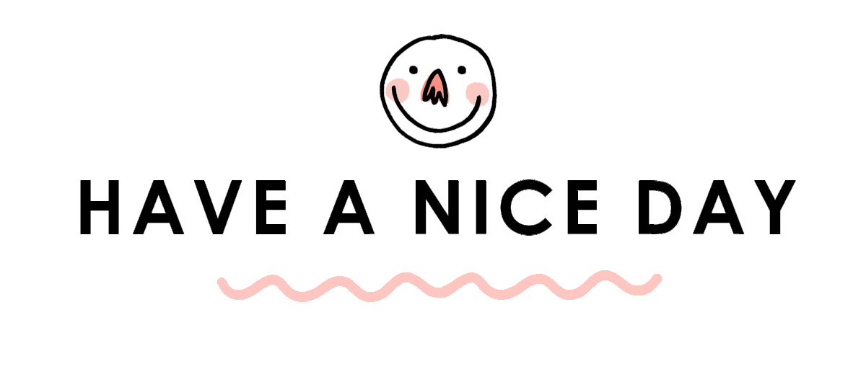


Slide 21
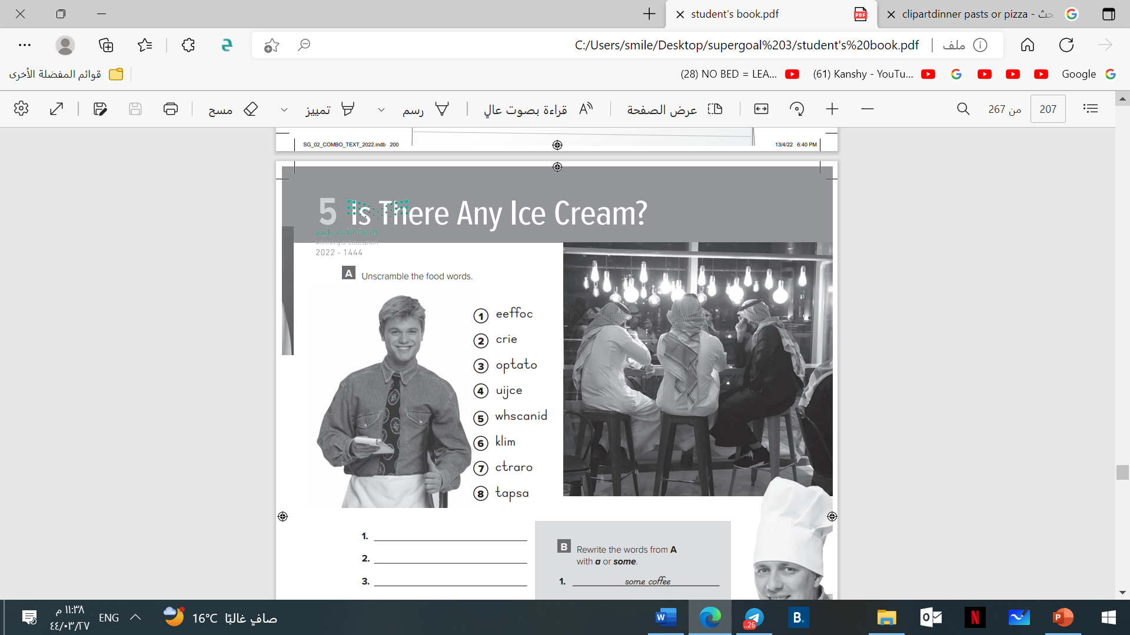
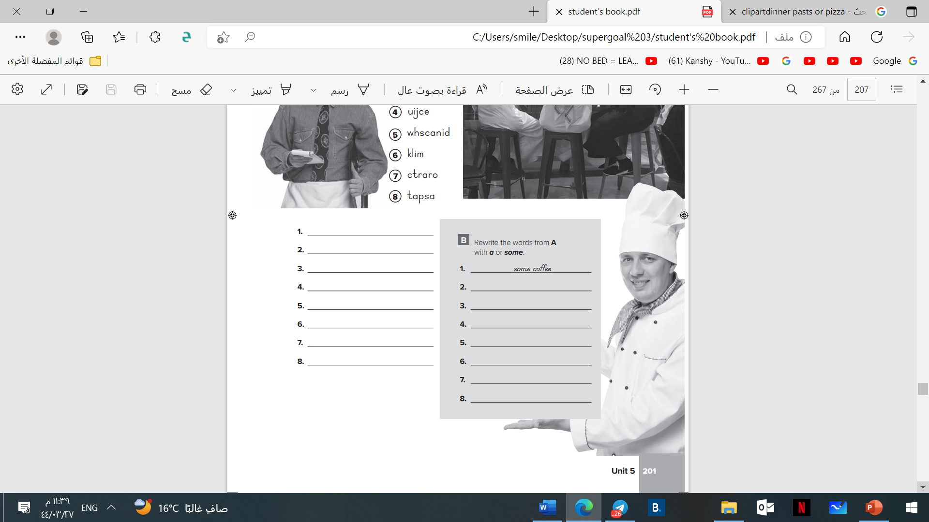
Page 201
coffee.
rice.
potato.
juice.
sandwich.
milk.
carrot.
pasta.

Slide 22
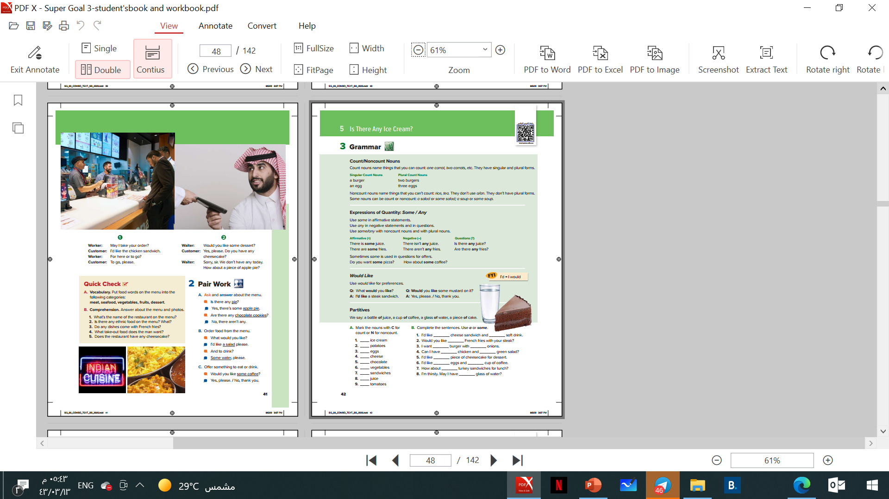
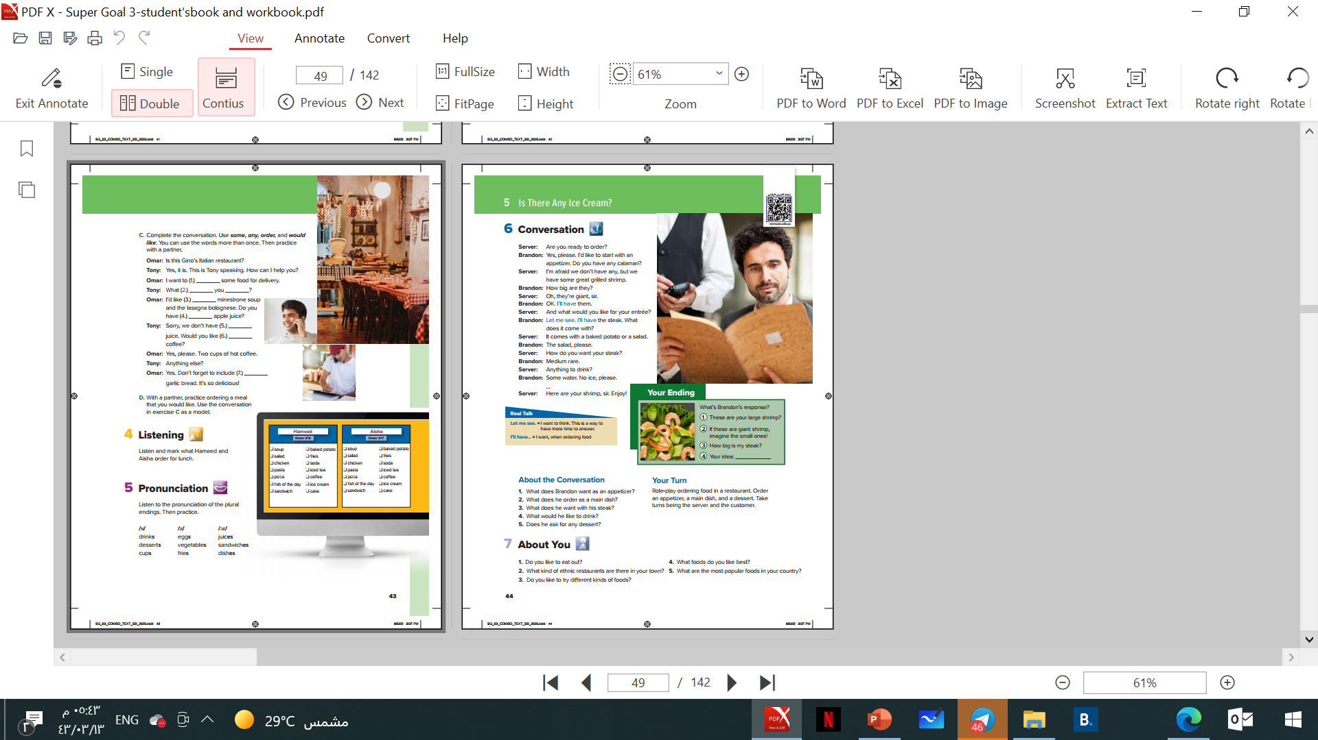
OBJECTIVES
● Ask using would like.
● Distinguish the count and non-count nouns.
● Use expressions of quantity.
● Choose the orders they hear.
● Recognize the pronunciation of plural endings.

Slide 23
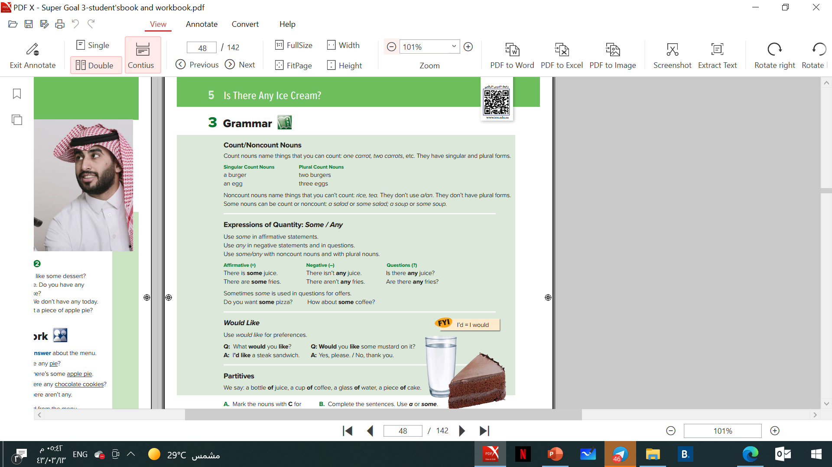
Page 42

Slide 24
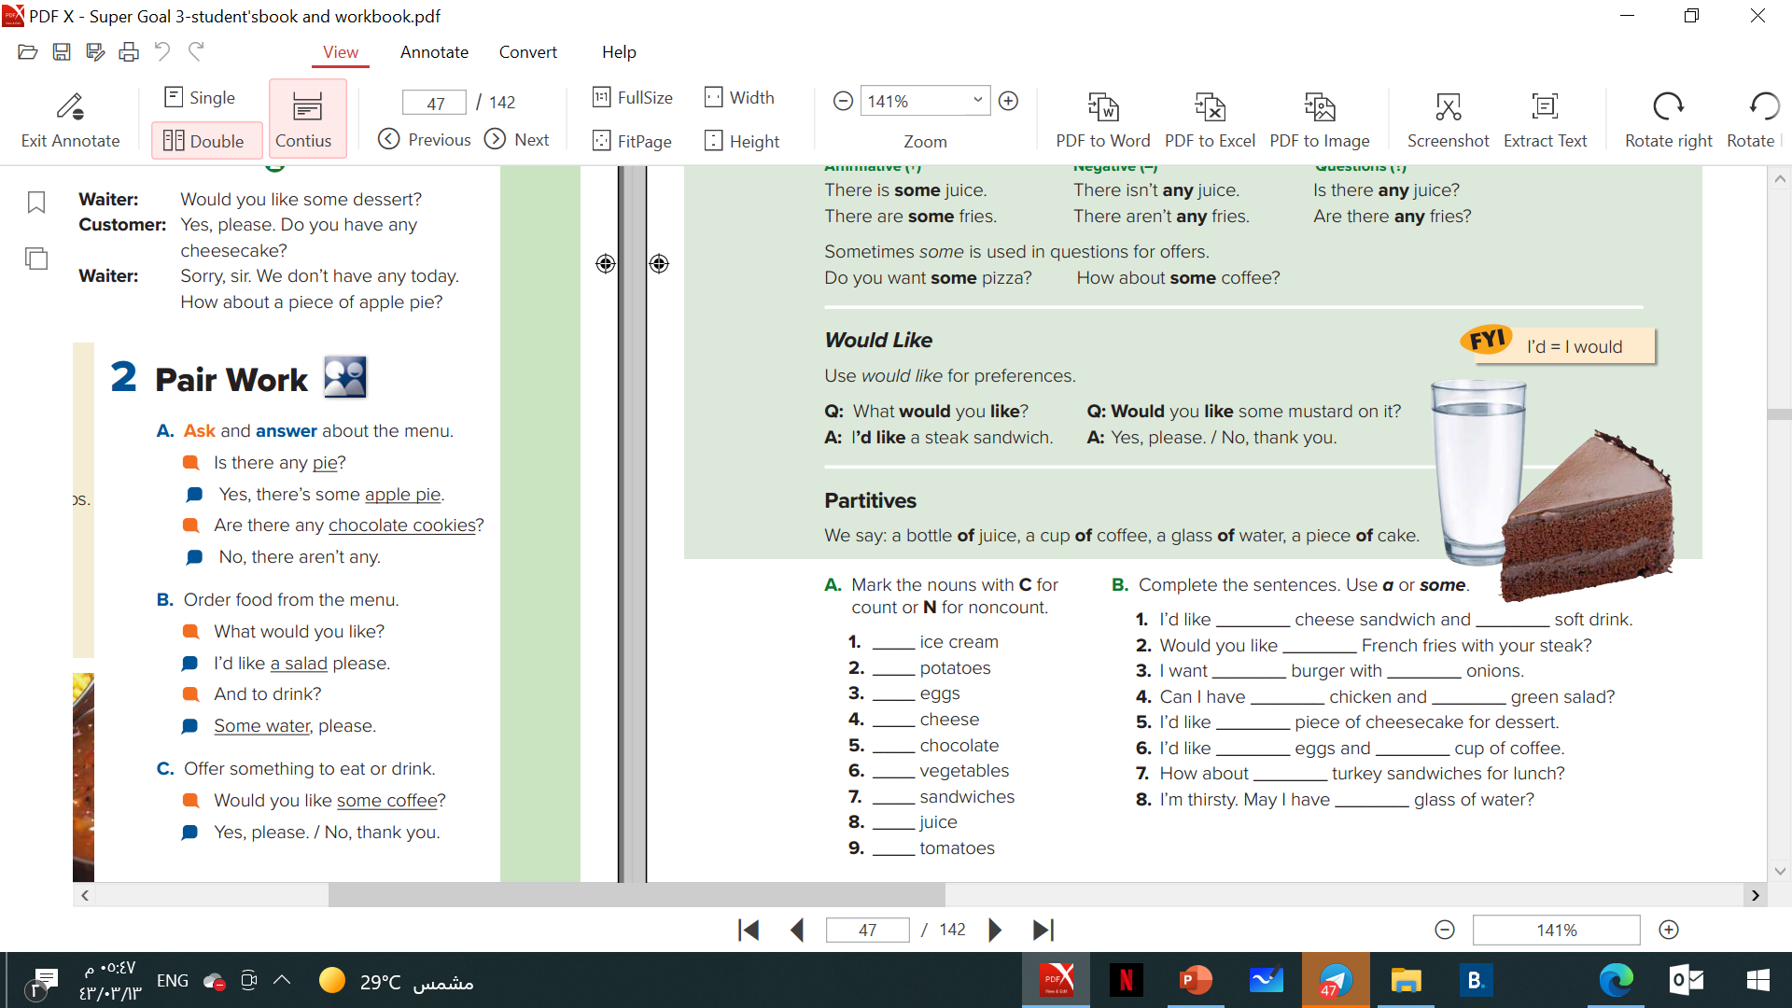

Page 42
N
C
C
N
N
C
C
N
C

Slide 25

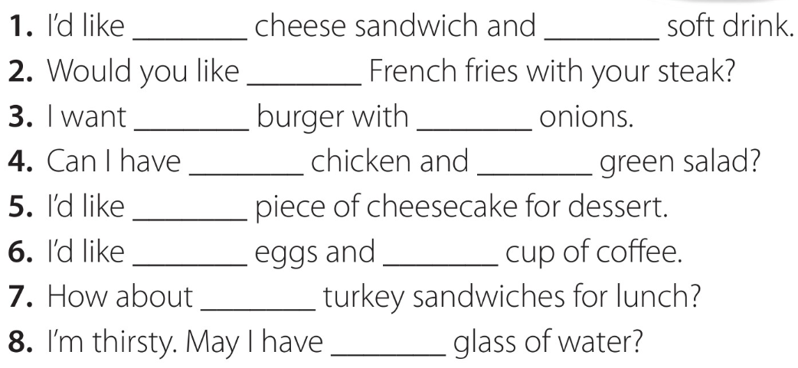
Page 42
a
a
some
a
some
some
a
a
some
a
some
a

Slide 26
Page 42

Slide 27
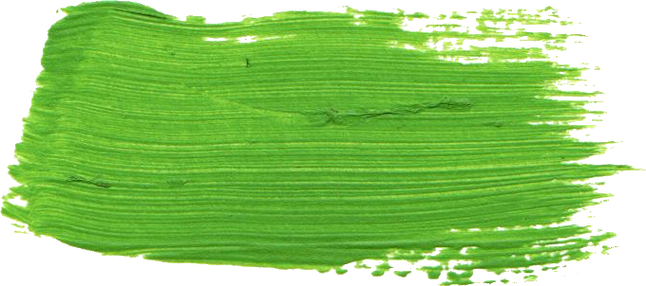
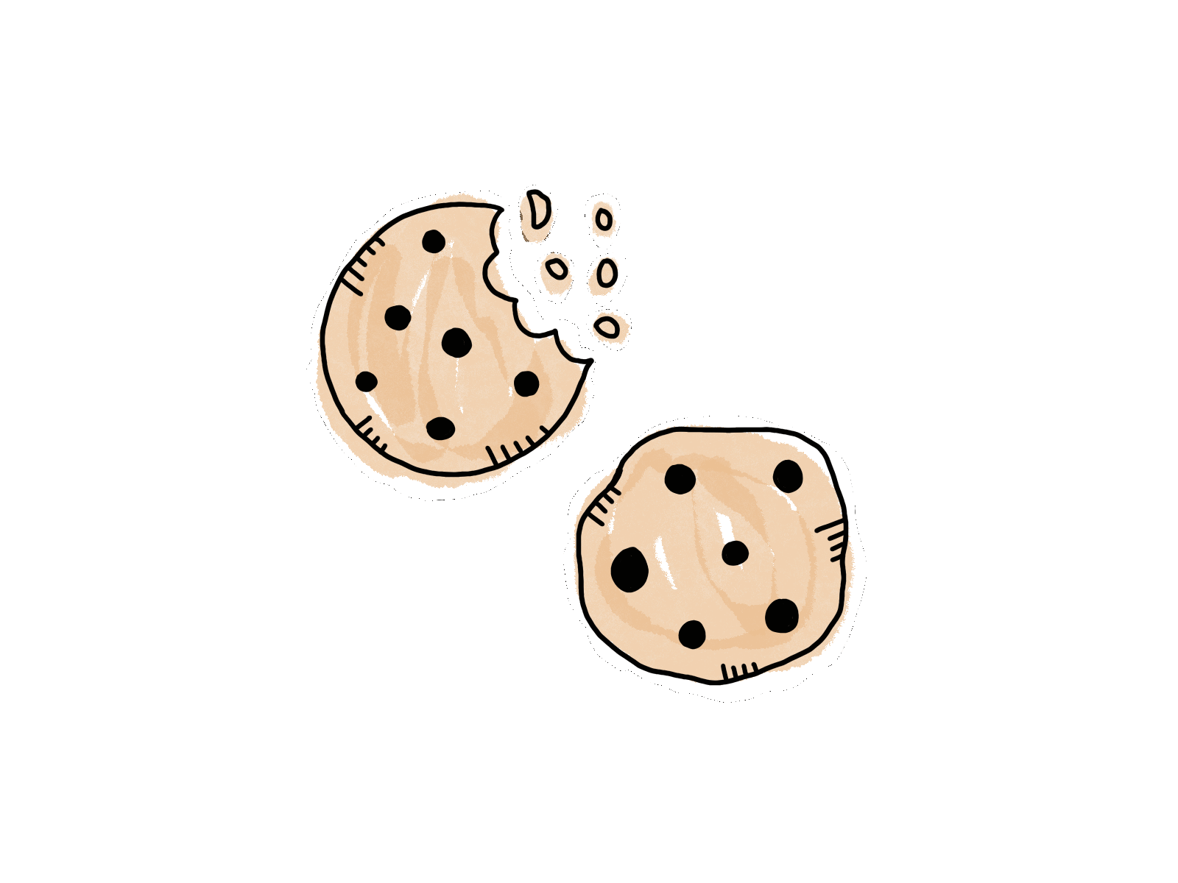
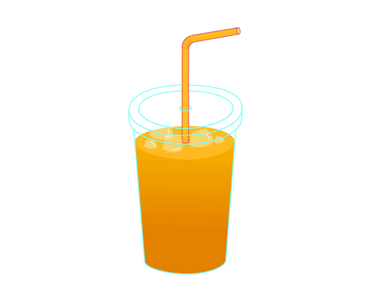
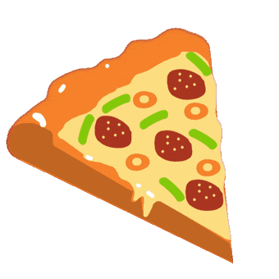
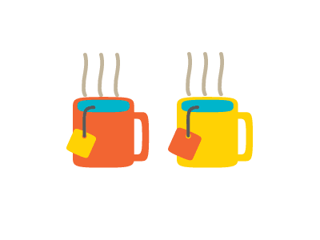
Some
Omar has some cookies.
Affirmative sentences
There is some juice
Do you want some pizza ?
Offers
How about some tea ?

Slide 28
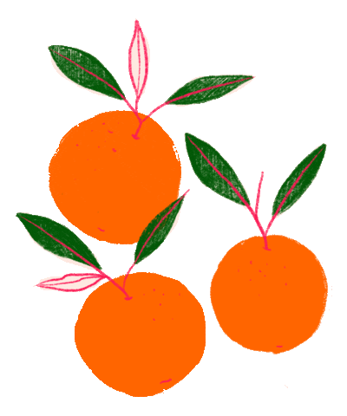

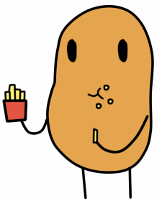
Any
There aren’t any oranges.
Negative sentences
There isn’t any ice cream.
Is there any coffee ?
Questions
Do you have any potatoes ?

Slide 30
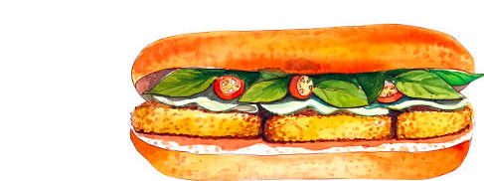

Would like
What would you like to eat ?
I would like ( ‘d like ) a chicken sandwich.
Would you like some daunts ?
Yes, please.
No, thank you.

Slide 31
Page 42

Slide 32
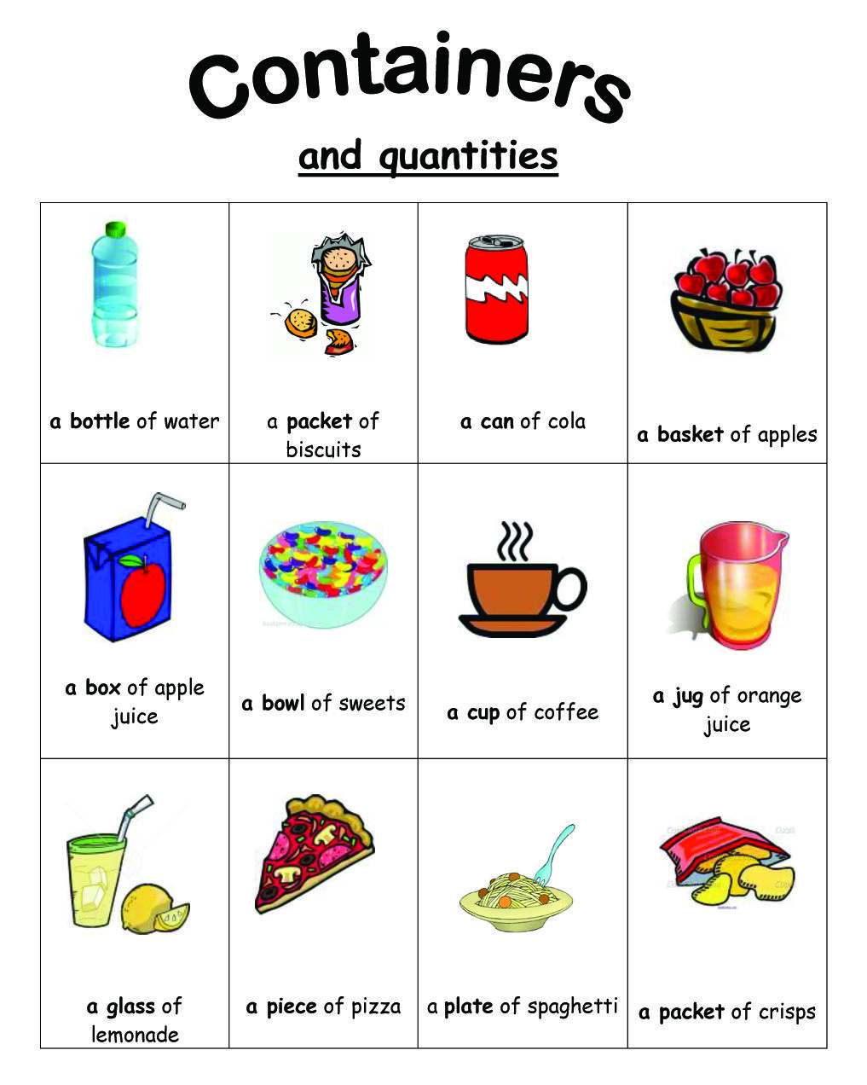

Slide 33
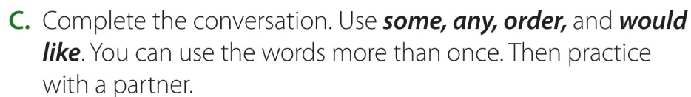
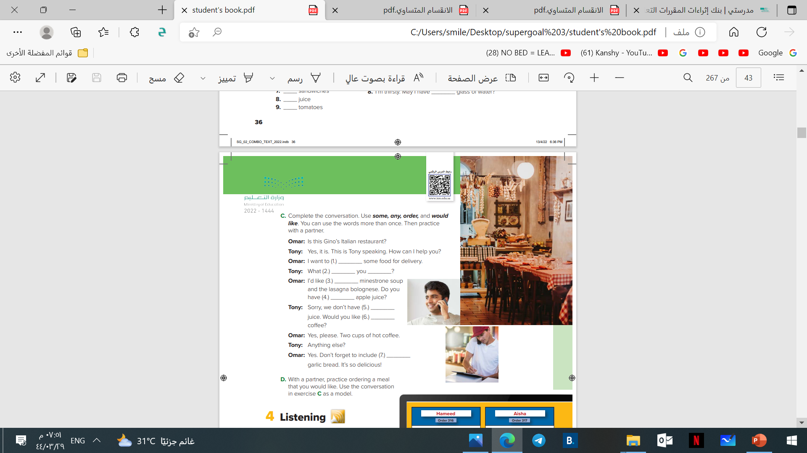
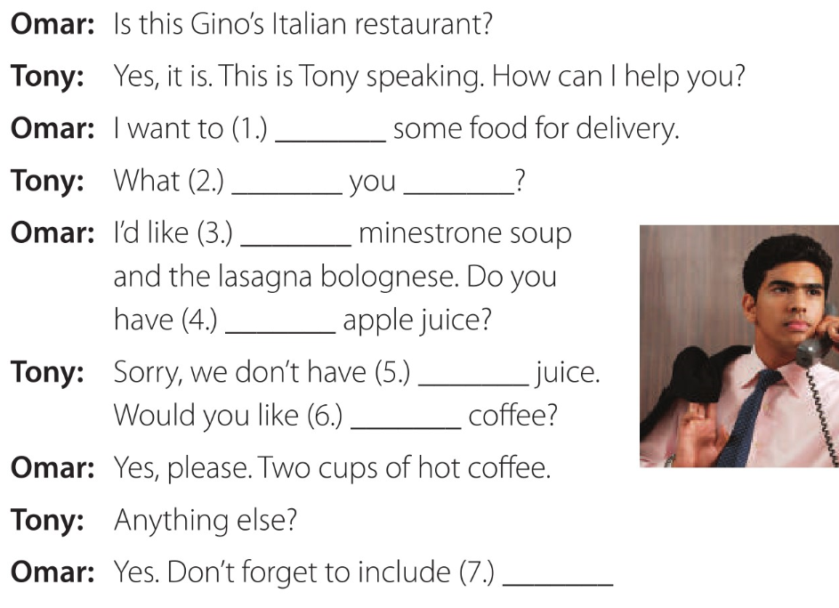
Page 43
order
would
like
some
any
any
some
some

Slide 34

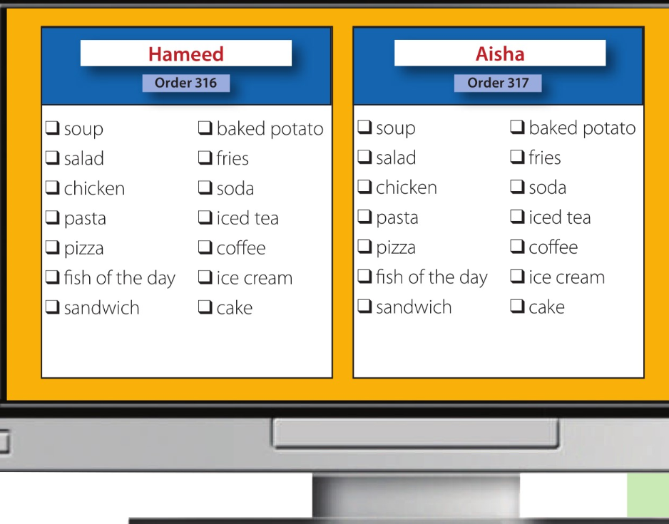


Page 43
listen and mark (√) what Hameed and Aisha order.

Slide 35
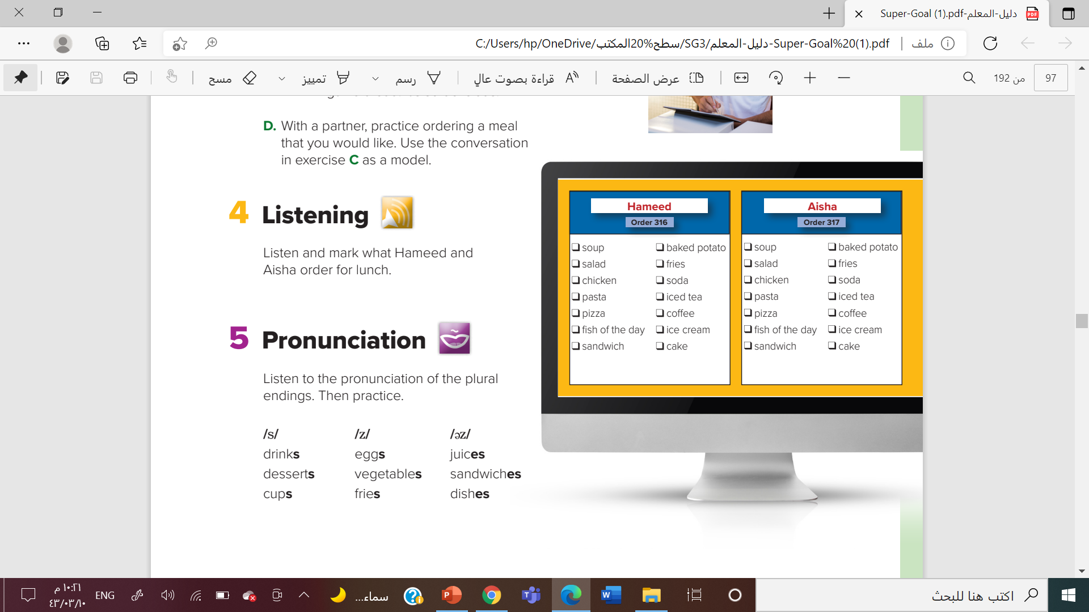
Page 43

Slide 36
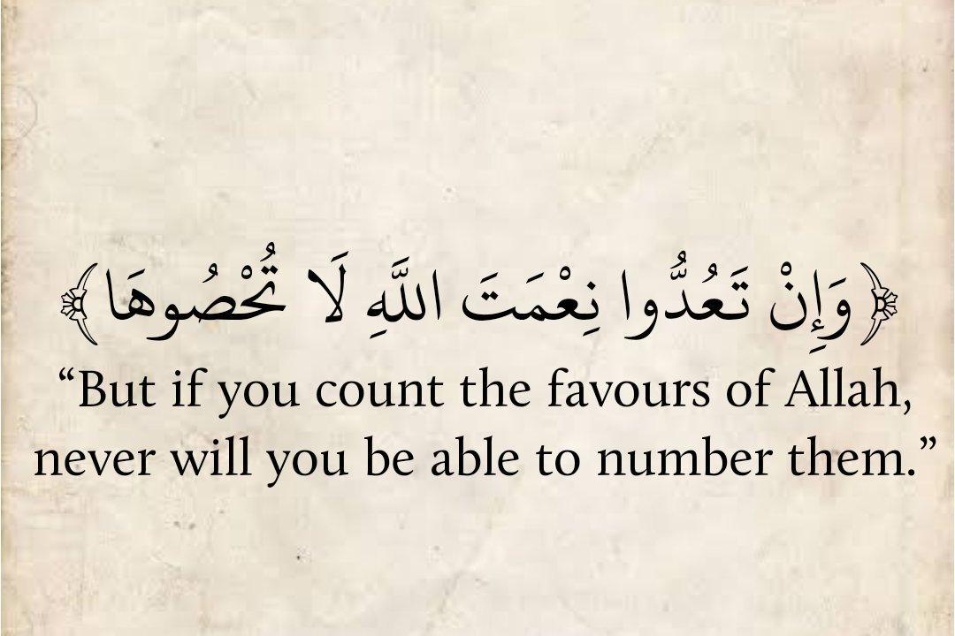

Slide 37
Page 202- 203

Slide 40
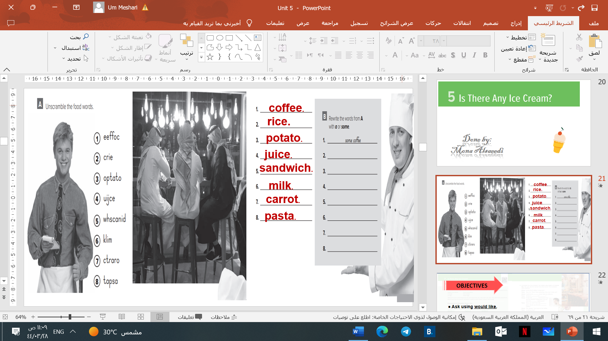
Page 201
Some rice.
A potato.
Some juice.
A sandwich.
Some milk.
A carrot.
Some pasta.

Slide 41
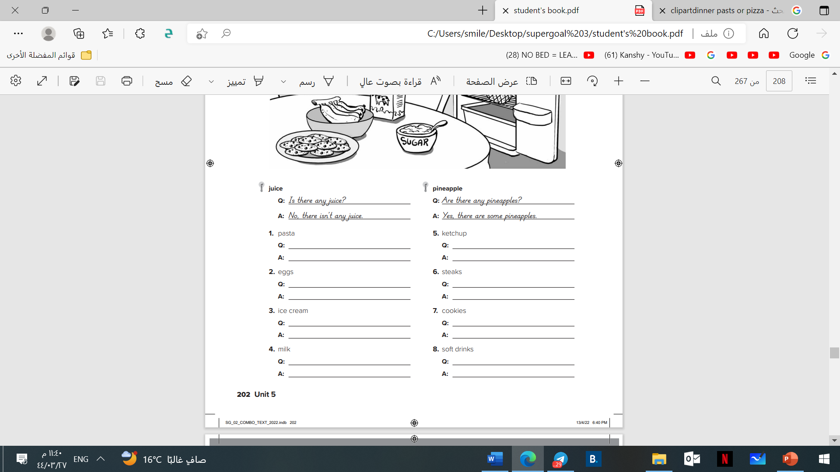
Page 202
Is there any pasta?
No, there isn’t any pasta.
Are there any eggs?
Yes, there some eggs.
Is there any ice cream?
No, there isn’t any ice cream.

Slide 42
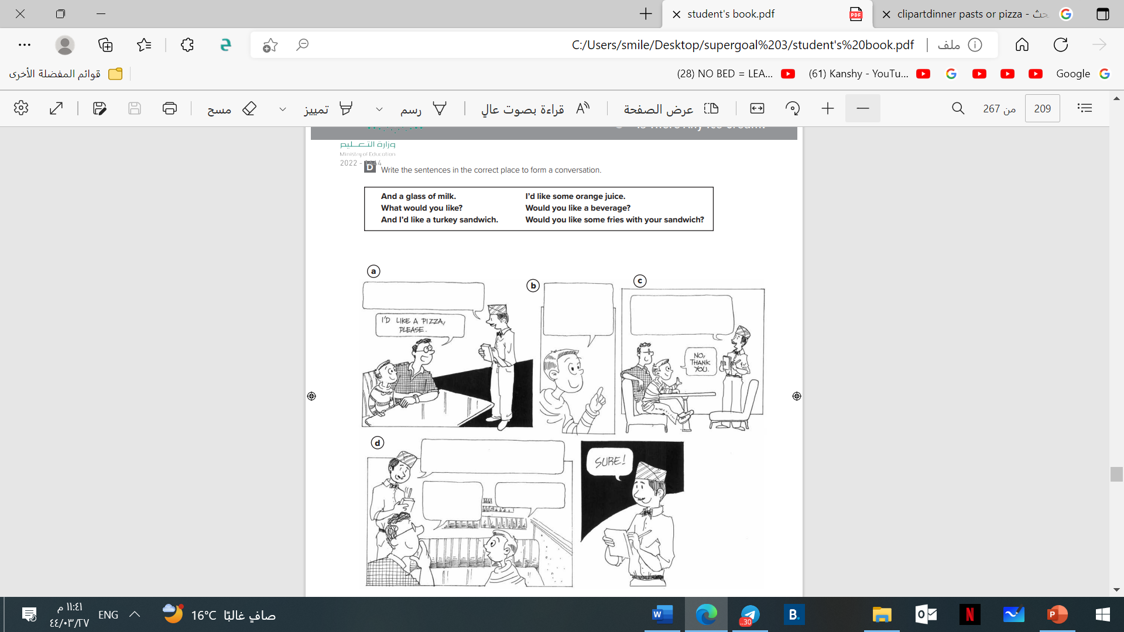
Page 203
What would you like?
And I’d
like a turkey sandwich.
Would you like some
fries with your
sandwich?

Slide 43
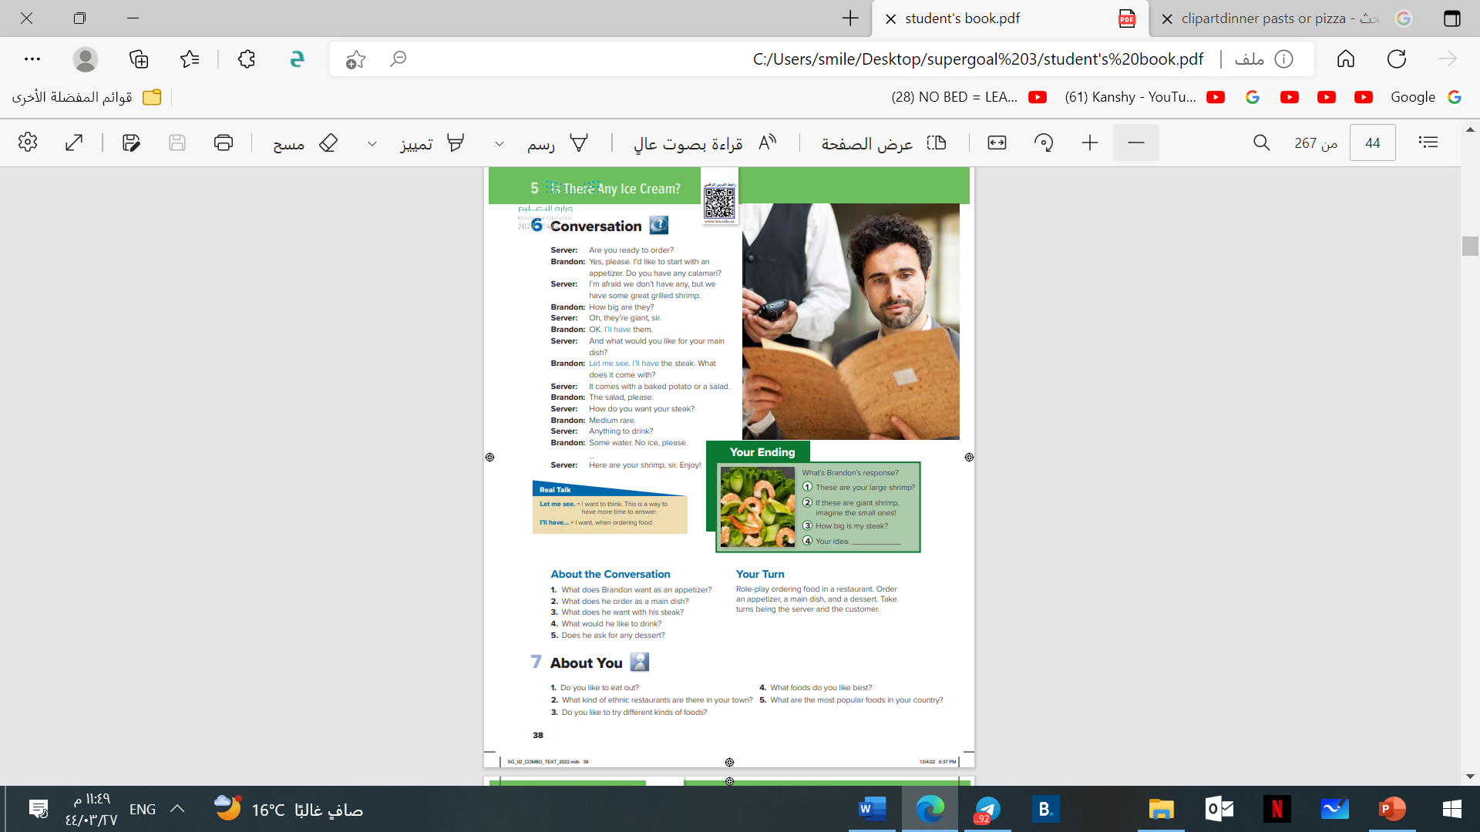
OBJECTIVES
objectives
Use the real talk in a conversation.
Find the meaning of words in the text.

Slide 44
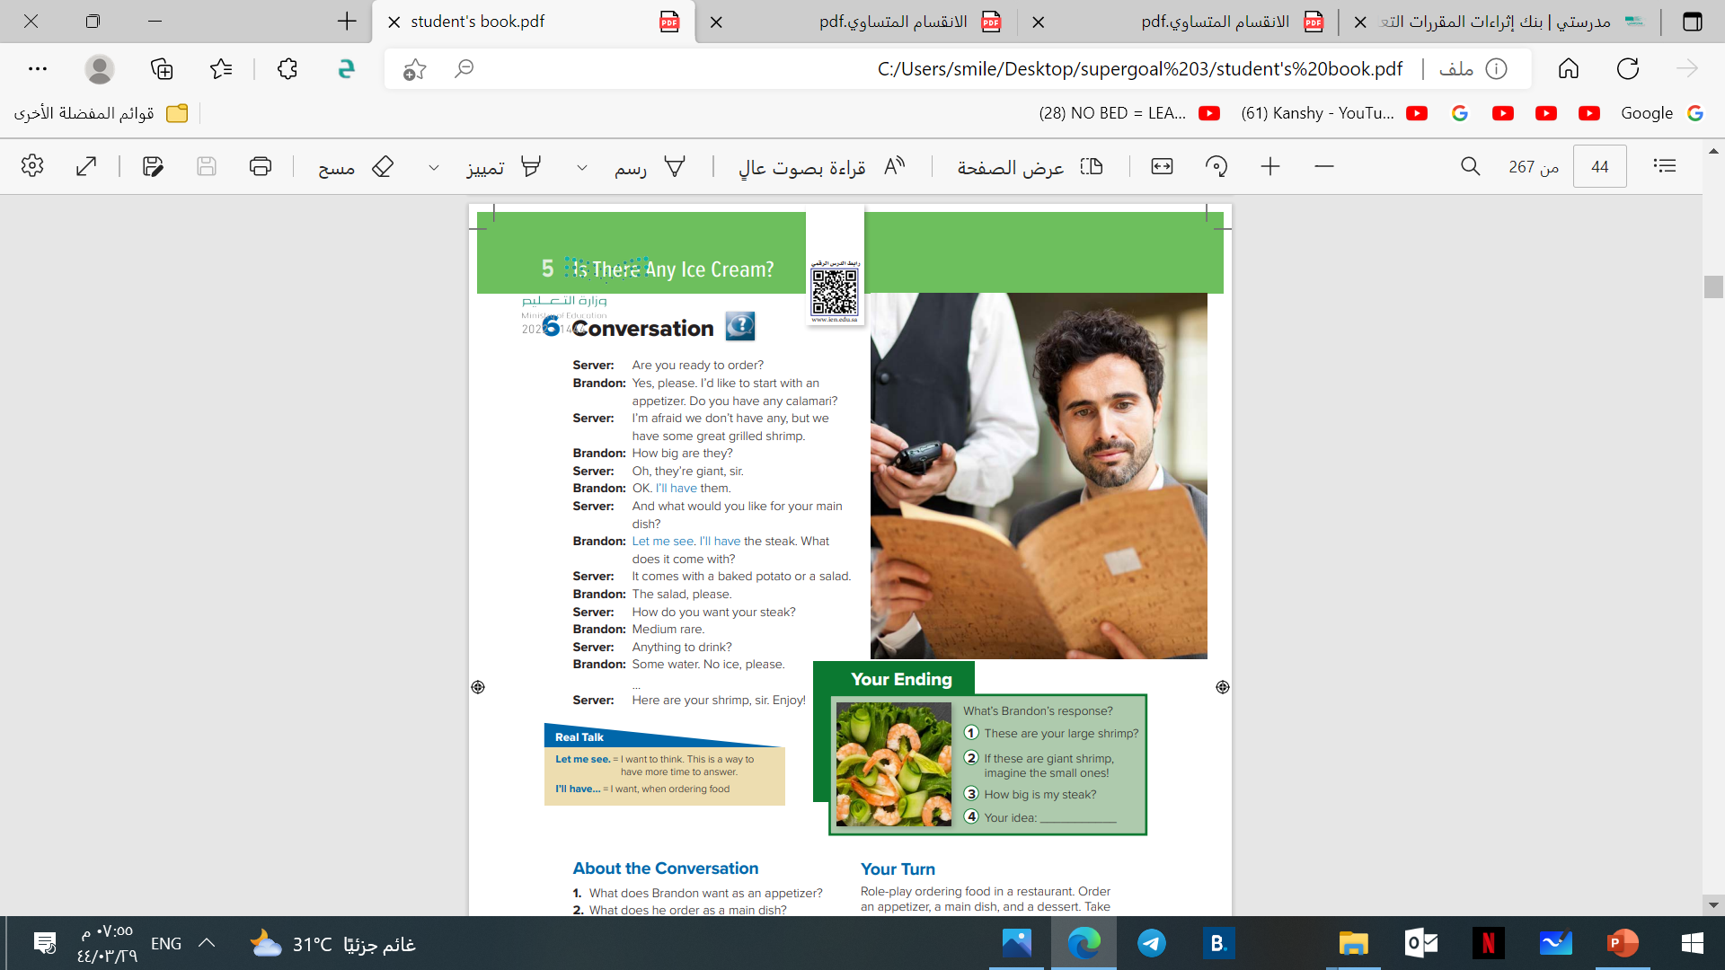
A waiter
A customer.
Who are the people in picture?
What are they doing?
What do you think they are
talking about?

Slide 45


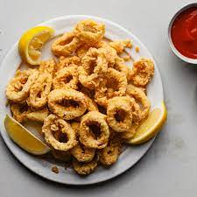
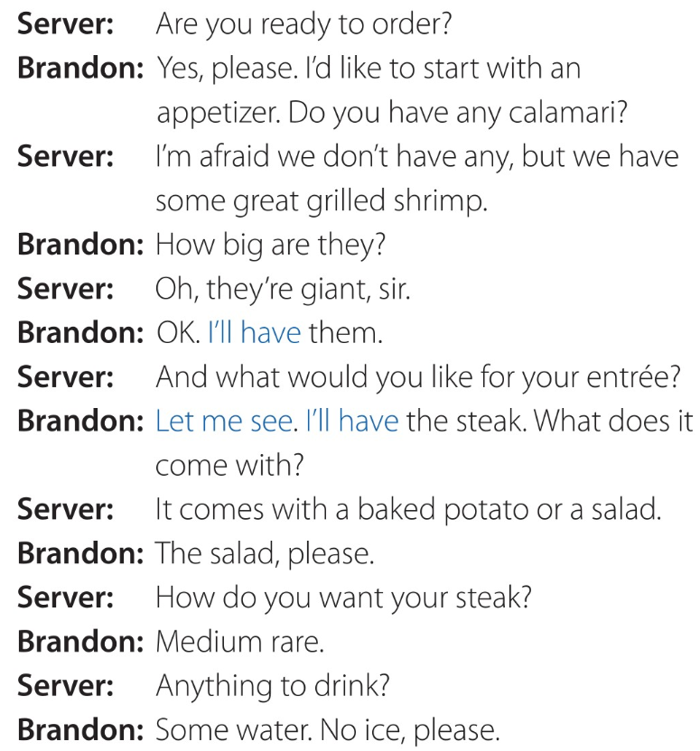
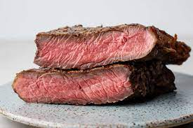
Page 44
huge , very big.

Slide 46
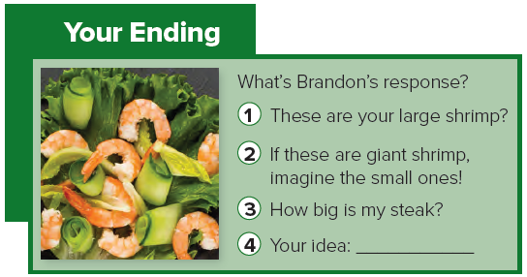
Page 44

Slide 47

Page 44

Slide 48


Page 44
1-He wants some calamari.
2-He orders the steak.
3-He wants the salad.
4-He would like some water (with no ice).
5-No, he doesn’t.

Slide 49

Page 44

Slide 53

OBJECTIVES
List some of the international foods.
Read the text about globalizations of foods.

Slide 54






Slide 55

Page 45
Try of find out the names of some continents.
Try of find out the names of some countries.
Try of find out the names of some cities.
Try of find out the names of some ethnic foods.
Try of find out the names of some famous restaurant and cafe.
4,800
78,000

Slide 56

Main ideas.
Page 45
The international popularity of
fast-food chains.
4,800
The international popularity of
ethnic foods.
Famous brand in different countries.
78,000

Slide 57

Page 45
    1- burgers, sandwiches, pizza, ice cream, coffee, and soft drinks.
    2. Yes, more or less.
3. Inca Kola .
4. Yes, it is.
5. doner.

Slide 58
Page 204

Slide 61

Page 204
It’s in Naples, Italy.
They are red ,white and green.
The mozzarella cheese is white.
I like ……… pizza.

Slide 62


OBJECTIVES
Use "Too and Enough "in a sentence.
Use "Too many and too much “ in a sentence
Answer the question in the book

Slide 63

Page 46

Slide 64

Page 46
5
2
8
6
1
4
7
3

Slide 65

Page 47

Slide 66



too
enough
Before adjectives and adverbs.
After adjectives and adverbs
The soup is too salty.
The soup is salty enough.
Before nouns
The tea is too sweaty.
I don’t have enough money to buy
this watch.
I have enough time to eat my breakfast.

Slide 67

Page 47
enough
too
too
enough
enough
too
too
enough

Slide 68
Page 47

Slide 69


Too much
Too many
Before non counts nouns.
Before counts nouns.
There is too much sugar in the tea.
There are too many cars in the street.

Slide 70


Page 47
too many
too many
Too much
too many
too much
too much
not enough
not enough

Slide 71
Page 47

Slide 72



The coffee is too hot to drink.
I have enough eggs to make an omelet.
It is too cold to go camping.

Slide 73
Page 47
to call her on the phone.
to finish the work.
to make a cake?
to drive a car.
to do my homework.
to talk to me?

Slide 74
Page 204

