Slide 1


Slide 2
What Will They Think of Next?
Conversation
Listening
Pronunciation
Vocabulary Building

Slide 3
Goals:
Invent a conversation using the new words
1
Find expressions and phrases for persuading in the conversation
2
Find out the meaning of the new words
3
Use the "real talk" in new sentences
4
Use phrases for persuading in sentence
5
6
Find the consonant cluster in a word
Match the words with their meanings
7

Slide 4
What Will They Think of Next?
Conversation

Slide 5
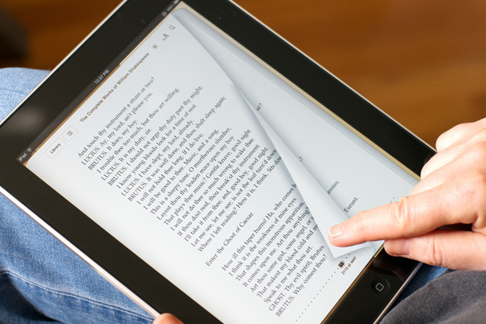
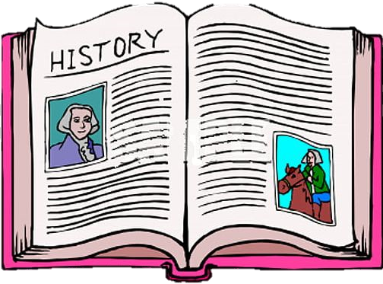
Electronic book
Paper book

Slide 6
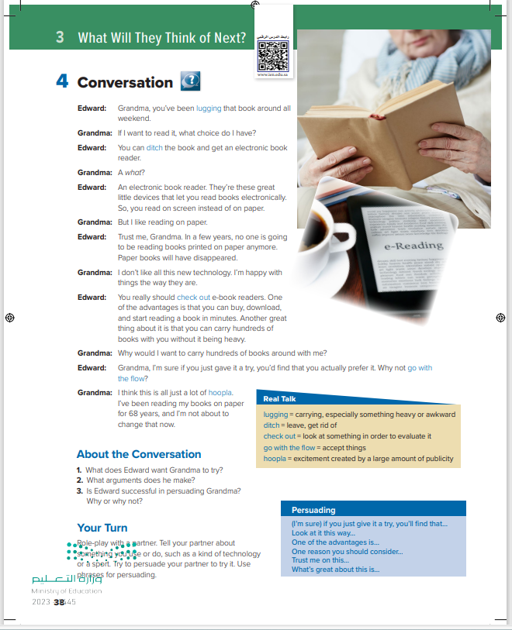
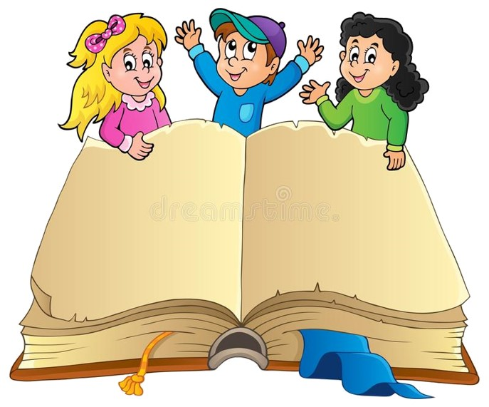
Students Book
P.38

Slide 7
What do you think the old lady is doing?
She is reading a book.
What device do you see?
an electronic book reader or e-reader
Do any of you use an e-reader?
What do you like about it?
What don’t you like about it?
How many books can it hold?

Slide 8

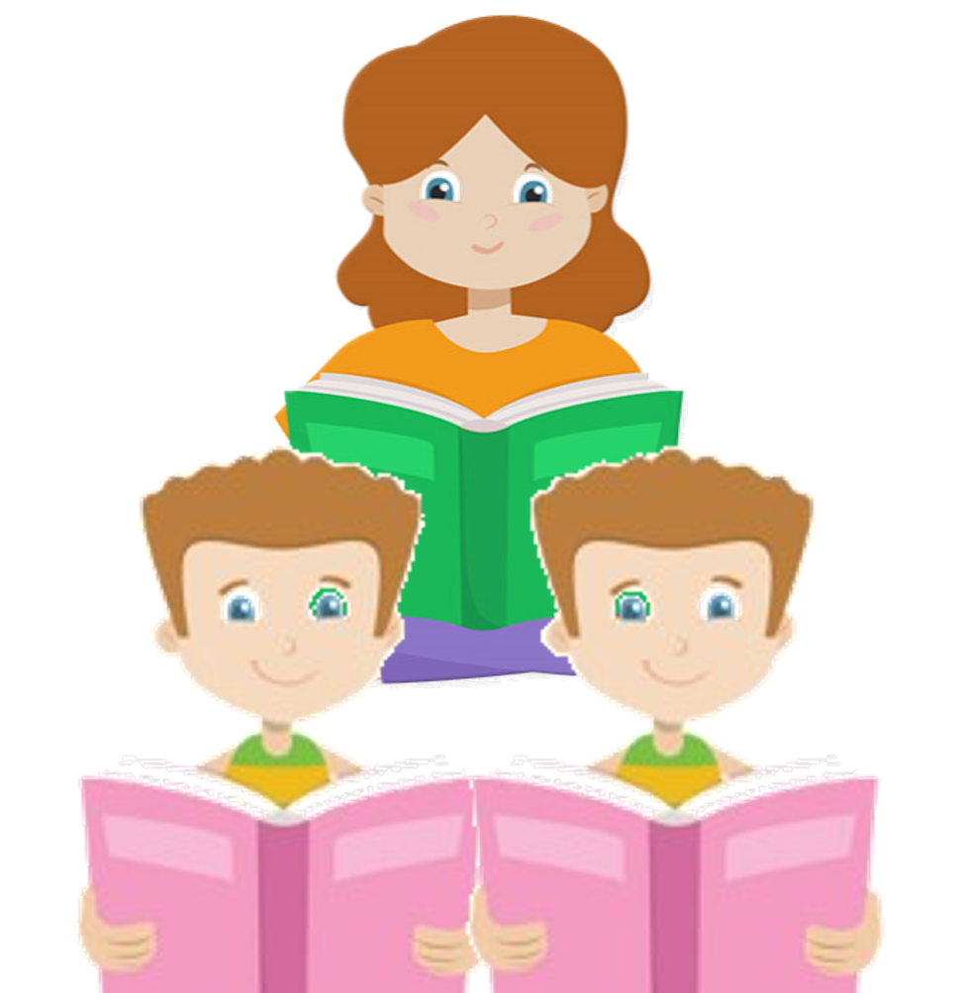

Book Closed & Listen

Slide 9
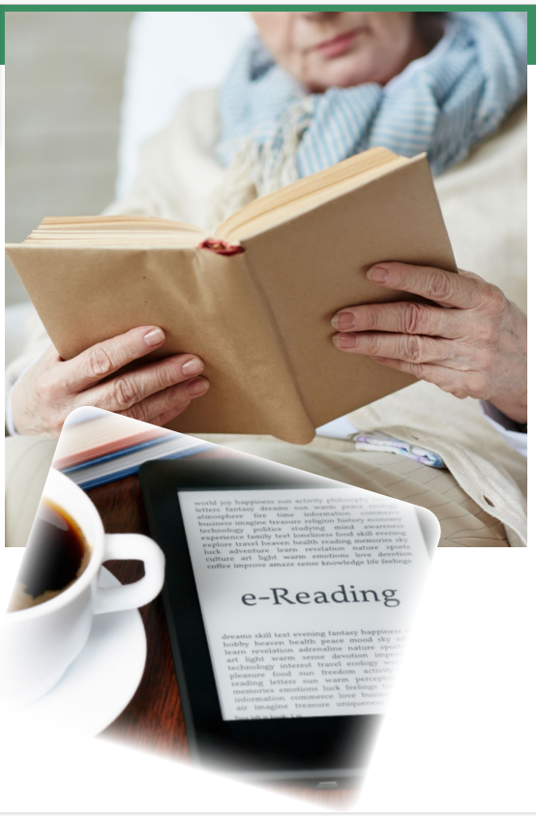
listen and read along.
Edward: Grandma, you’ve been lugging that book around all weekend.
Grandma: If I want to read it, what choice do I have?
Edward: You can ditch the book and get an electronic book reader.
Grandma: A what?
Edward: An electronic book reader. They’re these great little devices that let you read books electronically. So, you read on screen instead of on paper.
Grandma: But I like reading on paper.
Edward: Trust me, Grandma. In a few years, no one is going to be reading books printed on paper anymore. Paper books will have disappeared.
Grandma: I don’t like all this new technology. I’m happy with things the way they are.
Edward: You really should check out e-book readers. One of the advantages is that you can buy, download, and start reading a book in minutes. Another great thing about it is that you can carry hundreds of books with you without it being heavy.
Grandma: Why would I want to carry hundreds of books around with me?
Edward: Grandma, I’m sure if you just gave it a try, you’d find that you actually prefer it. Why not go with the flow?
Grandma: I think this is all just a lot of hoopla. I’ve been reading my books on paper for 68 years, and I’m not about to change that now

Slide 10
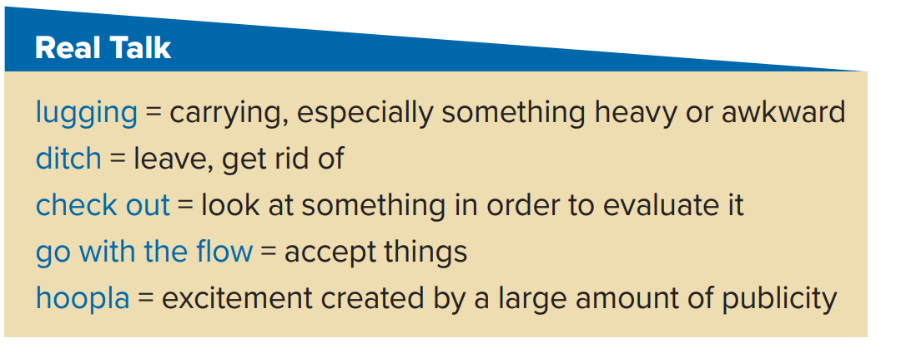
What is Grandma lugging around?
Her book
Edward: Grandma, you’ve been lugging that book around all weekend.
Grandma: If I want to read it, what choice do I have?
Edward: You can ditch the book and get an electronic book reader.
Grandma: A what?
Edward: An electronic book reader. They’re these great little devices that let you read books electronically. So, you read on screen instead of on paper.
Grandma: But I like reading on paper.
Edward: Trust me, Grandma. In a few years, no one is going to be reading books printed on paper anymore. Paper books will have disappeared.
Grandma: I don’t like all this new technology. I’m happy with things the way they are.
Edward: You really should check out e-book readers. One of the advantages is that you can buy, download, and start reading a book in minutes. Another great thing about it is that you can carry hundreds of books with you without it being heavy.
Grandma: Why would I want to carry hundreds of books around with me?
Edward: Grandma, I’m sure if you just gave it a try, you’d find that you actually prefer it. Why not go with the flow?
Grandma: I think this is all just a lot of hoopla. I’ve been reading my books on paper for 68 years, and I’m not about to change that now
What does Edward want Grandma to ditch?
Her book
What does Edward suggest Grandma check out?
e-book readers
If Grandma goes with the flow, what will she do?
read from e-book readers rather than books
Why does Grandma think using e-book readers is hoopla?
She thinks they are just the latest fad.

Slide 12
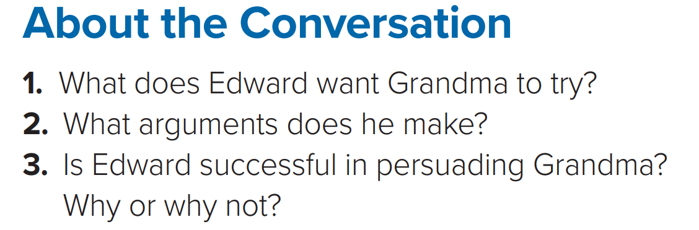
1.He wants her to try reading on an electronic book reader.
2. E-book readers can hold hundreds of books. You can buy, download, and start reading a book in minutes.
3. Edward does not persuade Grandma. She doesn’t want to change.

Slide 13
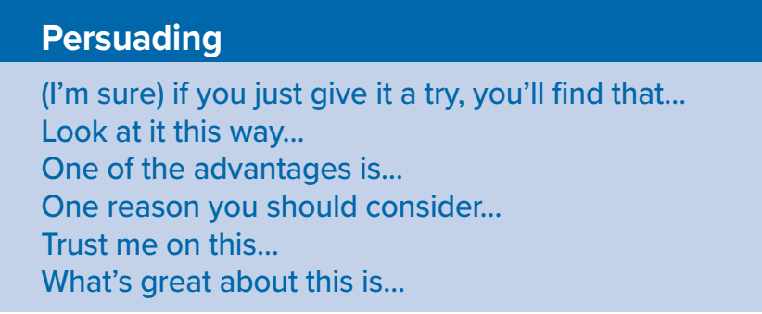


What is something that you dislike lugging around?
When you go to the mall, what do you like to check out?
(I always go to the video game store to check out what’s new
(I don’t like lugging around all of my books during the day. They are so heavy
Sometimes is it easier to go with the flow? Explain
What is something you would like to ditch?
(I didn’t want to go to watch a film last weekend but everyone else did so I just went with the flow
(I’d like to ditch my old laptop and get a new lighter one

Slide 15
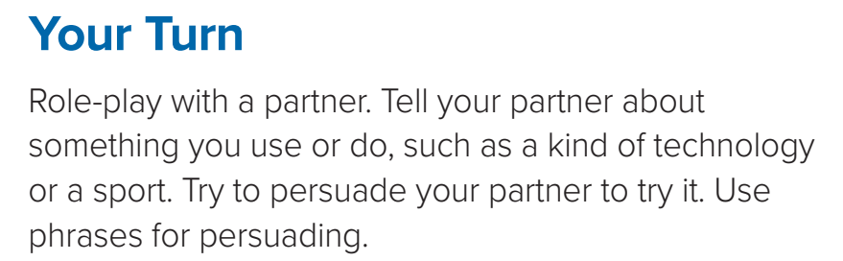

Slide 16
Listening

Slide 17


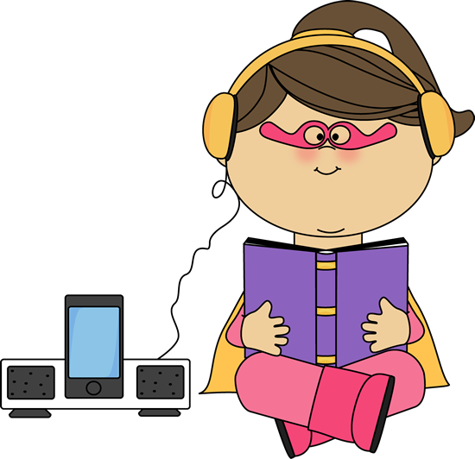
Listen to the information about the future of newspapers. Then complete the chart with the advantages and disadvantages of each news format
Newspapers | Advantages | Disadvantages
Print | large, lightweight, portable | not up-to-the-minute news; not free
Online | free; up-to-the-minute news, interactivity, video capability | computer screen graphics
Electronic | look more like paper than a computer screen; large, lightweight, portable; savings for newspapers

Slide 18
Pronunciation

Slide 19
Consonant clusters may contain two or three consonants, for example: broken, plan, understand, street, spray, hungry. Be careful not to separate the consonants in a cluster with a vowel sound or add a vowel sound before the cluster.
1-The Internet brought great change to the newspaper industry.
2. To stay competitive, it soon became important to have an online presence.
3. Newspapers could present up-to-the-minute news, instead of having to wait to print it.
4. The electronic newspaper reader will have the look and feel of a print newspaper.
5. It will have a portable screen that is flexible.
6. One newspaper publisher predicts, “By 2030, we will have stopped printing paper newspapers completely.”

Slide 20
Vocabulary Building

Slide 21
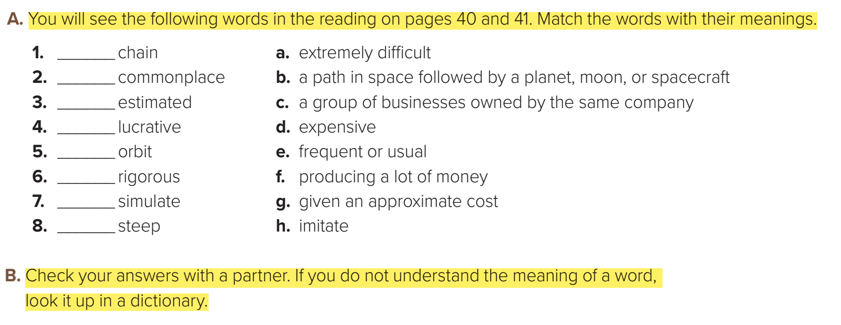
C
e
g
f
b
a
h
d

Slide 22


