Slide 1
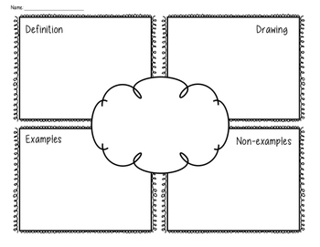
Frayer Model Strategy
Teacher : Huda Alsubhi

