Slide 1




تشابه المضلعات
@ amal_almazroai
@ ma3aly_alharbi

Slide 2
۞ وَهُوَ الَّذِي أَنشَأَ جَنَّاتٍ مَّعْرُوشَاتٍ وَغَيْرَ مَعْرُوشَاتٍ وَالنَّخْلَ وَالزَّرْعَ مُخْتَلِفًا أُكُلُهُ وَالزَّيْتُونَ وَالرُّمَّانَ مُتَشَابِهًا وَغَيْرَ مُتَشَابِهٍ ۚ كُلُوا مِن ثَمَرِهِ إِذَا أَثْمَرَ وَآتُوا حَقَّهُ يَوْمَ حَصَادِهِ ۖ وَلَا تُسْرِفُوا ۚ إِنَّهُ لَا يُحِبُّ الْمُسْرِفِينَ (141)
@ amal_almazroai
@ ma3aly_alharbi

Slide 3


صور للتشابه
@ amal_almazroai
@ ma3aly_alharbi

Slide 4
من الذي ليس له مثيل او شبيه ؟
الله سبحانه و تعالى
" ليس كمثله شيء و هو السميع البصير "
@ amal_almazroai
@ ma3aly_alharbi

Slide 5
فكرة الدرس
المفردات
المضلع
المضلعات المتشابهة
الأجزاء المتناظرة
التطابق
عامل المقياس
أعين المضلعات المتشابهة
وأجد القياسات الناقصة فيها
@ amal_almazroai
@ ma3aly_alharbi

Slide 6
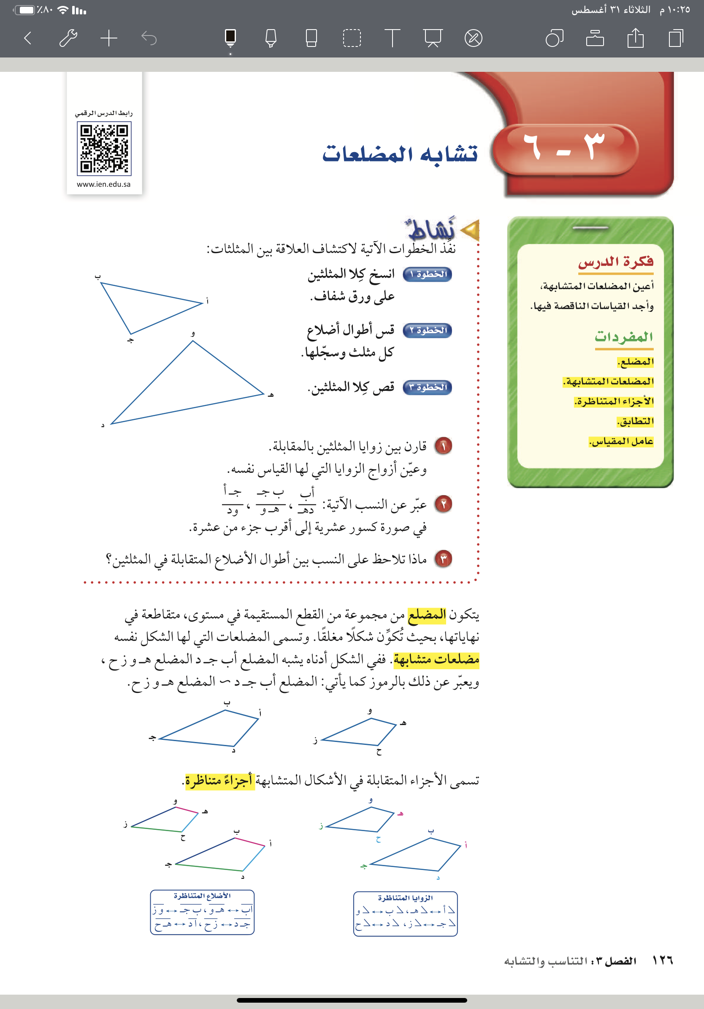
Contents of this template
Here’s what you’ll find in this Slidesgo template:
A slide structure based on a business portfolio presentation, which you can easily adapt to your needs. For more info on how to edit the template, please visit Slidesgo School or read our FAQs.
An assortment of graphic resources that are suitable for use in the presentation can be found in the alternative resources slides.
A thanks slide, which you must keep so that proper credits for our design are given.
In the resources slide, where you’ll find links to all the elements used in the template.
Instructions for use.
Final slides with:
The fonts and colors used in the template.
A selection of illustrations. You can also customize and animate them as you wish with the online editor. Visit Storyset to find more.
More infographic resources, whose size and color can be edited.
Sets of customizable icons of the following themes: general, business, avatar, creative process, education, help & support, medical, nature, performing arts, SEO & marketing, and teamwork.
You can delete this slide when you’re done editing the presentation.
@ amal_almazroai
@ ma3aly_alharbi

Slide 7
Contents of this template
Here’s what you’ll find in this Slidesgo template:
A slide structure based on a business portfolio presentation, which you can easily adapt to your needs. For more info on how to edit the template, please visit Slidesgo School or read our FAQs.
An assortment of graphic resources that are suitable for use in the presentation can be found in the alternative resources slides.
A thanks slide, which you must keep so that proper credits for our design are given.
In the resources slide, where you’ll find links to all the elements used in the template.
Instructions for use.
Final slides with:
The fonts and colors used in the template.
A selection of illustrations. You can also customize and animate them as you wish with the online editor. Visit Storyset to find more.
More infographic resources, whose size and color can be edited.
Sets of customizable icons of the following themes: general, business, avatar, creative process, education, help & support, medical, nature, performing arts, SEO & marketing, and teamwork.
You can delete this slide when you’re done editing the presentation.
@ amal_almazroai
@ ma3aly_alharbi

Slide 8
@ amal_almazroai
@ ma3aly_alharbi

Slide 9
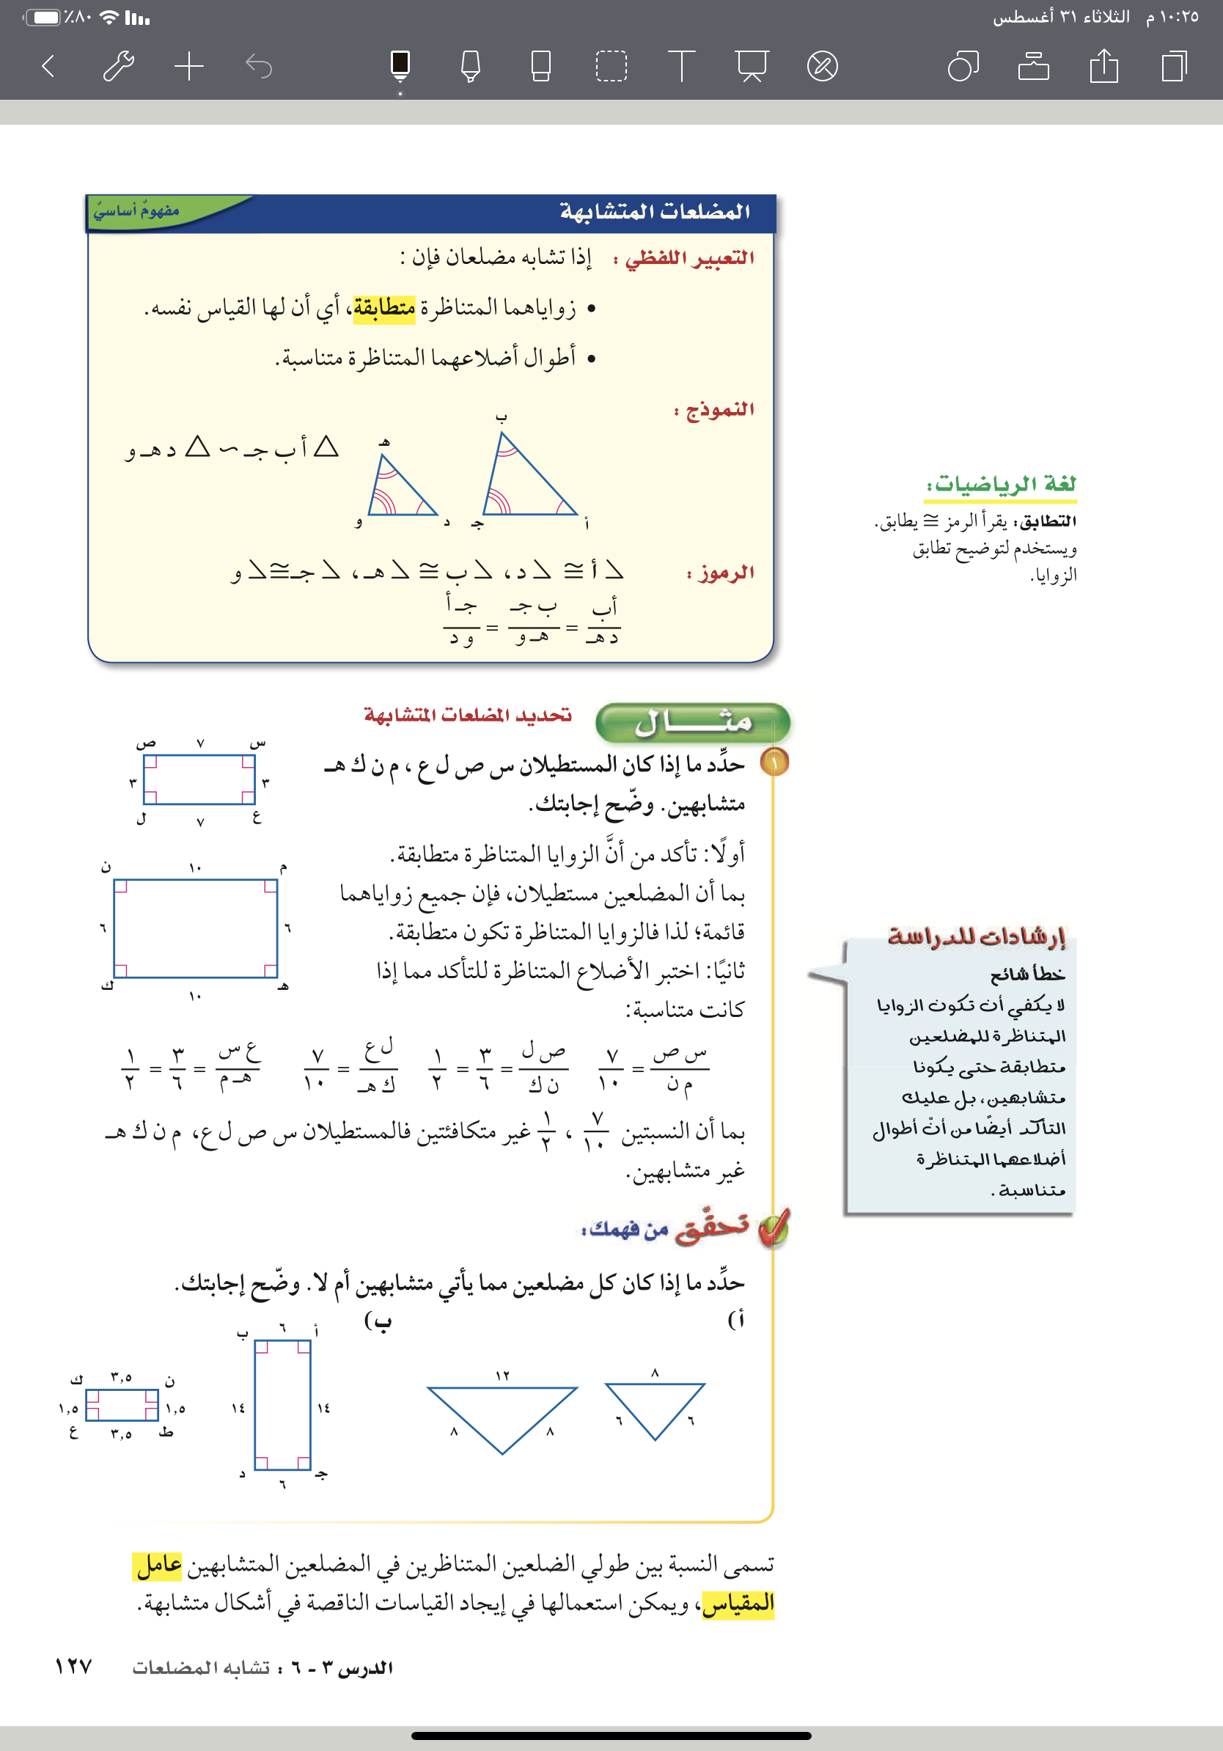
Contents of this template
Here’s what you’ll find in this Slidesgo template:
A slide structure based on a business portfolio presentation, which you can easily adapt to your needs. For more info on how to edit the template, please visit Slidesgo School or read our FAQs.
An assortment of graphic resources that are suitable for use in the presentation can be found in the alternative resources slides.
A thanks slide, which you must keep so that proper credits for our design are given.
In the resources slide, where you’ll find links to all the elements used in the template.
Instructions for use.
Final slides with:
The fonts and colors used in the template.
A selection of illustrations. You can also customize and animate them as you wish with the online editor. Visit Storyset to find more.
More infographic resources, whose size and color can be edited.
Sets of customizable icons of the following themes: general, business, avatar, creative process, education, help & support, medical, nature, performing arts, SEO & marketing, and teamwork.
You can delete this slide when you’re done editing the presentation.
@ amal_almazroai
@ ma3aly_alharbi

Slide 10
Contents of this template
Here’s what you’ll find in this Slidesgo template:
A slide structure based on a business portfolio presentation, which you can easily adapt to your needs. For more info on how to edit the template, please visit Slidesgo School or read our FAQs.
An assortment of graphic resources that are suitable for use in the presentation can be found in the alternative resources slides.
A thanks slide, which you must keep so that proper credits for our design are given.
In the resources slide, where you’ll find links to all the elements used in the template.
Instructions for use.
Final slides with:
The fonts and colors used in the template.
A selection of illustrations. You can also customize and animate them as you wish with the online editor. Visit Storyset to find more.
More infographic resources, whose size and color can be edited.
Sets of customizable icons of the following themes: general, business, avatar, creative process, education, help & support, medical, nature, performing arts, SEO & marketing, and teamwork.
You can delete this slide when you’re done editing the presentation.
@ amal_almazroai
@ ma3aly_alharbi

Slide 11
@ amal_almazroai
@ ma3aly_alharbi

Slide 12
Contents of this template
Here’s what you’ll find in this Slidesgo template:
A slide structure based on a business portfolio presentation, which you can easily adapt to your needs. For more info on how to edit the template, please visit Slidesgo School or read our FAQs.
An assortment of graphic resources that are suitable for use in the presentation can be found in the alternative resources slides.
A thanks slide, which you must keep so that proper credits for our design are given.
In the resources slide, where you’ll find links to all the elements used in the template.
Instructions for use.
Final slides with:
The fonts and colors used in the template.
A selection of illustrations. You can also customize and animate them as you wish with the online editor. Visit Storyset to find more.
More infographic resources, whose size and color can be edited.
Sets of customizable icons of the following themes: general, business, avatar, creative process, education, help & support, medical, nature, performing arts, SEO & marketing, and teamwork.
You can delete this slide when you’re done editing the presentation.
@ amal_almazroai
@ ma3aly_alharbi

Slide 13
Contents of this template
Here’s what you’ll find in this Slidesgo template:
A slide structure based on a business portfolio presentation, which you can easily adapt to your needs. For more info on how to edit the template, please visit Slidesgo School or read our FAQs.
An assortment of graphic resources that are suitable for use in the presentation can be found in the alternative resources slides.
A thanks slide, which you must keep so that proper credits for our design are given.
In the resources slide, where you’ll find links to all the elements used in the template.
Instructions for use.
Final slides with:
The fonts and colors used in the template.
A selection of illustrations. You can also customize and animate them as you wish with the online editor. Visit Storyset to find more.
More infographic resources, whose size and color can be edited.
Sets of customizable icons of the following themes: general, business, avatar, creative process, education, help & support, medical, nature, performing arts, SEO & marketing, and teamwork.
You can delete this slide when you’re done editing the presentation.
@ amal_almazroai
@ ma3aly_alharbi

Slide 14
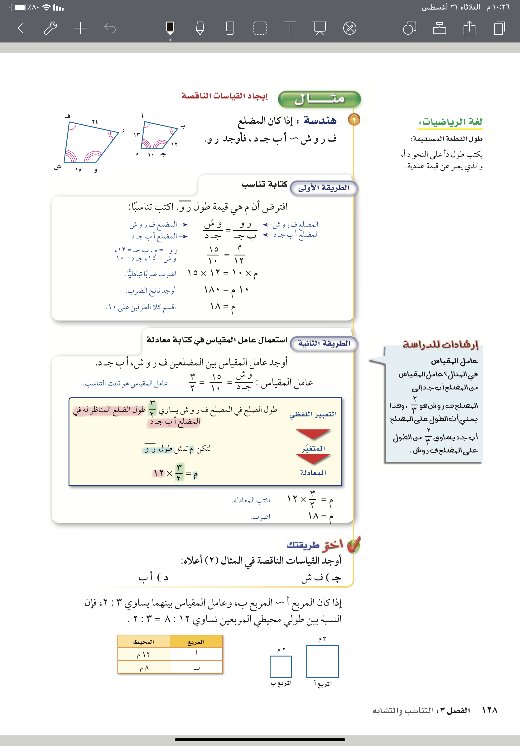
Contents of this template
Here’s what you’ll find in this Slidesgo template:
A slide structure based on a business portfolio presentation, which you can easily adapt to your needs. For more info on how to edit the template, please visit Slidesgo School or read our FAQs.
An assortment of graphic resources that are suitable for use in the presentation can be found in the alternative resources slides.
A thanks slide, which you must keep so that proper credits for our design are given.
In the resources slide, where you’ll find links to all the elements used in the template.
Instructions for use.
Final slides with:
The fonts and colors used in the template.
A selection of illustrations. You can also customize and animate them as you wish with the online editor. Visit Storyset to find more.
More infographic resources, whose size and color can be edited.
Sets of customizable icons of the following themes: general, business, avatar, creative process, education, help & support, medical, nature, performing arts, SEO & marketing, and teamwork.
You can delete this slide when you’re done editing the presentation.
@ amal_almazroai
@ ma3aly_alharbi

Slide 15
@ amal_almazroai
@ ma3aly_alharbi

Slide 16
Contents of this template
Here’s what you’ll find in this Slidesgo template:
A slide structure based on a business portfolio presentation, which you can easily adapt to your needs. For more info on how to edit the template, please visit Slidesgo School or read our FAQs.
An assortment of graphic resources that are suitable for use in the presentation can be found in the alternative resources slides.
A thanks slide, which you must keep so that proper credits for our design are given.
In the resources slide, where you’ll find links to all the elements used in the template.
Instructions for use.
Final slides with:
The fonts and colors used in the template.
A selection of illustrations. You can also customize and animate them as you wish with the online editor. Visit Storyset to find more.
More infographic resources, whose size and color can be edited.
Sets of customizable icons of the following themes: general, business, avatar, creative process, education, help & support, medical, nature, performing arts, SEO & marketing, and teamwork.
You can delete this slide when you’re done editing the presentation.
@ amal_almazroai
@ ma3aly_alharbi

Slide 17
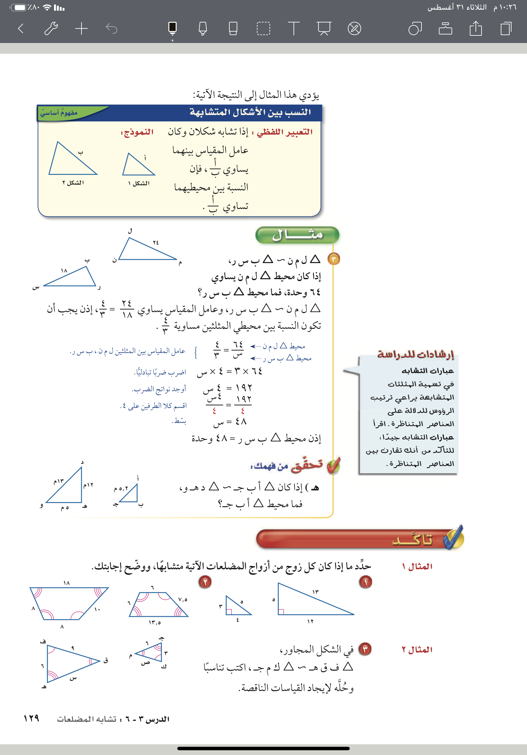
Contents of this template
Here’s what you’ll find in this Slidesgo template:
A slide structure based on a business portfolio presentation, which you can easily adapt to your needs. For more info on how to edit the template, please visit Slidesgo School or read our FAQs.
An assortment of graphic resources that are suitable for use in the presentation can be found in the alternative resources slides.
A thanks slide, which you must keep so that proper credits for our design are given.
In the resources slide, where you’ll find links to all the elements used in the template.
Instructions for use.
Final slides with:
The fonts and colors used in the template.
A selection of illustrations. You can also customize and animate them as you wish with the online editor. Visit Storyset to find more.
More infographic resources, whose size and color can be edited.
Sets of customizable icons of the following themes: general, business, avatar, creative process, education, help & support, medical, nature, performing arts, SEO & marketing, and teamwork.
You can delete this slide when you’re done editing the presentation.
@ amal_almazroai
@ ma3aly_alharbi

Slide 18
Contents of this template
Here’s what you’ll find in this Slidesgo template:
A slide structure based on a business portfolio presentation, which you can easily adapt to your needs. For more info on how to edit the template, please visit Slidesgo School or read our FAQs.
An assortment of graphic resources that are suitable for use in the presentation can be found in the alternative resources slides.
A thanks slide, which you must keep so that proper credits for our design are given.
In the resources slide, where you’ll find links to all the elements used in the template.
Instructions for use.
Final slides with:
The fonts and colors used in the template.
A selection of illustrations. You can also customize and animate them as you wish with the online editor. Visit Storyset to find more.
More infographic resources, whose size and color can be edited.
Sets of customizable icons of the following themes: general, business, avatar, creative process, education, help & support, medical, nature, performing arts, SEO & marketing, and teamwork.
You can delete this slide when you’re done editing the presentation.
@ amal_almazroai
@ ma3aly_alharbi

Slide 19
Contents of this template
Here’s what you’ll find in this Slidesgo template:
A slide structure based on a business portfolio presentation, which you can easily adapt to your needs. For more info on how to edit the template, please visit Slidesgo School or read our FAQs.
An assortment of graphic resources that are suitable for use in the presentation can be found in the alternative resources slides.
A thanks slide, which you must keep so that proper credits for our design are given.
In the resources slide, where you’ll find links to all the elements used in the template.
Instructions for use.
Final slides with:
The fonts and colors used in the template.
A selection of illustrations. You can also customize and animate them as you wish with the online editor. Visit Storyset to find more.
More infographic resources, whose size and color can be edited.
Sets of customizable icons of the following themes: general, business, avatar, creative process, education, help & support, medical, nature, performing arts, SEO & marketing, and teamwork.
You can delete this slide when you’re done editing the presentation.
@ amal_almazroai
@ ma3aly_alharbi

Slide 20
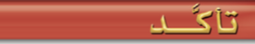
Here’s what you’ll find in this Slidesgo template:
A slide structure based on a business portfolio presentation, which you can easily adapt to your needs. For more info on how to edit the template, please visit Slidesgo School or read our FAQs.
An assortment of graphic resources that are suitable for use in the presentation can be found in the alternative resources slides.
A thanks slide, which you must keep so that proper credits for our design are given.
In the resources slide, where you’ll find links to all the elements used in the template.
Instructions for use.
Final slides with:
The fonts and colors used in the template.
A selection of illustrations. You can also customize and animate them as you wish with the online editor. Visit Storyset to find more.
More infographic resources, whose size and color can be edited.
Sets of customizable icons of the following themes: general, business, avatar, creative process, education, help & support, medical, nature, performing arts, SEO & marketing, and teamwork.
You can delete this slide when you’re done editing the presentation.
@ amal_almazroai
@ ma3aly_alharbi

Slide 21
Here’s what you’ll find in this Slidesgo template:
A slide structure based on a business portfolio presentation, which you can easily adapt to your needs. For more info on how to edit the template, please visit Slidesgo School or read our FAQs.
An assortment of graphic resources that are suitable for use in the presentation can be found in the alternative resources slides.
A thanks slide, which you must keep so that proper credits for our design are given.
In the resources slide, where you’ll find links to all the elements used in the template.
Instructions for use.
Final slides with:
The fonts and colors used in the template.
A selection of illustrations. You can also customize and animate them as you wish with the online editor. Visit Storyset to find more.
More infographic resources, whose size and color can be edited.
Sets of customizable icons of the following themes: general, business, avatar, creative process, education, help & support, medical, nature, performing arts, SEO & marketing, and teamwork.
You can delete this slide when you’re done editing the presentation.
@ amal_almazroai
@ ma3aly_alharbi

Slide 22
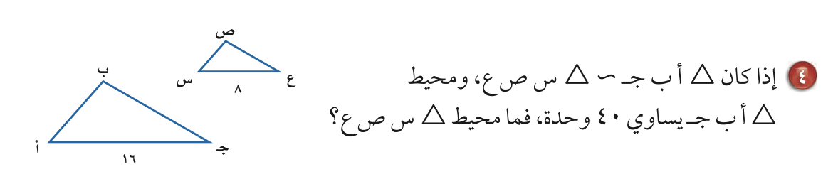
Contents of this template
Here’s what you’ll find in this Slidesgo template:
A slide structure based on a business portfolio presentation, which you can easily adapt to your needs. For more info on how to edit the template, please visit Slidesgo School or read our FAQs.
An assortment of graphic resources that are suitable for use in the presentation can be found in the alternative resources slides.
A thanks slide, which you must keep so that proper credits for our design are given.
In the resources slide, where you’ll find links to all the elements used in the template.
Instructions for use.
Final slides with:
The fonts and colors used in the template.
A selection of illustrations. You can also customize and animate them as you wish with the online editor. Visit Storyset to find more.
More infographic resources, whose size and color can be edited.
Sets of customizable icons of the following themes: general, business, avatar, creative process, education, help & support, medical, nature, performing arts, SEO & marketing, and teamwork.
You can delete this slide when you’re done editing the presentation.
@ amal_almazroai
@ ma3aly_alharbi

Slide 23
Contents of this template
Here’s what you’ll find in this Slidesgo template:
A slide structure based on a business portfolio presentation, which you can easily adapt to your needs. For more info on how to edit the template, please visit Slidesgo School or read our FAQs.
An assortment of graphic resources that are suitable for use in the presentation can be found in the alternative resources slides.
A thanks slide, which you must keep so that proper credits for our design are given.
In the resources slide, where you’ll find links to all the elements used in the template.
Instructions for use.
Final slides with:
The fonts and colors used in the template.
A selection of illustrations. You can also customize and animate them as you wish with the online editor. Visit Storyset to find more.
More infographic resources, whose size and color can be edited.
Sets of customizable icons of the following themes: general, business, avatar, creative process, education, help & support, medical, nature, performing arts, SEO & marketing, and teamwork.
You can delete this slide when you’re done editing the presentation.
@ amal_almazroai
@ ma3aly_alharbi

Slide 24
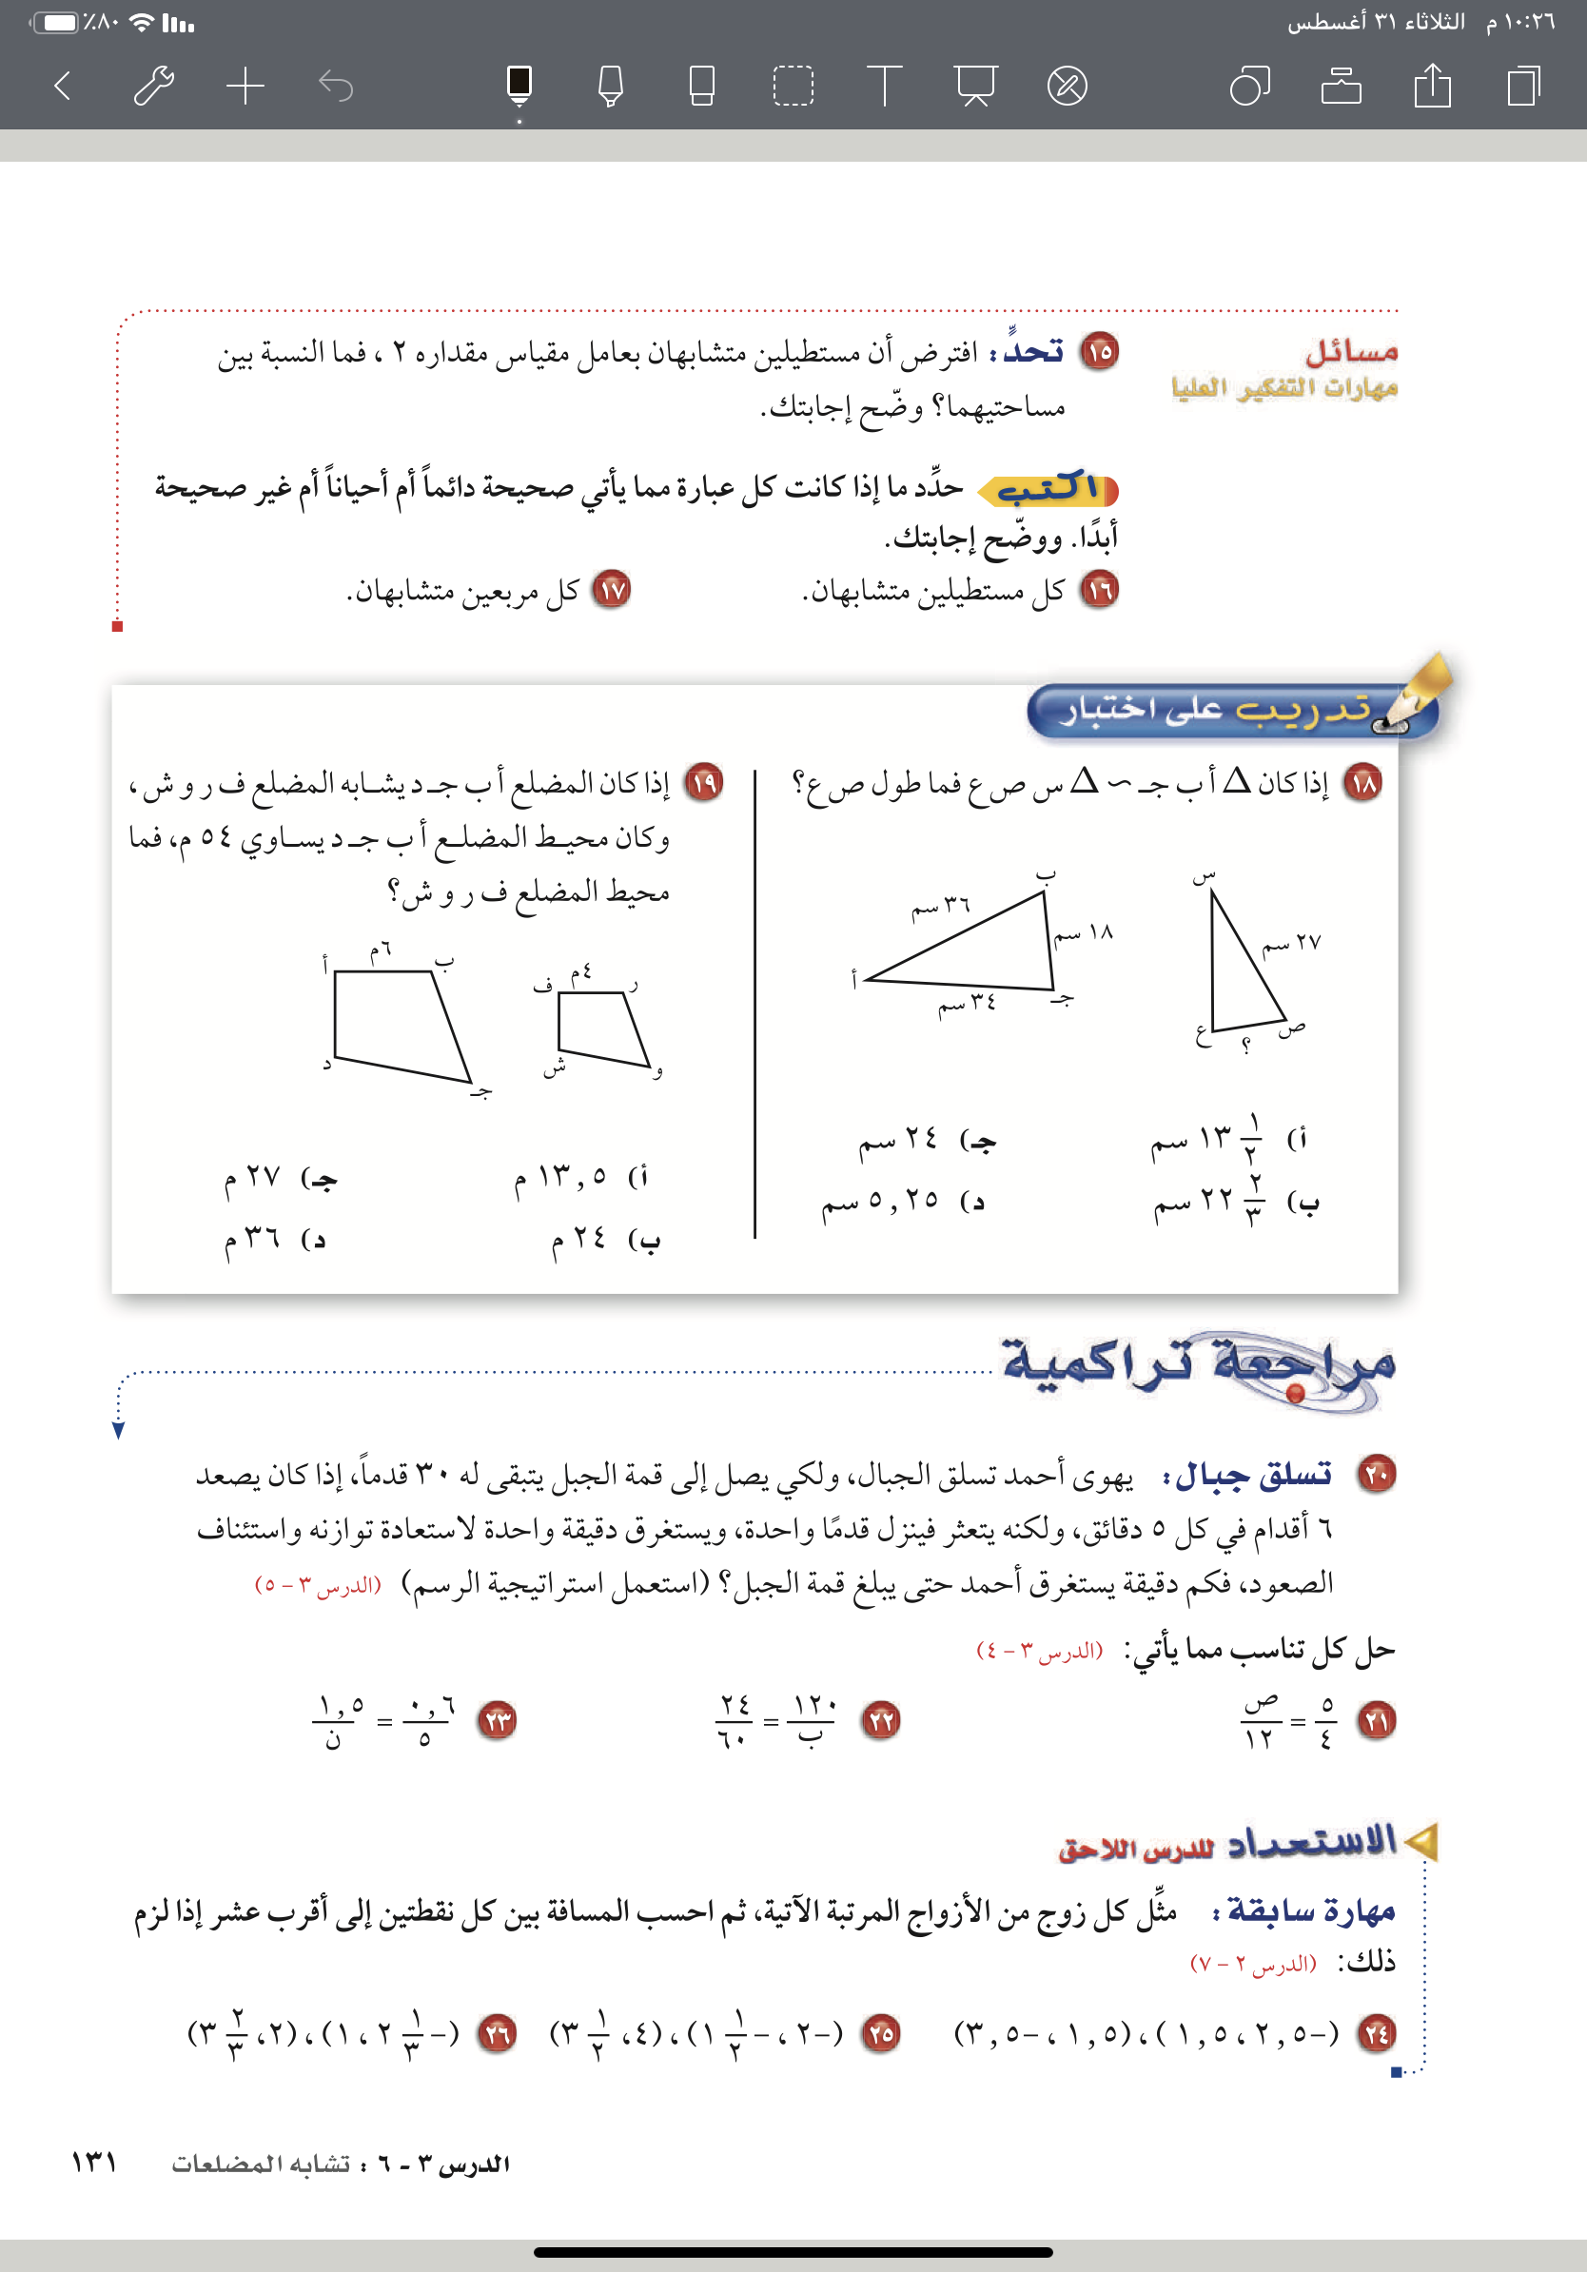
Here’s what you’ll find in this Slidesgo template:
A slide structure based on a business portfolio presentation, which you can easily adapt to your needs. For more info on how to edit the template, please visit Slidesgo School or read our FAQs.
An assortment of graphic resources that are suitable for use in the presentation can be found in the alternative resources slides.
A thanks slide, which you must keep so that proper credits for our design are given.
In the resources slide, where you’ll find links to all the elements used in the template.
Instructions for use.
Final slides with:
The fonts and colors used in the template.
A selection of illustrations. You can also customize and animate them as you wish with the online editor. Visit Storyset to find more.
More infographic resources, whose size and color can be edited.
Sets of customizable icons of the following themes: general, business, avatar, creative process, education, help & support, medical, nature, performing arts, SEO & marketing, and teamwork.
You can delete this slide when you’re done editing the presentation.
@ amal_almazroai
@ ma3aly_alharbi

Slide 25
ماذا تعلمت ؟
@ amal_almazroai
@ ma3aly_alharbi

Slide 26
Contents of this template
الواجب
@ amal_almazroai
@ ma3aly_alharbi

