Slide 1
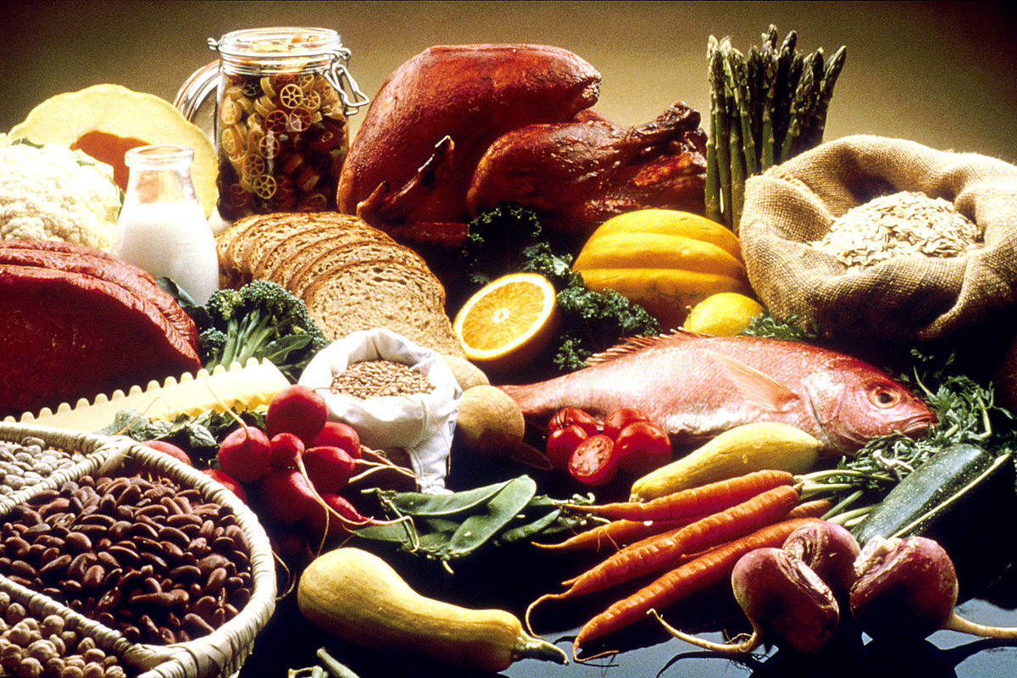
U 5
READING
Tr. Nora Khalid

Slide 2
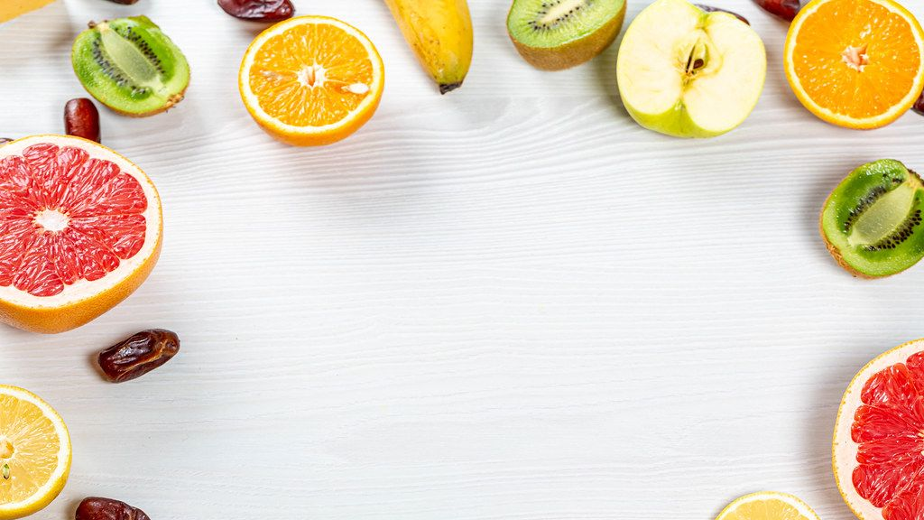
1- To read for the main idea.
2- To know some new vocabulary related to the reading topic “ Globalization of foods”.
3- To appreciate of diverse identities and cultures.

Slide 3
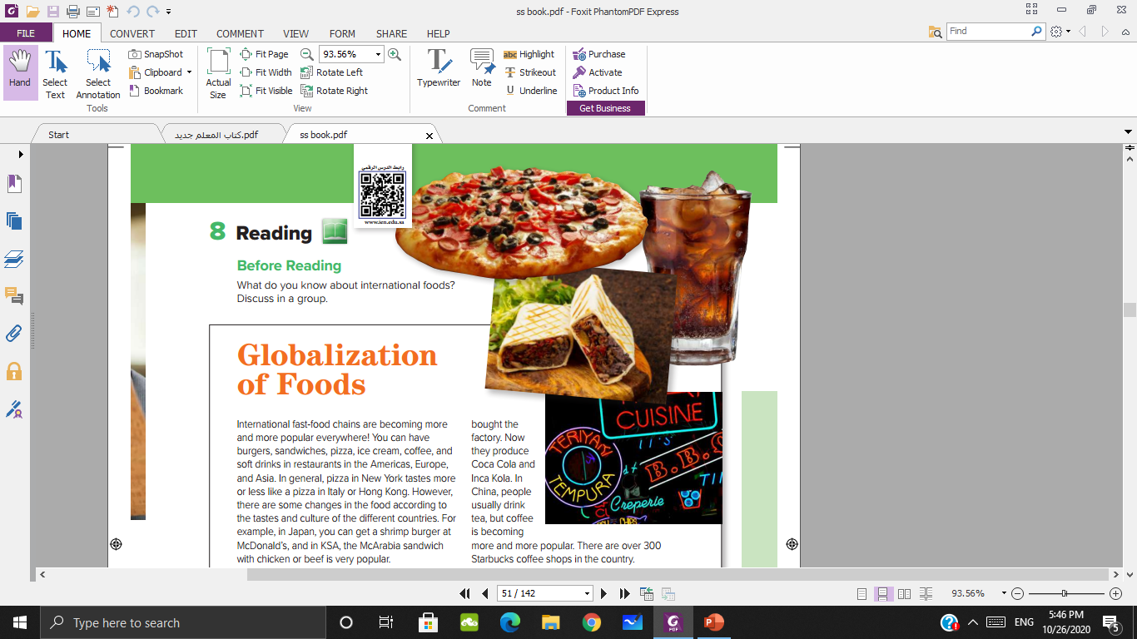



Sandwich
Fast food restaurant
& signs
Pizza
Soft drink

Slide 4
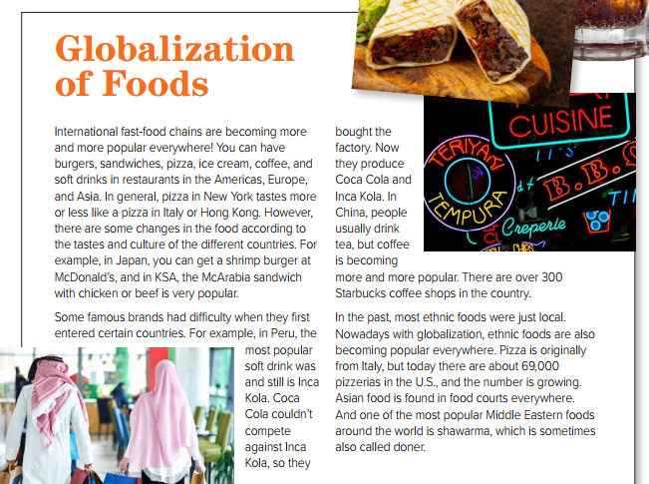

Globalization
Fast food
Chains
Popular
Ethnic
doner

Slide 5
What is the title of the reading?
How are the pictures connected to the title of the reading?
The food items and places in the pictures are examples of globalization

Slide 6

How many paragraphs of the reading?

Slide 7
The main idea
The international popularity of fast-food chains.
Famous brands in different countries.
The international popularity of ethnic foods.

Slide 8
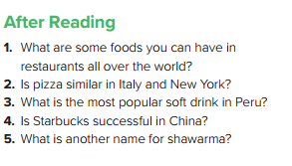
burgers, sandwiches, pizza,
ice cream, coffee, and soft drinks
Yes, more or less
Inca Cola
Yes, it is
Doner

Slide 9
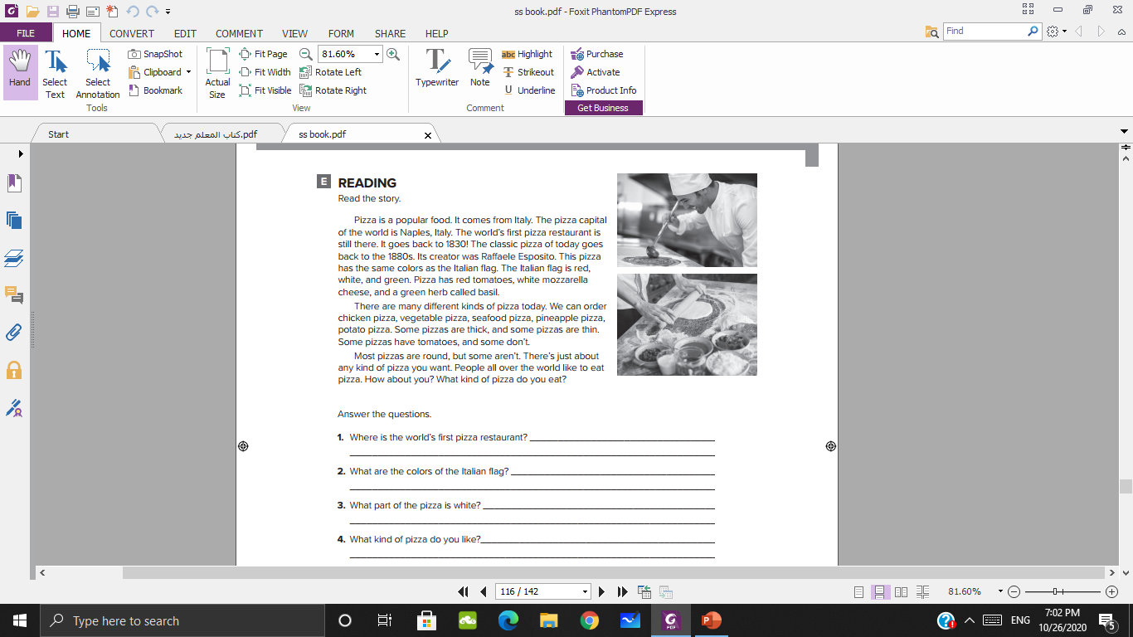
in Naples, Italy
The colors of the Italian flag is red, white and green
The cheese
I like ………………………

Slide 10
قال تعالى: "يا أيها الناس إنا جعلناكم شعوبا وقبائل لتعارفوا إن أكرمكم عند الله أتقاكم"
“O mankind, indeed We have created you from male and female and made you peoples and tribes that you may know one another”

Slide 11
Thank you

