Slide 1
Around The World

Slide 2
قال تعالى:
(يَا أَيُّهَا النَّاسُ إِنَّا خَلَقْنَاكُمْ مِنْ ذَكَرٍ وَأُنْثَى وَجَعَلْنَاكُمْ شُعُوبًا وَقَبَائِلَ لِتَعَارَفُوا إِنَّ أَكْرَمَكُمْ عِنْدَ اللَّهِ أَتْقَاكُمْ إِنَّ اللَّهَ عَلِيمٌ خَبِيرٌ )

Slide 3
- Where are you from?
I’m from Saudi Arabia.
- What’s your nationality?
I’m Saudi.
- What’s the capital of your country?
It’s Riyadh.
- What’s your first language?
It’s Arabic.

Slide 4
- What’s your telephone number?
It’s 0501234567
- What’s your address?
It’s 4321 Omar Street.
- What’s your email address?
It’s haifa_3@gmail.com

Slide 5
Hello, girls
-Today we will read a text about Lapland
- Learn some writing rules.

Slide 6
Now open your book p.31

Slide 9
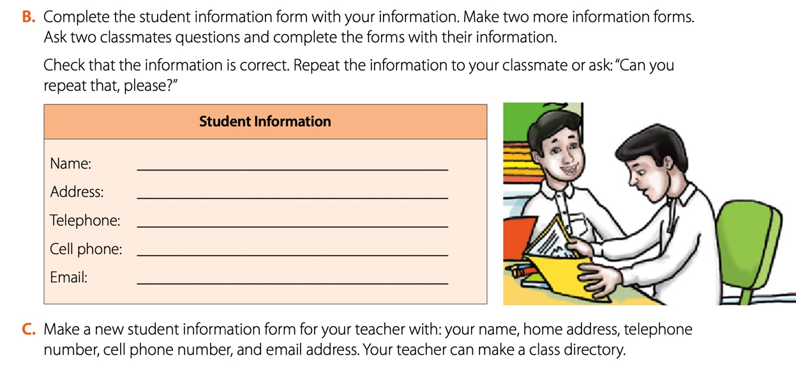

Slide 11
الطلبات والعروض
الطلب
القبول
الرفض
العرض
القبول
الرفض

Slide 12
Requests and Offers
Request: الطلب
Will $→$ you $→$ V …?
Can $→$ you $→$ V …?
مثال:
Will you open the door?
Can you help me?
Agree: القبول
Sure. Of course.
OK. No problem.
Refuse: الرفض
Sorry. I’m busy. Sorry. I can’t
ممكن
Offer: العرض
I $→$ will $→$ V …
I $→$ can $→$ V …
مثال:
I will open the door.
I can help you.
Agree: القبول
Thank you.
All right.
OK.
Thanks.
Refuse: الرفض
No thanks. No, that’s all right.
No, that’s OK.
سوف
استطيع

Slide 13
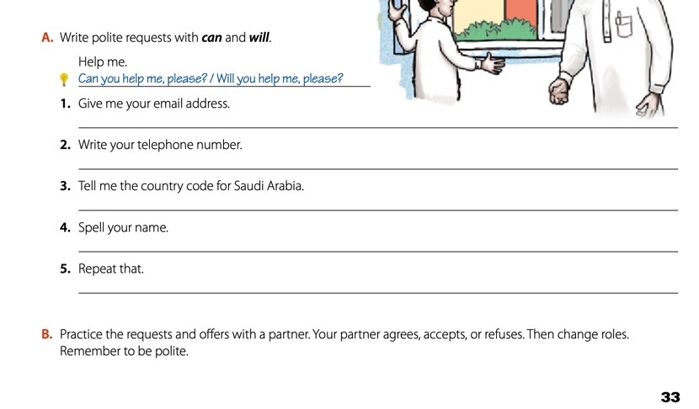
Will / Can you give me your email address?
Will / Can you write yourtelephone number?
Will / Can you tell me the country code for Saudi Arabia?
Will / Can you spell your name?
Will / Can you repeat that?

Slide 14
Now open your book p.102+103
and do exercise C+E

Slide 15
is
m
is
are
m
Are
re
Is
isn’t
is

Slide 16
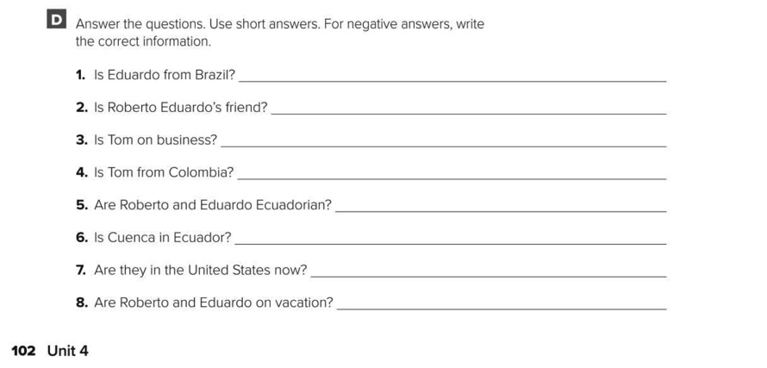
No, he isn’t.
Yes, he is.
No, he isn’t.
No, he isn’t.
Yes, they are.
Yes, it is..
No, they aren’t.
No, they aren’t.

Slide 17
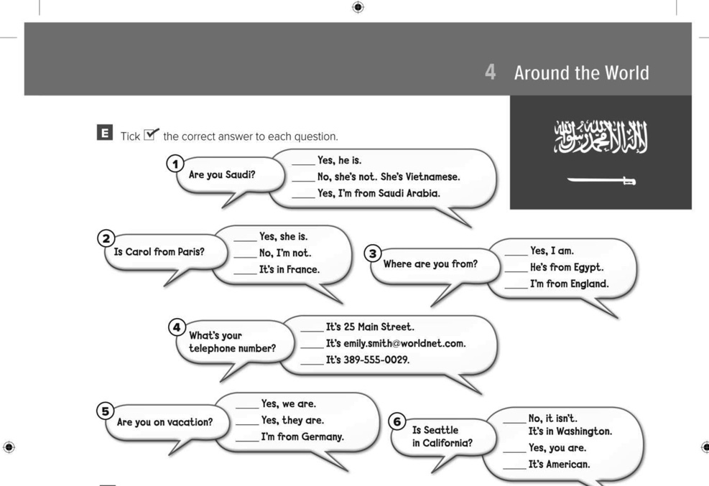
$$√$$
$$√$$
$$√$$
$$√$$
$$√$$
$$√$$

Slide 18
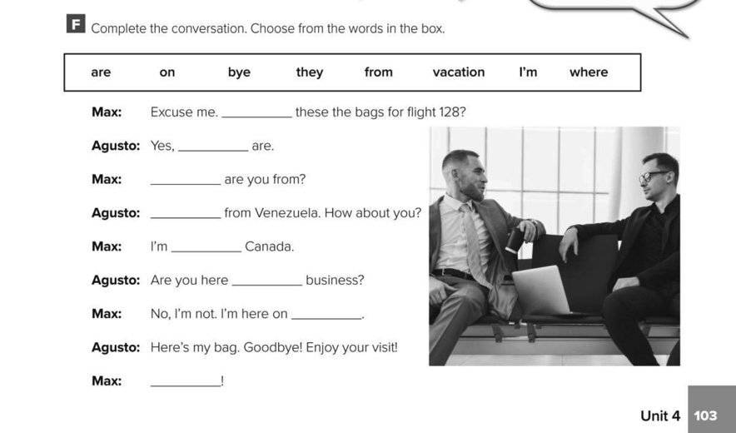
Are
They
Where
I’m
from
on
vacation
Bye

Slide 19
Carlos Torres
Chilean
Los Angeles, California, U.S.
18 years old
carlos123@worldnet.com
310-555-9901

