Slide 1
Welcome to class
T.Hanan Allaheeb

Slide 2
p 16

Slide 3
p 16

Slide 4
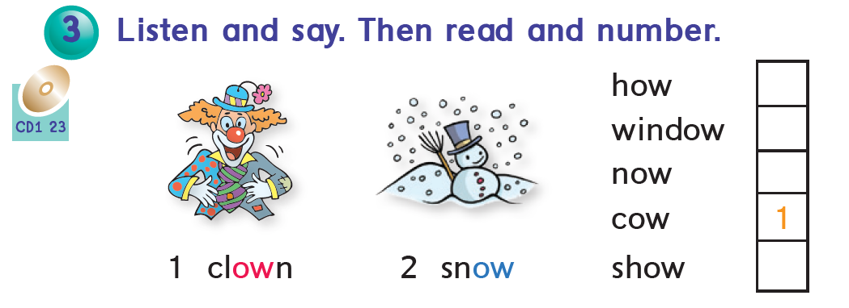
p 16

Slide 5
Complete
ow - ao
ow - ao
wind___
B___t

Slide 6
Complete
ou - ow
ow - ou
H____se
c___

Slide 7
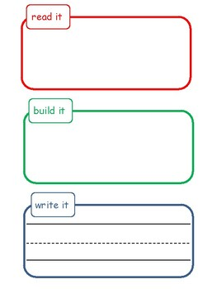

Slide 8
https://www.liveworksheets.com/nq2347094ht

