Slide 1


Slide 2


Slide 3
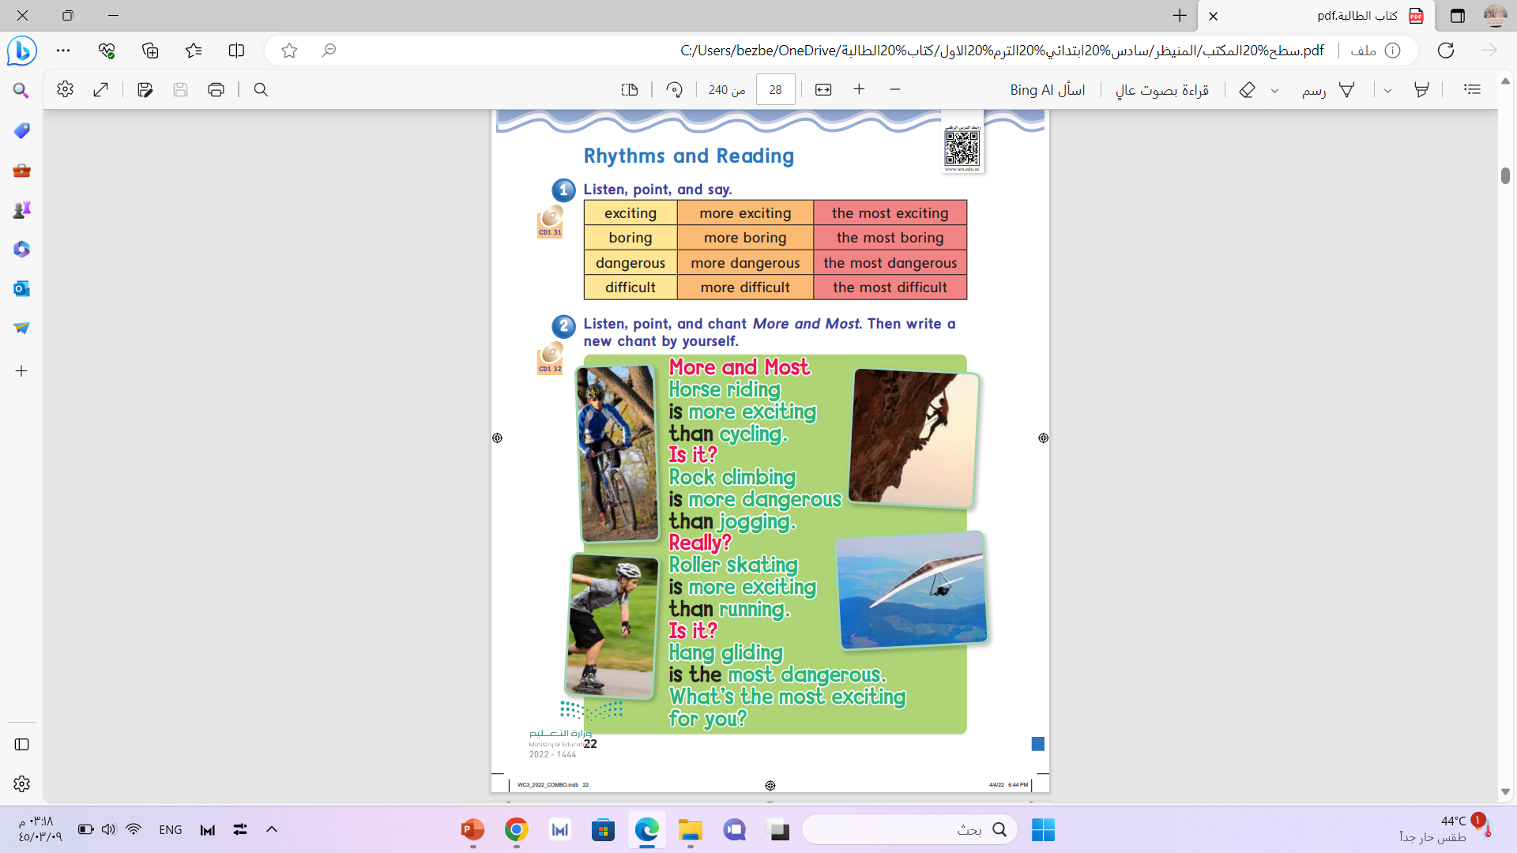
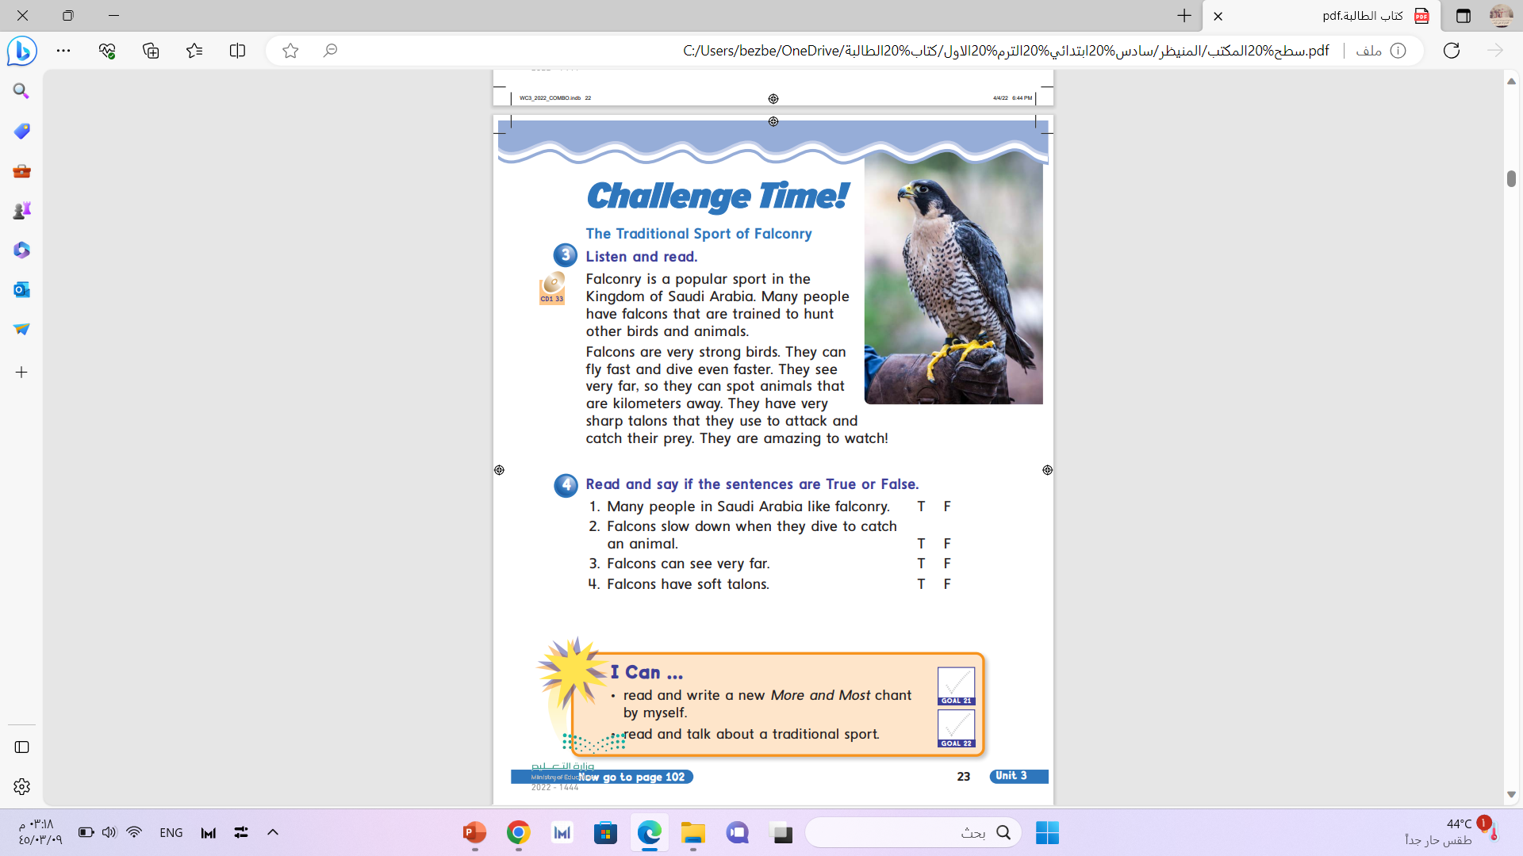

Slide 4
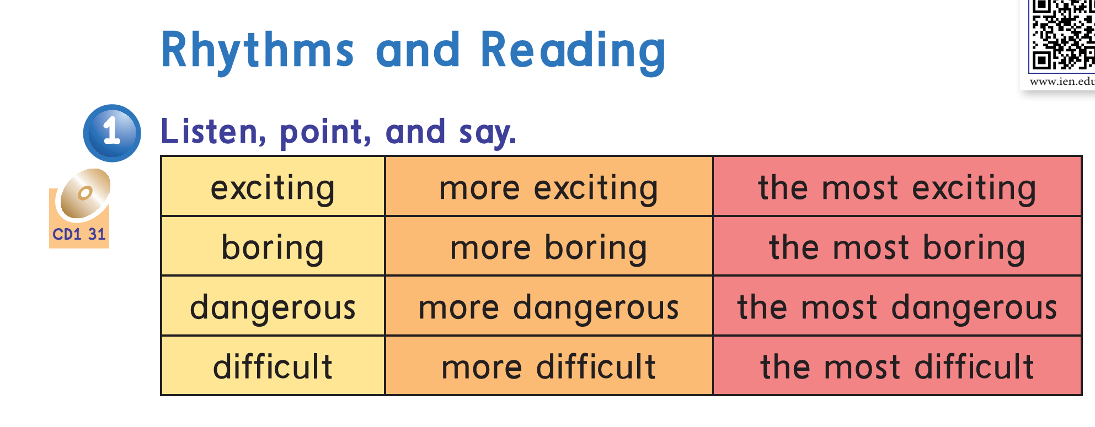


Slide 5


Exciting

Slide 6


Boring

Slide 7

Difficult

Slide 8

Dangerous

Slide 9

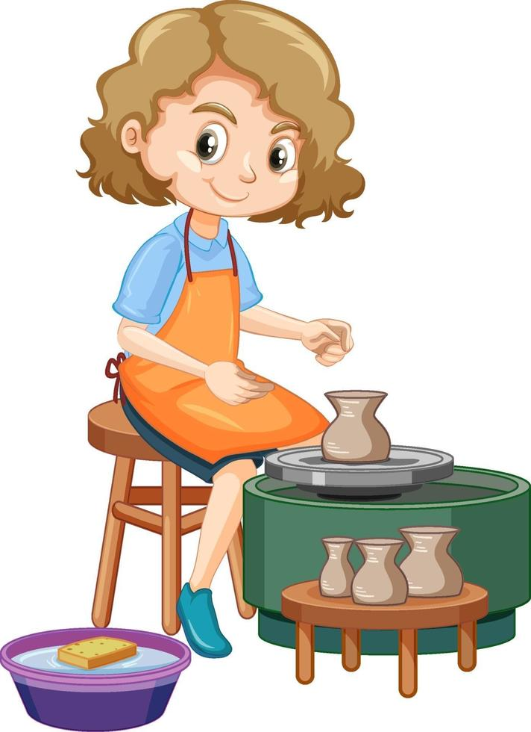
Exciting
Computer games
Pottery
Computer games is more exciting than pottery .

Slide 10
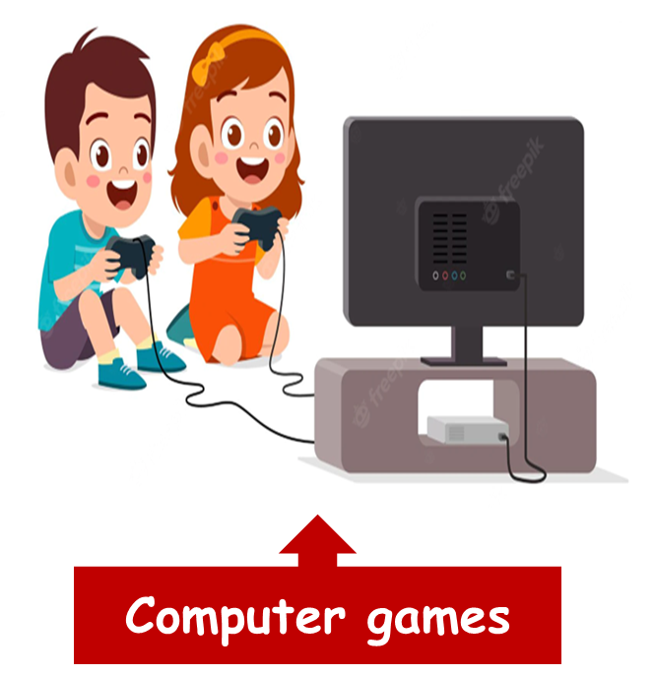


Painting
Exciting
Computer games is the most exciting.

Slide 11


Boring
Snowboard
golf
Golf is more boring than snowboard.

Slide 12

Boring
Snowboard
golf
Ski
Golf is the most boring.

Slide 13
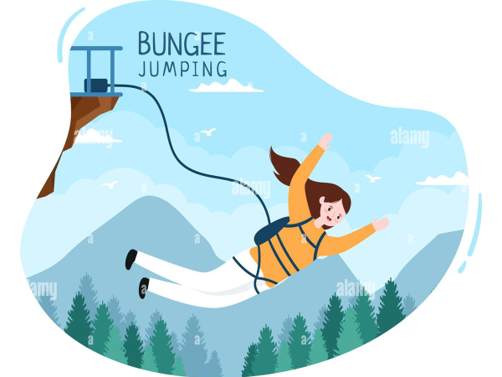
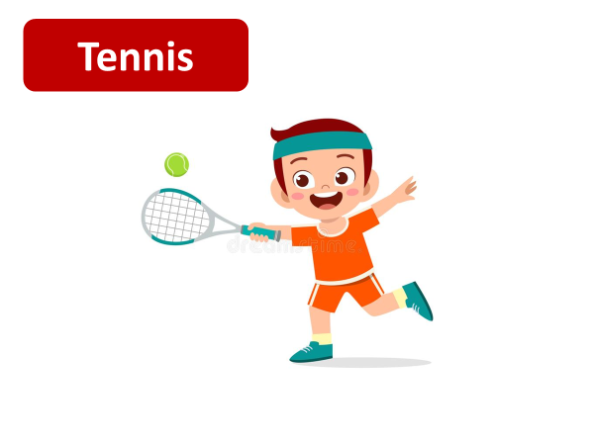
Dangerous
Bungee jumping is more dangerous than tennis.

Slide 14
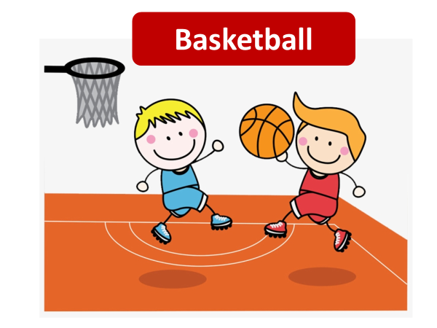
Dangerous
Bungee jumping is the most dangerous.

Slide 15
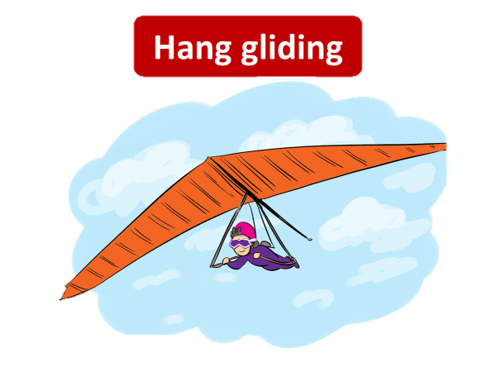
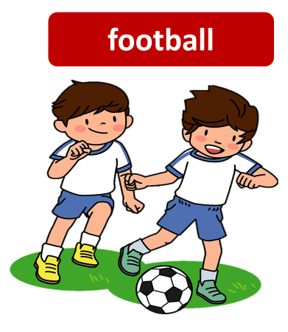
Difficult
Hang gliding is the more difficult than football.

Slide 16
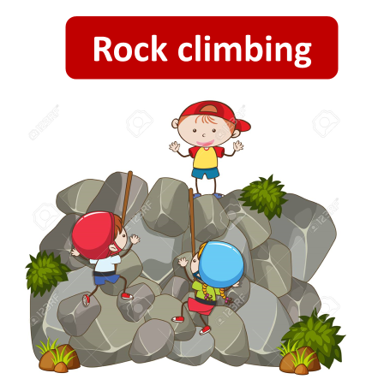
Difficult
Hang gliding is the most difficult .

Slide 17
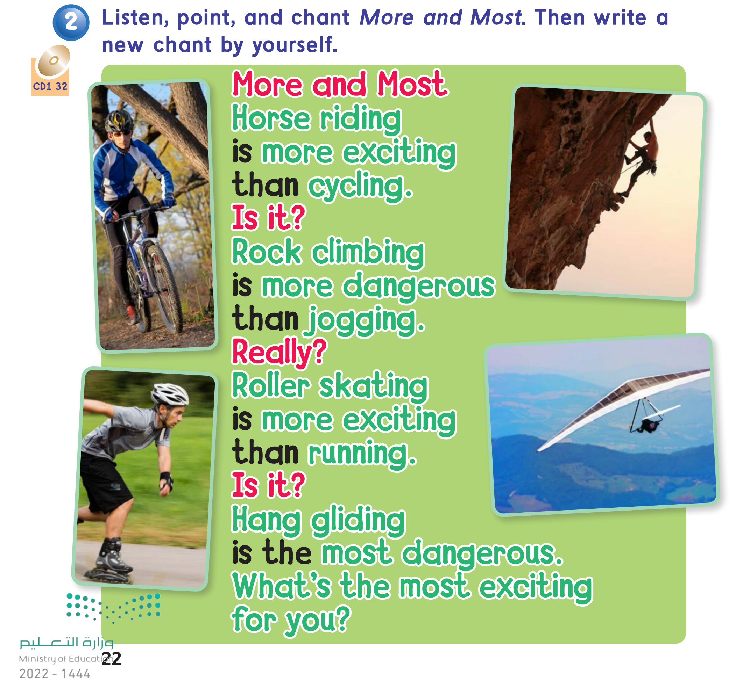

Slide 18
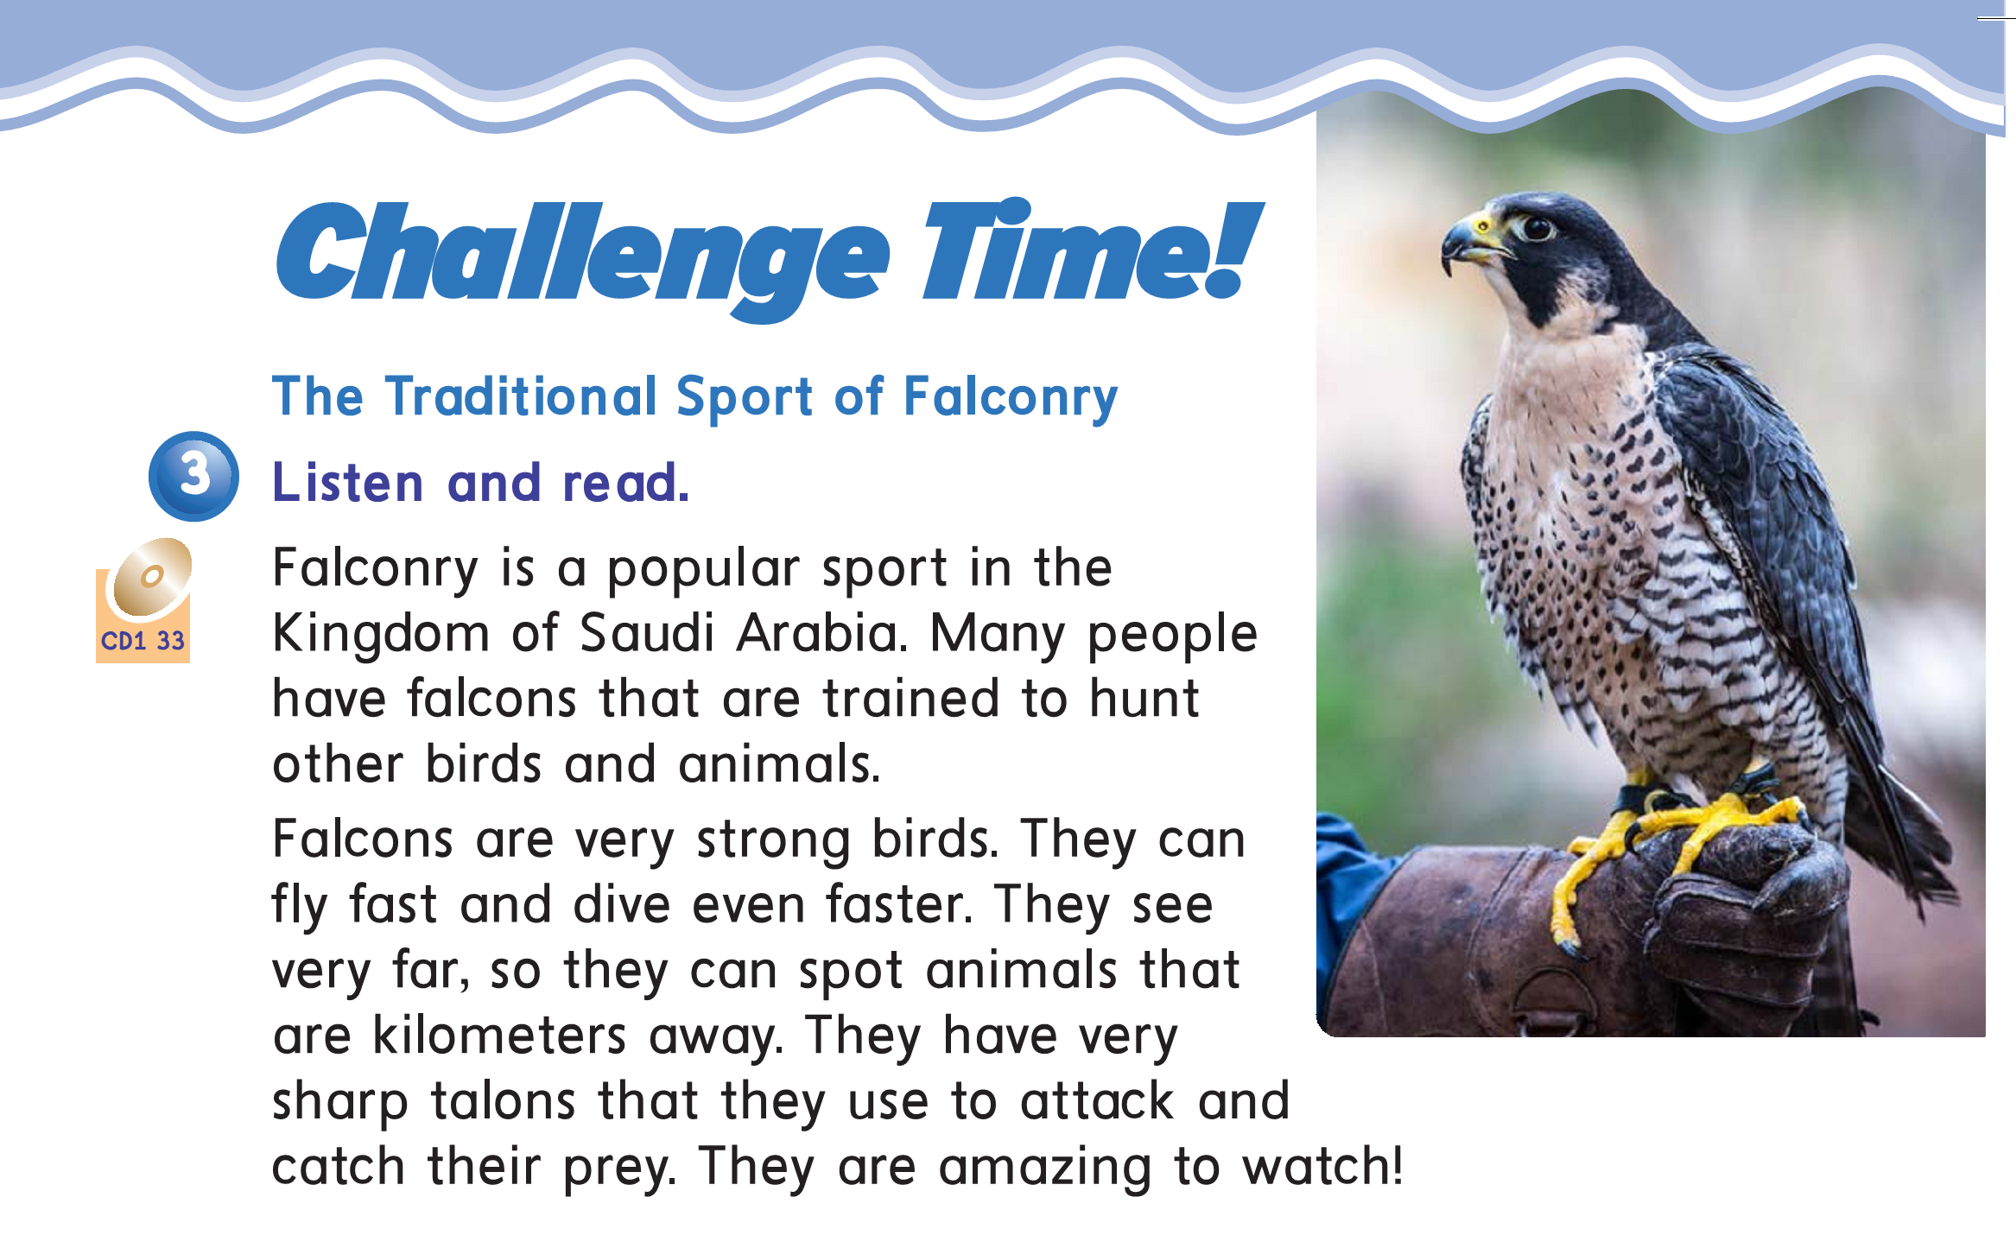

Slide 19
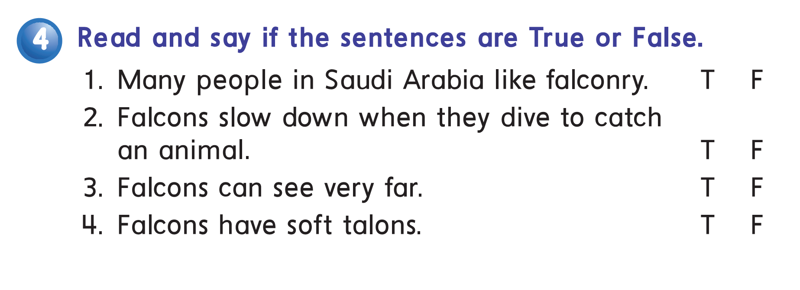


Slide 20

Workbook pages:
159-160 (1-2)

Slide 21
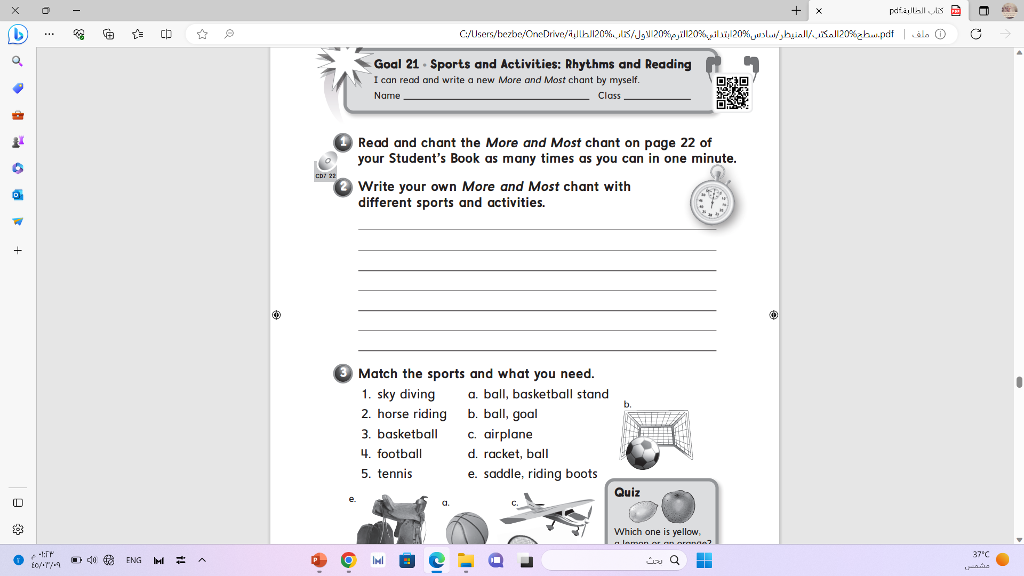

Slide 22
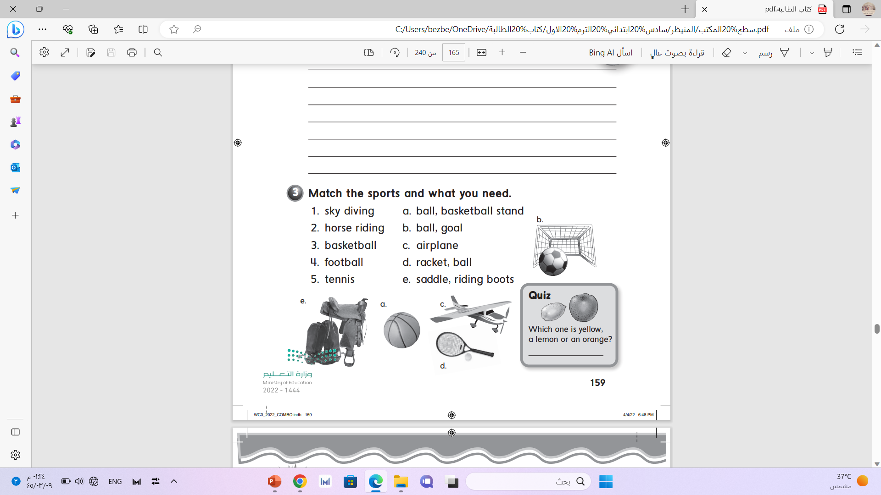

Slide 23
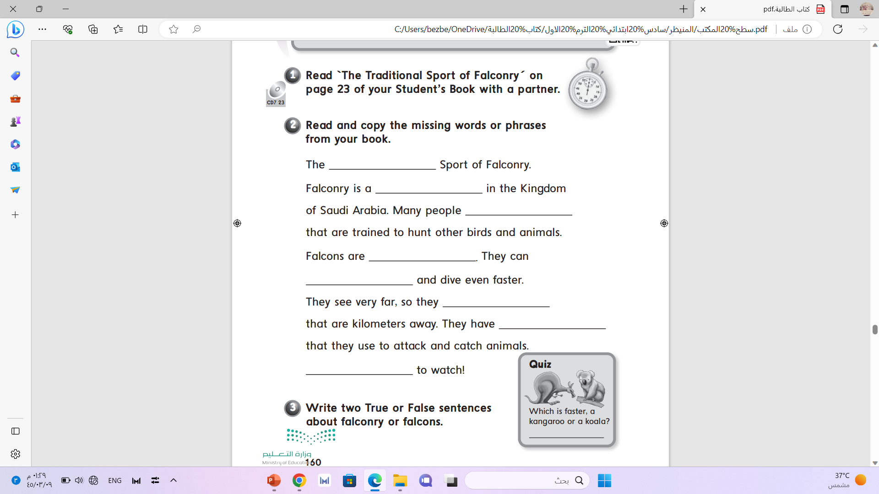
The Traditional
popular
have falcons
very strong birds
fly fast
can spot animals
very sharp talons
They are amazing

