Slide 1


Slide 2


Slide 3
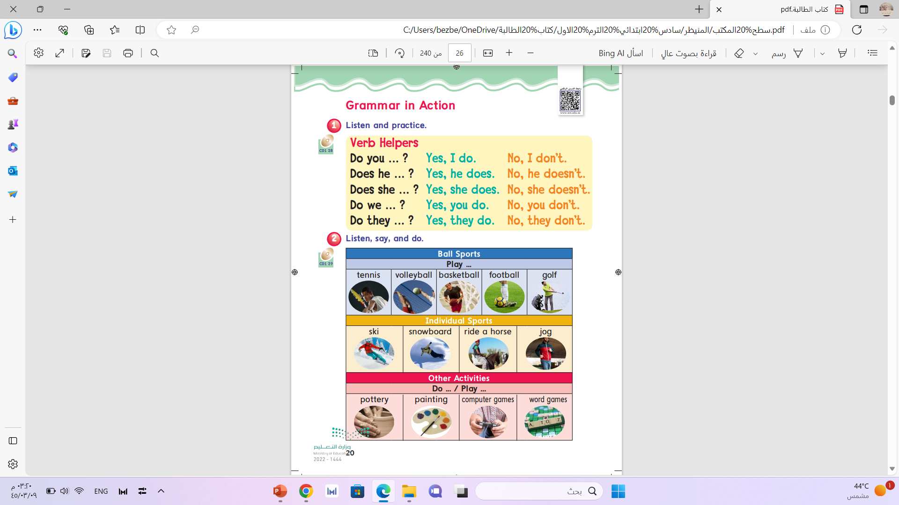
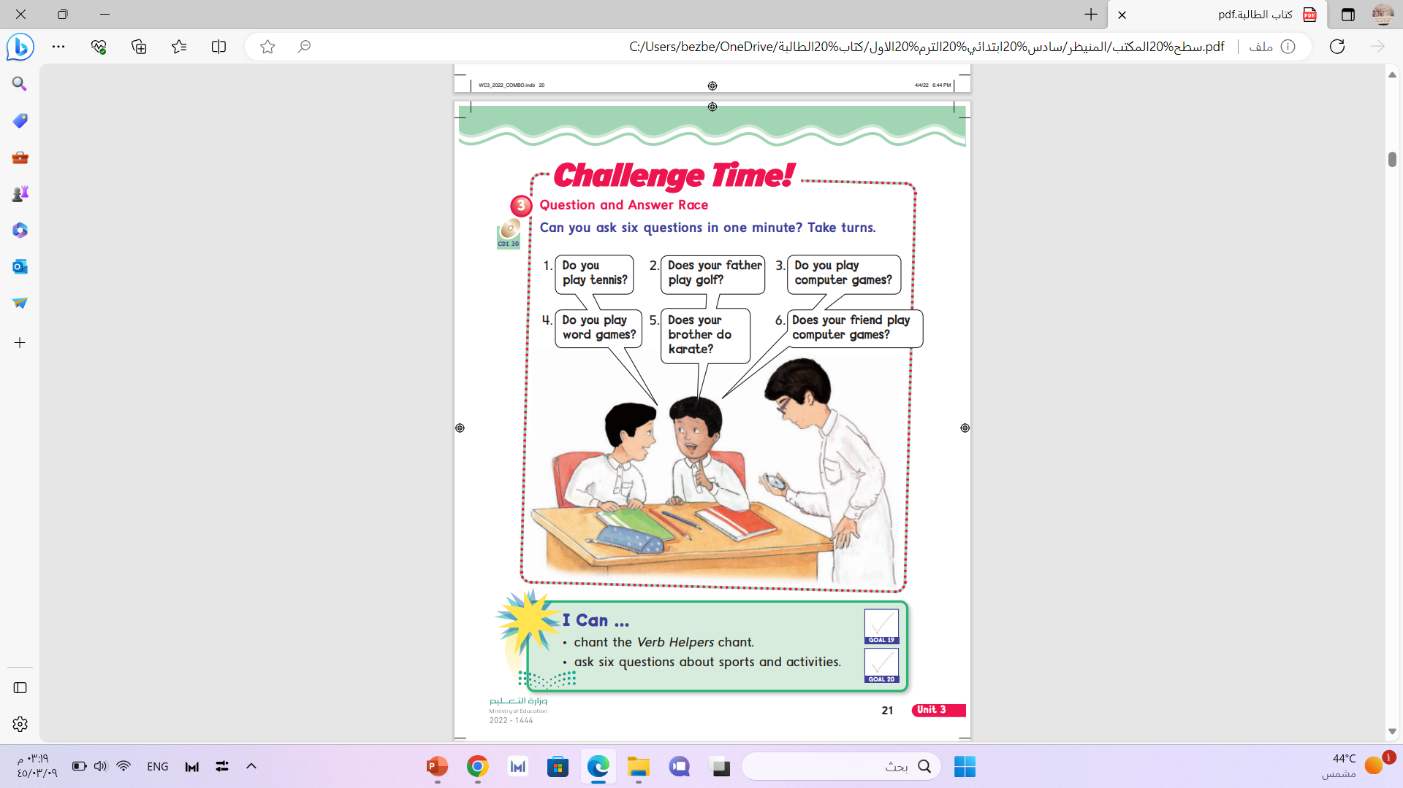

Slide 4
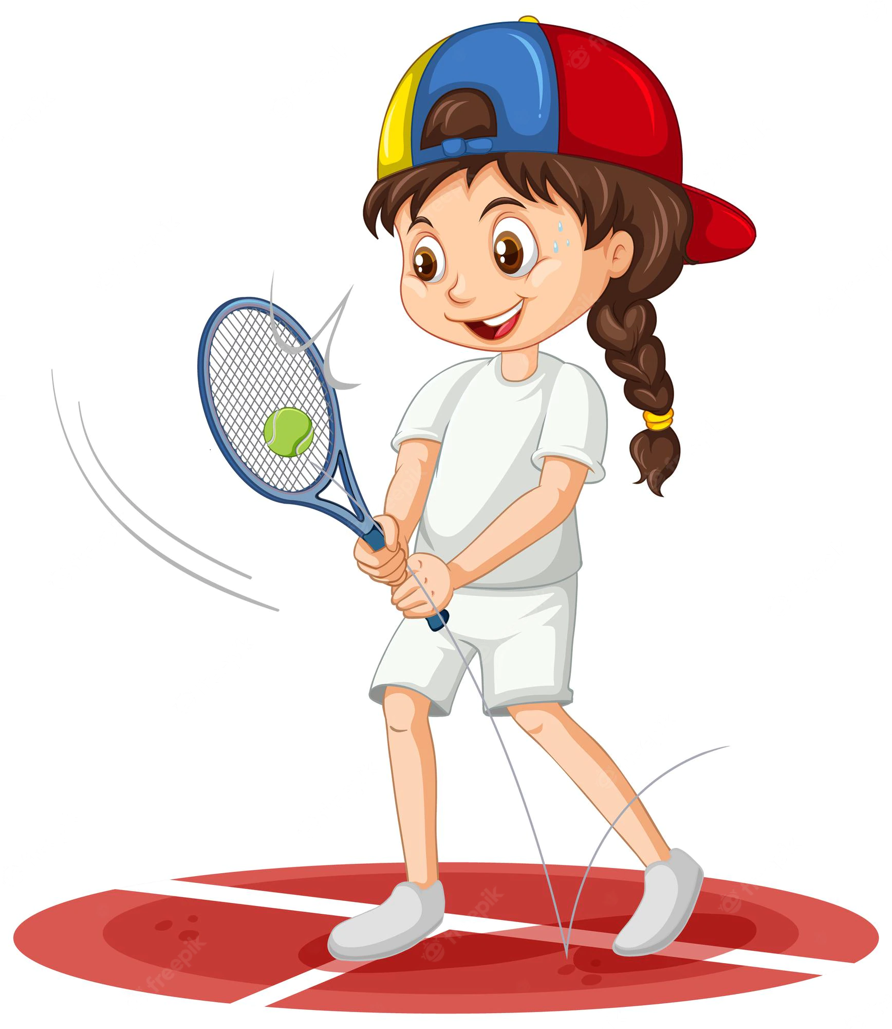
She likes tennis.

Slide 5
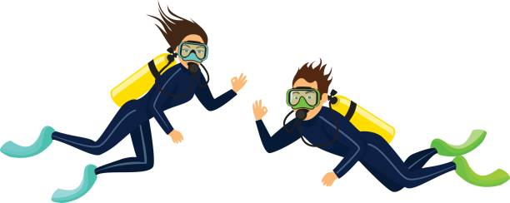
They like scuba diving.

Slide 6
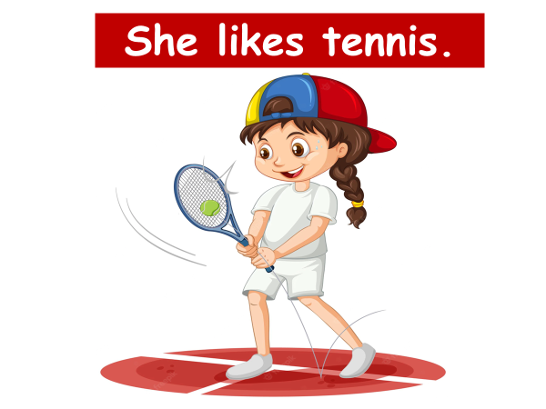

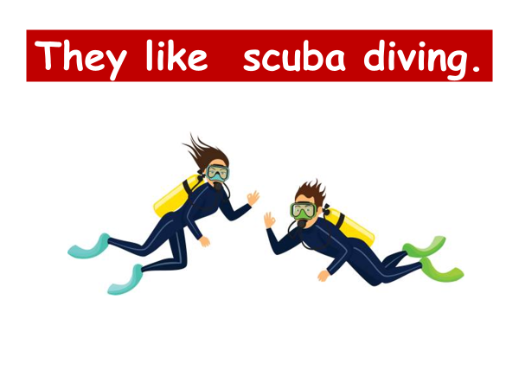

Slide 7

Does
She

Slide 8

Does
he

Slide 9


They

Slide 10
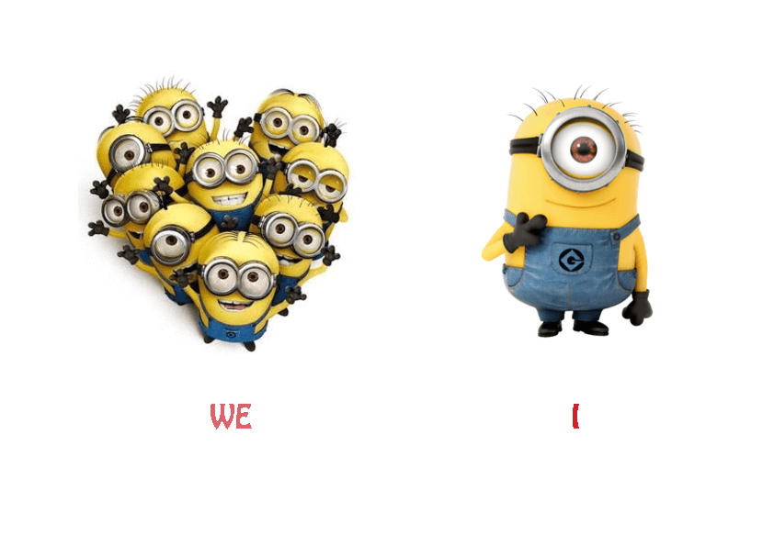

Slide 11
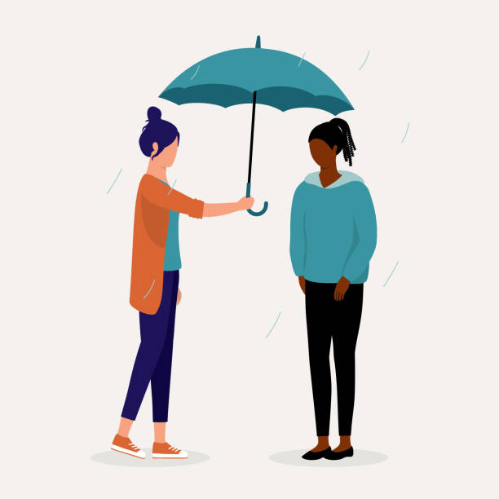
Do
You

Slide 12

Does she like tennis?
Yes, she does .

Slide 13
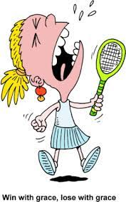
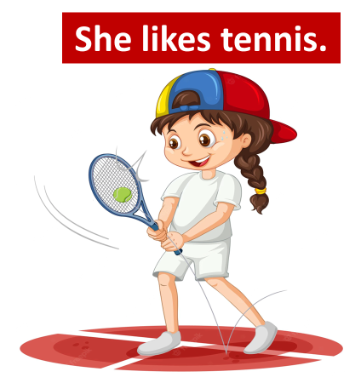
Does she like tennis?
No , she does not .

Slide 14

Do they like scuba diving?
yes , they do.

Slide 15
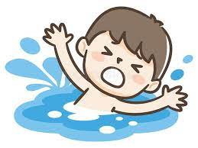
Do they like scuba diving?
No , they do not .

Slide 16
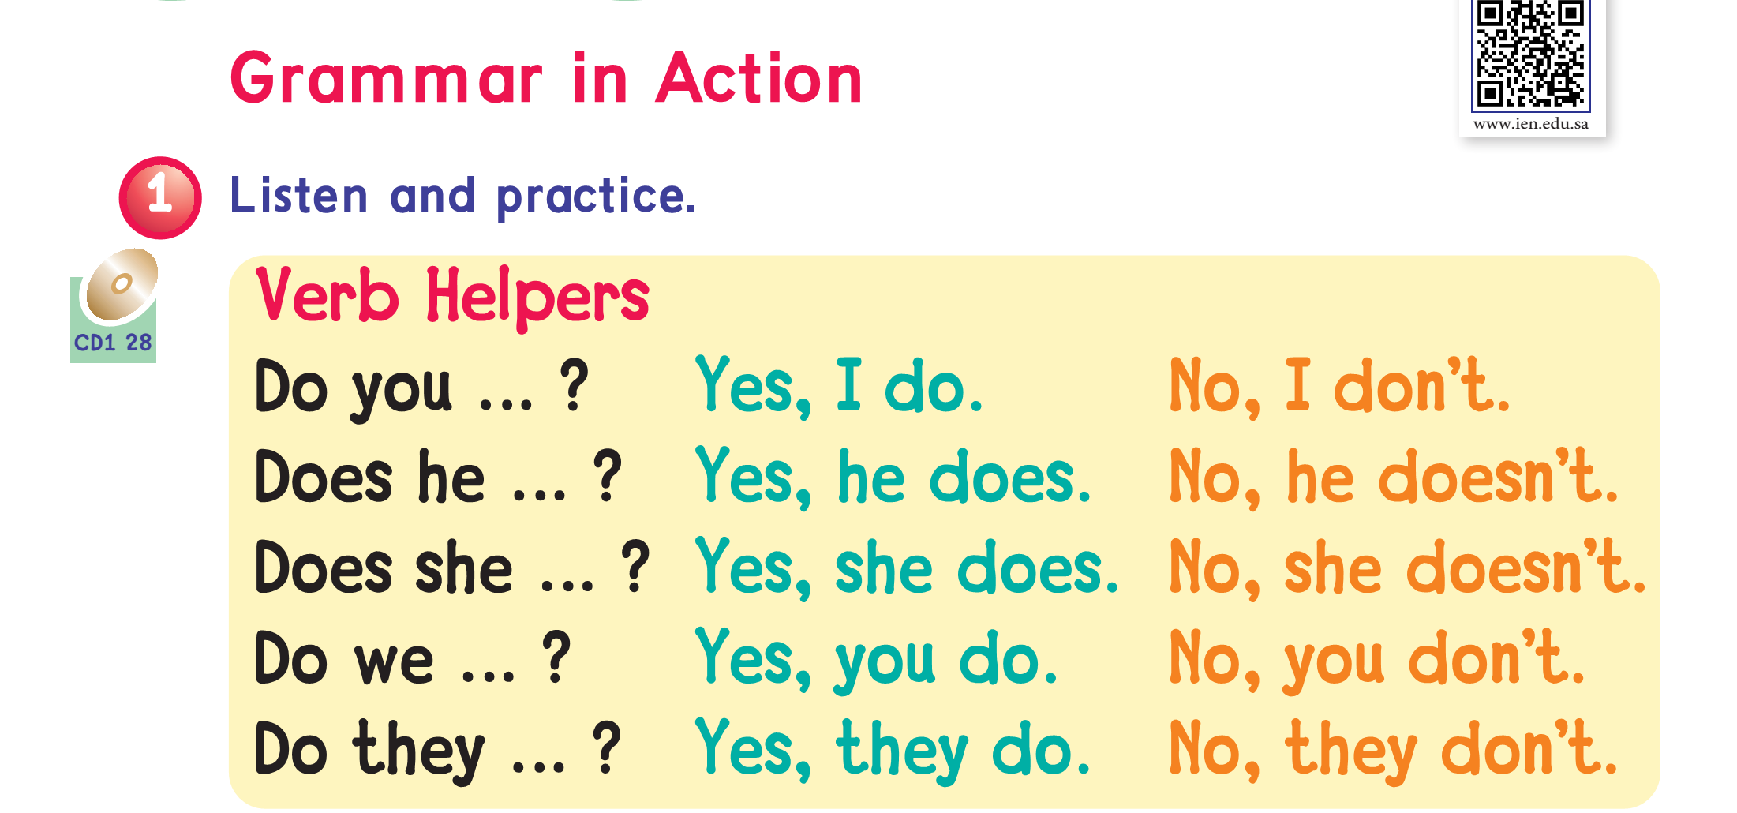


Slide 17
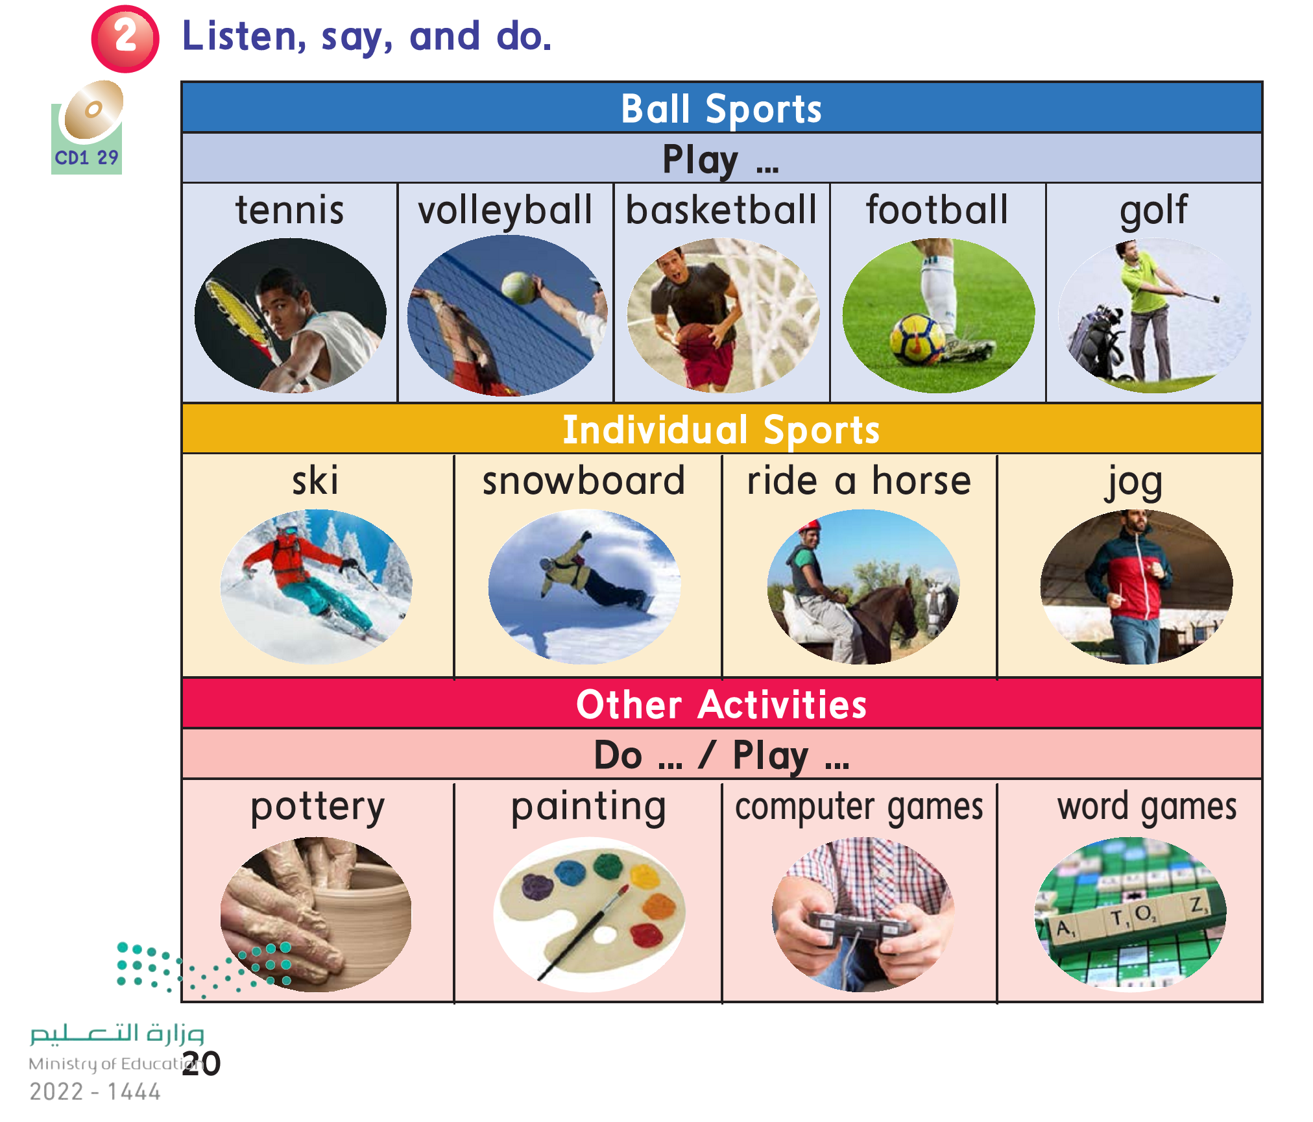

Slide 18
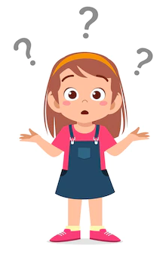
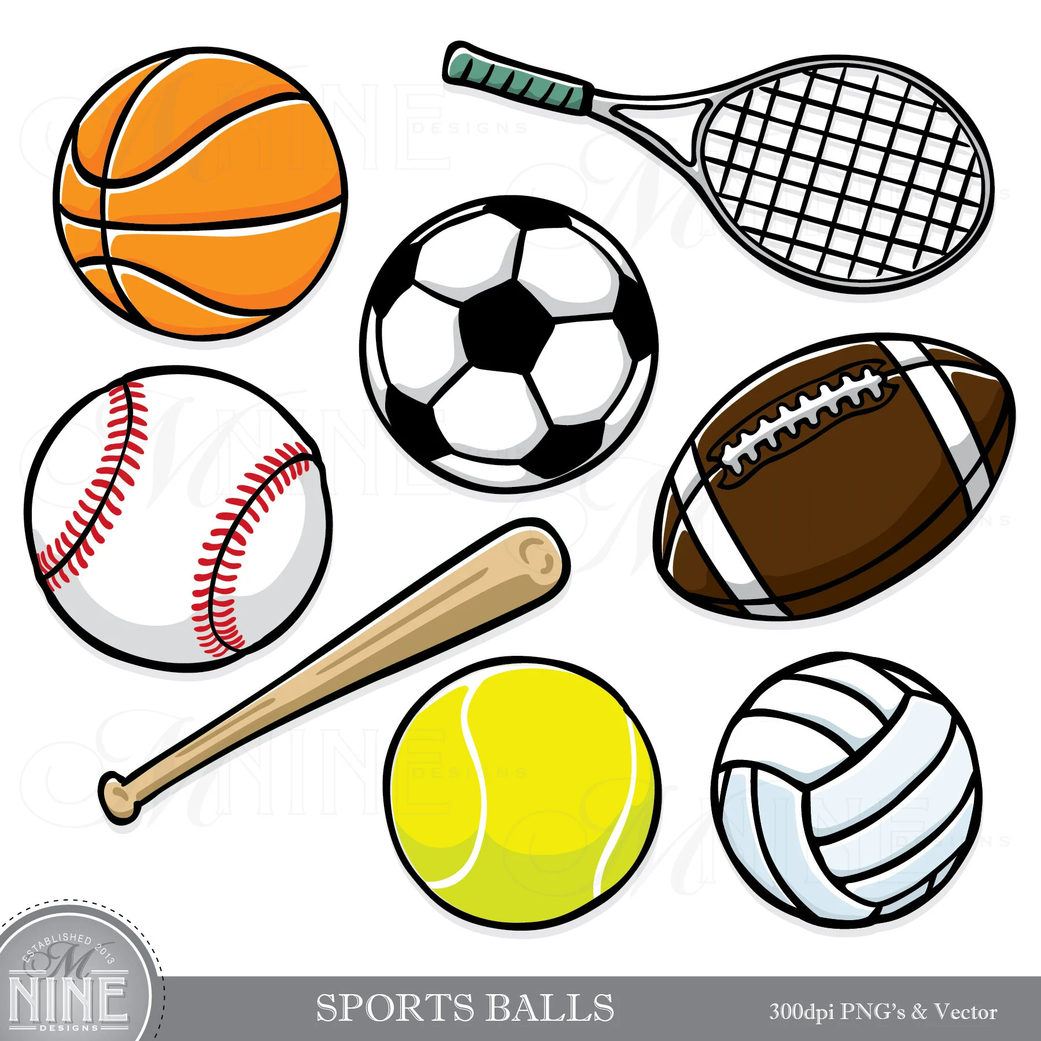
Which sports do we need ball to play?

Slide 19
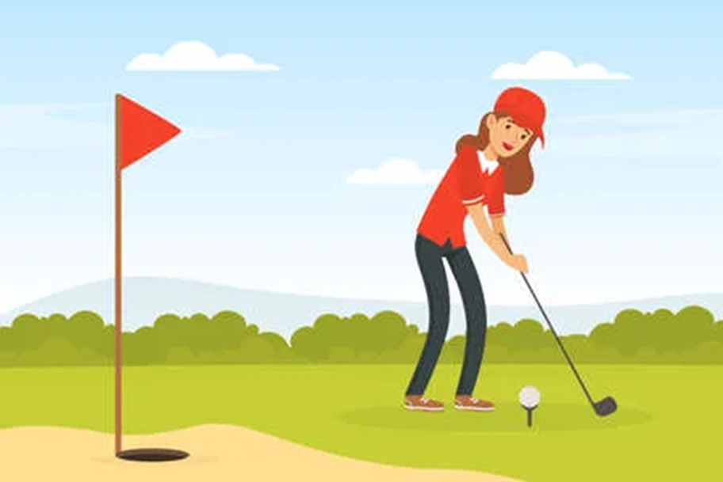
Golf

Slide 20
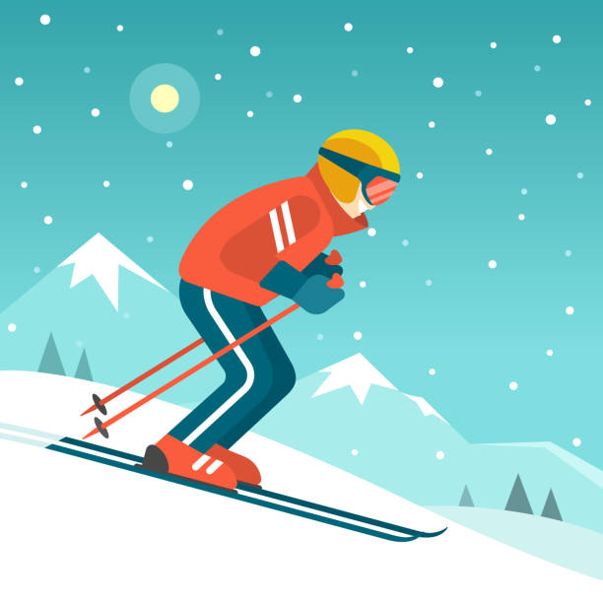
Which sports do we do them alone ?
Ski

Slide 21
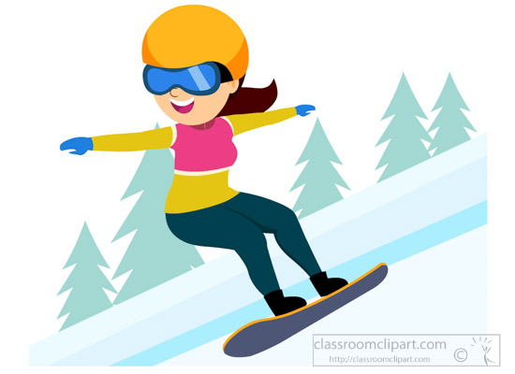
Which sports do we do them alone ?
Snowboard

Slide 22
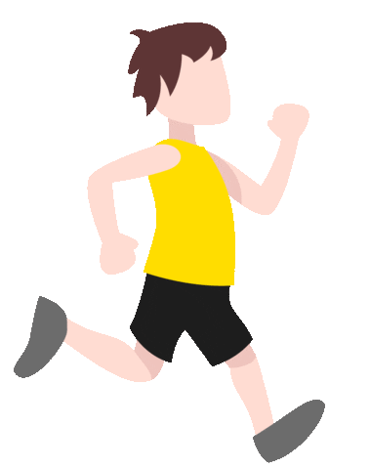
Which sports do we do them alone ?
Jog

Slide 23
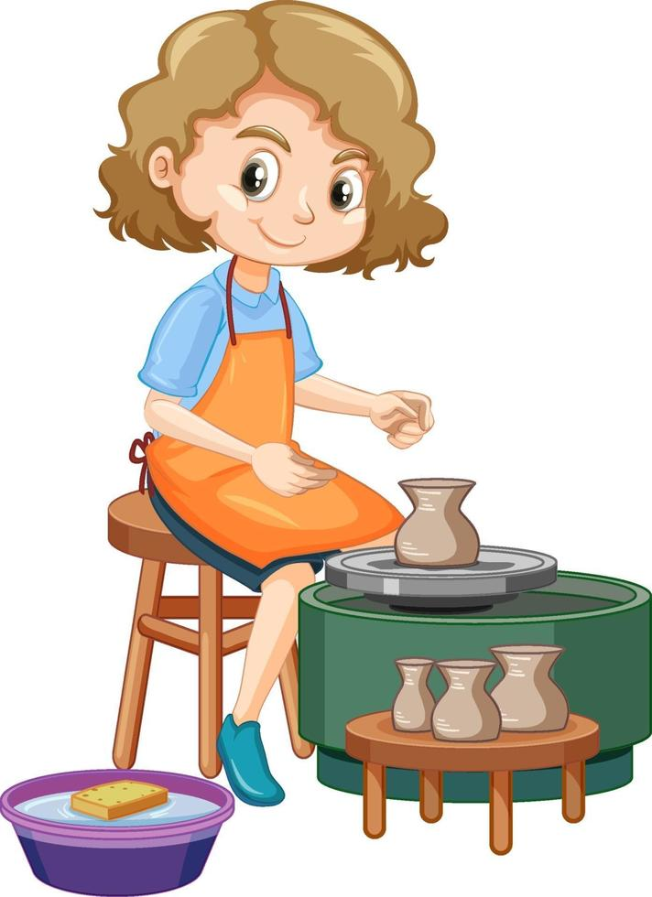
Which activity do we do it ?
Pottery

Slide 24
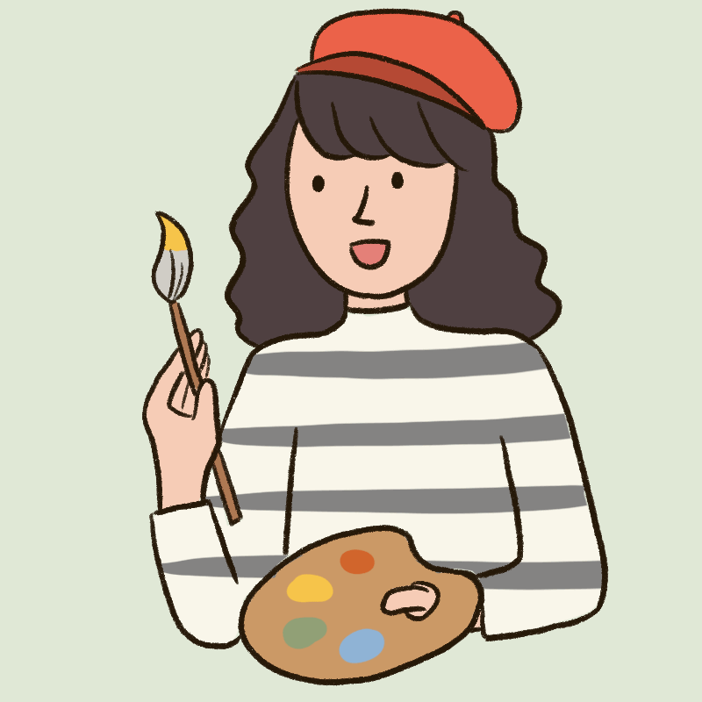
Which activity do we do it ?
Painting

Slide 25
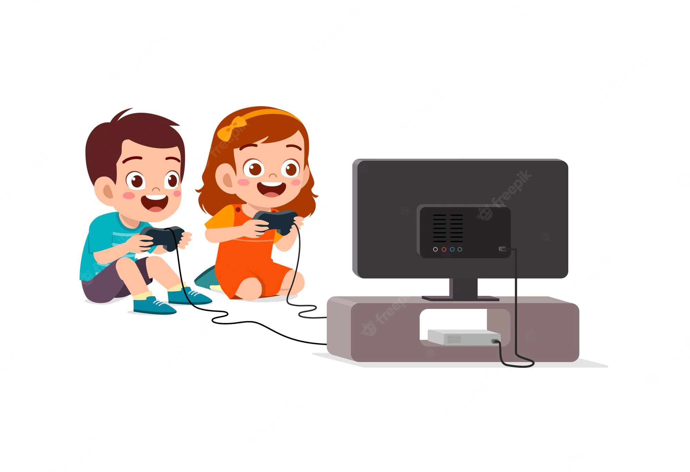
Which game do we play?
Computer
games

Slide 26

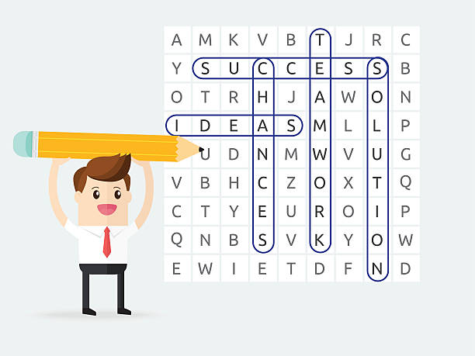
Which game do we play?
Word games

Slide 27
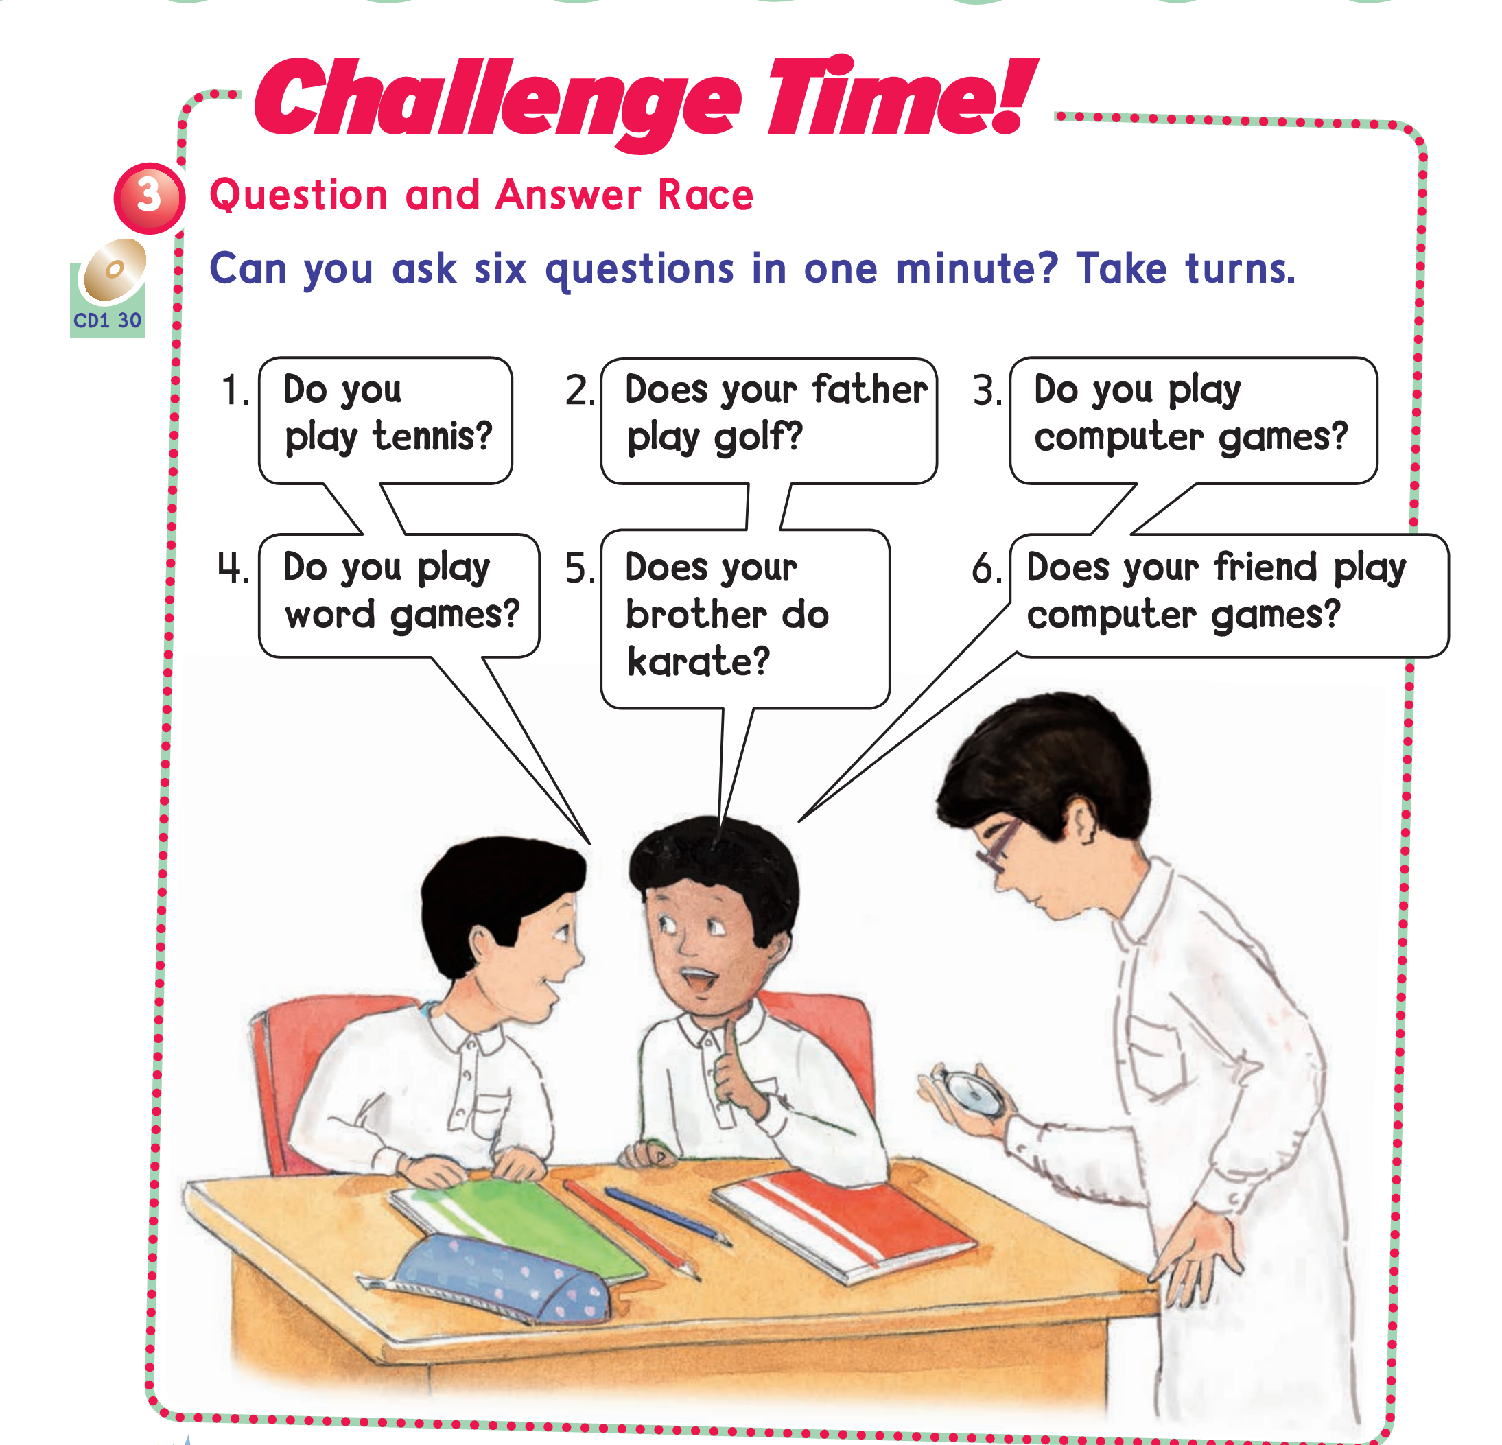

Slide 28

Workbook pages :
157 (1-2)
158 (1-2)

Slide 29
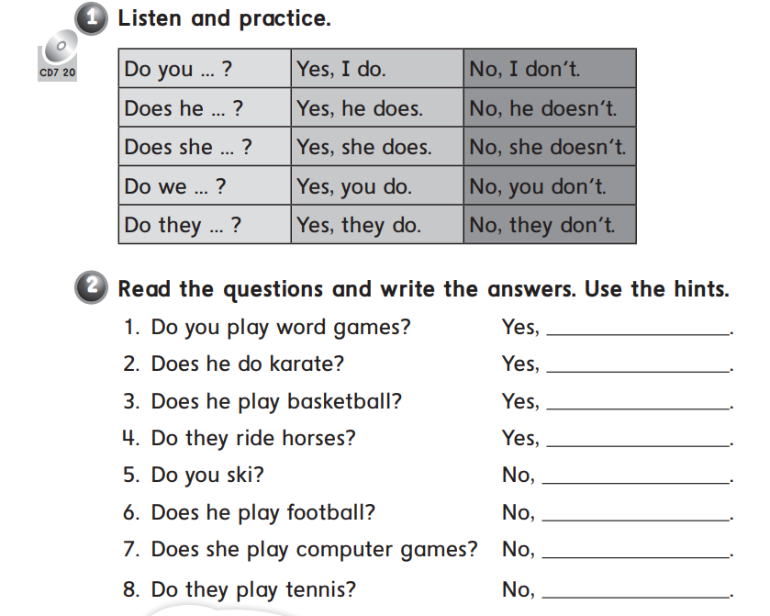

Slide 30
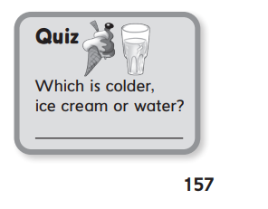
Ice cream

Slide 31
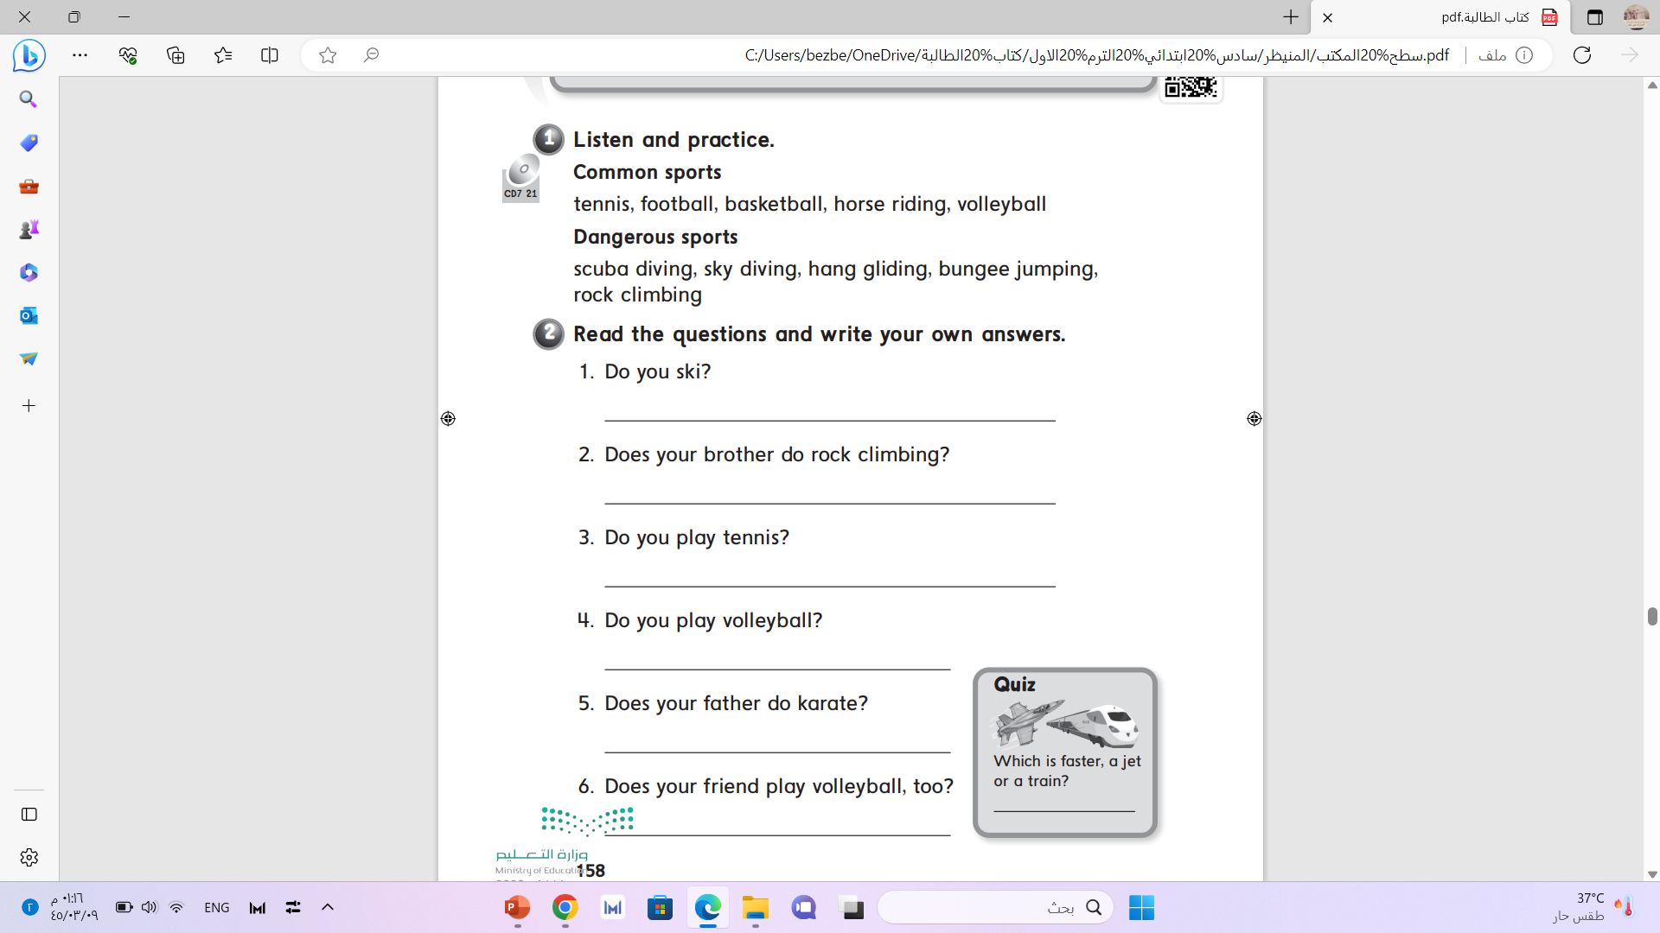
a jet

