Slide 1

U 5
Is there any ice cream?
Form, meaning and function
Tr. Nora Khalid

Slide 2
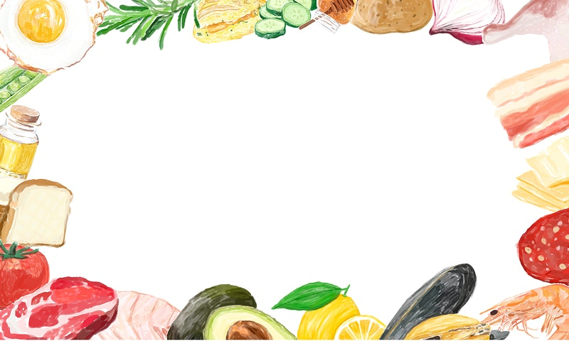

To clarify and practice
too, too much, too many , enough
in writing and speaking

Slide 3
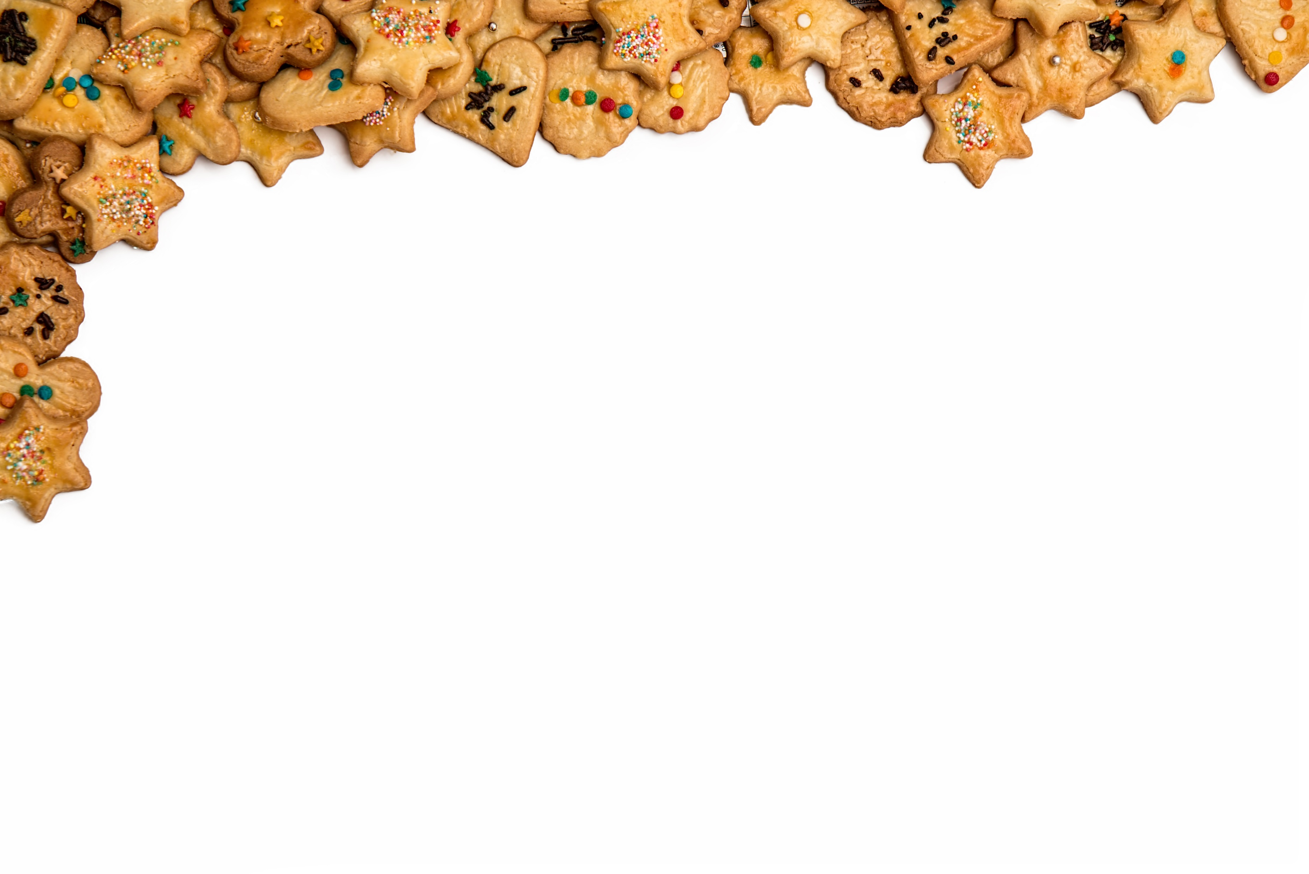

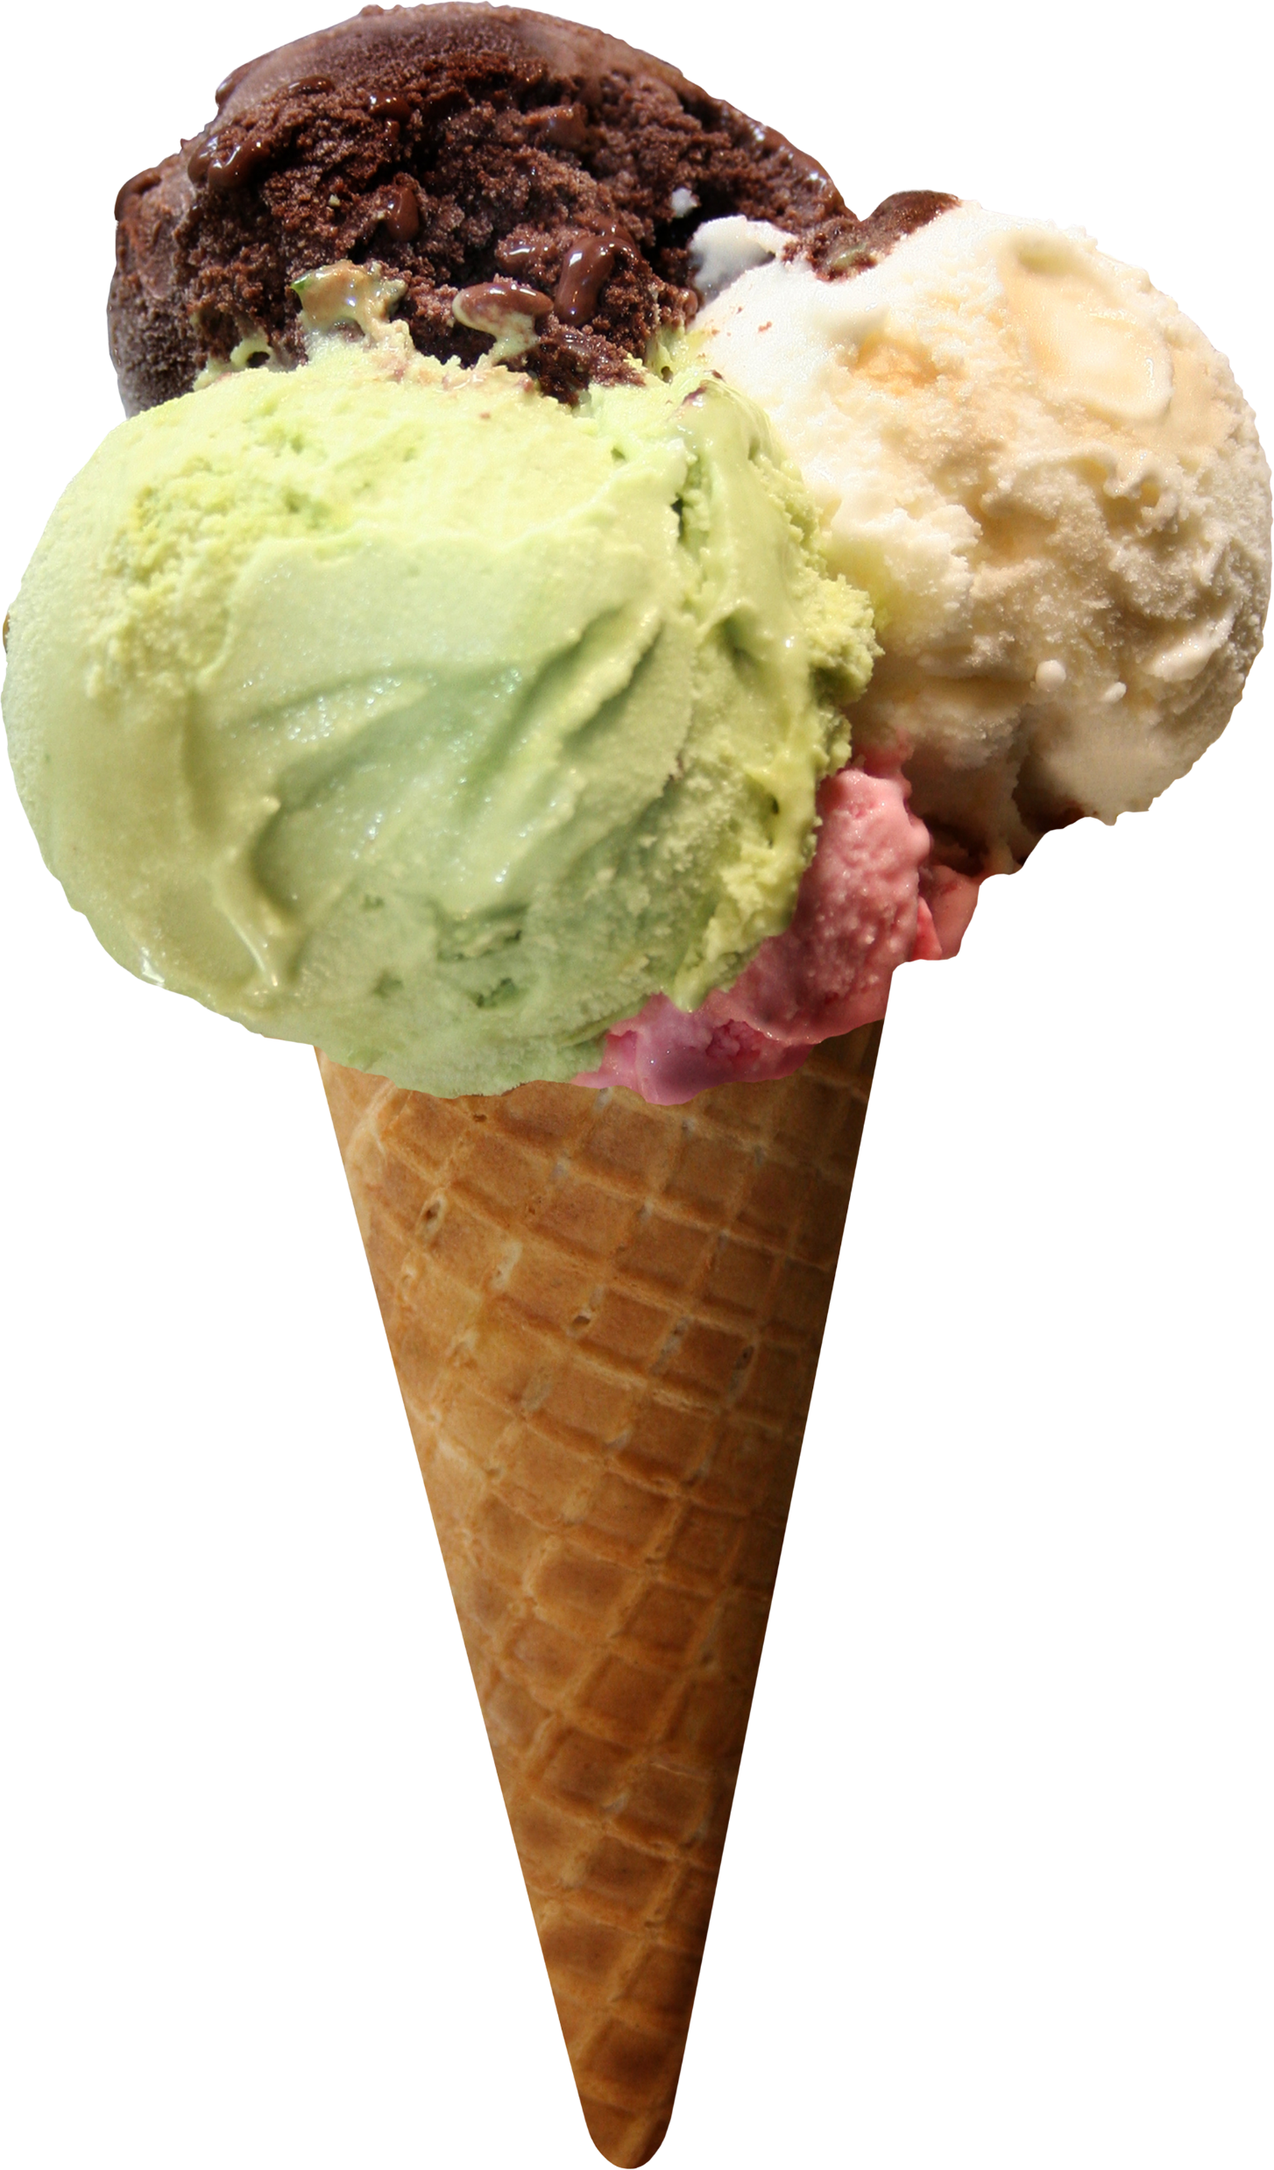
The coffee is too hot.
Adjectives
The ice cream is too cold.

Slide 4
The coffee is hot enough.
Adjectives
The ice cream is cold enough.

Slide 5
too
enough
Before adjectives
after adjectives

Slide 6
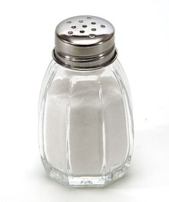
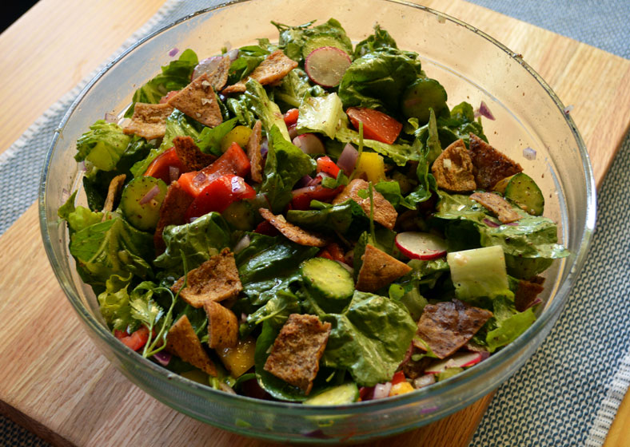
There is too much salt in the salad.
Nouns

Slide 7
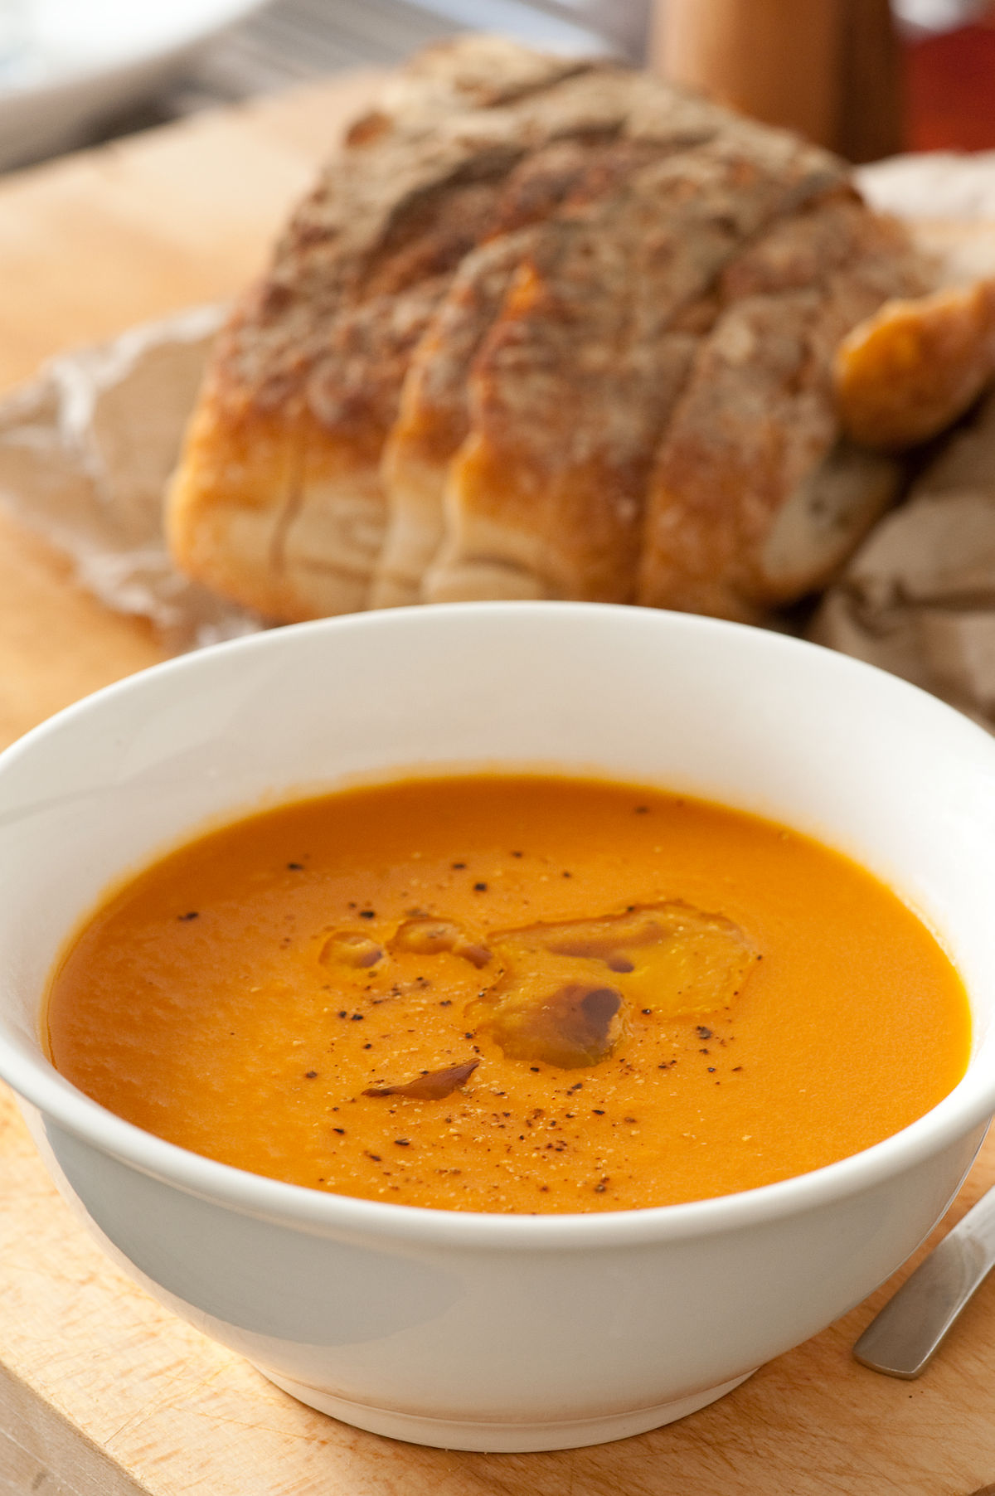
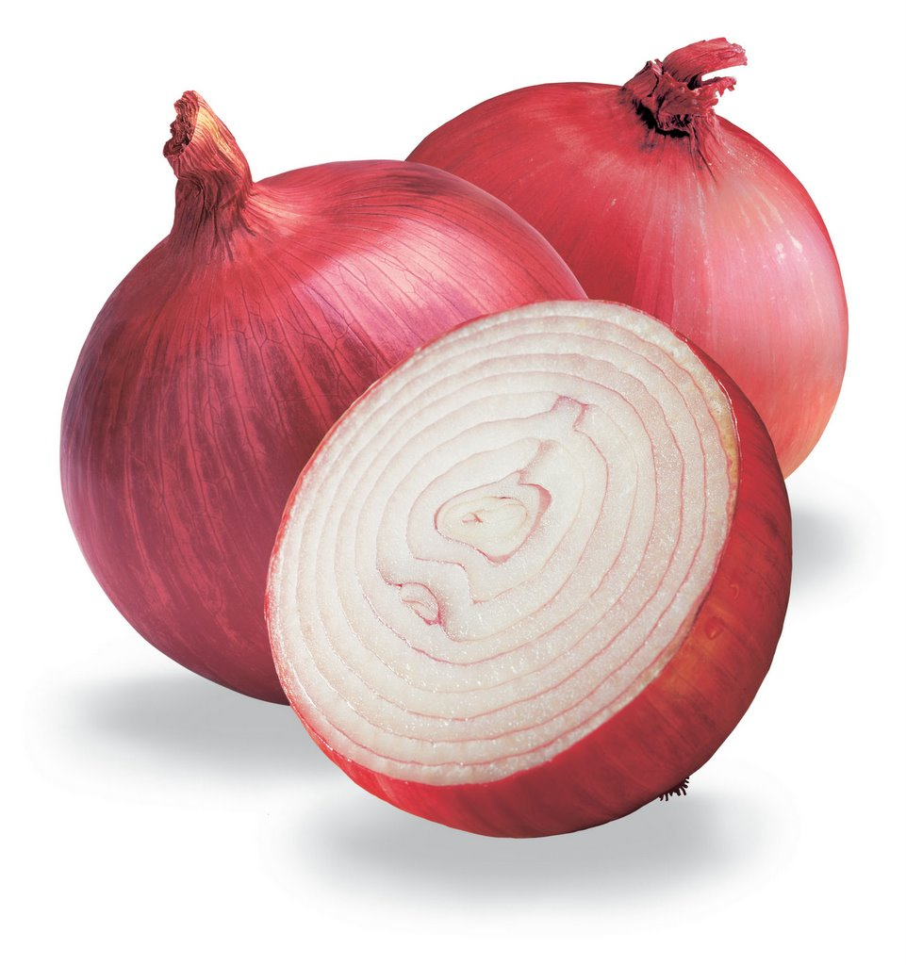
There are too many onions in the soup.
Nouns

Slide 8
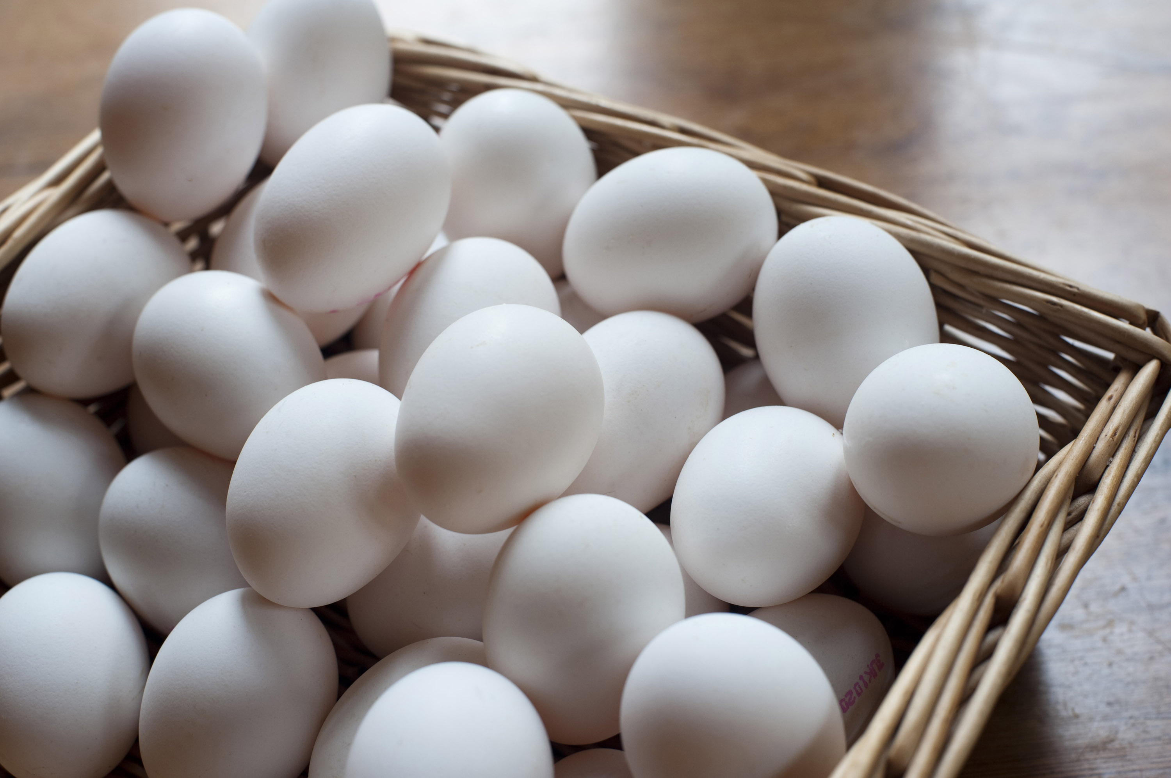
There are enough eggs to make a cake.
Nouns

Slide 9
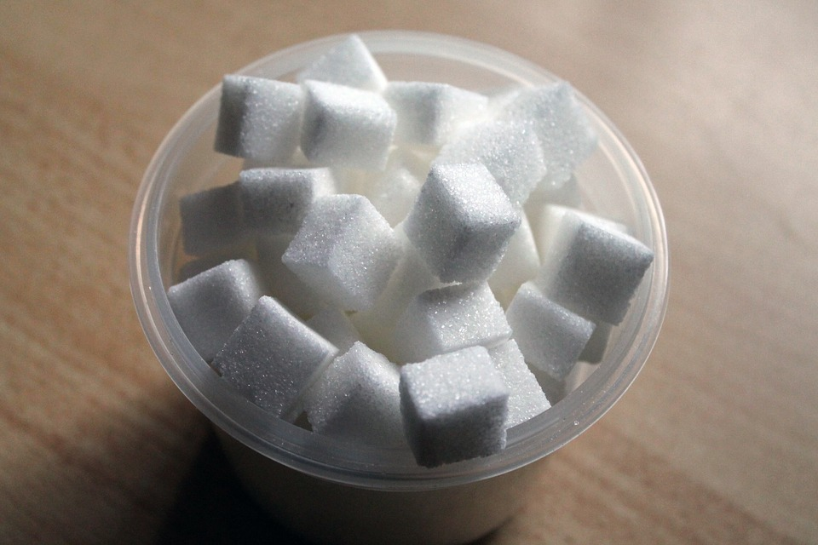
There isn’t enough sugar to make a tea.
Nouns

Slide 10
too many
too much
Count nouns
Noncount nouns
enough
Count nouns and
Noncount nouns

Slide 11
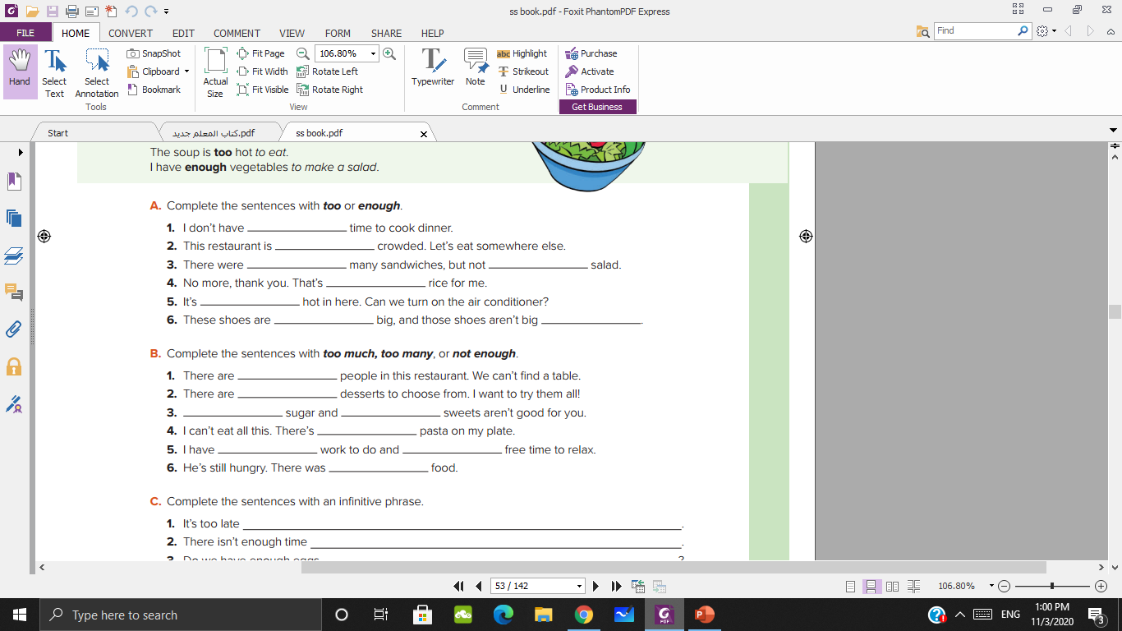
enough
too
too
enough
enough
too
too
enough

Slide 12
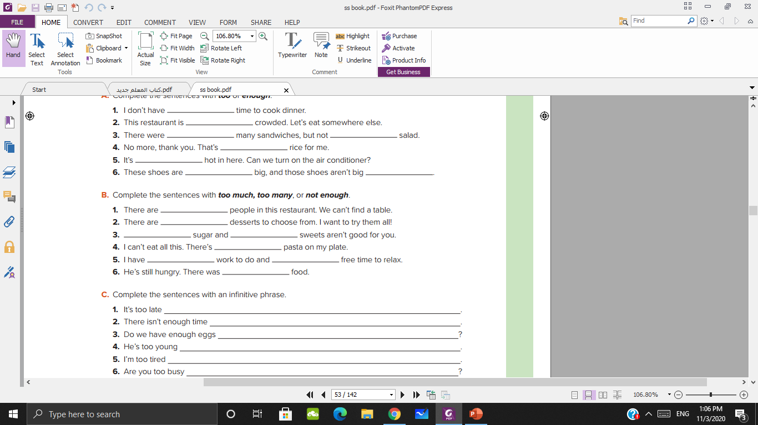
too many
too many
too much
too many
to much
too much
not enough
not enough

Slide 13
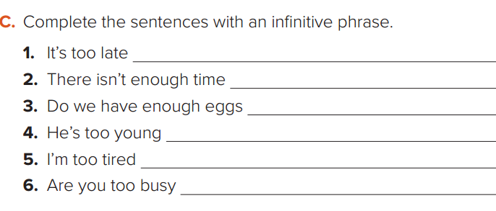
to call him on the phone.
to finish the work.
to make a cake?
to drive a car.
to go for a walk.
to help me with my homework?

Slide 14
https://wordwall.net/resource/6235614

Slide 15

Thank you
Tr. Nora Khalid

