Slide 1
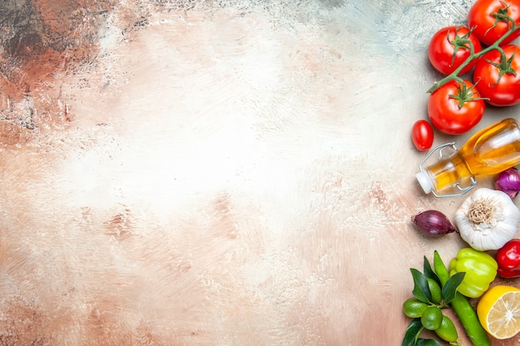
Food from the Americas
Unit 4 Reading

Slide 2
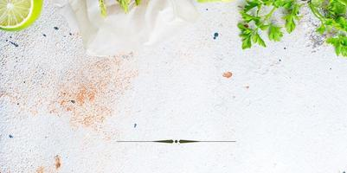
Name the food in the pictures
Find out new vocabulary
Answer with True / False for some sentences

Slide 3
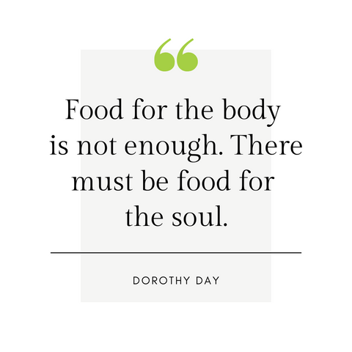
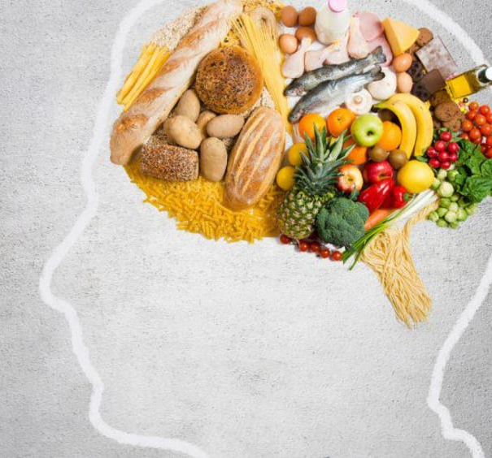

Slide 4
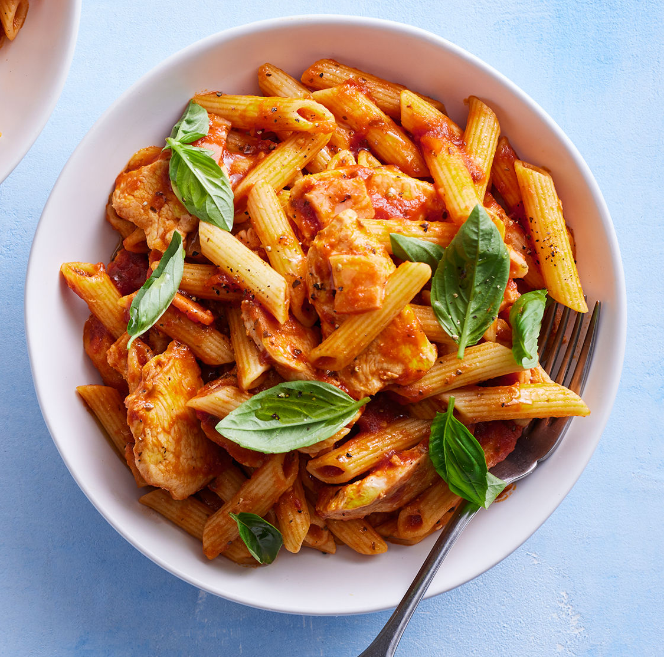
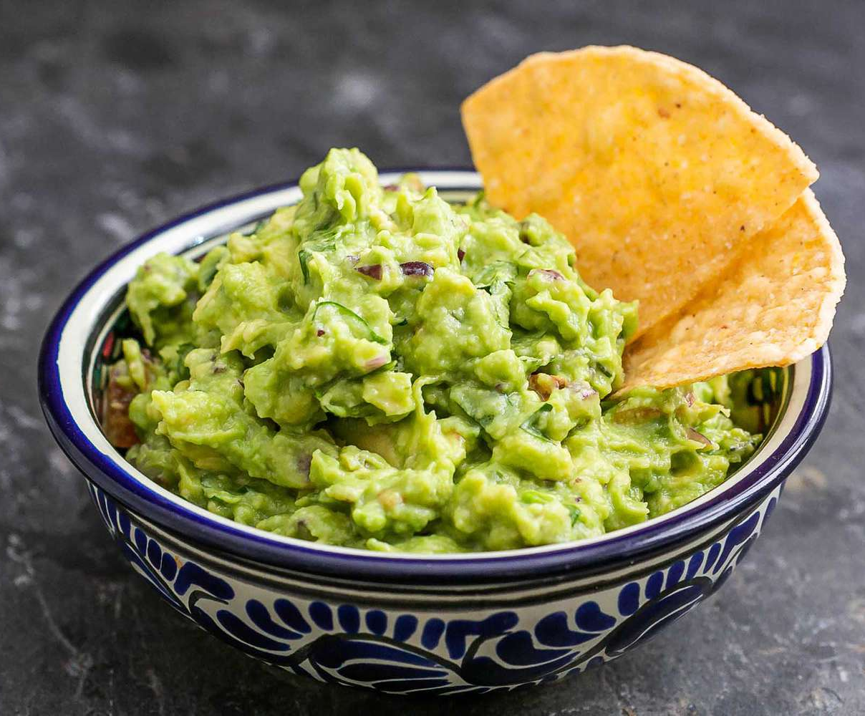
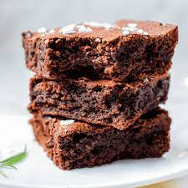

Slide 5
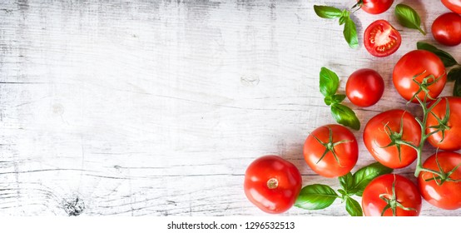
Tomatoes
native
poisonous
Who are tomatoes native to ?
What did the British think at first?

Slide 6
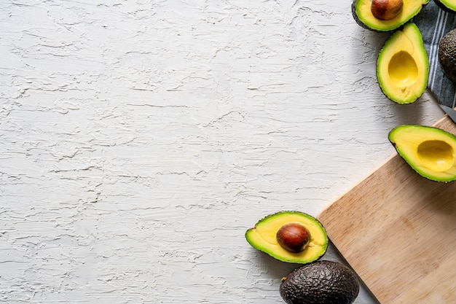
Avocado
ripe
Avocado is an … fruit, rich in vitamins .. , .. and..
Does it get ripe on the tree?

Slide 7
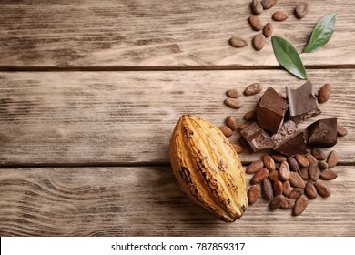
Chocolates
Nowadays
resist
How many cups of chocolate did the Aztec emperor use to drink

Slide 8
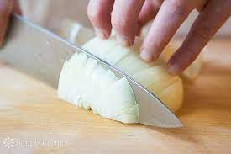
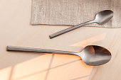
chop
teaspoon
tablespoon

Slide 9
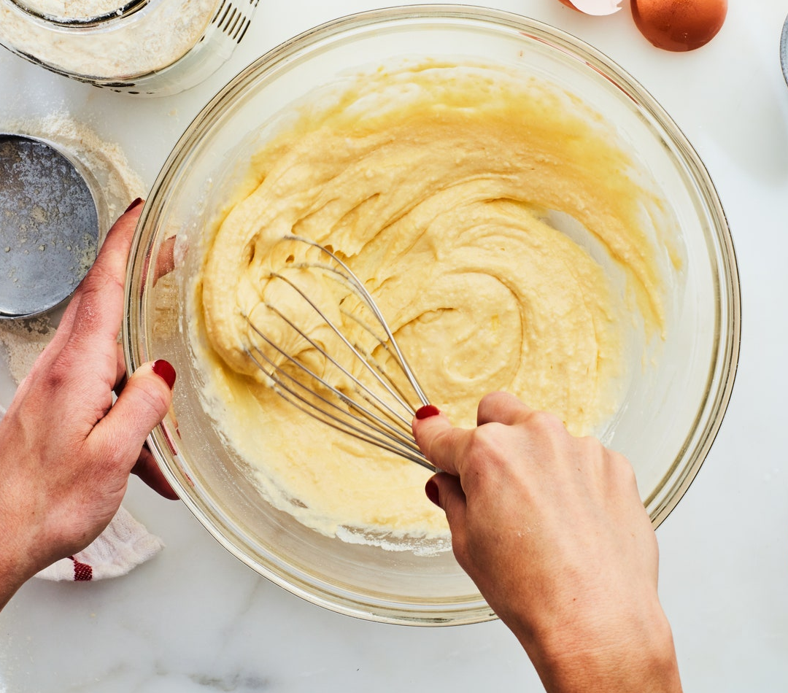
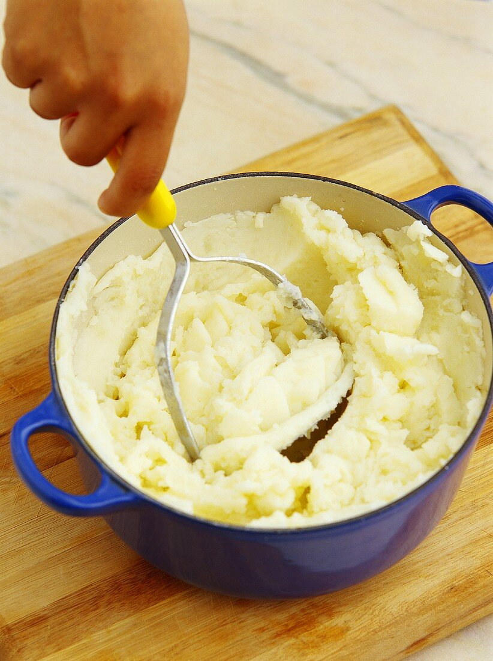
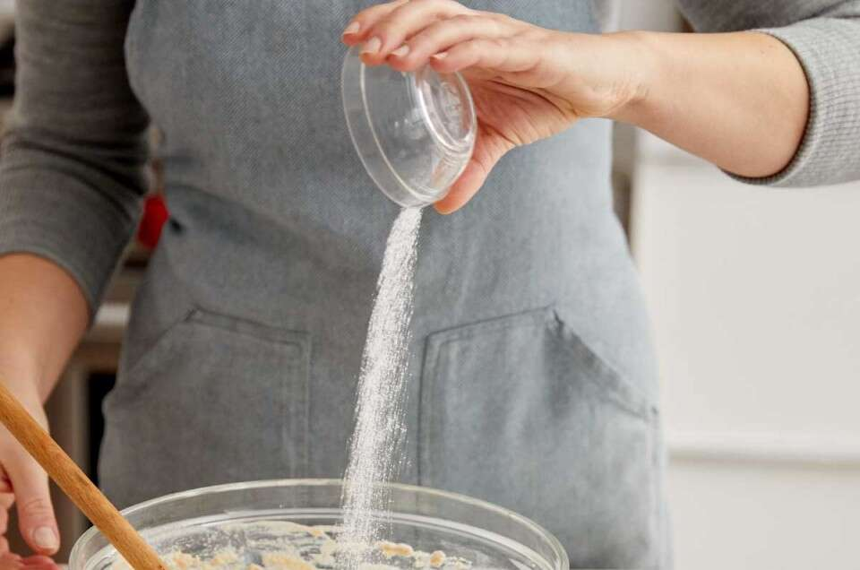
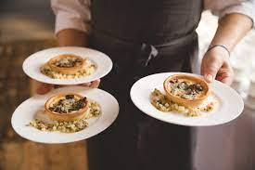
mix
mash
add
serve

Slide 10
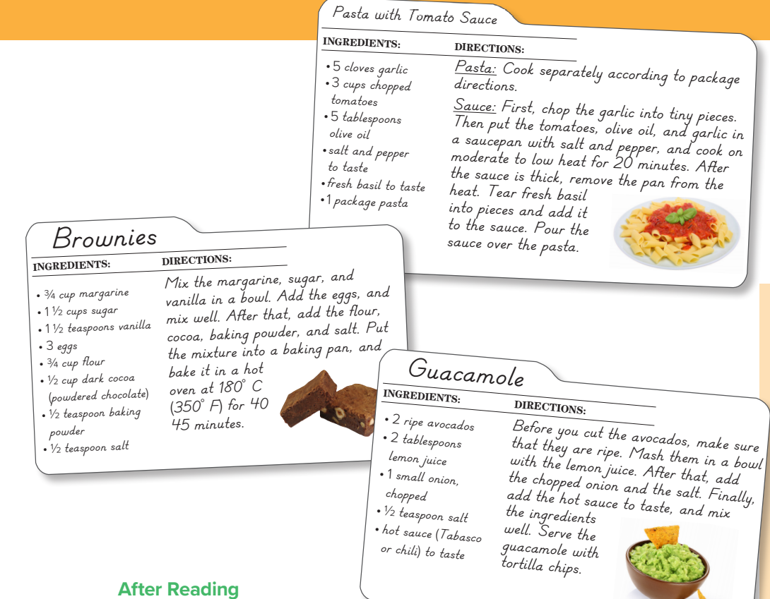
PRESENTATION BY: SLIDECORE

Slide 11
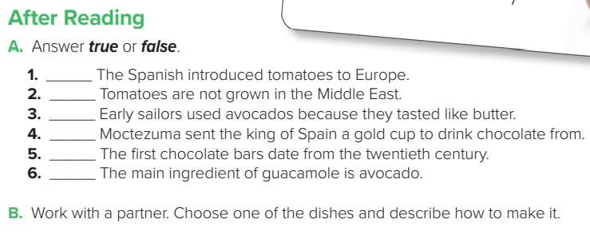
T
F
F
F
F
T

Slide 12
Workbook Page 189
Tr.Kholud

Slide 13
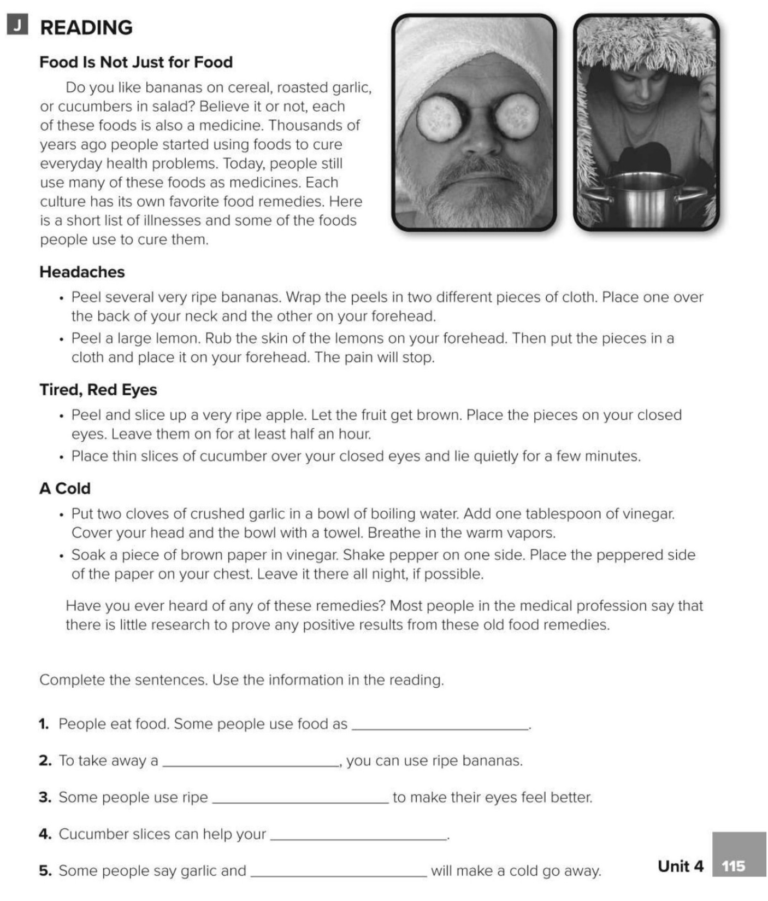
medicines
headache
apples
eyes
vinegar

