Slide 1

Unit 4
What do I need to buy?
Language in context
PRESENTATION BY: SLIDECORE

Slide 2

بسم الله الرحمن الرحيم
Day
Date

Slide 3


PRESENTATION BY: SLIDECORE

Slide 4
Learning Objectives
listen for specific information
02
make sentences about cooking food
01
differeintiate between different sound.
04
give an advice about cooking
03
05
talk about their habits in buying supplies from the supermarket

Slide 5
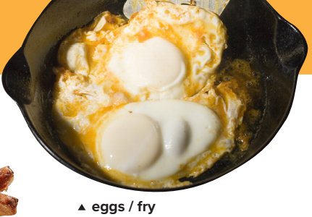
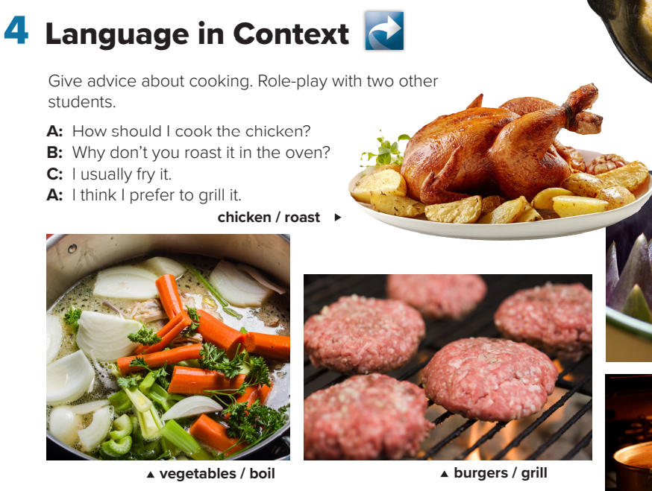
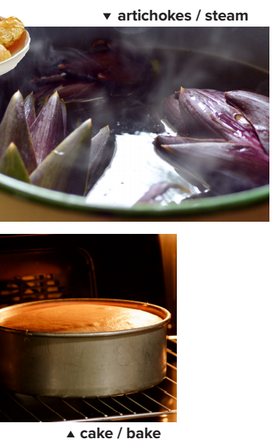
A: How should I make the vegetables?
B: Why don’t you boil them?
C: I usually steam them.
A: That’s what I’ll do
A: What’s a good way to cook eggs?
B: I fry them.
C: I don’t like fried eggs.
A: How about if I boil them?
Page:42
PRESENTATION BY: SLIDECORE

Slide 6
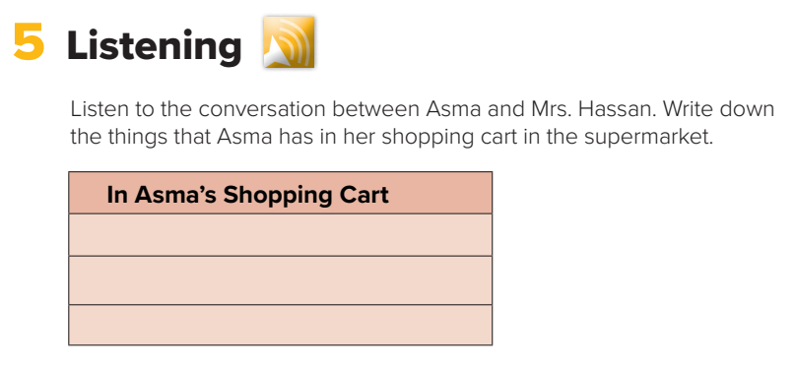

four packages of frozen chicken burgers
two dozen buns
extra large bags of potato chips
Page:42
PRESENTATION BY: SLIDECORE

Slide 7
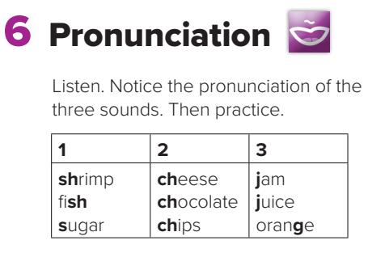
Page:42
PRESENTATION BY: SLIDECORE

Slide 8
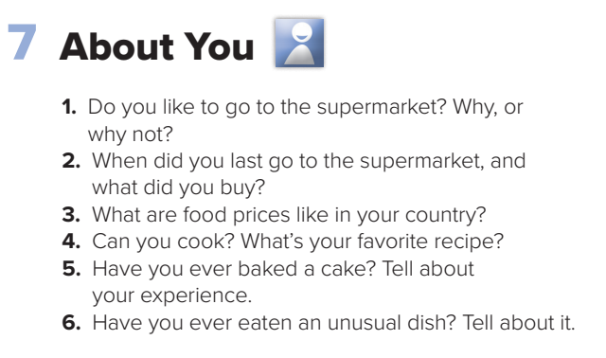
Page:42
PRESENTATION BY: SLIDECORE

Slide 9
Homework
Workbook page 187

Slide 10
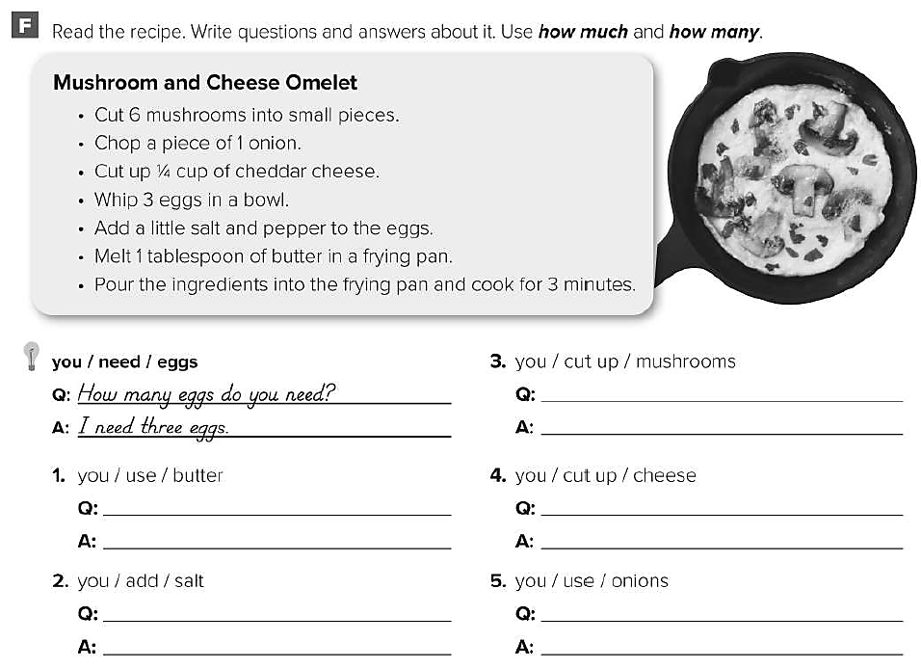
How many mushrooms do you cut up ?
You cut up 6 mushrooms .
How much butter do you use ?
You use 1 tablespoon of butter .
How much cheese do you cut up ?
You cut up ¼ cup of cheese .
How much salt do you add ?
You add a little salt .
How many onions do you use ?
You use a piece of 1 onion .

Slide 11
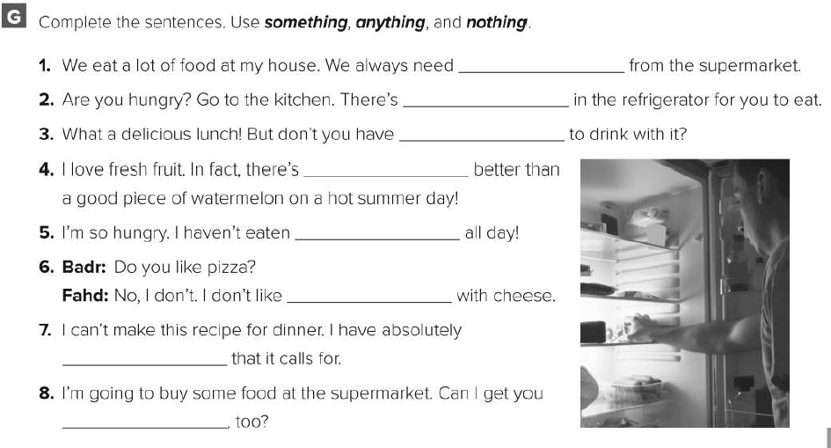
something
something
anything
nothing
anything
anything
nothing
something

Slide 12
Healthy life Flaticon icon pack
Icons by Manthana Chaiwong

Slide 13
Colored Food & Drink Icons
Icons by Icons8

Slide 14
Editable Icon Set
Things you can do:
Resize the icon
Change fill color and opacity
Add stroke
Add dash lines

