Slide 1
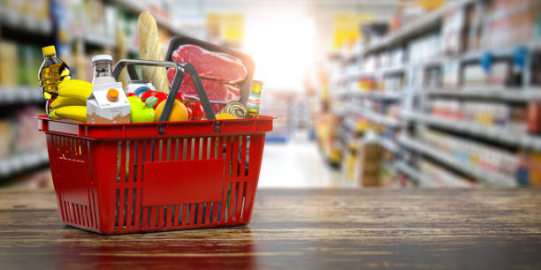
What do I Need to Buy ?
Unit 4
Listen & Discuss

Slide 2
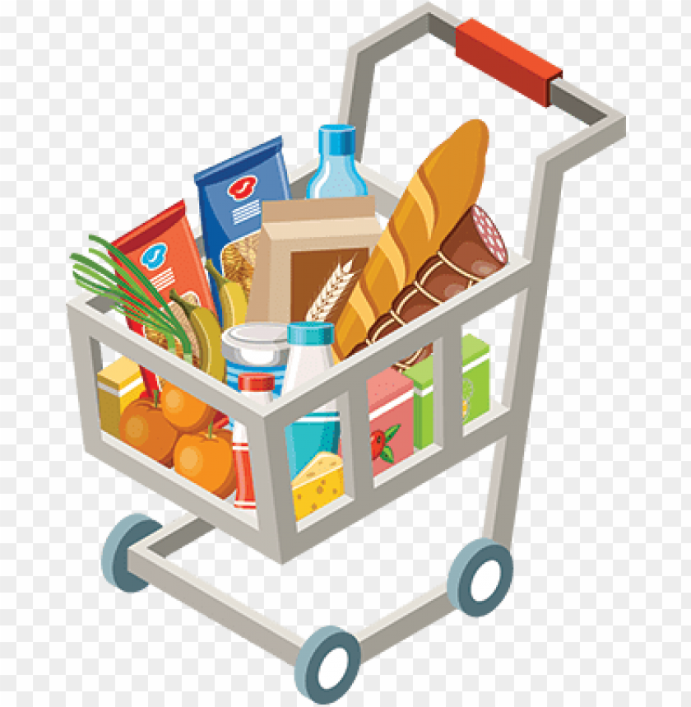
Learning Objectives
Read Food Vocabulary
Classify Food items
Listen to a conversation
Complete a chart about what is needed

Slide 3
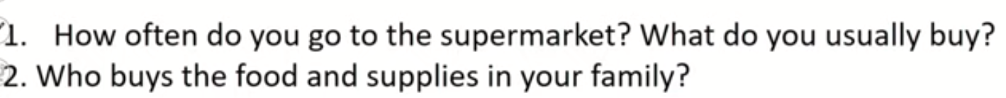
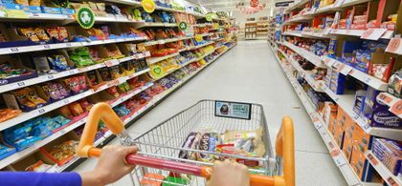


Slide 4

Food
Vocabulary

Slide 5
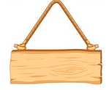

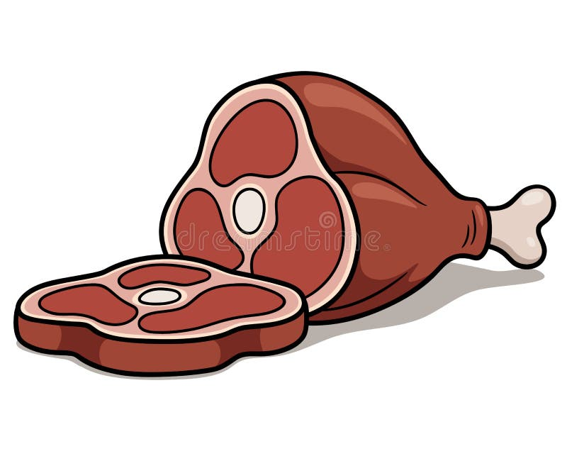


Meat
chicken
beef
lamb
sausage

Slide 6




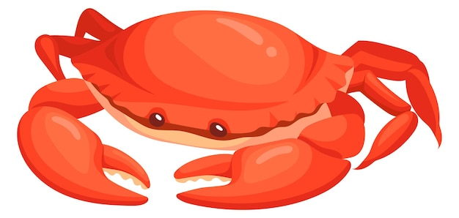
Seafood
salmon
shrimp
crab
squid

Slide 7







strawberries
mango
Fruit
avocado
grapes
papaya
dates
pineapple

Slide 8

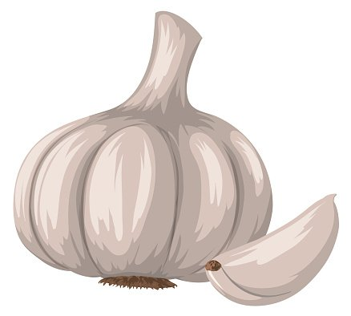

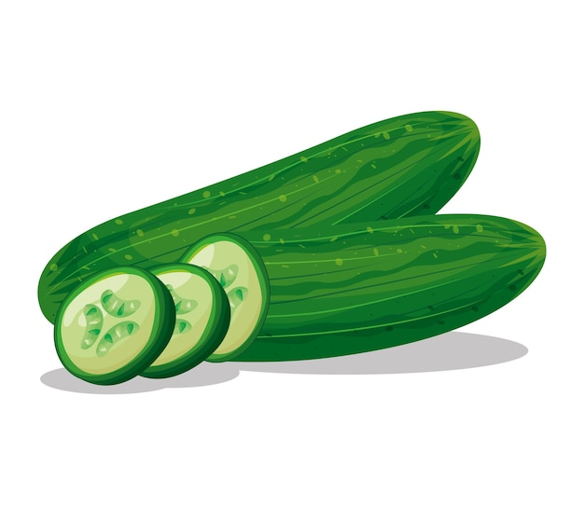


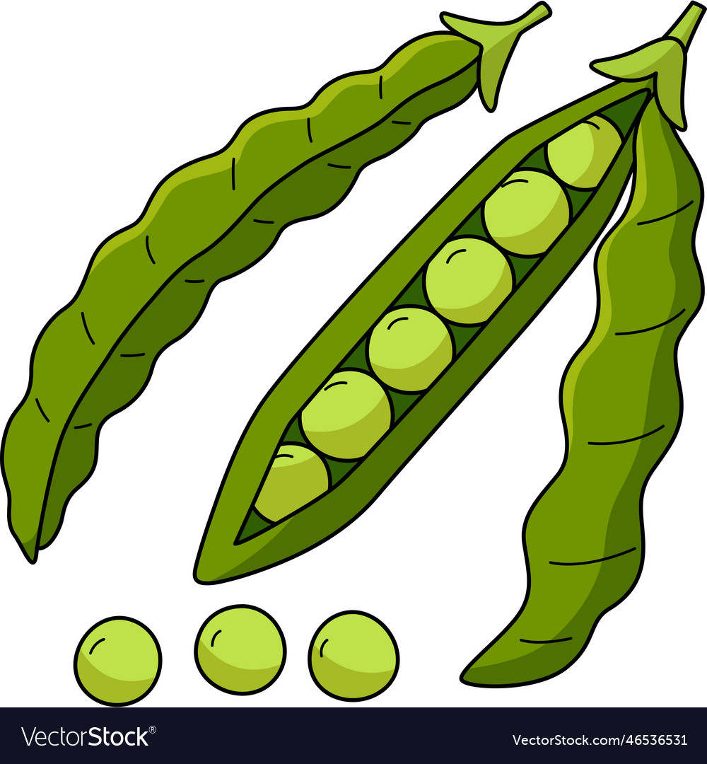
potatoes
garlic
Vegetables
onions
cucumbers
beans
carrots
peppers

Slide 9




Dairy
Products
milk
cheese
yogurt
butter

Slide 10

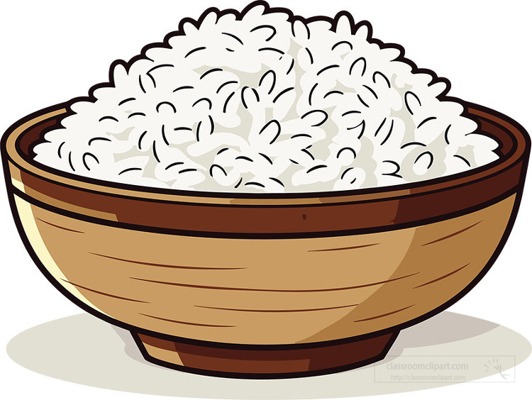

Bread &
Grains
bread
rice
cereals

Slide 11


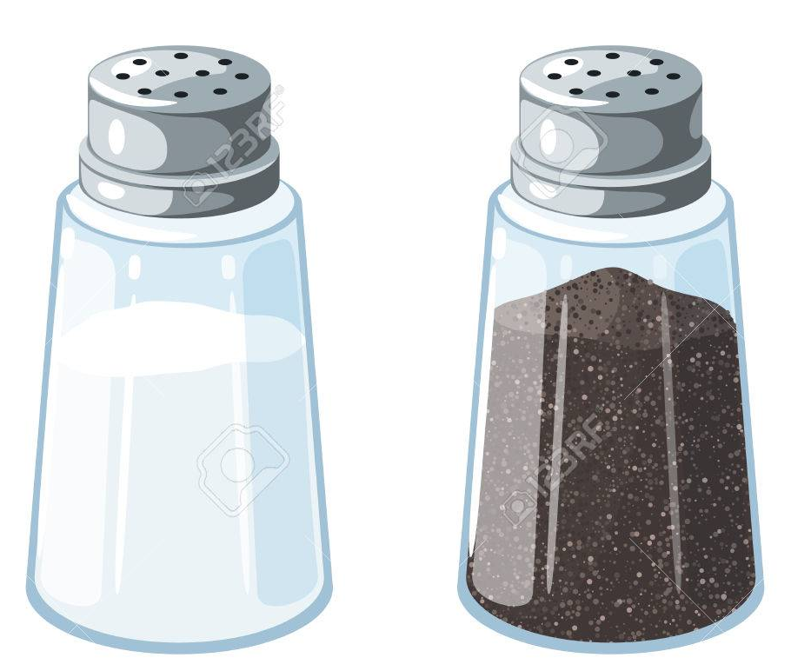
Oils &
Condiments
corn oil
olive oil
salt
pepper

Slide 12

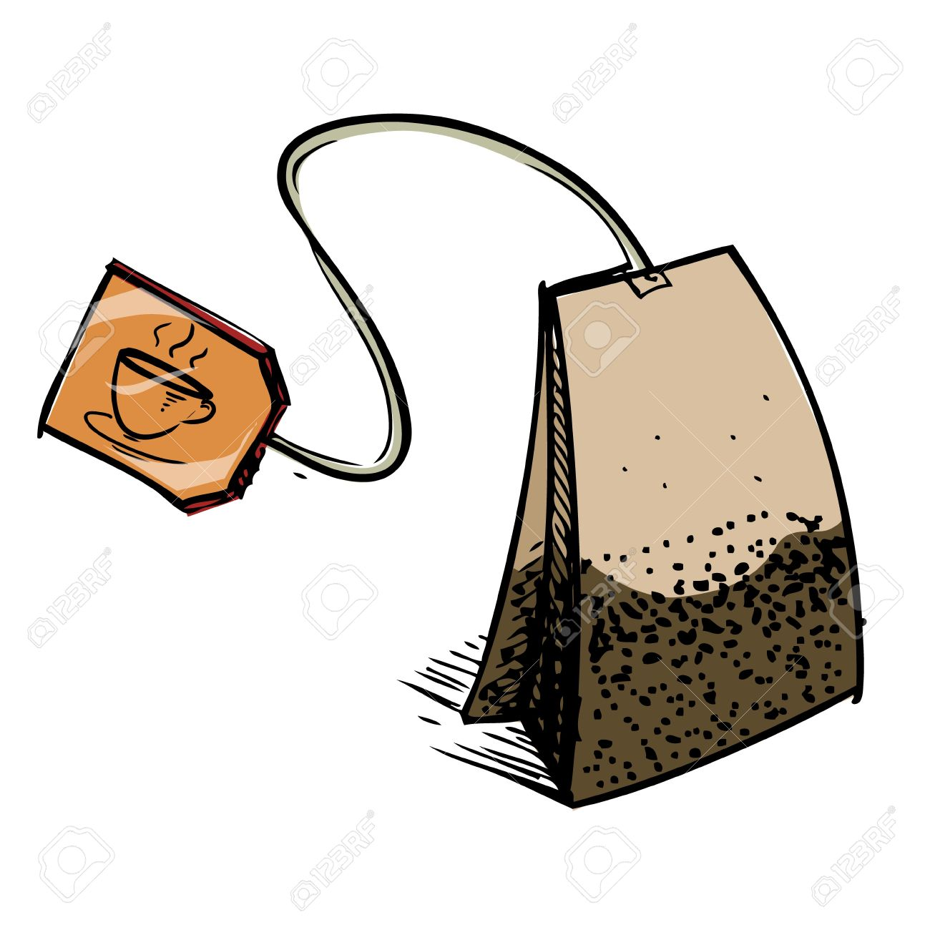
Drinks
coffee
tea

Slide 13


Other
sugar
flour

Slide 14
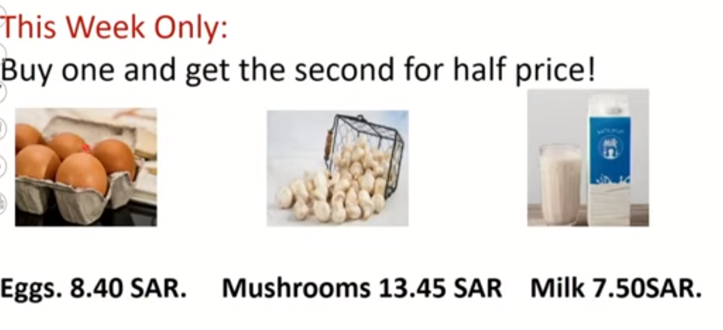

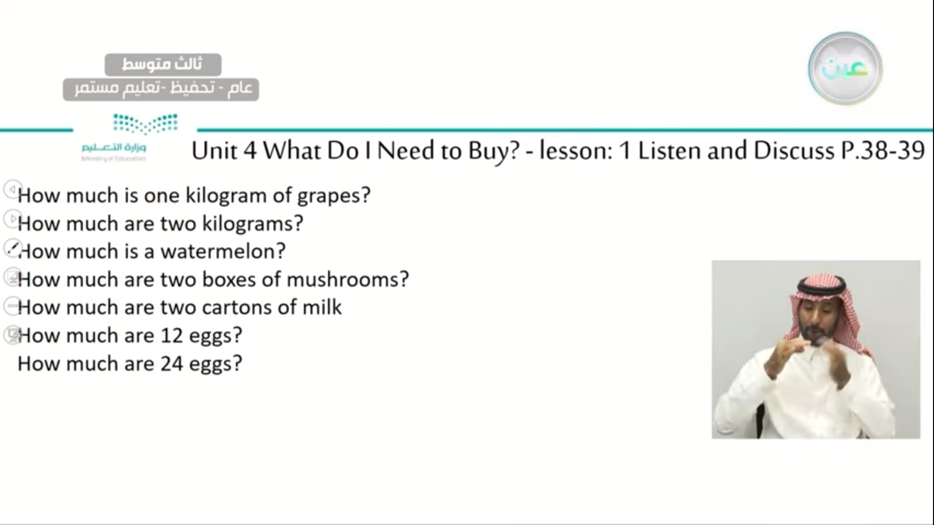
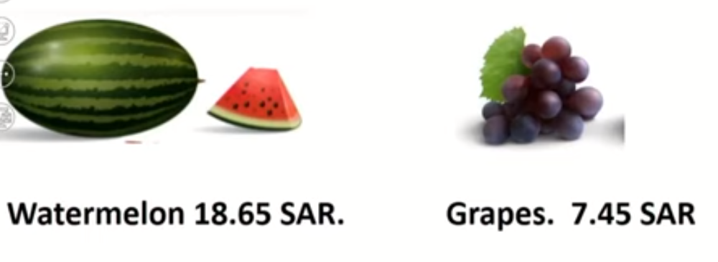

Slide 15
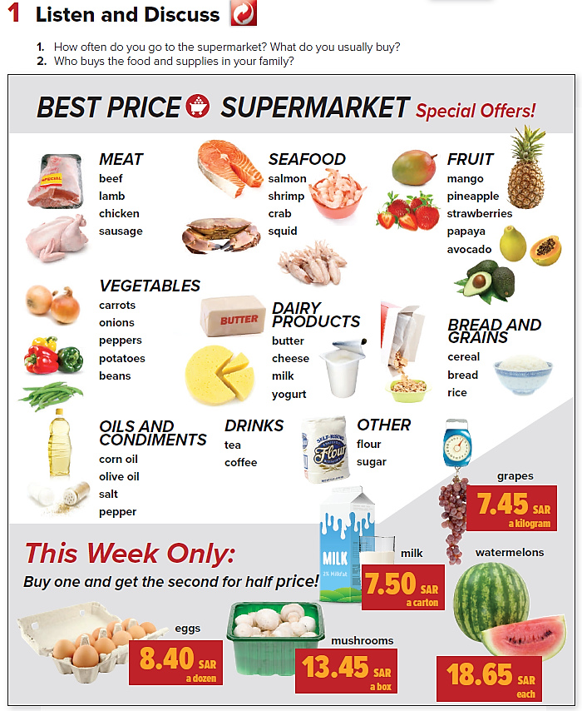

PRESENTATION BY: SLIDECORE

Slide 16
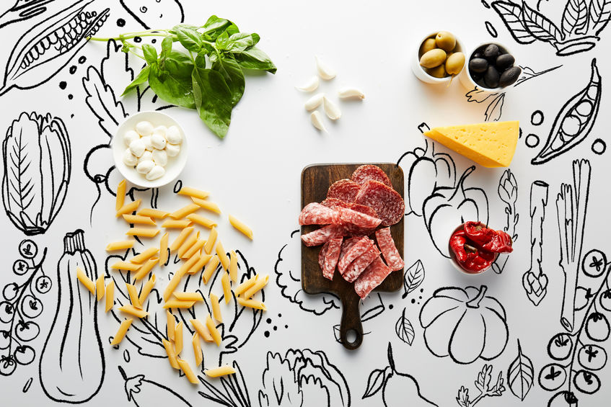

Practice

Slide 17
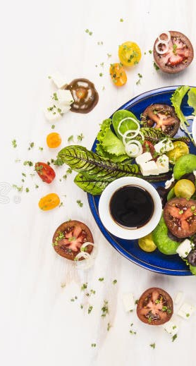
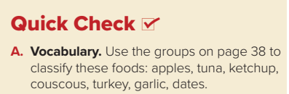

apples
fruit
meat
tuna
ketchup
other
meat
turkey
vegetables
garlic
fruit
dates

Slide 18
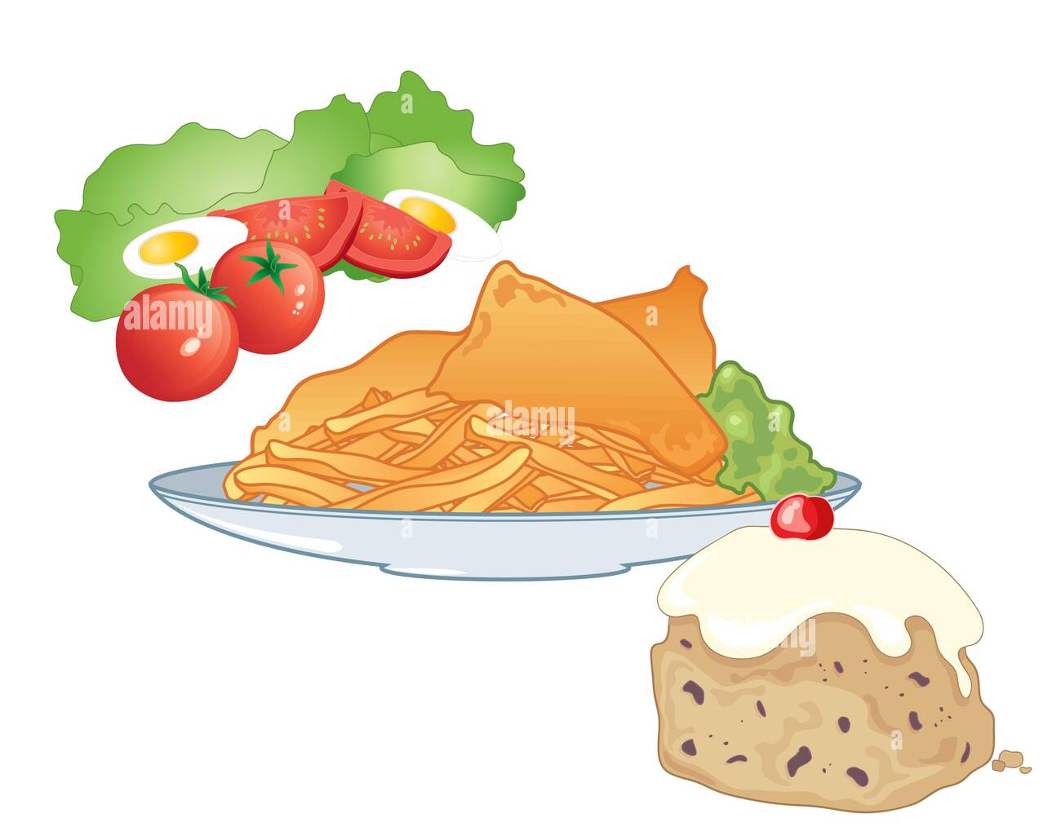
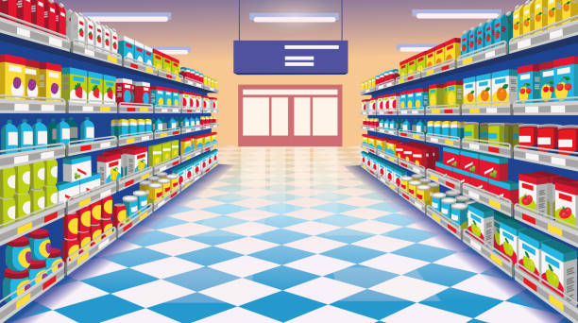
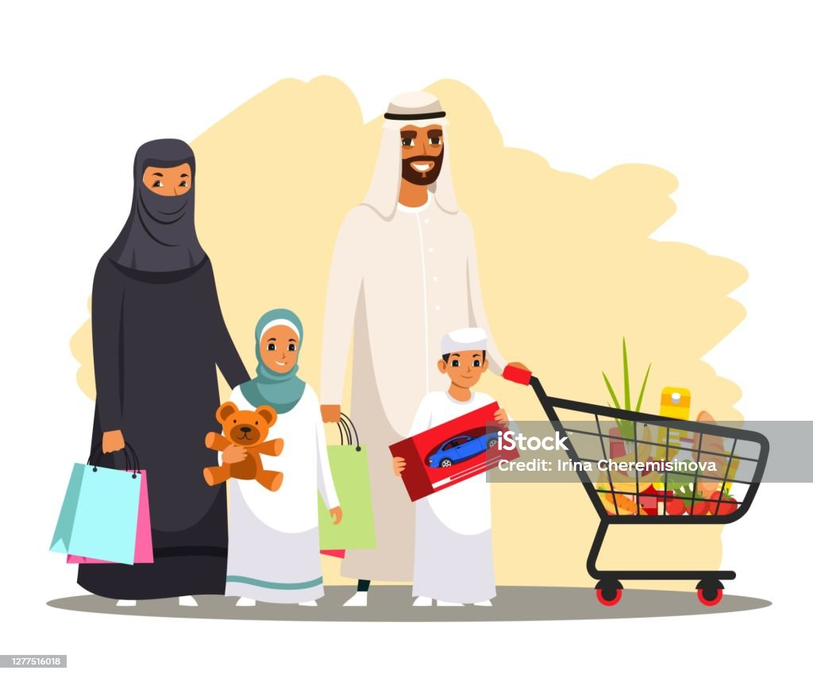
What I need to buy for dinner ?
appetizer
main dish
dessert

Slide 19
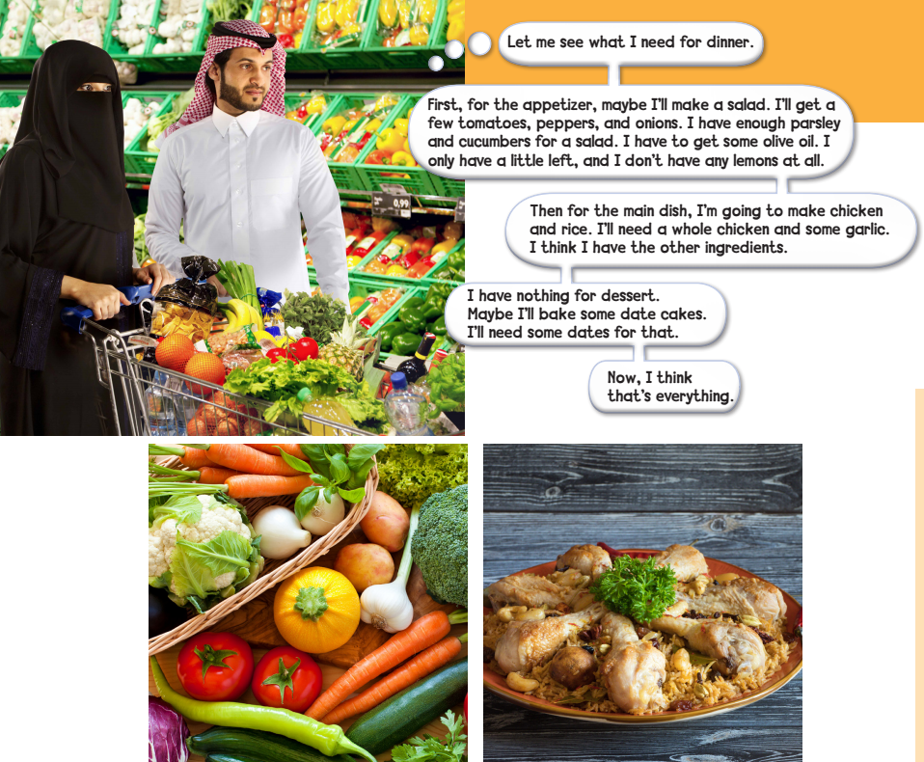
Page:39
PRESENTATION BY: SLIDECORE

Slide 20
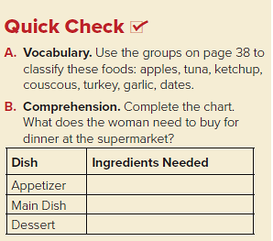
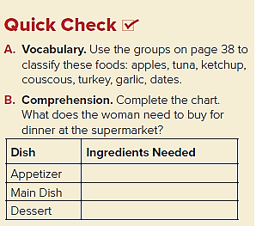
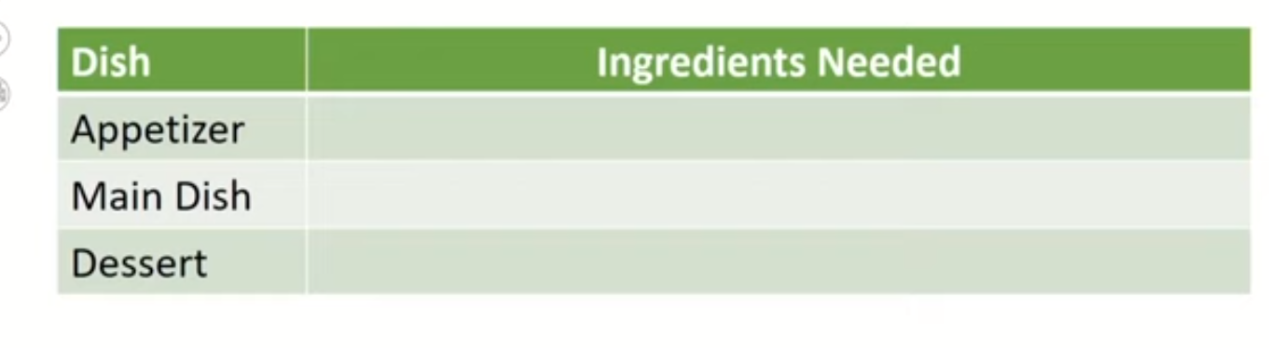
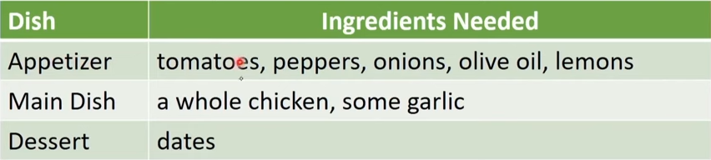
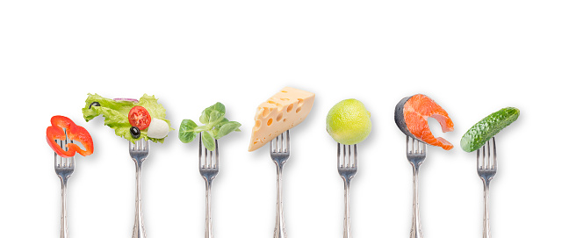

Slide 21

Workbook Page 185
Tr.Kholud

Slide 22
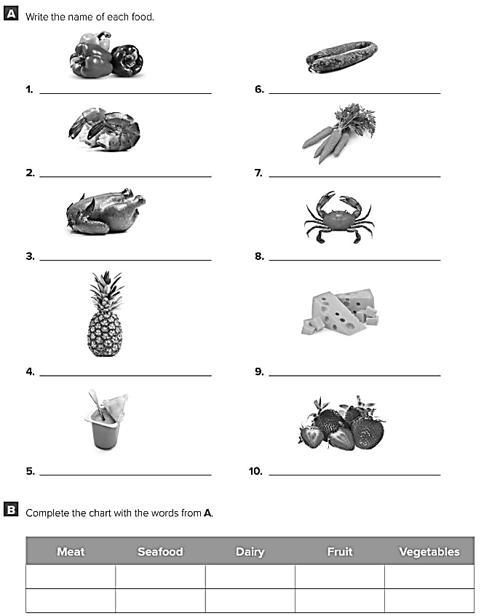
Peppers
Sausage
Shrimp
Carrots
Chicken
Crab
Pineapple
Cheese
Yoghurt
Strawberries
Chicken
Shrimp
Yoghurt
Pineapple
Peppers
Sausage
Crab
Cheese
Strawberries
Carrots

