Slide 1

Unit 4
What do I need to buy?
Writing
PRESENTATION BY: SLIDECORE

Slide 2
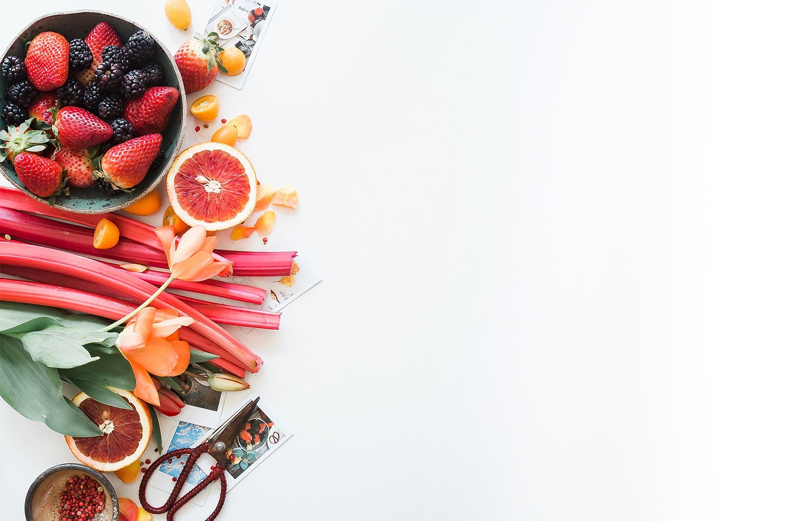
بسم الله الرحمن الرحيم
Day
Date

Slide 3
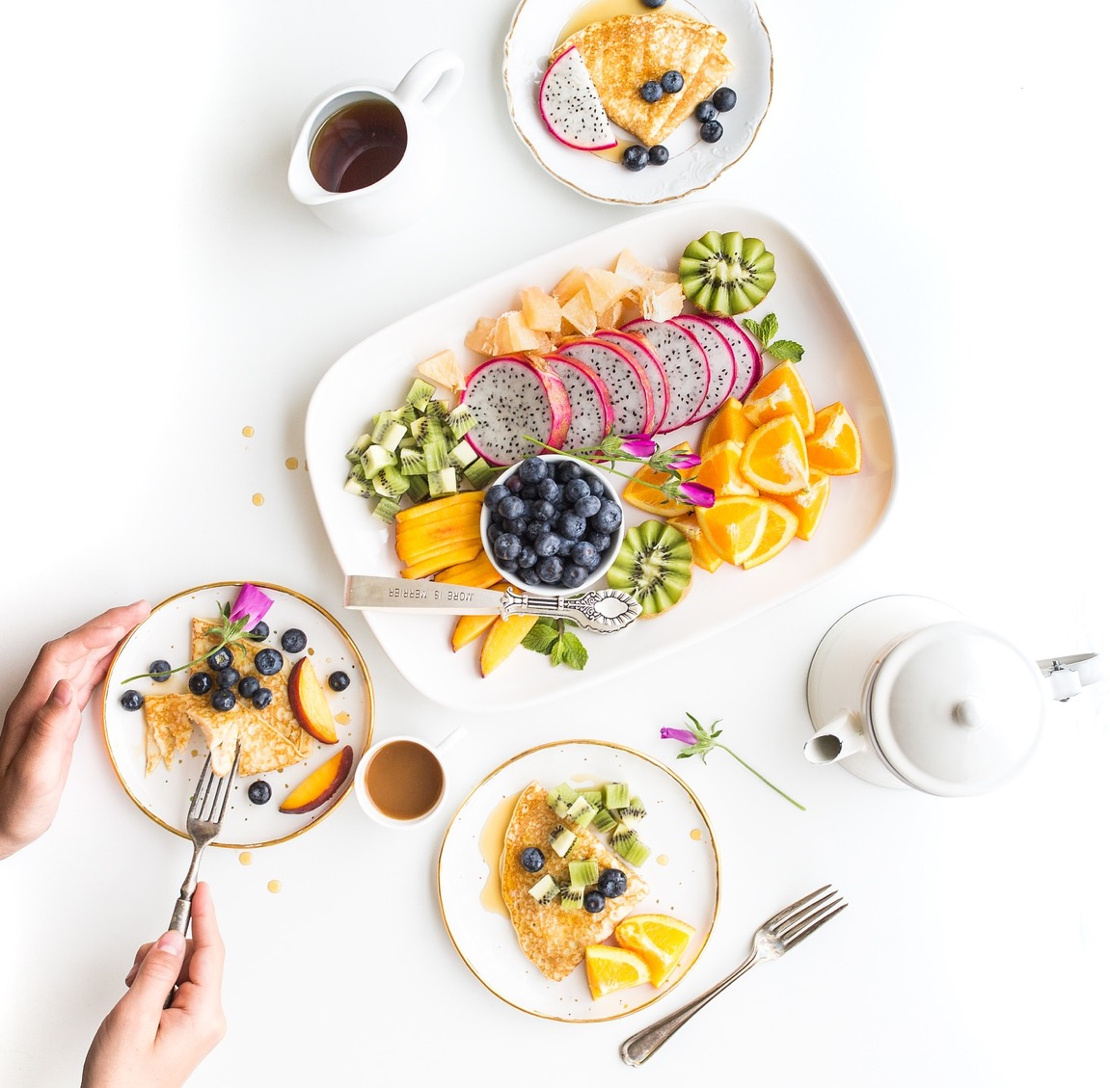

PRESENTATION BY: SLIDECORE

Slide 4
Learning Objectives
use sequence words to show the order
01
write favorite meal ingredients & directions
02
write a recipe of meal & illustrate it.
03

Slide 5
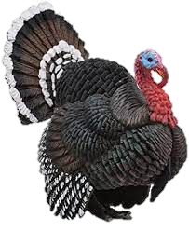
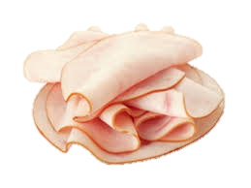
Vocabulary
Turkey

Slide 6
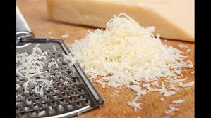
Vocabulary
Granted paremeasn
cheese

Slide 7
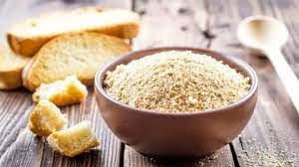
Vocabulary
Bread crumbs

Slide 8
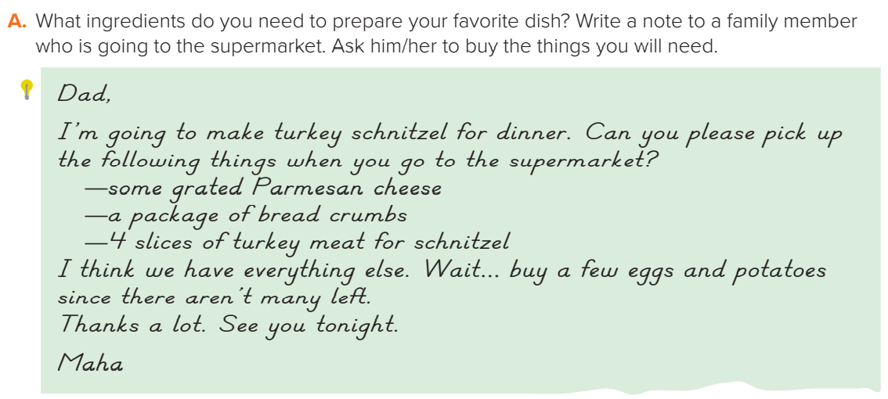
PRESENTATION BY: SLIDECORE
Page:46

Slide 9

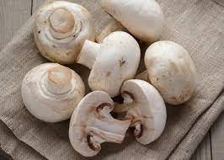
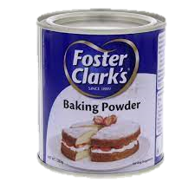
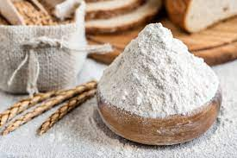
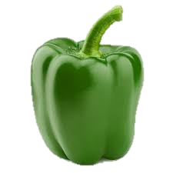
Mom,
I’m going to make pizza for dinner. Can you please pick up the following things when you go to the supermarket?
— baking powder
— a bag of flour
— some green pepper
- Some mushrooms
I think we have everything else.
Thanks a lot. See you tonight.
Maha
PRESENTATION BY: SLIDECORE

Slide 10
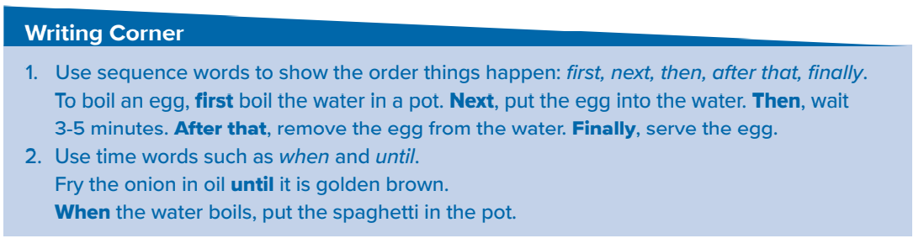
PRESENTATION BY: SLIDECORE

Slide 11
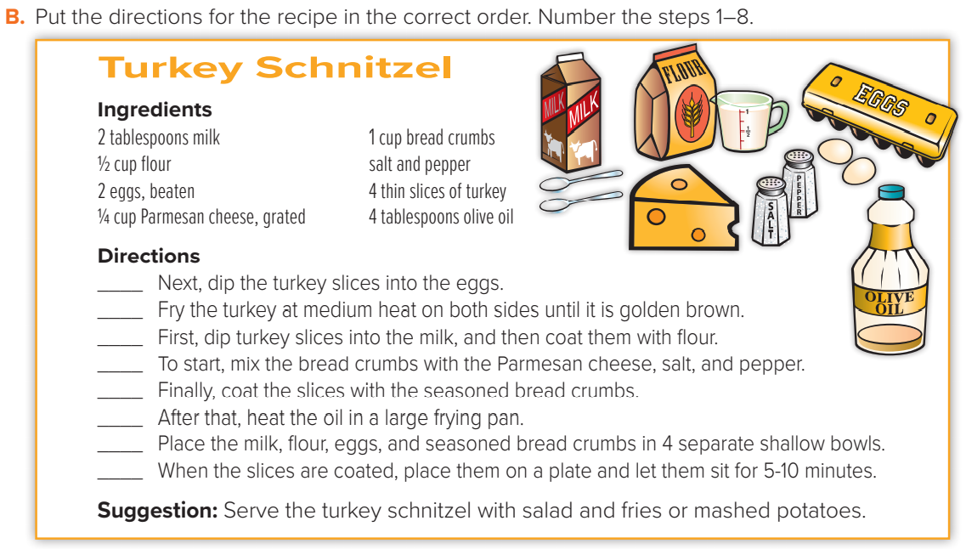
4
8
3
1
5
7
2
6
PRESENTATION BY: SLIDECORE

Slide 12
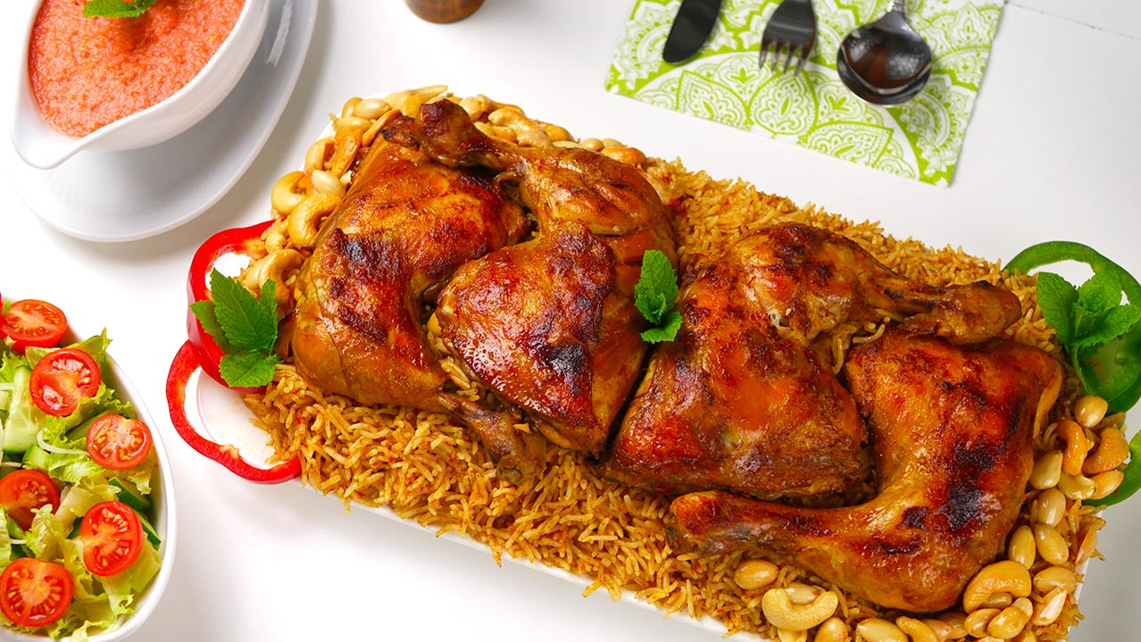
Ingredients
1 chopped onion
2 cloves garlic
1 whole chicken, cut into 8 pieces
¼ cup tomato mash
2 table spoon of tomato paste
Salt & mixed kabsa spices
3 ¼ cups hot water
2 ¼ cups unrinsed basmati rice
First, Heat some oil in a large pot over medium heat and stir in the garlic and onion until the onion has softened for 5 minutes.
Next, add the chicken pieces and brown them over medium-high heat about 10 minutes.
Then, Mix in the tomato mash and stir in the tomato paste with the kabsa spices .and add the hot water and cook for 30 minutes
After that, gently stir in the rice and cover the pot until the rice dry and its grains are separate.
Finally put the rice into a large serving plate and arrange the chicken pieces on top. Serve it with hot sauce and fresh salad
PRESENTATION BY: SLIDECORE

Slide 13
Homework
Workbook page 190

Slide 14
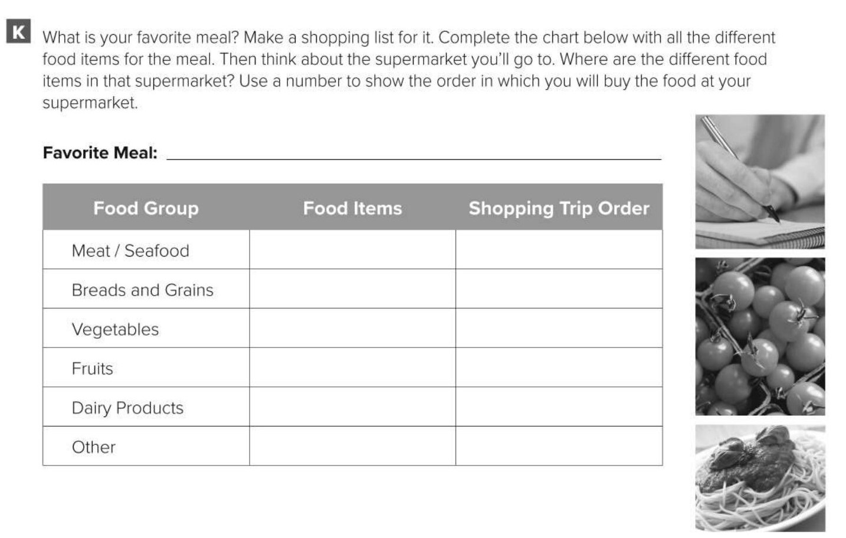
roasted chicken with salad and fries.
chicken
3
bread
1
lettuce, tomatoes,
potatoes
2
cheese
4

Slide 15
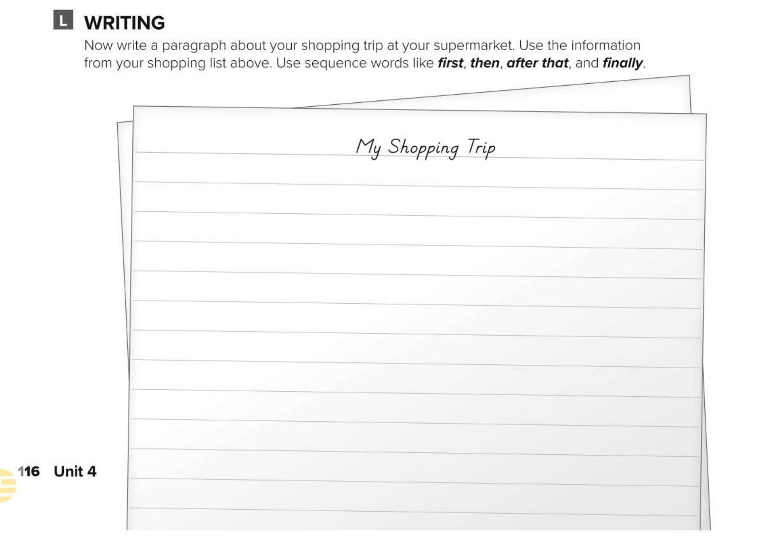
I’ll go to the supermarket to buy food for my favorite meal roasted chicken with salad and fries. First, I’ll buy some bread.
Then I’ll buy some lettuce, two tomatoes, and one kilo of potatoes. After that, I’ll buy the chicken. Finally, I’ll buy some cheese for the salad.

Slide 16
Healthy life Flaticon icon pack
Icons by Manthana Chaiwong

Slide 17
Colored Food & Drink Icons
Icons by Icons8

Slide 18
Editable Icon Set
Things you can do:
Resize the icon
Change fill color and opacity
Add stroke
Add dash lines

