Slide 1
Revision SG2
Final Exam
First Term
written

Slide 2


Marks :
10 Listen & speak
30 Written test
5
online listening
5
Oral speaking

Slide 3
30 Written test
6 composition
6 Reading comprehension
7 Grammar
7 Vocabulary
4 Spelling

Slide 4





compostion
6 marks

Slide 5
Write a paragraph about ……………
By answering the following questions . In not less than 50 words :
1) A hotel stay
2) The Internet
3) My Dream Job
4) My Hobby
5) Favorite food
ملف مراجعة التعبير

Slide 6
comprehension
6 marks

Slide 7
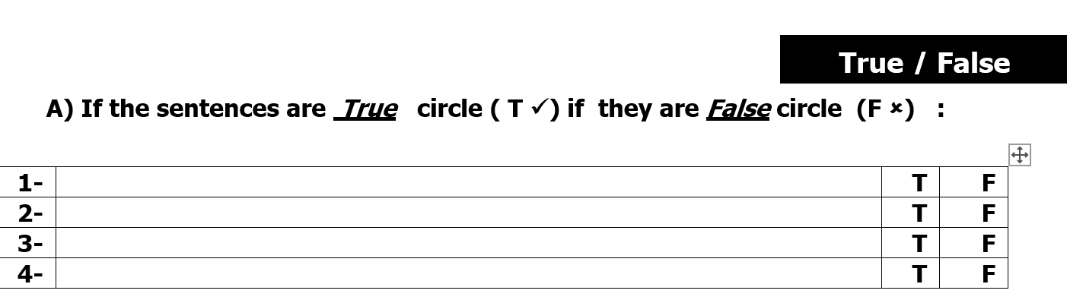
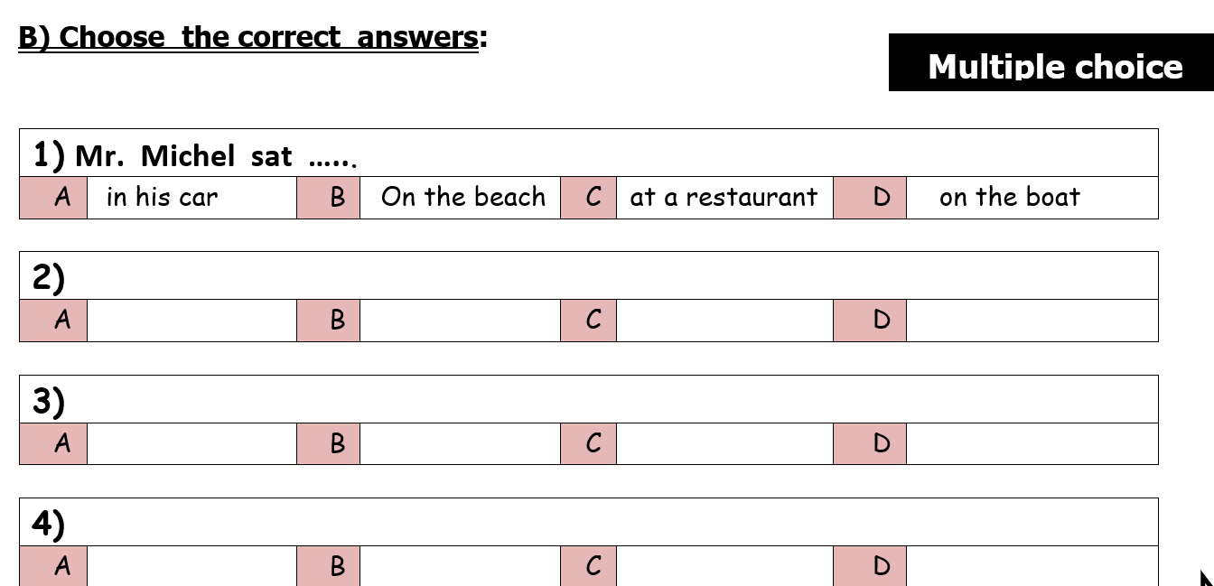
Read
Then answer:
True & false
Choose

Slide 8
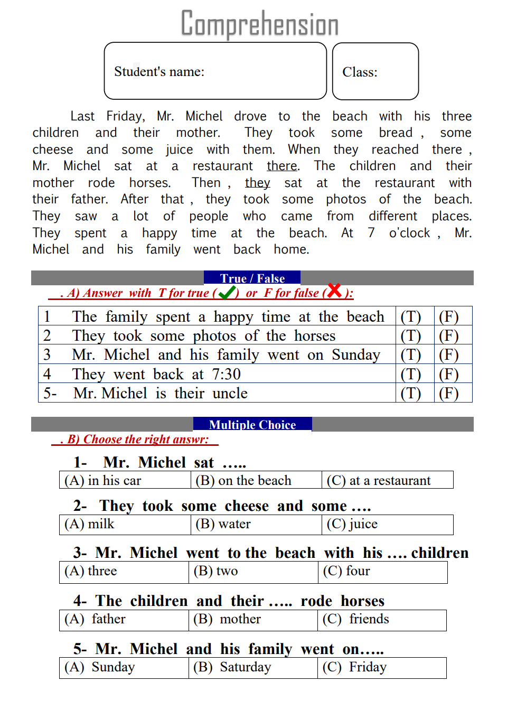
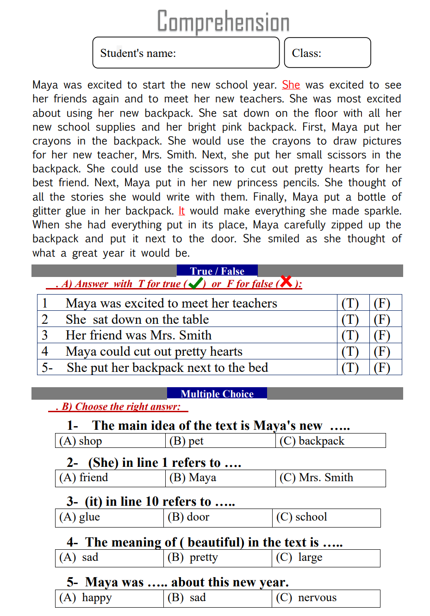
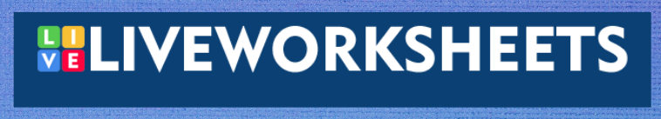
here
example
here

Slide 9
Grammar
7 marks

Slide 10
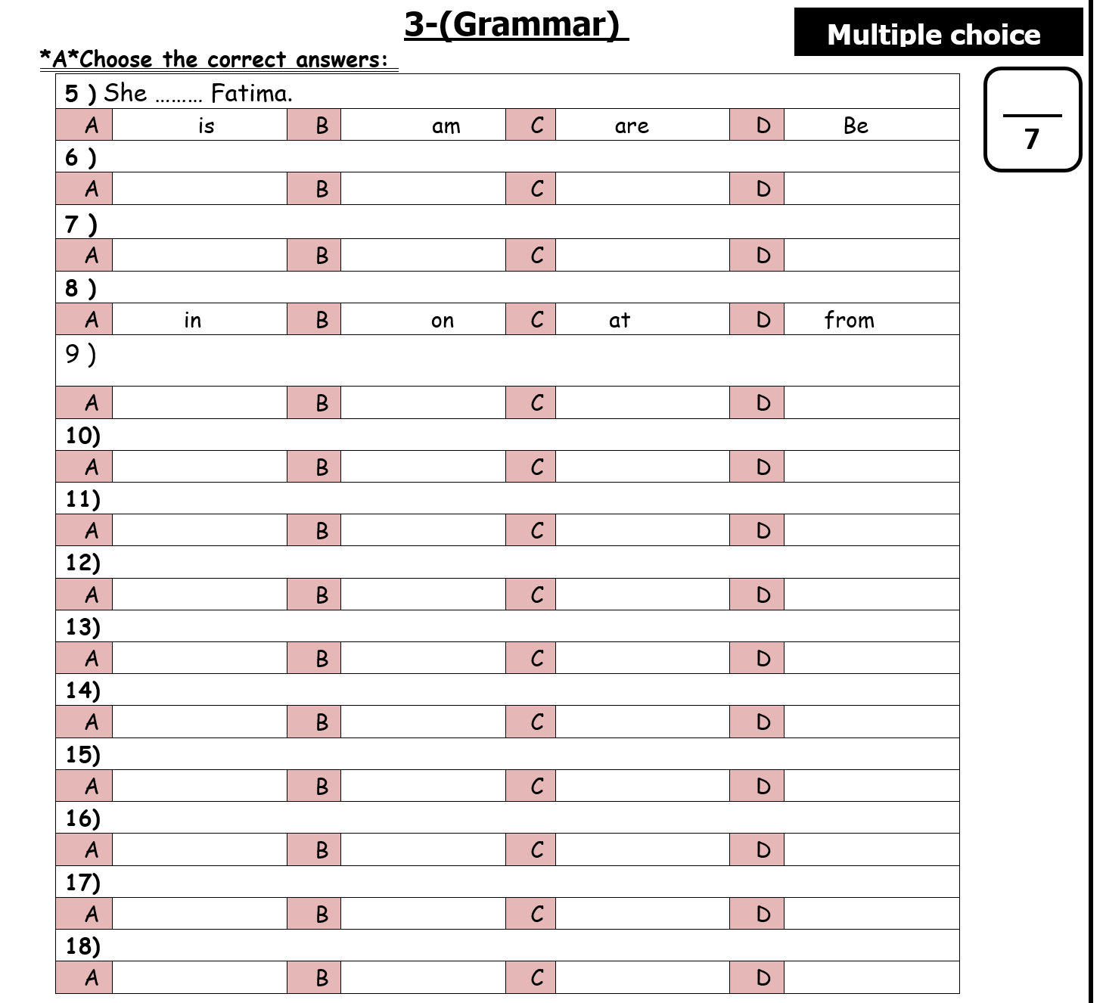
Choose

Slide 11
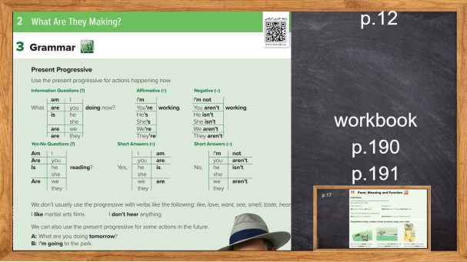
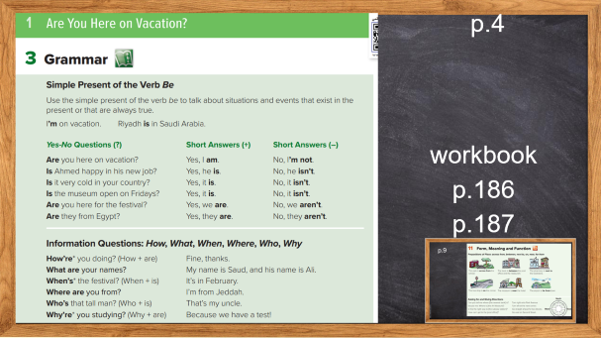
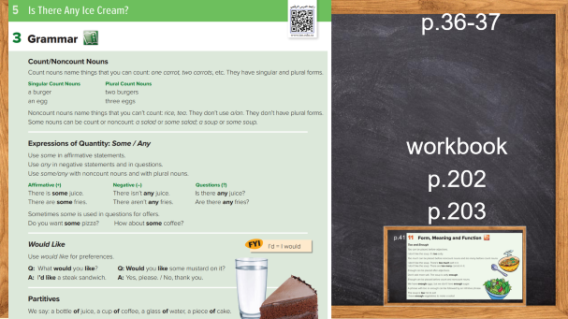
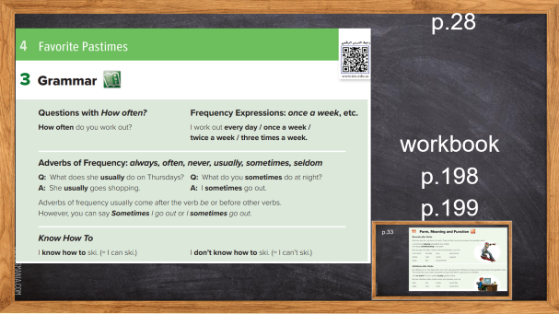
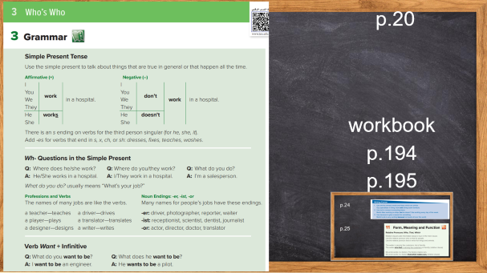

Slide 12
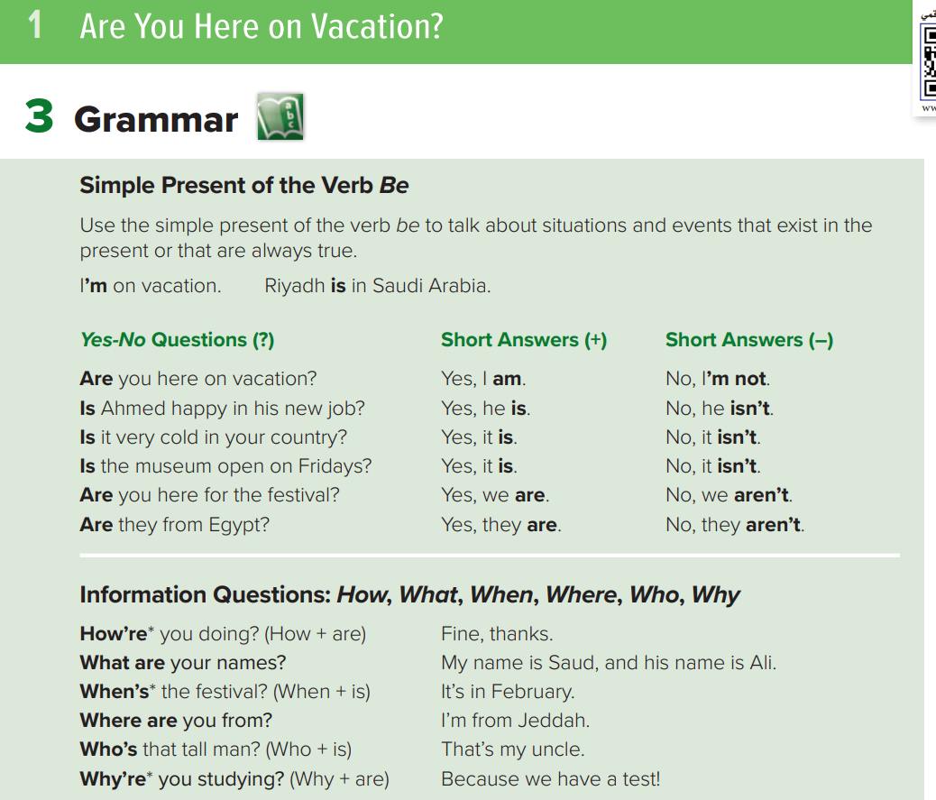
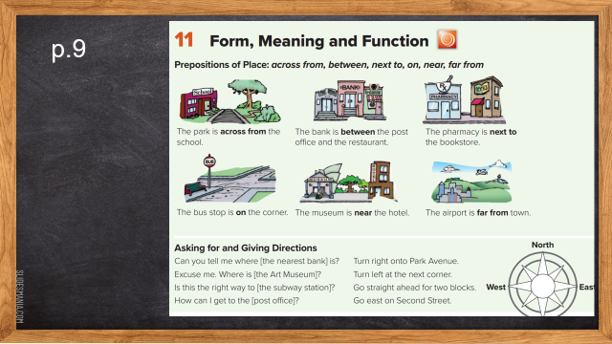
p.4
workbookp.186
p.187

Slide 13
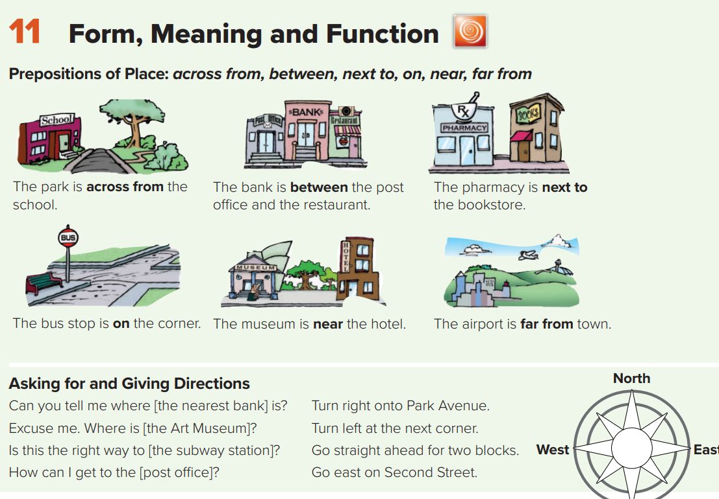
p.9

Slide 14
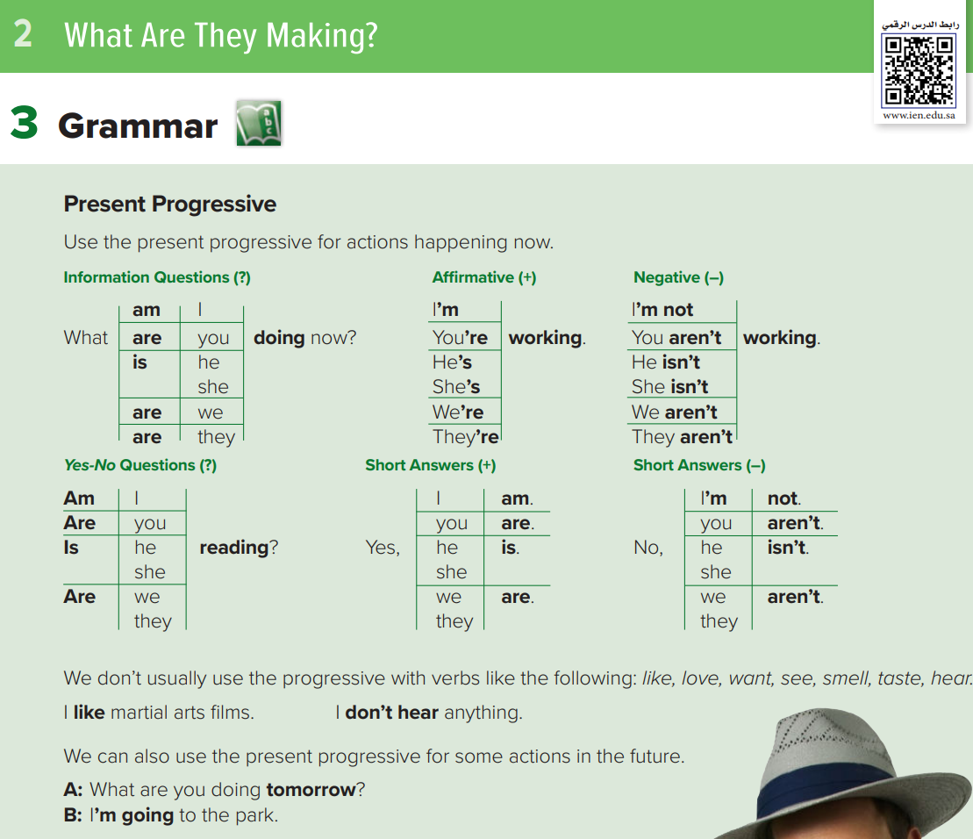
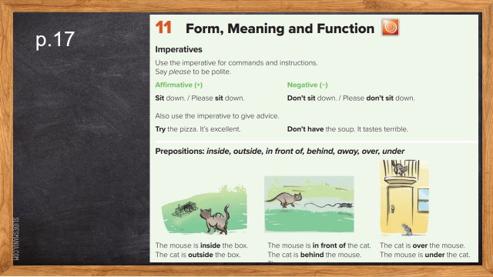
p.12
workbookp.190
p.191

Slide 15
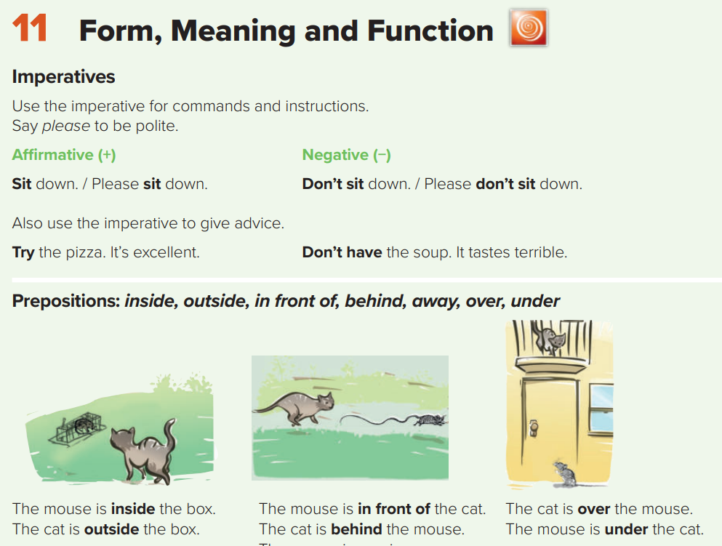
p.17

Slide 16
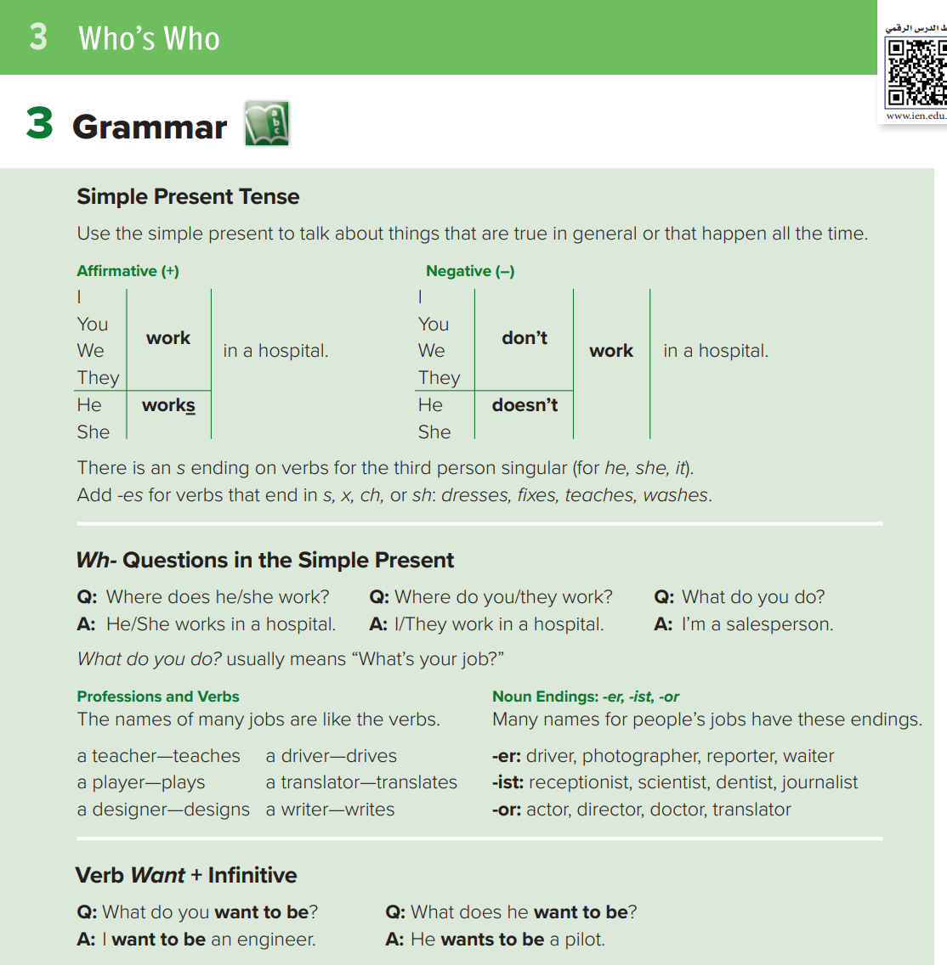
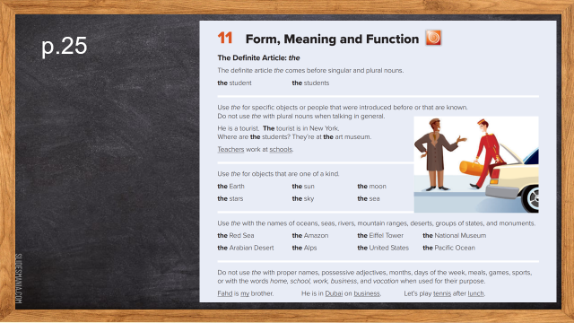
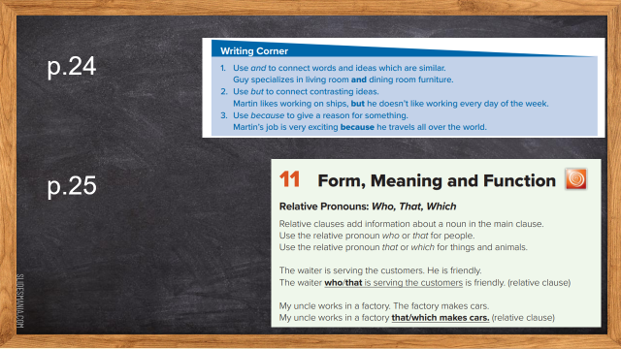
p.20
workbookp.194
p.195

Slide 17
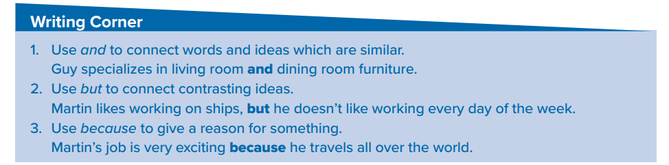
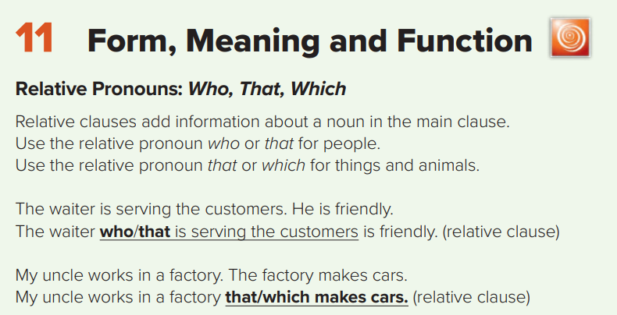
p.24
p.25

Slide 18
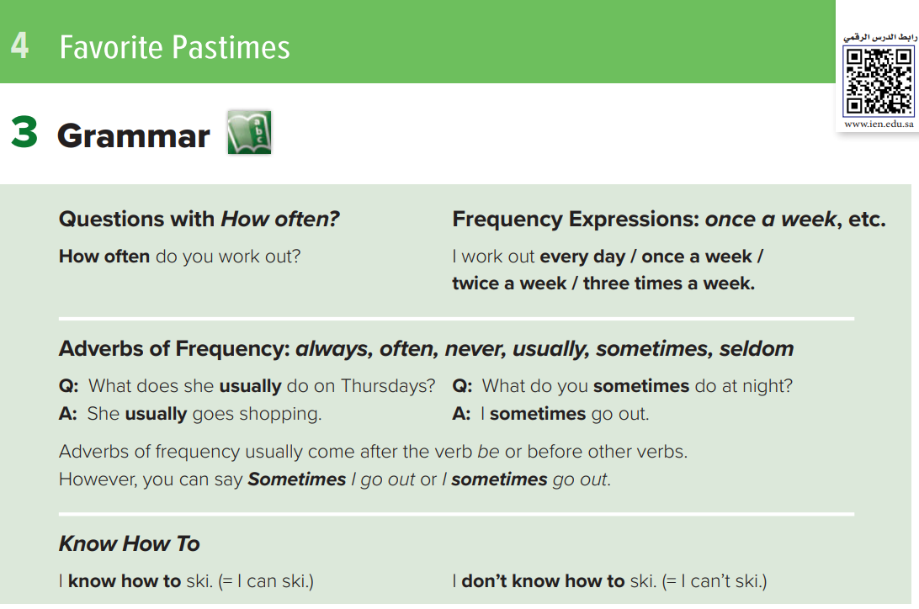
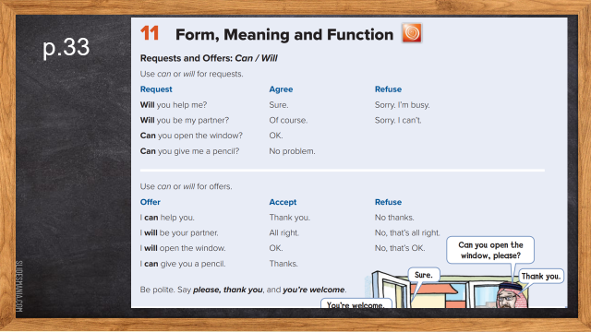
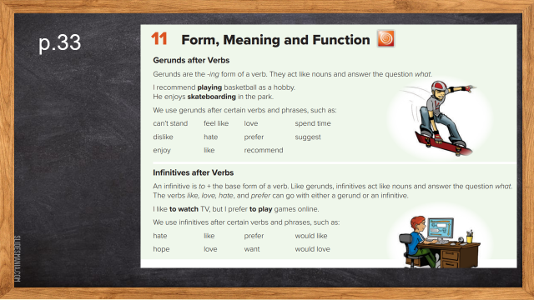
p.28
workbookp.198
p.199

Slide 19
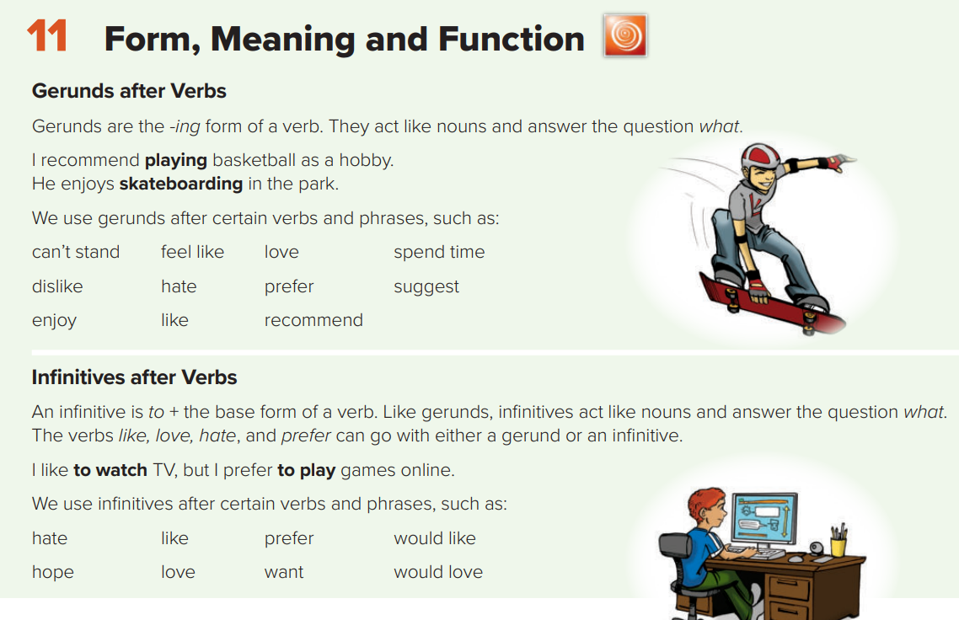
p.33

Slide 20
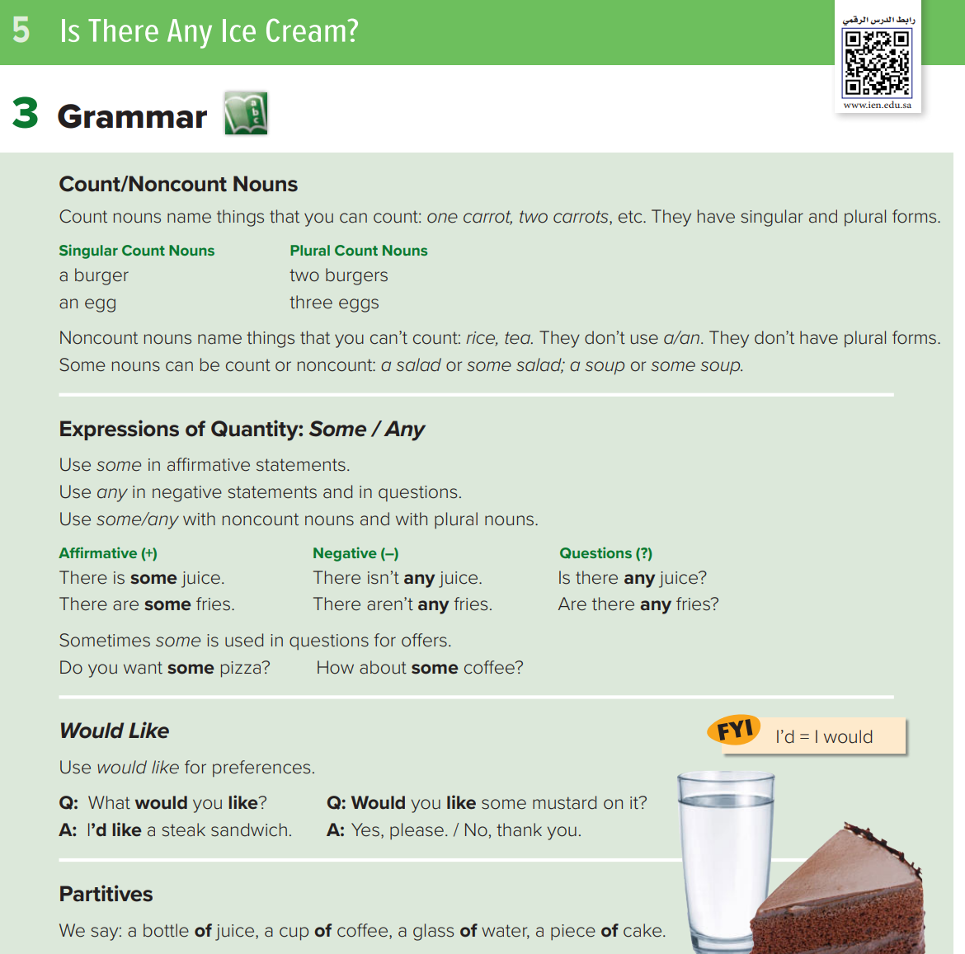
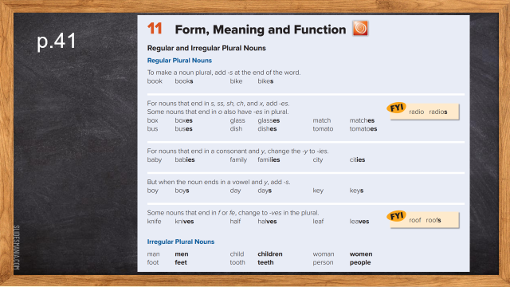
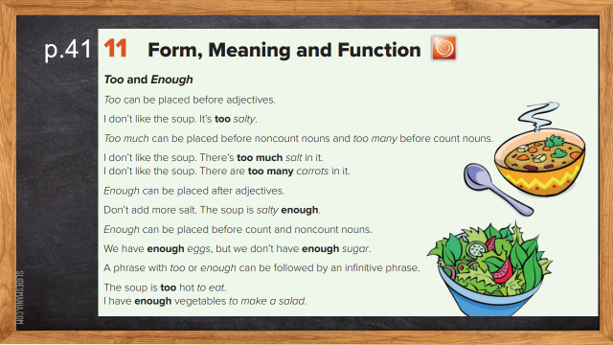
p.36-37
workbookp.202
p.203

Slide 21
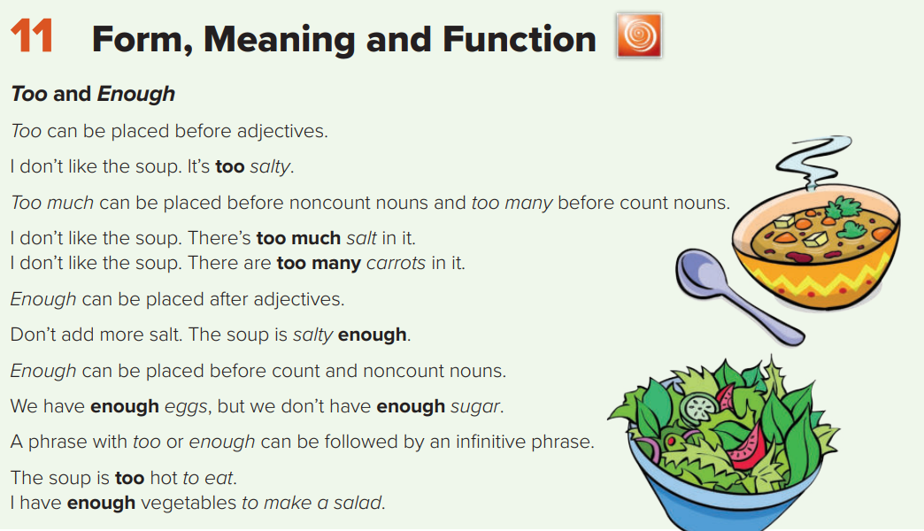
p.41

Slide 22


01
There isn’t ……………. juice.
A
B
C
D
some
any
of
Lots of

Slide 23
spelling
4 marks

Slide 24
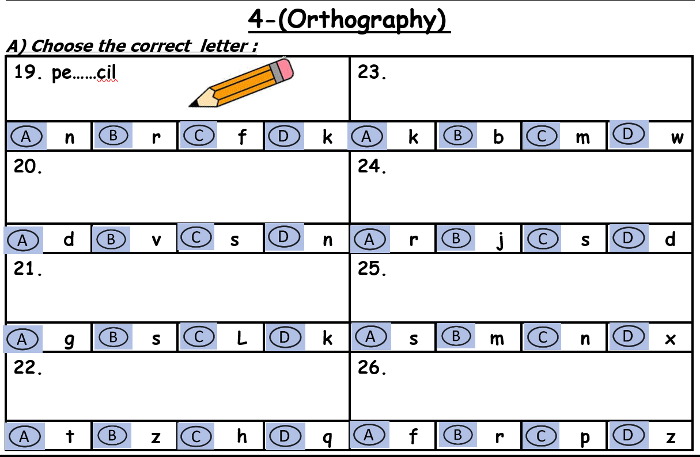
Choose

Slide 25
Complete the missing letter:
appe….izer

Slide 26
Vocabulary
7 marks

Slide 27
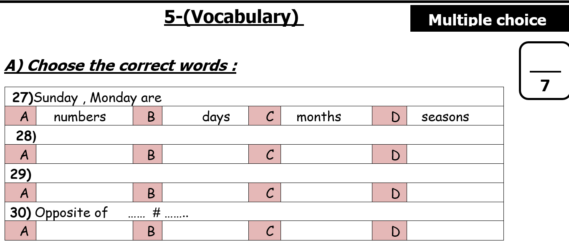
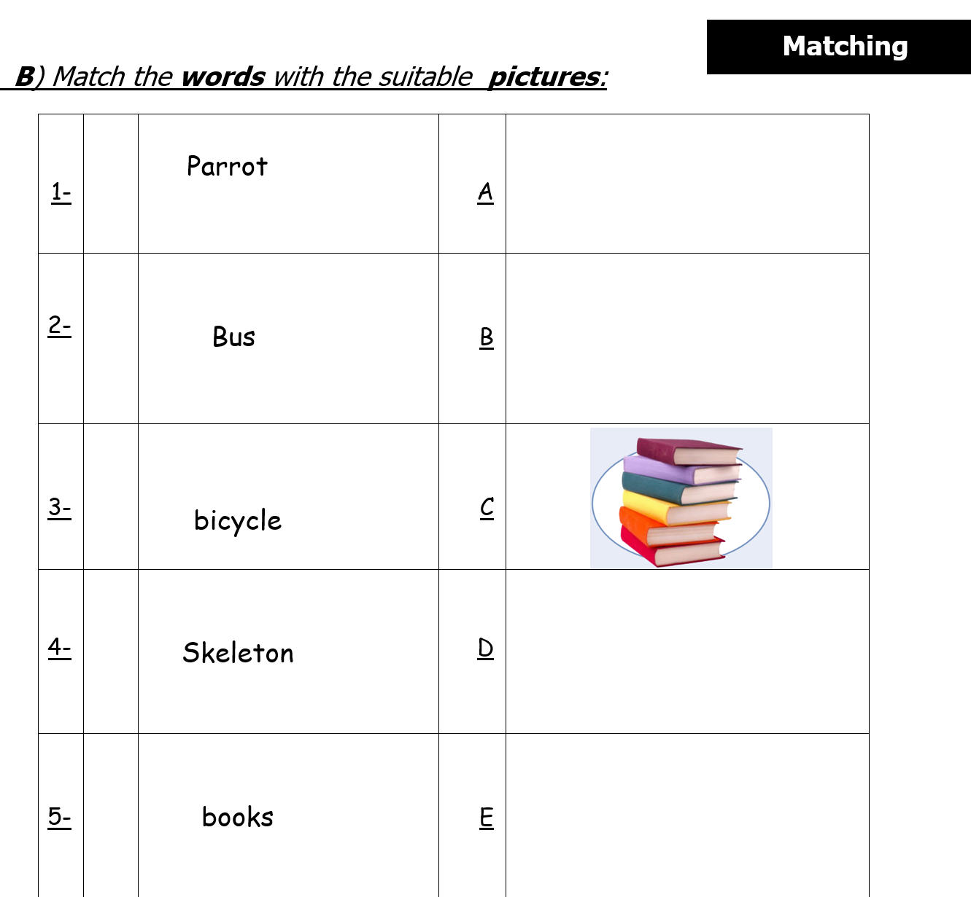
Choose
match

Slide 28
01
………. takes care of sick people
A
B
C
D
nurse
pilot
engineer
Travel agent

Slide 29
Prepared By
Dalal Al-Juaid
t.me/dalalforenglish

