Slide 1
Revision SG1
Final Exam
First Term
written

Slide 2


Marks :
10 Listen & speak
30 Written test
5
online listening
5
Oral speaking

Slide 3
30 Written test
6 composition
6 Reading comprehension
7 Grammar
7 Vocabulary
4 Spelling

Slide 4





compostion
6 marks

Slide 5
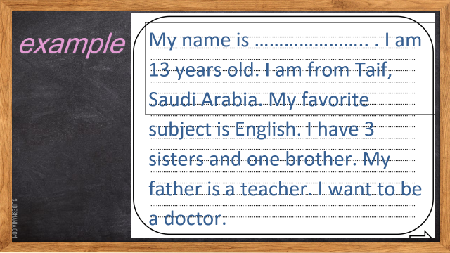
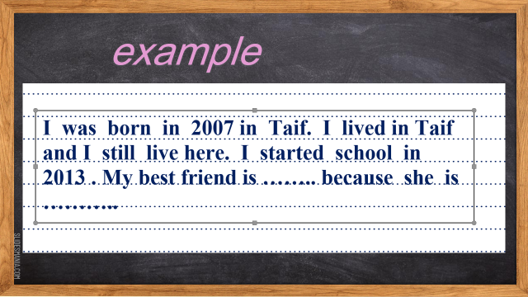
Write a paragraph about yourself
By using own your information not less than 40 words :
[Name- years old – from – favorite subject – father's job - want to be ]

Slide 6

example
My name is ………………….. . I am 13 years old. I am from Taif, Saudi Arabia. My favorite subject is English. I have 3 sisters and one brother. My father is a teacher. I want to be a doctor.

Slide 7
comprehension
6 marks

Slide 8
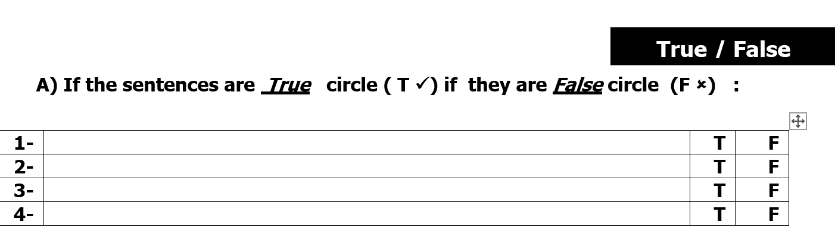
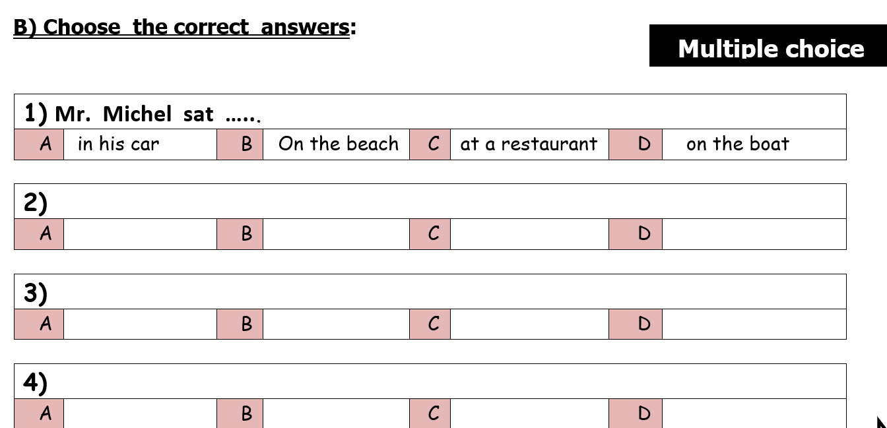
Read
Then answer:
True & false
Choose

Slide 9
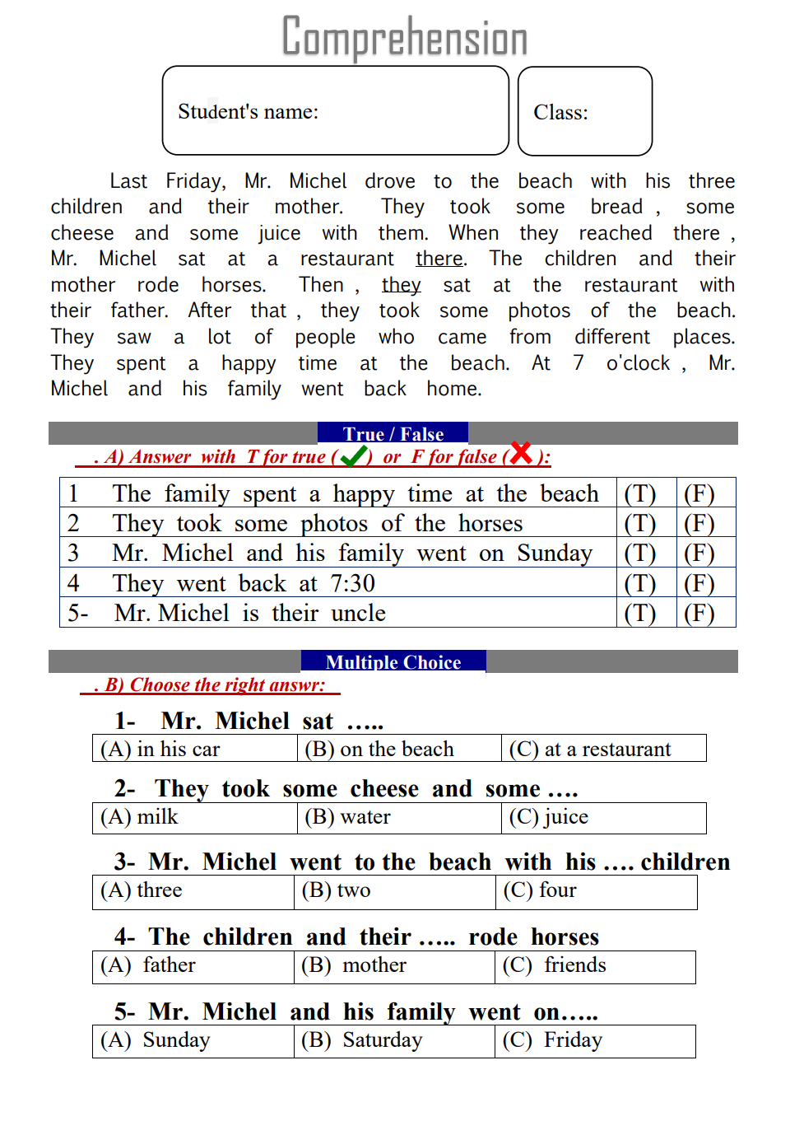
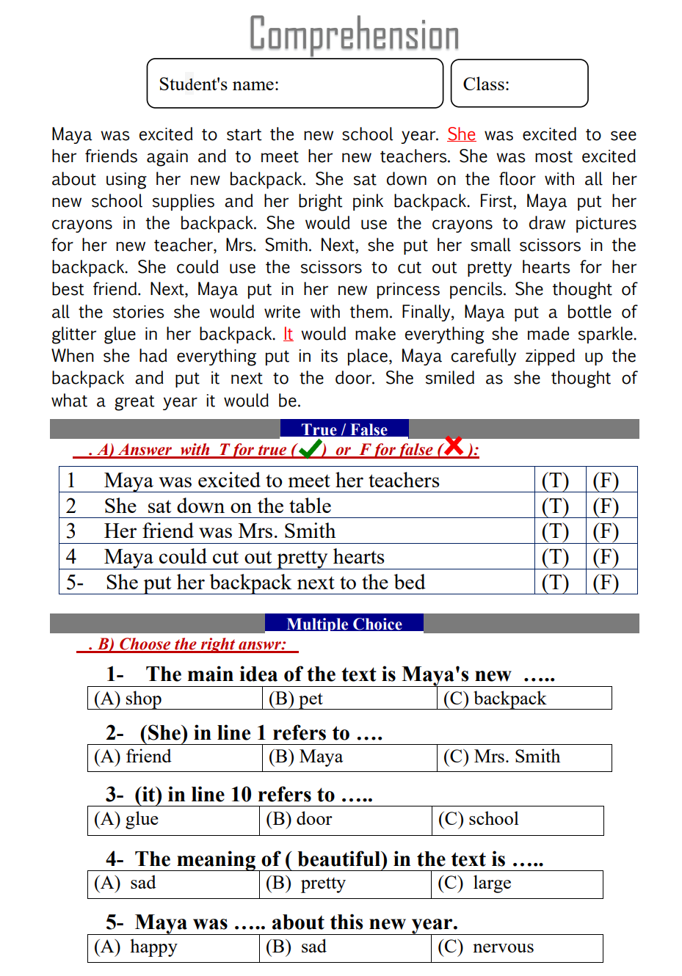
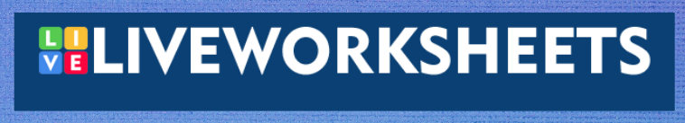
here
example
here

Slide 10
Grammar
7 marks

Slide 11
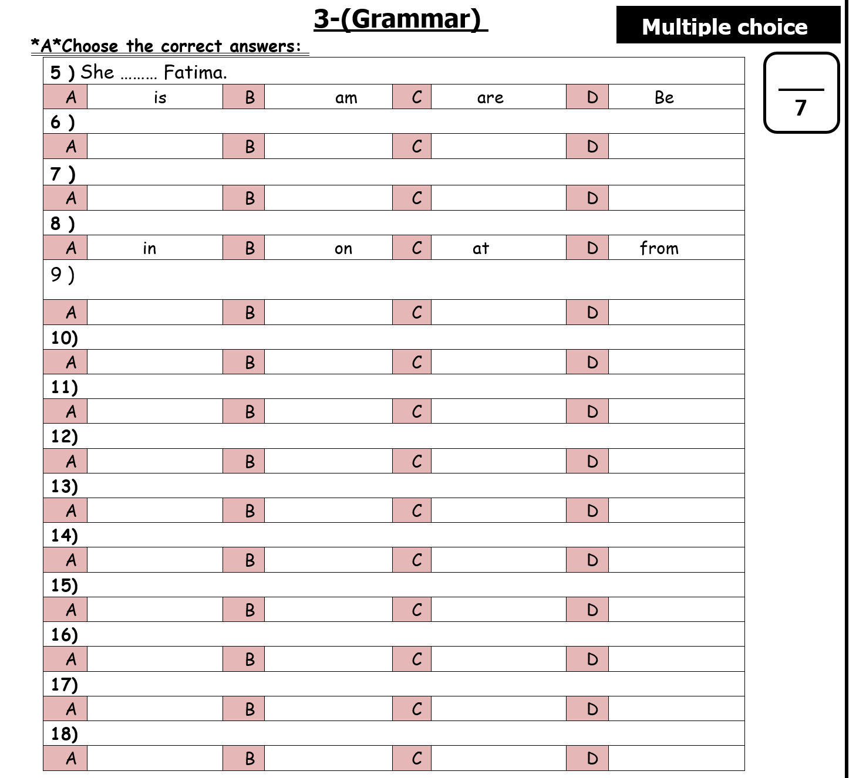
Choose

Slide 12
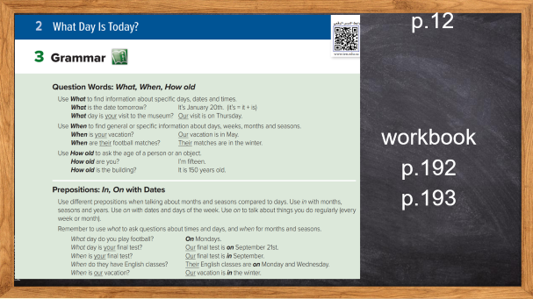
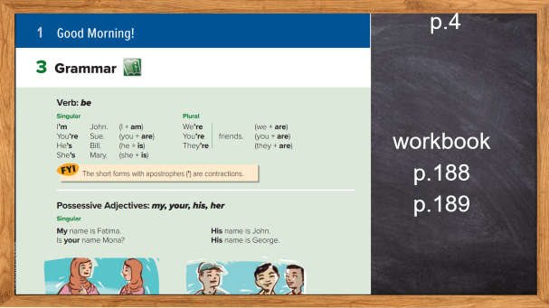
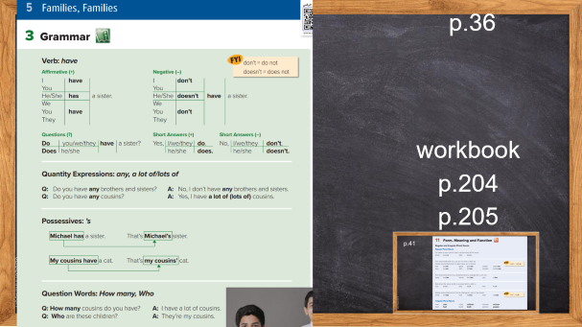
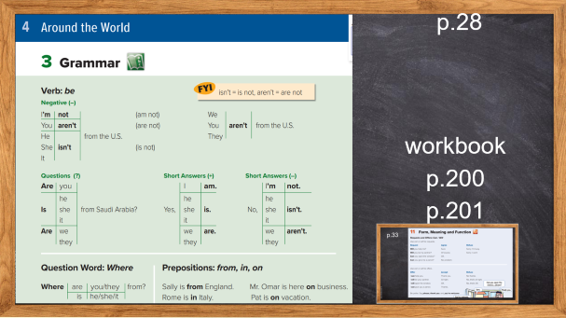
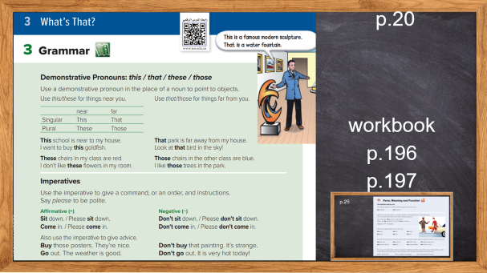

Slide 13
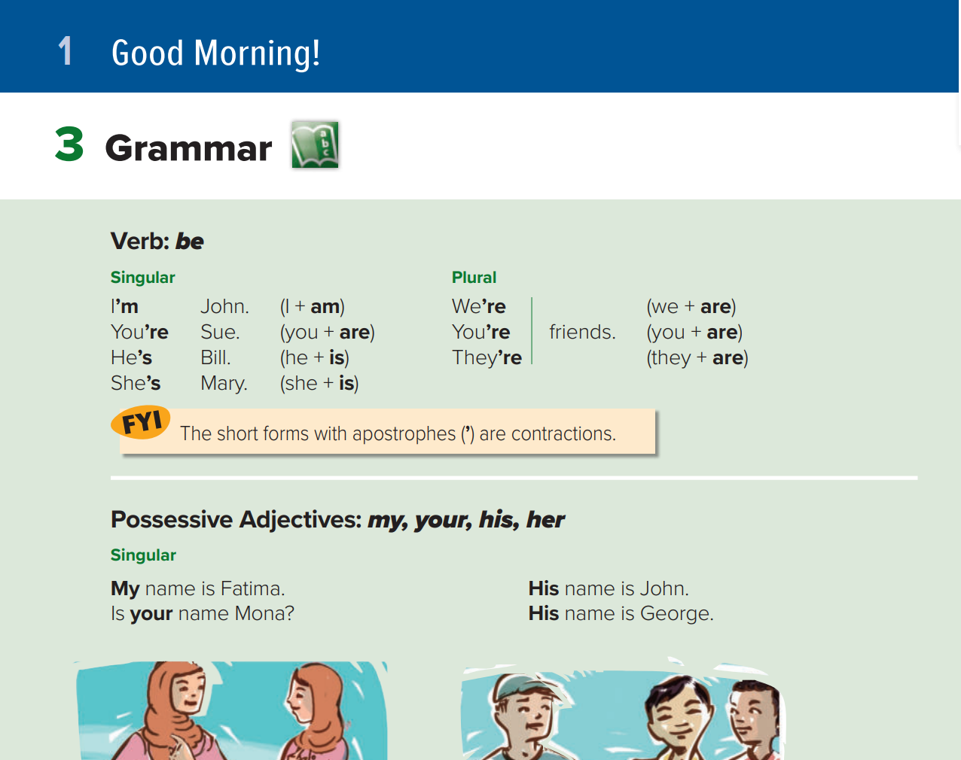
p.4
workbookp.188
p.189

Slide 14
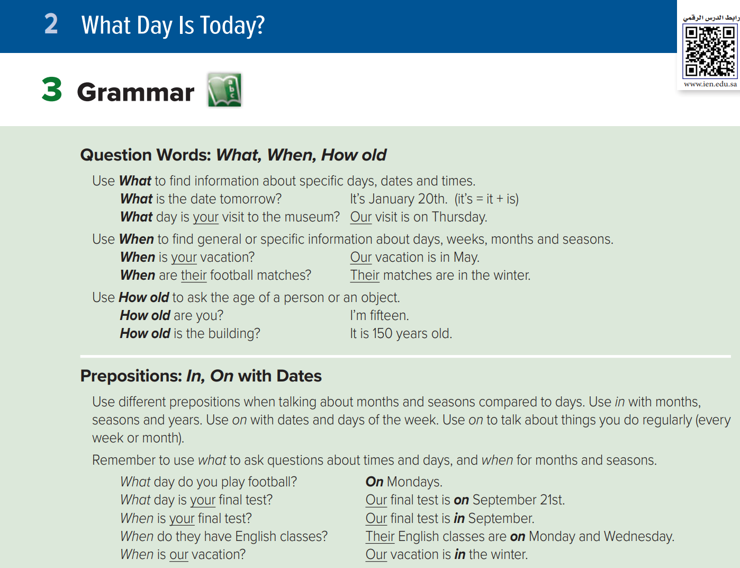
p.12
workbookp.192
p.193

Slide 15
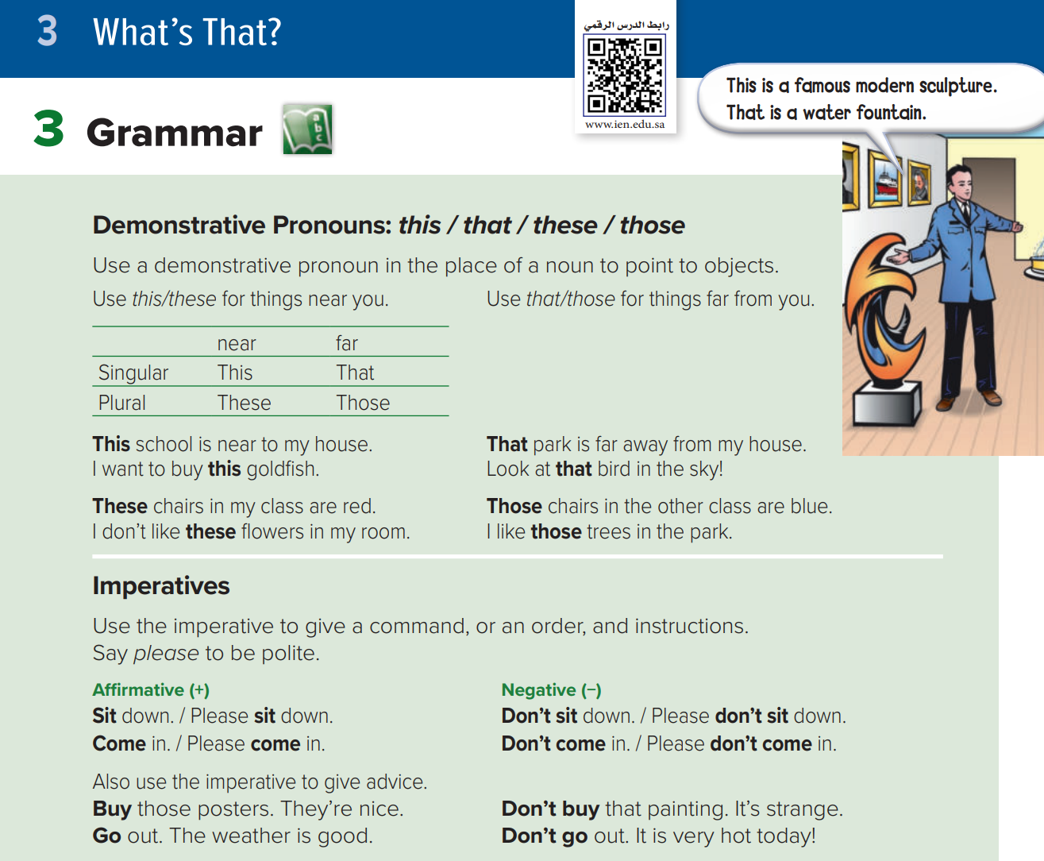
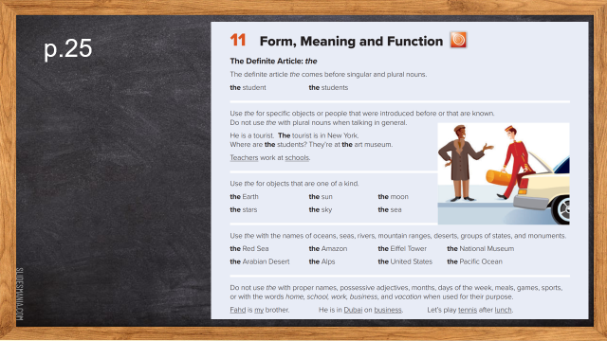
p.20
workbookp.196
p.197

Slide 16
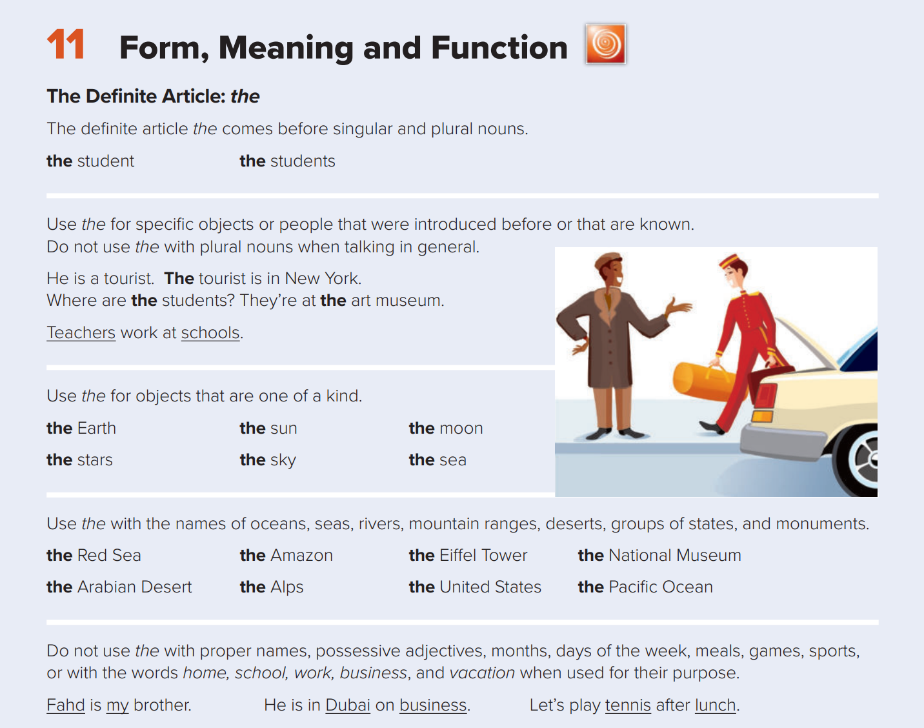
p.25

Slide 17
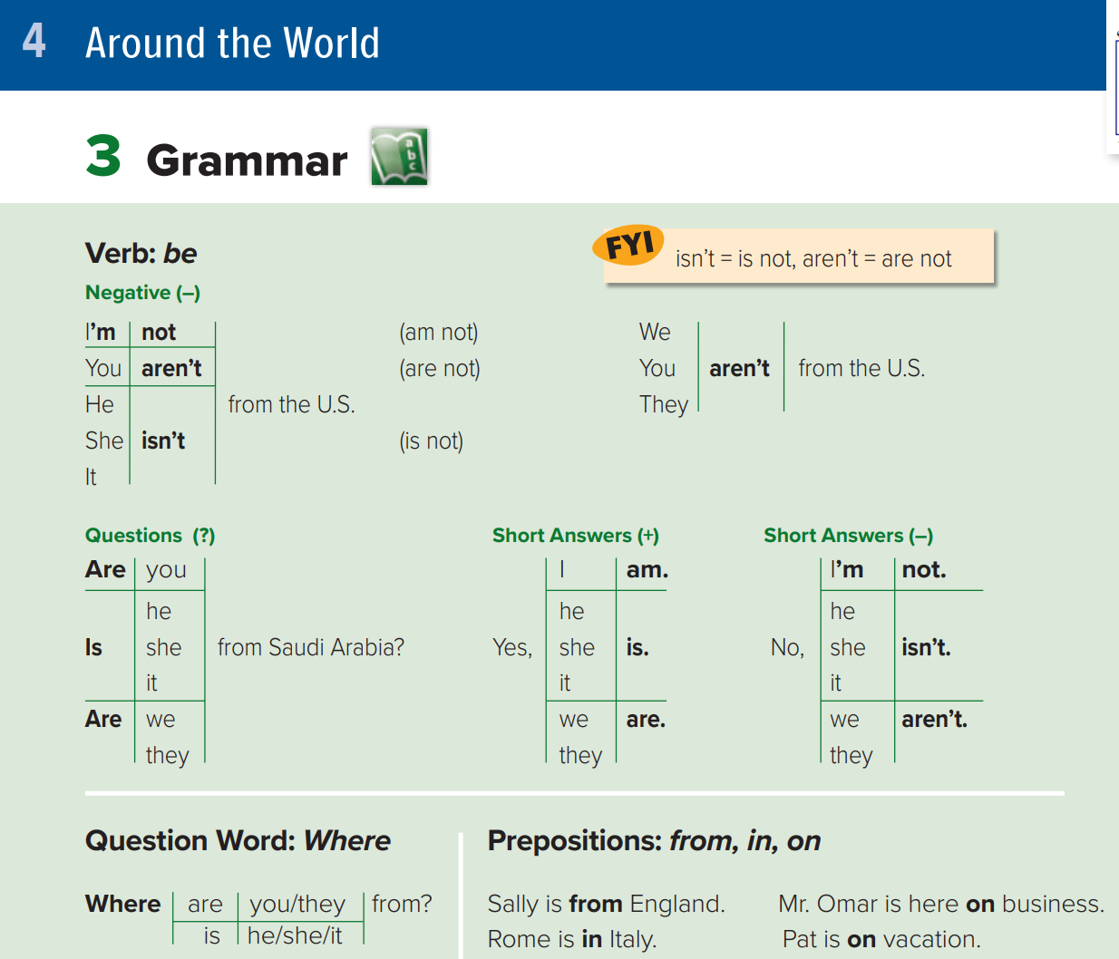
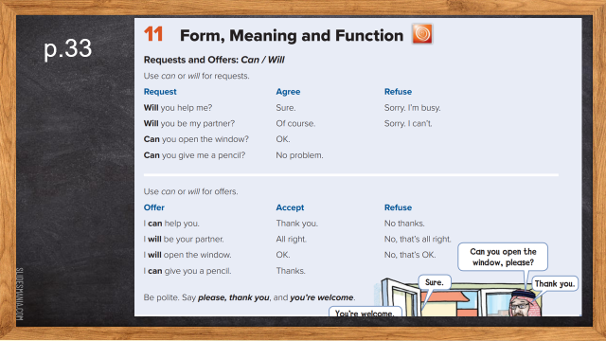
p.28
workbookp.200
p.201

Slide 18
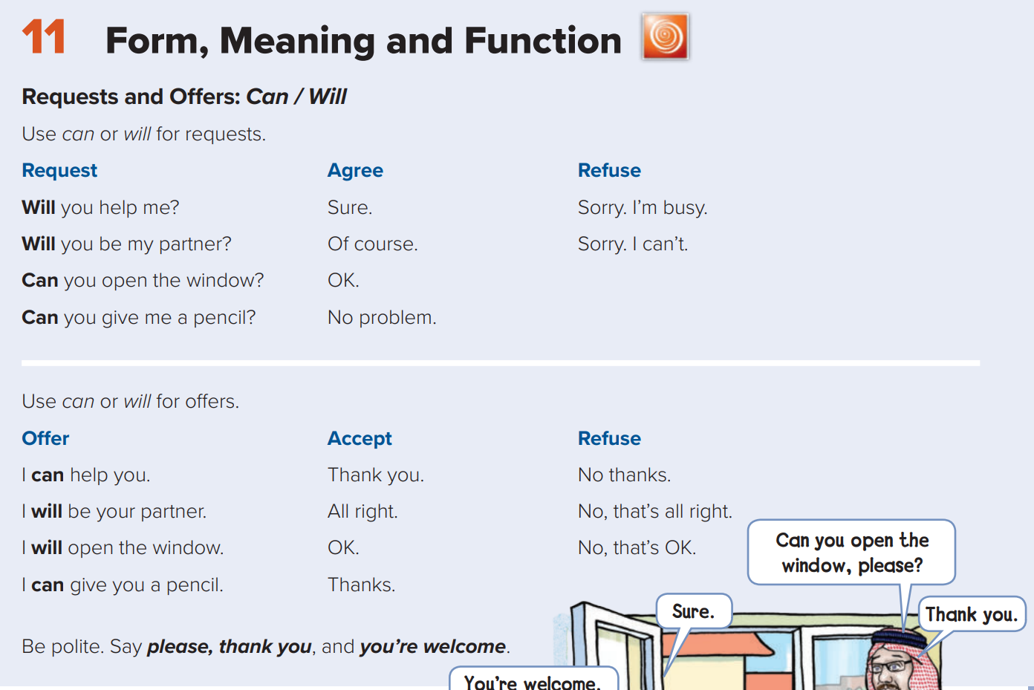
p.33

Slide 19
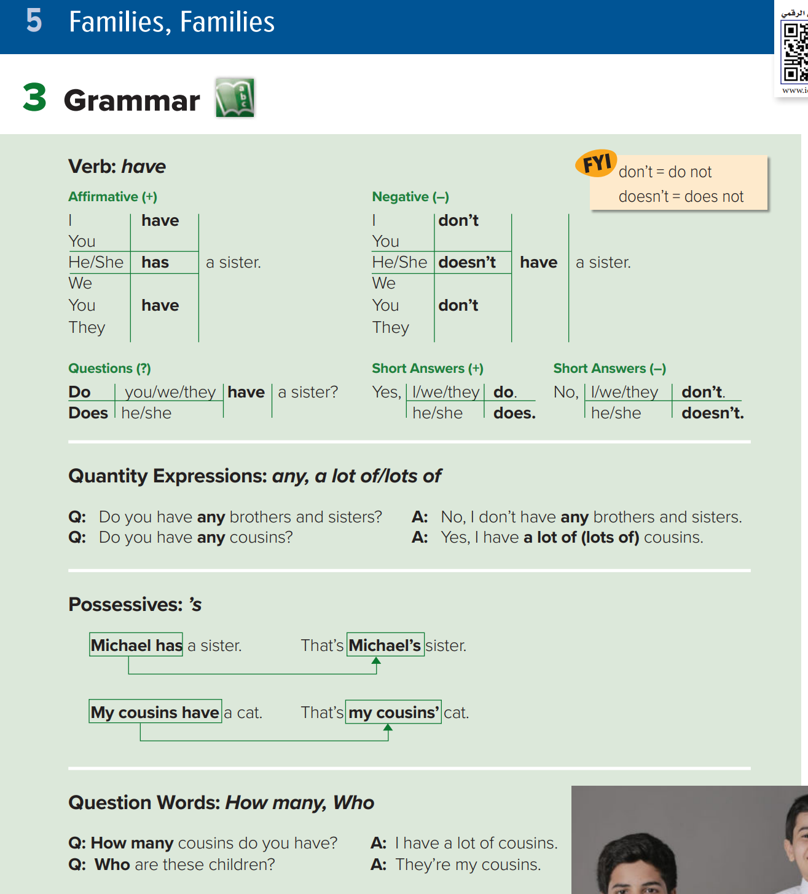
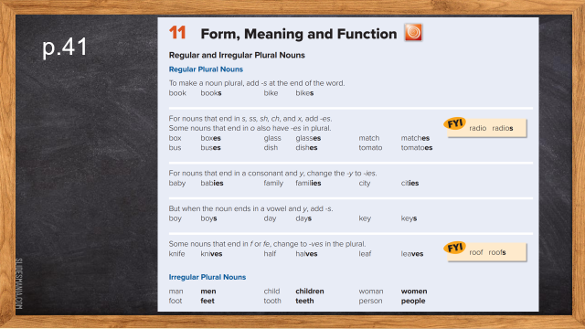
p.36
workbookp.204
p.205

Slide 20
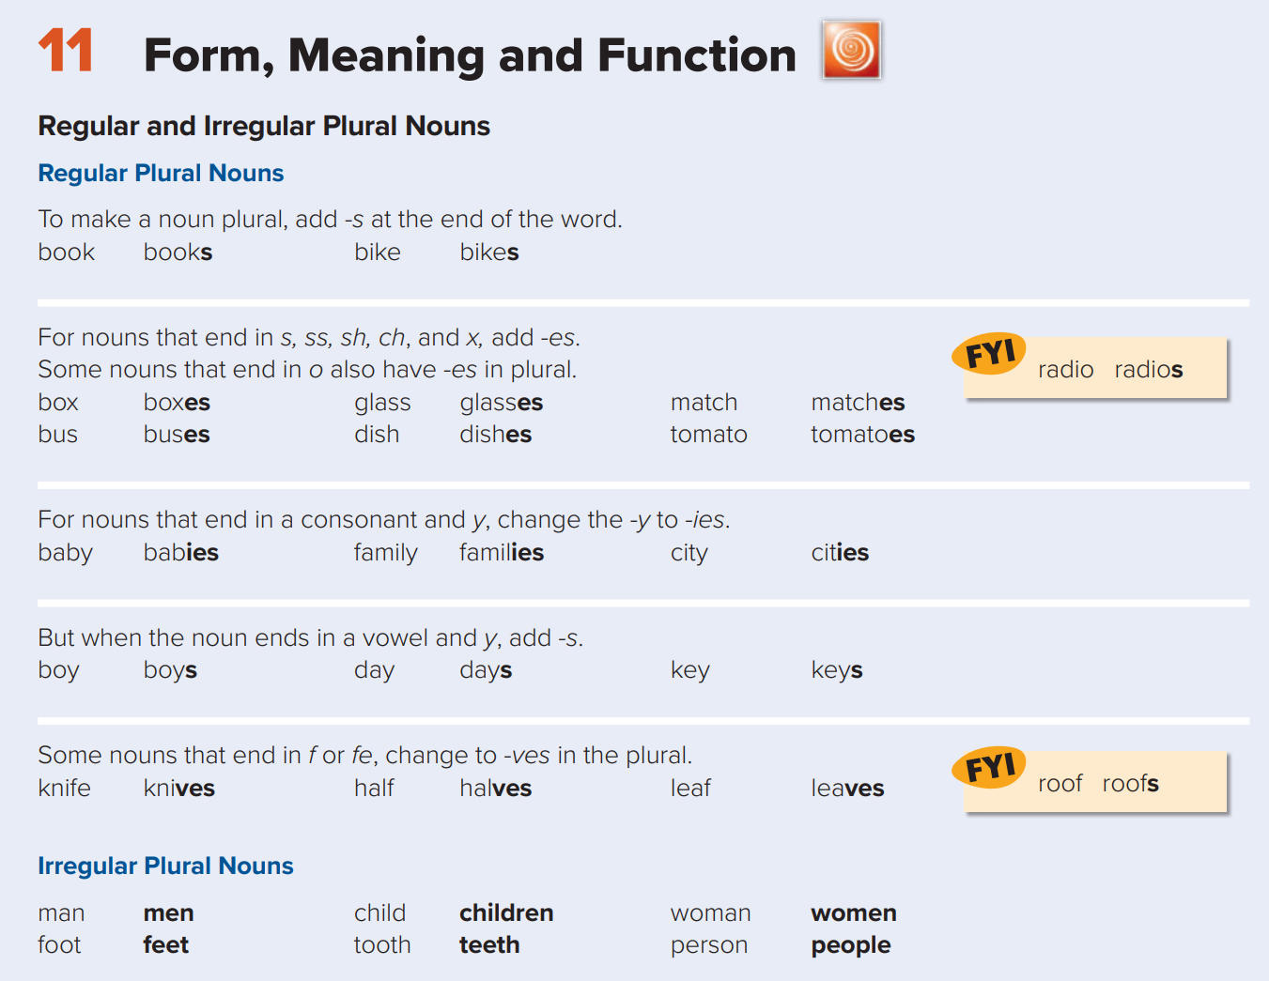
p.41

Slide 21


01
How______ cousins do you have?
A
B
C
D
many
long
much
far

Slide 22
spelling
4 marks

Slide 23
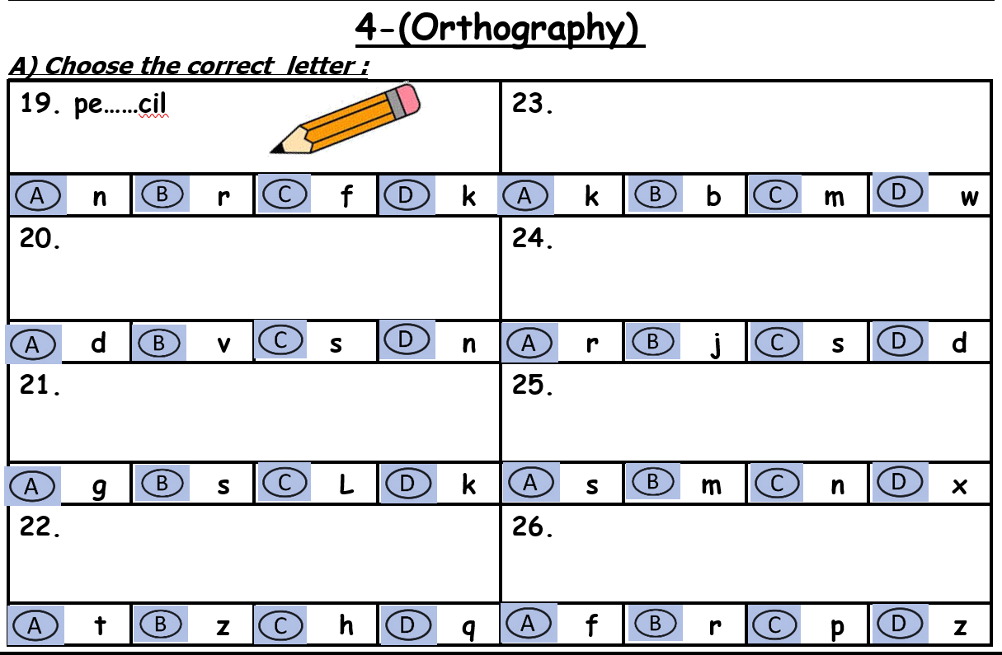
Choose

Slide 24



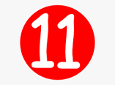




Complete the missing letter:
Pe…….cil
Hu….band

Slide 25
Vocabulary
7 marks

Slide 26
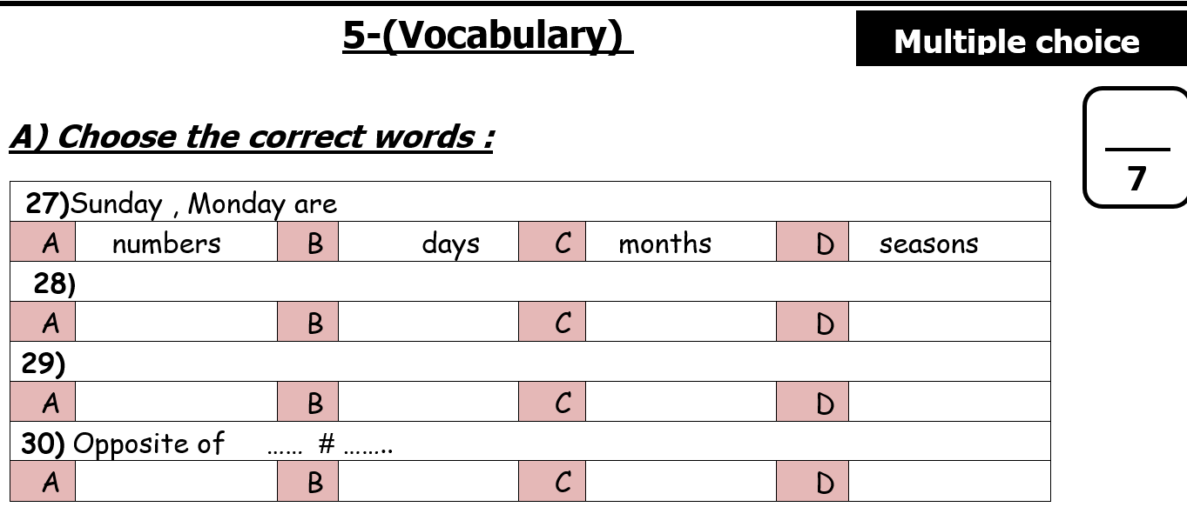
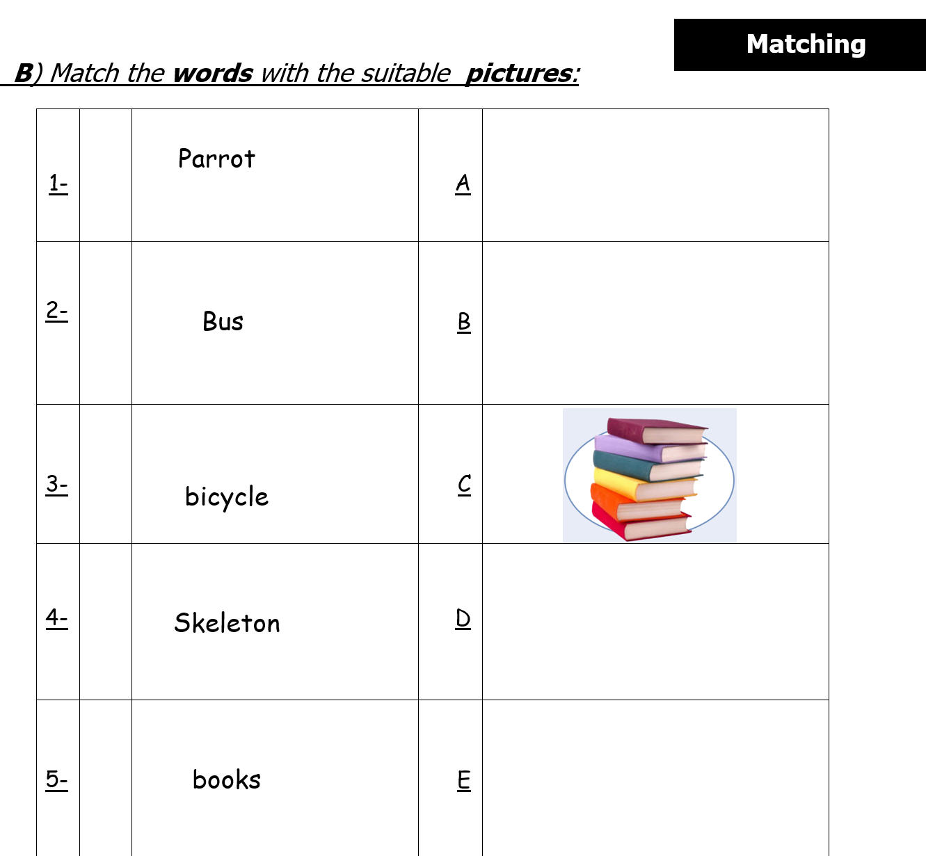
Choose
match

Slide 27
01
He is from England. He is ……….
A
B
C
D
England
English
London
UK

Slide 28
Prepared By
Dalal Al-Juaid
t.me/dalalforenglish

