Slide 1
Unit 5
Since when?
Grammar

Slide 2
بسم الله الرحمن الرحيم
Day:
Date:
Inventions

Slide 3
Learning Objectives
1
Identify past expressions.
2
Distinguish between past & present perfect.
3
Differentiate between (since & for).
4
Form questions using (How long) correctly

Slide 4
Pages 50- 51
Grammar
Perfect Simple Tense
Subject | Helping Verb | Main Verb(Past Participle)
I You They We | have | decided finished lost chosen gone
She He It | has

Slide 5
Grammar
 |  | + | - | ?
I We You They | Have V3 | have played | haven’t played | Have…
He She It | Has V3 | has played | hasn’t played | Has…

Slide 6
Grammar
Positive form | Negative form | Question form
I worked | I didn’t (=did not) work | Did I work?
You worked | You didn’t work | Did you work?
We worked | We didn’t work | Did we work?
They worked | They didn’t work | Did they work?
She worked | She didn’t work | Did she work?
He worked | He didn’t work | Did he work?
It worked | It didn’t work | Did it work?

Slide 7
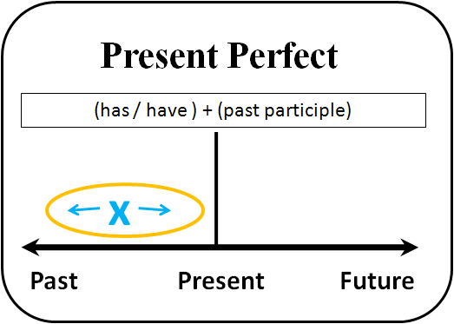
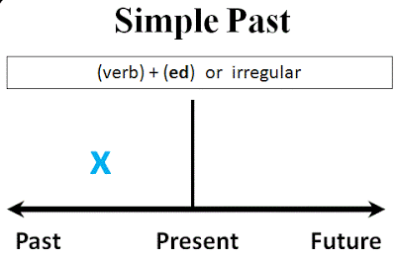
Grammar

Slide 8
Grammar

Slide 9
Practice

Slide 10
Page 50
Grammar

Slide 11
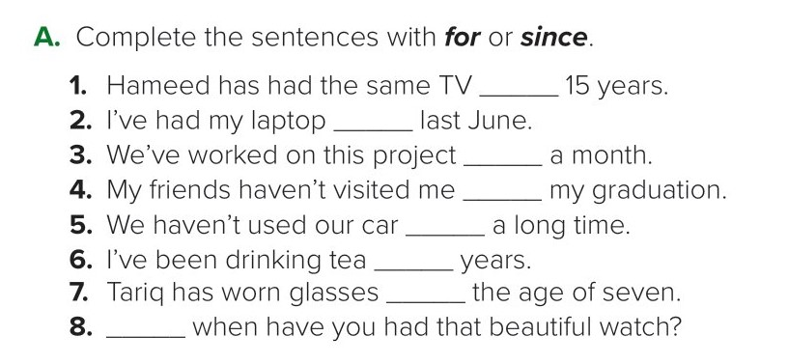
for
since
for
since
for
for
since
since
Page 50

Slide 12
Answers
People have eaten canned food since the early 1800s.
People have worn wristwatches for over 100 years.
People have had radios since 1901.
People have used toothpaste for over 170 years.
People have used electric light bulbs since 1879.
People have made films since 1895.
People have used paper clips since the 1890s.
People have flown airplanes since 1903.
People have used ballpoint pens for a long time.
Page 51

Slide 13
Sample conversation:
A: Do you have a cell phone?
B: Yes, I do.
A: How long have you had it?
B: I’ve had it since 2018. / I’ve had it for two years.
*Make similar conversation using the following information:
-Live in Riyadh / 2016 or 4 years
-go to the gym / June or 5 months
-play football / I was a child or 16 years
-clean your room / 7:00 p.m. or 1 hour
Answers
Page 51

Slide 14
have tried
invented
kept
imported
put
built
appeared
have
preserved
became
have cooled
Page 51

Slide 15
Homework
Page 198

Slide 16
arrived
ate
did
call
finished
passed
were

Slide 17
My brother has played tennis in the new park.
Saeed has tried to learn French.
We have gone camping in the mountains.
My parents have eaten at the Indian restaurant by the bookstore.
Has your brother played tennis in the new park?
Has Saeed tried to learn French?
Have you gone camping in the mountains?
Have your parents eaten at the Indian restaurant by the bookstore?

