Slide 1

Unit 5
Since when?
Language in Context

Slide 2
بسم الله الرحمن الرحيم
Day:
Date:
Inventions

Slide 3
Learning Objectives
1
Practice talking about old habits using (have / haven’t).
2
Listen for specific information about actions in past.
3
Contract (have) in questions & sentence correctly.
4
Answer questions about themselves using since and for.

Slide 4
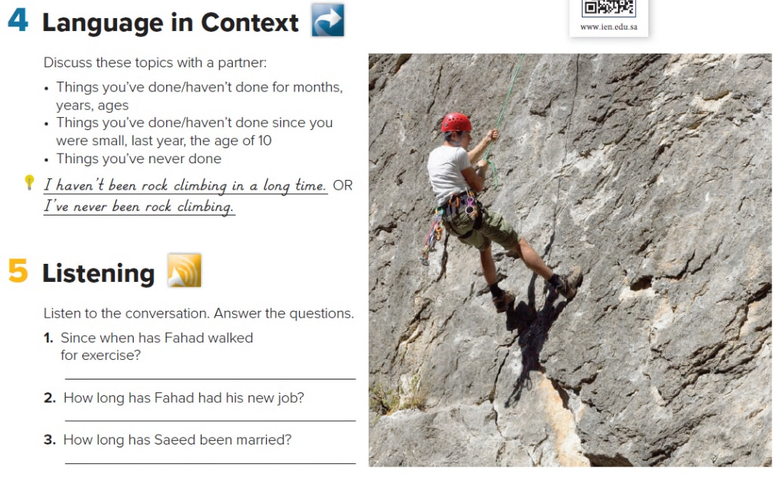
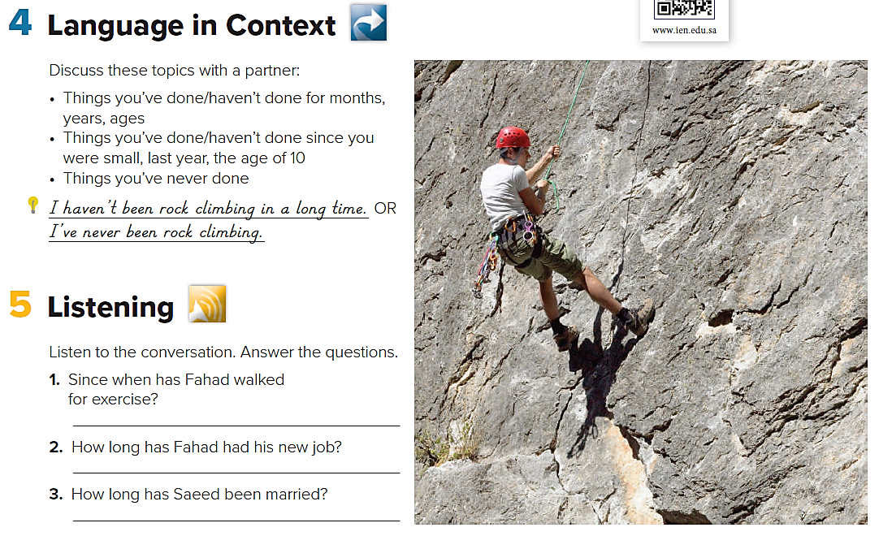
Page 52
Language in Context
Guide words:
go bowling, work out at a gym, go to an amusement park, …….
Sample sentence:
I’ve worked out at a gym everyday since I was 20 years old.

Slide 5

Page 52
Listening
Fahad has walked for exercise since he had his heart problem.
Fahad has had his new job for six months.
Saeed has been married for almost a year.

Slide 6
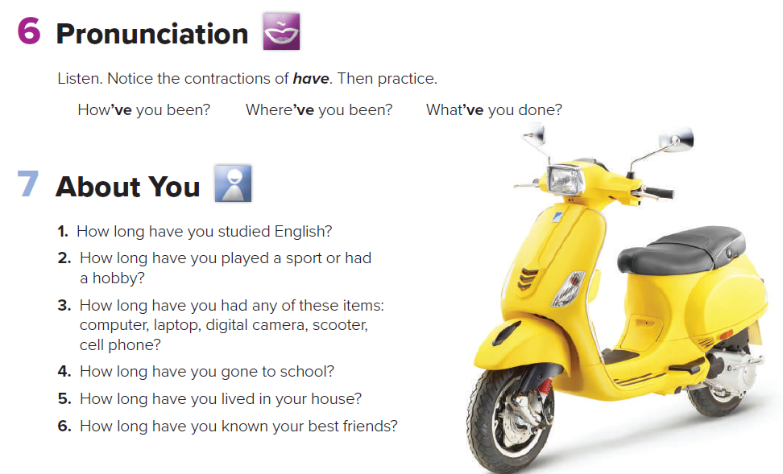

Pronunciation
Page 52

Slide 7
Page 52
About
You
Answer
1- I have studied English since 2015.
2- I have written short stories since I was 7 .
3- I have had my computer since I was 13 .
I have had my scoter for three years .
4- I have gone to school for 9 years .
5- I have lived in my house since I was born.
6- I have known my best friends since 2013.

Slide 8

Homework
Page 199

Slide 9
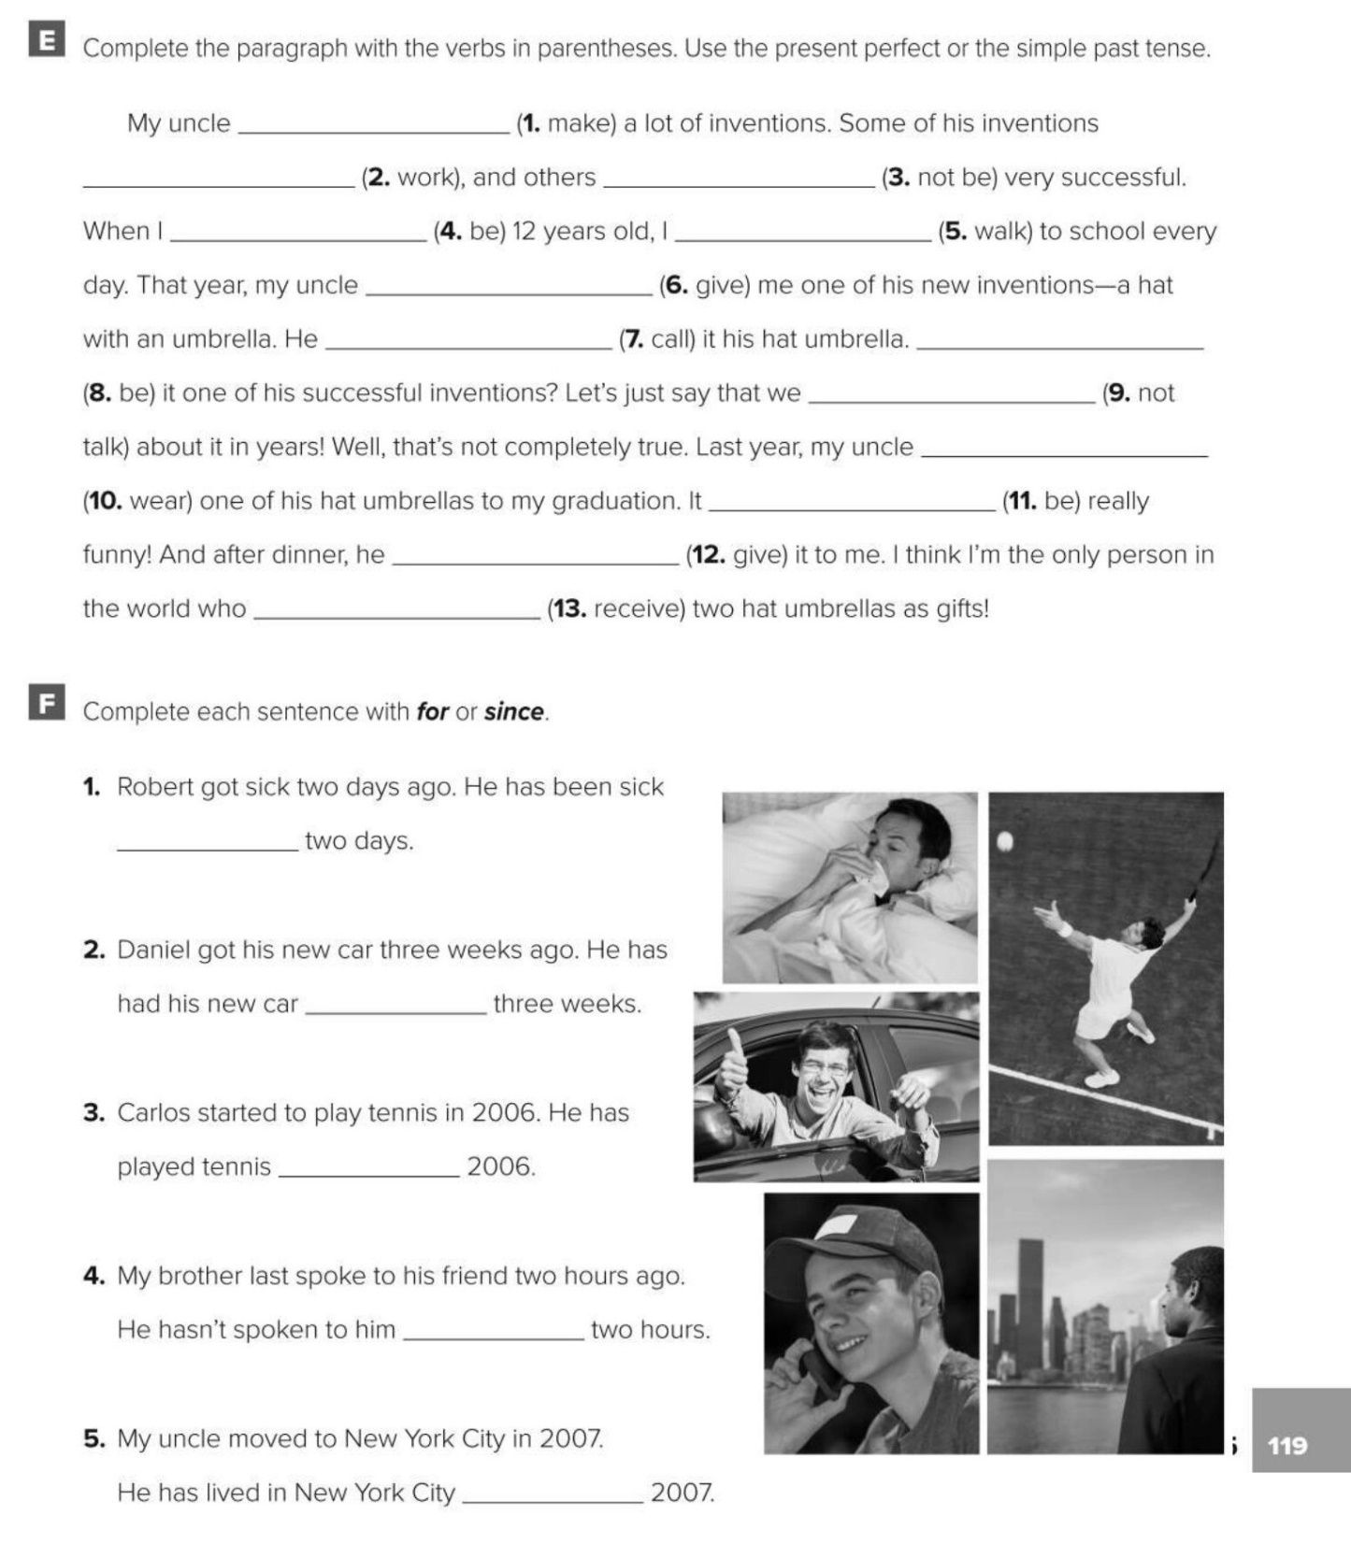
has made
have worked
have not been
was
walked
gave
called
was
haven’t talked
wore
was
gave
has received
for
for
since
for
since

