Slide 1

Unit 5
Since when?
Conversation

Slide 2
بسم الله الرحمن الرحيم
Day:
Date:
Inventions

Slide 3
Learning Objectives
1
Listen for specific information in a conversation.
2
Practice using real talk phrases.
3
Answer questions about the conversation.
4
Practice talking about old habits using (have/haven't).

Slide 4
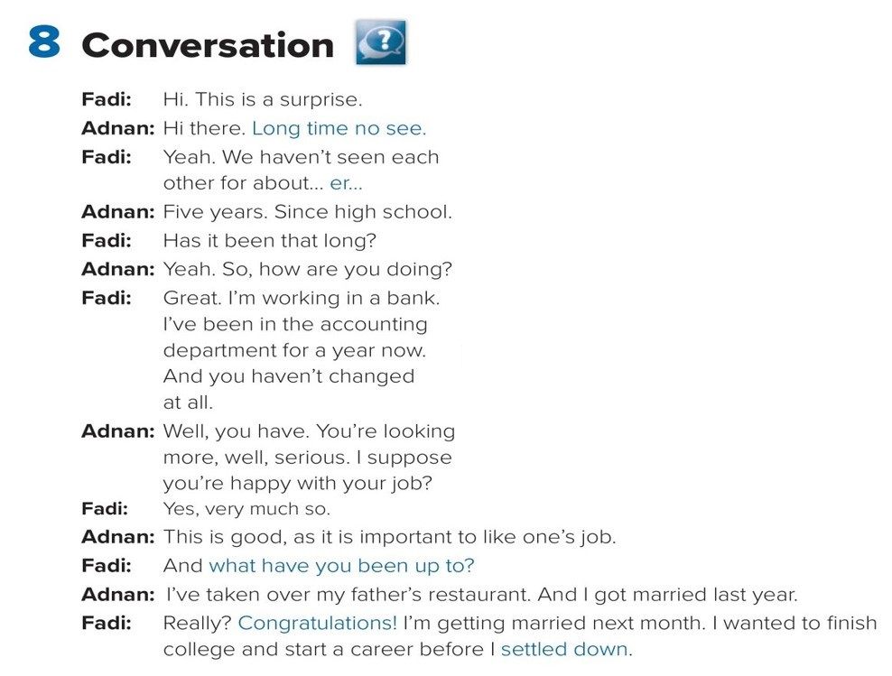

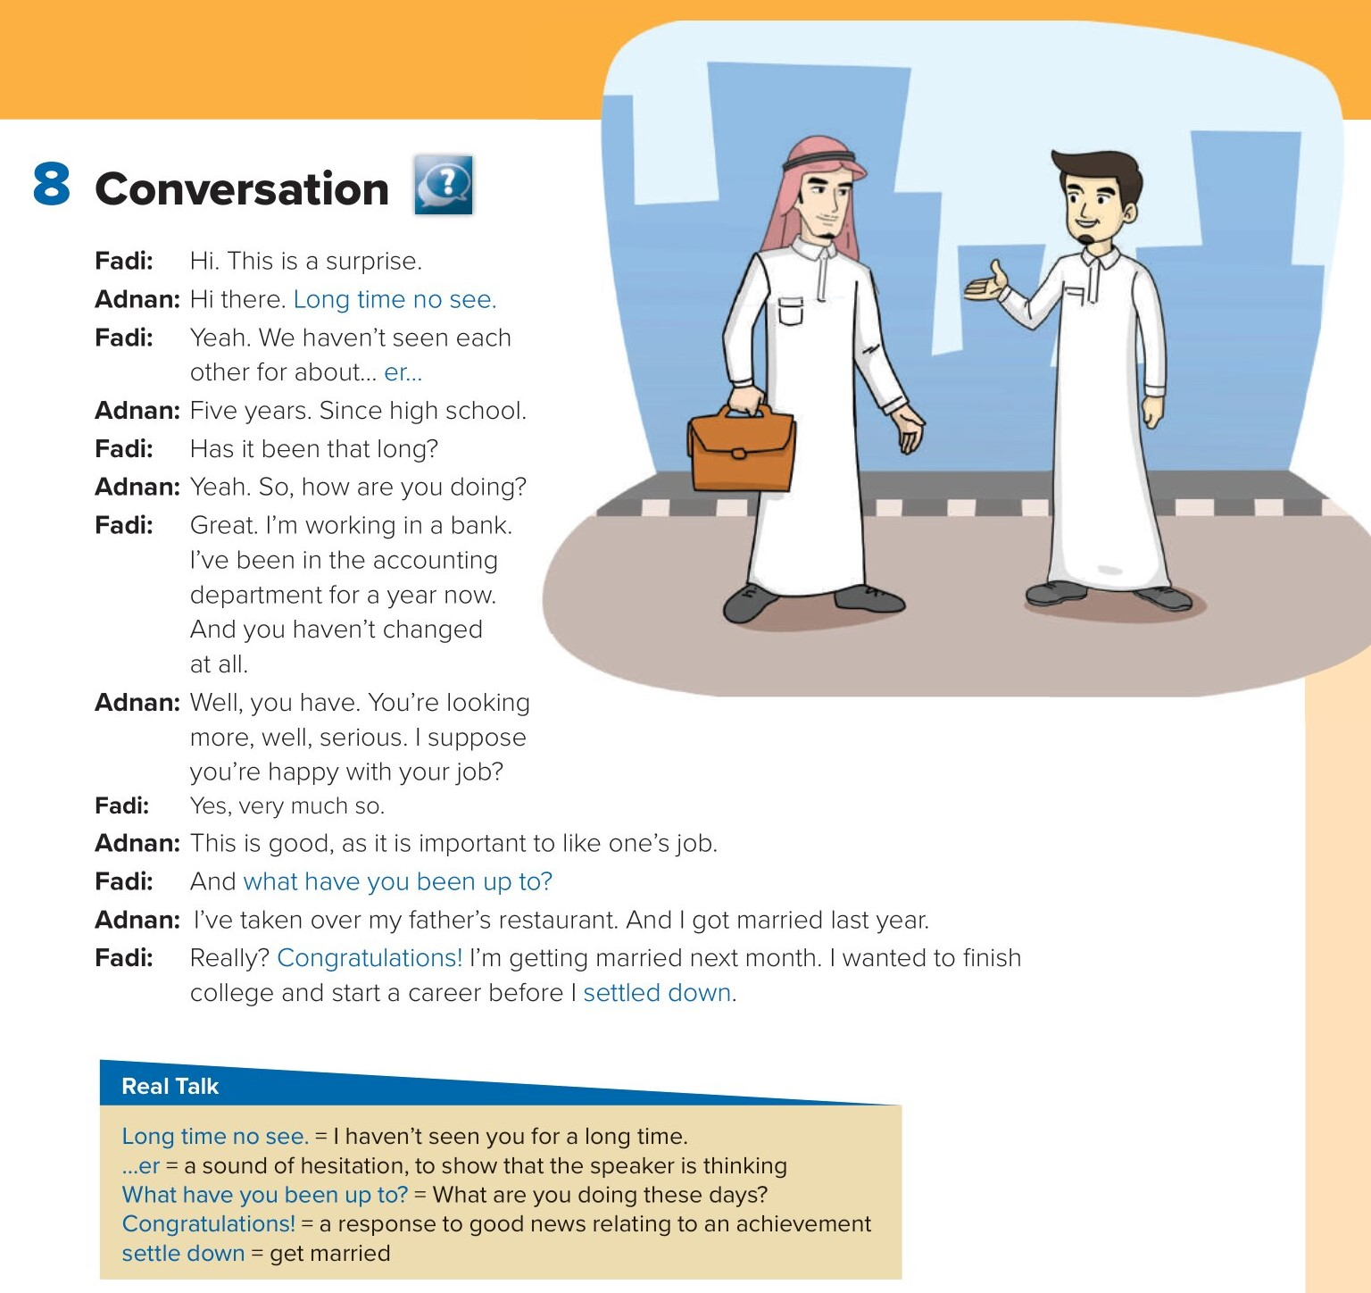
Page 53
Conversation

Slide 5
Page 53
Conversation

Slide 6
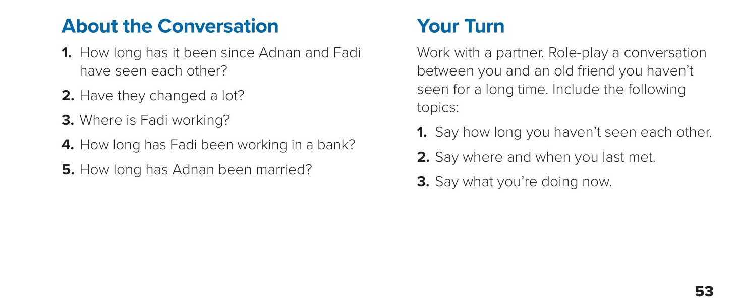
Answers
1. They haven’t seen each other for five years/since high school.
2. Adnan hasn’t changed at all, but Fadi looks more serious.
3. Fadi is working in a bank.
4. Fadi has been working for a year.
5. Adnan has been married for about a year.
Page 53

Slide 7
Page 53

Slide 8

Homework
Page 200

Slide 9
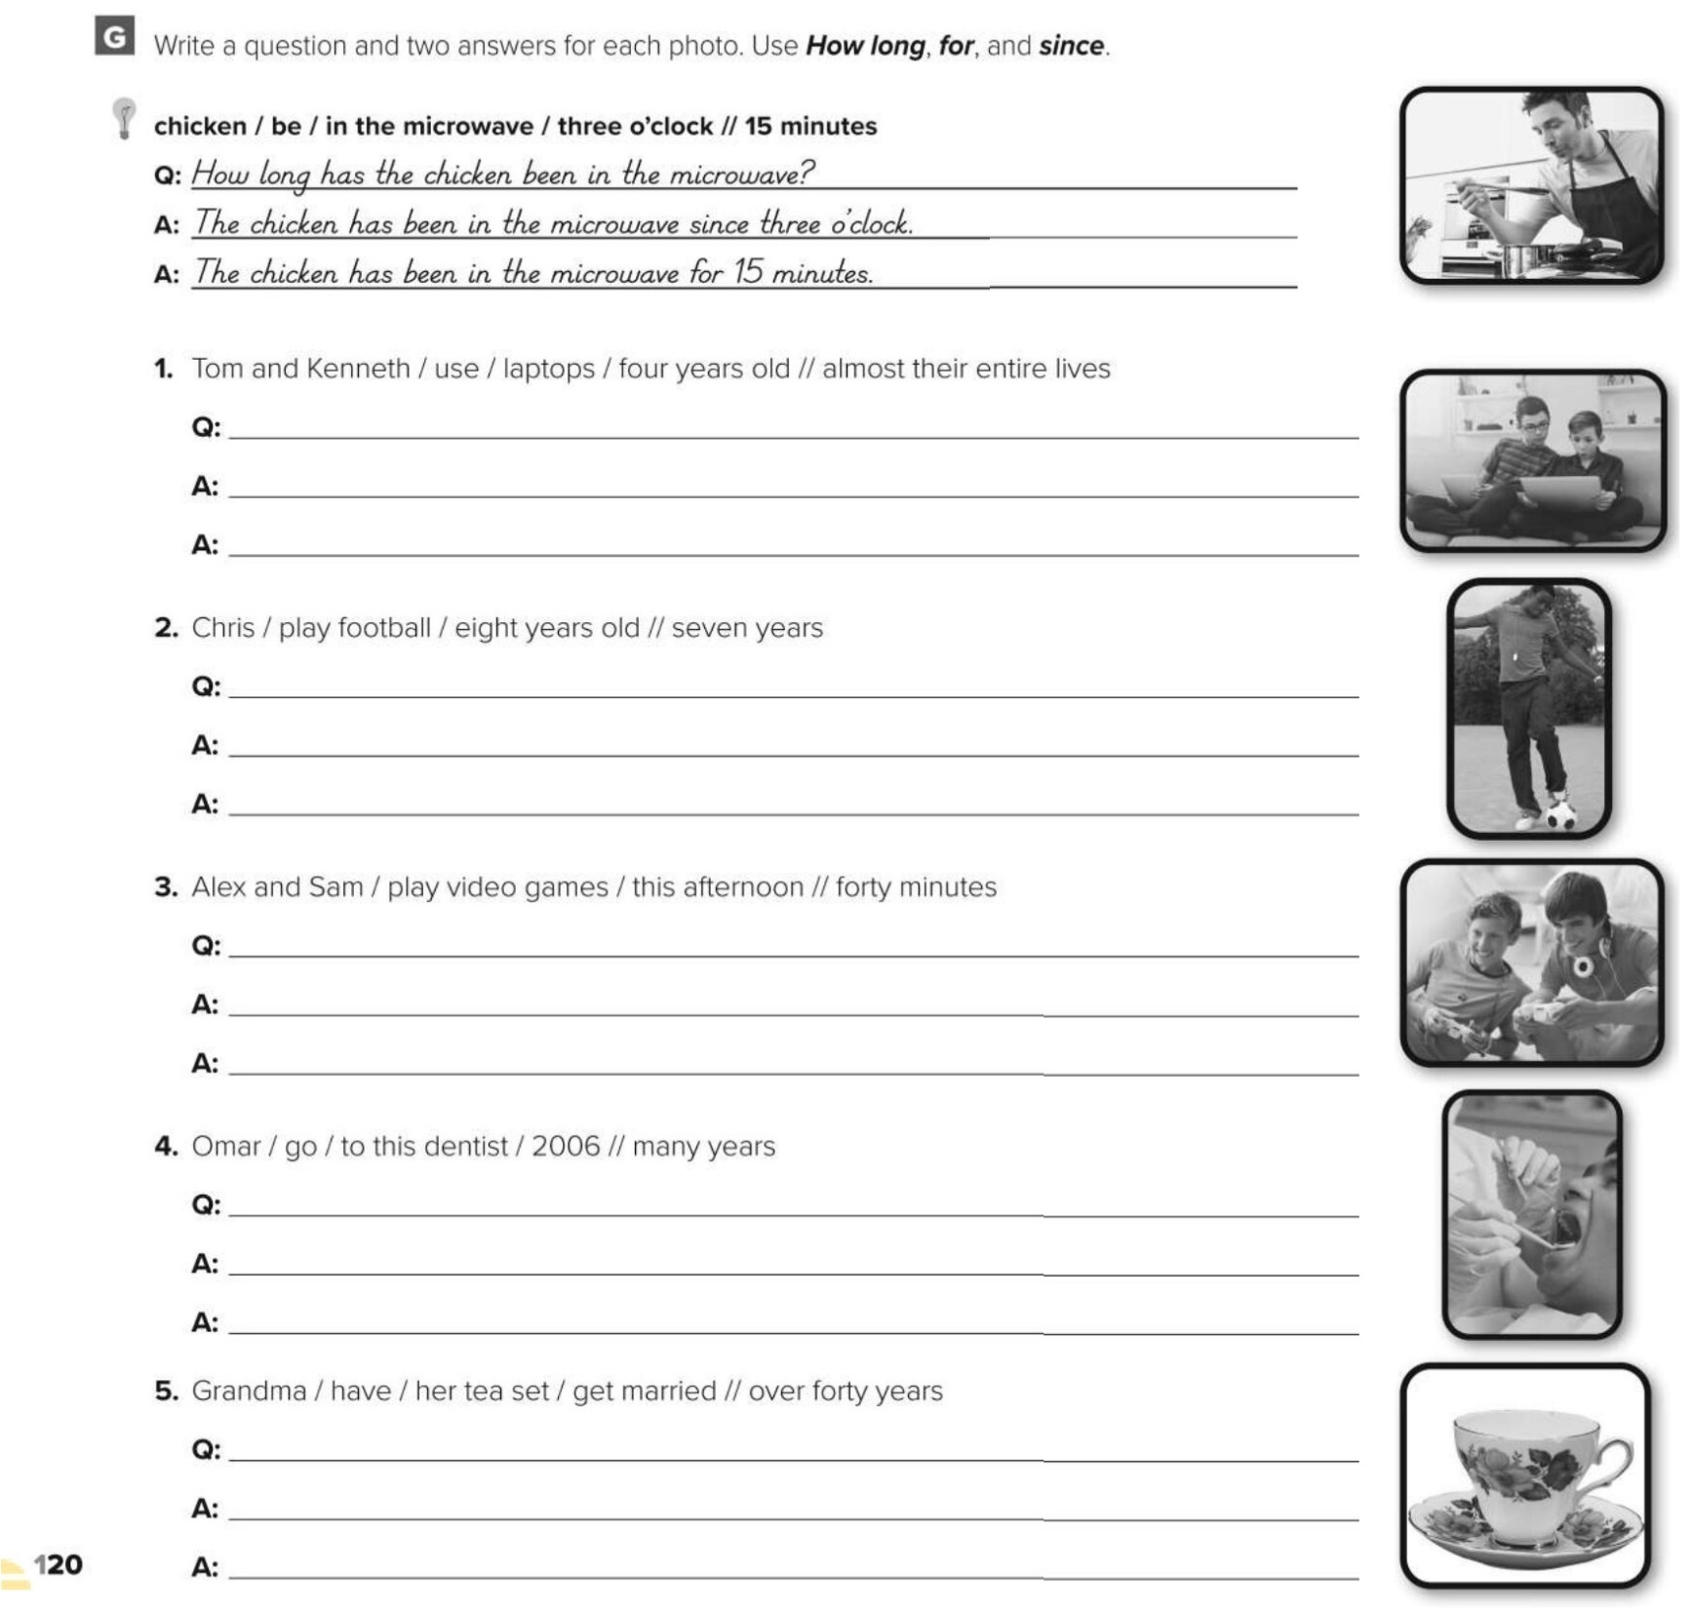
How long have Tom and Kenneth used laptops?
Tom and Kenneth have used laptops since they were four years old.
Tom and Kenneth have used laptops for almost their entire lives.
How long has Ali played football?
Ali has played football since he was eight years old.
Ali has played football for seven years.
How long have Alex and Sam played video games?
Alex and Sam have played video games since this afternoon.
Alex and Sam have played video games for four hours.
How long has Omar gone to this dentist?
Omar has gone to this dentist since 2006.
Omar has gone to this dentist for many years.
How long has Grandma had her tea set?
Grandma has had her tea set since she got married.
Grandma has had her tea set for over forty years.

