Slide 1

Unit 5

Slide 2

3. Grammar
Objectives
Form sentences in the present perfect.
Change sentences into questions.
Differentiate between the present perfect & past simple.
talk about old habits using (have/haven't) .

Slide 3

Present Perfect simple

Slide 4
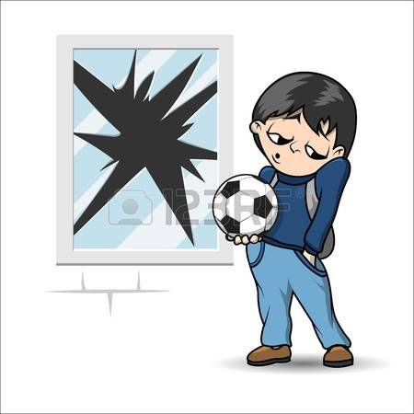

What has he done?

Slide 5
What has he done?
He
has
broken
the window.
Change into negative?
He
has
not
broken
the window
He
hasn’t
broken
the window.

Slide 6
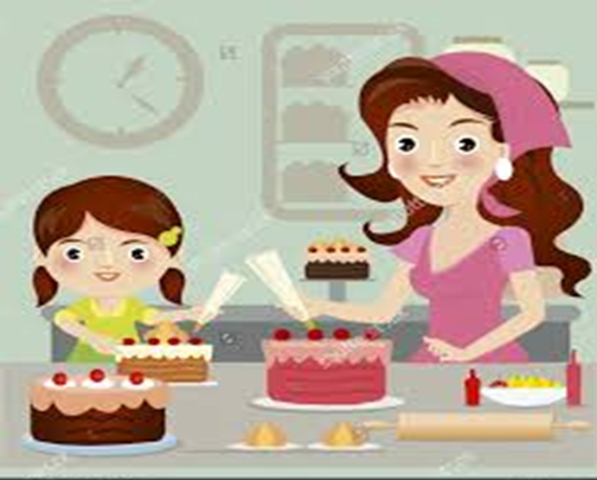
What have they done?
They
have
baked
a cake.
Change into negative?
They
have
not
baked
a cake.
They
have
n’t
baked
a cake.

Slide 7
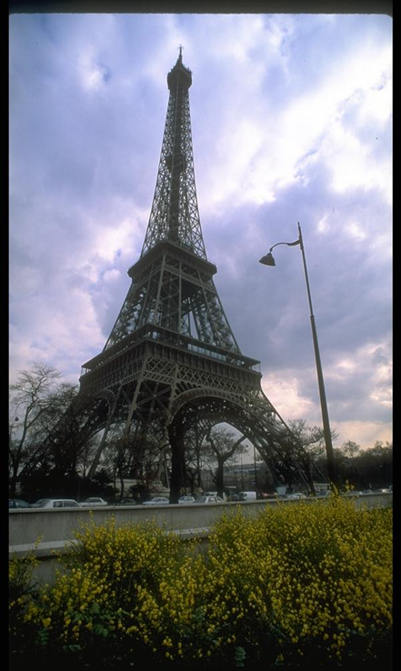
Where has Amal been?
Amal
has
been
to Paris already.
Change into negative?
Amal
has
not
been
to Paris.
Amal
has
n’t
been
to Paris.

Slide 8
She
He
It
Has
They
We
You
I
Have

Slide 9

Present perfect
has / have
V3
played
She
He
It
They
We
You
I
watched
seen
taken
cut
been

Slide 10

Short from :
She has she’s
They have they’ve

Slide 11
Choose the correct word:
I have just[ start – started – starting ] a new computer course.
We[ have had – has had– had] 2 exams so far.
I [ has – have – am ] been to London twice.
They haven’t [ go – went – gone ] to school yet.
[ She – You – We ] has read the book before.

Slide 12
Form a Yes / No question.
He has broken the window.
Has
he
ever
broken the window?
Yes,
has.
he
No,
he
hasn‘t.

Slide 13
Form a Yes / No question.
They have baked a cake.
Have
they
ever
baked a cake?
Yes,
they
have.
No,
they
haven‘t.

Slide 14
Form a Yes / No question.
Amal has been to Paris.
Has
Amal
ever
been to Paris?
Yes,
she
has.
No,
she
hasn‘t.

Slide 15

Past simple
Present Perfect
simple

Slide 16
What has he done?
He
has
broken
the window
already.
What did he do?
He
broke
the window
yesterday.

Slide 17
What have they done?
They
have
just
baked
a cake.
What did they do?
They
baked
a cake
2 hours ago.

Slide 18
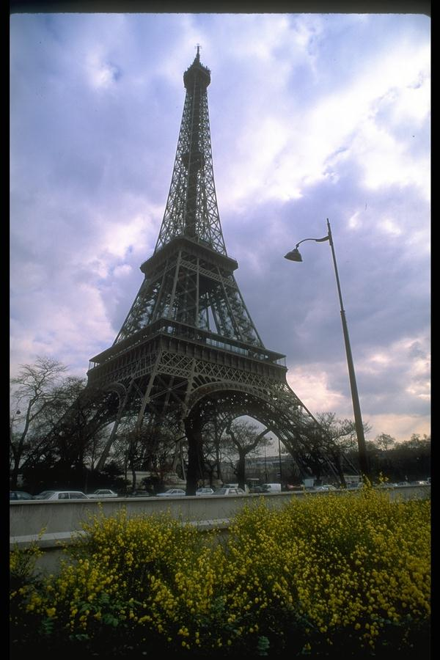
Where has Amal been?
Amal
has
been
to Paris
twice.
Where did Amal go?
Amal
went
to Paris
last year.

Slide 19
Past simple
Present Perfect simple
happened in the past at a definite time
Happened in the past, but we don’t know when
Ever / never / before / yet / just / so far / always / already / once / since / for
Yesterday / ago / last / in
has / have + V3
V2

Slide 20
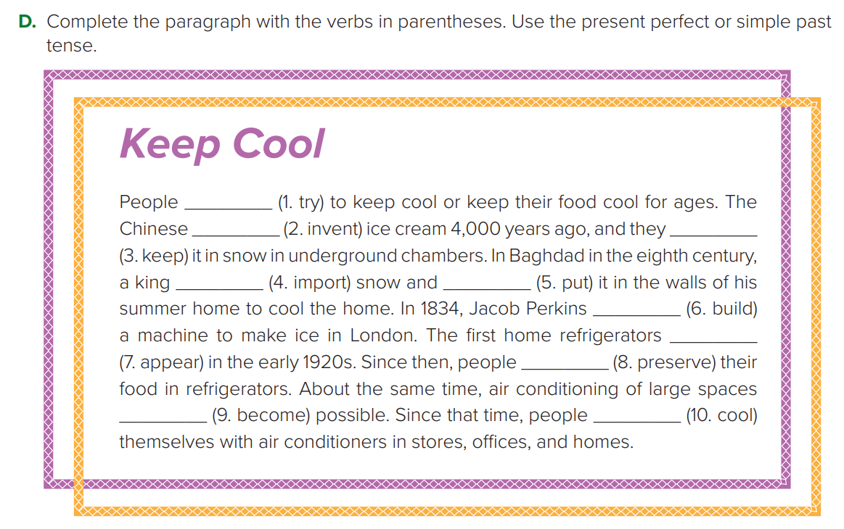

P. B. p. 51
have tried
invented
kept
imported
put
built
appeared
preserved
became
have cooled

Slide 21

Present perfect
for & since

Slide 22
What time is it?
I came to school at 6:30.
When did you come to school?
It’s 11:30 now

Slide 23
How long
has
been
Amal
at school ?
6:3o 11:30
Amal
has been
at school
for
5 hours.
since
6:30.

Slide 24
Noura is helping her Mom. She started cleaning the house at 9:00 in the morning. It’s 11:00 now.

Slide 25
How long
has
been
Noura
cleaning the house ?
9:00 11:00
Noura
has been
cleaning the
house
for
2 hours.
since
9:00.

Slide 26
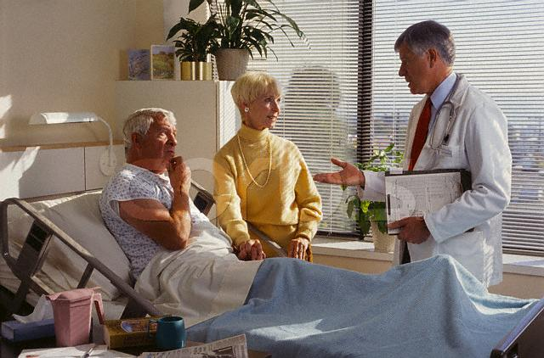
It’s Monday today and I was admitted last Friday.

Slide 27
How long
has
been
he
at the hospital ?
Friday Monday
He
has been
at the hospital
for
3 days .
since
Friday.

Slide 28
How long
For
Since
a year
2 days
4 months
9 hours
7:00
1428 H
Friday
Safer

Slide 29
Complete with “ since” or “ for”:
since
I have worked late …………… April.
2. She has been my friend …......... 6 months.
3. I have gone to school ………… a year.
4. He has been married to her ….…………
last year.
5. She has been at the center ………………
8:30.
for
for
since
since

Slide 30
Now change them into negative:
Amal has been at school for 5 hours.
Amal hasn’t been at school for 5 hours.
Noura has been cleaning the house since 9:00.
Noura hasn’t been cleaning the house since 9:00.
They have been at the hospital for 3 days.
They haven’t been at the hospital for 3 days.

Slide 31
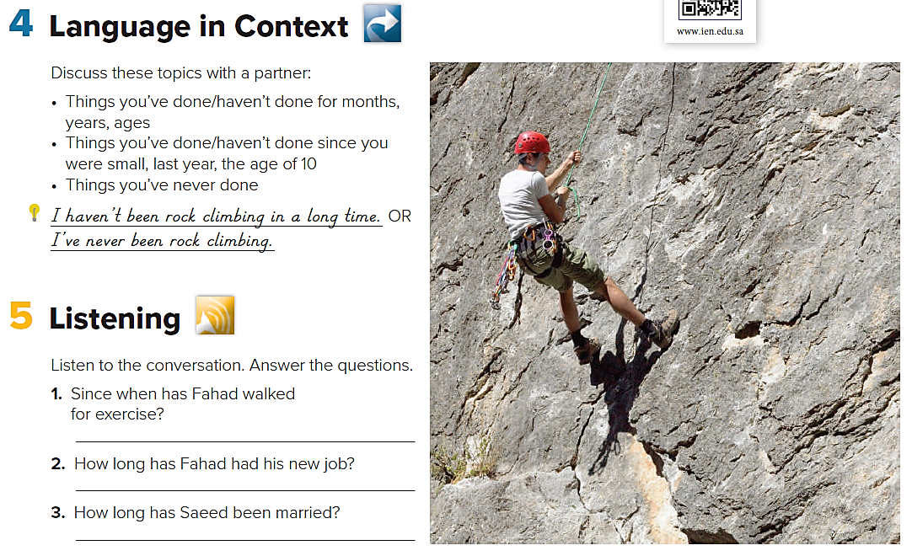
Language in Context
What have you done lately?
What haven’t you done lately?

Slide 32
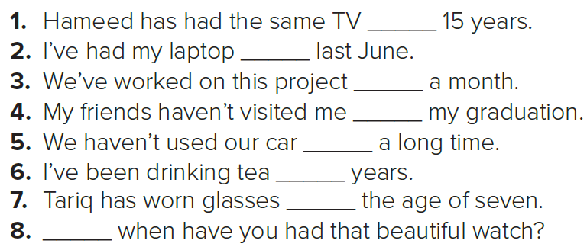
P. B. p. 50
for
since
for
since
for
for
since
Since

Slide 33
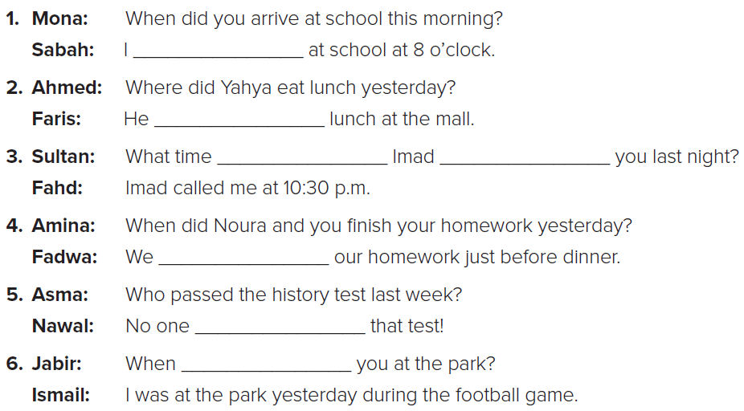
W. B. p. 198
arrived
had
did
call
finished
passed
were

Slide 34

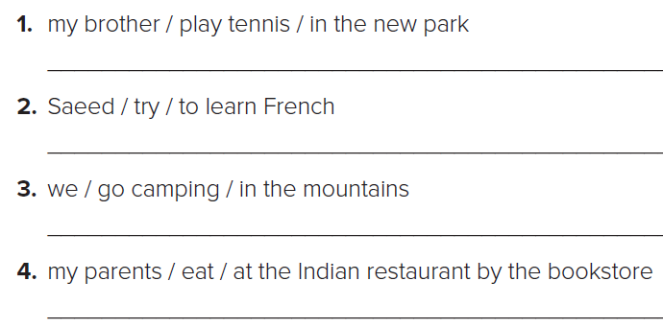
W. B. p. 198
My brother has played tennis in the new park.
Saeed has tried to learn French.
We have gone camping in the mountains.
MY parents have eaten at the Indian restaurant by the bookstore.

Slide 35

W. B. p. 198
1. Has your brother played tennis in the new park?
2. Has Saeed tried to learn French?
3. Have you gone camping in the mountains?
4. Have your parents eaten at the Indian restaurants by the bookstore?

Slide 36
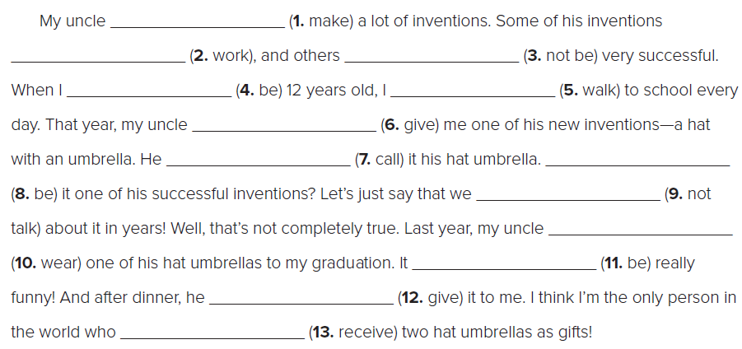
W. B. p. 199
has made
have worked
haven’t been
was
walked
gave
was
called
haven’t talked
wore
was
gave
has received

Slide 37

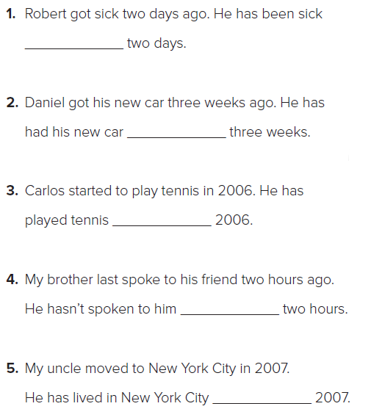
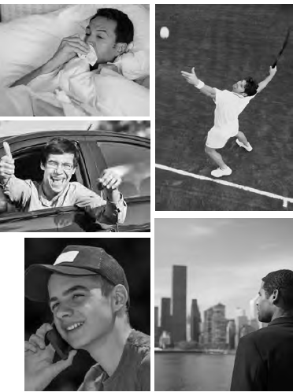
W. B. p. 199
for
for
since
for
since

Slide 38
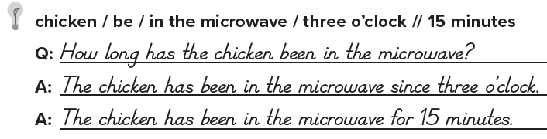

W. B. p. 200

Slide 39
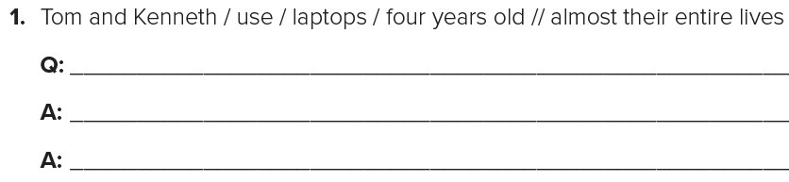

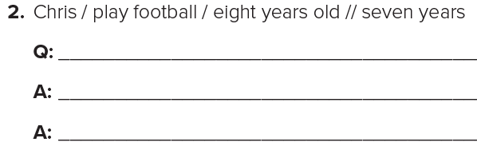
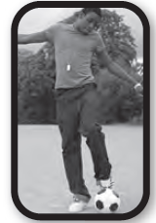
W. B. p. 200
How long have Tom and Kenneth used laptops?
Tom and Kenneth have used laptops since they were four years old.
Tom and Kenneth have used laptops for almost their entire lives.
How long has Chris played football?
Chris has played football since he was eight years old.
Chris has played football for seven years.

Slide 40
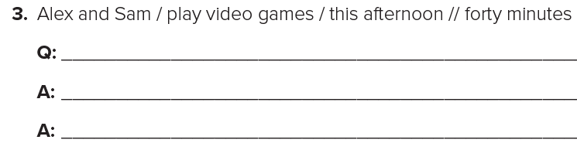

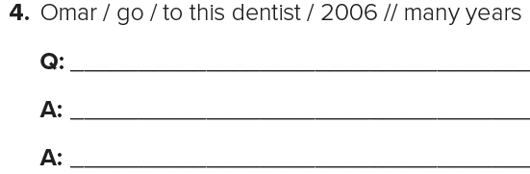

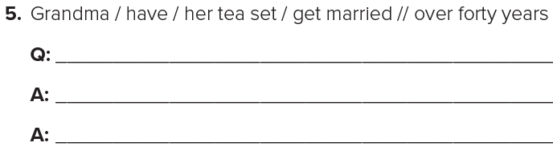

How long have Alex and Sam played video games?
Alex and Sam have played video games since this afternoon.
Alex and Sam have played video games for four hours.
How long has Omar gone to this dentist?
Omar has gone to this dentist since 2006.
Omar has gone to this dentist for many years
How long has Grandma had her tea set?
Grandma has had her tea set since she got married.
Grandma has had her tea set for over forty years.

Slide 41


