Slide 1
Day & Date
Form, Meaning and Function

Slide 2

Objectives
Use passive voice for simple present tense correctly
Use passive voice for present perfect tense correctly
Use passive voice for past tense correctly
Transform active sentences into passive
Transform passive sentences into active

Slide 3
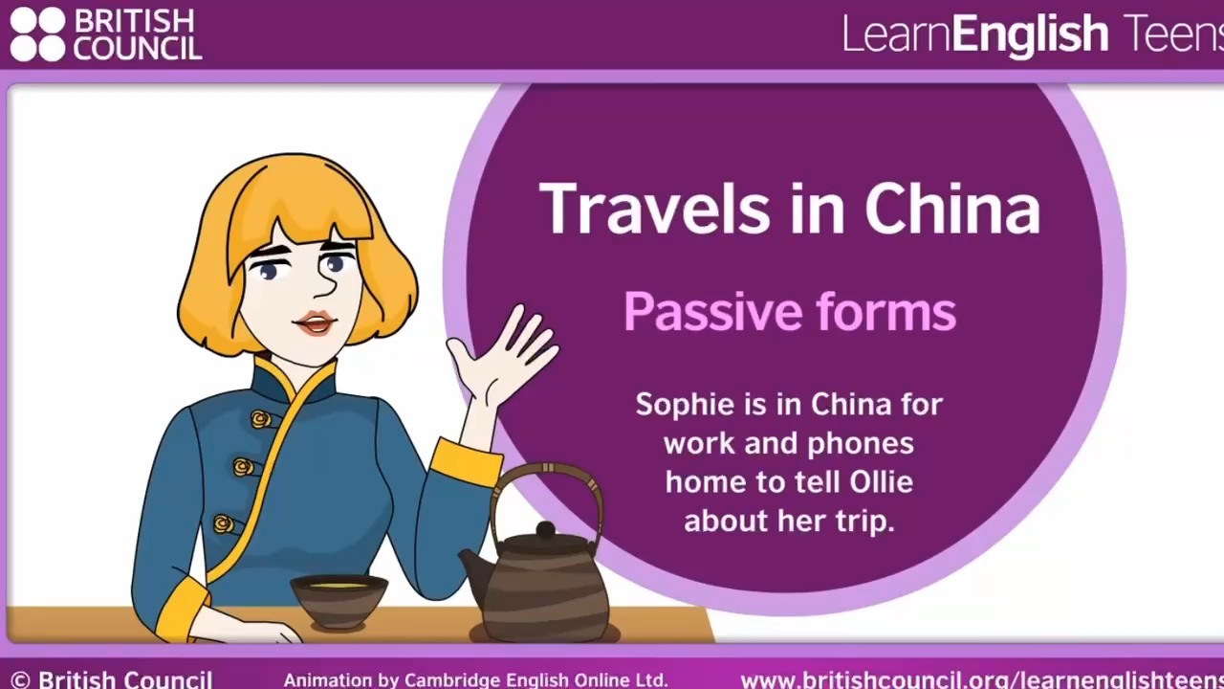

Slide 4
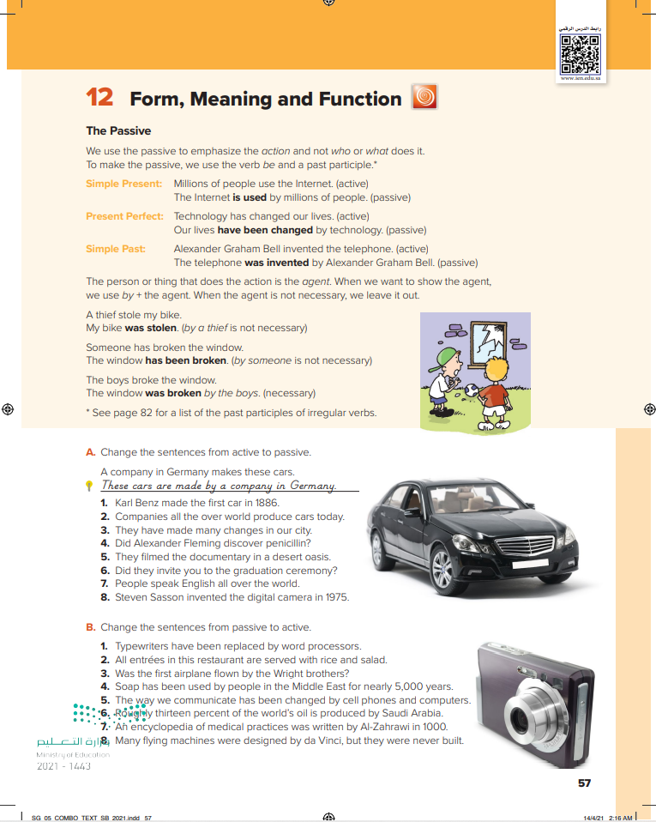

57

Slide 5
active OR passive ?
57
Ali opened the door.
Sara is reading the book now.
Bader will meet his teacher at the library.
Dinner is cooked.

Slide 6
Use the passive when …
1- we are interested in the action rather than the people who do the action (agent / doer).
57
2- we don’t know exactly the agent (doer)
3- it is understood who did the action
Examples:
1- The school was built in 1981.
2- His car has been stolen.
3- Talking is not permitted.

Slide 7
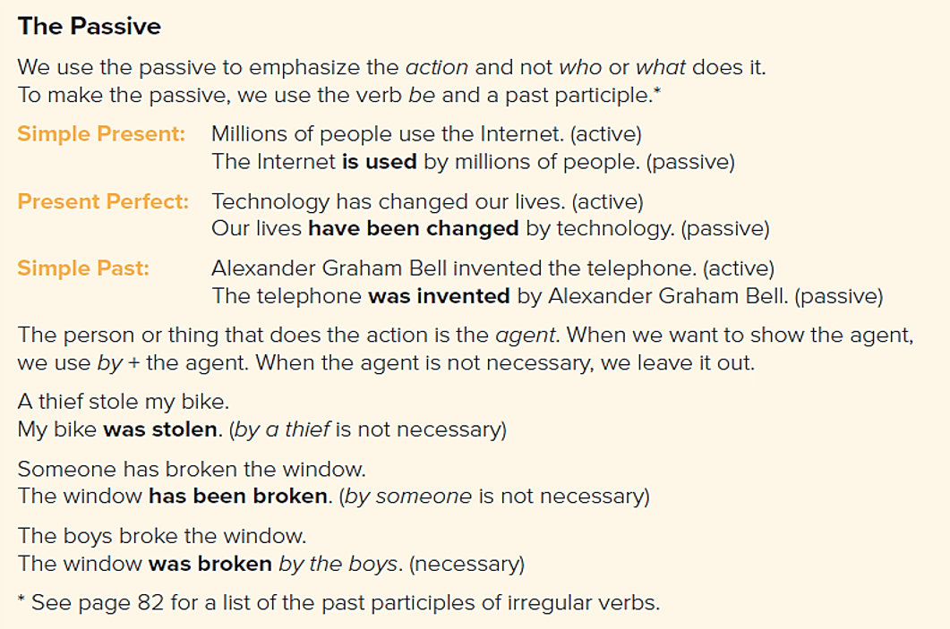
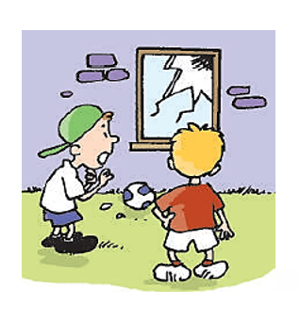
57

Slide 8
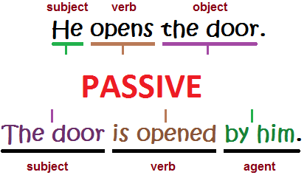
57
Simple present
S + V + O
Simple present passive
O + be(am\is\are) + V3 + by ….

Slide 9

57
Present perfect
S + have\has + V3 + O
Present perfect passive
O + have\has + been + V3

Slide 10
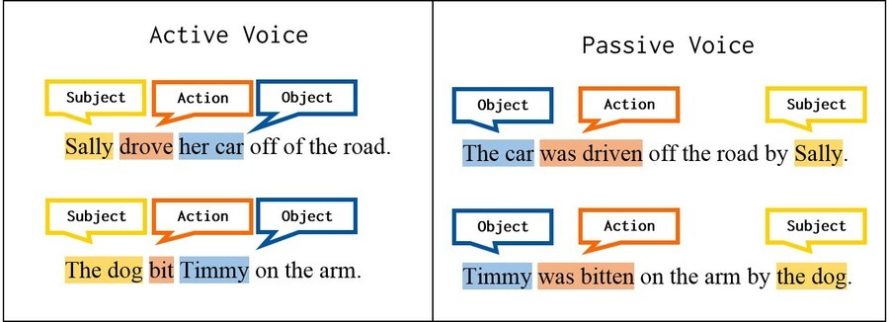
57
Simple past
S + V2 + O
Simple past passive
O + be(was\were) + V3 + by ….

Slide 11
active passive
Ali writes the story.
57
… tense?
… subject ?
… verb?
… object?
Present simple
Ali
write
The story

Slide 12
active passive
Ali writes the story.
57
The story is written by Ali.

Slide 13
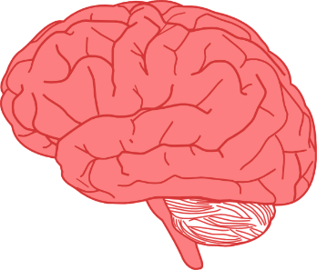
Refresh your memory
Notes should be considered
when changing into passive
57
1- keep on the tense of the active sentence
2- use correct verb to be / has / have
3- use past participle
4- by is used to introduce the agent
5- by is not used if it is not important who does the action

Slide 14
Let’s Practice
Change into passive!
57
Sami receives a letter .
A letter is received by Sami.

Slide 16
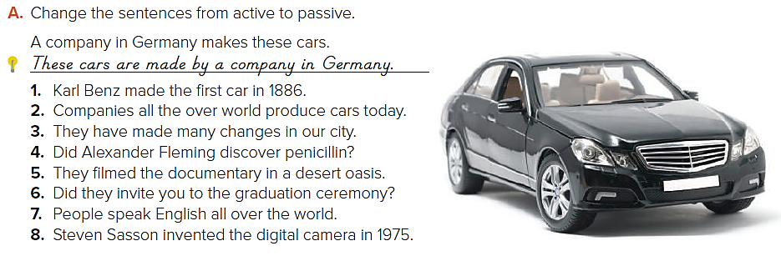
Notes:
1. The first car was made by Karl Benz in 1886.
2. Cars are produced all over the world today.
3. Many changes have been made in our city.
4. Was penicillin discovered by Alexander Fleming?
5. The documentary was filmed in a desert oasis.
6. Were you invited to the graduation ceremony?
7. English is spoken all over the world.
8. The digital camera was invented by Steven Sassoon in 1975.

Slide 17
1. The first car was made by Karl Benz in 1886.
2. Cars are produced all over the world today.
3. Many changes have been made in our city.
4. Was penicillin discovered by Alexander Fleming?
5. The documentary was filmed in a desert oasis.
6. Were you invited to the graduation ceremony?
7. English is spoken all over the world.
8. The digital camera was invented by Steven Sassoon in 1975.
Notes:
1. The first car was made by Karl Benz in 1886.
2. Cars are produced all over the world today.
3. Many changes have been made in our city.
4. Was penicillin discovered by Alexander Fleming?
5. The documentary was filmed in a desert oasis.
6. Were you invited to the graduation ceremony?
7. English is spoken all over the world.
8. The digital camera was invented by Steven Sassoon in 1975.

Slide 18
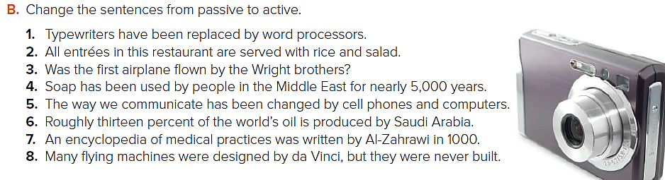
Notes:
1. Word processors have replaced typewriters.
2. This restaurant serves all entrees with rice and salad.
3. Did the Wright brothers fly the first airplane?
4. People in the Middle East have used soap for nearly 5,000 years.
5. Cell phones and computers have changed the way we communicate.
6. Saudi Arabia produces roughly thirteen percent of the world’s oil.
7. Al-Zahrawi wrote an encyclopedia of medical practices in 1000.
8. Da Vinci designed many flying machines, but he never built them.

Slide 19
1. Word processors have replaced typewriters.
2. This restaurant serves all entrees with rice and salad.
3. Did the Wright brothers fly the first airplane?
4. People in the Middle East have used soap for nearly 5,000 years.
5. Cell phones and computers have changed the way we communicate.
6. Saudi Arabia produces roughly thirteen percent of the world’s oil.
7. Al-Zahrawi wrote an encyclopedia of medical practices in 1000.
8. Da Vinci designed many flying machines, but he never built them.
Notes:
1. Word processors have replaced typewriters.
2. This restaurant serves all entrees with rice and salad.
3. Did the Wright brothers fly the first airplane?
4. People in the Middle East have used soap for nearly 5,000 years.
5. Cell phones and computers have changed the way we communicate.
6. Saudi Arabia produces roughly thirteen percent of the world’s oil.
7. Al-Zahrawi wrote an encyclopedia of medical practices in 1000.
8. Da Vinci designed many flying machines, but he never built them.

Slide 20
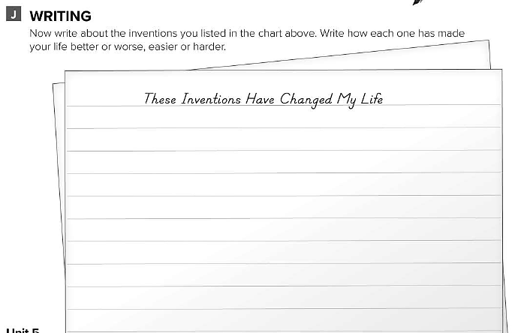
WORKBOOK
202

Slide 21


