Slide 1
Day & Date
Writing

Slide 2



Objectives
Discuss the topic based on Ss’ information
Talk about most important possessions
Use possessive pronouns or possessive adjectives correctly
Take
notes on a written text
Write
a paragraph

Slide 3
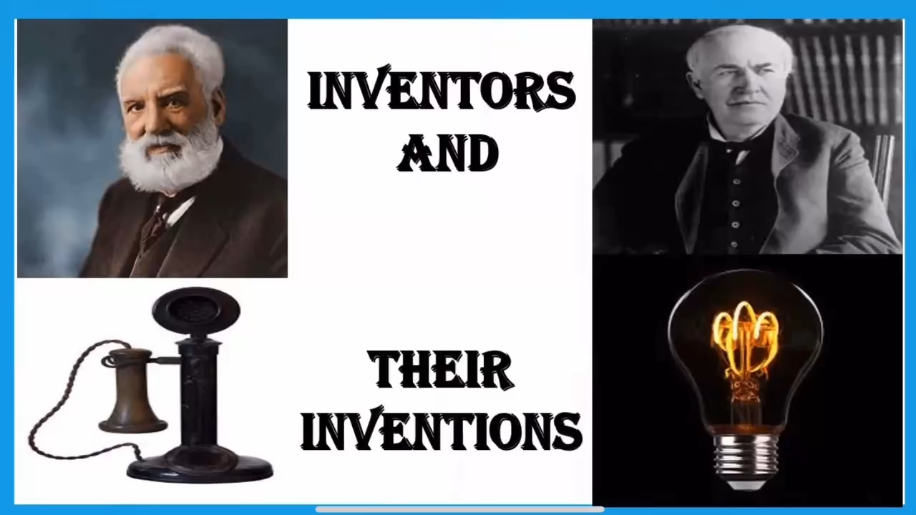
Objectives

Slide 4



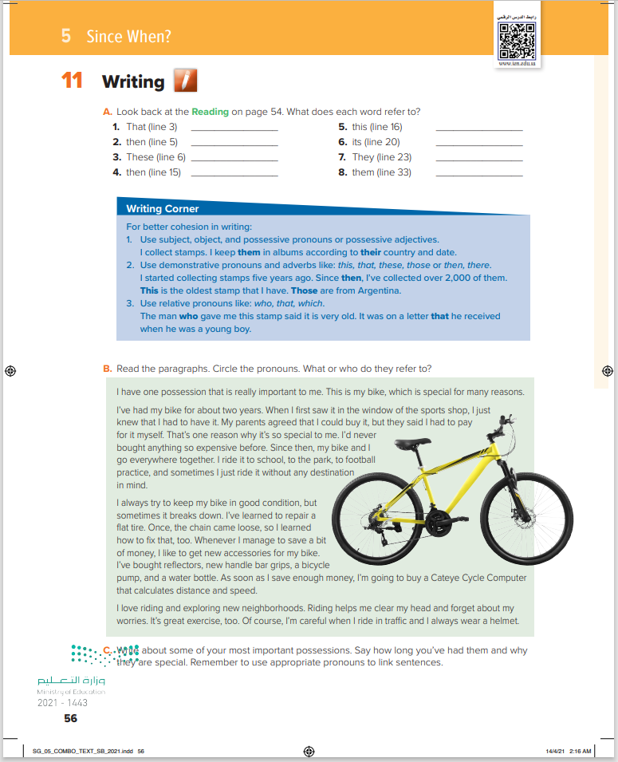
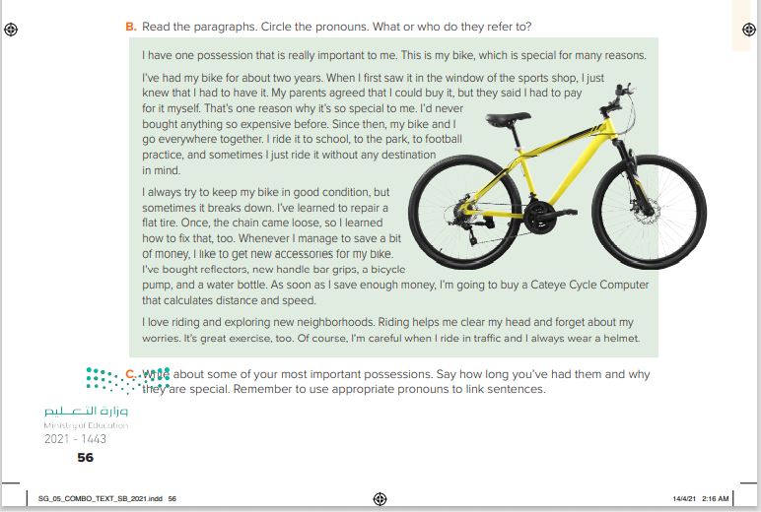

56

Slide 5
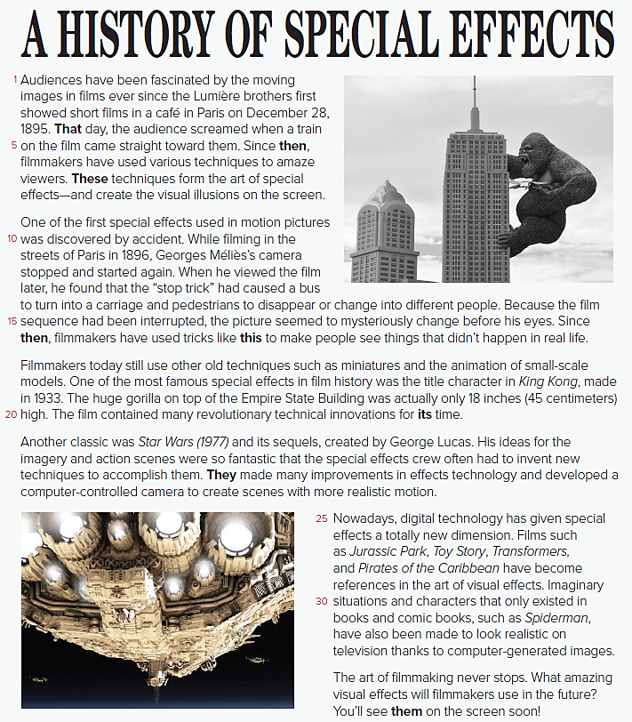

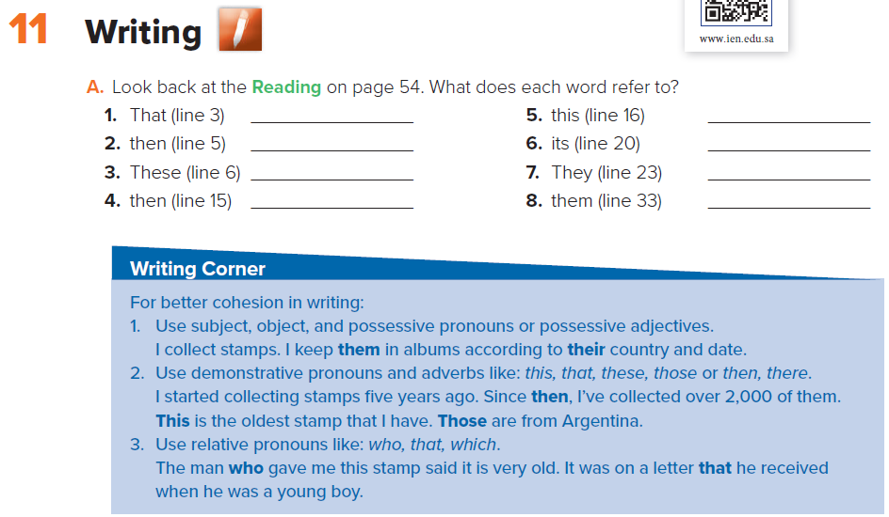


December 28, 1895
December 28, 1895
Techniques filmmakers use
1896
The “stop trick”
The film king kong
The special effects crew
Amazing visual effects

Slide 6
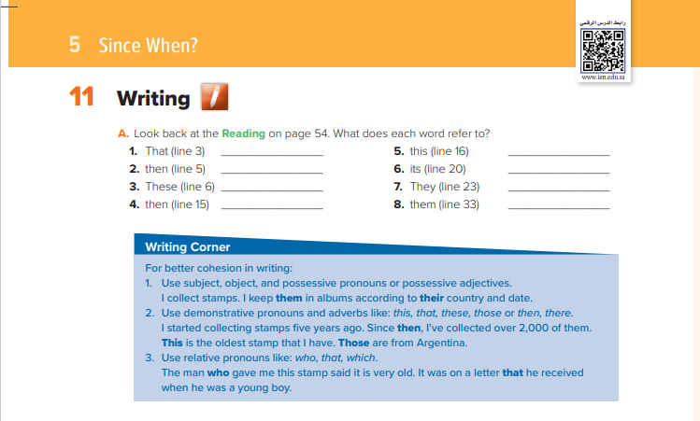

Slide 7
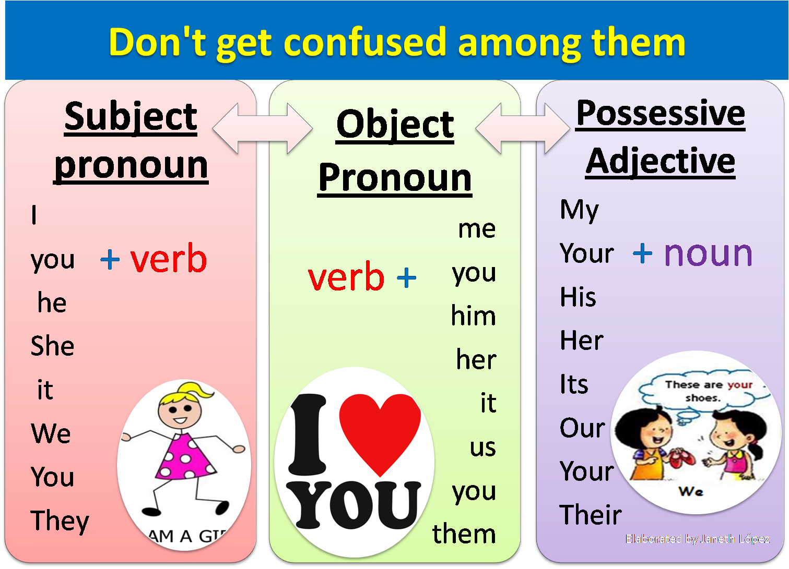

Slide 8
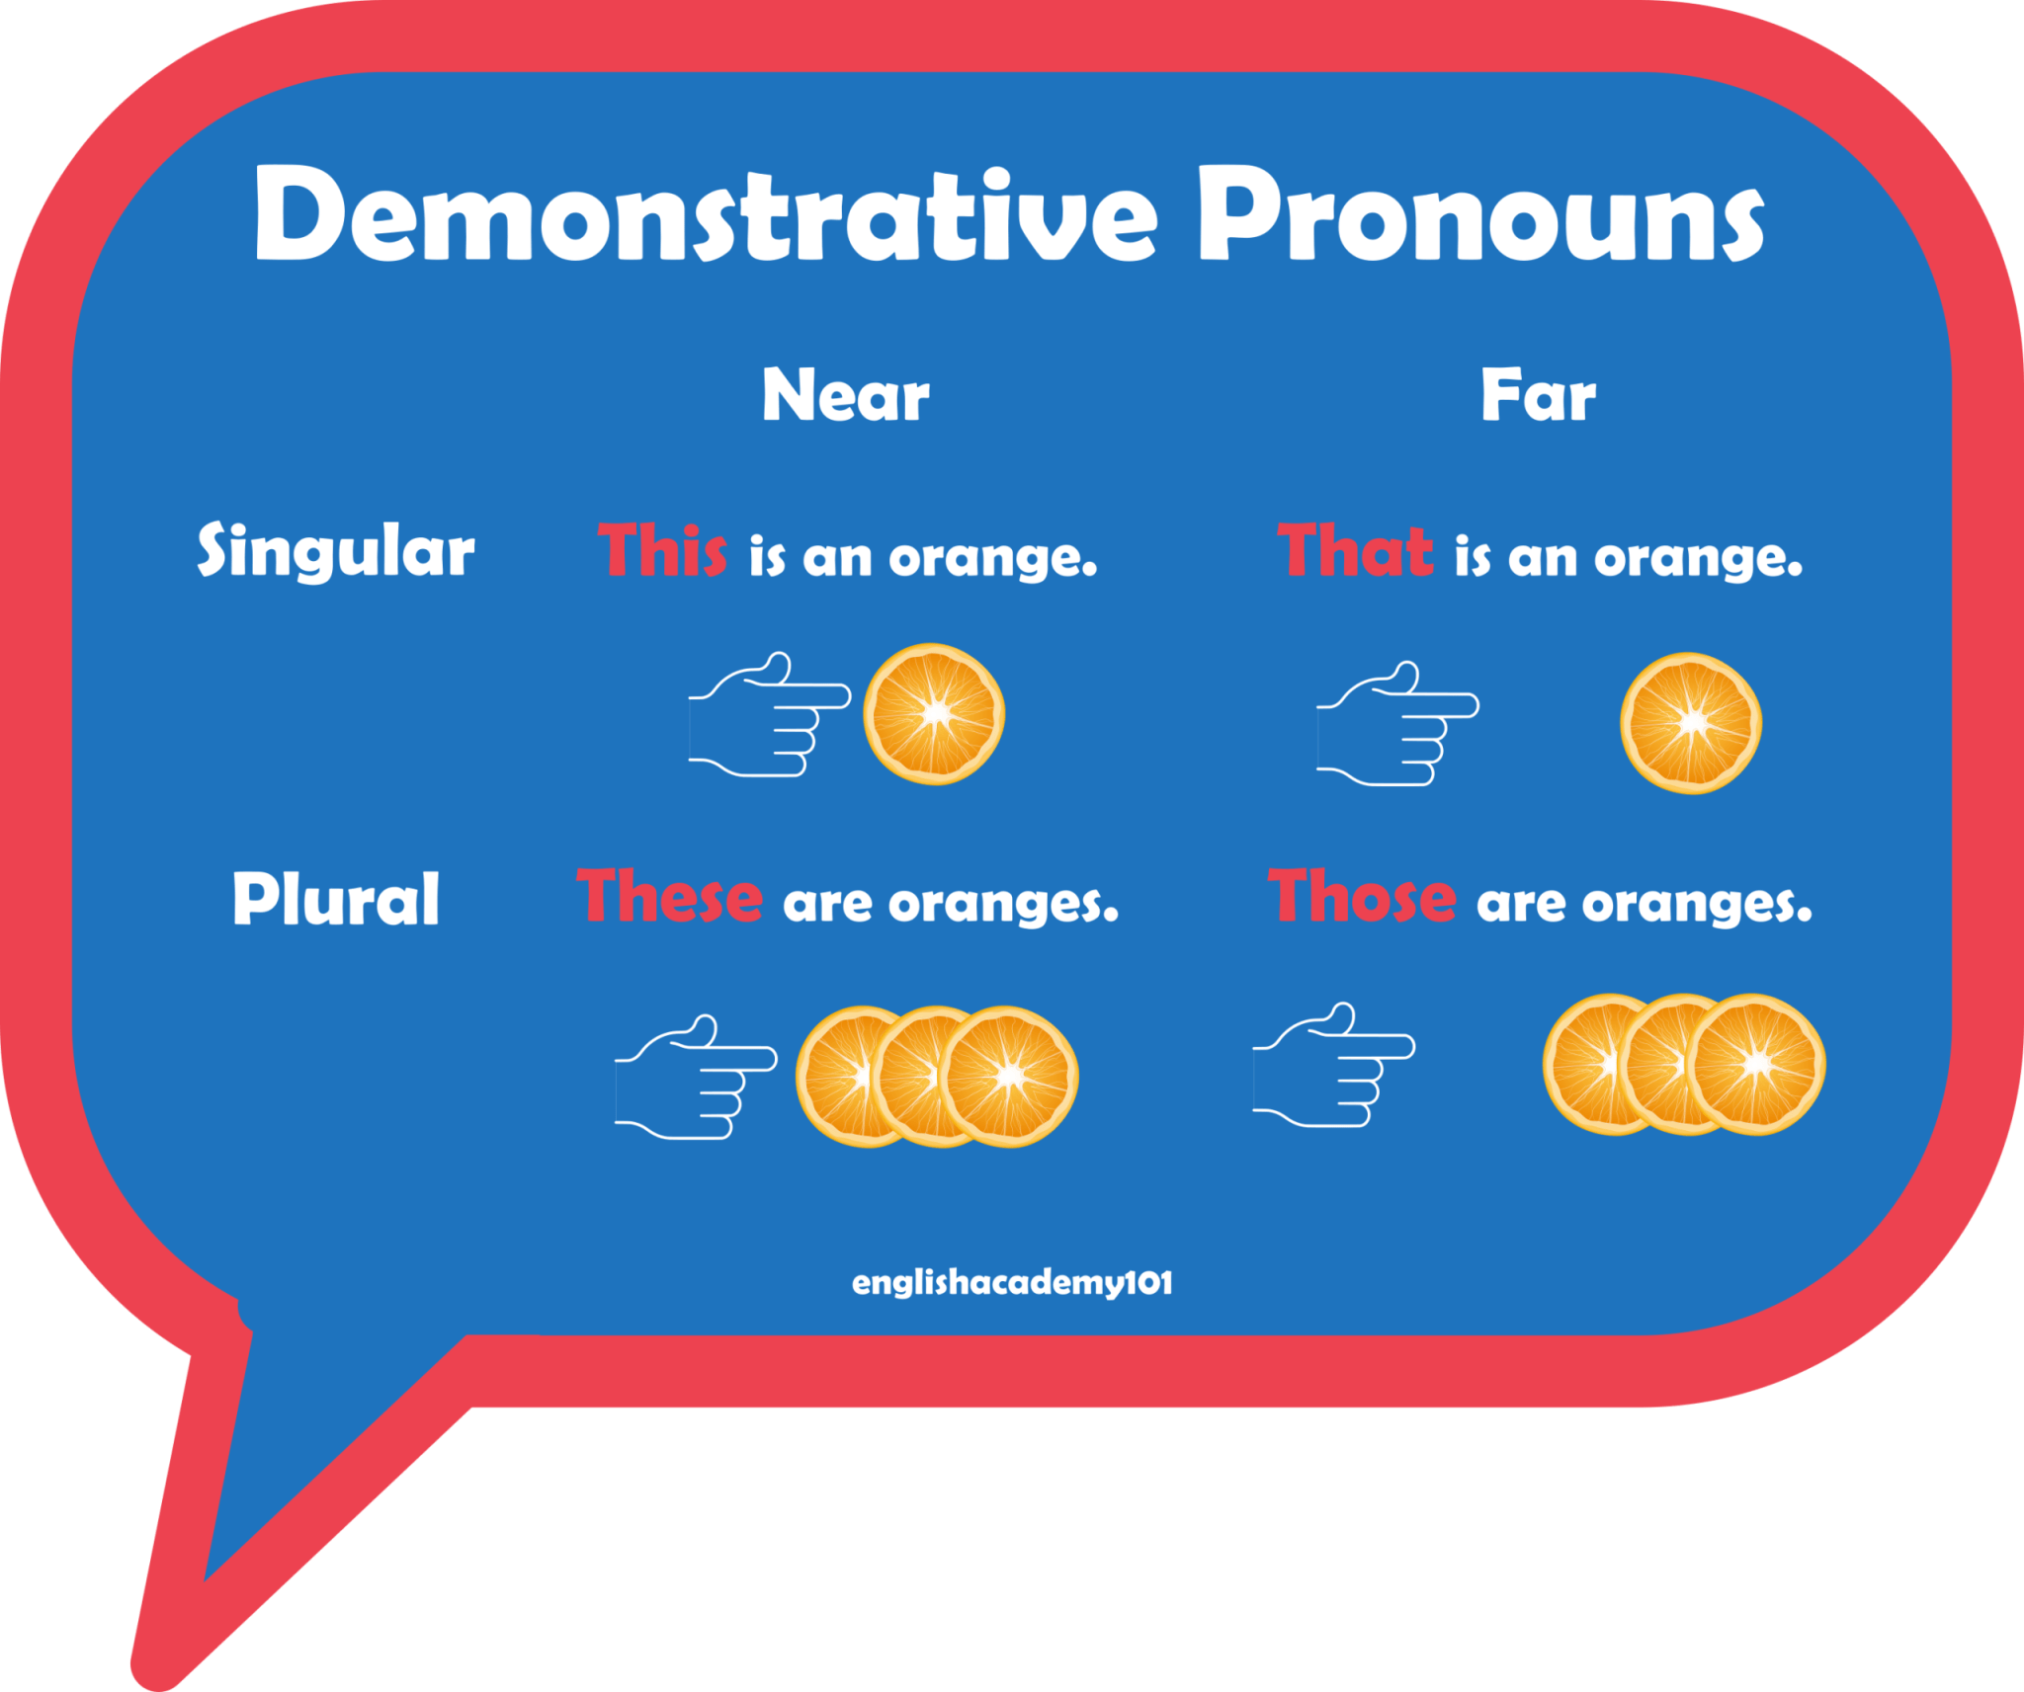

Slide 9
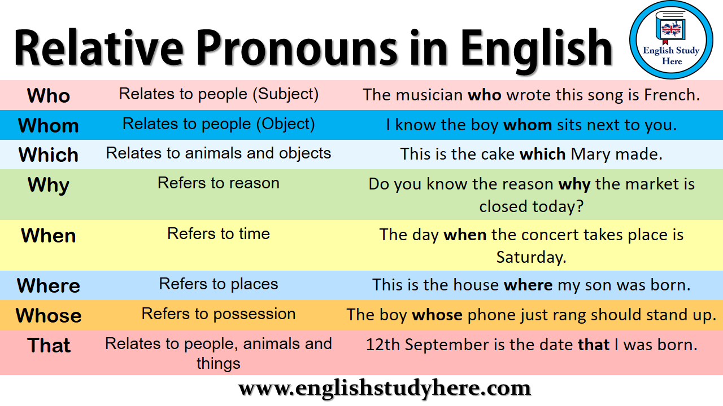

Slide 10
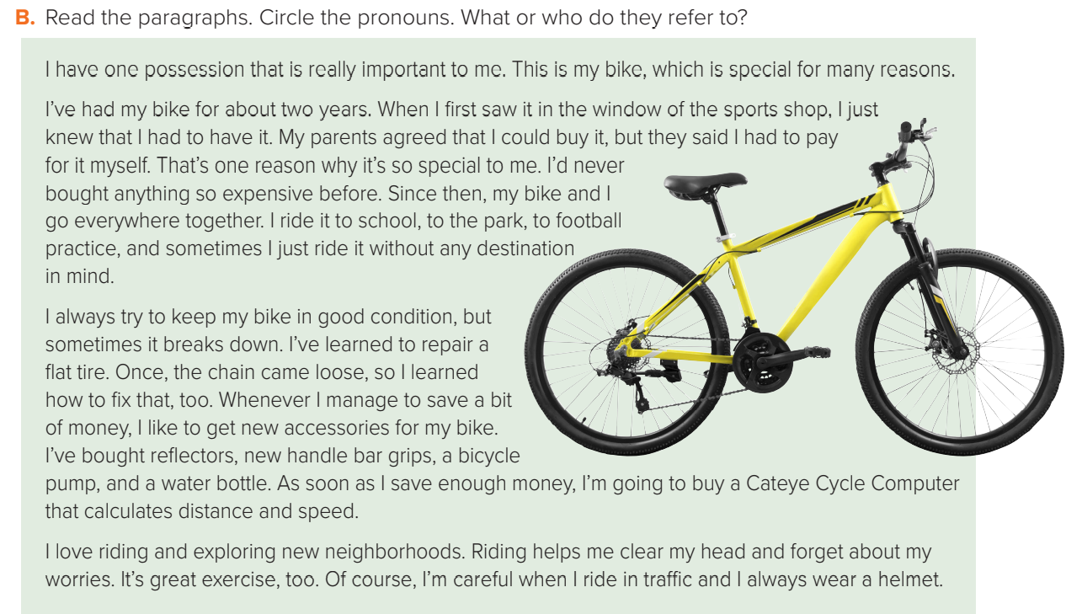
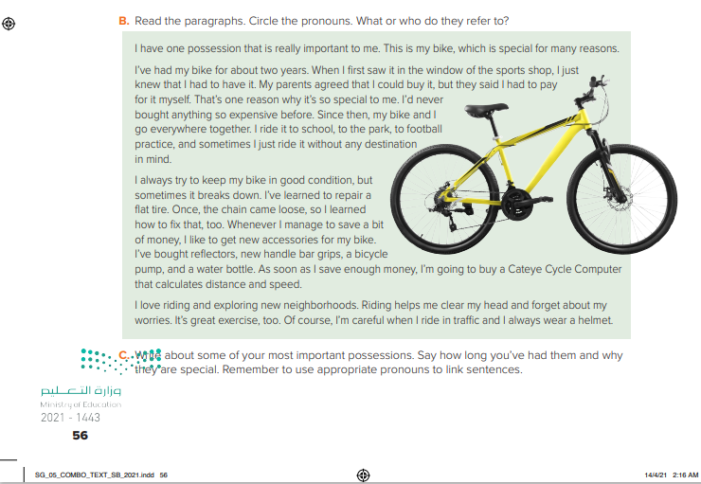
Who paid for the bike?
Why is the bike so special?
When did the person get the bike?
What did the person do when the chain came loose?
Paragraph 1 I/me = the owner of the bike that = one possession This = the important possession
which = my bike
Paragraph 2 I/myself/me = the owner of the bike it = the bike they = my parents That = having to pay for it
myself then = buying the bike
Paragraph 3 I = the owner of the bike it = the bike (fix) that = a loose chain that = Cateye Cycle Computer
Paragraph 4 I/me = the owner of the bike It = riding
Notes:
Paragraph 1 I/me = the owner of the bike that = one possession This = the important possession
which = my bike
Paragraph 2 I/myself/me = the owner of the bike it = the bike they = my parents That = having to pay for it
myself then = buying the bike
Paragraph 3 I = the owner of the bike it = the bike (fix) that = a loose chain that = Cateye Cycle Computer
Paragraph 4 I/me = the owner of the bike It = riding

Slide 11
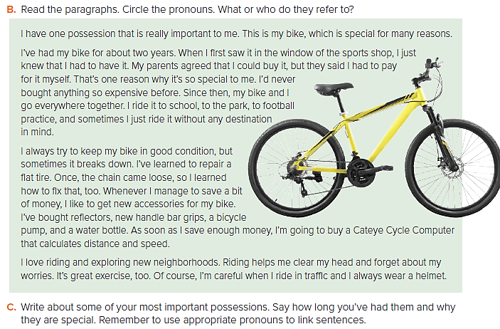
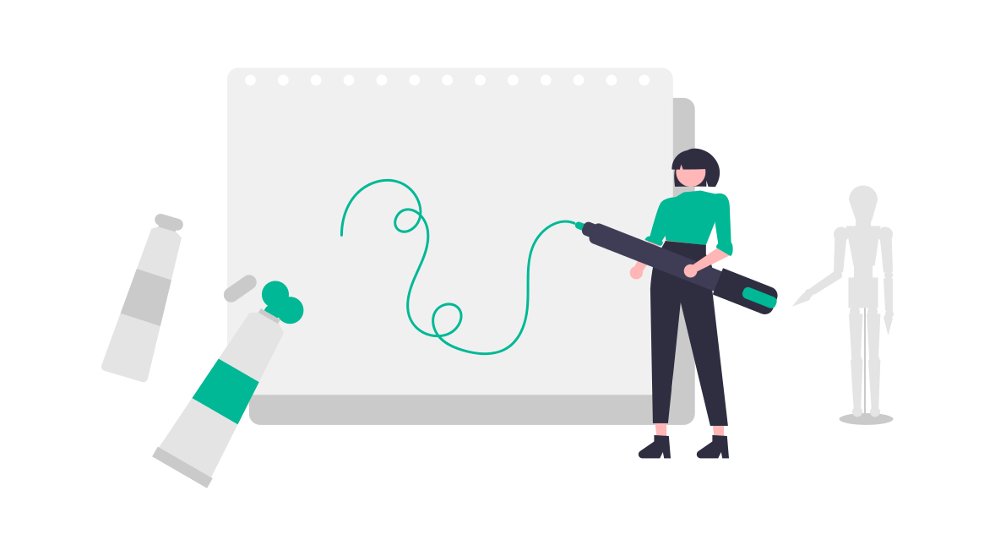

Slide 12
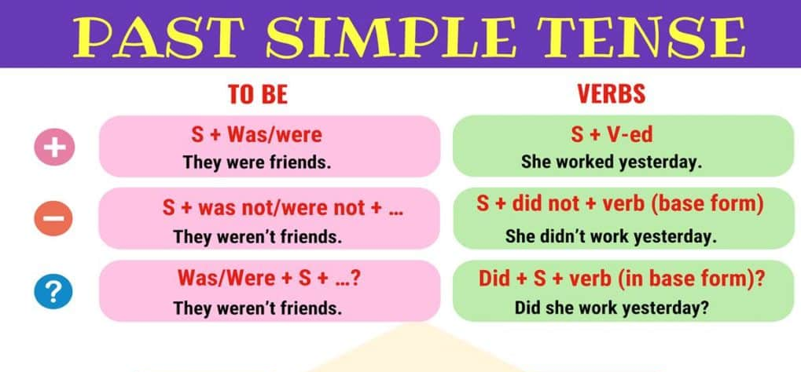

Slide 13
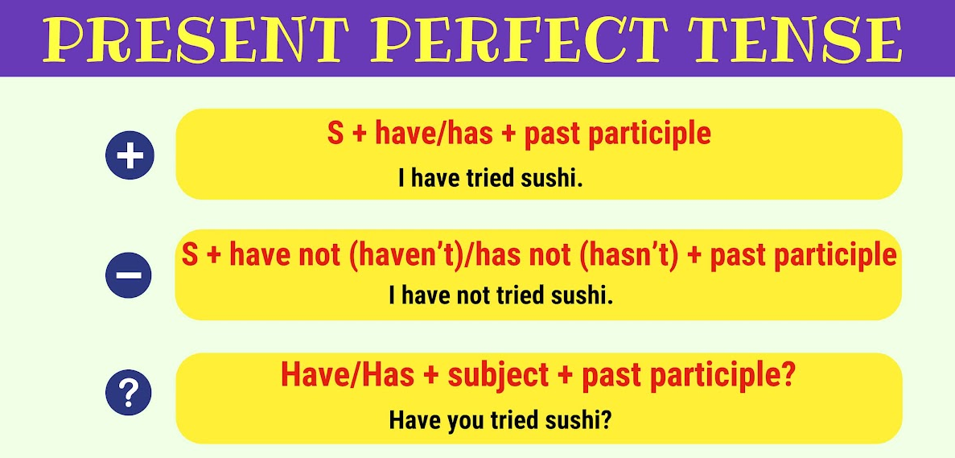

Slide 14
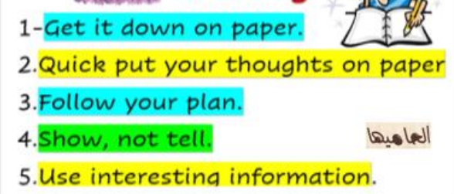
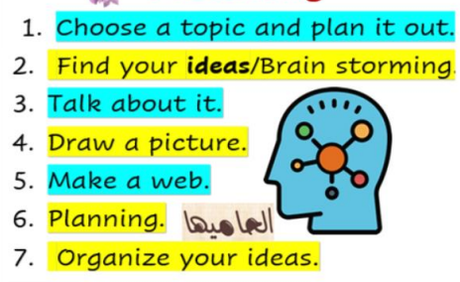
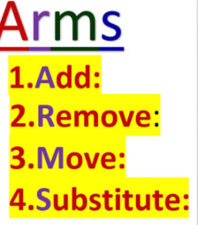
Writing Process
Drafting
Prewriting
Revising

Slide 15
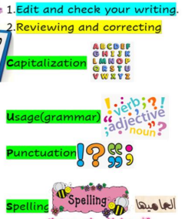

Writing Process
Editing

Slide 16
Sample paragraph
My most important possession is my cellphone, Samsung Galaxy J2 Prime, which is my strength and my stress reliever. My cellphone is important to me, because I use it to communicate with my friends and family. I use my phone to watch movies or anime because I don’t watch television. I also can call my friends. I get nervous when my phone is misplaced, or my friends hide it.

Slide 17
1. What is your most important belonging?
2. What is it like?
3. How can you use it correctly?
4. Why is it important to you?

Slide 18
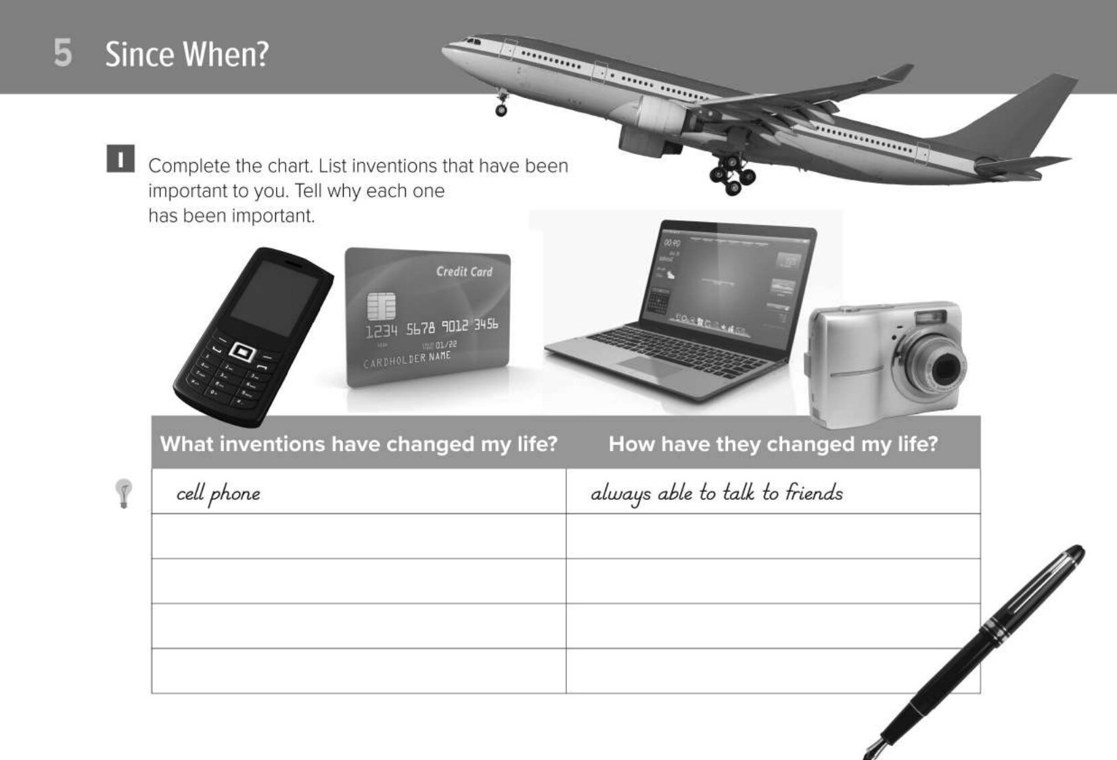
Page 202
Notes:
credit card can shop without cash
plane can travel quickly around the world
Laptop can use the Internet
digital camera can take photos on vacation

Slide 19


