Slide 1

Unit 6
Do you Know Where It Is?
Conversation

Slide 2
بسم الله الرحمن الرحيم
Day:
Date:

Slide 3
Learning Objectives
02
practice using real talk phrases
01
03
listen for specific information in a conversation
answer questions about the conversation

Slide 4
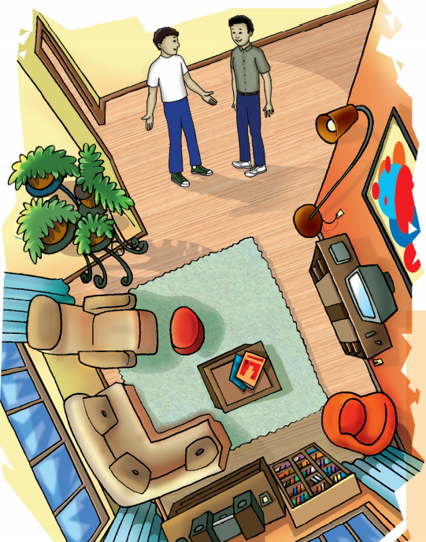
Page:63

Slide 5

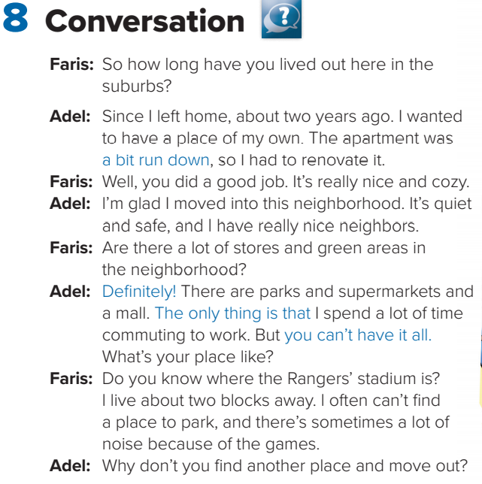
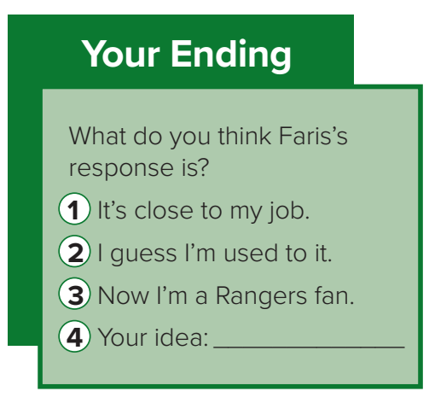
Page:63

Slide 6
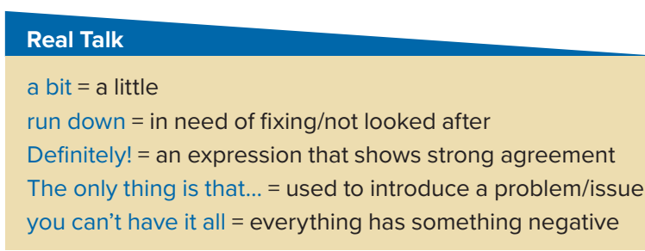
Page:63

Slide 7
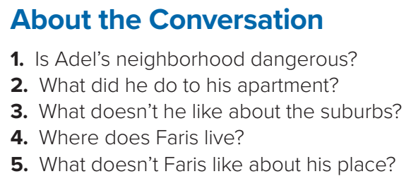
1. No, it isn’t. It’s safe.
2. Adel renovated his apartment.
3. He spends a lot of time commuting to work.
4. Faris lives near Rangers Stadium.
5. He often can’t find a place to park, and sometimes there is a lot of noise.
Page:63

Slide 8
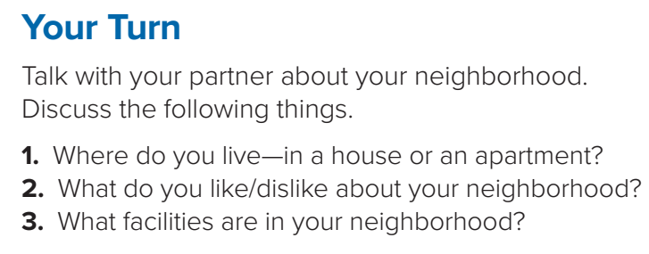
Page:63

Slide 9
Homework!
Page 206

Slide 10
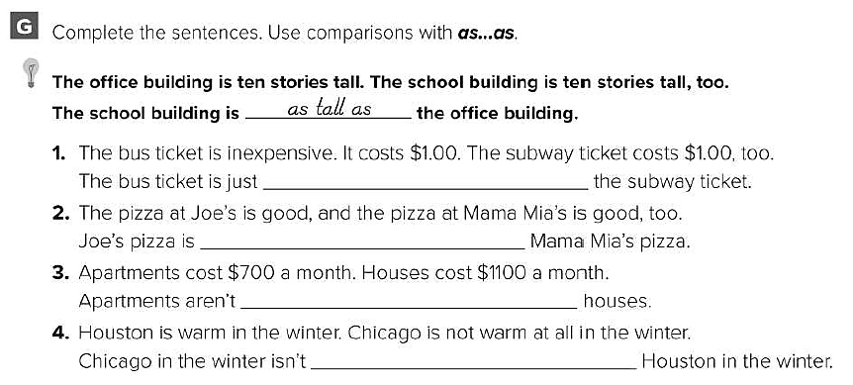
as expensive as
as good as
as expensive as
as warm as

Slide 11
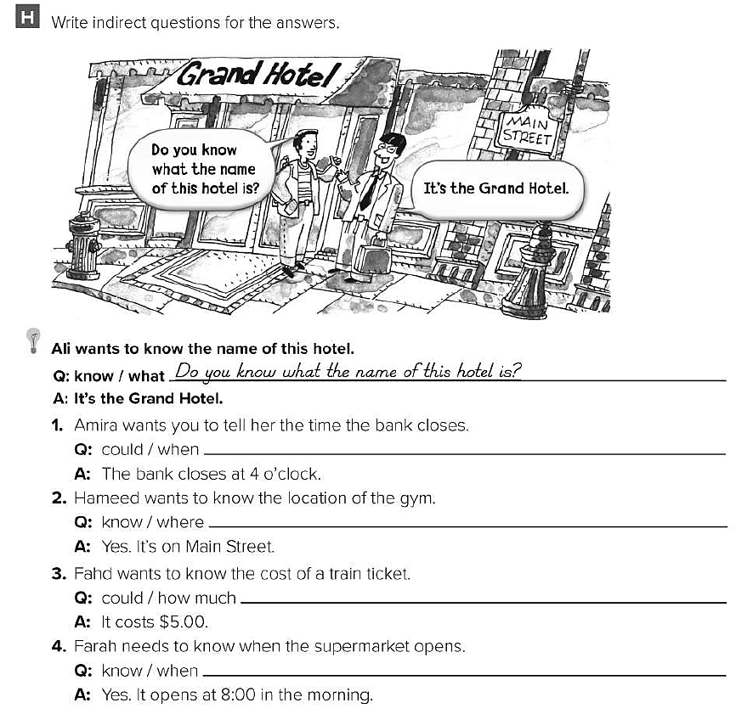
Could you tell me when the bank closes ?
Do you know where the gym is ?
Could you tell me how much a train ticket costs ?
Do you know when the supermarket opens ?

