Slide 1

Unit 1
It’s a Good Deal, Isn’t It?

Slide 2

Unit 1
It’s a Good Deal, Isn’t It?

Slide 3


The objectives of the lesson :
At the end of this session, the students will be able to :
Practice the conversation
Answer the questions

Slide 4

Where are the people?
Where do you think the people are from?

Slide 5

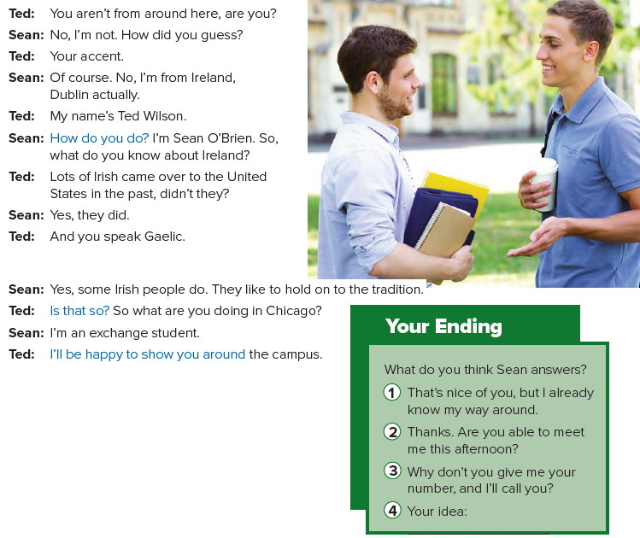

Slide 6
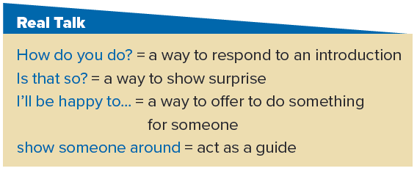

Slide 7
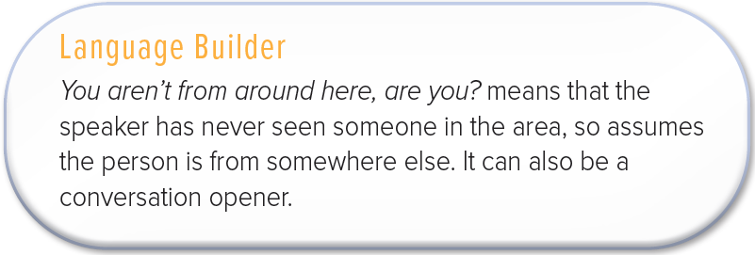

Slide 8
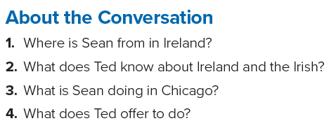
1. Sean is from Dublin.
2. He knows that many Irish came to the United States in the past, and he knows they speak Gaelic.
3. He is an exchange student.
4. Ted offers to show Sean around the campus.

Slide 9

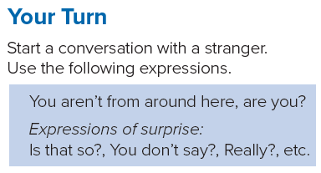

Slide 10

Page 93

